Slide 3
Optimization at GSI using evolutionary algorithms
Multi-turn injection into SIS18 is one bottleneck to reach intense beams for FAIR.
New approach is the use of genetic algorithms (GA) and particle swarm (PA)
In simulation evolutionary algorithms can improve MTI and found a loss-free injection.
Required injector brilliance window could be defined for both SIS18 injectors.
The loss-induced vacuum degradation is an important key intensity-limiting factor for intermediate charge state ions.

Slide 4
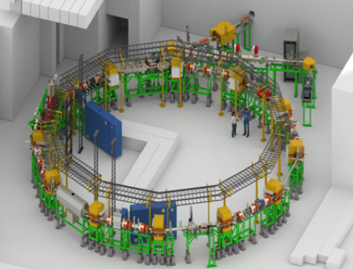
Optimization at GSI using evolutionary algorithms
As a result of the promising simulation outcome an adjustment project evolutionary algorithms has been launched.
CRYRING
Since all GSI accelerators except Cryring has been shut down till mid 2018, the local Cryring injector was the obvious choice for a proof of principle in online optimization.
The first results and gained experience of an automatized optimization at the CRYRING injector are presented here.

Slide 5
Y. Chao ICFA Workshop 2017
When is a Machine-Learned Model Useful?
Why don’t I simply run the model 10000 times to map out the entire parameter space?
This is pretty much what one has to do to get a machine-learned model in the first place anyway.
It may be most useful when several ML models are combined to model behavior in the “cross terms”.
The real gain seems to happen with increasing number of models used in conjunction.
Examples abound in accelerator design of such optimization schemes.
ML 1
ML 2

Slide 6
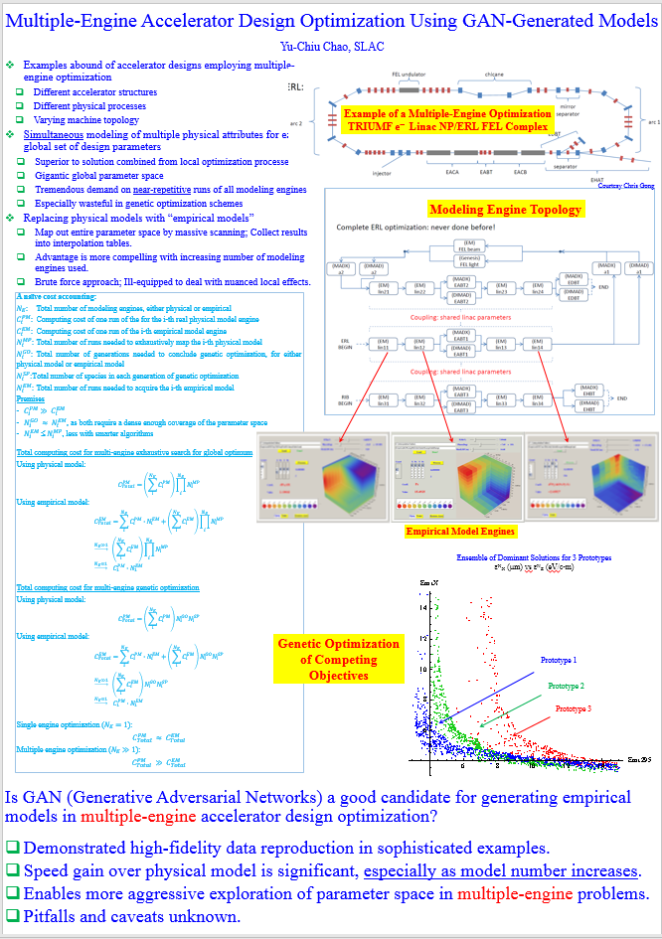

Slide 9
Surrogate Models based on Supervised Learning and Polynomial Chaos for the Argonne Wakefield Accelerator
A. Adelmann (PSI)
A.L. Edelen (UCO) & N. Neveu (ANL)

Slide 10
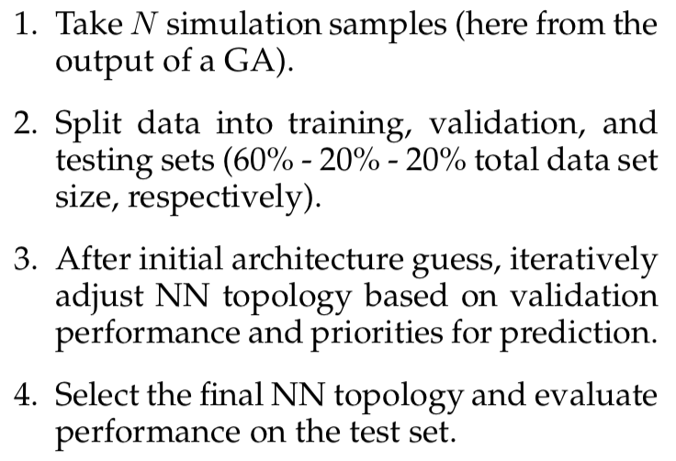
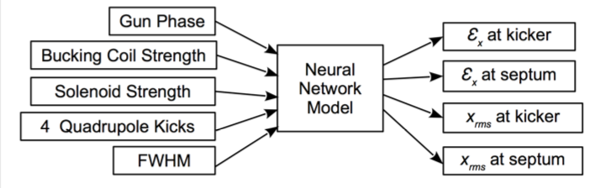
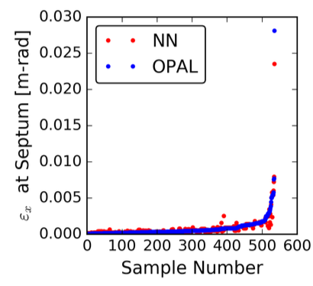
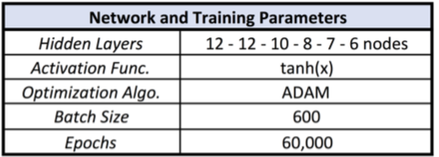
Approach 1: NN as Surrogate Model

Slide 11
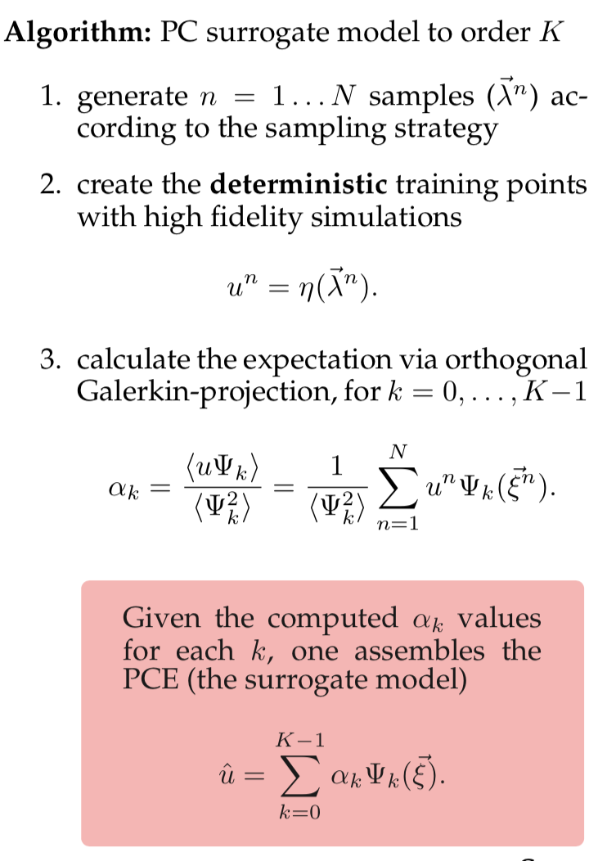
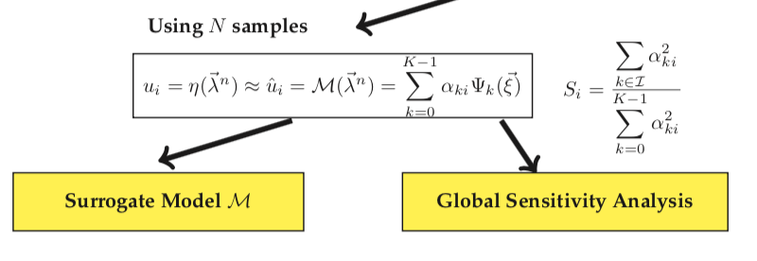
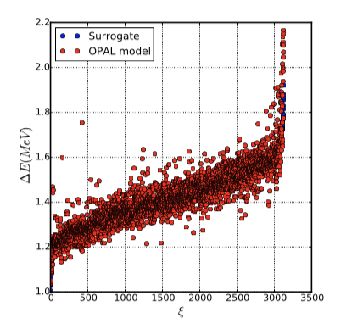
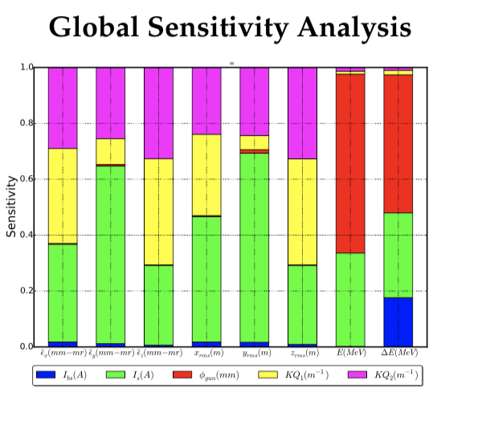
Approach 2: PC as Surrogate Model

Slide 12
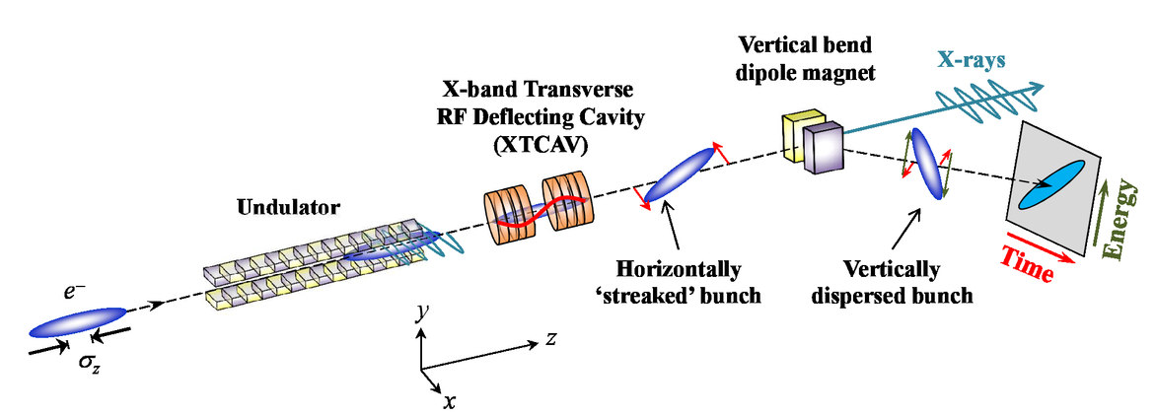
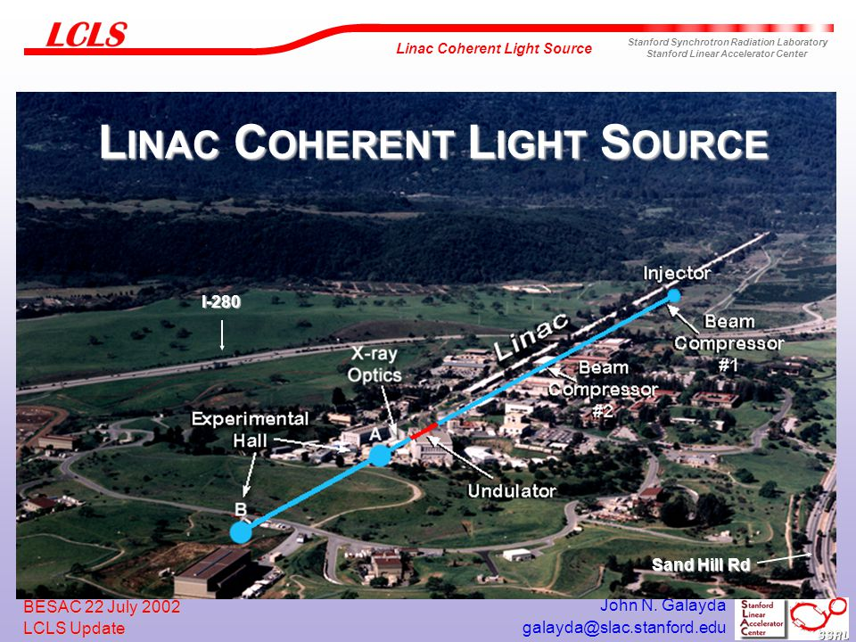
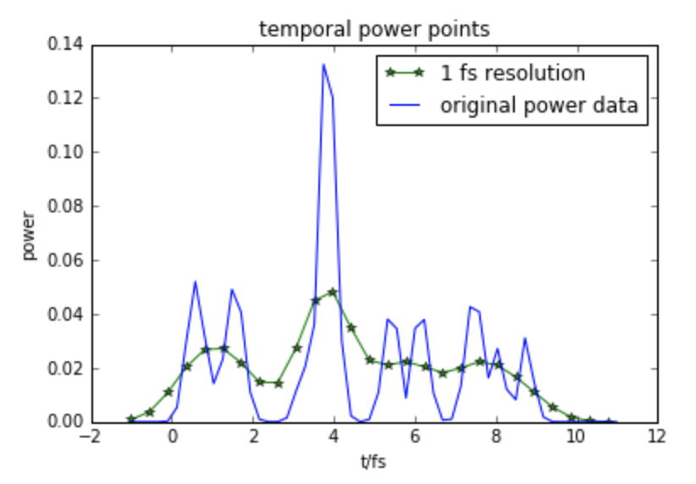
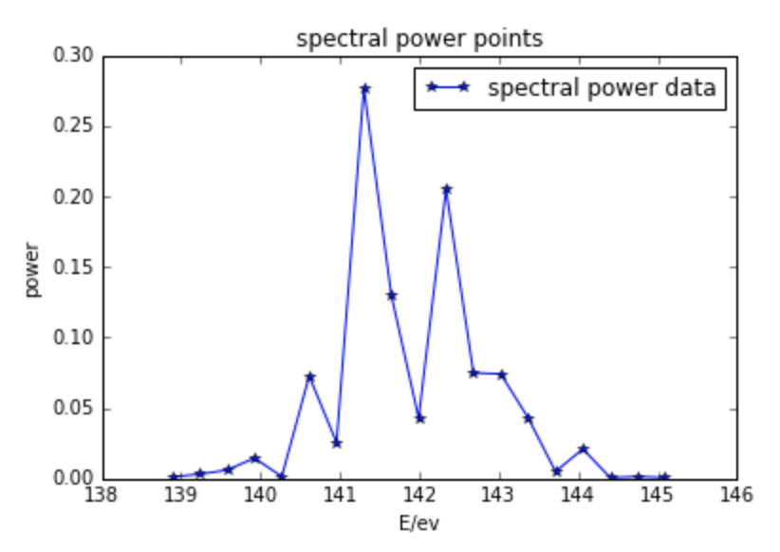
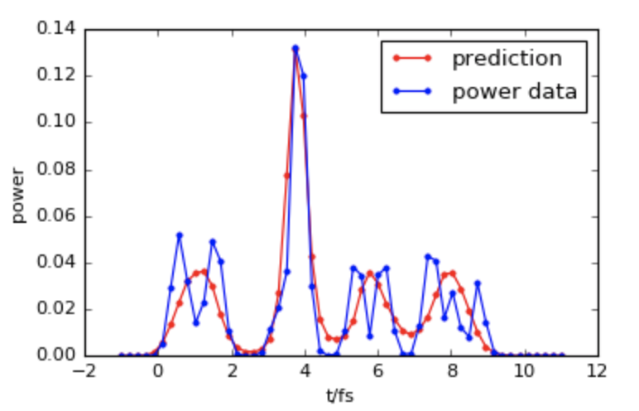
Temporal electric field reconstruction
Maxwell, Timothy J., et al. International Society for Optics and Photonics, 2014.
a) Goal: full reconstruction (amplitude AND phase) of a femtosecond X-ray pulse from an XFEL
Input power points
(1fs resolution)
Input spectral power points (80meV resolution)
b) Problem: temporal diagnostics have bad resolution. No way to measure phase.
c) Proposed solution: combine temporal+spectral diagnostics with iterative optimization... or with a neural network!
Prediction and test data
Notes:
Temporal electric field reconstruction is an important topic in FEL physics, since reconstructed data has much better accuracy compared to the raw measured data. Traditionally, although iterative reconstruction algorithm can lead to high accuracy, the time consumed by this algorithm is huge. My research is using deep learning technique to realize fast and accurate reconstruction.

Slide 13
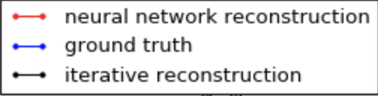
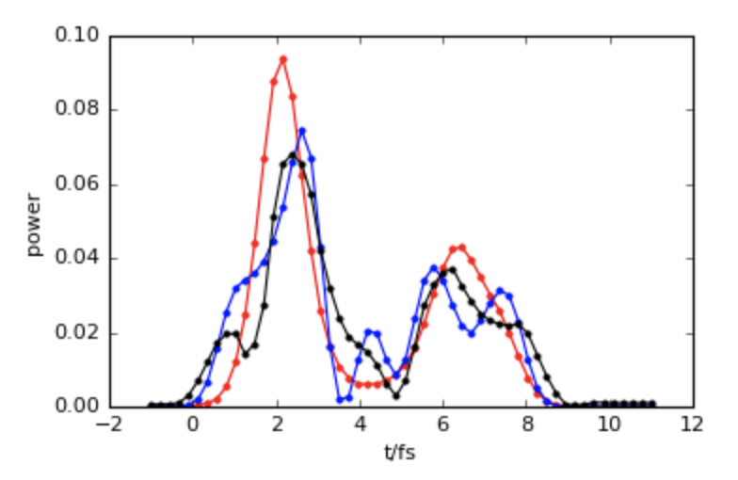
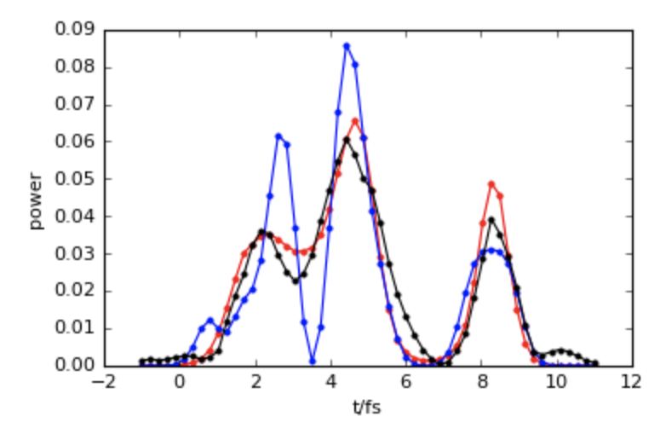
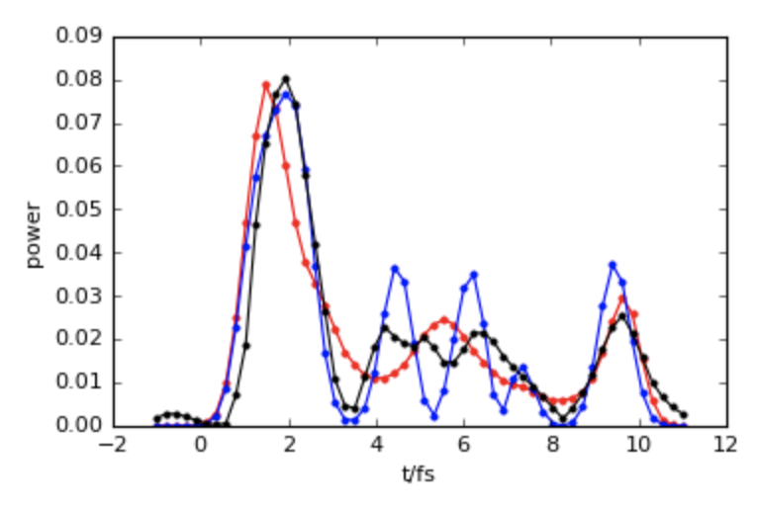
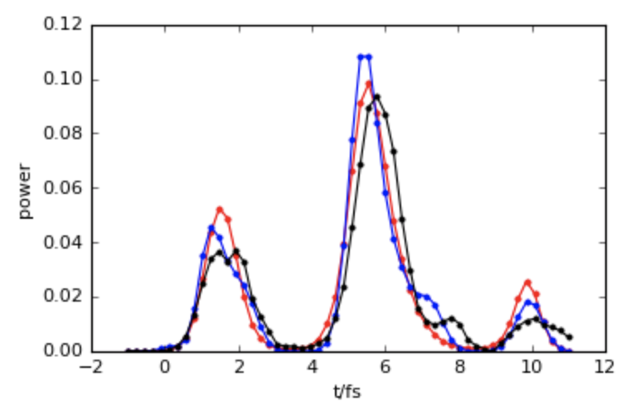
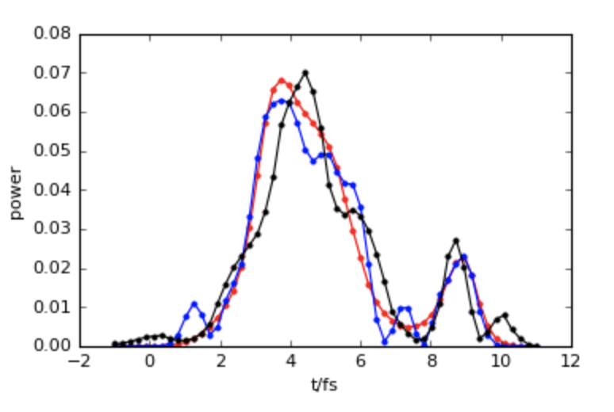
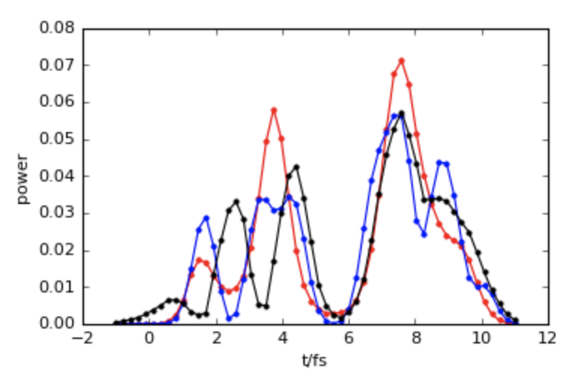
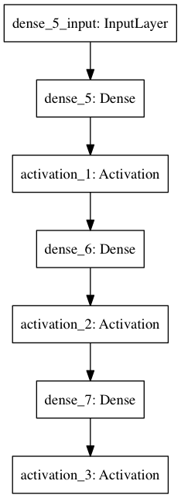
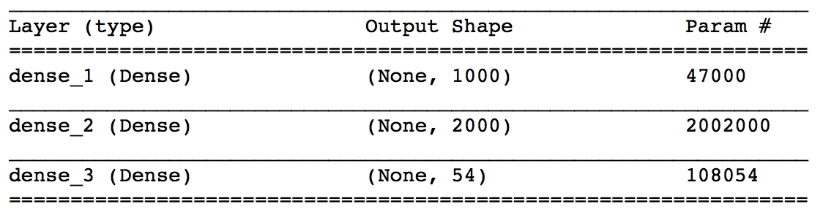
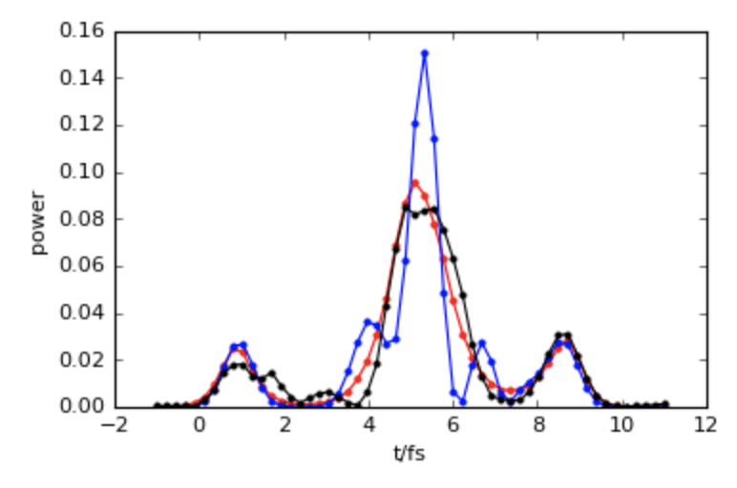
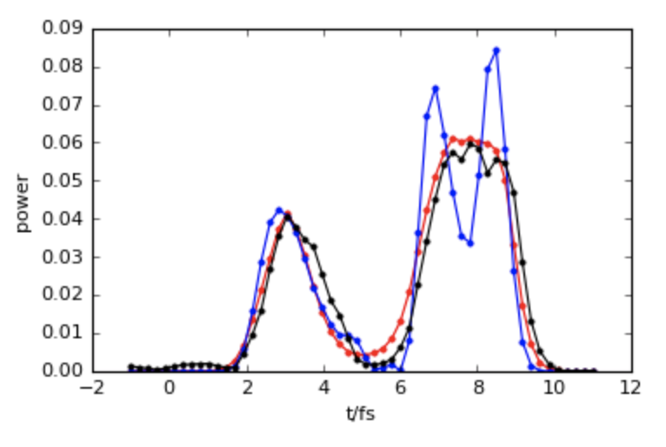
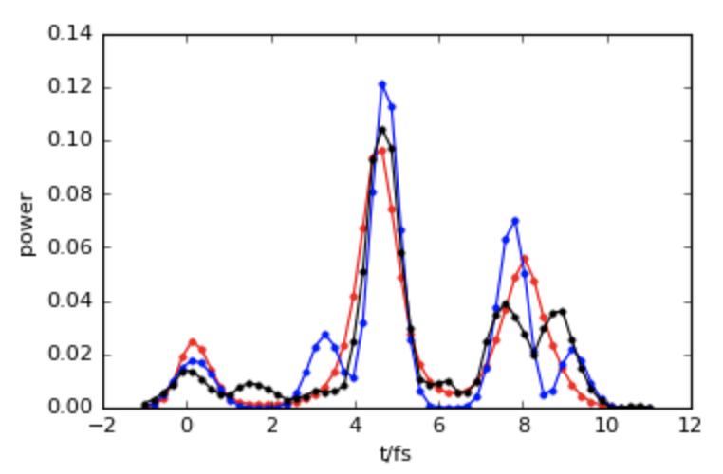
Prediction on simulated “fake” SASE dataset (superposition of several Gaussian packages):
Datasets:
37500 training samples and 12500 testing samples.
Preprosessing:
normalization of groundtruth, spectral input power and scaling corresponding input temporal power.
Network:
3 layers model (2 dense layers following with relu activation and 1 dense layer with softmax)
Adagrad for optimization with learning rate of 0.01 and 0 decay. 500 epochs.
Neural network reconstruction: On average 0.19ms per prediction
Iterative reconstruction: 30s per prediction
Next Steps:
Simulated 1D SASE dataset -> Simulated Genesis -> Real temporal electric field data
Notes:
First, I tried on simulated “fake” SASE dataset, which is superposition of several Gaussian packages. Although it is not SASE electric field, the shape of the curve is similar to SASE curve. I used two methods, traditional iterative method and deep learning method. The result and time consumed are shown above.
After this, the following steps are applying neural network on SASE 1d simulated data, GENESIS simulation of SASE and finally real data.
Datasets
We trained this simple model on the “fake” SASE dataset which is superposition of several Gaussian packages, and then convoluted by Gaussian funtions with different coherant length to simulate low resolution measured data. It consists of 37500 training samples and 12500 testing samples.
Preprosessing: normalization of groundtruth, spectral input power and scaling corresponding input temporal power.
The network is implemented in Keras. After trying different width and depth of the network, we find the following 3 layers model (2 dense layers following with relu activation and 1 dense layer with softmax) works best. We choose Adagrad for optimization with learning rate of 0.01 and 0 decay. We trained each model from scratch in 500 epochs, batch size 75.
Network:
3 layers model (2 dense layers following with relu activation and 1 dense layer with softmax)
Adagrad for optimization with learning rate of 0.01 and 0 decay. 500 epochs, batch size 75.

Slide 14
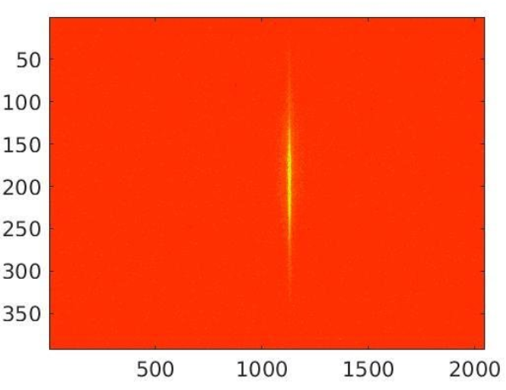
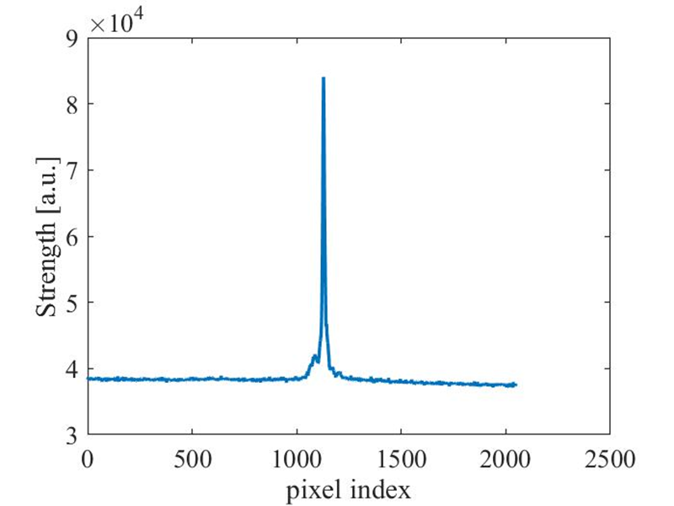
Spectrometer data description @4.62keV
Basically, it a 392x2048 two-dimension array, indicating the strength of each pixel detected on the screen. An example is shown below.
After projection, we get
the FEL spectrum.
Guanqun Zhou, SLAC

Slide 15
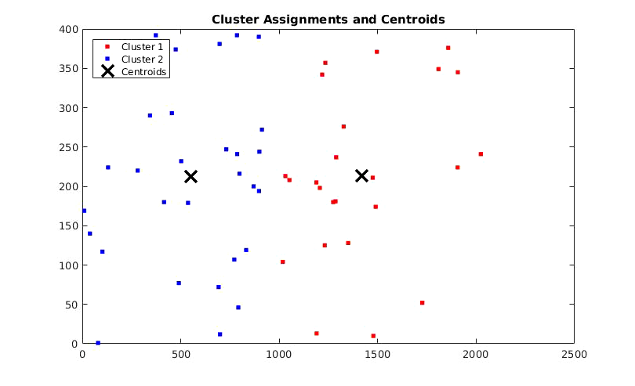
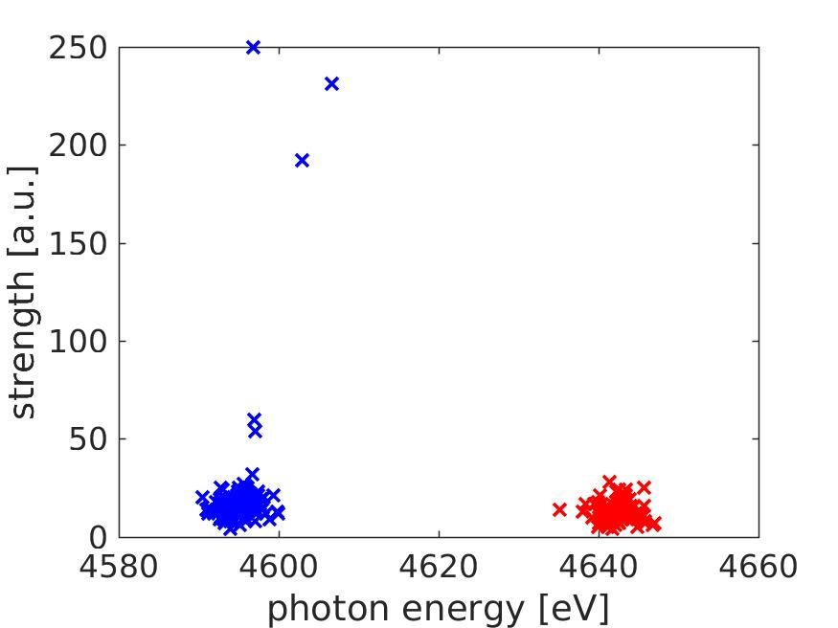
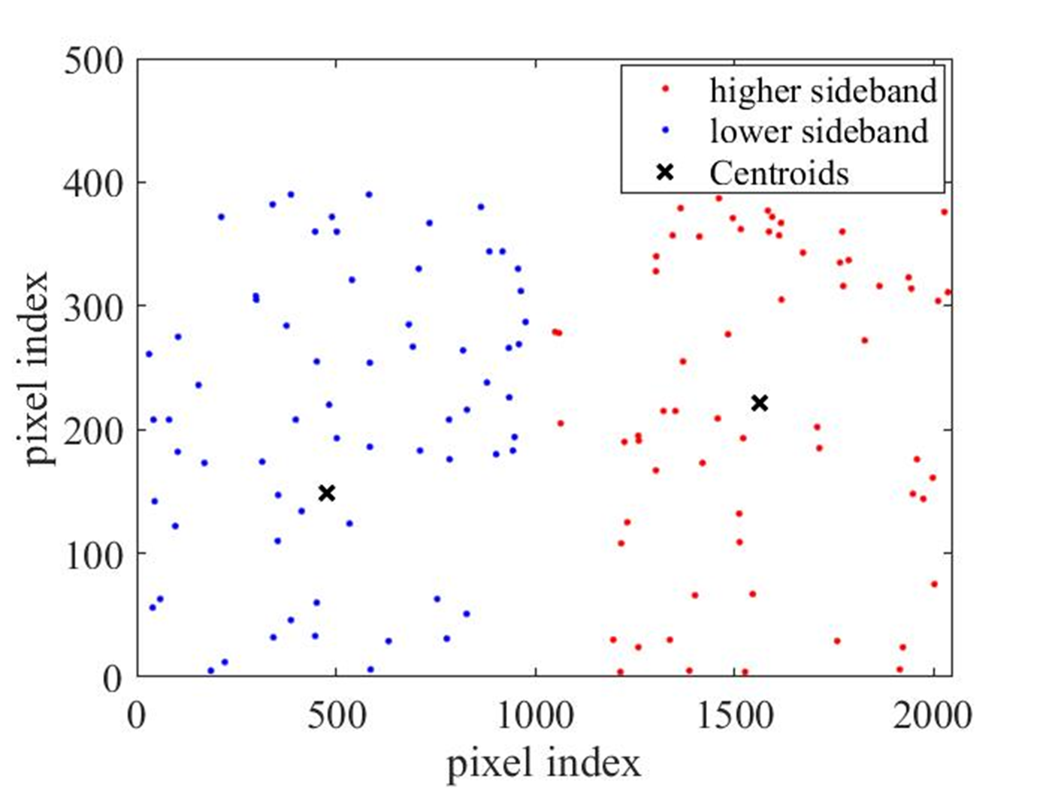
Analysis with unsupervised clustering
these two photon energy
are out of hard x-ray FEL gain bandwidth
Central frequency
Guanqun Zhou, SLAC

