Slide 1
How to Talk Science with Just About Anyone
Andre Salles and Brian Nord
Users Meeting
June 21, 2018

Slide 2
Hello!

Slide 3
What we’re going to cover
The basics of connecting with a public audience.
How to engage with people so their eyes don’t glaze over.
Distilling your message to the essentials.
Creating a narrative out of your message.
Facing your fear of being the story.
Creating engaging presentations.
Talking with the media.
Spreading science on social media.
Anything else you want!

Slide 4
Ground rules for interacting
Raise Hands if you want to say something
Share the air. If you have been dominating the discussion or participating disproportionately, let others participate. Alternatively, if you haven’t said much, you are encouraged to participate more.
Be aware of power dynamics in the room. A frequent occurrence in discussions is that members of historically overrepresented groups often dominate the discussion. We should ask ourselves the questions: Who is talking the most? Who is asking the most questions?
Respect the preferred pronouns of others.

Slide 5
What is successful science communication?
Who can you name who communicates science well?
What are the qualities of a good science communicator?
Who should be communicating science?
HINT: The answer to the last one is “all of us.”

Slide 6
What does successful communication look like?
All communication is interaction. What do we want people to walk away with?
A better understanding of your work.
A positive feeling about you and your work.
An excitement to share what they have learned.

Slide 7
Trying it out

Slide 8
The physics equivalent

Slide 9
The importance of narrative
Science is fundamentally about people – either the people who do it or the people who are affected by it. Science communication is fundamentally the story of those people.

Slide 10
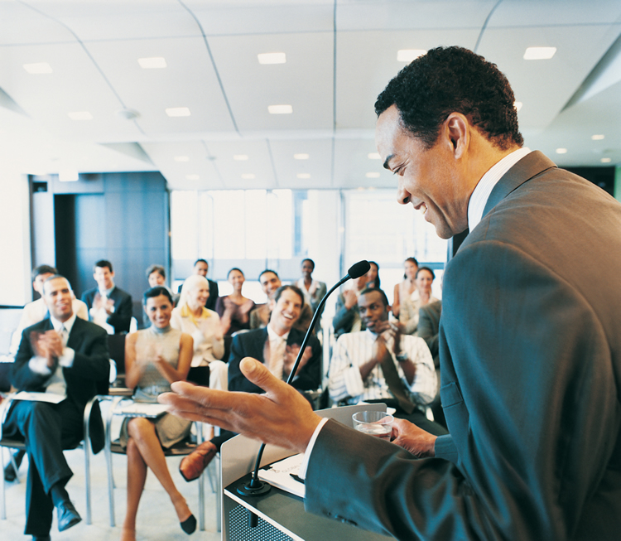
The importance of narrative
Story is how we learn, but more importantly, story is how we connect, and connection is the most crucial part of communication. Show me a graph or an equation, I probably won’t remember. Tell me a story, I’m in.

Slide 11
Connecting with an audience
Personal connections are the most important part of communication.
It’s not what your audience knows as much as it is what they connect with.

Slide 12
Who is your audience?
Remember that this is all about your audience. Connect with them! Ask these important questions:
WHO is this for?
WHAT are they interested in?
WHAT do they already know?
HOW can you get this specific audience to engage with you?

Slide 13
Communication is interaction
This means listening is just as important as talking.
Ask questions, learn about who you are speaking with.
Engage with them, don’t just talk to them.
Watch for the eyes-glazing-over moment.

Slide 14
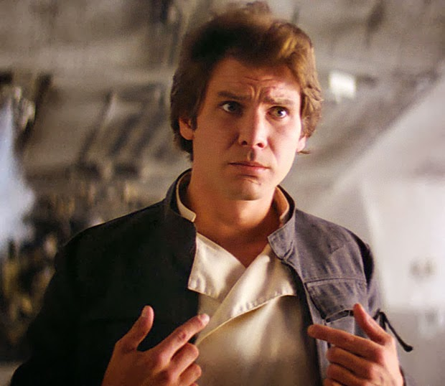
You are a story
Your audiences are interested in connecting with you. Tell them your story. Personalizing your science takes nothing away from the work.

Slide 15
Make it relevant
In order for audiences to connect with your work, you need to make it relevant to their lives. Connect it to what is important to them. Make it part of their story.

Slide 16
Analogies yes, jargon no
Reframing concepts in interesting ways can help capture and keep an audience’s attention. Analogies require some brainstorming, but are effective.

Slide 17
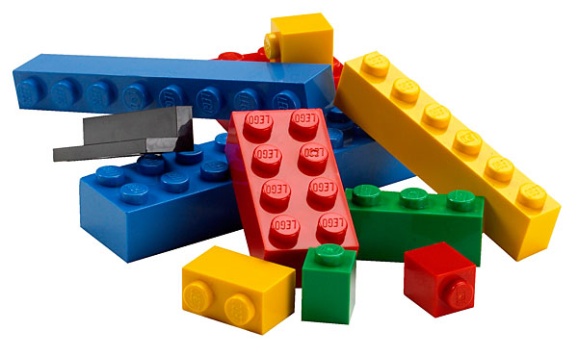
Lego exercise

Slide 18
Distilling your message
If you only have a few minutes with someone, what do you most want them to know and understand about your work?
It’s a cliché, but elevator speeches work.

Slide 19
Key messages
Think of the two or three most important messages you want to get across.
Examples:
Neutrinos are very hard to study, but important.
The experiment I am working on is amazing because ____
It takes a team of hundreds from around the world to make an experiment like this work.
Then stick to those messages! When you feel yourself drifting away from them, return to them.

Slide 20
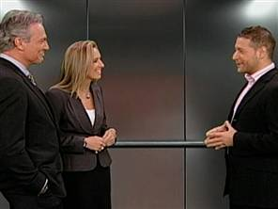
Let’s try it out!
Using these example messages (or your own), create your own elevator speech.
Neutrinos are very hard to study, but important.
The experiment I am working on is amazing because ____
It takes a team of hundreds from around the world to make an experiment like this work.

Slide 21
Sample speech
Hello, I’m ___ and I study the mysteries of the universe. One of the biggest mysteries is a particle called a neutrino. Trillions of them go through you and everything else every minute, which makes them hard to study, but we know they had an important role in the formation of the universe. My experiment will use a huge machine in an old gold mine to give us insight into how these particles behave. More than a thousand of us around the world work on this, and we’re all excited about it because it might tell us why we exist at all.

Slide 22
Your elevator pitch is not a story
It is the starting point of a narrative. It’s the crux of the information you want to convey. Telling a story is the best way to convey it so that people will respond.

Slide 23
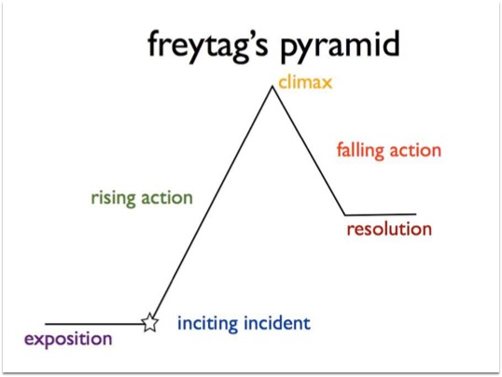
Types of narrative
We’re all familiar with narrative structure from the films and television shows we watch and the books we read.

Slide 24
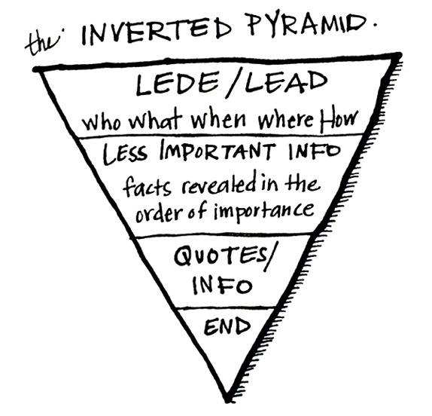
Types of narrative
Journalism has its own self-imposed structure. The best stories – the ones you remember – ignore this completely.

Slide 25
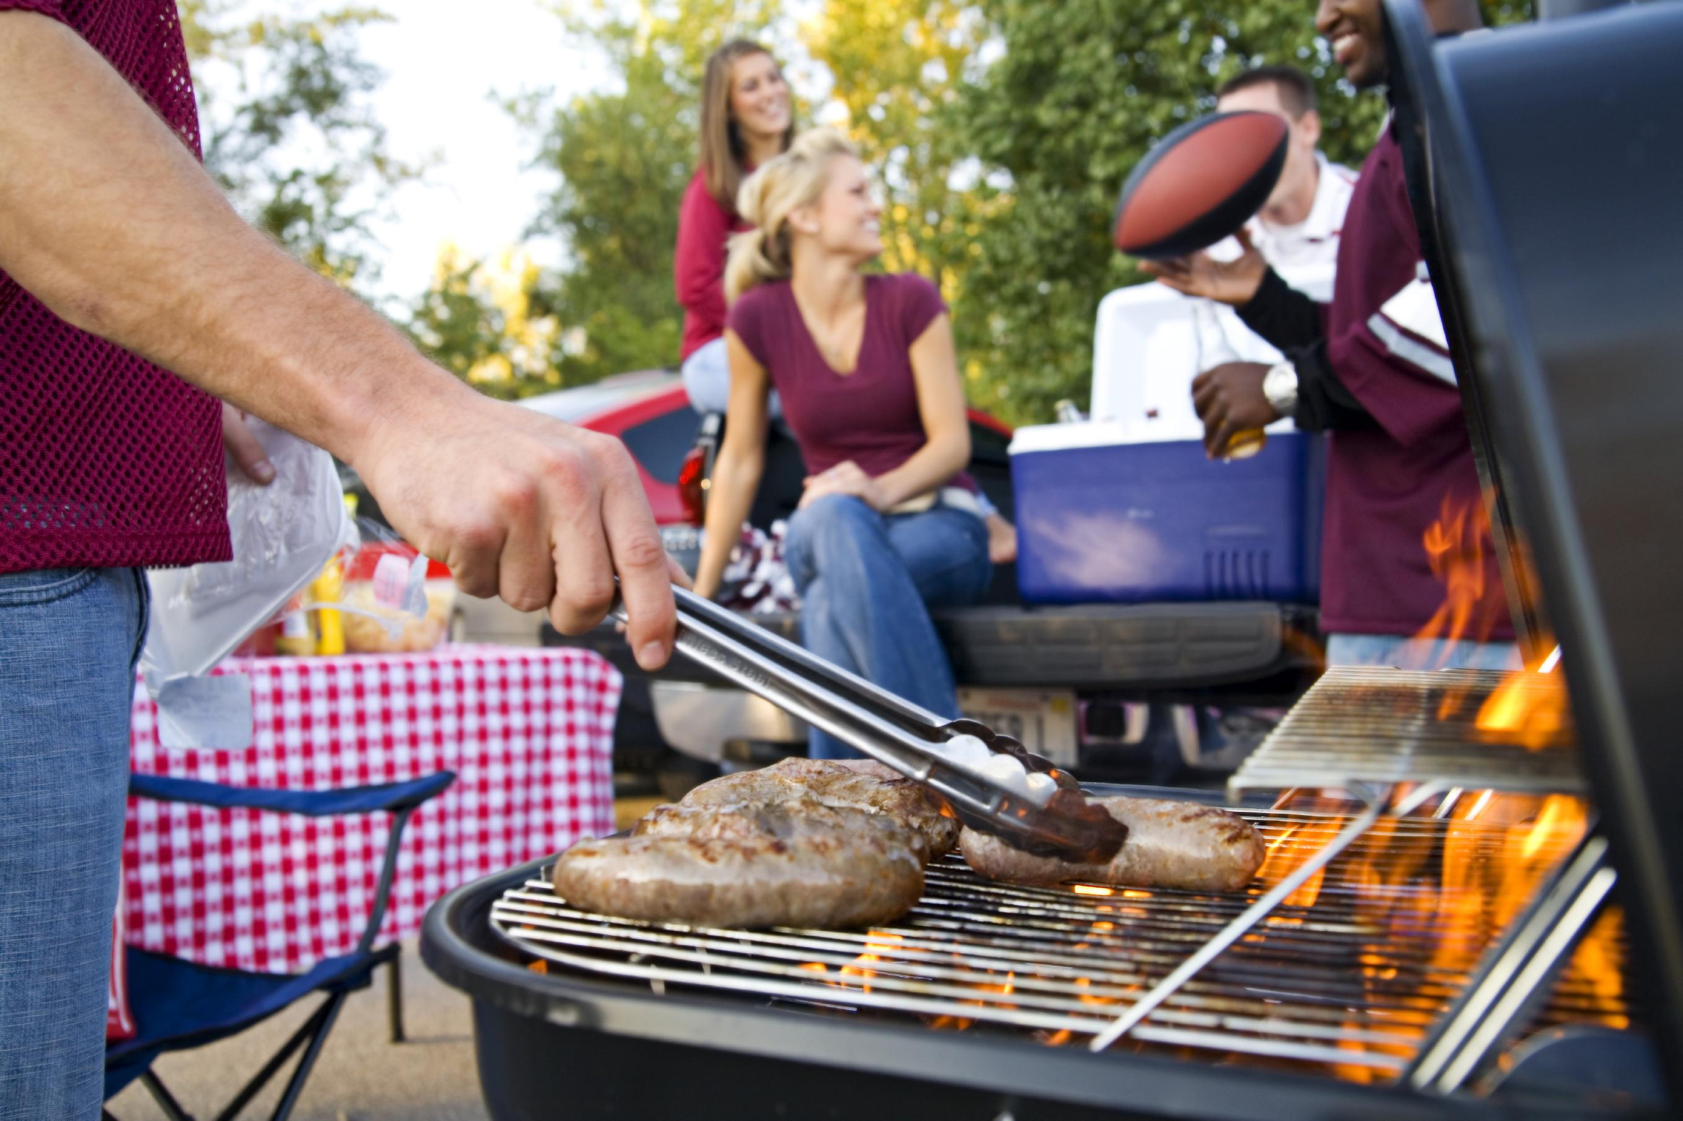
How to build a story
Stories have a beginning, a series of events in the middle, and an ending. (That ending can be “we don’t know yet!”)
Start with the question you are aiming to answer. What does your audience want to know? What will grab them? Then work backwards. If we have the answer, how did we find it? Were there any interesting people involved? Were you one of them? Tell a story like you are talking to your neighbor at a backyard barbecue.

Slide 26
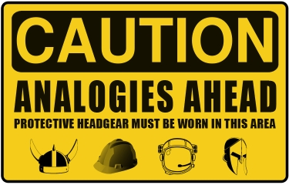
How to build a story
One way to build a story is to keep asking questions. How did we get here? What happened? What happened next? Draw a through-line from the questions to the answers (or the answers to the questions) until you have a compelling tale.
Keep the language clear. Use analogies, relate your story to everyday things. Avoid jargon. Ask someone who isn’t in this field to listen and tell you if you say something they don’t understand.

Slide 27
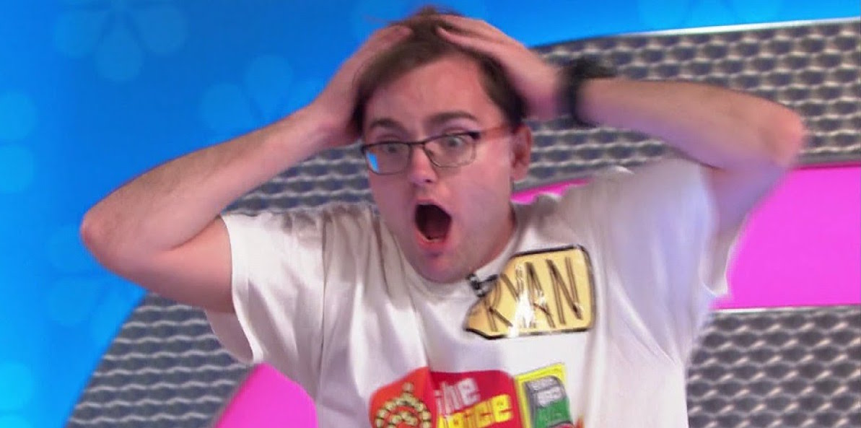
Above all
Be excited! If you are not inspired by your story, no one else will be. Craft your story in a way that would make you want to listen to it. Then tell it in a way that will make others want to listen.

Slide 28
When it’s not working
You’re trying to get your audience to follow, but they’re not getting it. Here are some questions to ask yourself:
Have you provided enough background information to keep them from getting lost?
Are you using words they don’t understand?
Are you moving too quickly?
Are you assuming they know or understand something that they may not?
It’s OK to ask if they’re not getting it, and find out why!

Slide 29
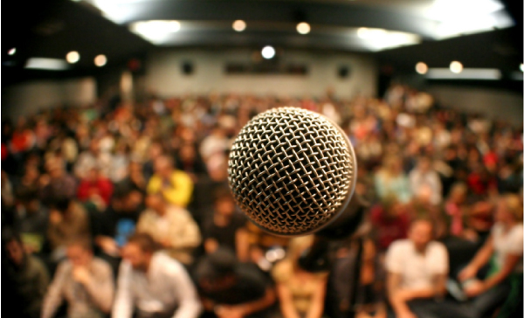
Keeping that connection
Remember, it’s all about interaction and engagement.

Slide 30
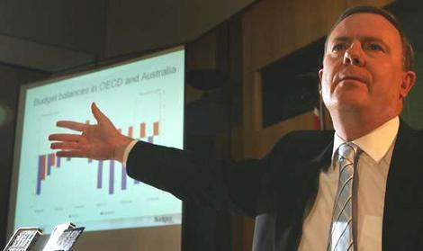
Creating good presentations
Here’s what to avoid:
Slides with too much text
Jargon
Charts and graphs
Equations
Reading slides out loud with a laser pointer

Slide 31
Don’t do this

Slide 32
Ask questions and take questions

Slide 33
Talking with the media

Slide 34
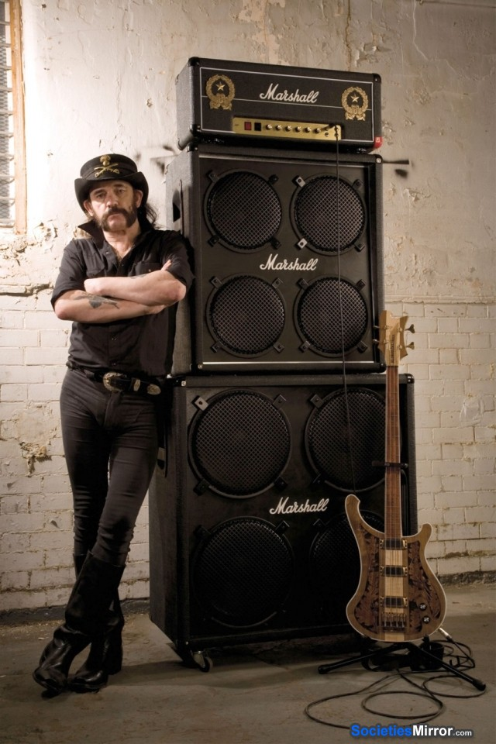
Why is media important?
Amplification!

Slide 35
Things to understand about the media
They exist to tell stories that people will read/watch.

Slide 36
Things to understand about the media
We cannot control what they print or broadcast.

Slide 37
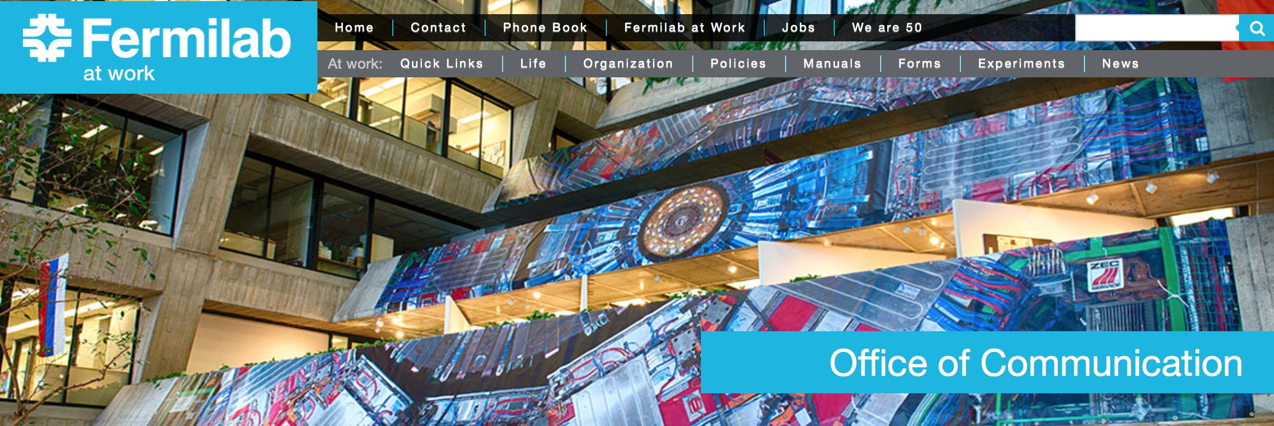
Your communications office
Your institution has one, and they are here to help!

Slide 38
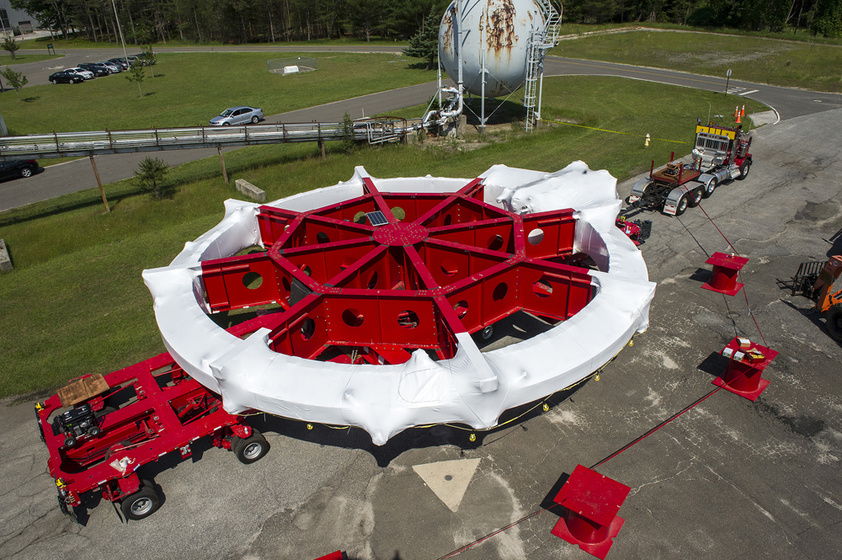
The media loves stories
They’re interested in scientific results, but they’re more interested in the stories that surround them.

Slide 39
You are a story
Reporters are looking to personalize any story, especially complex ones. Your story is a way in for them and for their readers/viewers. Don’t be afraid to share your story!

Slide 40
Media interviews
Relax and be yourself.
Help them to get it right.
Stick to what you know.
Don’t bluff or make things up.
You don’t have to answer anything that makes you uncomfortable.
Stay away from politics, religion, etc.
Remember your key messages and tell your story

Slide 41
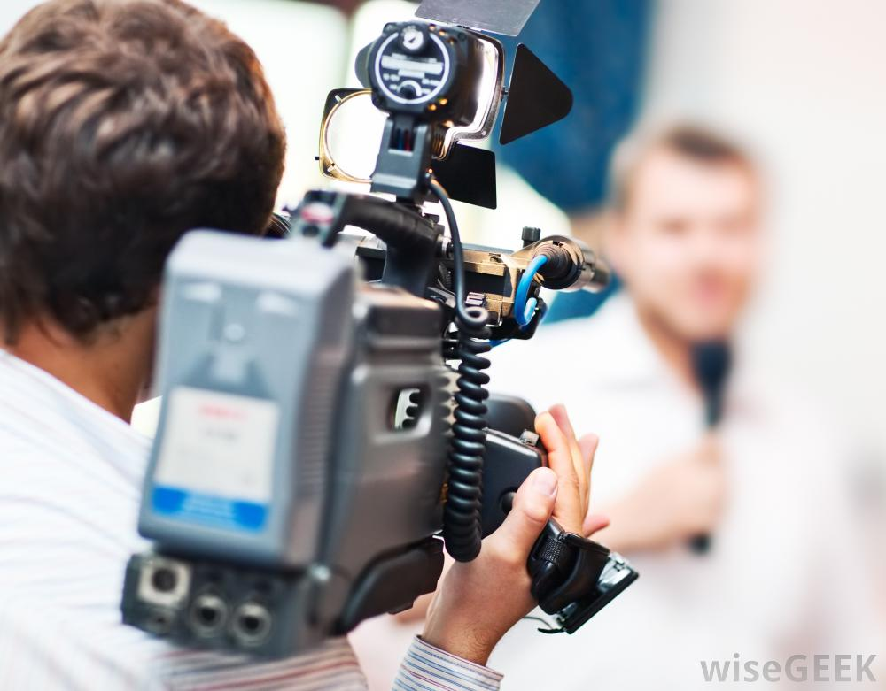
On-camera interviews
Deep breaths! Relax!
Watch your body language.
Smile and be engaging.
Don’t let them steer the narrative
Remember your key messages and tell your story

Slide 42
Communicating on social media
Should scientists use social media? Hint: Yes.

Slide 43
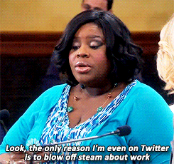
Social media
Benefits:
Meet people where they are
Reach diverse audiences
Relaxed atmosphere

Slide 44
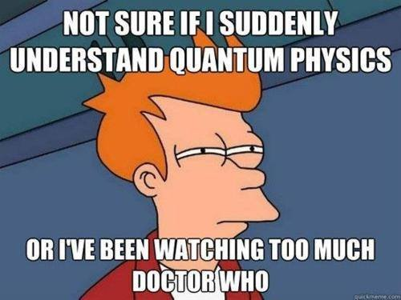
Social media
Techniques
Be informal but respectful
Include imagery whenever relevant/possible
Look for ways to tie your science in to pop culture, news items, hashtags, etc.

Slide 45
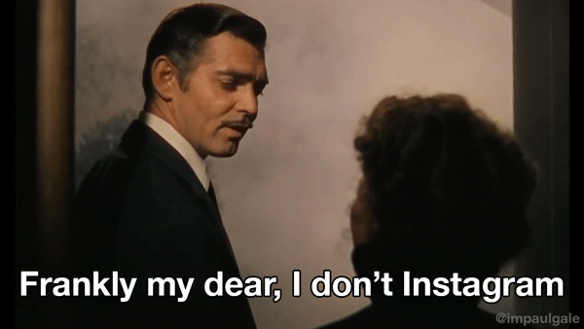
Social media
Techniques:
Interact with others and answer questions
Show a slice of your life as a scientist (ups, downs, what you actually do) in addition to explaining the science

Slide 46
Summary
Communicating science is vitally important and we all should do it, and get better at it.
Science is about people.
Forging connections with your audience is step one. Know who they are and what they want to know.
Tell stories. Don’t forget that you are a story.
Keep your key messages in mind.
Use analogies. Stay away from jargon.
Work with the media to tell your story. Help them to get it right, and don’t answer anything you don’t know or don’t want to answer.
Use social media to spread the word.

Slide 47
Always leave time at the end!

