Slide 1
Quantum Computing
James Amundson
51st Annual Users Meeting
June 20, 2018

Slide 2

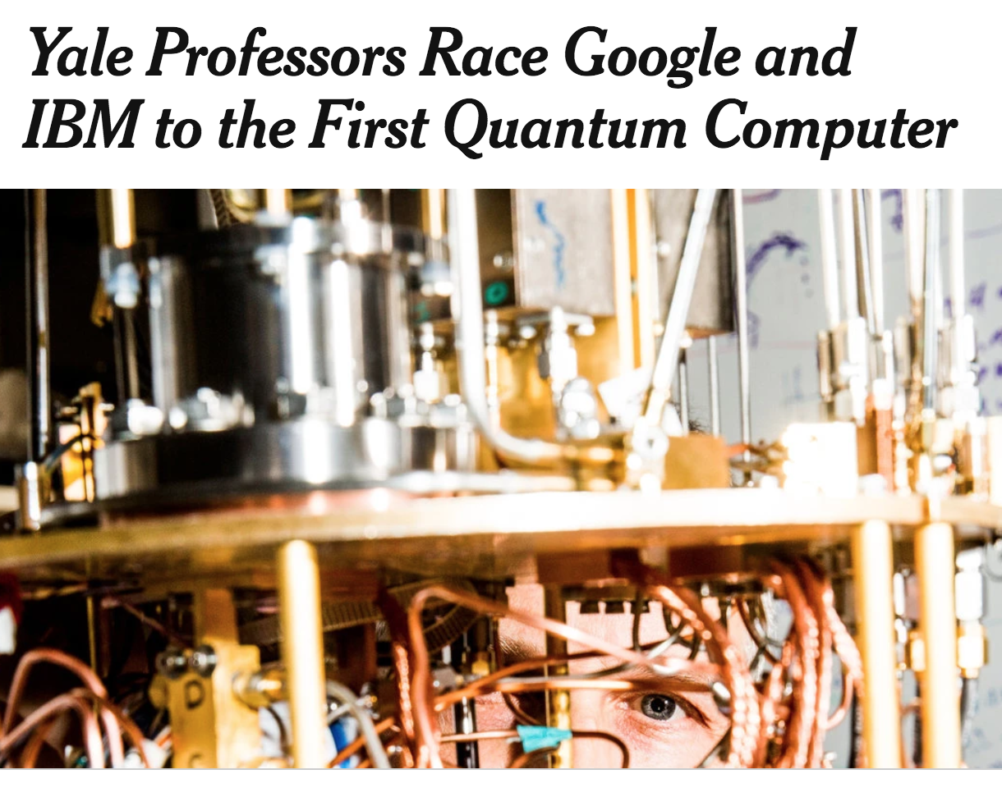
Quantum Computing Excitement
Nov. 13, 2017

Slide 3

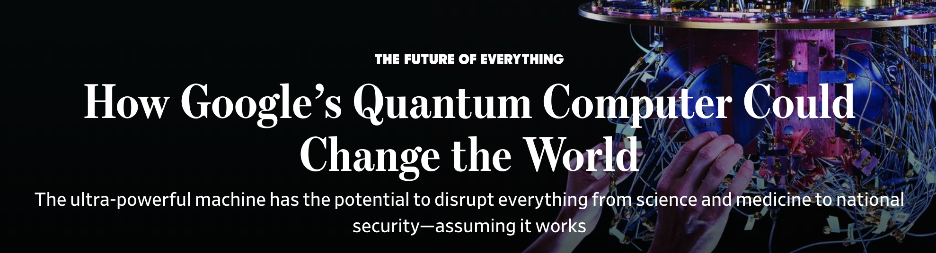
More Quantum Computing Excitement
October 16, 2017

Slide 4

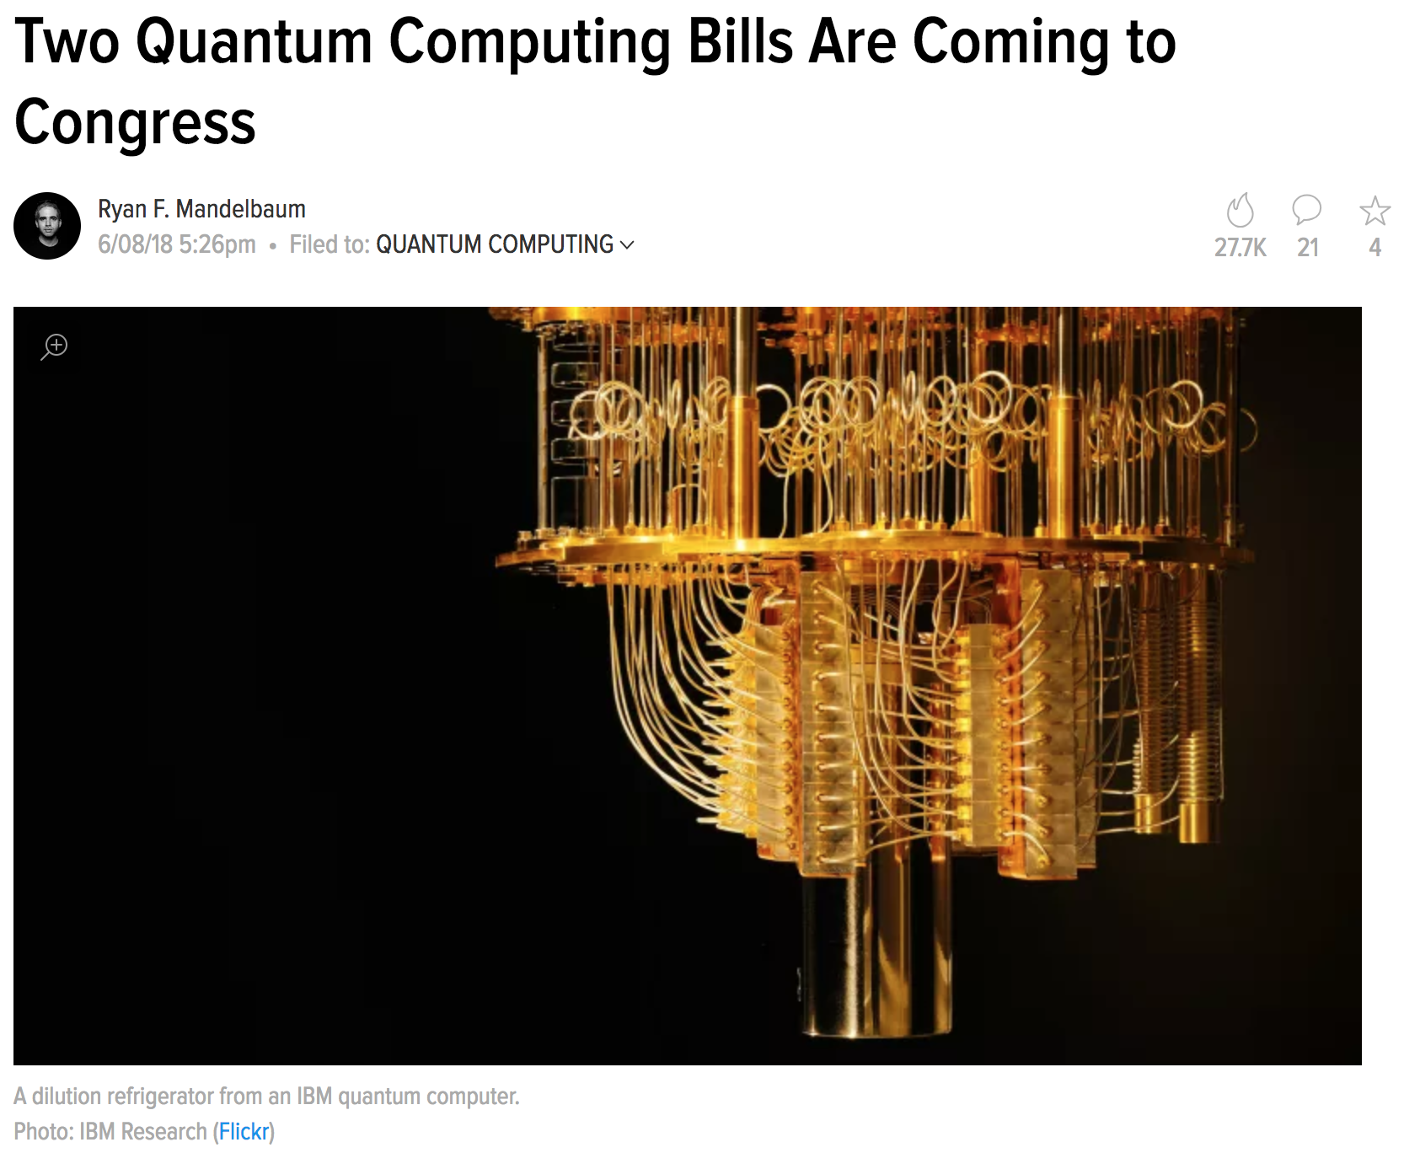
Quantum Computing Excitement Has Reached the U.S. Congress
June 8, 2018

Slide 5
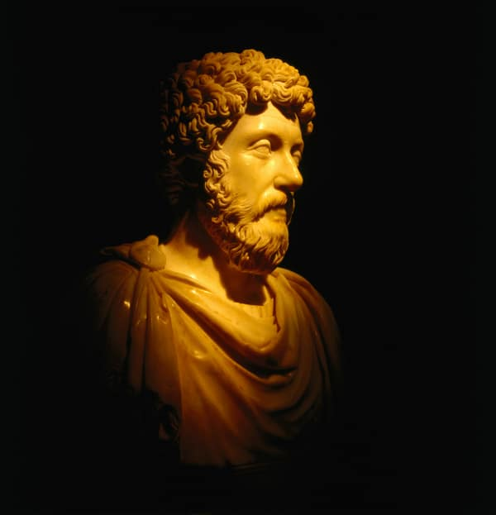
A Classical Take on Quantum Computing
Marcus Aurelius on Quantum Computing:
Anything in any way beautiful derives its beauty from itself and asks nothing beyond itself. Praise is no part of it, for nothing is made worse or better by praise.

Slide 6
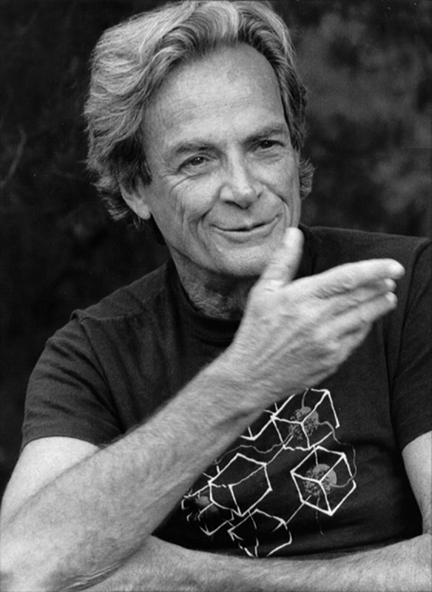
A Quantum Take on Quantum Computing
Feynman was one of the originators of the idea…
Trying to find a computer simulation of physics seems to me to be an excellent program to follow out
. . .
the real use of it would be with quantum mechanics
. . .
Nature isn’t classical . . . and if you want to make a simulation of Nature, you’d better make it quantum mechanical, and by golly it’s a wonderful problem, because it doesn’t look so easy.
—1981

Slide 7
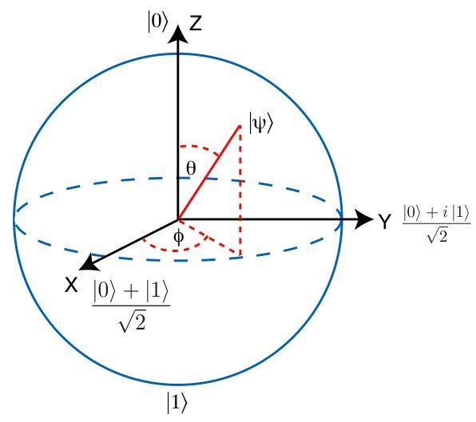
Quantum Information
n classical 2-state systems: n bits of information
b₁ … b_{n}
b₁
b₂
b₃
…
b_{n}
n quantum 2-state systems: 2^{n} “bits” of information
a₁ … a_{k} where k = 2^{n}

Slide 8
Where the Excitement Started
Peter Shor: A general-purpose quantum computer could be used to efficiently factor large numbers
  Shor’s Algorithm (1994)
  Resource estimates from LA-UR-97-4986 “Cryptography, Quantum Computation and Trapped Ions,” Richard J. Hughes (1997)
num size | 1024 bits | 2048 bits | 4096 bits
qubits | 5124 | 10244 | 20484
gates | 3x10¹⁰ | 2x10¹¹ | 2x10¹²
n.b. This is an old estimate; improvements have been made in the meantime.

Slide 9

Theoretical Computer Science
Classical Computing
  “Easy” problems can be solved in “polynomial time” (P)
  “Hard” problems require “nondeterministic polynomial time” (NP)
    Proving P ≠ NP is a great unsolved problem in computer science
Quantum Computing
  Some problems are easy in quantum computing, but hard in classical computing
  Some problems appear to be hard either way
?
P≠NP
hard
quantumly easy
classically easy

Slide 10
Quantum Algorithms
Shor’s Algorithm: factorization
  Speedup: Superpolynomial
Grover’s Algorithm: search
  Speedup: Polynomial
Many more available at the Quantum Algorithm Zoo
  https://math.nist.gov/quantum/zoo/

Slide 11
Current and Near-term Quantum Hardware
Thanks to Andy Li
  Fermilab Scientific Computing Division’s first quantum computing postdoc!
4

Slide 12
Current Commercial Quantum Computing Efforts
Many companies have announced that they have produced small quantum computers in the 5-72 qubit range
  Google
  IBM
  Intel
  Rigetti
  IonQ
  Other companies…
  Academic efforts…
  D-Wave
    Quantum Annealing machine
      Subject of a much longer talk

Slide 13
Counting Qubits is Only the Beginning
The number of gates that can be applied before losing quantum coherence is the limiting factor for most applications
  Current estimates run few – thousand
  Not all gates are the same
    The real world is complicated
IBM has a paper proposing a definition of “Quantum Volume”
  Everyone else seems to dislike the particular definition
  The machines with the largest number of qubits are unlikely to have the largest quantum volume
From the earlier factoring estimate
num bits | 1024 bits | 2048 bits | 4096 bits
qubits | 5124 | 10244 | 20484
gates | 3x10¹⁰ | 2x10¹¹ | 2x10¹²
“Logical qubits” incorporating error correction are the goal
  Probably require ~1000 qubits per logical qubit
    Minimum fidelity for constituent qubits is the current goalpost

Slide 14
Fermilab Quantum Efforts
Fermilab has a mixture of on-going and proposed work in quantum computing in four areas:
  Quantum Computing for Fermilab Science
  HEP Technology for Quantum Computing
  Quantum Technology for HEP Experiments
  Quantum Networking

Slide 15
Quantum Computing for Fermilab Science
Quantum Computing will require the sort of infrastructure Fermilab already provides for classical computing
  HEPCloud will extend to Quantum Computing
  On-going testbed effort in collaboration with Google
    Partially funded by Fermilab LDRD
Three promising areas for quantum applications in the HEP realm
  Optimization
    Area under active investigation in the quantum world
    NP-hard problems
    Quantum Approximate Optimization Algorithm (QAOA)
      Farhi, Goldstone and Gutmann
  Machine Learning
    Computationally intensive
    Also under active investigation in the quantum world
  Quantum Simulation
    Good reason to believe that quantum systems should be well-suited to quantum computation

Slide 16
Fermilab Quantum Application Efforts
Quantum Optimization and Machine Learning
  Proposed work by Gabe Purdue, et al.
Quantum Information Science for Applied Quantum Field Theory
  Marcela Carena, et al., including y.t. (yours truly)
  Scientific Computing Division/Theory Department collaboration
    Also includes University of Washington and California Institute of Technology
  First effort: Digital quantum computation of fermion-boson interacting systems

Slide 17
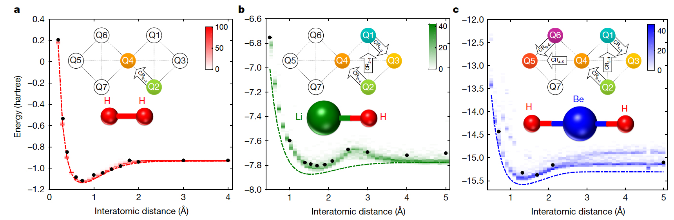
Successful Quantum Simulation
Quantum Chemistry has the first big successes in quantum simulation.
GitHub has a project for general simulations of interacting fermions.
However, interesting HEP systems, e.g., QCD, also require boson-fermion interactions.
https://github.com/quantumlib/OpenFermion

Slide 18
Digital quantum computation of fermion-boson interacting systems
Previous encoding schemes for bosons on quantum computers had errors of O(n_{occupation}/n_{qubits})
Alexandru Macridin, Panagiotis Spentzouris, James Amundson, Roni Harnik
  Digital quantum computation of fermion-boson interacting systems
    arXiv:1805.09928
    Accurate and efficient simulation of fermion-boson systems; simple enough for use on near-term hardware
  Electron-Phonon Systems on a Universal Quantum Computer
    arXiv:1802.07347
    First application was to polarons – electron dressed by phonons. Cross-disciplinary interest.

Slide 19
HEP Technology for Quantum Computing
SRF resonators
Ultra-High Q Superconducting Accelerator Cavities for Orders of Magnitude Improvement in Qubit Coherence
  Alex Romanenko, et al.
Novel Cold Instrumentation Electronics for Quantum Information Systems
  Davide Braga, et al.

Slide 20
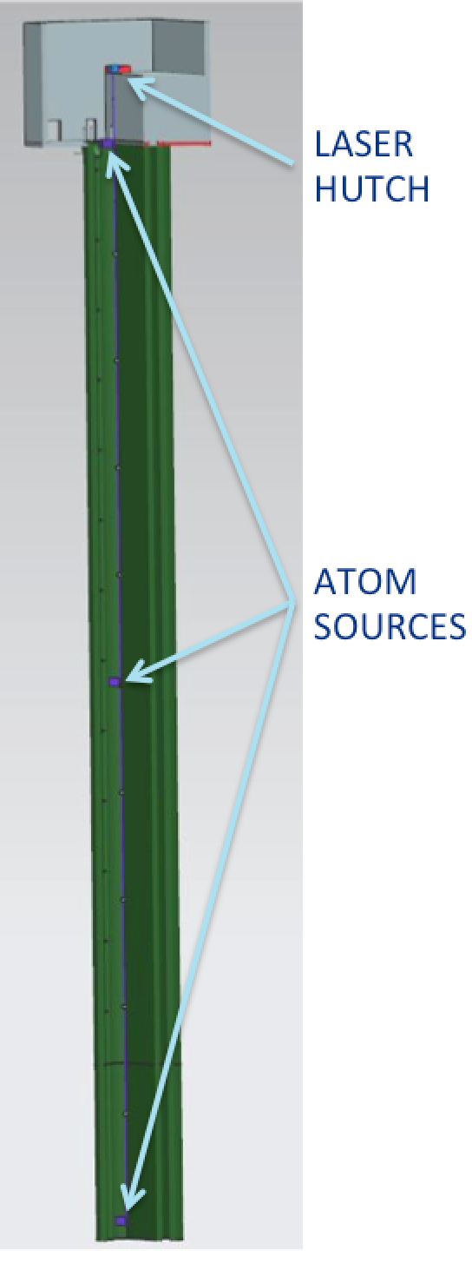
Quantum Technology for HEP Experiments
Sensor concept
Matter-wave Atomic Gradiometer Interferometric Sensor
(MAGIS-100)
  Robert Plunkett, et al.
Skipper-CCD: new single photon sensor for quantum imaging
  Juan Estrada, et al.
Quantum Metrology Techniques for Axion Dark Matter Detection
  Aaron Chou, et al.
Atoms in free fall
Probed using common laser pulses
Quantum superposition
Matter wave interference pattern readout
Atom Source 1
50 meters
100 meters
Atom Source 2
50 meters
Atom Source 3
Laser pulse (red)
CAD model of detector in 100-meter MINOS shaft )

Slide 21
Quantum Networking
Quantum Networking is outside the scope of this talk
  We are working on it at Fermilab, in collaboration with the California Institute of Technology
  Quantum Communication Channels for Fundamental Physics
    Maria Spiropulu, et al. (California Institute of Technology)

Slide 22
Conclusions
Quantum computing holds the promise of remarkable new computational capabilities
  The future is not here yet
    … but we are getting there
Fermilab has quantum computing efforts on many fronts
  Quantum Applications
  HEP technology for QC
  QC technology for HEP experiments
  Quantum Networking

