Slide 1
DUNE
Stefan Söldner-Rembold
Users Meeting
21 June 2018
Fermilab

Slide 2
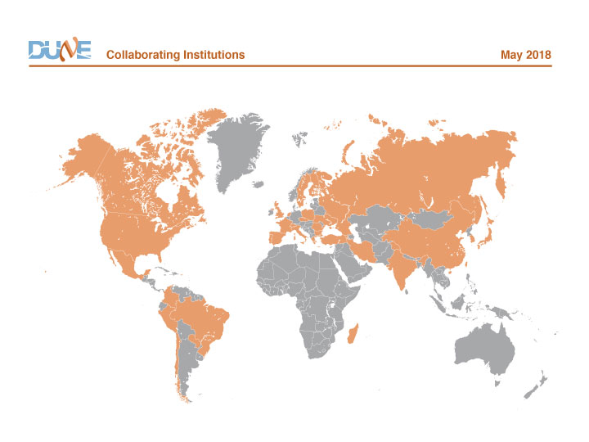
DUNE is growing
1132 collaborators from 179 institutions in 32 countries
624 faculty/scientists, 188 postdocs, 106 engineers, 214 PhD students
Growing at a rate of about 100 collaborators/year
Armenia, Brazil, Bulgaria, Canada,
CERN, Chile, China, Colombia,
Czech Republic, Spain, Finland,
France, Greece, India, Iran, Italy,
Japan, Madagascar, Mexico,
Netherlands, Paraguay, Peru,
Poland, Romania, Russia, South
Korea, Sweden, Switzerland,
Turkey, UK, Ukraine, USA.
Recently joined: Portugal

Slide 3
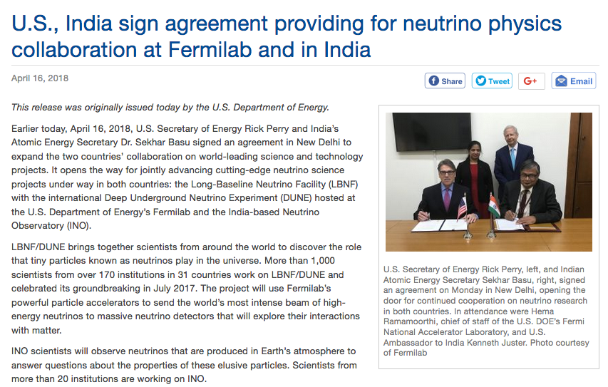

Slide 4
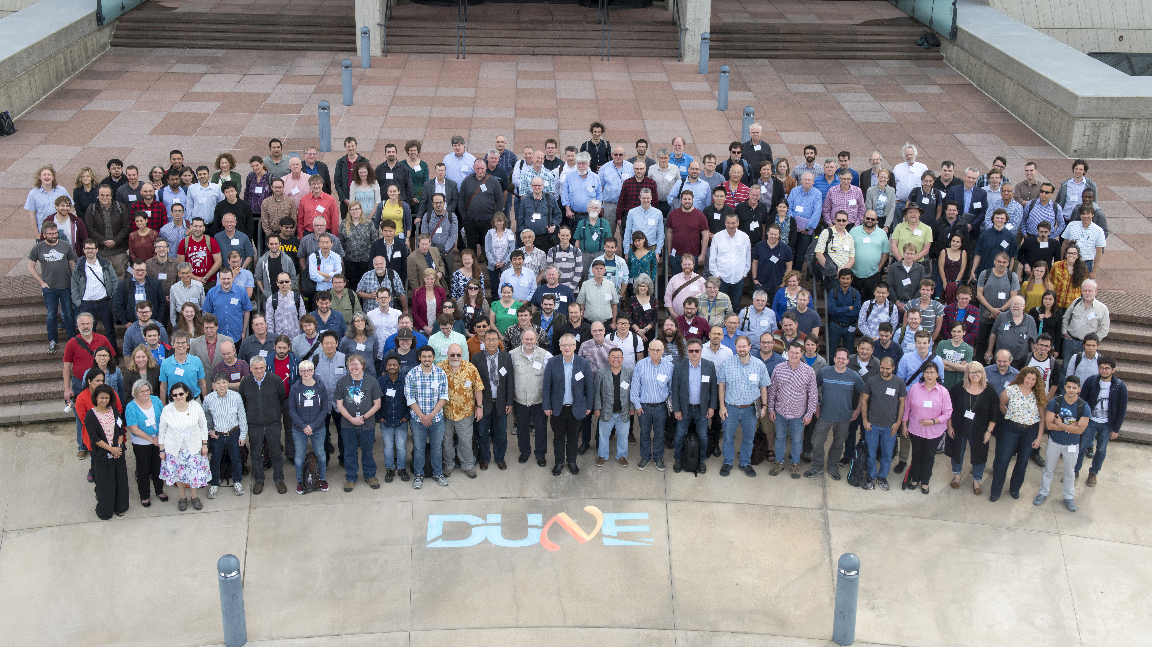
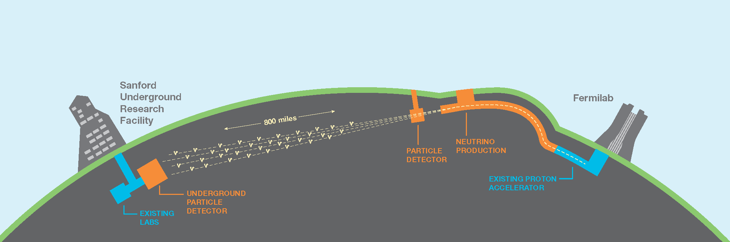
DUNE
May 2018
1300 km
FD
ND
  Approximately 40 kt fiducial mass liquid-argon Far Detector.
  Located at SURF’s 1478 m level with 1300 km baseline.
  Near Detector located approximately 575 m from neutrino source.
  Wide-band neutrino beam (~ GeV range).
  Flagship physics topics: CPV, supernova neutrinos, proton decay.

Slide 5
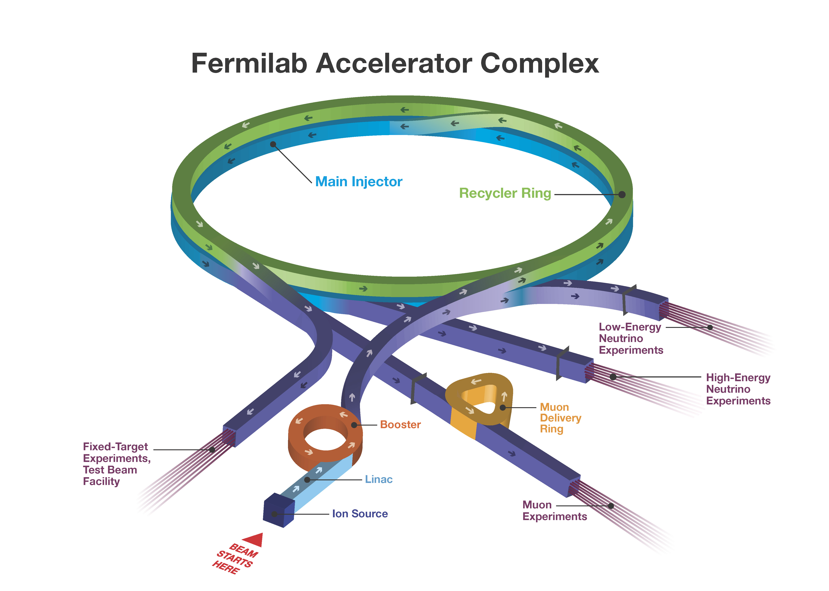
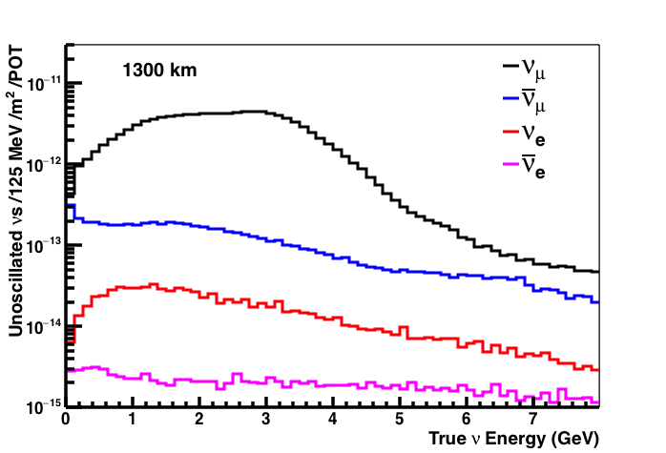
The LBNF Beam
Neutrino Flux at 1300 km
(CDR Optimized Beam)
60-120 GeV proton beam at 1.2 MW, upgradeable to 2.4 MW
Horn-focused neutrino beam line optimized for CP violation sensitivity using genetic algorithm
Engineering design of 3-horn focusing system based on optimized parameters in progress
Neutrino (FHC) and antineutrino (RHC) modes

Slide 6
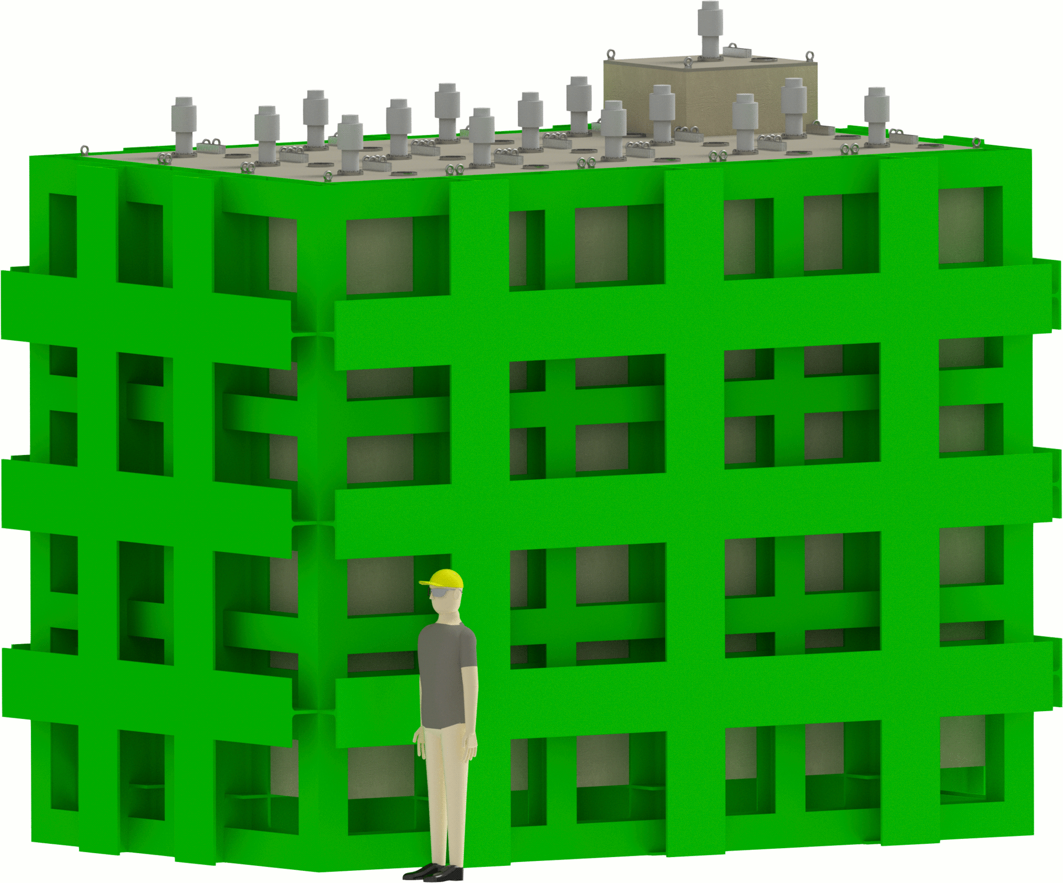
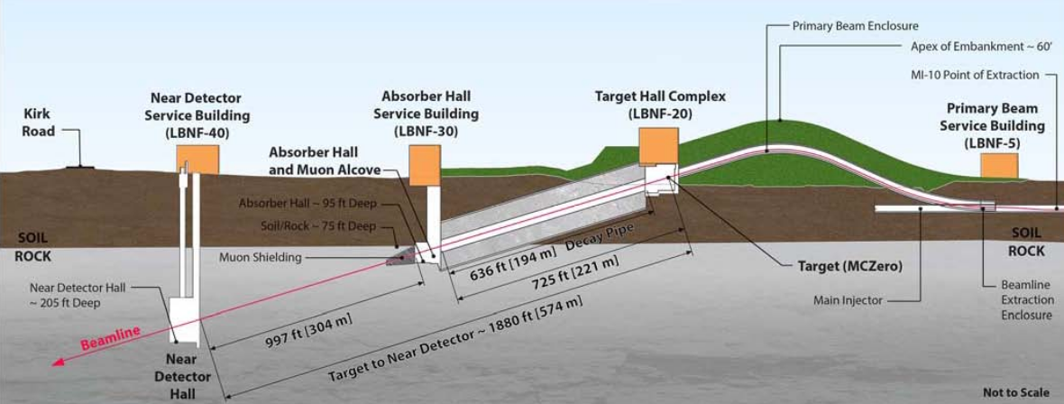
The DUNE Near Detector
Constrain systematic uncertainties for long-baseline oscillation analysis
  flux, cross-section, and detector
DUNE ND design concept near final
  Active ND Design Group
  ND Conceptual Design Report (CDR) planned for 2019
DUNE ND design concept is an integrated system composed of multiple detectors:
  Highly segmented LArTPC
  Magnetized multi-purpose tracker
  Electromagnetic calorimeter
  Muon chambers
Conceptual design will preserve option to move ND for off-axis measurements
>100 million interactions will also enable a rich non-oscillation physics programme

Slide 7
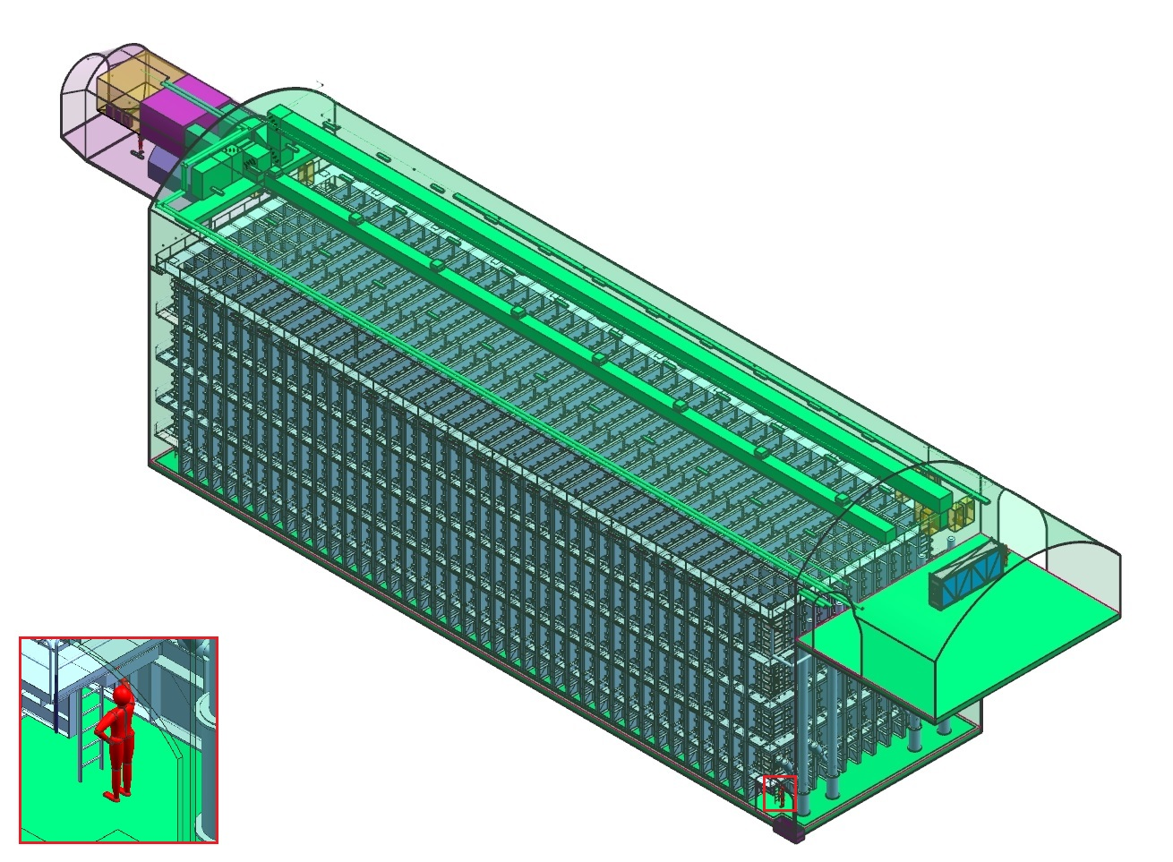
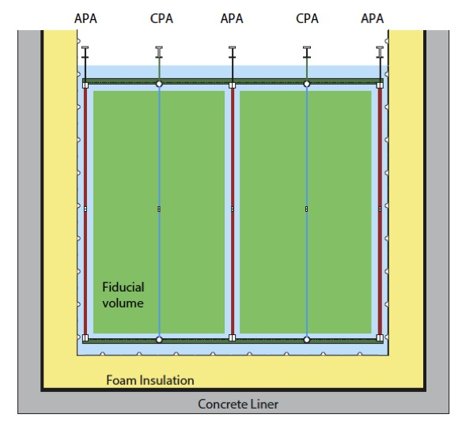
DUNE Far Detector
Four 10-kt (fiducial) liquid argon TPC modules
Single and dual-phase detector designs (1st module will be single phase)
Integrated photon detection (need wavelength shifting to visible)
Modules will not be identical
384,000 readout wires
150 “APAs” (2.3 m x 6 m)
12 m high
15.5 m wide
58 m long
Single-phase: charge drifts to wire planes (APAs)

Slide 8
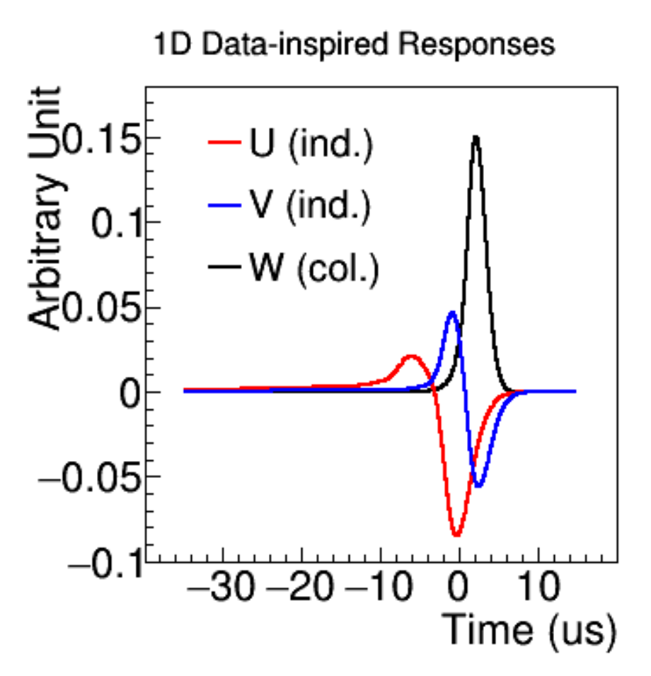
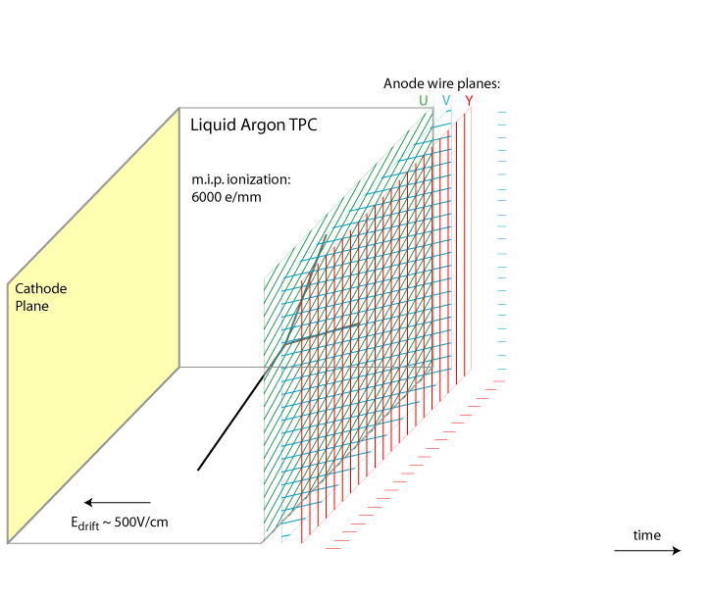
Single Phase Concept
170 kV
time
3.4 m → 2.13 ms

Slide 9
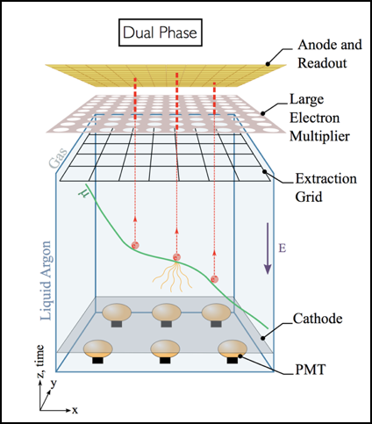
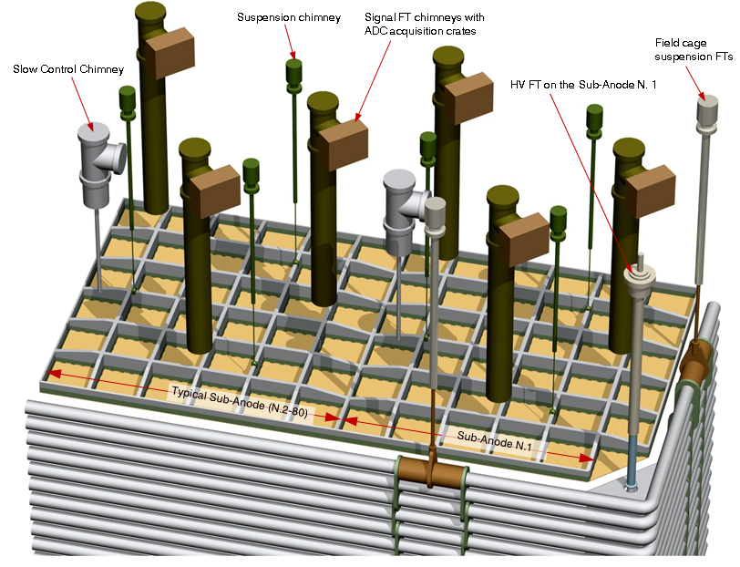
Dual Phase TPC
Larger drift distance (12 m) – higher fields
Potentially better signal to noise
Readout/HV access through chimneys on top.
153,600 channels
80 3x3 m² Charge Readout Planes

Slide 10
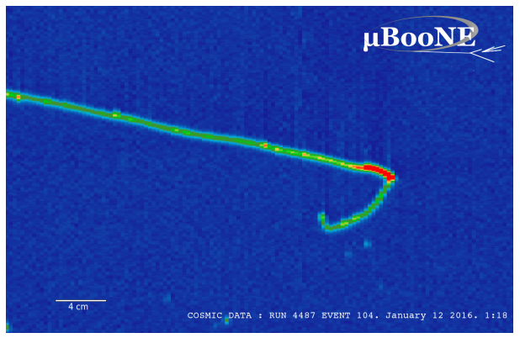
A powerful imaging technology
Stopping Muon
MIP Region
Bragg Peak
Michel
Electron
Photons
Textbook plot…

Slide 11
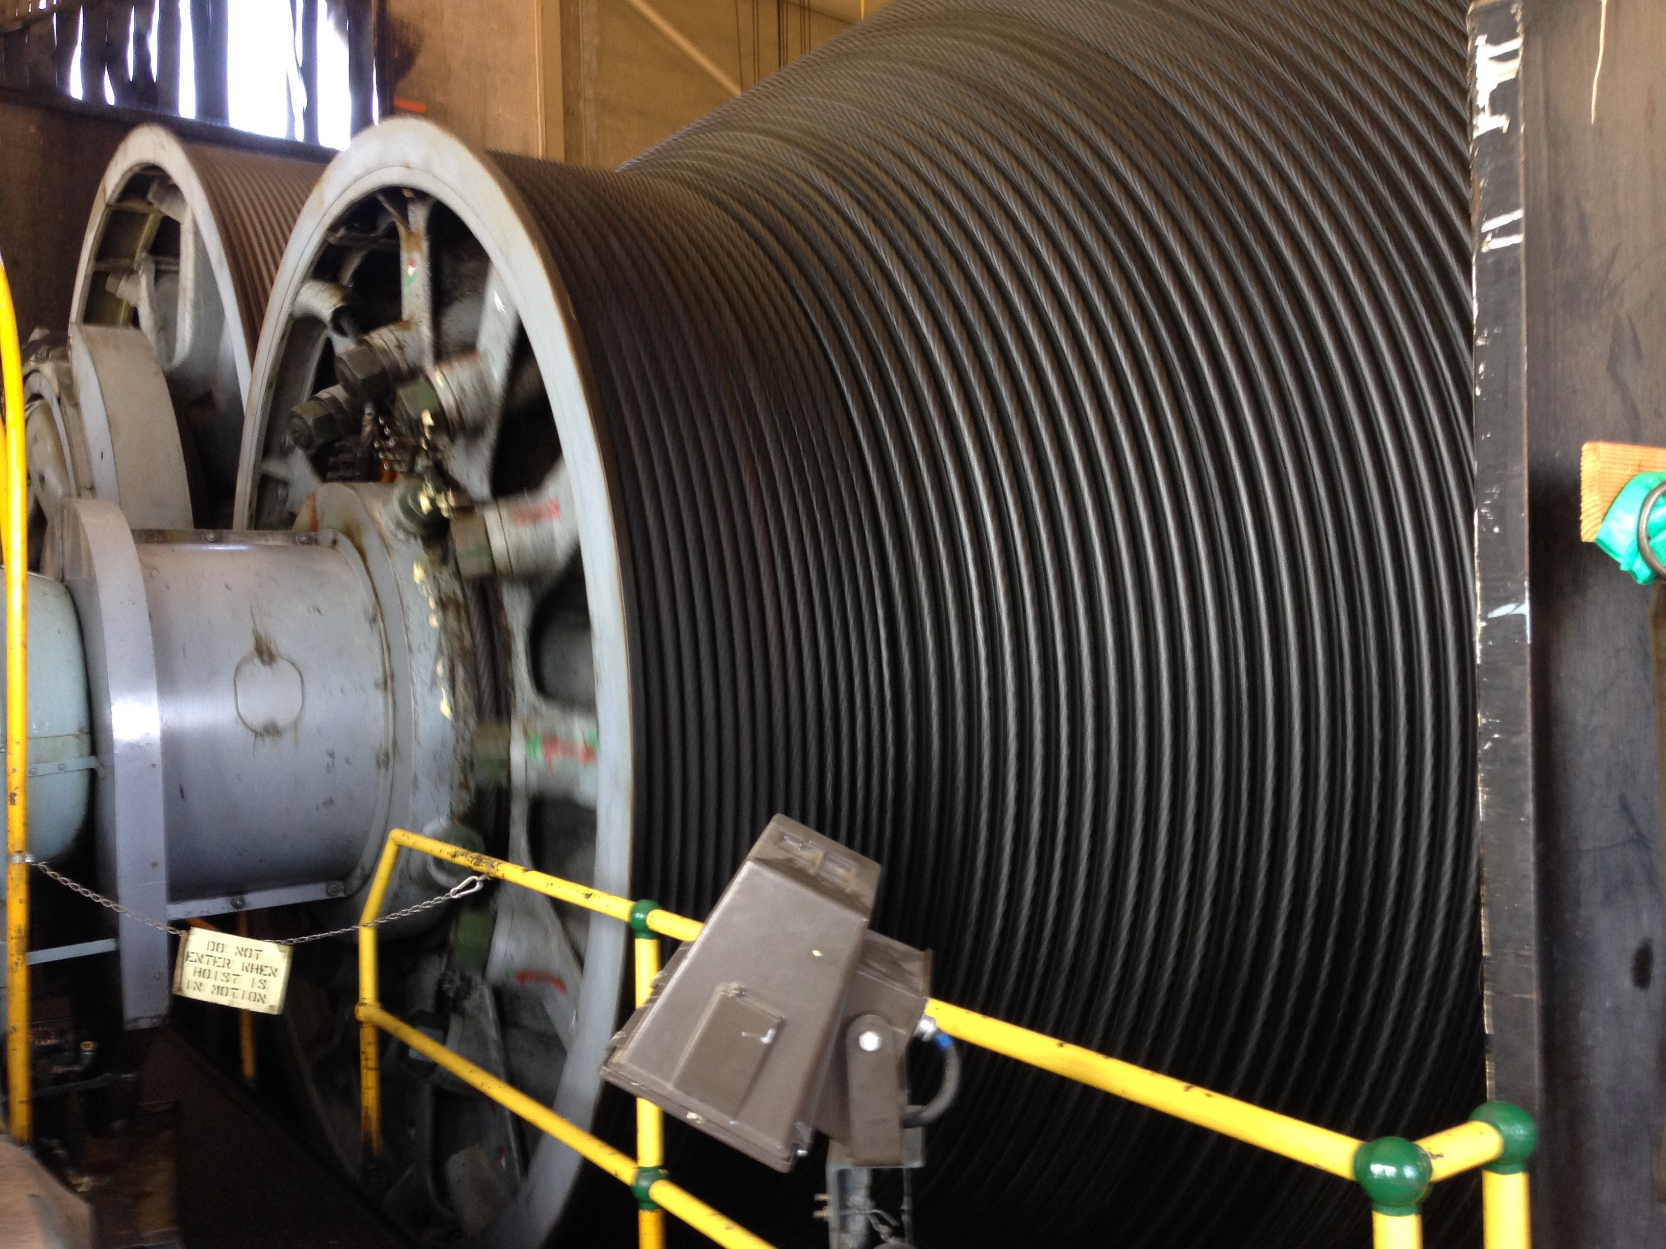
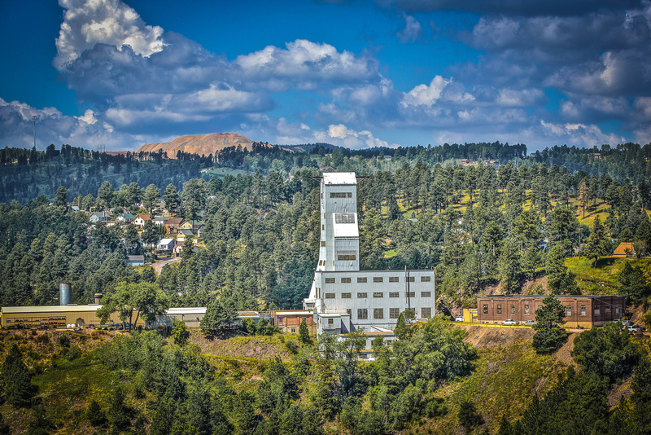
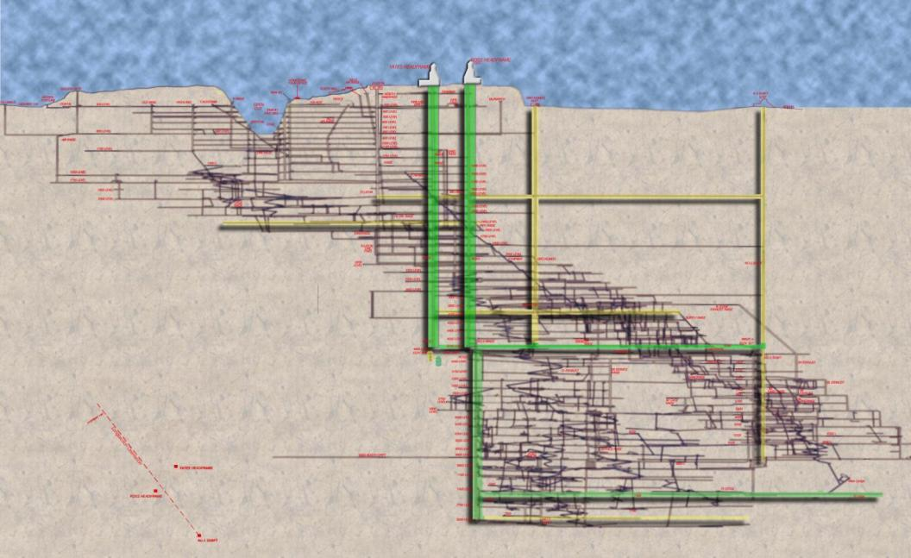
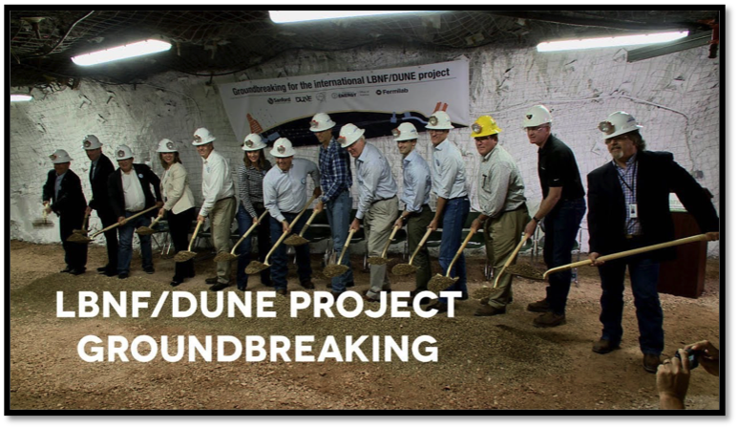
Sanford Underground Research Facility (SURF)
1478 m
Experimental facilities at a level
of 1478 m, located in South Dakota
Two vertical access shafts currently
being refurbished
Large excavation for 40 kt modules

Slide 12
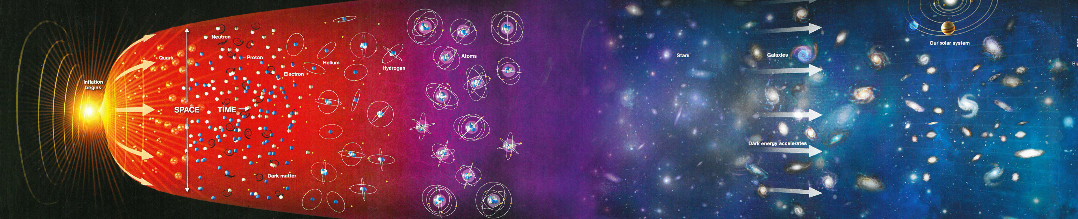
Testing the standard “three-flavour” paradigm
complex phase
CP Violation in the lepton sector might provide support for Leptogenesis
as mechanism to generate the Universe’s matter-antimatter asymmetry.
CP Violation:
Caveat:
No direct evidence for Leptogenesis, since a model is needed to connect the low-scale CPV observed here to high-scale CPV for heavy neutrinos that lead to Leptogenesis.

Slide 13
Testing the standard “three-flavour” paradigm
complex phase
CP Violation in the lepton sector might provide support for Leptogenesis
as mechanism to generate the Universe’s matter-antimatter asymmetry.
CP Violation:
Caveat:
No direct evidence for Leptogenesis, since a model is needed to connect the low-scale CPV observed here to high-scale CPV for heavy neutrinos that lead to Leptogenesis.

Slide 14
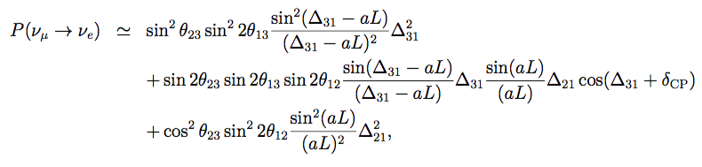
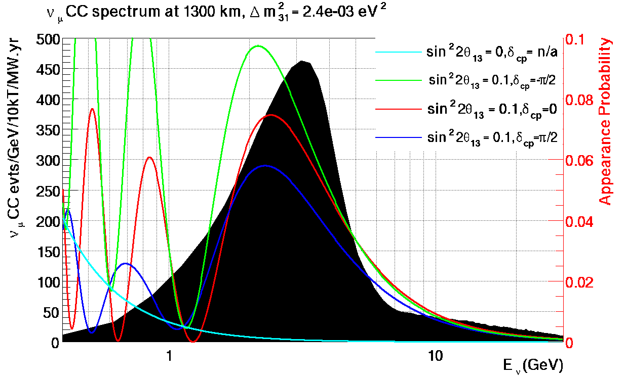
DUNE Oscillation Strategy
ν_{e} appearance amplitude depends on θ₁₃, θ₂₃, δ_{CP}, and matter effects – measurements of all four possible in a single experiment
Large value of sin²(2θ₁₃) allows significant ν_{e} appearance sample
-π/2
0
Event rate:
π/2

Slide 15
DUNE Oscillation Strategy
    Measure ν_{e} appearance and ν_{μ} disappearance over range of energies
    Disentangle mass ordering and CP violation effects
muon-neutrino disappearance
electron-neutrino appearance
ν_{μ}
ν_{e}
7 years
of data
ν_{μ}
ν_{e}
DUNE CDR, arXiv:1512.06148

Slide 16
Mass Ordering and CPV
Sensitivities in DUNE CDR based on GLoBES calculations, with approximated systematics
Width of the bands represents the range of sensitivities for 90% C.L. range in θ₂₃

Slide 17
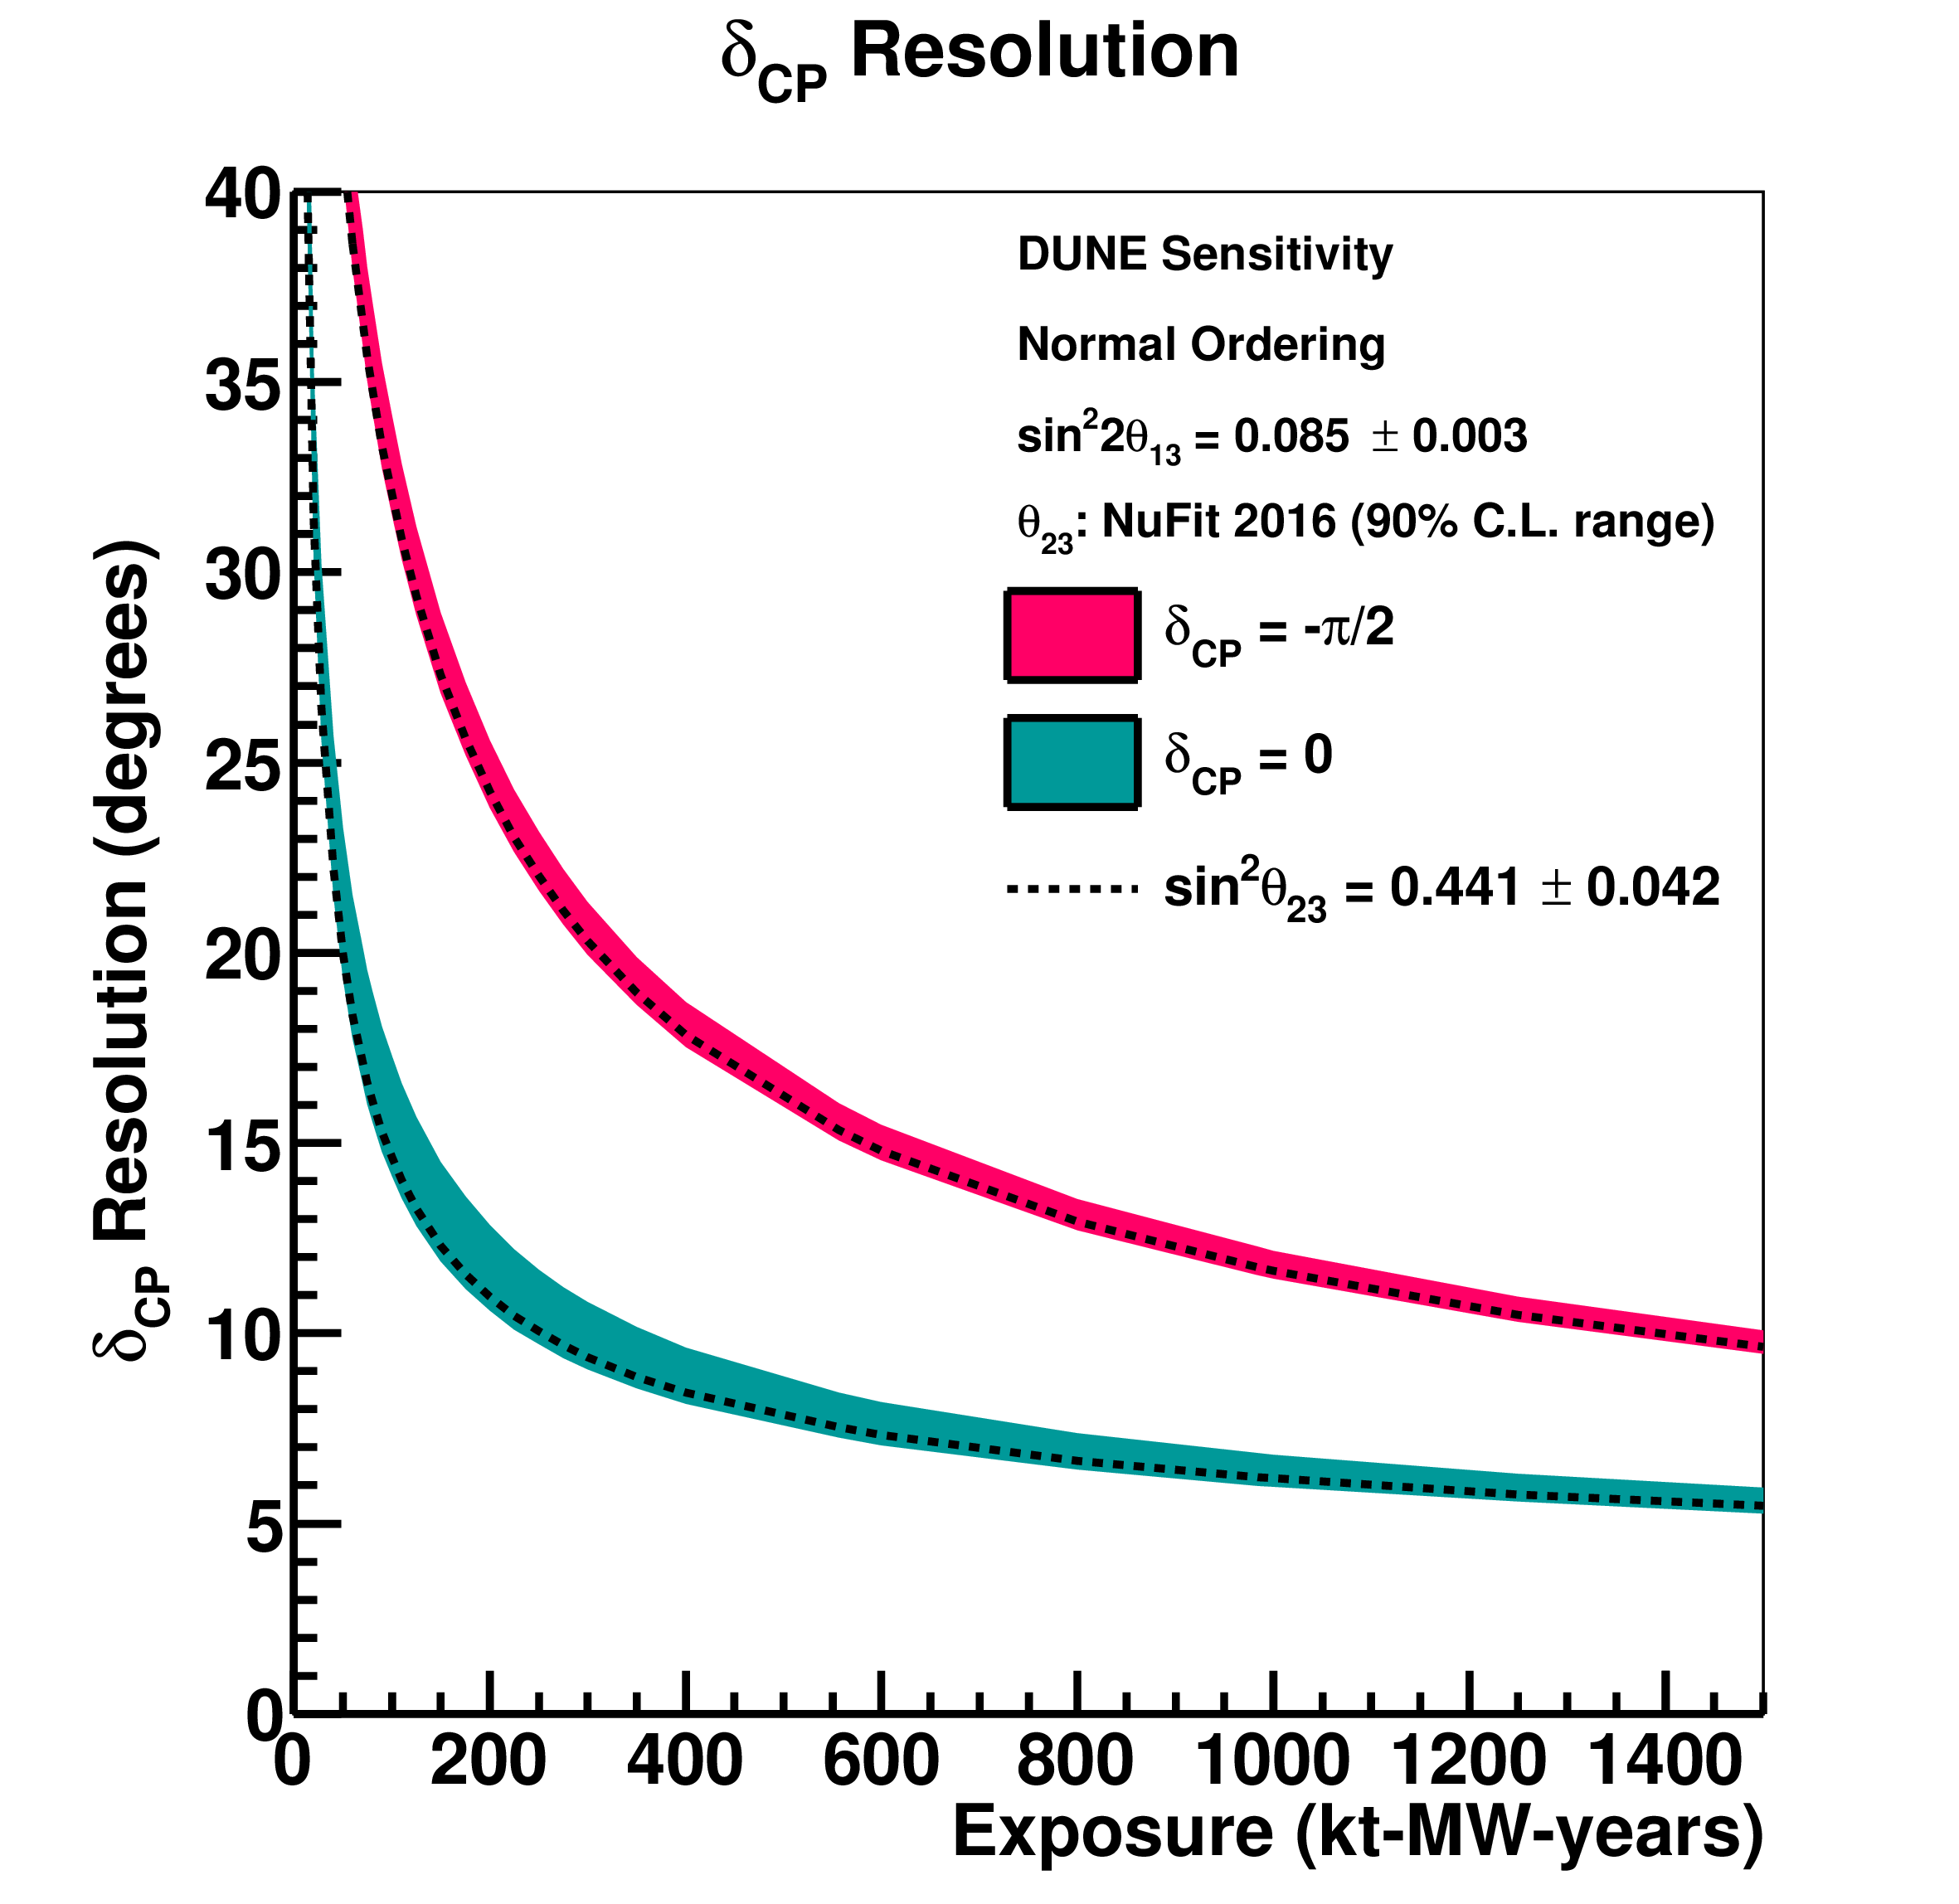
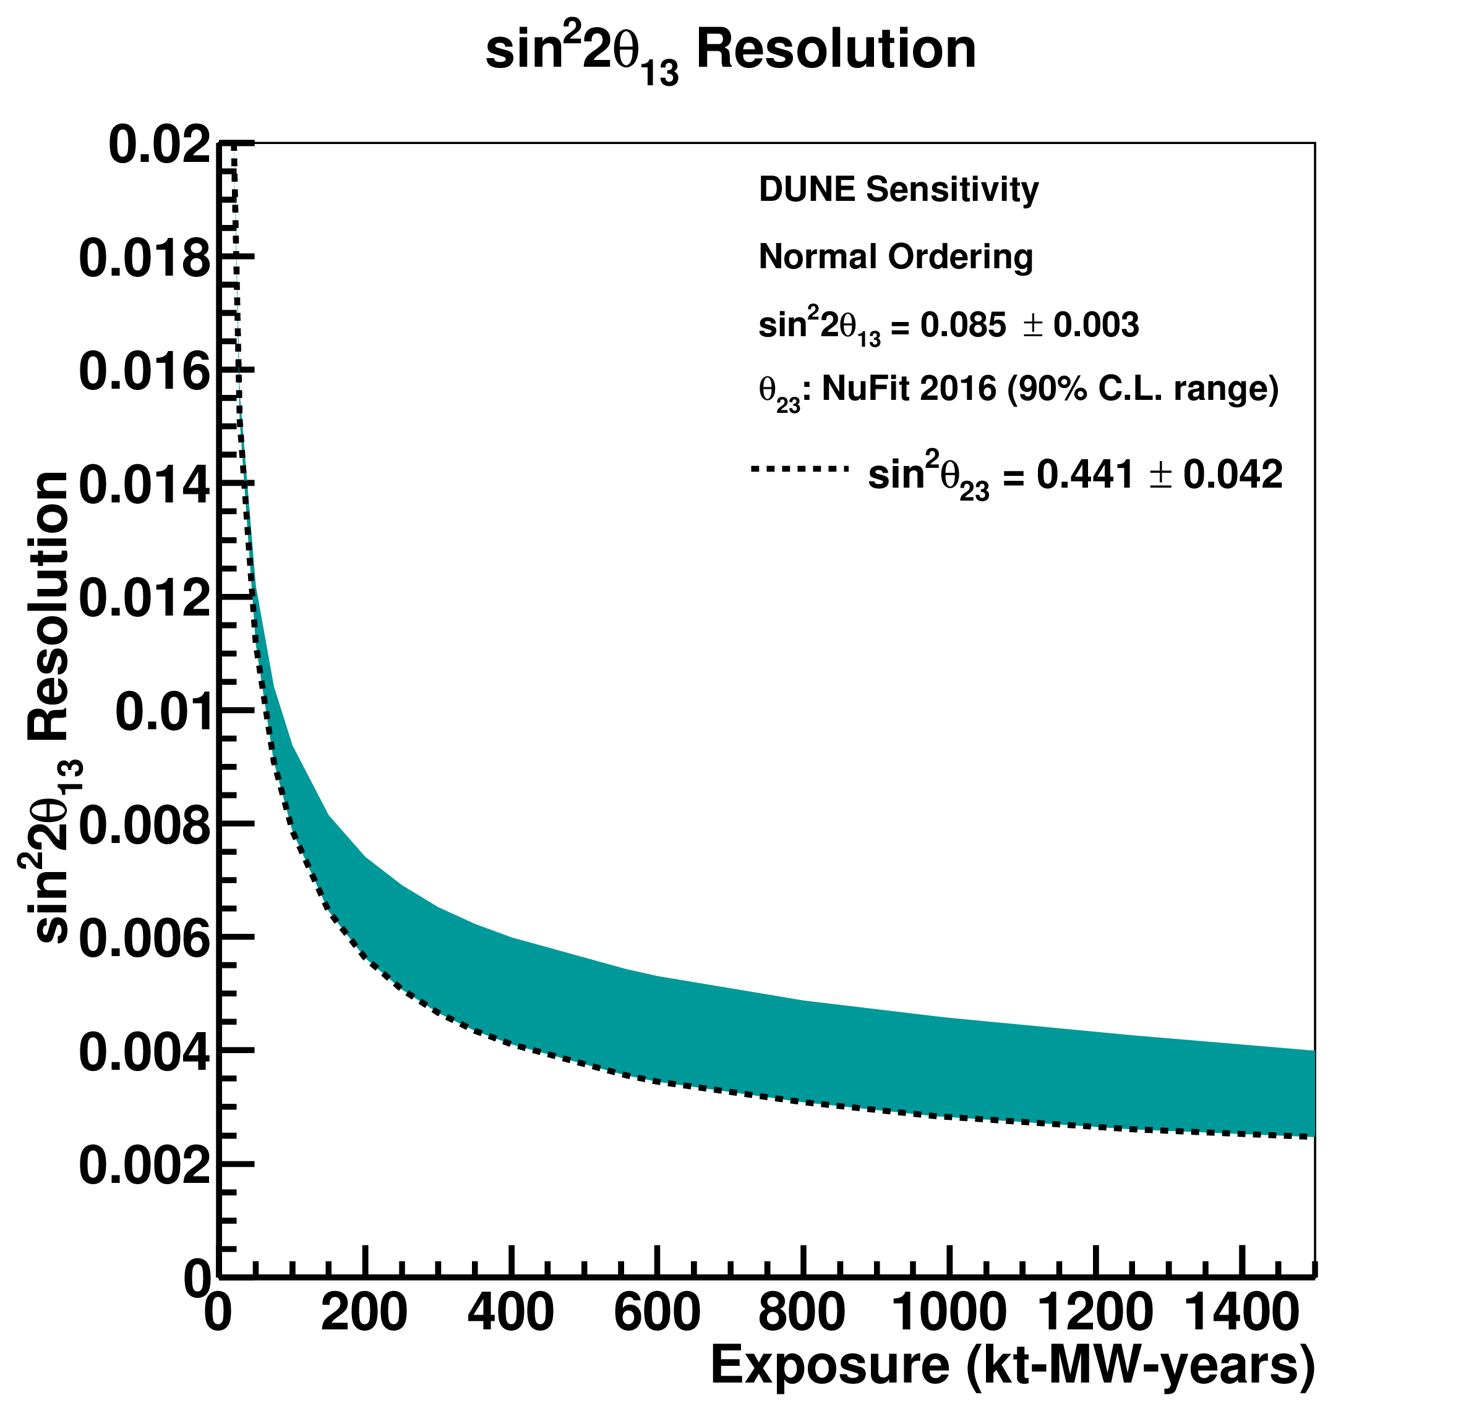
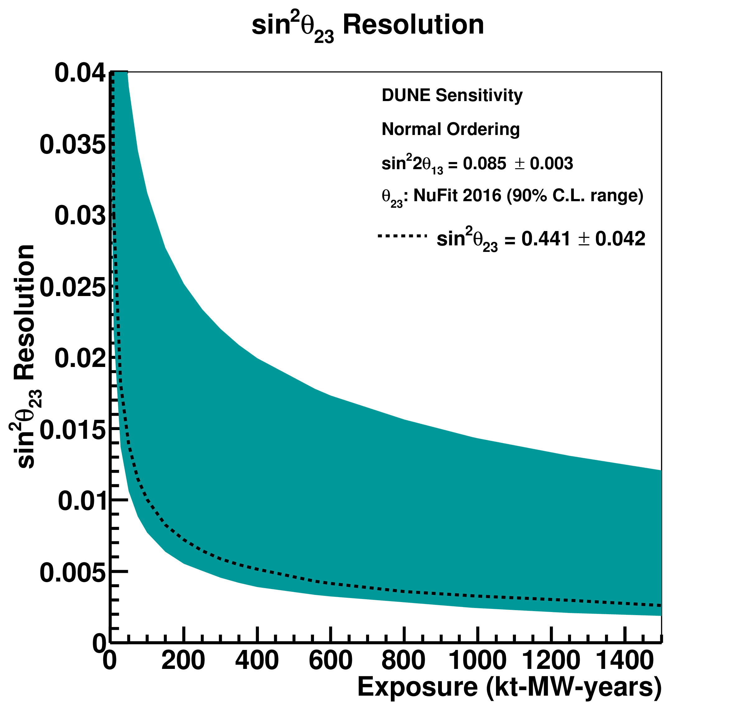
Oscillation Parameter Sensitivity
DUNE CDR

Slide 18


Monte Carlo Analysis
GEANT4 beam simulation of updated beam design
Full LArSoft Monte Carlo simulation
  Shared framework among many LArTPC experiments
  GENIE event generator and GEANT4 particle propagation
  Detector readout simulation including realistic waveforms and white noise
Automated signal processing and hit finding
Automated energy reconstruction
  Muon momentum from range (contained) or multiple Coulomb scattering (exiting)
  Electron and hadron energy from calorimetry
Event selection using Convolutional Visual Network (CVN)
Oscillation analysis using CAFAna fitting framework (shared with NOvA)
CDR-style systematics analysis (update coming in 2019)
Results are for single phase; dual phase analysis in progress

Slide 19
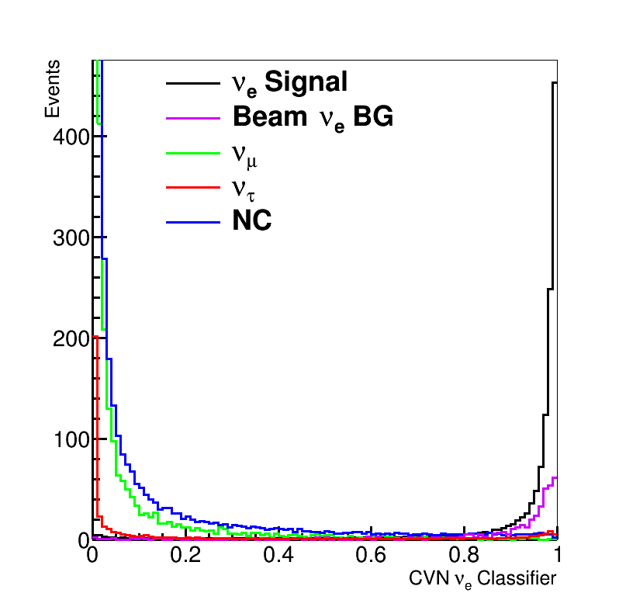
CVN Event Selection
ResNet architecture implemented in TensorFlow
Training performed on sets of 500 x 500 DUNE MC images
DUNE MC images classified into categories
  ν_{e}^{CC}, ν_{μ}^{CC}, ν_{τ}^{CC}, NC
Event selection by applying cuts on ν_{e}^{CC}-like and ν_{μ}^{CC}-like CVN classifiers
  ν_{e}^{CC}-like cut chosen by optimizing CPV sensitivity
Optimized cut = 0.85

Slide 20
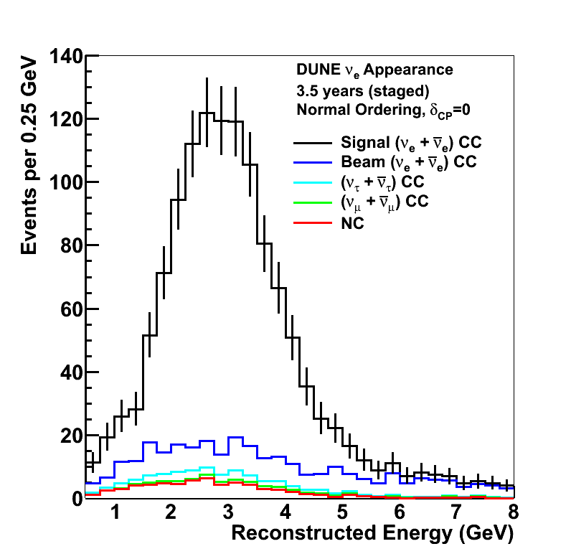
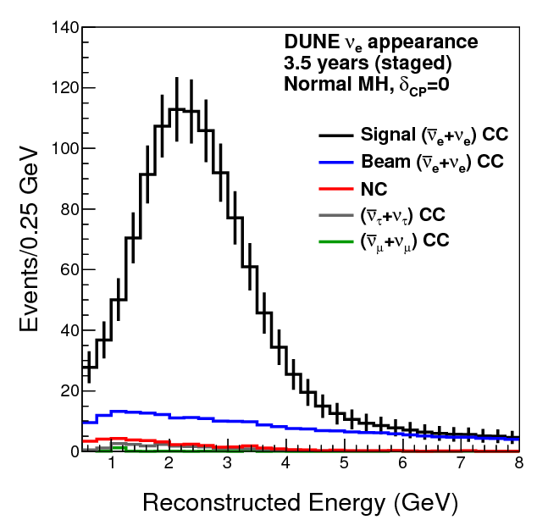
Results of improved MC analysis
Sensitivity from MC-based analysis with automated reconstruction and event selection exceeds CDR sensitivity
Full update planned for TDR in 2019

Slide 21
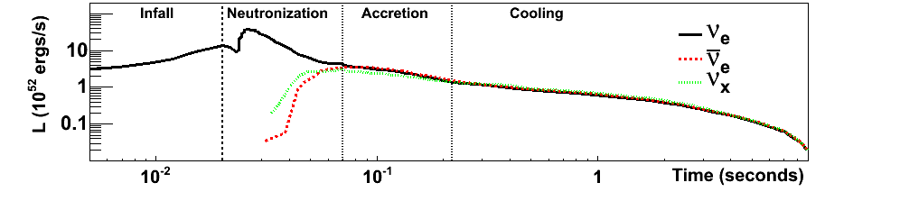
Supernova Neutrinos
In LArTPC, SNB signal dominated by electron neutrinos:

Slide 22
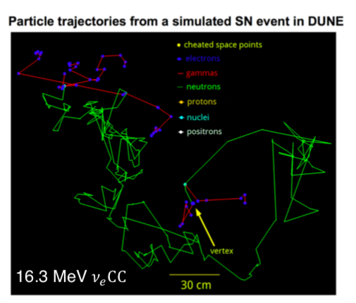
Supernova Neutrinos
In LArTPC, SNB signal dominated by electron neutrinos:
MARLEY event generator: marleygen.org

Slide 23
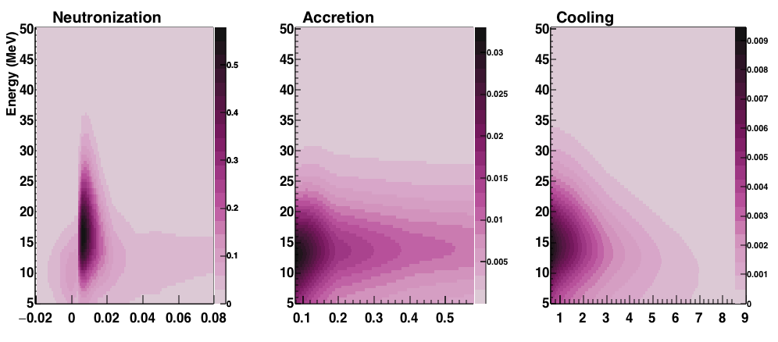
Supernova Neutrinos
In LArTPC, SNB signal dominated by electron neutrinos:
Events per 0.5 MeV per ms, 40 kton @10 kpc

Slide 24
Supernova Neutrinos
In LArTPC, SNB signal dominated by electron neutrinos:
Measurement at early times tests mass ordering and SNB model

Slide 25
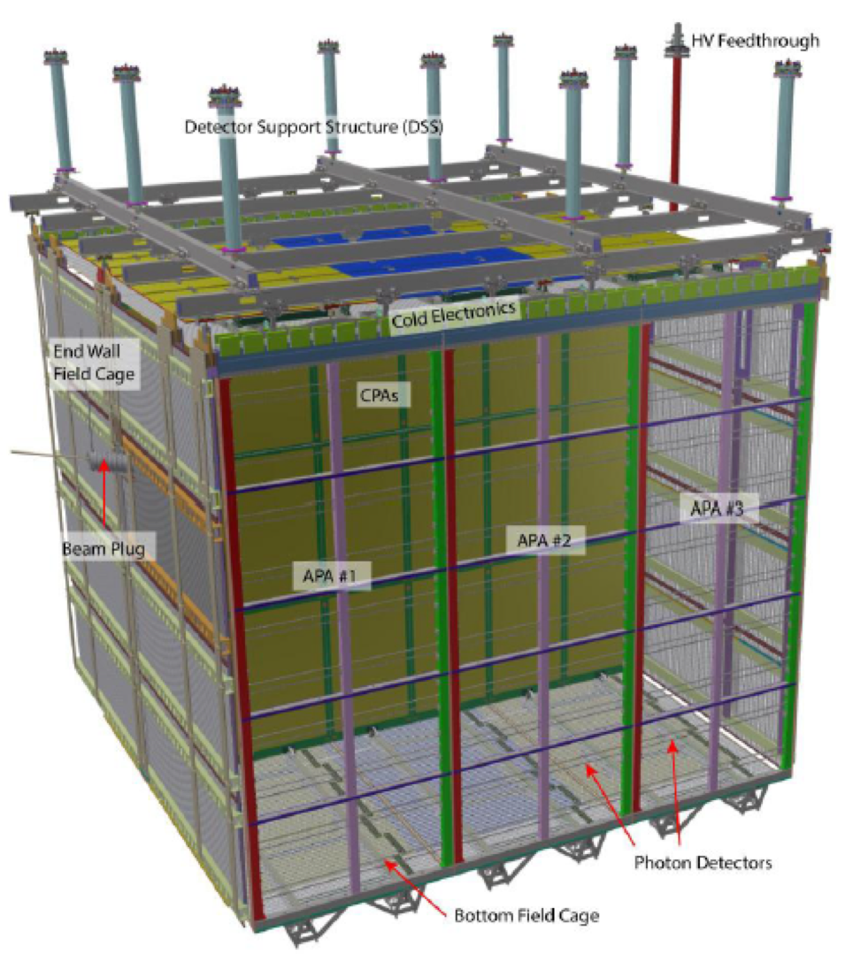
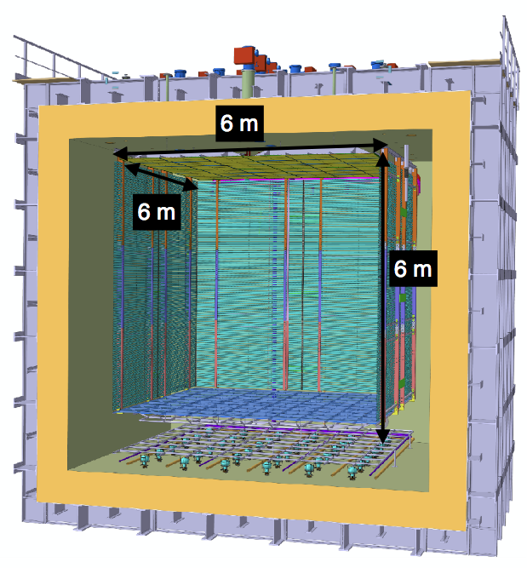
ProtoDUNE(s)
Single Phase
Dual Phase
Active volume 6.9 x 7.2 x 6 m³
Active volume 6 x 6 x 6 m³

Slide 26
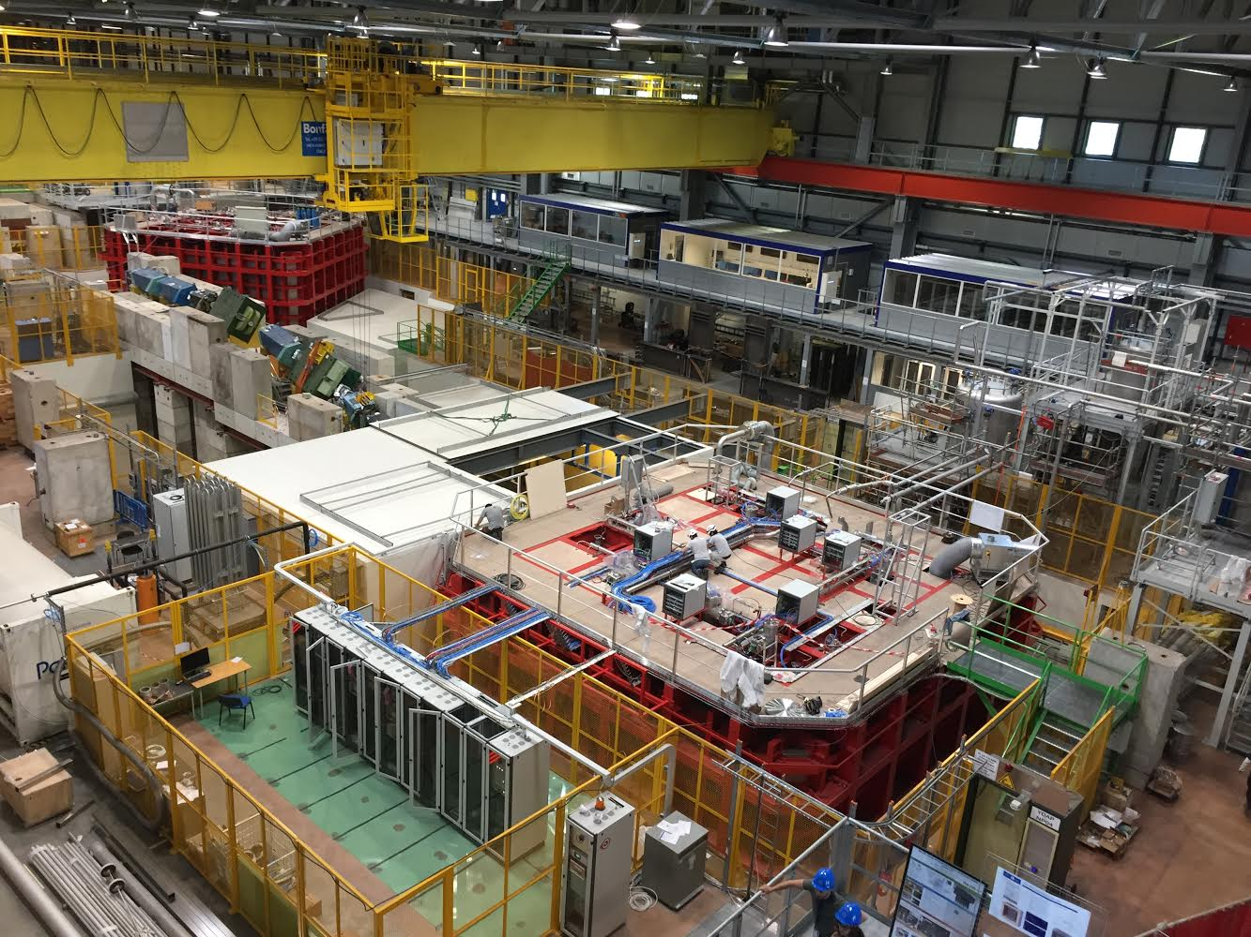
CERN North Area

Slide 27
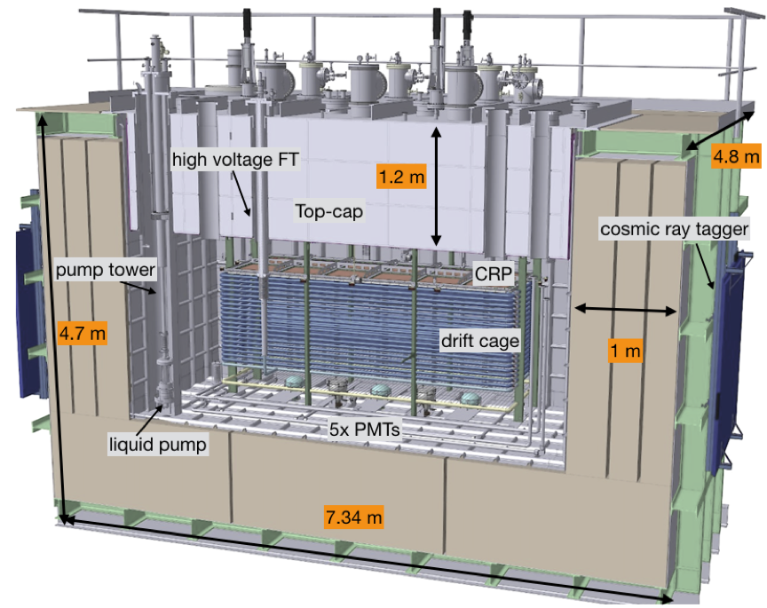
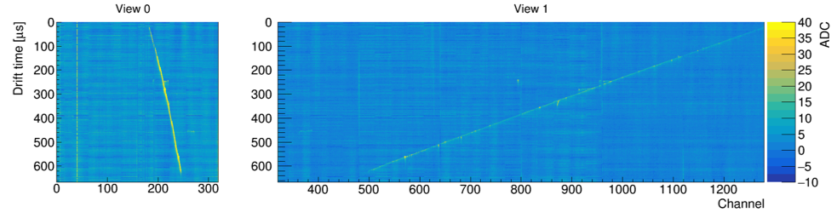
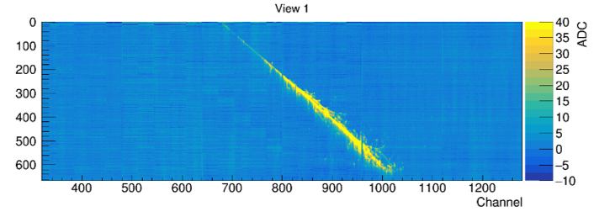
3x1x1 Dual Phase Prototype
Muon
EM Shower
3x1x1 prototype ran from June to November 2017
Successful demonstration of dual phase LArTPC concept
ENC <1800 e⁻ (S/N ≈ 100 for a MIP)
Led to improved designs for protoDUNE dual phase
arXiv:1806.03317

Slide 28
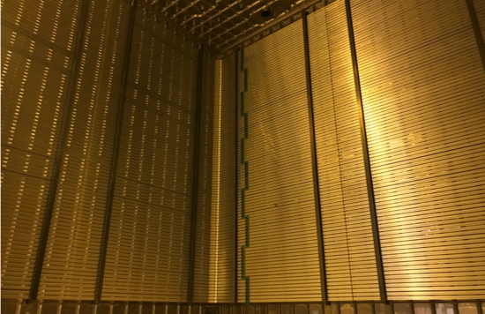
ProtoDUNE DP Field Cage

Slide 29
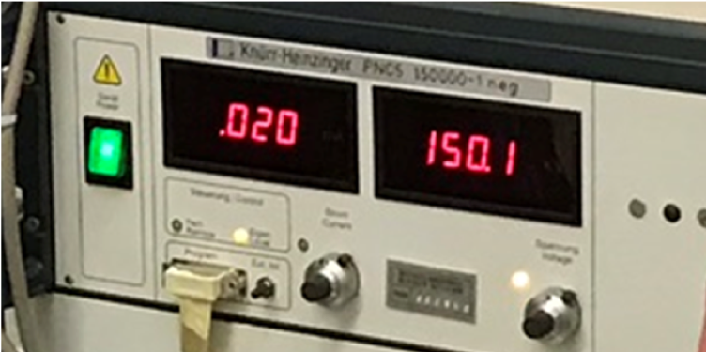
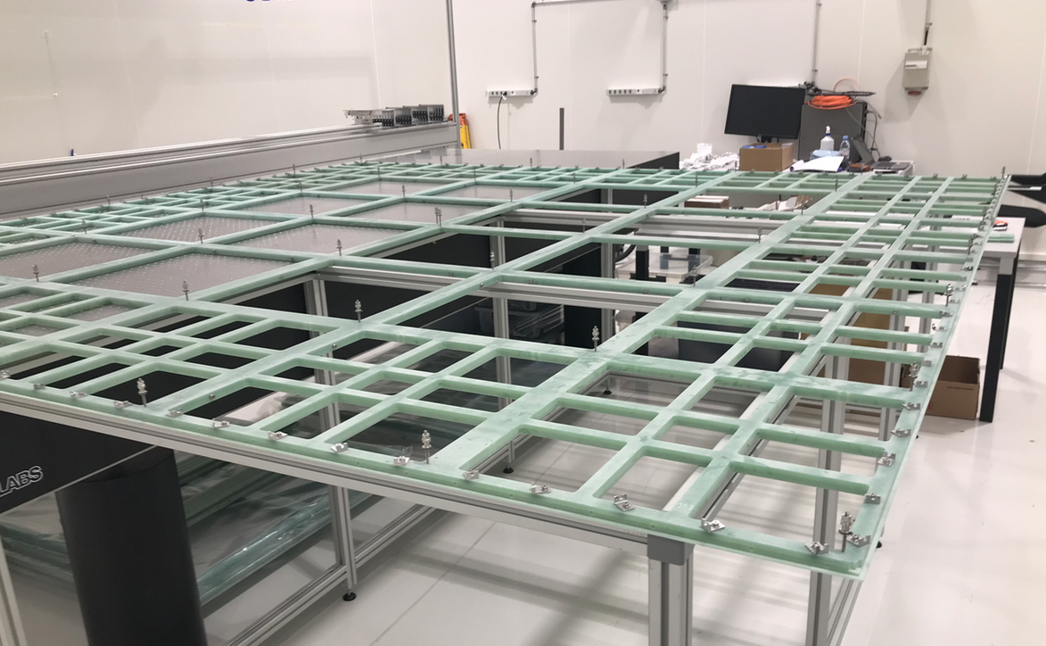
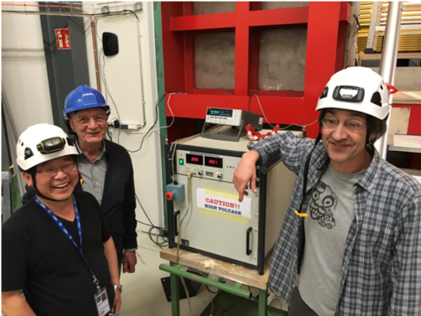
ProtoDUNE DP Field Cage
Holding 150 kV
CRP Construction

Slide 30
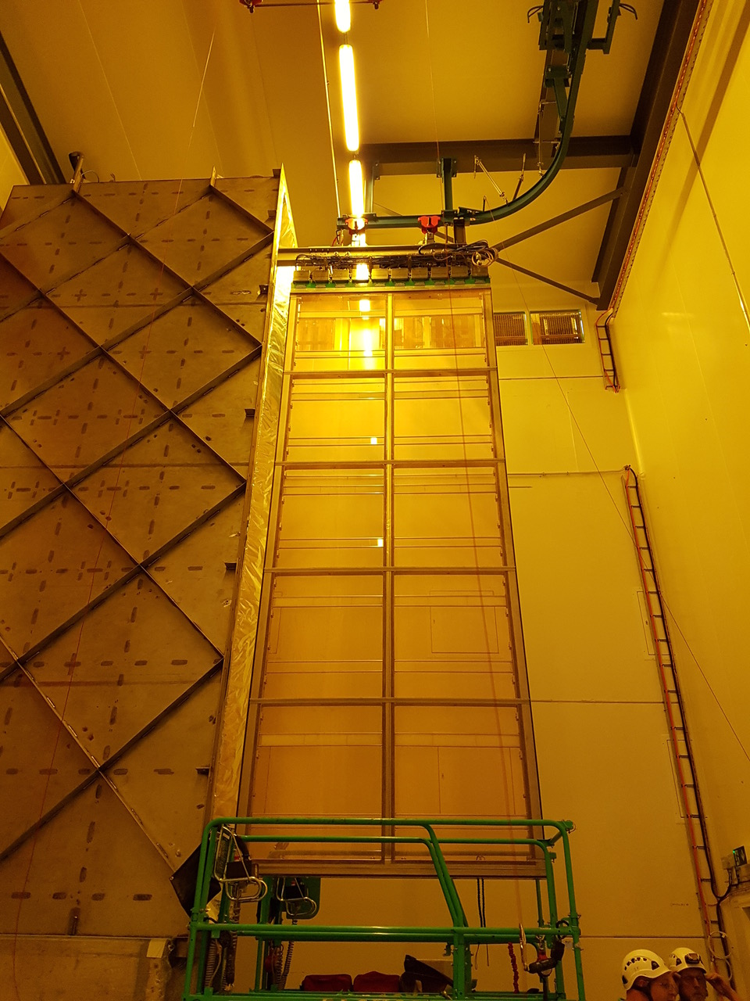
ProtoDUNE SP Cold Box
Allows testing of assembled APA and electronics before installation in protoDUNE
Incorporates feed-through, cabling, and readout system identical to protoDUNE
Filled with cold nitrogen gas for testing at “cool” temperature (~160 K)
Successful demonstration of required noise levels at cryogenic temperature
Cold Box
APA

Slide 31
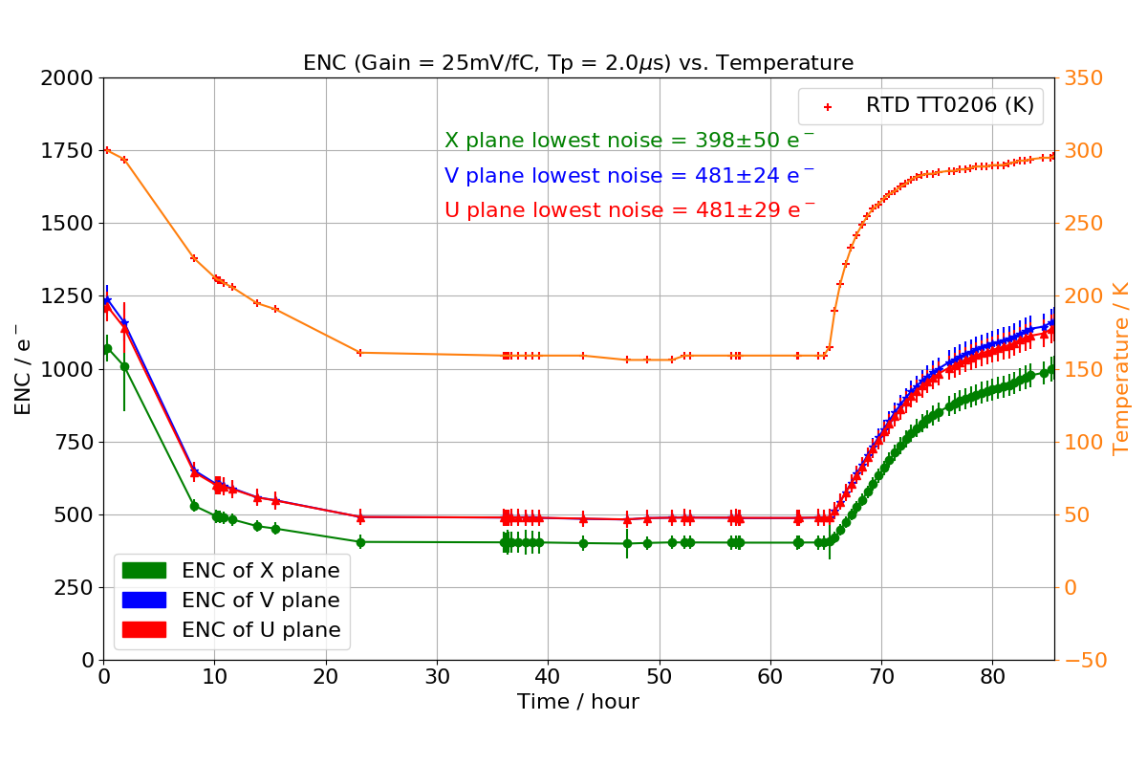
ProtoDUNE SP Cold Box

Slide 32
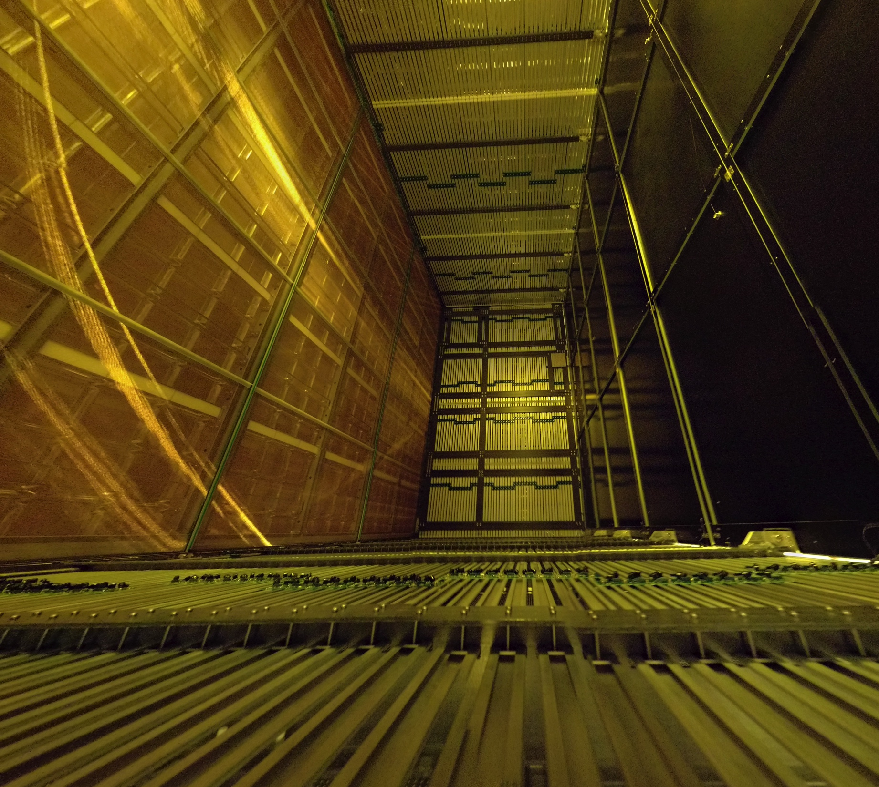
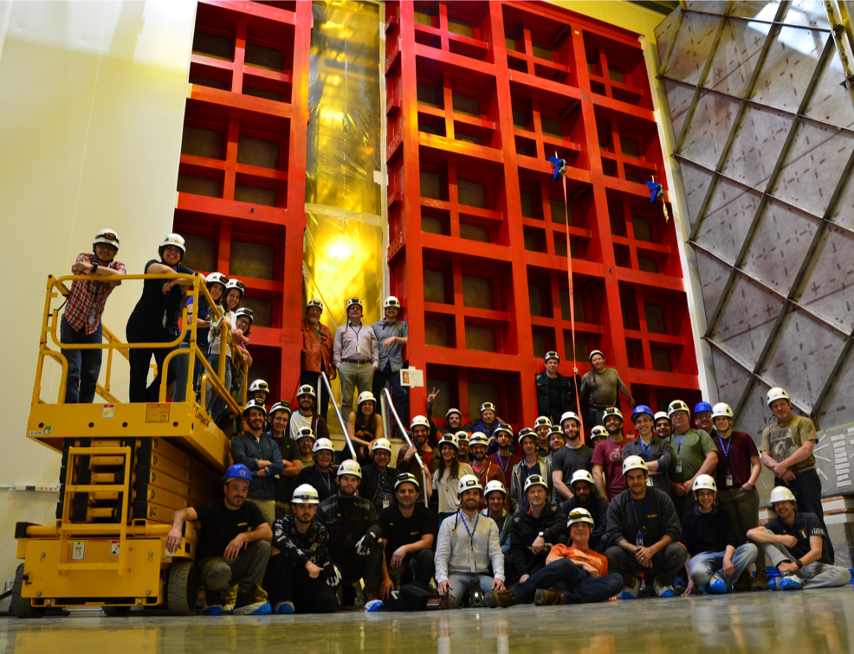
ProtoDUNE Schedule
Single Phase Installation Complete: May 2018
Single Phase Cooldown: July 2018
Single Phase Beam: August-November 2018
Dual Phase Installation Complete: Fall 2018

Slide 33
Far Detector Interim Design Report
Three Volumes (Executive Summary, Single Phase, Dual Phase), about 600 pages
Describes the first two FD modules (DP,SP)
Not yet a detailed technical document, no costing
Important milestone on the way to the TDR in 2019
Will be made public within ~ 1 month

Slide 34
DUNE Progress
now: Decision on conceptual design of ND
now: Far Detector Interim Design Report
July 2018: Completion of DUNE prototypes at CERN
April 2019: DUNE TDR submitted
Oct 2019: CD2/3b Review of LBNF, US DUNE scope
International Project Milestones | Date
Start Main Cavern Excavation | 2019
Start Detector #1 Installation | 2022
Beam on with two detectors | 2026

