Slide 1
The Engineering Promotion Process
Engineering Promotion Committee Co-Chairs
4th Annual All Engineers Retreat
20 February 2018

Slide 2
Agenda
Review the 2017 Promotions
Engineering Promotion Policy
Process Overview / Promotion Perspectives
Senior Principal Engineer Promotion
Engineering Title Classifications
What’s Ahead for 2018

Slide 3
EPC 2017 Review
2017 Schedule
February: EPC memo to dept. heads
April: First promotion package received
May-August: EPC review committees meeting
August-September: promotions approved
EPC selection committees consisted of:
HR Partner (Jeff Artel or Deanne Randich)
EPC Co-Chair (Maurice, Mayling, Jamieson)
3-4 Additional Engineers
Supervisor(s), etc.

Slide 4
EPC 2017 Review
19 Non-Competitive Promotions
Engineer to Staff Engineer (2)
Staff Engineer to Senior Engineer (10)
Senior Engineer to Principal Engineer (5)
Principal Engineer to Senior Principal Engineer (2; Directorate)
229 Engineers at the lab (as of April 2017)
65 Engineers were asked to serve on EPC review committees
54 Engineers joined EPC review committees
24% of the engineering workforce at Fermilab was involved in the promotion process in 2017

Slide 5
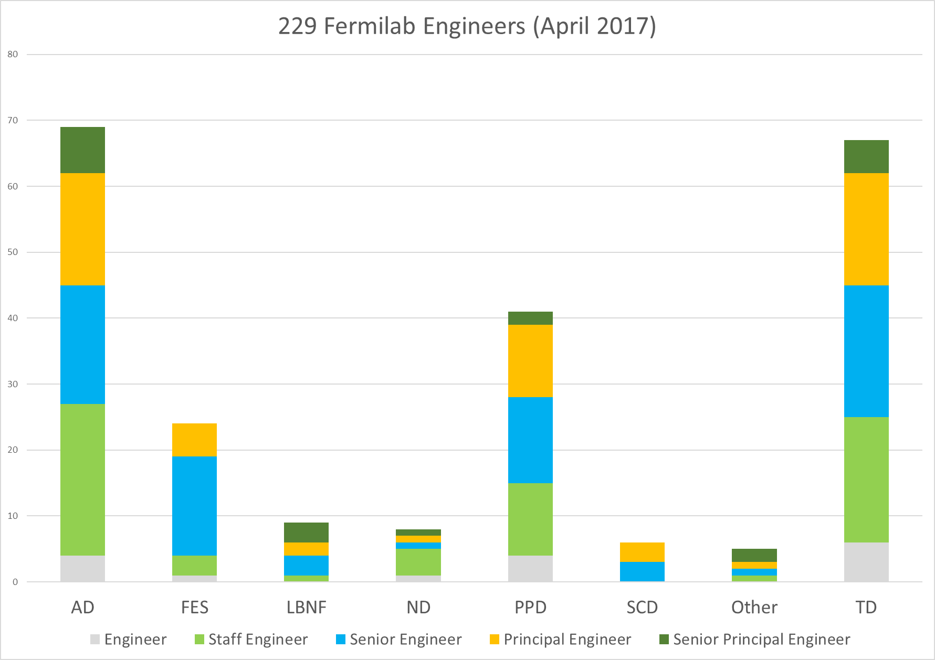
Engineers at Fermilab

Slide 6
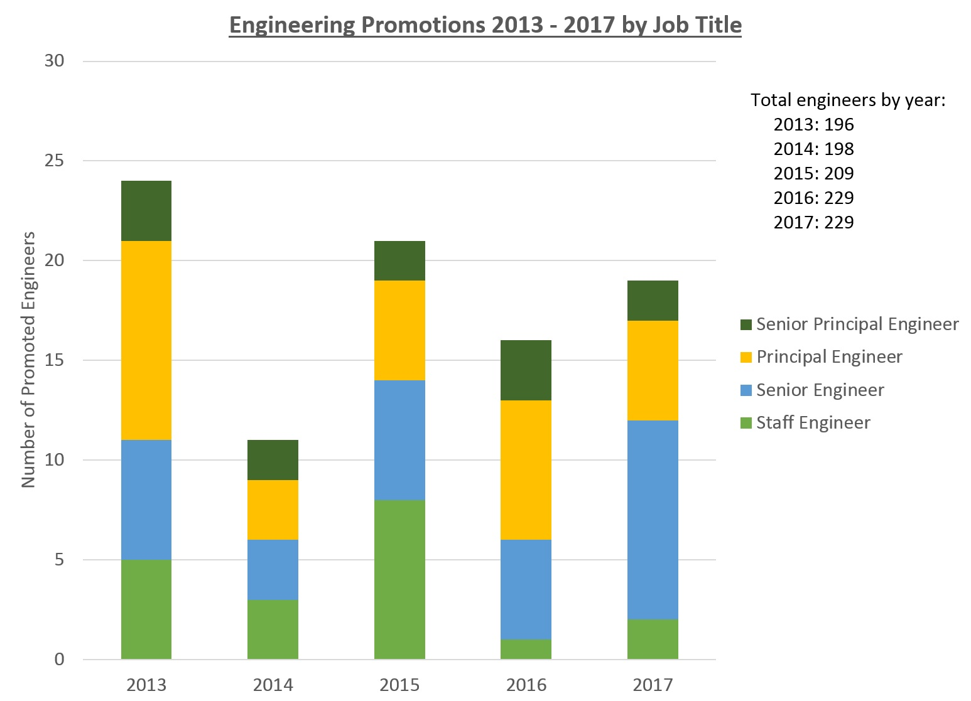

Slide 7
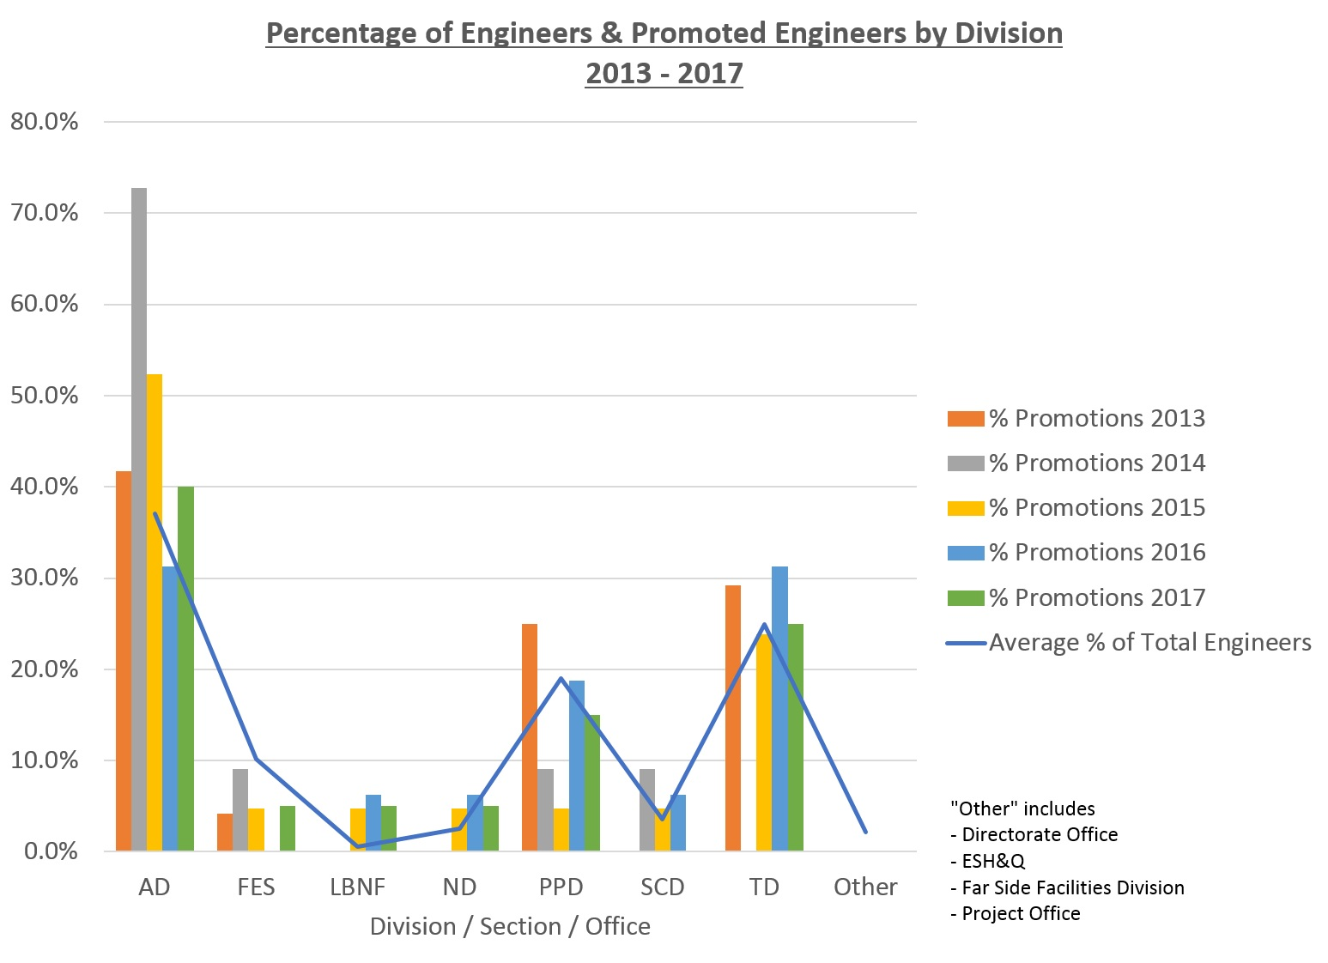

Slide 8
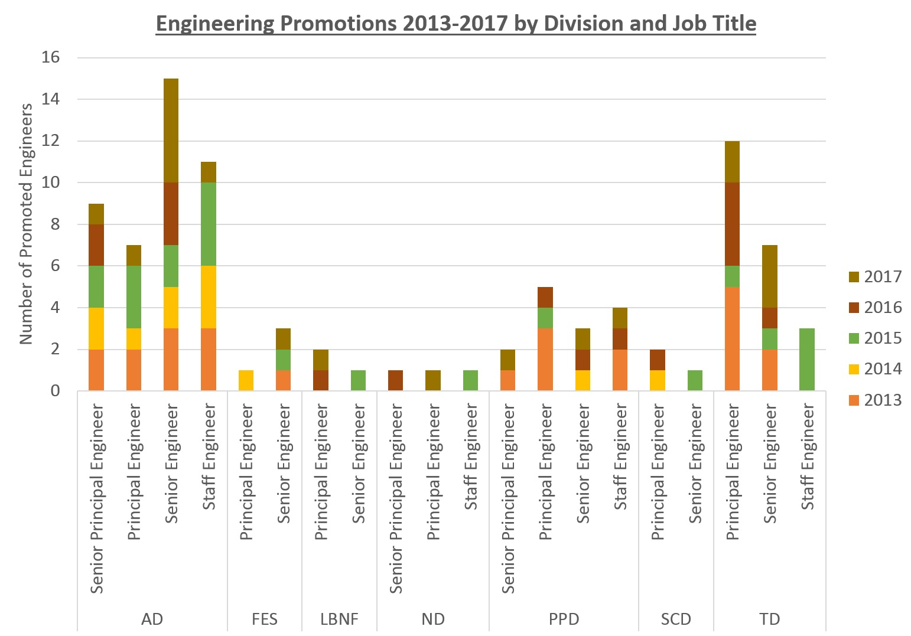

Slide 9
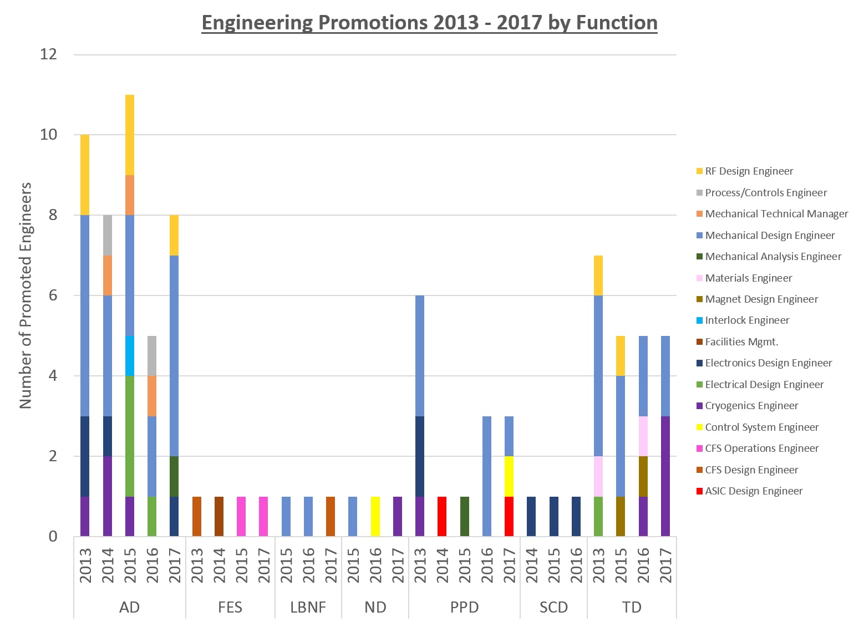

Slide 10
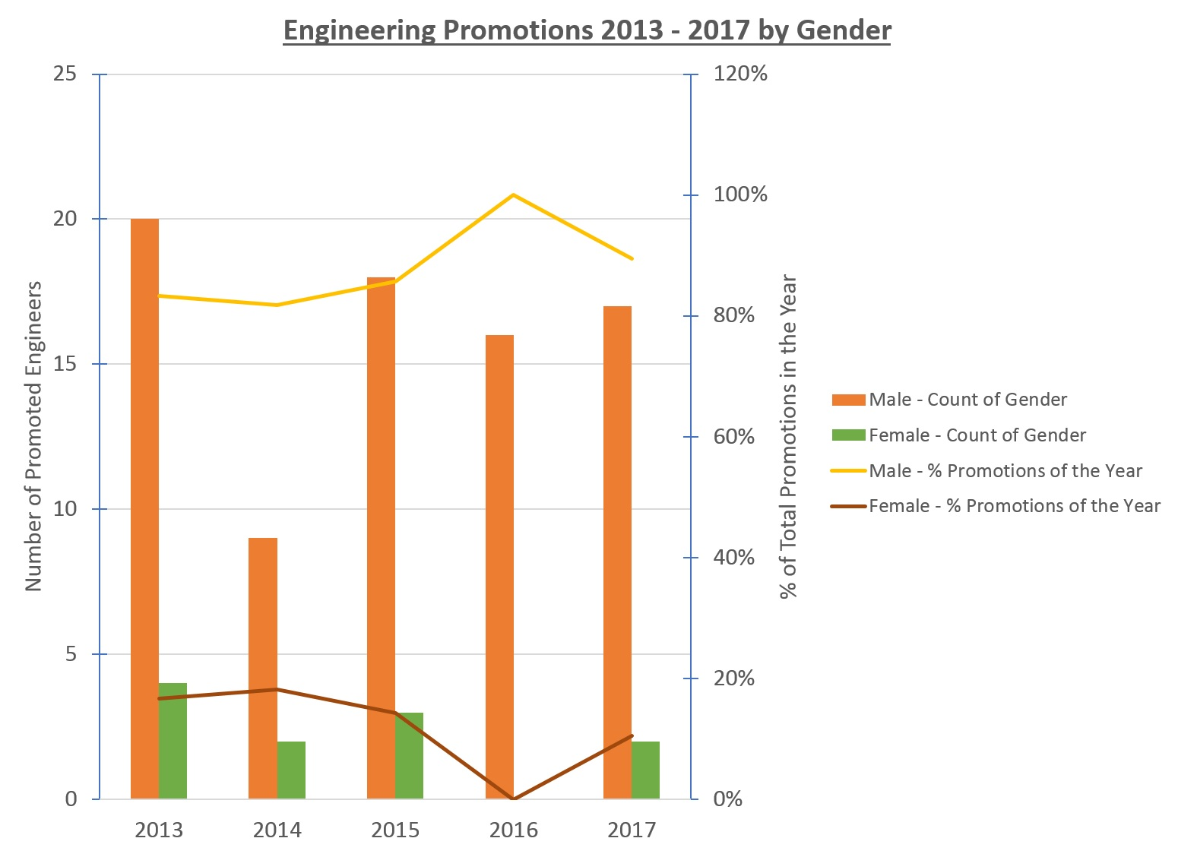
Total Female Engineers
in 2017: 23

Slide 11
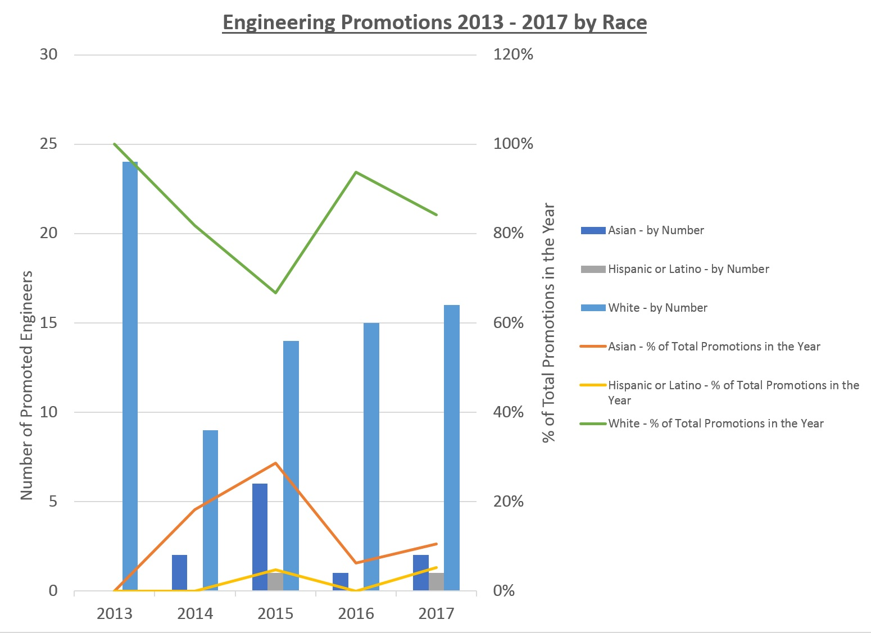
Total URM Engineers in 2017:
Asian (Non Hispanic or Latino) = 33
Black or African American = 5
Hispanic or Latino = 11

Slide 12
Engineering Promotion Policy
A link to this policy is on Engineering at Fermilab website:
http://engineering.fnal.gov/epc
The Engineering Promotion Policy describes:
Engineering Job Titles / Classification
Procedures, Checklists, Required Documents
Competitive vs Non-Competitive Promotions
Roles and Responsibilities
Job / Performance Criteria
Engineering Associate (EA) and Engineering Physicist (EP) promotions are managed by WDRS policy

Slide 13
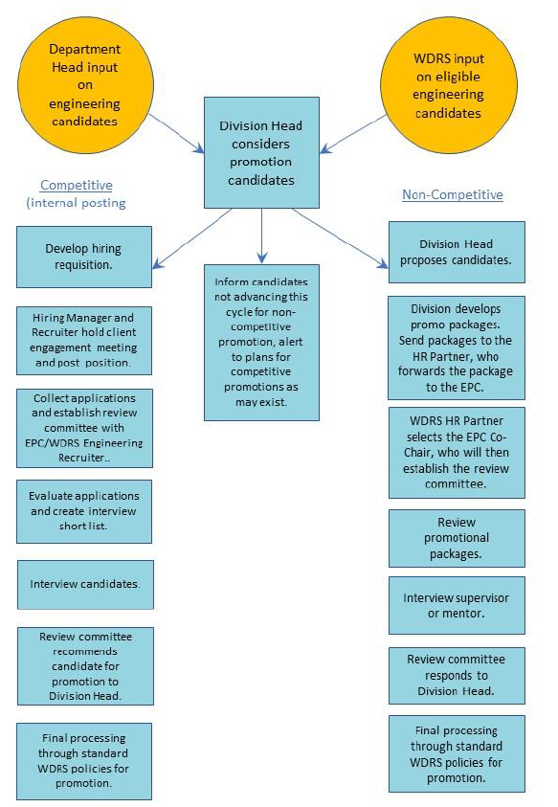
Promotion Types
Competitive
Internal posting
More flexible funding options
Process managed by WDRS not EPC
See Policy section 4.2 for details
Non-Competitive
Historically most promotions happen this way
Fund allocation limited by DOE
EPC / WDRS process

Slide 14
Promotion Perspectives: Division Head
What does the N-C process look like for a Division Head?
Receive sorted list time-in-grade from WDRS (January)
Receive memo from EPC (January)
Consult with Department Heads and Group Leaders
Evaluate division needs, resources, funds available
Competitive / Non-Competitive
Statement/Letter to approve funding for promotions
Work with WDRS to put package together (June 20th)
Optional: write letter of recommendation
Checklist is in the policy
Wait for recommendation from EPC Selection Committee and WDRS (July/August)

Slide 15
Promotion Perspectives: Department Head
What does the N-C process look like for a Department Head or Group Leader?
Contacted by Division Head
Consult with Division Head, Group Leaders, Supervisors
Recommend individuals for promotion
Required: write letter of recommendation (June 20th)

Slide 16
Promotion Perspectives: Supervisor
What does the N-C process look like for a Supervisor?
Work with Dept. Head and/or Group Leader recommend individuals for promotion
Optional: write letter of recommendation
Approach others to write letters of recommendation
Suggest ask employee for updated resume or list of accomplishments, project work, etc.

Slide 17
Promotion Perspectives: EMPLOYEE
Finally, what does the N-C process look like for YOU?
How can you help this process along?
Market Yourself!
Degrees, awards, publications, talks, etc.
Project and Volunteer work
Update resume or online profile (LinkedIn, etc.)
Upload resume / update profile in Workday
Discuss with supervisor during performance review
Share with supervisor list of co-workers who can speak of performance

Slide 18
Promotion Perspectives: EMPLOYEE
Serve on an EPC Selection Committee
Meets once or twice to review promotion package
Check conflict of interest
Check Engineer grade level
Must be at or above level being considered
Selection Committee consists of:
EPC Co-Chair(s)
WDRS staff
Typically 3 other Engineers
Optional: Supervisor(s)

Slide 19
Senior Principal Engineer Promotion Process
Guided by Engineering Promotion Policy
Process is managed by Chief Engineer and a Director-appointed selection committee
Requirements of Appendix A of the Engineering Promotion Policy
Components of promotion packages:
A letter of recommendation from the Department Head citing examples of actions that are described in the various engineering title classifications of Appendix A of the Engineering Promotion Policy
A minimum of two additional letters of recommendation from internal and/or external experts who are familiar with the work of the individual and citing specific examples of the candidate's role on the design efforts and/or projects
Copy of the candidate’s three most recent performance reviews
Statement from the Division Head approving the promotion request
Updated résumé

Slide 20
Senior Principal Engineer Promotion Process
The purpose of the promotion package is to cite examples of design efforts or projects in which the candidate has been involved. These would exemplify technical ability or leadership activities at the new engineering level. Examples could include:
Authored engineering notes
Top level drawings
Technical papers
Published papers
Patents or copyrights
Policies
Procedures
Supervisory role
Project milestones accomplished as a result of the candidate's leadership
Presentations from milestone project reviews
Committee assignments
Other Engineering / Leadership documentation

Slide 21
Engineering Title Classifications
The following slides are just a brief snapshot
Names (“Senior Engineer”) preferred over numbers (E3)
Better match to industry trends
Acknowledge there are two paths/tracks:
Managerial Expertise
Technical Excellence
“May supervise…”
Appendix A = Engineering Title Classifications (14 pages)
Appendix B = Engineering Job Grid Family (3 pages)

Slide 22
Engineer (E1)
Entry level to intermediate level.
This is the initial level within the engineering job family.
Entry level engineers with an engineering degree from an accredited institution will perform assignments requiring knowledge and application of basic engineering principals.
An entry level engineer may require guidance on design, codes, standards, and laboratory functions or requirements from their supervisor and more senior engineers.

Slide 23
Staff Engineer (E2)
Intermediate to senior level
A Staff Engineer is expected to be independent and self-directed, less oversight required
Typically, a Staff Engineer is responsible for:
developing design documents for sub-components of a larger system
acquiring the appropriate resources for its development and construction
writing well-structured engineering notes and specifications with little guidance from more senior engineers
Examples from past year:
“A leader when working with team of Engineers, Technicians, and drafters”
“generates designs and solutions”
“writes procedures and engineer notes, specifications”
“Provides support for projects and operations”

Slide 24
Senior Engineer (E3)
Expert / Lead Engineer
This is the Journey level within the Engineering job family
This level requires either leadership or independent, self-directed work on a very complex technical problem requiring substantial design
Task oriented -> project/planning oriented; “big picture”
A Senior Engineer is typically distinguished by the presence of leadership or a larger complexity/scope of work
Examples from past year:
Technical leadership role in larger projects
Published in numerous industry journals and conference proceedings
Serving as a L4 manager or Control Account Manager (CAM) on a lab Project
Overseeing multi-discipline Engineering efforts
Interacting with project managers to define scope of the project
Overseeing/supervising Engineers and Staff Engineers
Participate in technical/safety committees

Slide 25
Principal Engineer (E4)
Expert/Managerial
This level requires both leadership and technical complexity as defined in each area of focus
Roughly, a principal-level engineer has an impact on many teams/projects and the functions of the lab as a whole
Not every engineer is expected to reach this post-journey level engineer title
Examples from past year:
Known lab-wide and beyond as a technical expert
L2 or L3 manager or a Subcontracting Officer’s Technical Representative (SOTR) within a lab Project
Serve as a deputy department head
Leader of technical review/safety committee within and outside of the lab

Slide 26
Senior Principal Engineer (E5)
Expert/Managerial. This is the apex of the engineering job family
Typically, this level has an immediate impact at the divisional level, has extensive industry accomplishments, and profoundly impacts the laboratory or broader engineering and science community
Technical authority, leadership, creativity to shape policies, program goals, develop strategies, set priorities, etc.
Personal Contacts include high ranking officials outside the lab (members of Congress, Governors, etc.)
Promotion to Senior Principal Engineer is managed by Chief Engineer and Selection Committee appointed by Director

Slide 27
Promotion Schedule for 2018
November 1, 2017 – FY18 Promotion Season Begins.
November 1, 2017 – First Half promotion allocations are released.
January – Memo to Div. Heads / time-in-grade list sent
March – Second Half promotion allocations are released.
June 20 – All FY18 promotion packages under consideration must be submitted to EPC for assessment by promotion Selection Committee. Sooner is better!
July 20 – All FY18 approved promotions must be submitted in Workday

Slide 28
EPC Membership
Current EPC Co-Chairs 2017 - 2020
Mayling, Maurice, and Jamieson
Four year term appointment
Add 1 new member each year starting in 2018
The overlap allows for ease of transition of responsibilities and committee duties
April-July are busy months as promotion packages arrive and Selection Committees are being formed
Interested in joining the EPC? Contact Chris Mossey

Slide 29
Conclusion
Benefits of the Engineering Promotion Policy
Defines role of the Engineering Promotion Committee
Results in greater participation of the engineering community in the promotion process
To those who participated, many thanks for your time and expertise!
Results in greater transparency in the promotion process
Refer to job grid in the policy for description of responsibilities at each job grade
Components of a strong promotion package
Better understanding of the review process
Questions? Comments? Contact any of the EPC Co-Chairs
Would you like to join the EPC as a Co-Chair? Contact Chris Mossey

Slide 30
Backup Slides

Slide 31
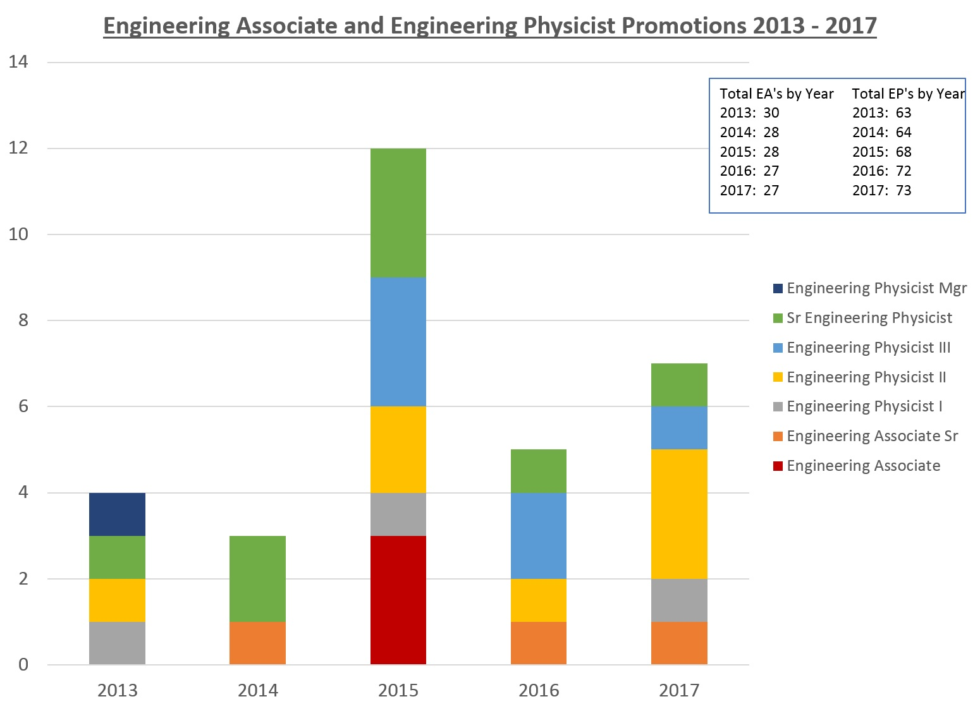

Slide 32
