Slide 1
Engineering at FERMILAB Scientific Computing Division
Gustavo Cancelo
Engineering retreat
20 February 2018

Slide 2
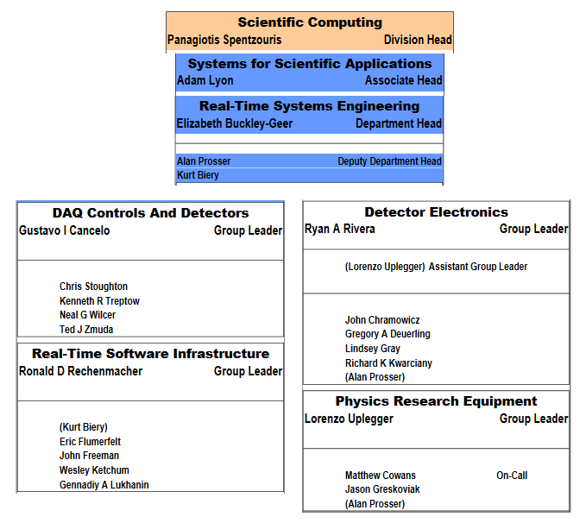
Real Time Systems Engineering
The Scientific Computing Division (SCD) designs, develops and maintains hardware, firmware and software solutions for HEP and Astrophysics experiments in the areas of data acquisition (DAQ) and real-time systems.

Slide 3
Real Time Systems Engineering
We are a versatile group of mostly senior level Technicians, Engineers, Scientists and Computer professionals.
We develop electronic hardware, firmware and software with emphasis on Data Acquisition.
We get involved in the science.
CMS, neutrino experiments, Detector R&D, CMB-S4, dark matter, dark energy.
We get involved with detectors and test beams.
We are at the cutting edge of EE for new detectors.
Low noise, high speed, mixed analog/digital electronic design.
From conceptual design, layout, characterization and production.
Cold and warm electronics for cryogenic detectors.
Mathematical modeling and simulations.
Data analysis.
Detector characterization.
Optoelectronics.
We build and support the systems that we develop.

Slide 4
ART and ARTDAQ: Software Engineering for DAQ
Used in MANY current/future neutrino, muon, test-beam experiments
protoDUNE, Mu2e, SBND, ICARUS, DUNE, etc.
Scalable: test stands through production experiments
Flexible: extensive use of software plugins
Experiment-specific pieces (e.g. readout of custom electronics) typically developed by experiments.
Uses the art event handling toolkit for event filtering and data quality monitoring
Events are written to disk in art/ROOT format, so the data is ready for further analysis in art
Software and hardware engineers in the division work in partnership with experiments to deploy the DAQ systems that the experiments need.

Slide 5
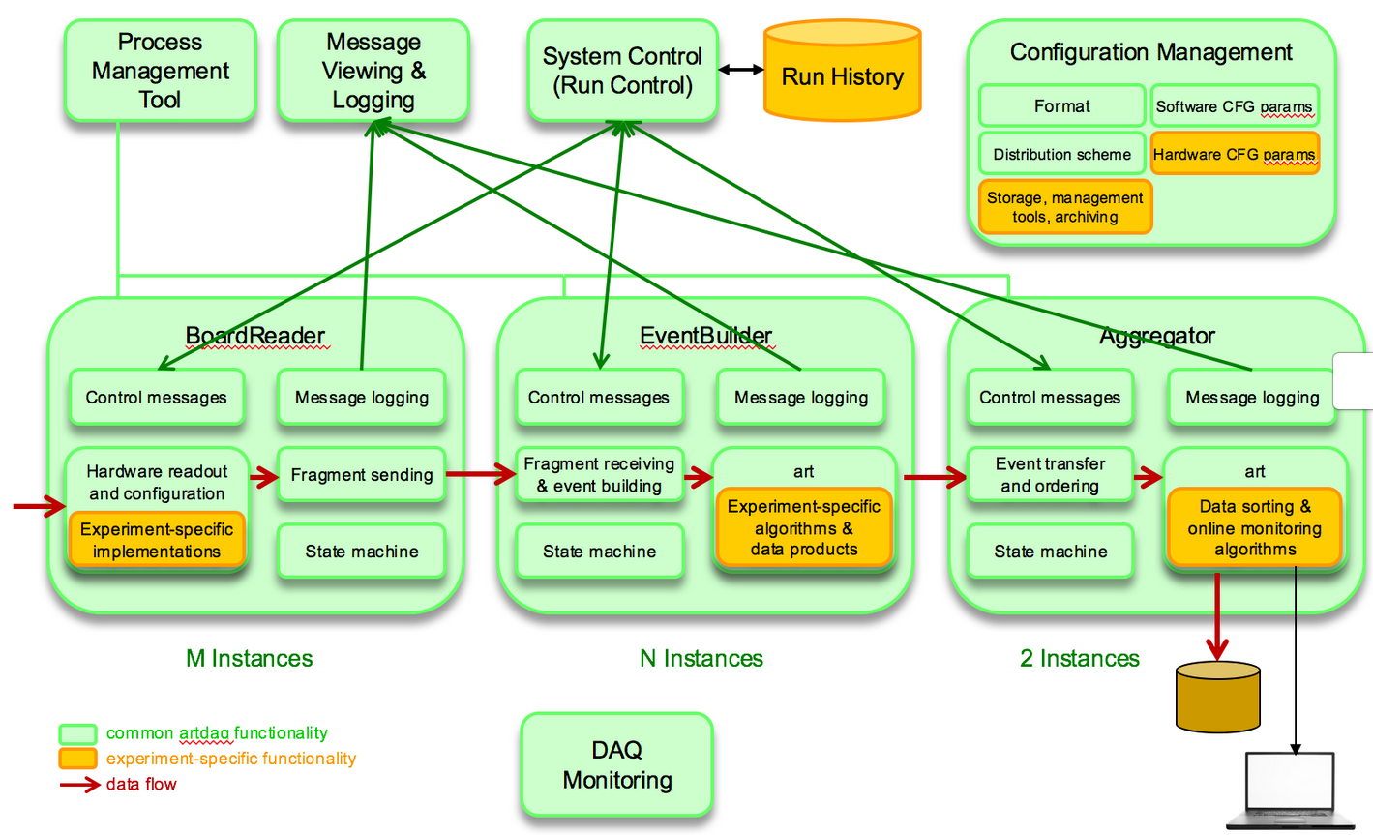
artDAQ block diagram
https://cdcvs.fnal.gov/redmine/projects/artdaq-demo/wiki

Slide 6
OTS is used at FNAL’s test beam and CCD DAQ
a

Slide 7
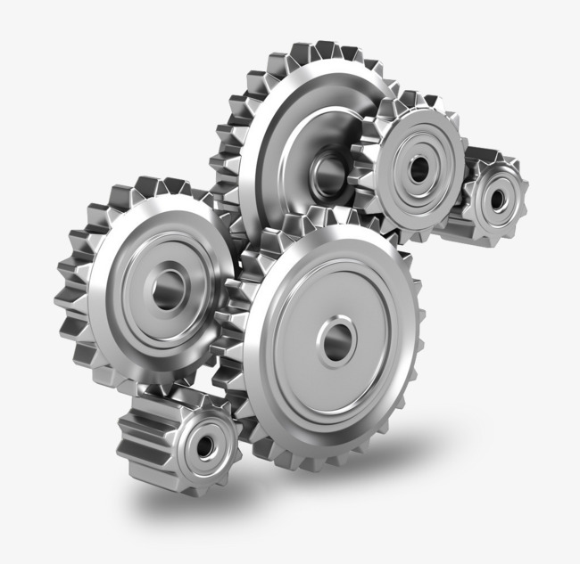
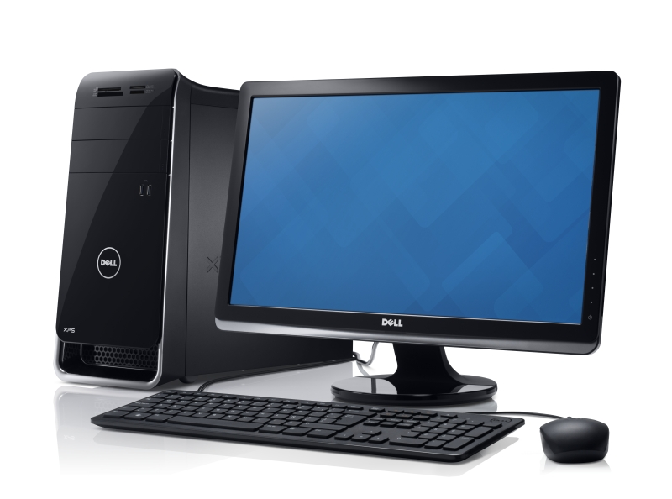
Real Time Systems Engineering, R&D and science
science
Detectors
Engineering
Collaborations
Data, Results
Publications
Engineering supports and participates of Detector R&D and science, often improving the detector-engineering realization.
We aim for experiments that push the envelope of detector and engineering in a tightly coupled design.

Slide 8
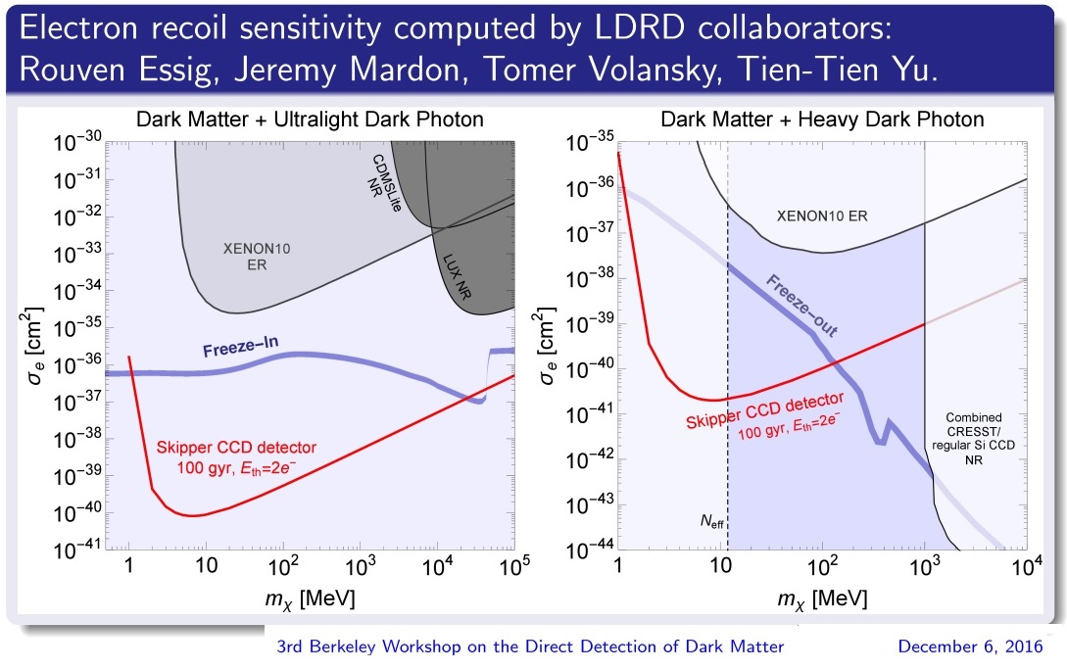
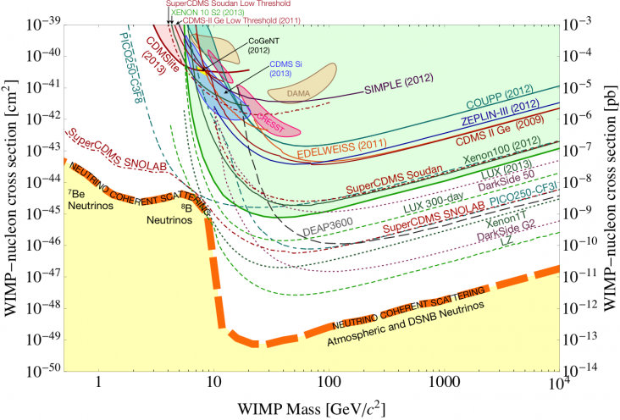
Low energy detectors for Dark Matter and Coherent Neutrino scattering
Science: DM, CNNS, QC
Detectors:
Skipper CCDs
LTA, OTS
Engineering
Collaborations
Data, Results
Publications
Skipper CCDs achieve <0.1 electron of noise (RMS) (zero quantum noise)
LTA electronics and OTS DAQ will be used for the SENSEI detector in search of Dark Matter.
SENSEI will explore unprecedented low energies of the DM phase space. [REF Javier Tiffenberg]

Slide 9
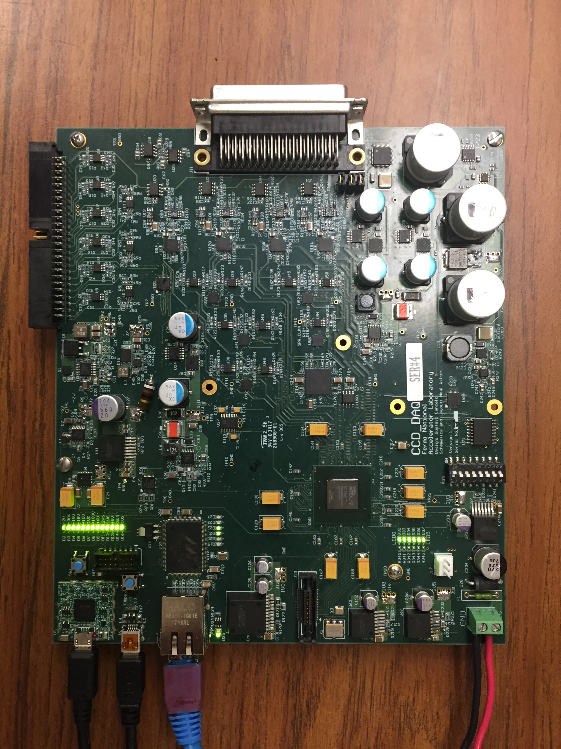
SENSEI and the 20K channel skipper CCD experiments
The current Low Threshold Electronics reads 1 CCD (4 channels)
We are designing a 4 CCD version (16 channels).
SENSEI science reach: light dark matter, dark photon, etc. $500K funding from SIMONS foundation.
Applications: DM, CNNS, nuclear safety.
Current experiments with CCDs: CONNIE, DAMIC.
LTA/OTS design has generated one of the best engineering collaborations with Latino America:
Univ. del Sur (Argentina), CNEA (Argentina), UNAM (Mexico), Univ. of Asuncion (Paraguay)
It has generated 4 Master thesis, one PhD thesis.

Slide 10
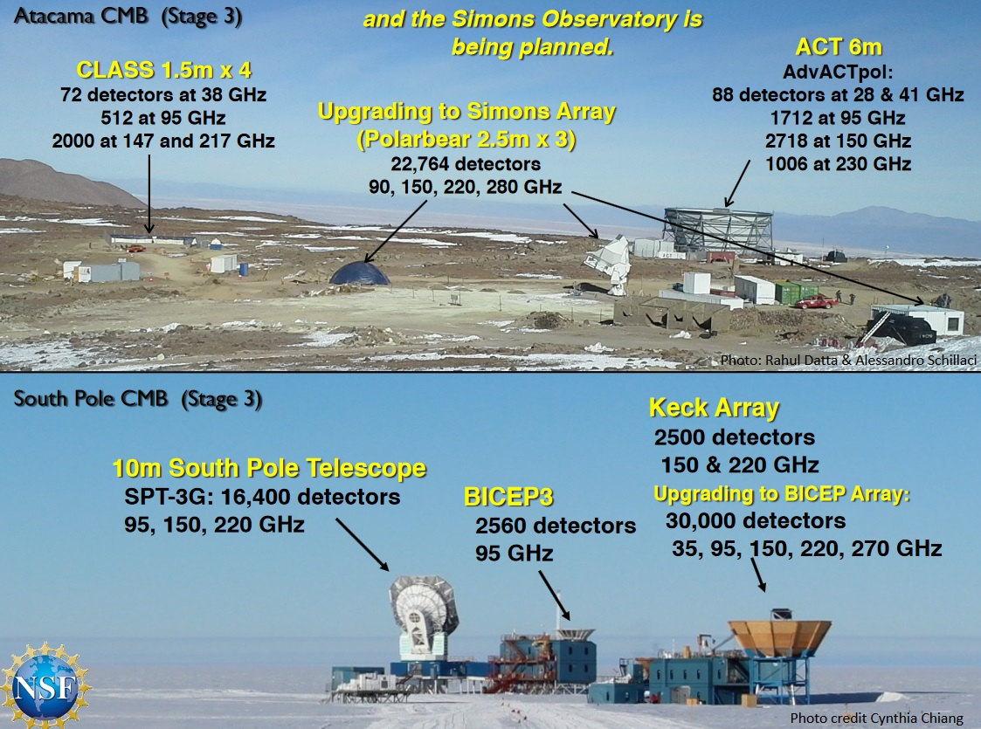
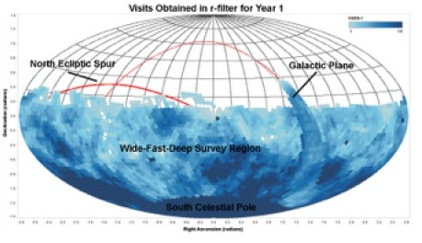
DAQs for Dark energy and the evolution of the universe
ACT experiment
LSST will generate >1 billion galaxy catalog.
Opportunities for spectroscopic surveys!!
SPT3 experiment
Electronics and DAQ
CMB future: CMB S4
A collection of CMB telescopes at the South pole and Atacama
Superconducting detectors: Frequency Multiplexed TES or MKIDS.
Future optical surveys:
High and low resolution spectroscopy.
100,000 channels high res spectrometer?
Low res MKIDs based instrument? Could cover the near infrared spectrum!

Slide 11
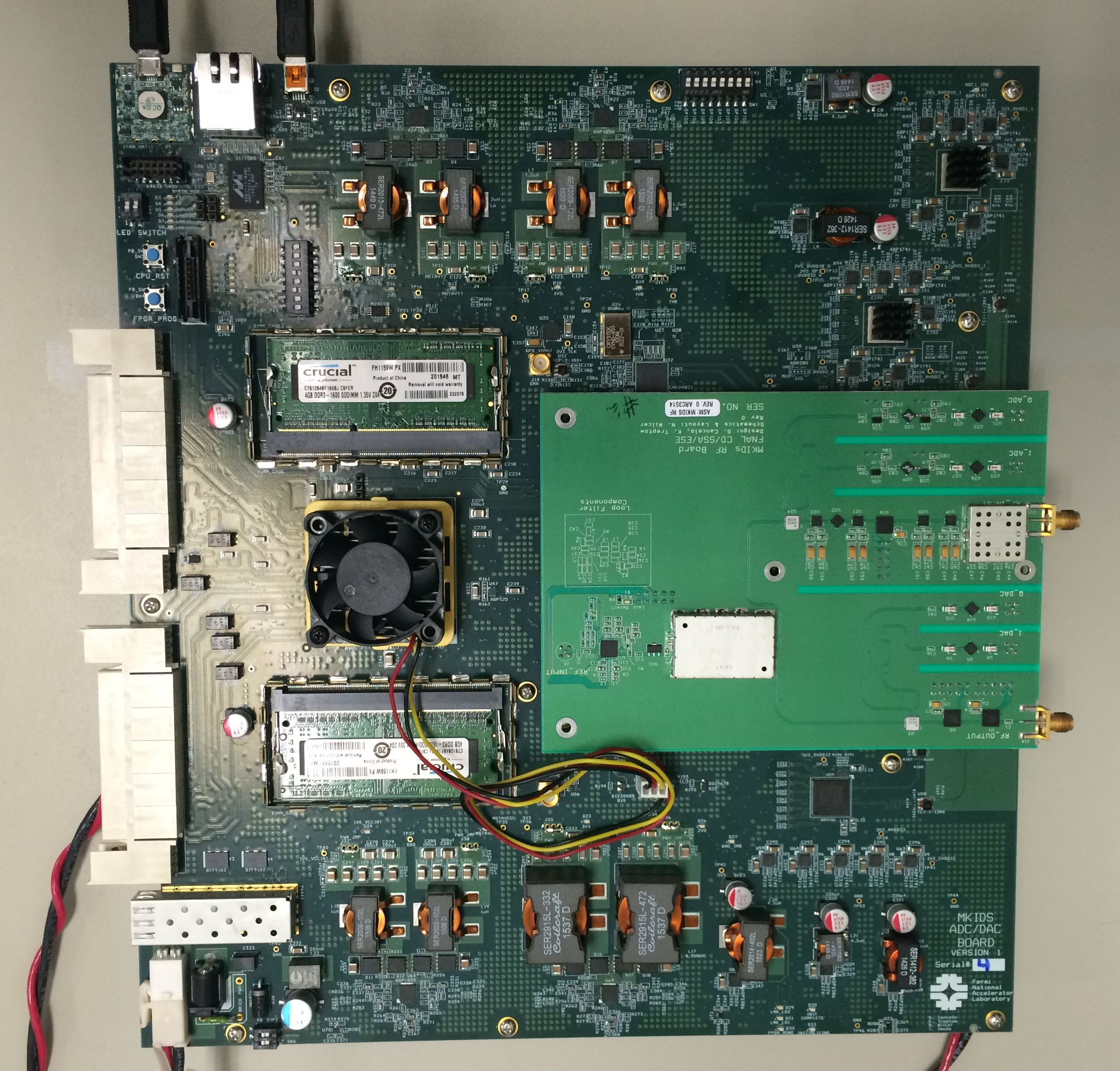
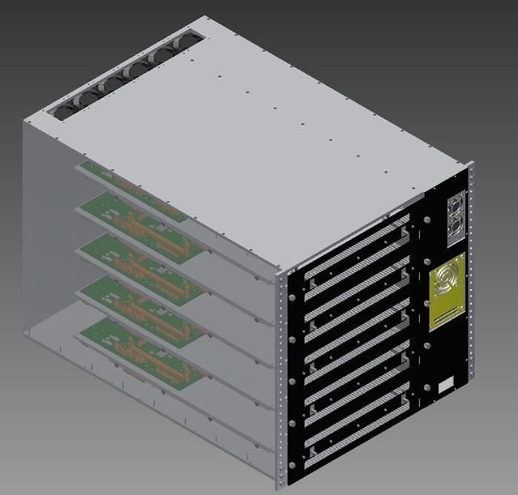
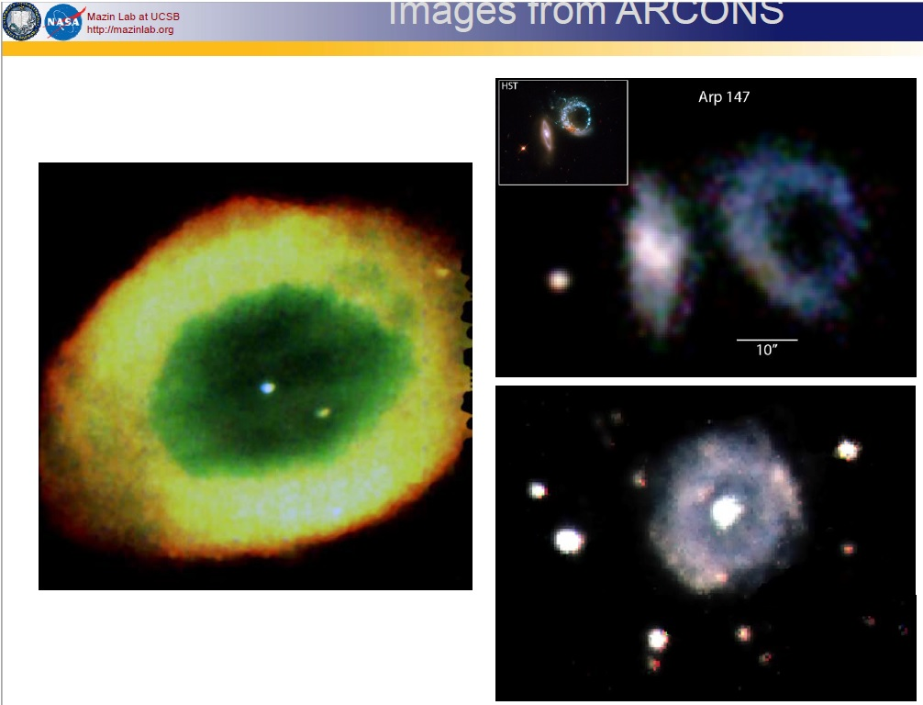
Warm electronics for superconducting detectors (fMESSI)
fMESSI for CMB
MKIDs and quantum sensors
Total of 75 boards are operational. 2 astronomical instruments
Science achieved:
DARKNESS instrument (coronagraph) at Palomar. Three rounds of observations.
CMB and MKIDs R&D:
Fermilab: CMB-s4 R&D, and MKIDs optical.
NIST
ANL.
U Chicago.
Arizona State University.
Images from Palomar

Slide 12
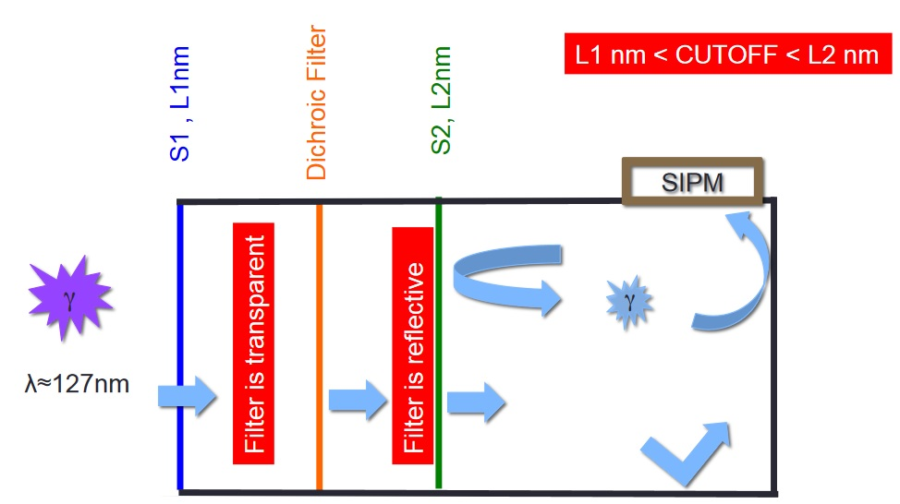
DUNE photon detector
The DUNE far photon detector must provide T0 for non beam events, proton decay candidates and supernova neutrinos with high efficiency. It is also important in the discrimination of backgrounds.
The technical objective is to achieve a photon detection efficiencies > 1%.
That efficiency has not been achieved by other detectors, so we picked up an interesting idea of a device called ARAPUCA developed by Ettore Segreto (UNICAMP, Brazil) et al and created a collaboration for ARAPUCA R&D.

Slide 13
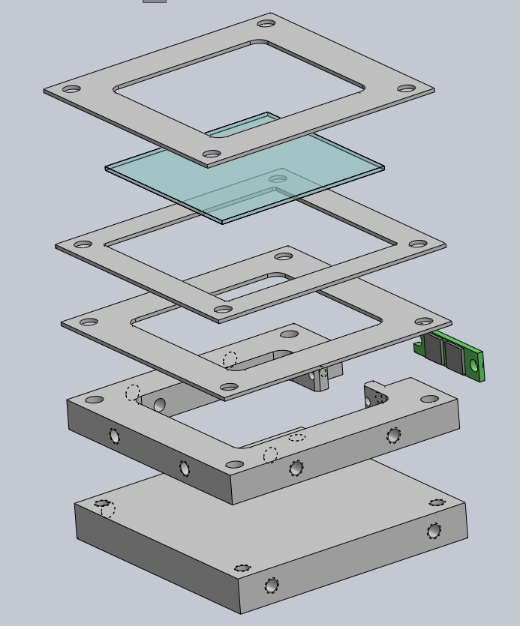
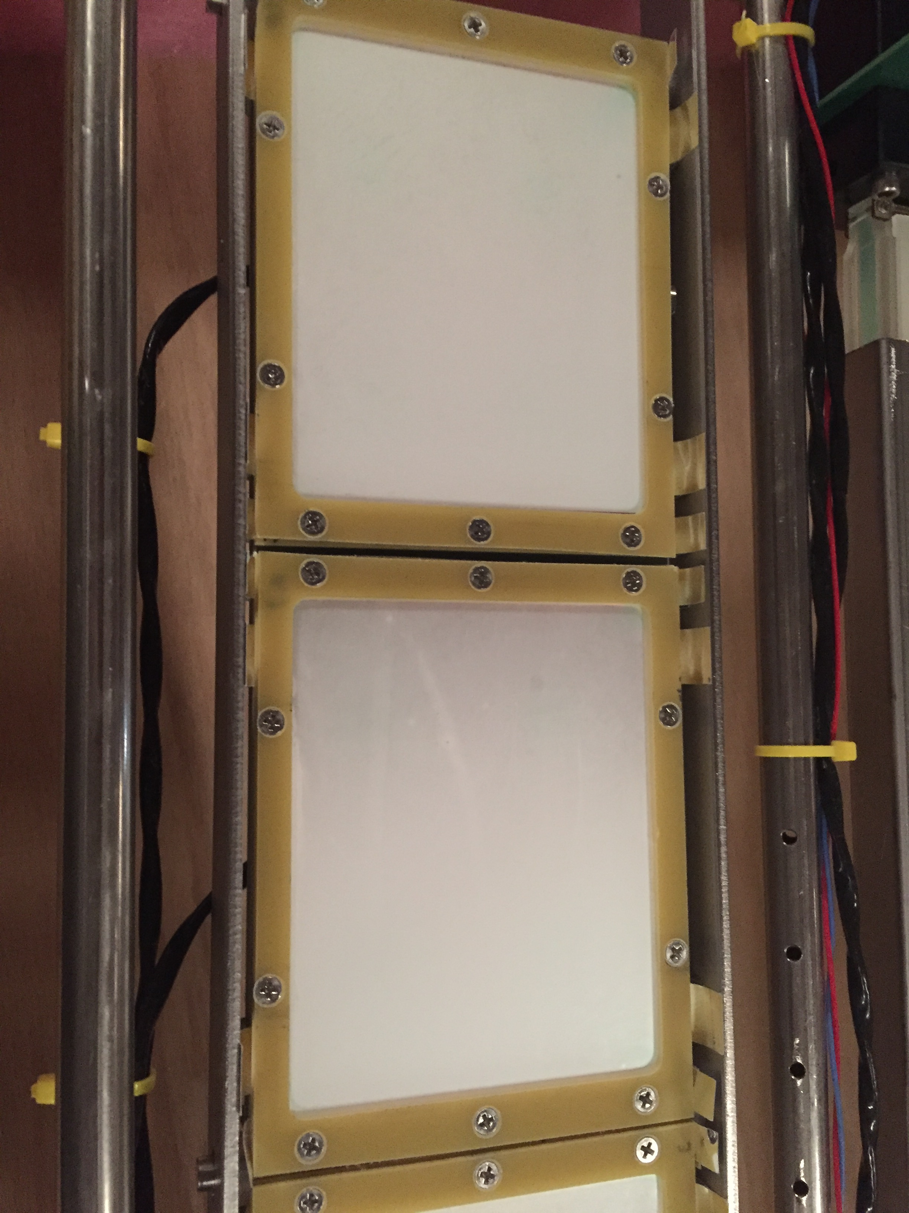
DUNE photon detector
Currently funded by LDRD
ARAPUCAs
Status: 1st year of LDRD finished successfully.
Achievements:
Improved ARAPUCA design.
Optical measurements and 2 LAr tests at TallBo.
Last run compared IU light bar technology and ARAPUCAs. Data analysis pending.
We created an ARAPUCA collaboration and the PD consortium leader is from our community.
We developed active ganging of SiPMs and made it work at TallBo. It was used by IU bars.
2nd year of LDRD: too many things to do.
Trying to include more collaborators.

Slide 14
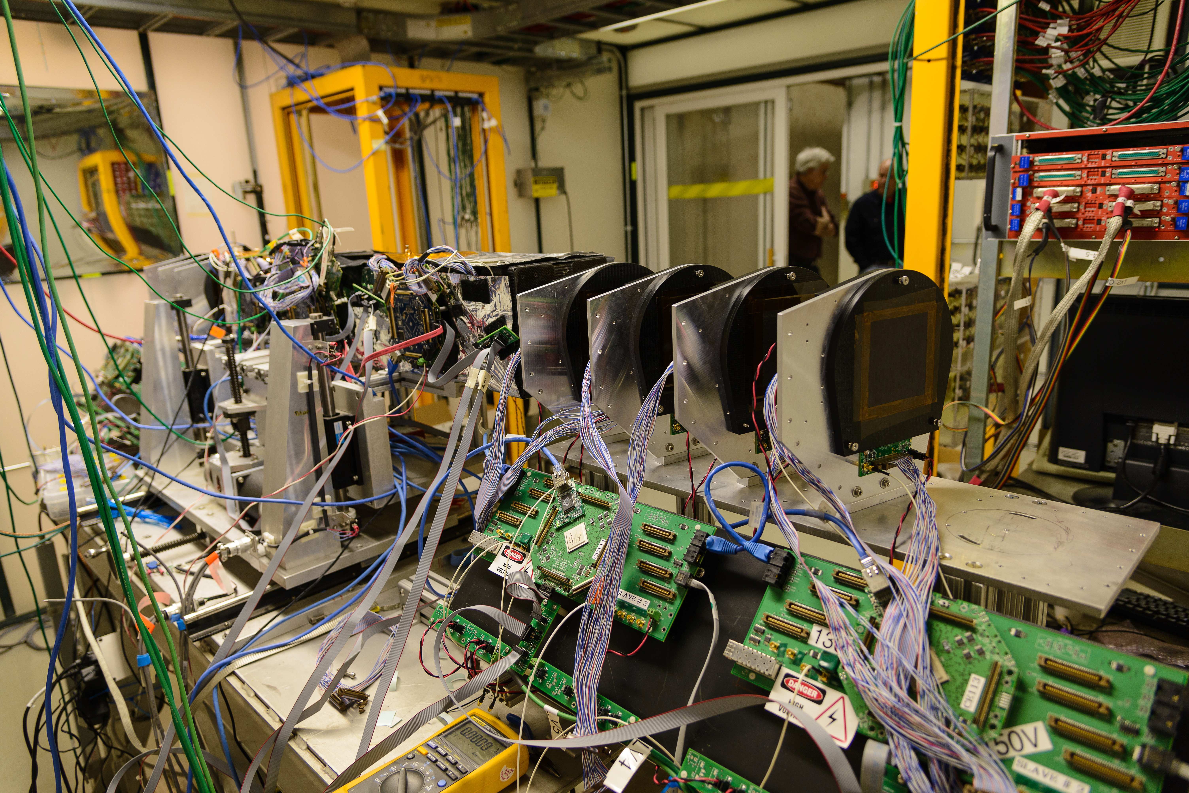
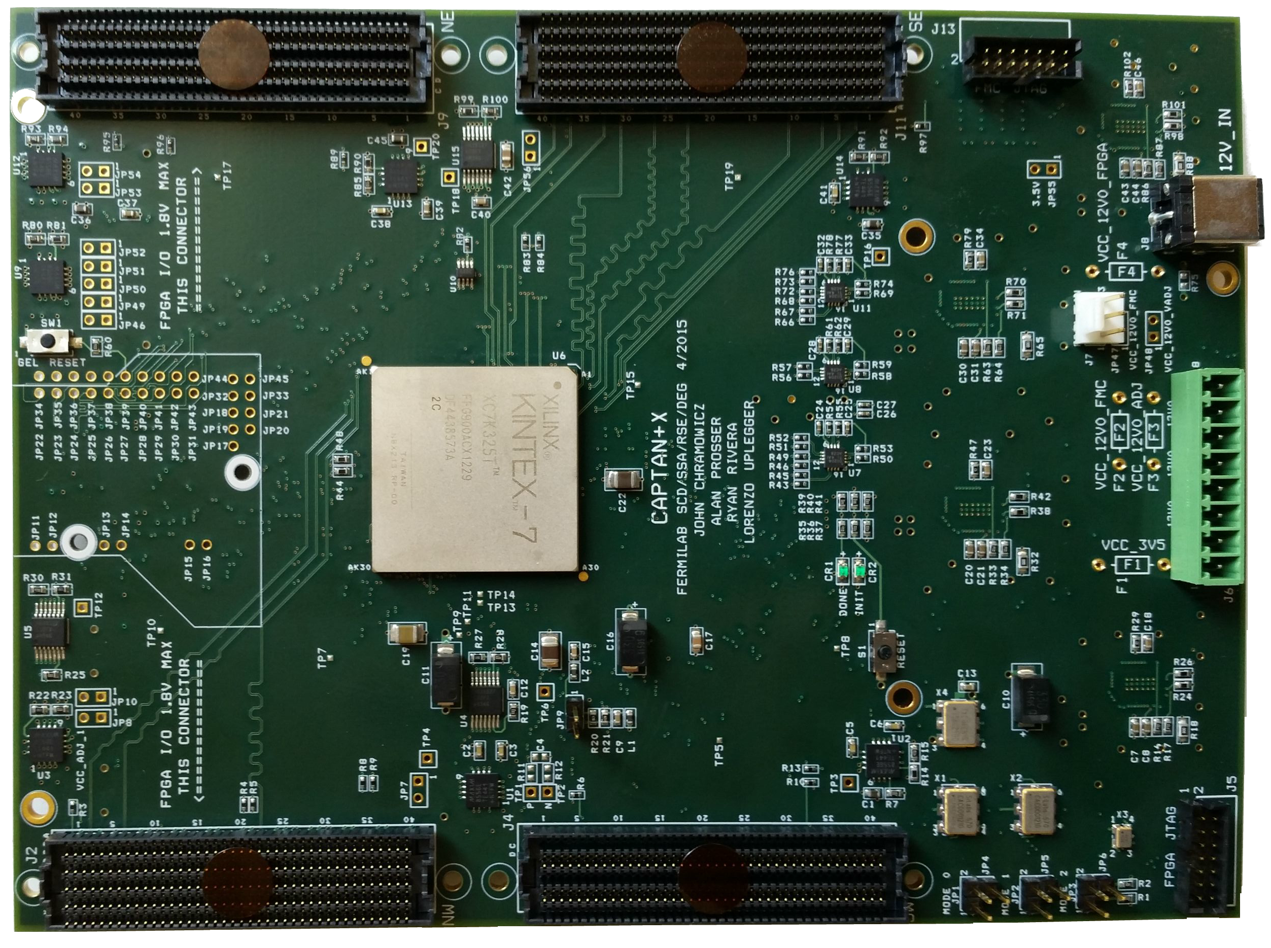
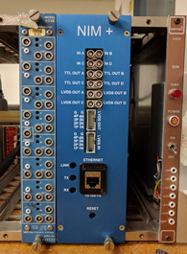
The CAPTAN+/OTS system for the Test beam
CAPTAN+ is a general purpose board based on a Xilinx 7 series and up to 10 Gbps data transfers. Featuring:
Gigabit Ethernet, 4 FMC connectors, 400 GPIO
Single DC 12V Input Power Block
CAPTAN user community:
Fermilab: PPD, SCD, Test Beam Facility
Purdue University
University of Colorado Boulder
INFN Milano and Lecce
UNAM, Mexico
Universidad Nacional del Sur, Argentina
Instituto Balseiro, CNEA, Argentina
Universidad Nacional de Asuncion, Paraguay
CAPTAN based telescope at the Test Beam
Also used in the
Replacement of old NIM modules

Slide 15
NOVA and Mu2e DAQ and Timing Systems
CFO
Beam Sync
DTC
Data Storage Switch
Over 100 DTCs and ~20 CFOs built for NOVA; in operation for 5 years, performing excellent. All NOVA data goes through this electronics.
DTC
4.8 Gbps Fiber
Event Building Switch
DTC
ROCs
Timing
DAQ Servers
10GbE Switches
Data

Slide 16
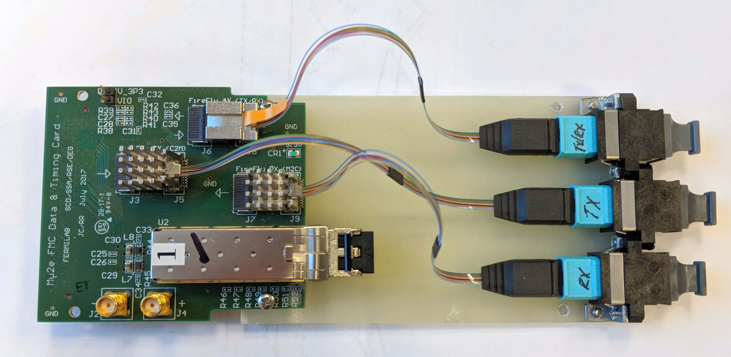
DTC / CFO Board & FMC Card for Mu2e
Data Transfer Controller (DTC)
Commercial PCIe board
Custom FMC Card
Custom Firmware
6 – 4.8Gbps ROC links
1 – Timing System link
1 – 10Gb Ethernet link
Collects data from ROCs
Builds and Filters Events
Command Fanout (CFO)
Commercial PCIe board
Custom FMC Card
Custom Firmware
Fans out system clock
Sends encoded Beam Sync
Sends event by event commands to DTCs

Slide 17
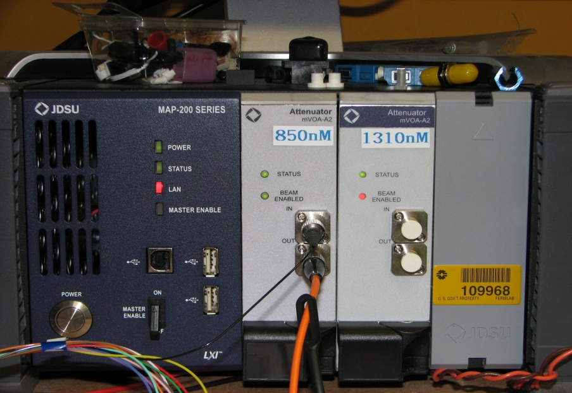
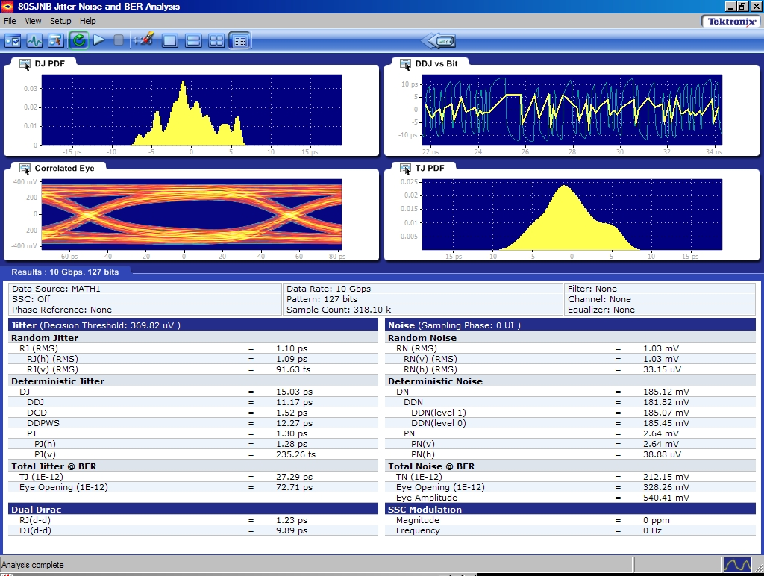
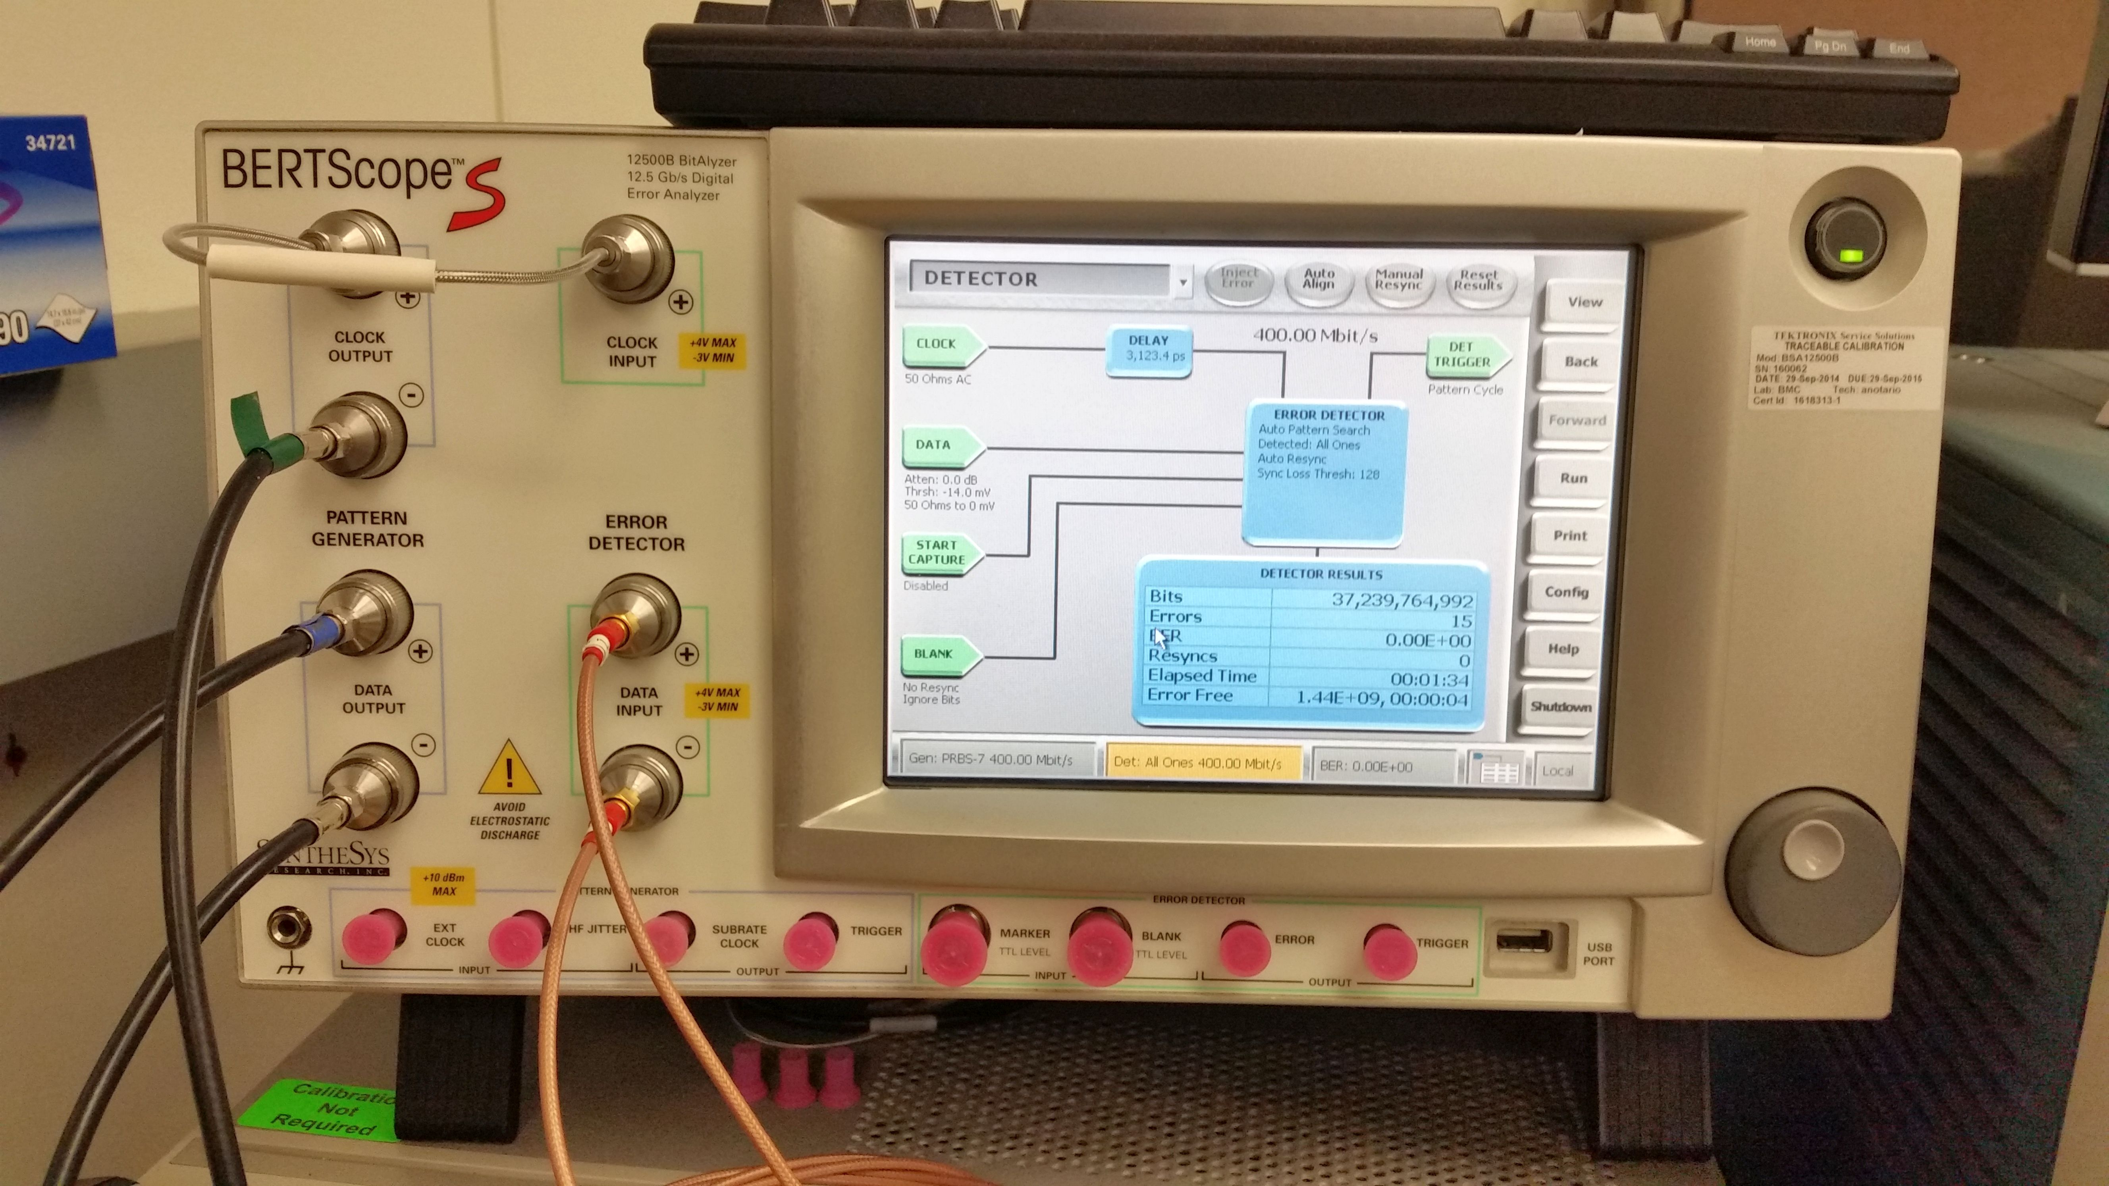
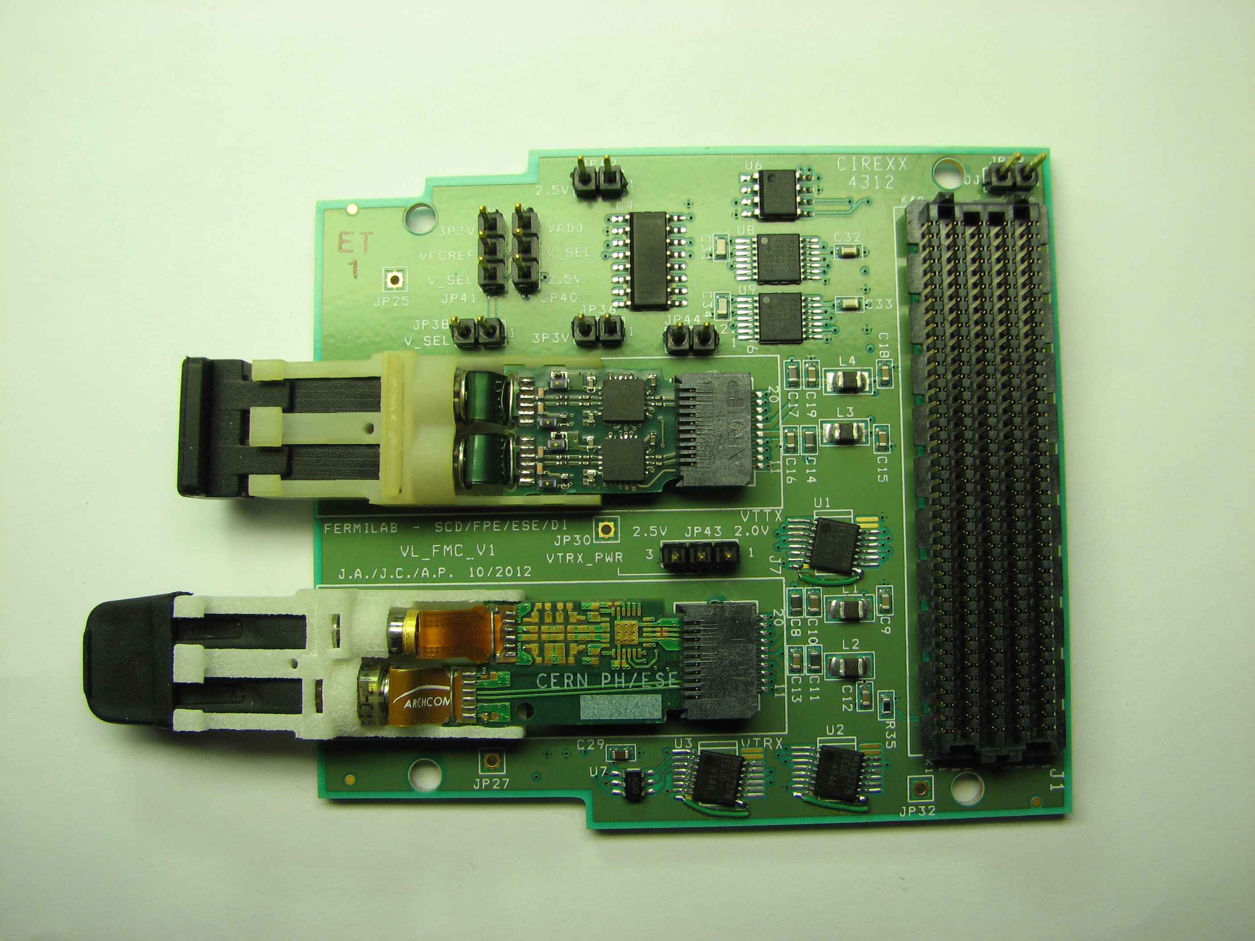
SCD/RSE High Speed Links Test and Measurement Facilities
Variable Optical Attenuators
Jitter Decomposition
Tx and Rx Devices
BERTScope BSA12500B (BER Testing)
Versatile Link
VTRx (Tx/Rx; 4.8G)*
Colaborators:
Academia Sinica (Taiwan), CERN, FNAL, Oxford, SMU.
CERN:
The 7 channel Pixel Opto Hybrid transmitter module (RSE designed, tested, and delivered 120 of these modules for use on the CMS FPix detector and the Precision Proton Spectrometer at CERN) .
RSE leads the specification of the Versatile Link Plus project.
Mu2e optical link project.
VTTx (Tx x 2; 4.8G)*
Notes:
SCD/RSE has assembled a number of test equipment devices for use in its optical links efforts. These include:
A Digital Signal Analyzer which performs eye diagram and jitter analyses in the optical and electrical domain up to 10 Gbps.
A Bit Error Rate (BER) Tester which generates test patterns and performs bit error checking up to 12.5 Gbps
Variable Optical Attenuators (850 nm and 1310 nm) to simulate link impairments for BER and receiver sensitivity testing
An environmental chamber to control temperature and humidity
These units are controlled using Labview Vis for automated transmitter, receiver, and link testing.
We welcome the opportunity to provide testing and consultation services to other experiments and collaborations.

Slide 18
Summary
RSE department is very busy.
We are well aligned with Fermilab’s program. And we will continue on that path.
We strongly collaborate across the Lab, nationally and internationally.
In the last 15 years we have seen an important increase of engineer labor cost for projects.
Projects are only willing to pay for top notch engineering that they can’t find somewhere else.
That’s our strength.
Engineer managers now engage a lot more in the science and in search for funding to keep the department competitive.
We want to thank the division for investing in engineering to allow RSE to be at the cutting edge of EE and Software.

