Slide 1
Engineering Training & Outreach
Lucy Nobrega
All Engineers Retreat
February 20, 2018
Notes:
A lot of this you already know about or have heard before.

Slide 2
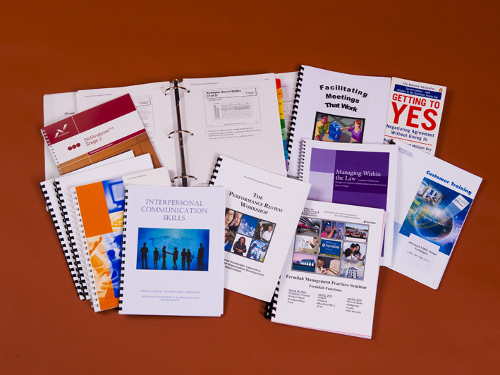
FOR YOU: Professional development and training
FOR YOUR COLLEAGUES: Developing our future workforce
FOR THE COMMUNITY: Education outreach
Notes:
Self-improvement. Help your colleagues.

Slide 3
Engineering Development & Training- Workshops & Seminars http://hr.fnal.gov
Onsite and online workshops and seminars, including new on-demand leadership courses, 0.5 - 2.5 hours long
Notes:
30 days to complete on-demand courses at your own pace.

Slide 4
Engineering Development & Training http://hr.fnal.gov/
Specialized technical training arranged onsite on request: Vacuum Technology, GD&T, Welding and Brazing (Barb Brooks)
USPAS (US Particle Accelerator School) college-accredited courses. Next session: Michigan State University, June 4-15. uspas.fnal.gov
Other offsite workshops/courses coordinated through your department
Notes:
USPAS 2x/year, usually great location, always challenging. 1 or 2 week courses, always something for engineers as well as physicists.

Slide 5
Engineering Development & Training http://hr.fnal.gov/
The Tuition Assistance Program (TAP) currently has 50 employees enrolled.
Changes to TAP, effective 1/1/2018:
Paid by centralized lab budget
Approvals for PhD, master’s, and bachelor degrees increased to chief level; associate’s approvals increased to division level.
Yearly maximum for tuition & fees. Book costs not reimbursed.
Bachelor’s: maximum $10,000 yearly
Master’s and PhD: maximum $13,000 yearly
Tuition and fees for associate degrees, certificate programs and individual courses still advanced 100%; books reimbursed 100%.
Employees who terminate employment within one year of completion required to reimburse all tuition and fees from final year of TAP participation.
Notes:
Changes to TAP are to make funds more accessible to everyone.

Slide 6
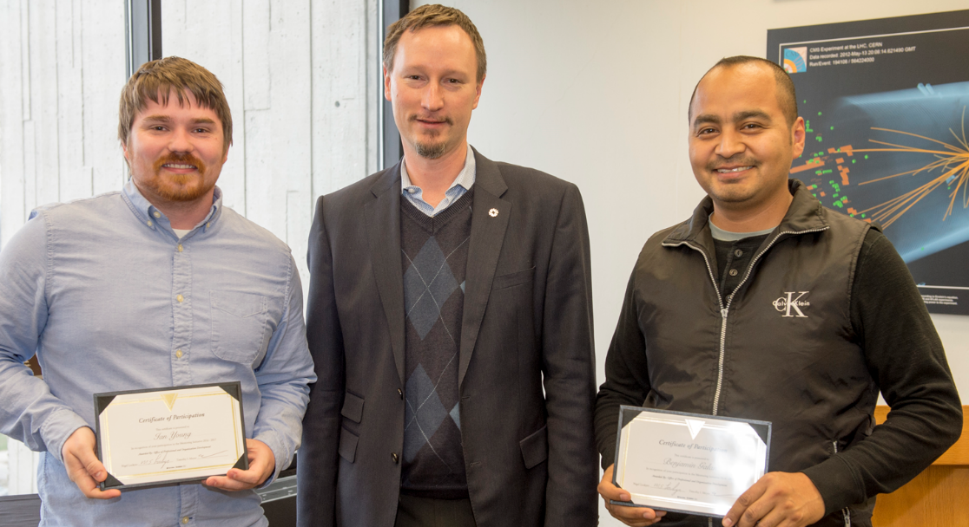
Engineering Development & Training http://hr.fnal.gov/
Mentoring program – currently 30 employees enrolled
(Holly Lett, http://hr.fnal.gov/training/mentoring/)
Notes:
12-month program, starts at beginning of each CY. Great feedback from all participants that I talked with. Great to mentor or mentee – even if you have been at Fermilab for a long time but are starting a new role. Meet 1x per month.

Slide 7
Developing our Future Workforce. Pipeline programs: mentor a student (Mario Lucero, Sandra Charles) http://ed.fnal.gov/interns/programs/
TARGET for high school students with aptitude and interest in physics, engineering, math, and computer science
Coop (Cara Brown)
SIST (Summer Internships in Science and Technology) for undergrads studying physics, engineering, math, and computer science
SULI (Science Undergraduate Laboratory Internship) for undergrads in science and engineering
Lee Teng Undergraduate Fellowship in Accelerator Science & Engineering
GEM – summer internships for graduate students in science or engineering
Internships for Italian Students physics & engineering graduate students)
VetTech – summer internships for technicians who are veterans
Notes:
Excellent opportunity for students, but of course we can later hire these students knowing that they are fantastic workers. VetTech intern pictured here, working on a coil for the High Lumi project in TD.

Slide 8
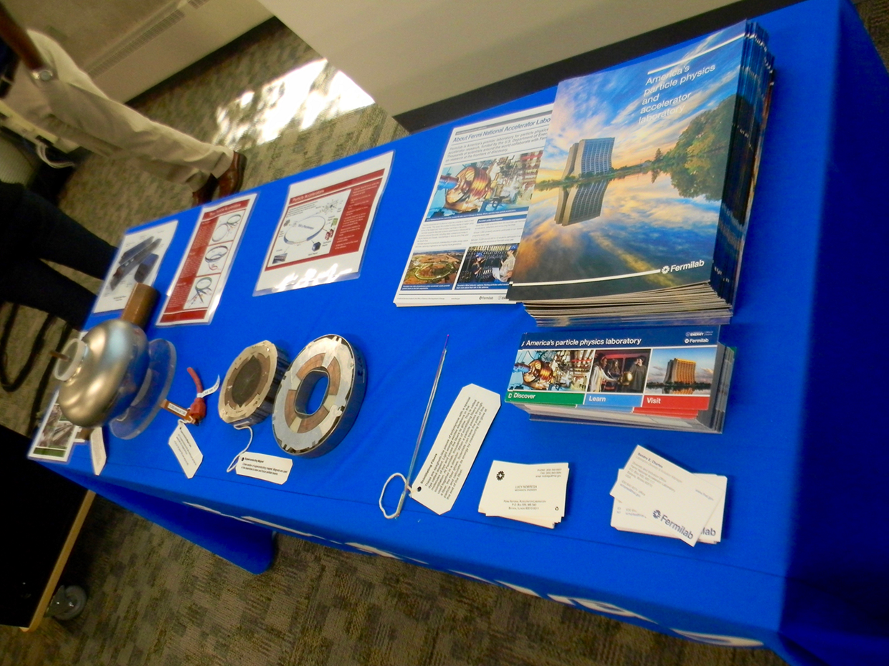
Developing our Future Workforce. Diversity Outreach (Mario Lucero, Lucy Nobrega)
Notes:
These are visits to local universities to tell students about Fermilab. 1-3 engineers typically go on outreach visit to a university within a 3 hour drive of the lab. Visits coordinated thru SWE, NSBE, SHPE, or other organization but open to all students. ~30-50 attendees. Difficult to maintain relationships w universities because Fermilab is not large and doesn’t hire consistently. Great way to let people know about Fermilab. Package show and tell and presentation ready to go.

Slide 9
Education Outreach. K-12 & public outreach through Education Office http://ed.fnal.gov/home/volunteer.shtml
STEM Career Expo (every April at Fermilab)
Family Open House
Local STEM (Science, Technology, Engineering, & Math) events
Notes:
Switching gears to what you can do for the community. Fermilab very involved in outreach, Education Office has lots of opportunities to volunteer.
STEM career EXPO industry partners.
Local STEM events – table with hands on experiments.

Slide 10
Education Outreach. K-12 & public outreach through Education Office http://ed.fnal.gov/home/volunteer.shtml
Classroom presentations at local schools
Charge! Electricity and Magnetism
Cryogenics Show - Mr. Freeze
Forces and Motion
Light and Color
Physics in the Real World
Physics of Sports
Space, Time and the Universe
Engineering – Marshmallow Challenge
Notes:
Jerry Zimmerman’s alter ego Mr. Freeze. Other presentation with materials and lesson plan.

Slide 11
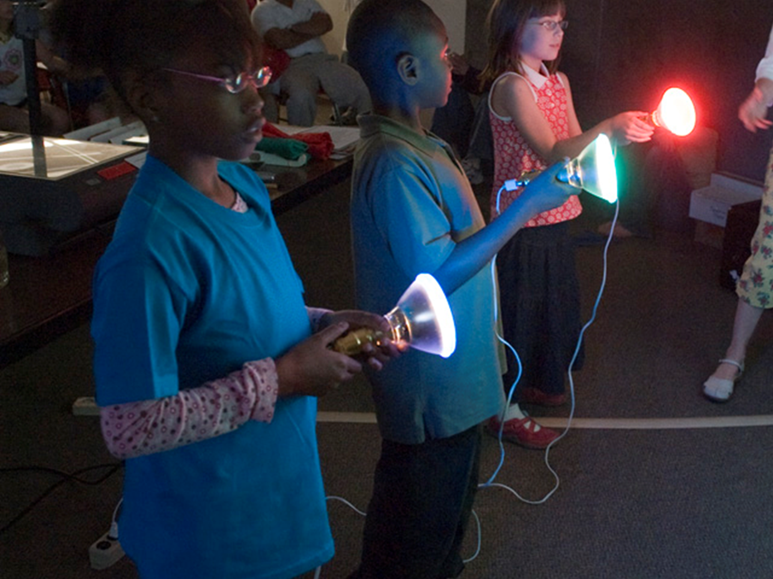
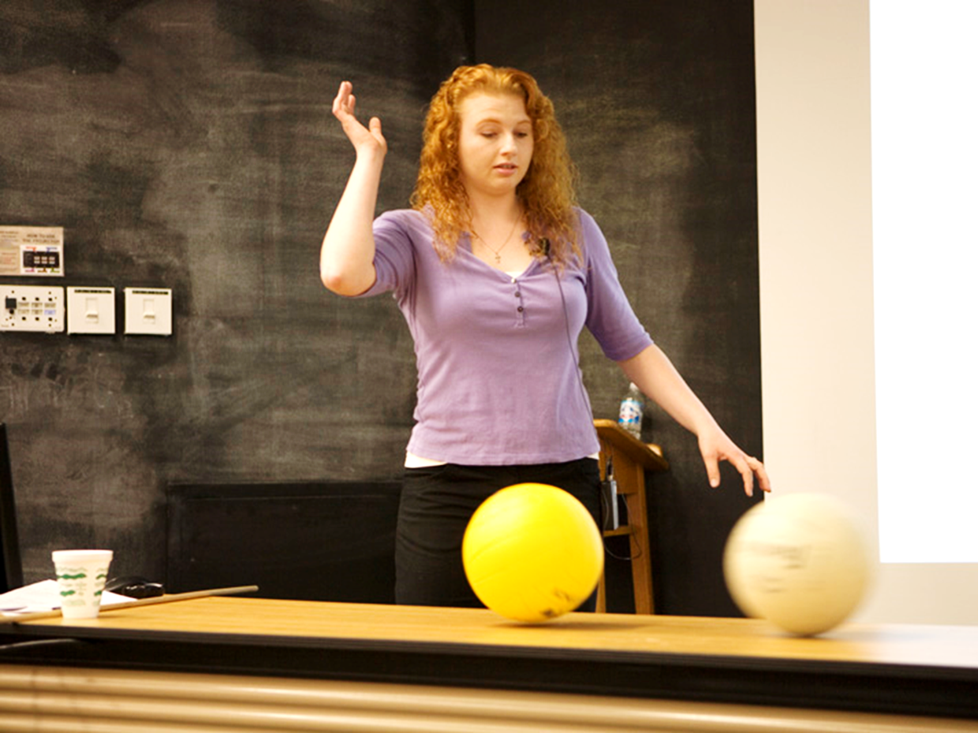
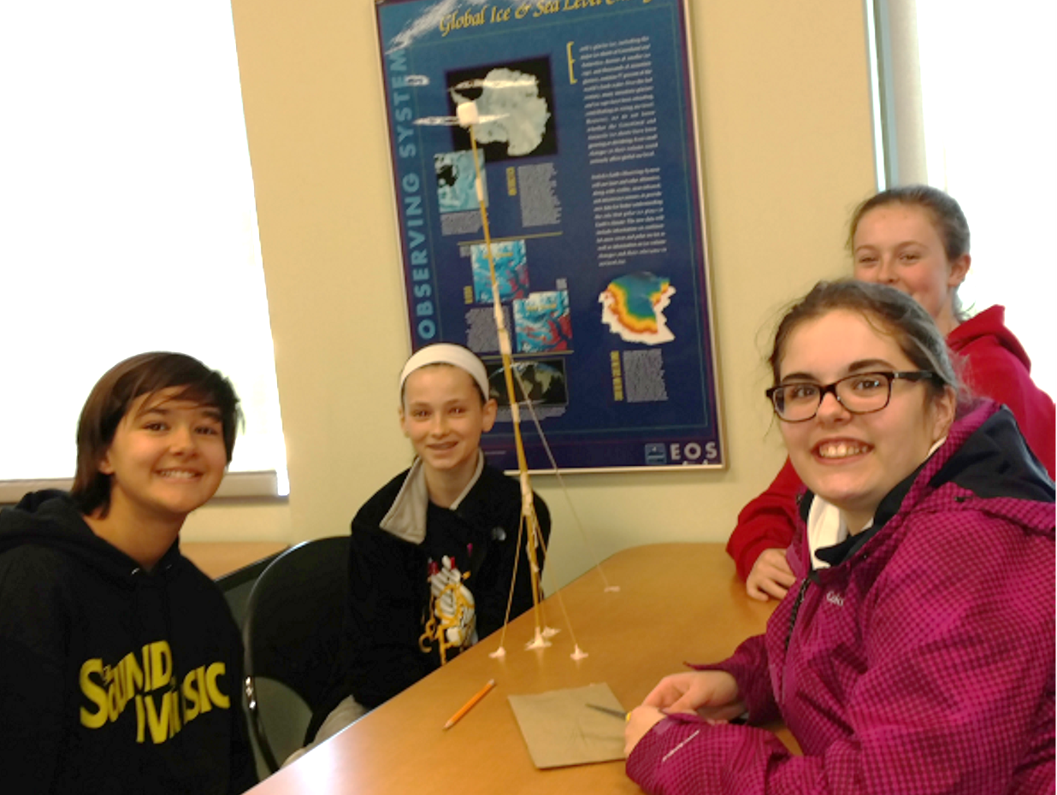
Physics of Sports
Light and Color
Forces and Motion
Engineering – Marshmallow Challenge
Notes:
30-50 minute presentations, hands-on or heavy audience participation. Audience participation demonstrating conservation of angular momentum.

Slide 12
Education Outreach. K-12 & public outreach through Education Office http://ed.fnal.gov/home/volunteer.shtml
Mentor a teacher in a TRAC (Teacher Research Associates) summer internship
Ask-An-Engineer: NEW! Just like Ask-A-Scientist. 1-4pm on the first Sunday of the month. Presentation, tour, Q&A.
Help design and maintain equipment
Brown bag lunch Tuesday, February 27, One West
Notes:
Colder than Cool a big hit at Open House a couple weeks ago. Other things you can do…

Slide 13
Summary - Links and Contacts
Engineering development & training, Tuition Assistance Program (TAP) - http://hr.fnal.gov
Specialized training by request – Barb Brooks
US Particle Accelerator School – uspas.fnal.gov
Mentoring Program - Holly Lett, http://hr.fnal.gov/training/mentoring/
Pipeline programs - http://ed.fnal.gov/interns/programs/
Diversity outreach (Mario Lucero, Lucy Nobrega)
Education outreach - http://ed.fnal.gov/home/volunteer.shtml, or brown bag lunch Tuesday, February 27, One West

Slide 14
“Every expert was once a beginner”
-Helen Hayes

