Slide 1
Ghost Train Generator, “Instant Flagman”
Derek Plant , dkplant@fnal.gov
Fermi National Accelerator Laboratory

Slide 2
Railroad beds are elevated for a reason
A freight train can weigh 20,000 tons, and travel 70 MPH. Same mass as 4 CDF detectors!
Stable, flexible and adequately drained substrate is absolutely essential, therefore the rails are elevated wherever possible

Slide 3
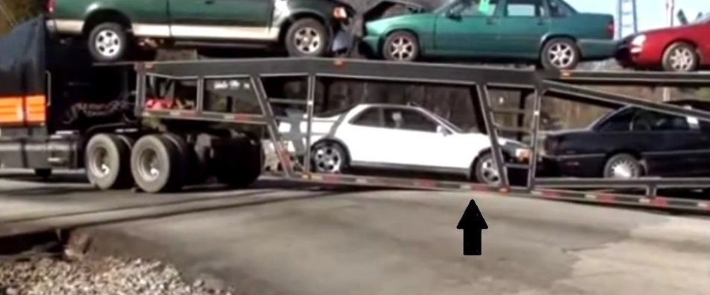
Perfect example of a “high centered” vehicle

Slide 4
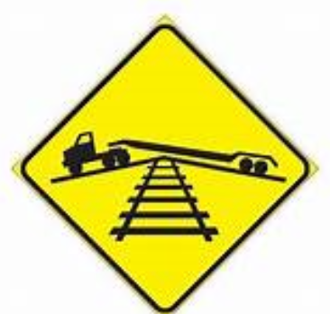

Slide 5
Box trailers also have poor ground clearance
This also adds an area for human error

Slide 6
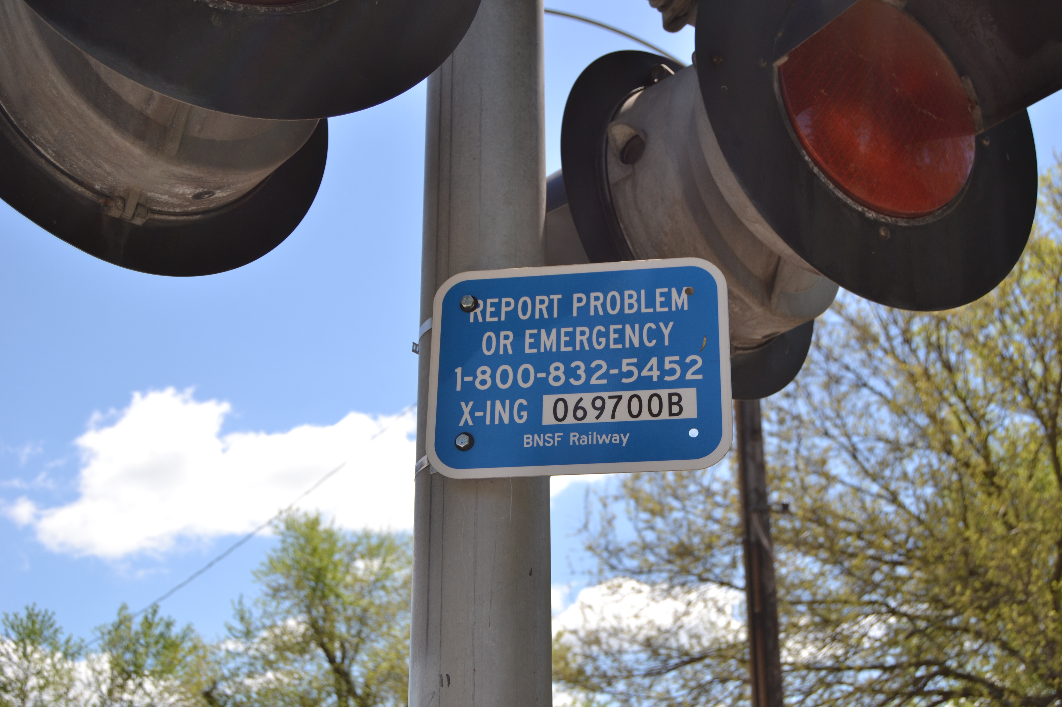
There are at least 4 people in the response chain. There is no data set. 10 to 15 minutes is common
Click to add caption text [16pt Bold]

Slide 7
How It Works
Railroad traffic control systems use the rails and train wheels ELECTRICALLY, to keep track of a train’s location, and to keep trains from colliding (Low voltage)
Basically, a train on the track “shorts” the DC track circuit, forcing red lights at a distance from the train
The Ghost Train Generator also forces the existing signal system to change to red condition, alerting oncoming trains to a blocked track
Almost like having a person instantly waving a red flag several miles down the track
Eliminates the 15 minute blind spot

Slide 8
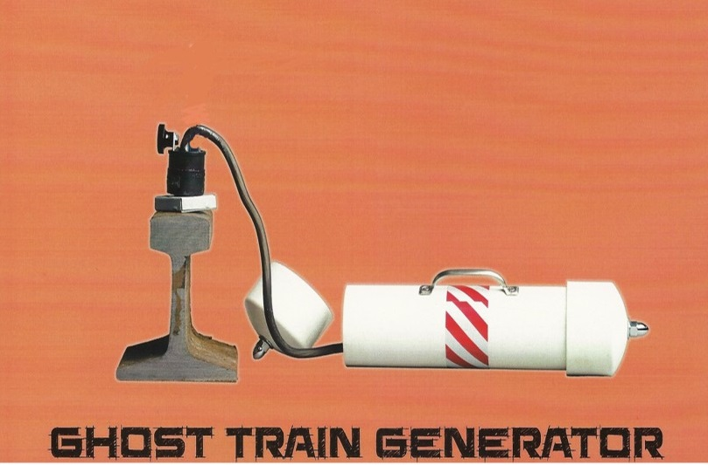
The Device
Ghost train
Generator
device
rail
cross
section
5 lb, 14” long:
similar to average kitchen/home fire extinguisher

Slide 9
Wayside Block Signal (East Gate)

Slide 10
Deploying the Device
Uses High Power magnets
NdFeB, Grade N42, encapsulated in copper
13.2 kGauss
Large surface area
What are the benefits?
Reliable, secure connection to the track
Ideal for high traffic, high speed rail crossings where these types of collisions typically occur
Quick deployment

Slide 11
Market Size/Impact
Potential Customers
Heavy commercial vehicles
Emergency or first response vehicles
School buses, charter buses, stretch limousines
According to Federal Motor Carriage Safety Administration:
10 million trucks

Slide 12
Where are we now?
Device works very well; tested at Railway Museum in Union, Illinois
Easy to manufacture and nearly ready for market
More testing to understand any technical limitations, e.g. at the Federal Railway Administration (FRA) test facility in Pueblo, CO
Understanding the regulatory environment
We are seeking Licensing Partners
Patent pending

Slide 13
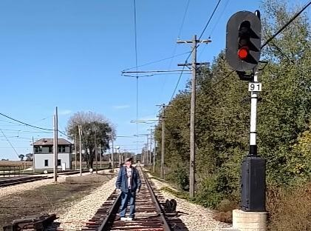
Testing at the Illinois Railway Museum (with permission)

Slide 14
Do you have an idea?
JUST DO IT. Call the OPTT. What can you lose?
It does not have to be complicated or impressive
There are incentives, and opportunity
Does your colleague have an idea? Help them out
Bridge the gap

