Slide 1
Patenting Process at Fermilab
Aaron Sauers

Slide 2
OPTT Activities
Intellectual Property (IP)
  Patents
  Copyrights
  Trademarks
Licensing
  Open Source Software
  Commercial Licensing
  Academic Distribution
Sponsored Research
  Strategic Partnerships Program (SPP)
  Cooperative Research & Development Agreements (CRADAs)
Proposals / Funding (NIH, NSF, NASA, etc.)

Slide 3
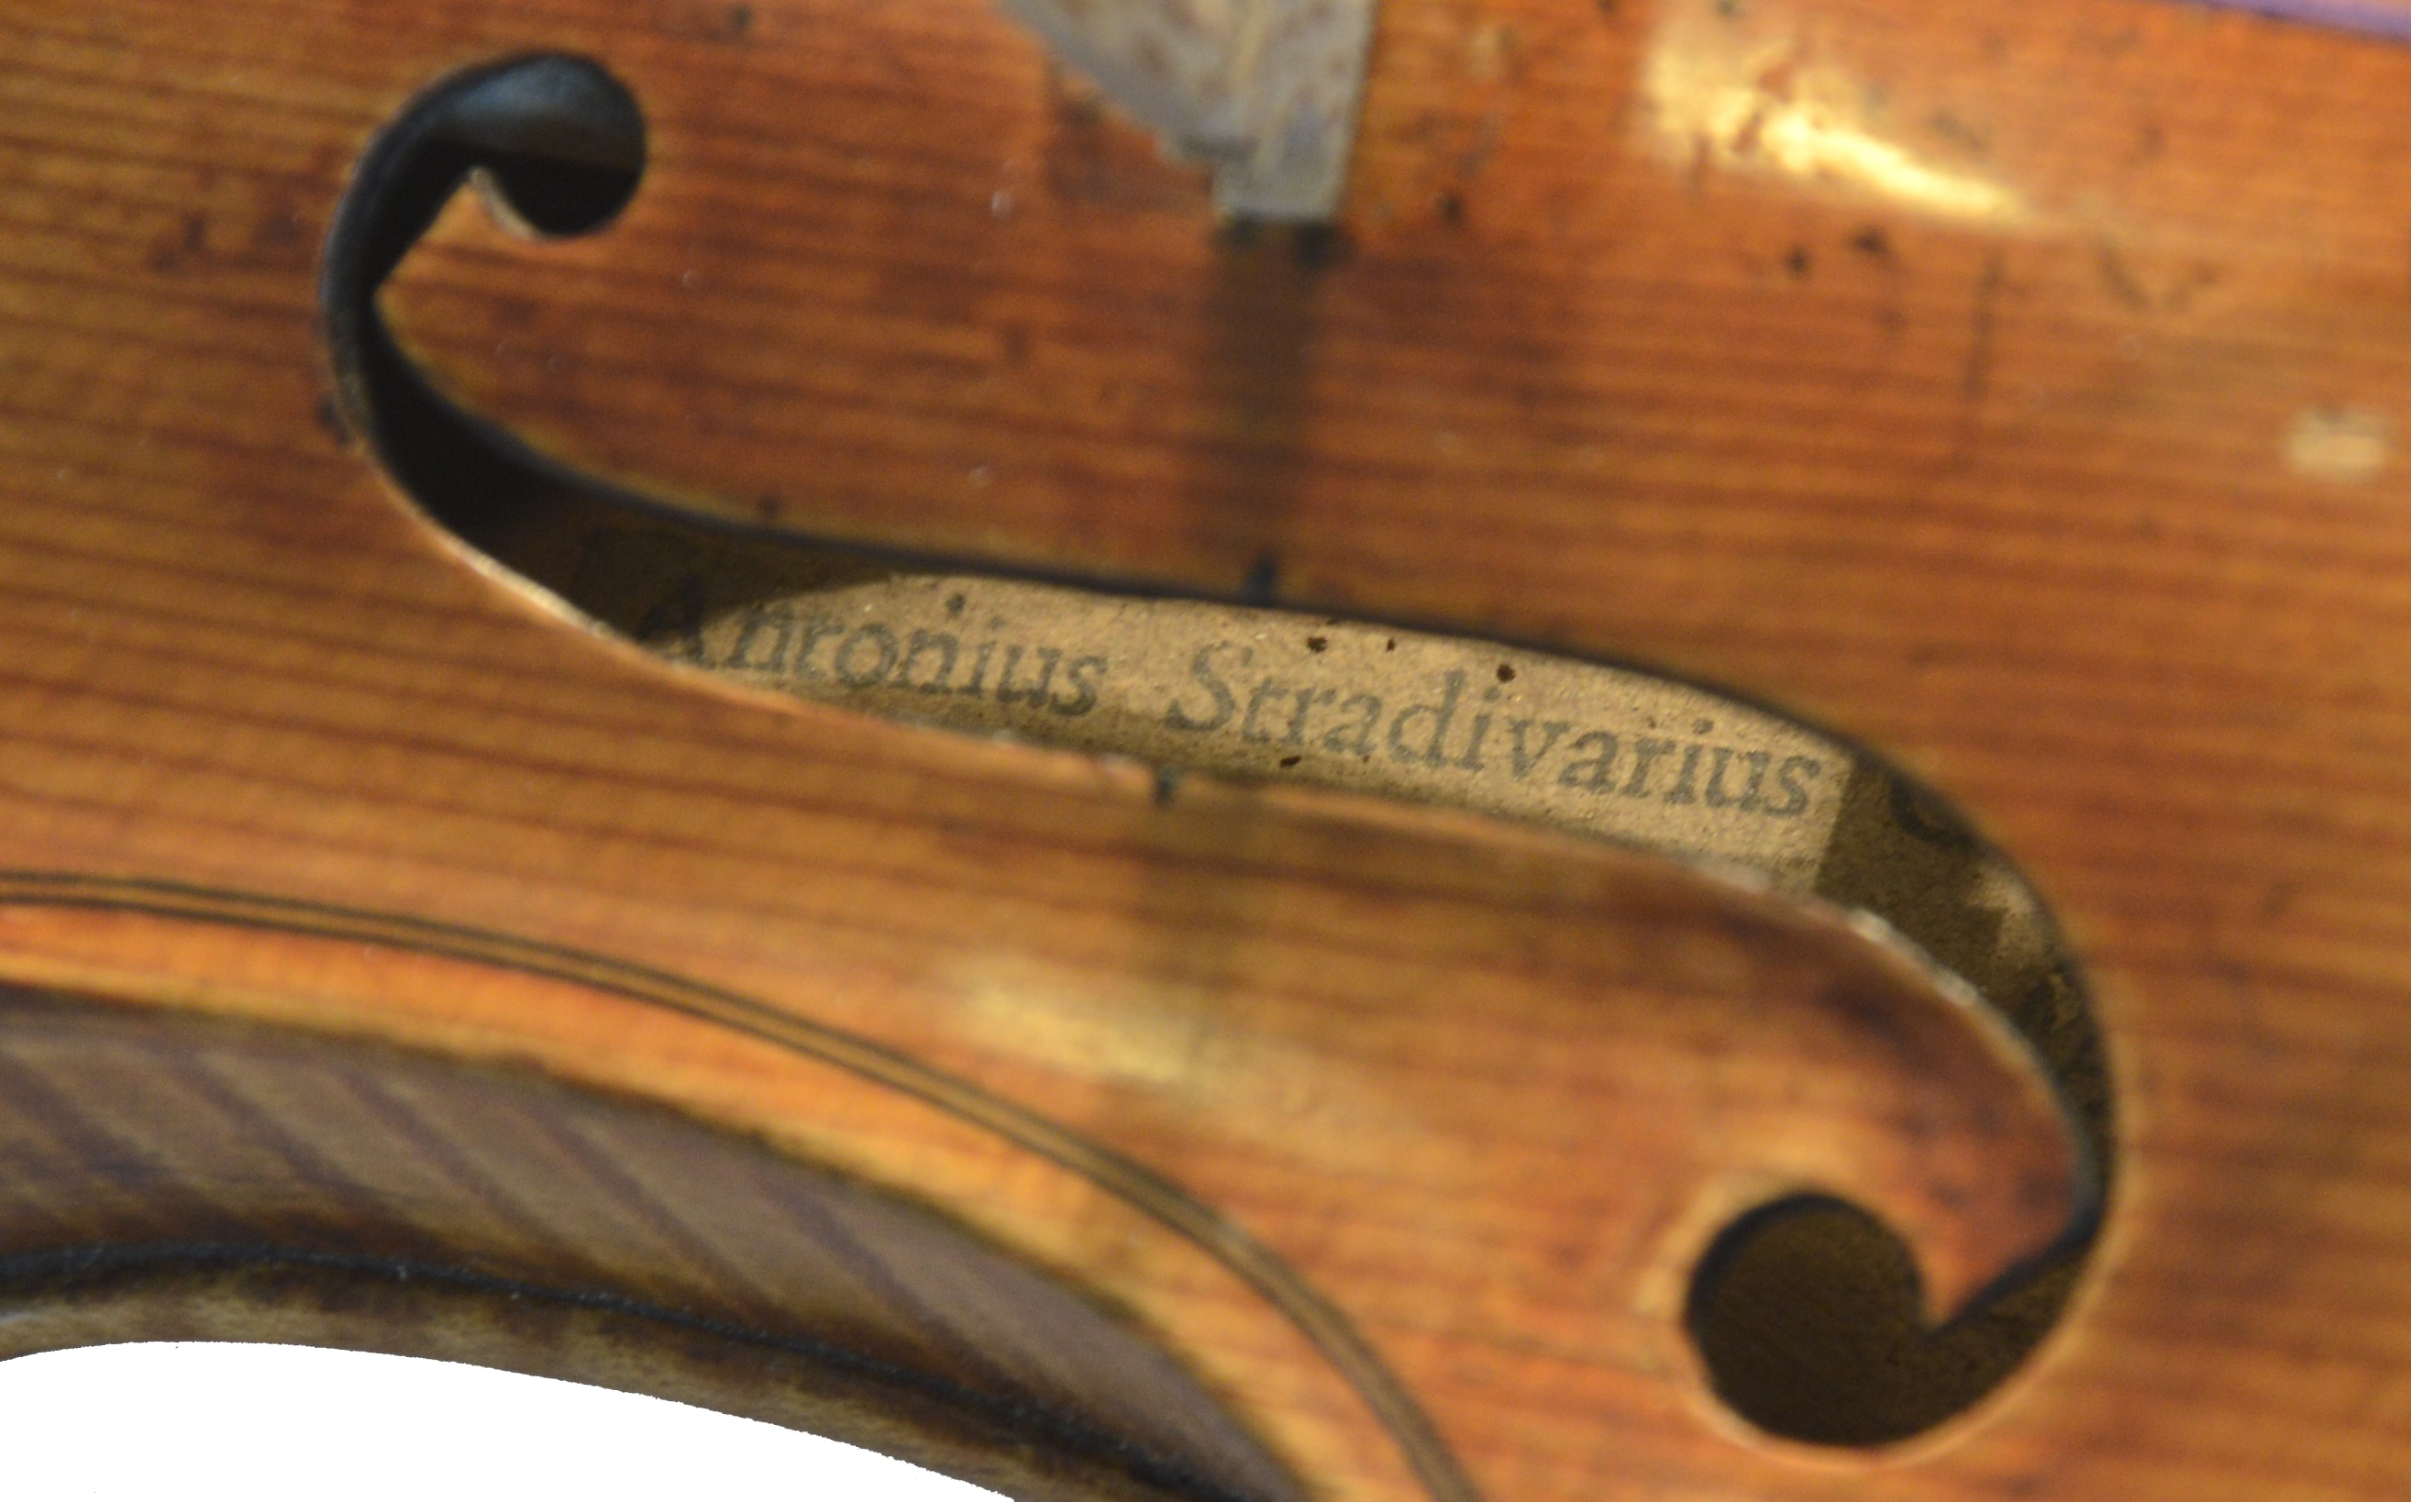
What is a Patent?
Notes:
How many people are familiar with Stradivarius?
Famous violin maker/luthier. Maybe the best.
Other famous makers: Amati, Guarneri
Why are Stradivarius violins so good?
People still study this. Is it the Varnish? Stradivarius made his own varnish. Is it the glue? Stradivarius made his own glue.
Stradivarius did not publish the formula for his varnish. Stradivarius did not publish the formula for his glue.
For good reason! These are closely-held secrets! Competitive edge.
Stradivarius methods are lost to the ages.
The patent system is really an attempt to prevent this kind of loss. The idea is to create an incentive to publish.

Slide 4
What is a Patent?
United States Constitution
Article 1, Section 8
“The Congress shall have Power…
To promote the Progress of Science and useful Arts, by securing for limited Times to Authors and Inventors the exclusive Right to their respective Writings and Discoveries;”
The Patent Act seeks to accomplish this goal by granting to the inventor property rights in the idea in exchange for disclosure.
Notes:
The patent authority is in the United States Constitution, and this is in line with the rest of most of the world in what is called the Patent Cooperation Treaty
“To promote the Progress of Science”
The key exchange at the core of the patent system is that the inventor is given property rights in exchange for disclosure.
Think of the property right like owning a house. You can invite your friends and family over. You can rent parts of the house out to tenants. Or, you could even let complete strangers stay there for free. It’s up to you. It’s your house. The difference is, the most you can own the patent is for 20 years. After that, it belongs to everyone— but you will always be the inventor and that never changes.
By disclosing, hopefully key technologies will not be lost to the ages.
Now, the violin example is not a perfect analogy. Trade secret is also a legally protected form of intellectual property. But this analogy works pretty well when it comes to technology.

Slide 5
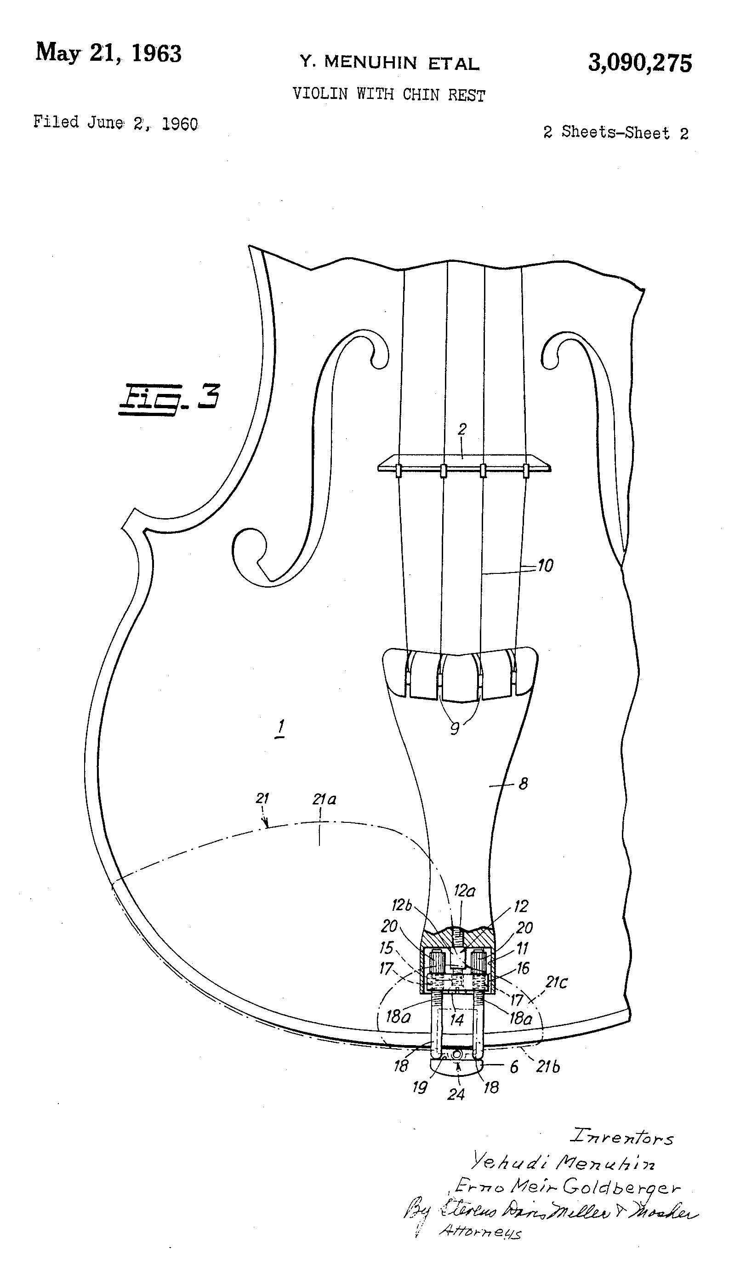
What is a Patent?
A patent is a publication
A patent teaches others how to practice your invention
A patent must be
  New
  Non-obvious
  Useful
Notes:
As a publication, the patent must teach others how to practice your invention. It can’t be intentionally obscure!
These three criteria— novelty, non-obviousness, and utility, are what drive the patent process.
The patent laws and procedures could fill a large telephone book, but you don’t have to worry about that. That’s why you have a tech transfer office.
Really, the patent is a publication refereed to ensure it satisfies those specific conditions.
As a result, the patent demonstrates a certain level of proficiency and expertise.

Slide 6
Prime Contract Requirements
Employees are required to disclose information on any invention, discovery, creation, or improvement arising from or related to work at Fermilab that is conceived while employed by the laboratory that may have potential commercial value.
FRA must disclose each invention to the DOE Patent Counsel within 2 months after the inventor discloses it in writing to OPTT.
OPTT must make election decisions within 2 years of disclosure and notify DOE of these decisions.

Slide 7
Publication Requirements and Patent Reviews
Publication can affect the Laboratory’s ability to protect its Intellectual Property (IP)
In order to ensure that publication will not adversely affect the patent interest of DOE or FRA, the Prime Contract stipulates approval for publication must be secured from OPTT prior to release.

Slide 8
Intellectual Property Policy
Employees are required to disclose information on any invention, discovery, creation, or improvement arising from or related to work at Fermilab that is conceived while employed by the laboratory that may have potential commercial value.
Employees will not disclose or publicly display Proprietary Information belonging to Partners with whom we do business that is subject to a signed non-disclosure agreement or which has been marked clearly as proprietary.
Employees and Partners will not disclose any information that has been marked Protected CRADA Information.

Slide 9
Invention Disclosure Committee
OPTT convenes an Invention Disclosure Committee (IDC) Meeting as needed to review ROI/FAA packages and IP-related decisions.
OPTT consolidates input/responses from IDC and obtains additional input from inventor(s) if necessary.
OPTT informs Inventor(s), D/S/C/ head(s), and Legal, and updates FAA to include election decision and DOE response.

Slide 10
Some Questions to Ask
Are “novel,” “unique,” or “technology,” keywords in your:
  Proposals
  Grant
  Program reviews
  Draft articles?
Is your program developing tools out of necessity?
Might these tools be useful in other domains?

Slide 11
Monetary Benefits
Licensing of IP can generate a royalty stream.
FRA employees currently share 50% of the net royalties (after direct expenses) for the first $10,000, and 25% of the net royalties in excess of $10,000.
DOE doesn’t tell us how to spend royalties
As a result, royalties can be a flexible source of funding for any of our mission responsibilities (purchase equipment, roll funds over to next year, use on new programs, etc.)

Slide 12
Recognition
IP protection and licensing can provide positive recognition to your staff, group, and the Laboratory.
Building an IP portfolio within a specific patent space can help you expand a recognized Laboratory capability around the work you do.
IP can help to attract business in the form of SPPs, CRADAs, and government sponsorship in areas for which Fermilab has demonstrated IP-based competencies.
Staff members get patent and publication on resume, and increasing interest in entrepreneurial pursuits
http://partnerships.fnal.gov/internal/gismo-form/

Slide 13
Contact
Aaron Sauers
asauers@fnal.gov
630-840-4432
http://partnerships.fnal.gov/internal/gismo-form/

