Slide 1
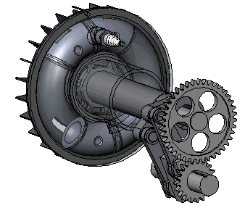
Welcome to the All Engineers Retreat!
20 February 2018

Slide 2
Safety Reminders
Exits
Nearest tornado shelter
Building assembly area – edge of east parking lot
In event of an emergency, call x3131 or 630-840-3131
Restrooms

Slide 3
Purpose of Today’s Retreat
Provide a chance for the engineering professionals at the lab to come together as a community
Celebrate accomplishments of engineering community in support of Fermilab’s science mission!
Discuss what engineers do across the lab!
Identify and talk about issues that affect the engineering community (succession planning… promotions… professional development… and more)!
Provide some info on lab-wide initiatives of particular interest to the engineering community. Ask questions.
Have some pizza and a beer! Or wine. Check out the posters!

Slide 4
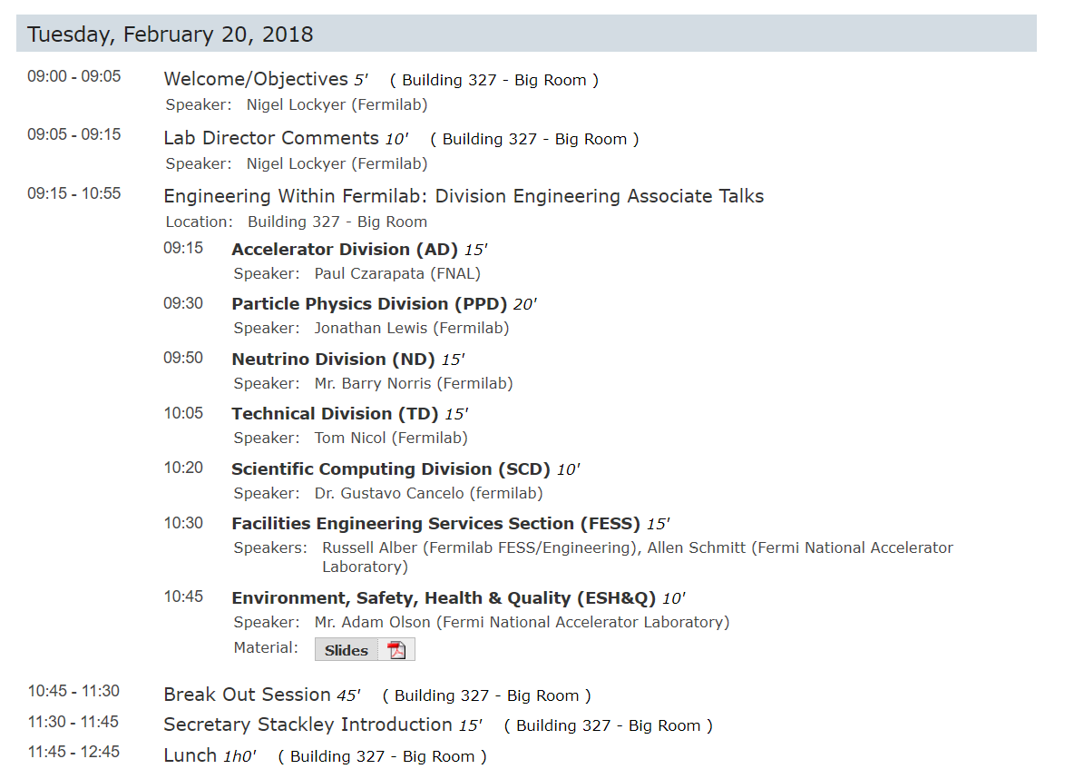
A Very Ambitious and Full Agenda!
Bus transport available to WH from 12p to 1p

Slide 5
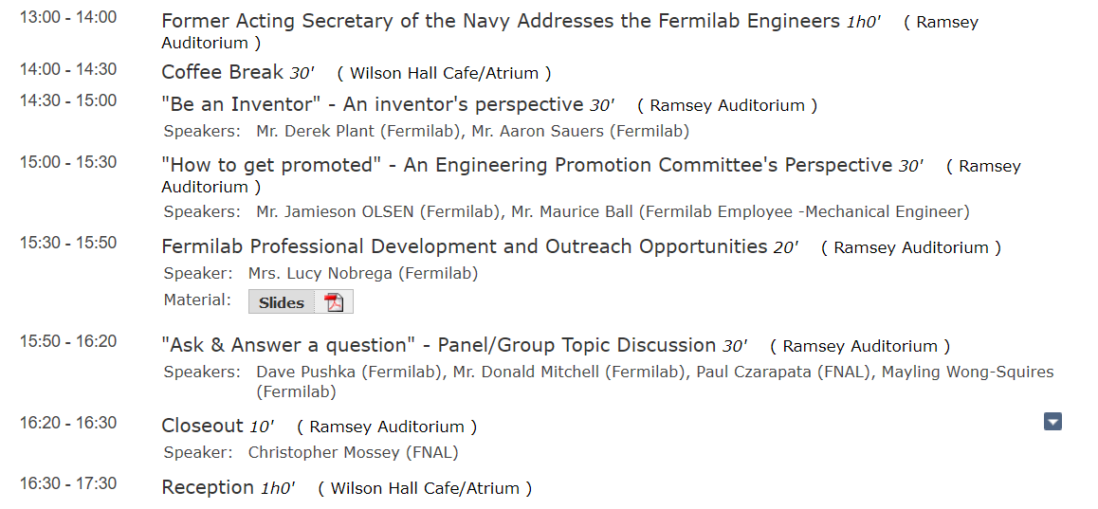
Afternoon…shift to Wilson Hall for Keynote Address

Slide 6
National Engineer Week… Other Events
Thursday:
Social event at 4 pm at the User’s Center
Sponsored by:
fSWE (Society of Women Engineers, Fermi Chapter)
fSHPE (Fermi Society of Hispanic Professional Engineers), and
Nascent fNSBE (National Society of Black Engineers)
Friday:
First fEngineering Symposium at 2 pm at One West
Featuring Bradly Verdant, a former Fermilab engineer who now works for Elon Musk’s SpaceX Aerospace company
Talk about “Making Humanity an Interplanetary Species” and in particular the rockets and rocket systems they’re developing to enable interplanetary transport.

