Slide 1
Particle Physics Division Engineering
Jonathan Lewis
Engineers’ Retreat
20 February 2018

Slide 2
Overview
PPD Engineers work closely with scientists through all phases of an experiment
  Detector R&D
  Design
  Construction
  Operation
  Decommissioning
Engineers driving technology innovations to expand horizons of science

Slide 3
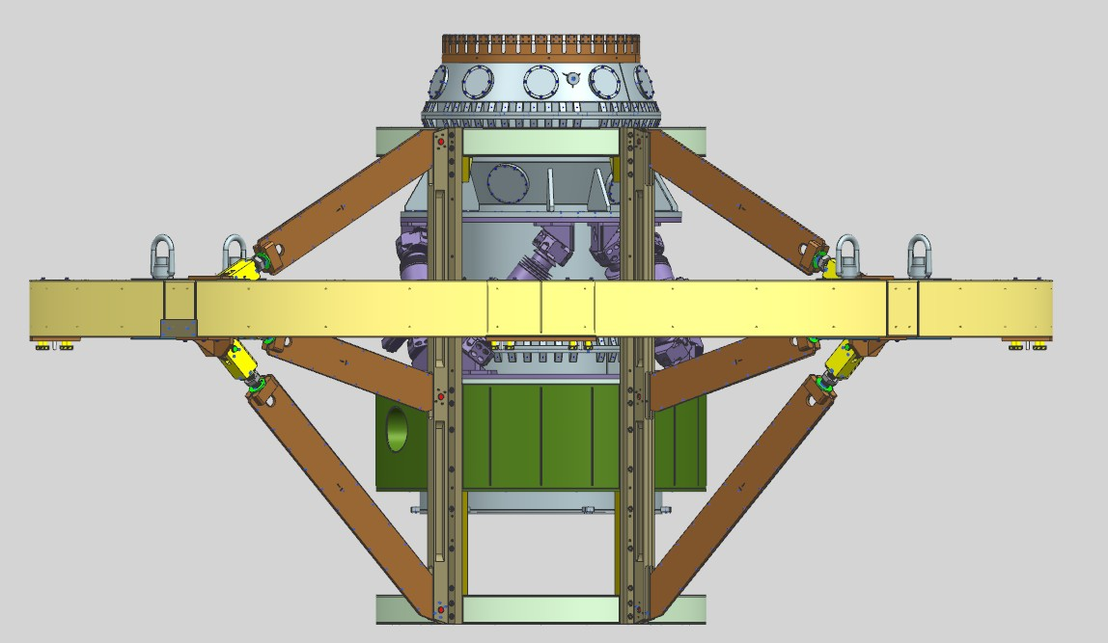
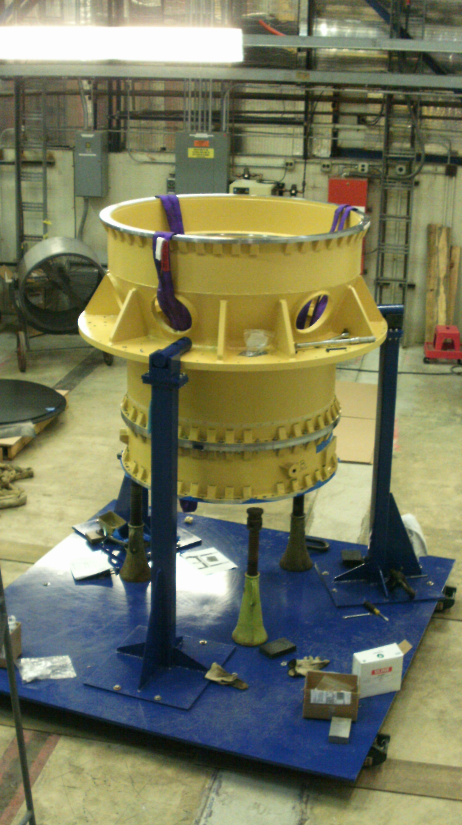
Mechanical Engineering:
Mechanical Design Engineering
Don Mitchell
Giuseppe Gallo
Luke Martin
Jim Kilmer
Structures, supports, shielding, modeling, general detectors
Dark Energy Survey Instrument
Dept. Head: Russ Rucinski

Slide 4
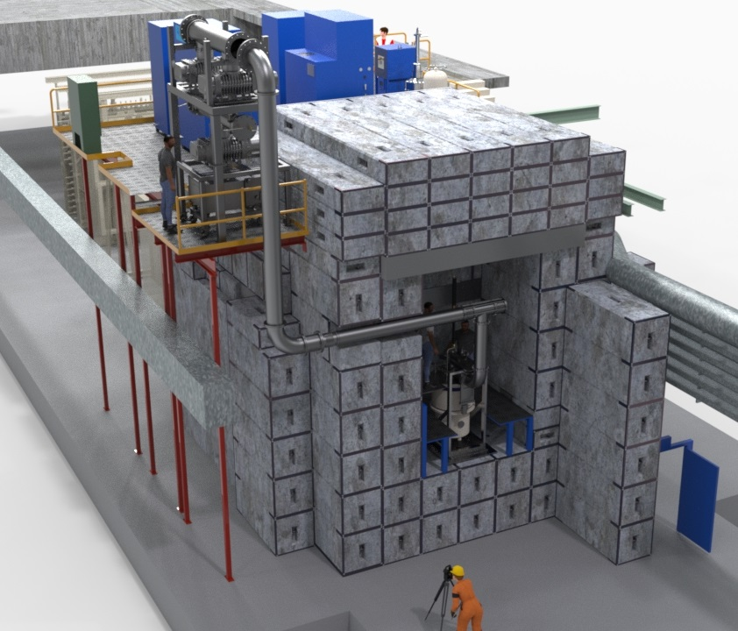
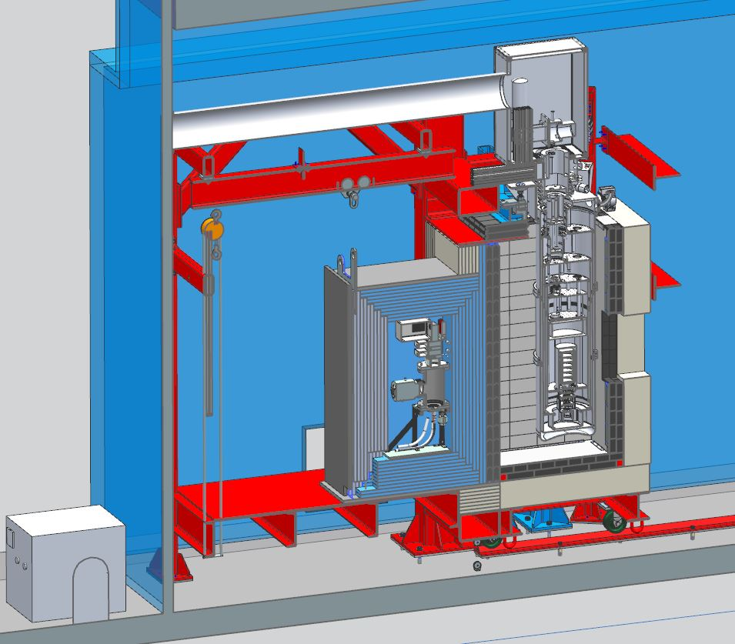
Mechanical Engineering: Mechanical Design Engineering
Structures, supports, shielding, modeling, general detectors
E-1039 at NM4
NEXUS dark matter R&D facility in MINOS cavern

Slide 5
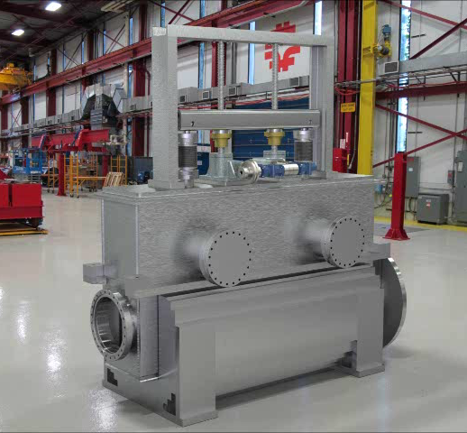
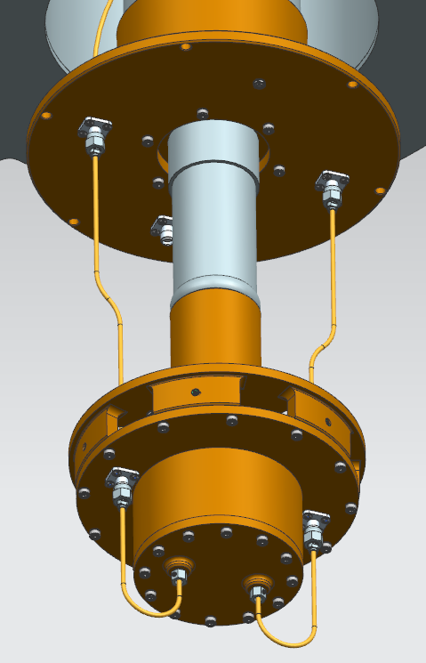
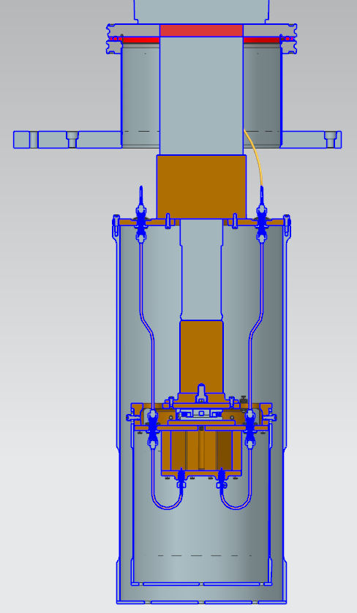
Mechanical Engineering: Mechanical Design Engineering
Structures, supports, shielding, modeling, general detectors
Mu2e Protection Collimator
AXION detector prototype

Slide 6
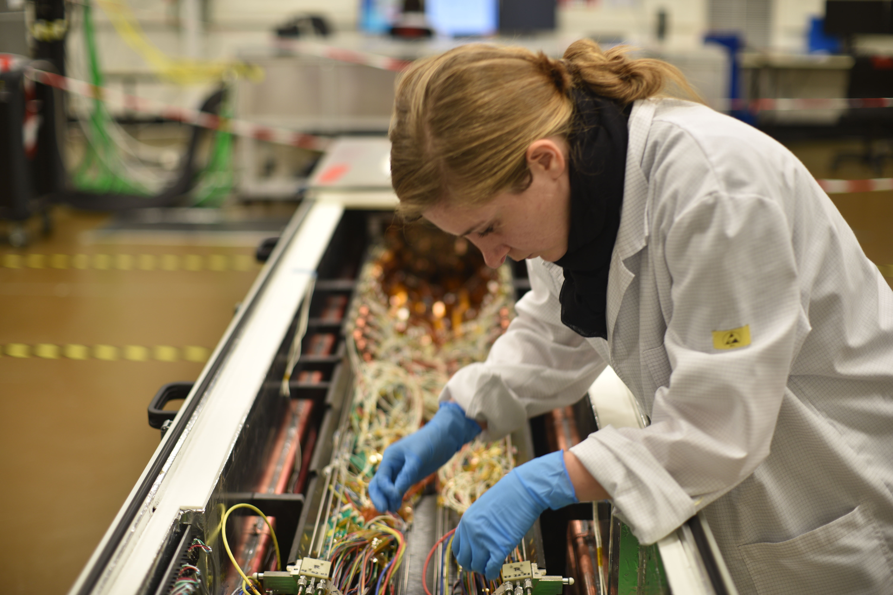
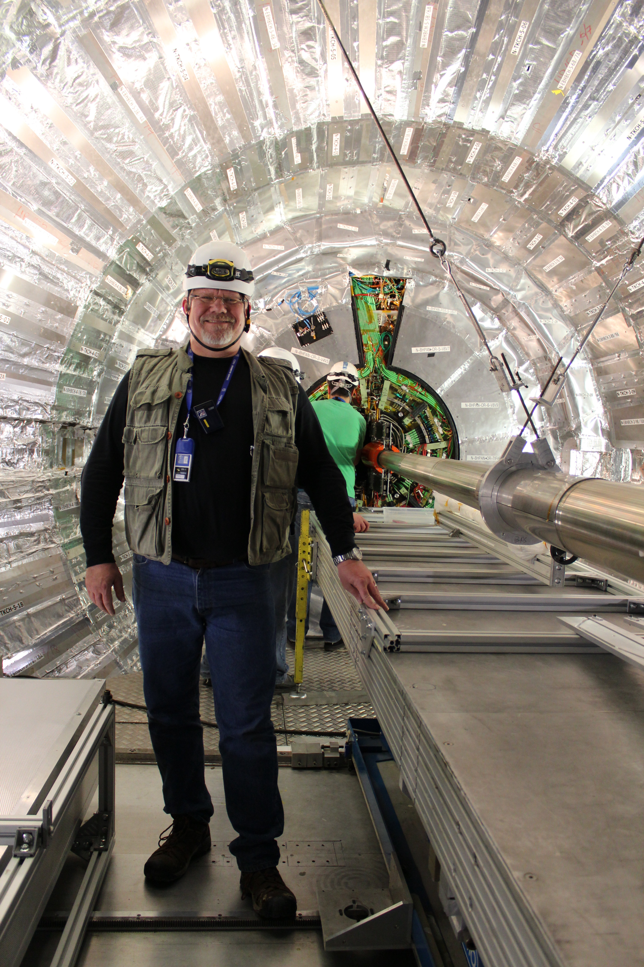
Mechanical Engineering: High Precision Design Engineering
Silicon detectors, carbon fiber and special materials
Greg Derylo
C.M. Lei
Stephanie Timpone
CMS detector at CERN

Slide 7
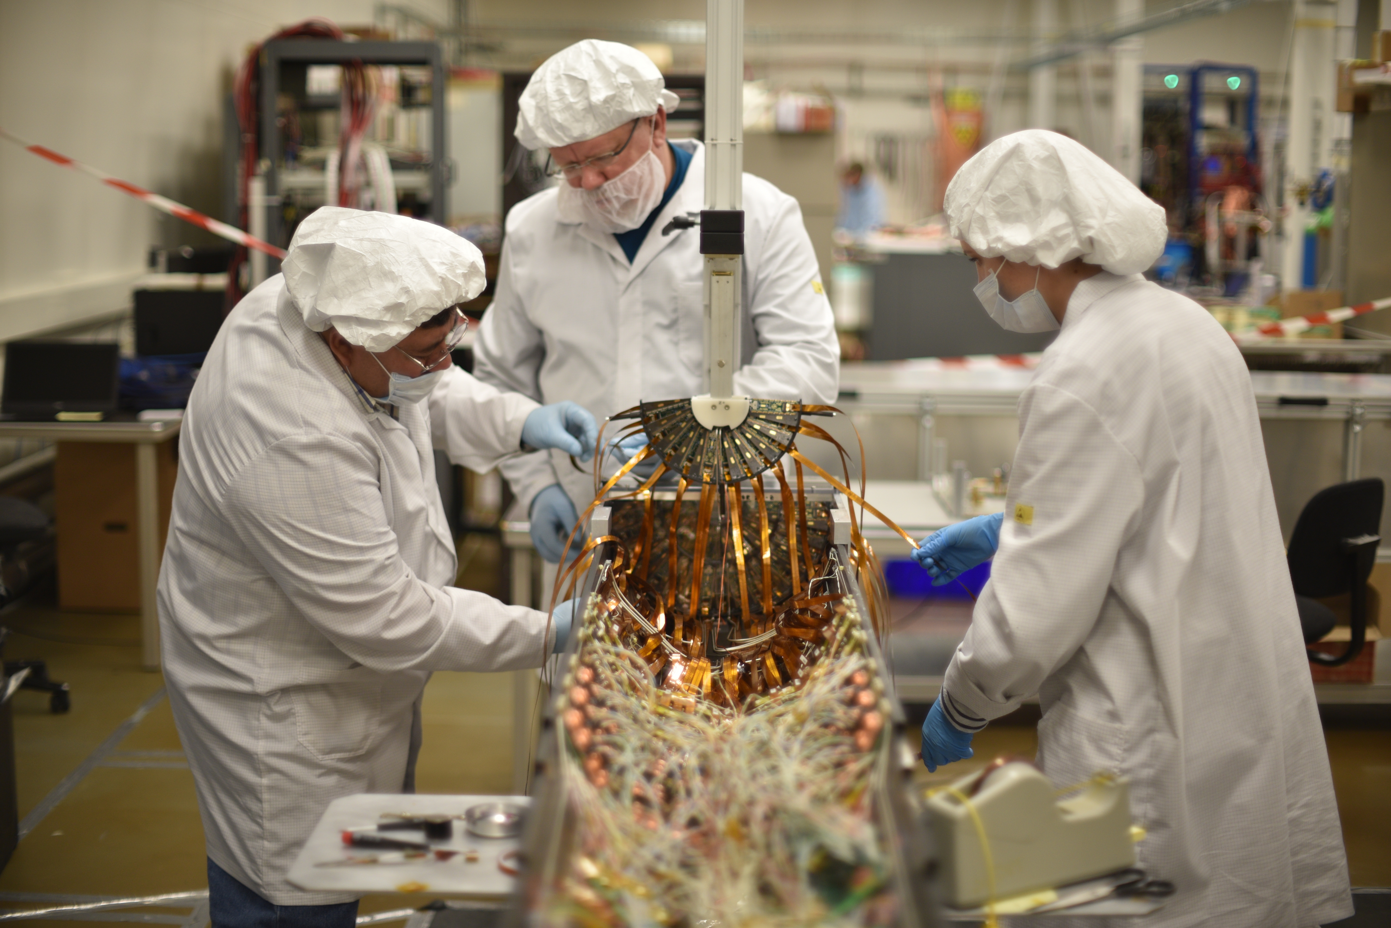
Mechanical Engineering: High Precision Design Engineering
Silicon detectors, carbon fiber and special materials
Innovations:
Dual Phase CO2 cooling
Structure built with Thermal Pyrolytic Graphite (TPG) encapsulated in carbon fiber
CERN CMS Phase 1 Forward Pixel Detector

Slide 8
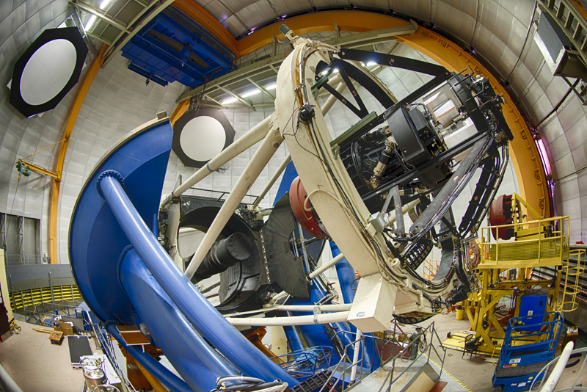
Mechanical Engineering: High Precision Design Engineering
Dark Energy Survey Camera
2003-2012: DECAM, at 0.57 Gigapixels, is the second largest digital camera in the world.

Slide 9
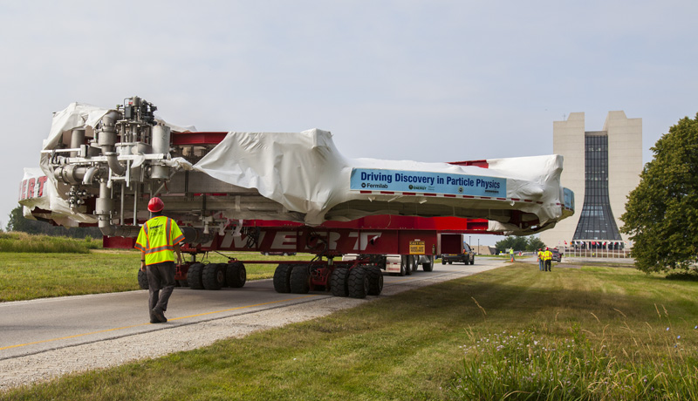
Mechanical Engineering: Fluids and Thermal Engineering
Heat transfer, fluids and gas systems integrated with detector elements
Del Allspach
Cary Kendziora
Jacob Kintner
Robert Sanders
Erik Voirin
g-2 Experiment – Responsible of the move from BNL

Slide 10
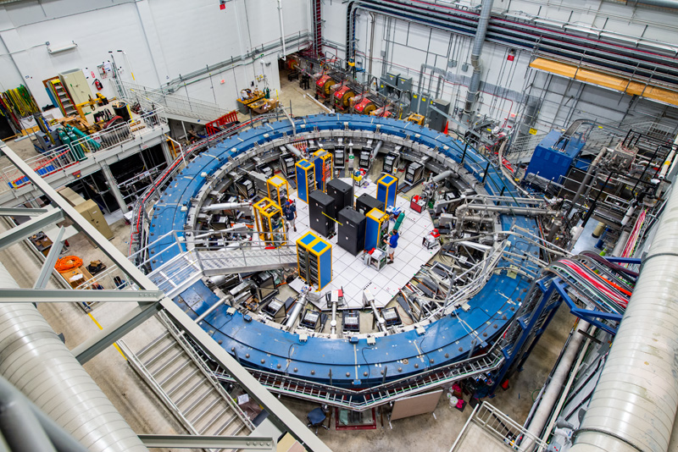
Mechanical Engineering: Fluids and Thermal Engineering
Heat transfer, fluids and gas systems integrated with detector elements
g-2 Experiment
Superconducting magnets
Vacuum
Gas systems

Slide 11
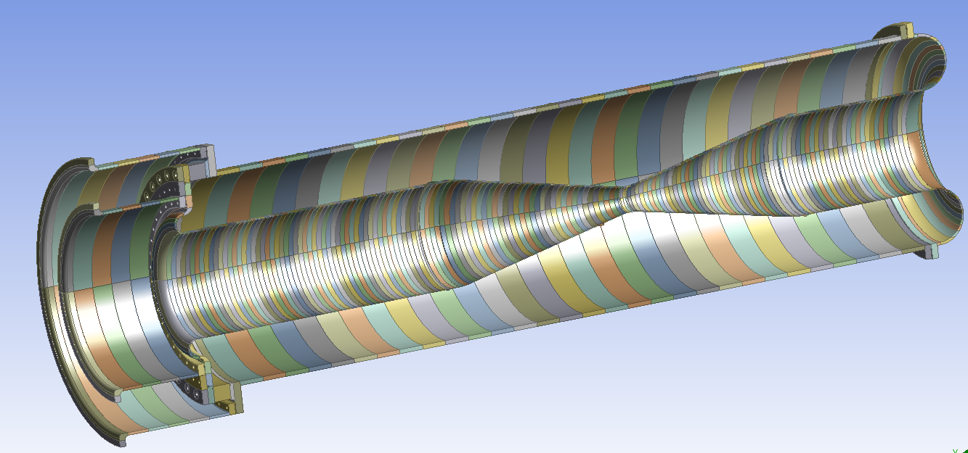
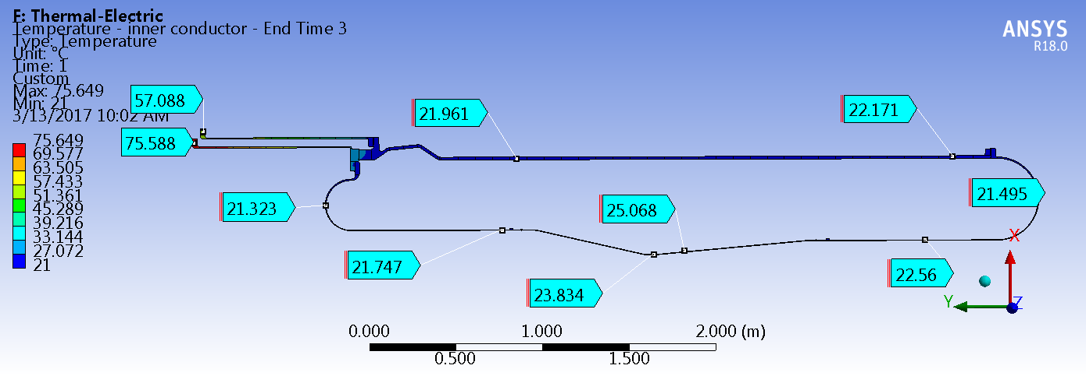
Mechanical Engineering: Engineering Analysis
Finite element analysis and computational fluid dynamics, magneto statics
Horn B thermal model
Bob Wands
Ingrid Fang
Ang Lee
Zhijing Tang
Erik Voirin
Steady state temperature (C) 1.2 MW

Slide 12
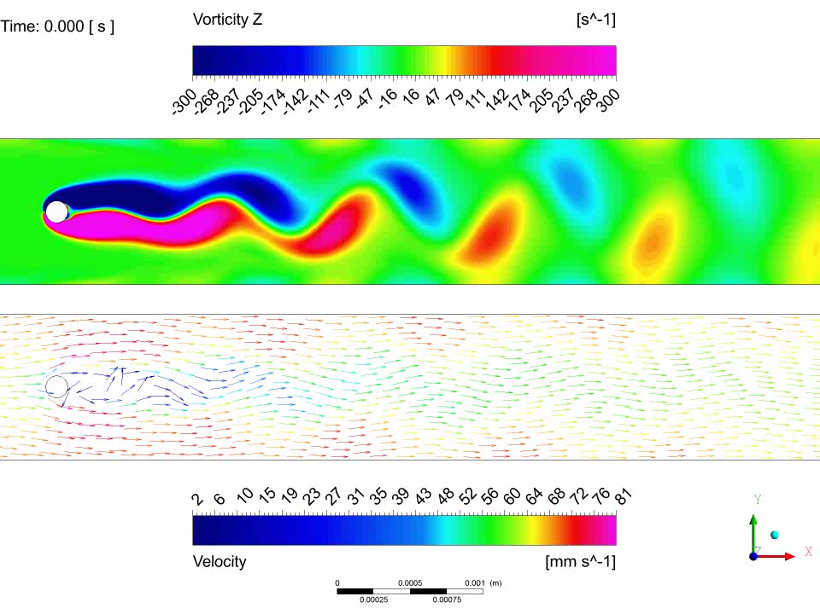
Mechanical Engineering: Engineering Analysis
Finite element analysis and computational fluid dynamics, magneto statics
SBN
TPC Wire Forces and Vortex Induced Motion from LAr Flow

Slide 13
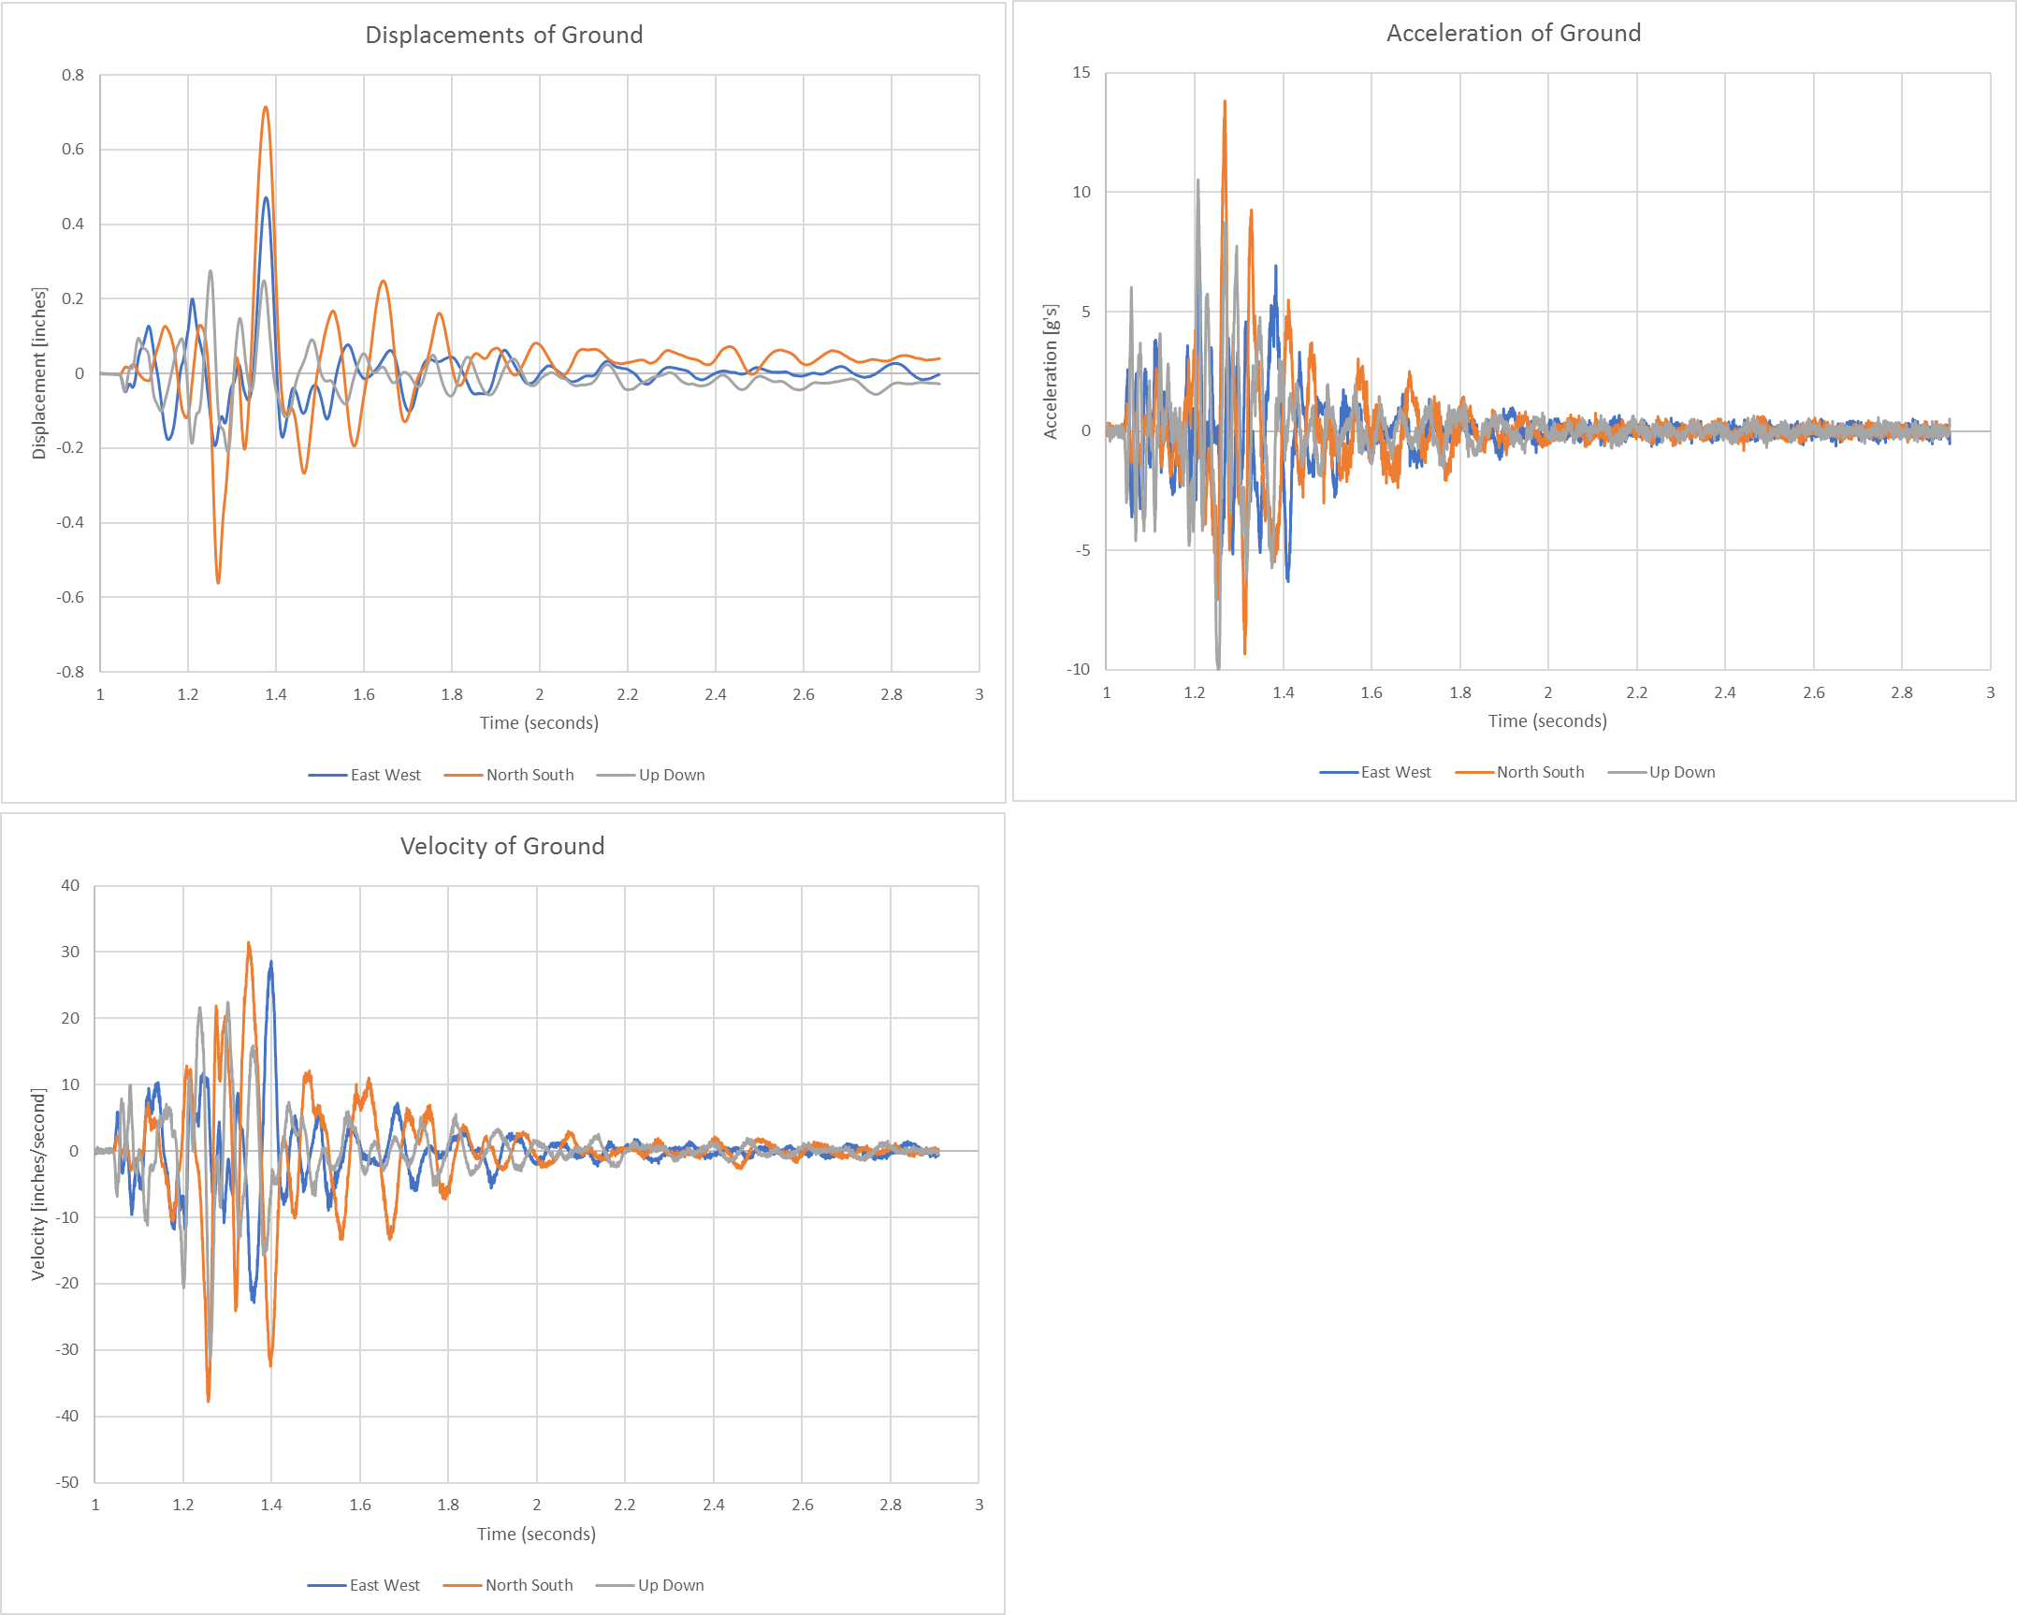
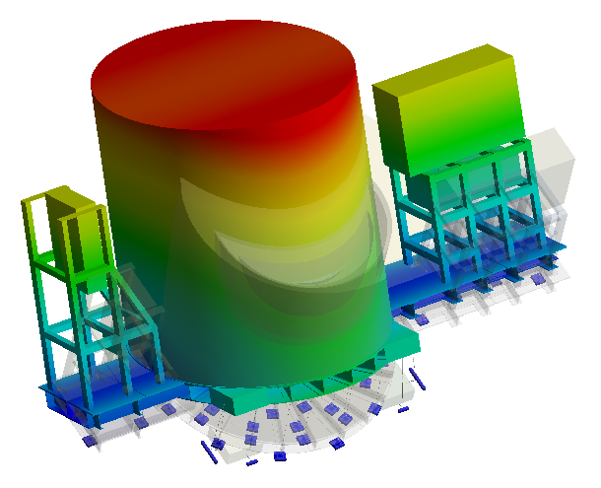
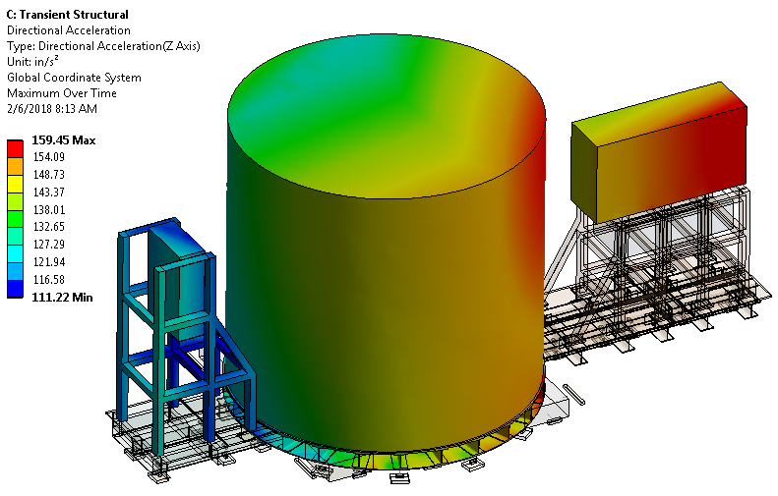
Mechanical Engineering: Engineering Analysis
Finite element analysis and computational fluid dynamics, magneto statics, vibration analysis
0.97 Hz
SCDMS
Seismic Base Analysis

Slide 14
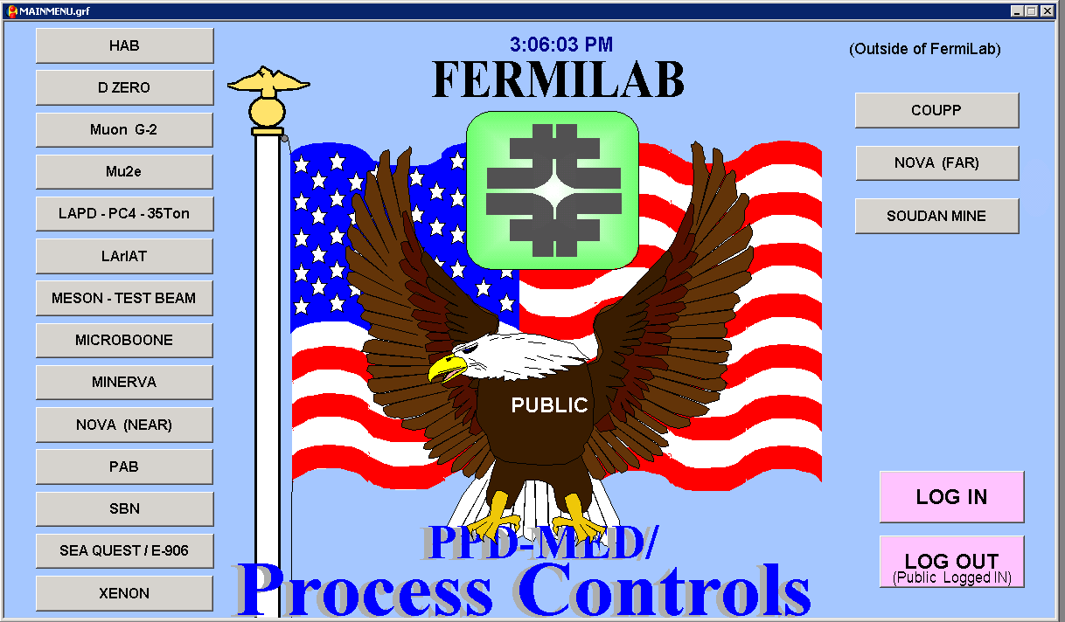
Mechanical Engineering: Process Controls
Process Control systems design and implementation
Daniel Markley
Roberto Davila
Timothy Martin
Kim Overhage
Shreya Ranpariya
Michael Sarychev
Ian Young
User Interface to access Controls For Experiments

Slide 15
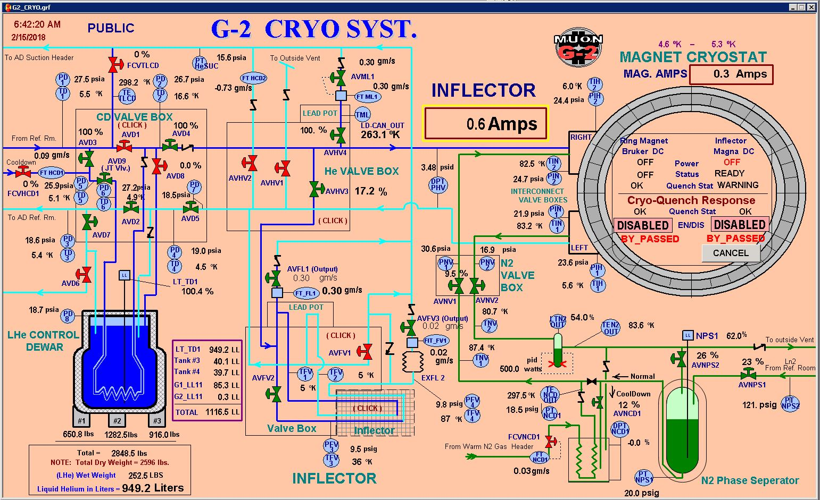
Mechanical Engineering: Process Controls
Process Control systems design and implementation

Slide 16
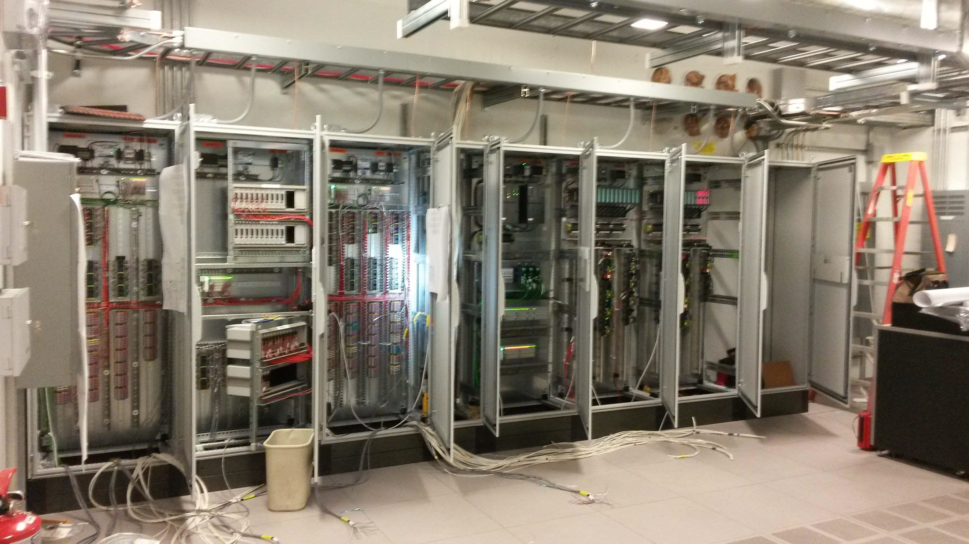
Mechanical Engineering: Process Controls
Process Control systems design and implementation
g-2 process controls racks

Slide 17
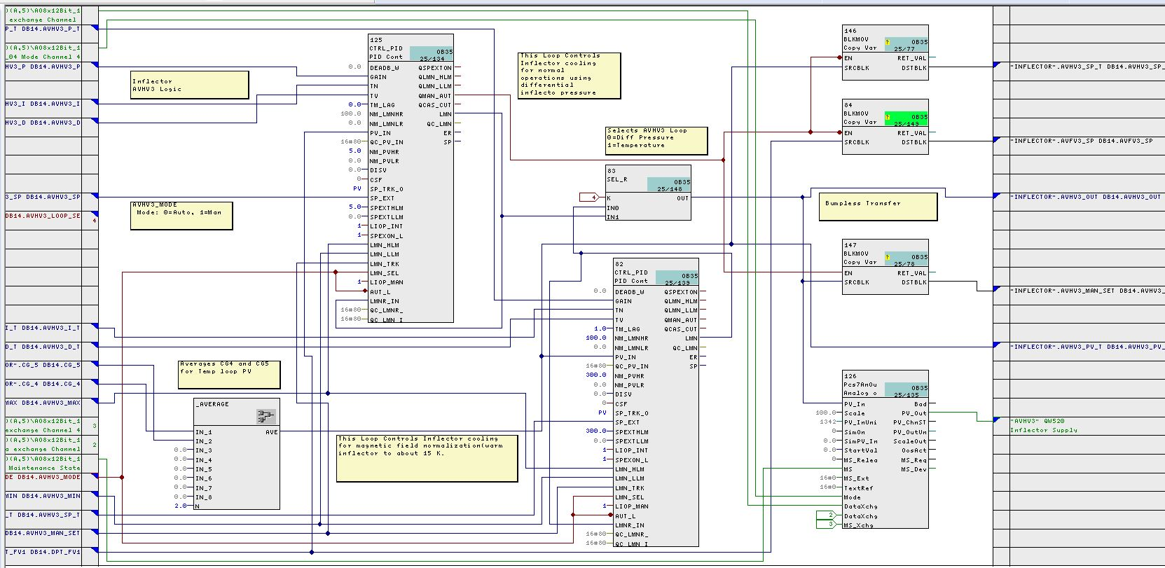
Mechanical Engineering: Process Controls
Process Control systems design and implementation
Programmable Logic Controller programming

Slide 18
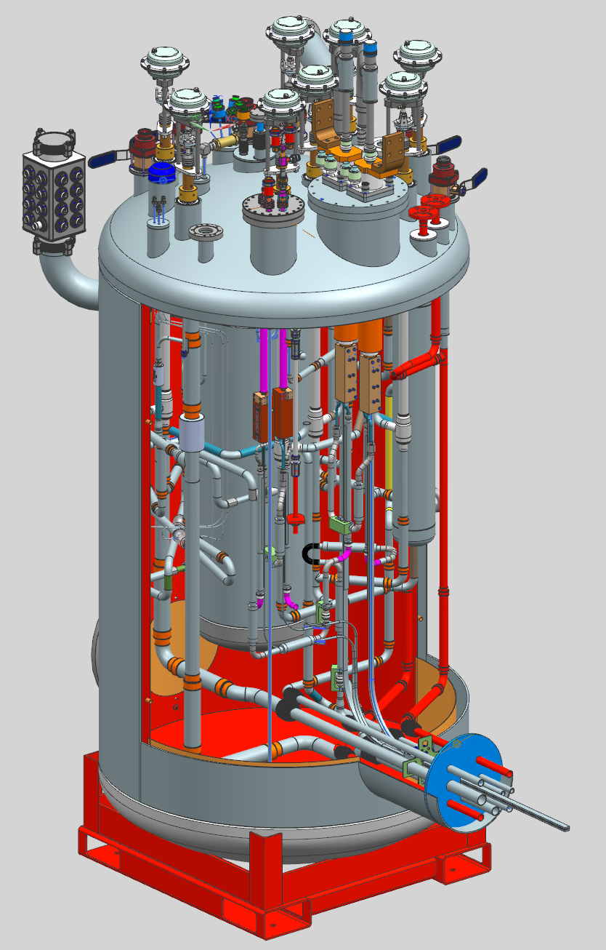
Mechanical Engineering: Design and Drafting
Designer 3D modeling, detail drawing, and P&ID drafting services
Mu2e Feedbox
John Rauch
Bill Cyko
Brian Ellison
Don Friend
Richard Reinert
Sean Sellberg
Gary Smith
Tom Sperry
Mu2e Protection Collimator

Slide 19
Electrical Engineering
Dept. Head: Terri Shaw
PPD/EED provides support for a wide variety of High Energy Physics, Astrophysics and other basic science experiments.
Our work is far-ranging and our products can be found at Fermilab, CERN, the top of a mountain in Chile, and many other locations.
Support is available for new experiments in terms of consulting and infrastructure design. Long-term support is available for any operating experiments.
Many design and support disciplines are available within EED.

Slide 20
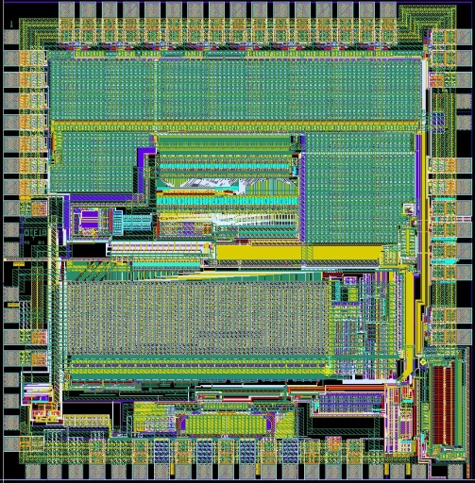
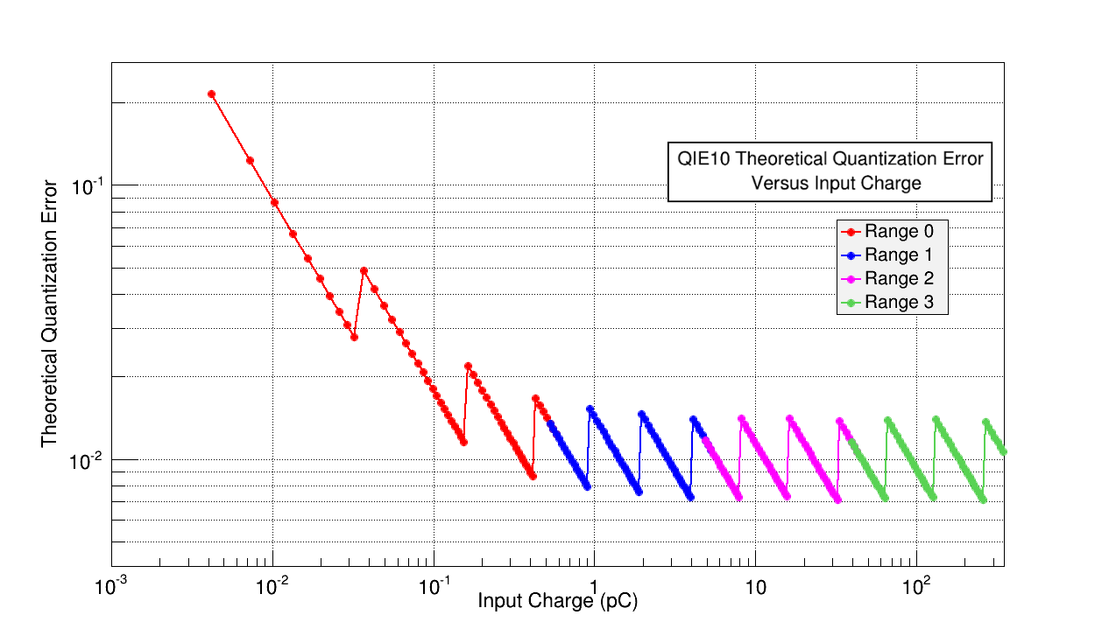
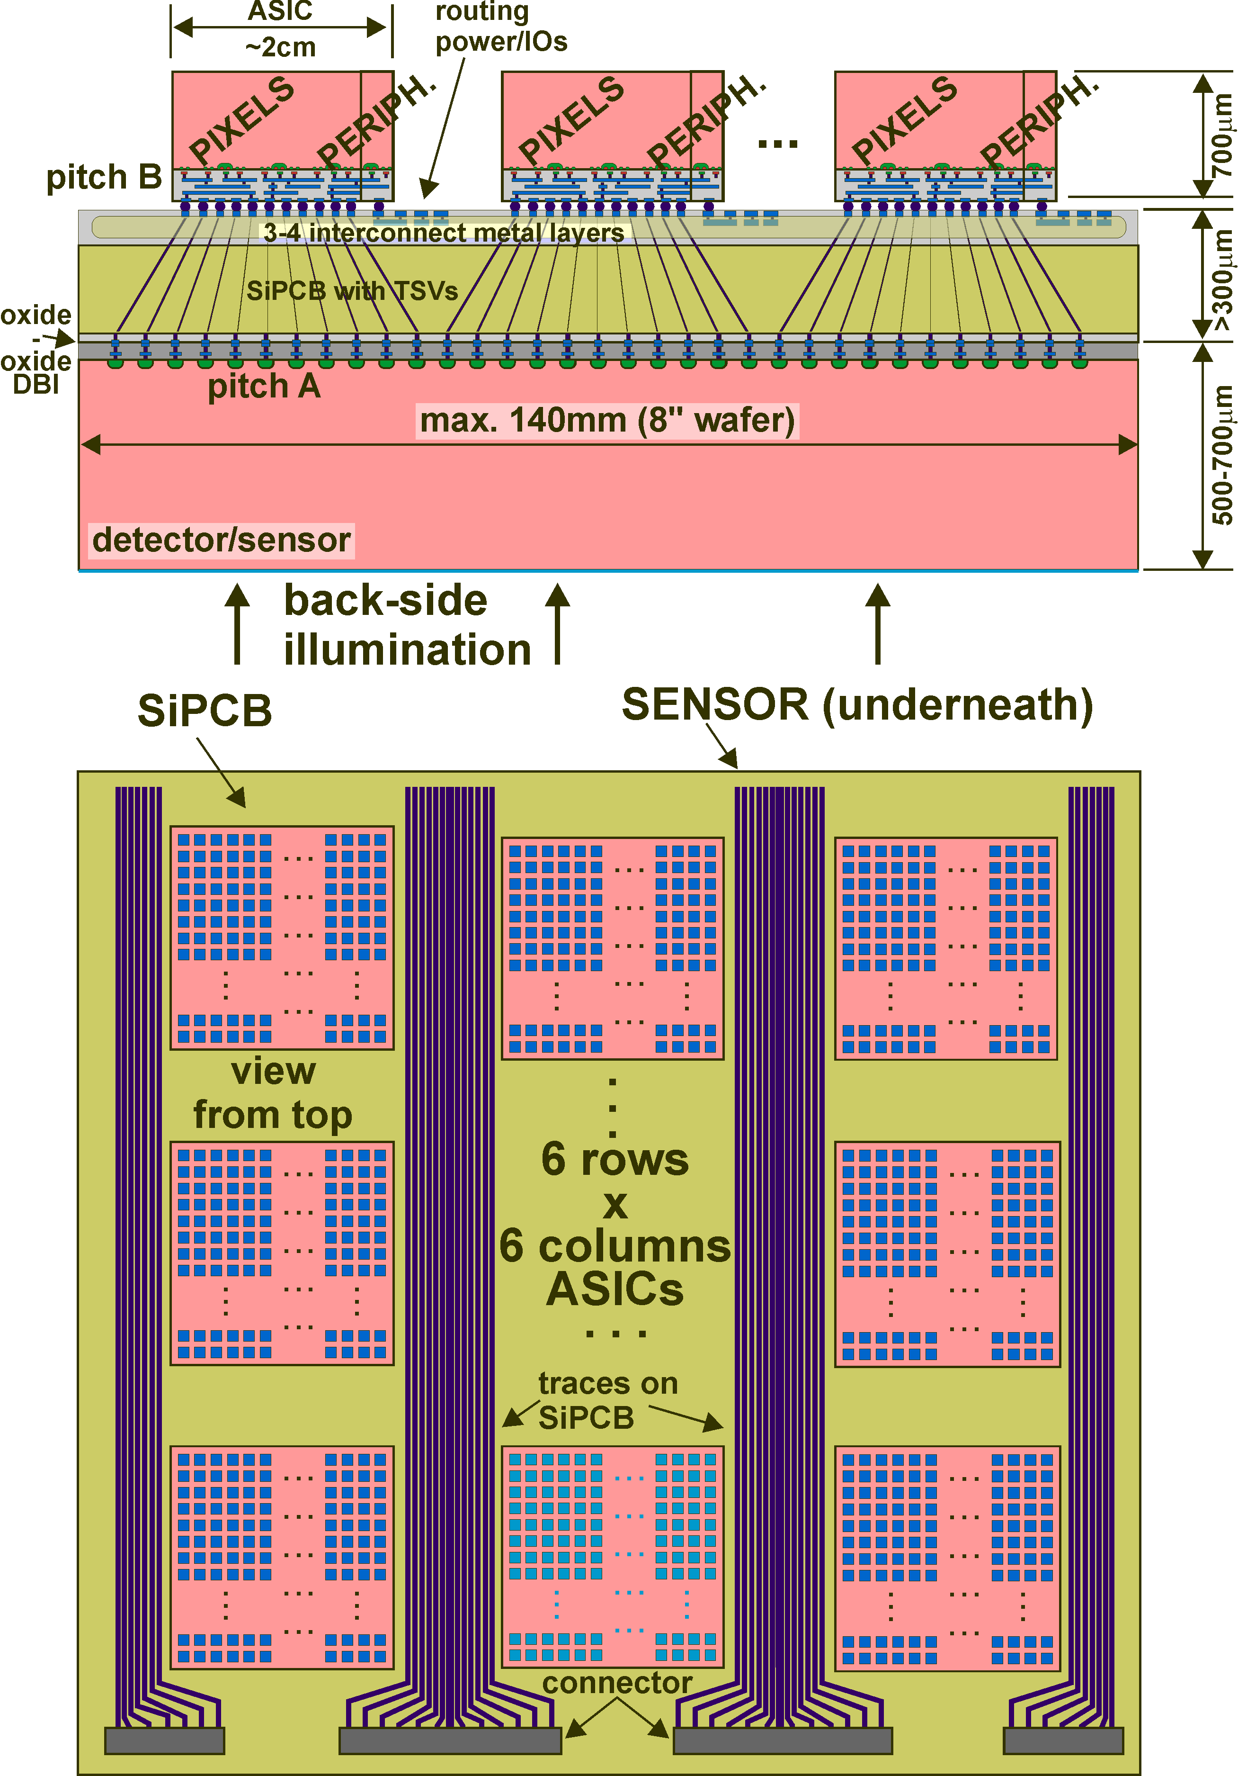
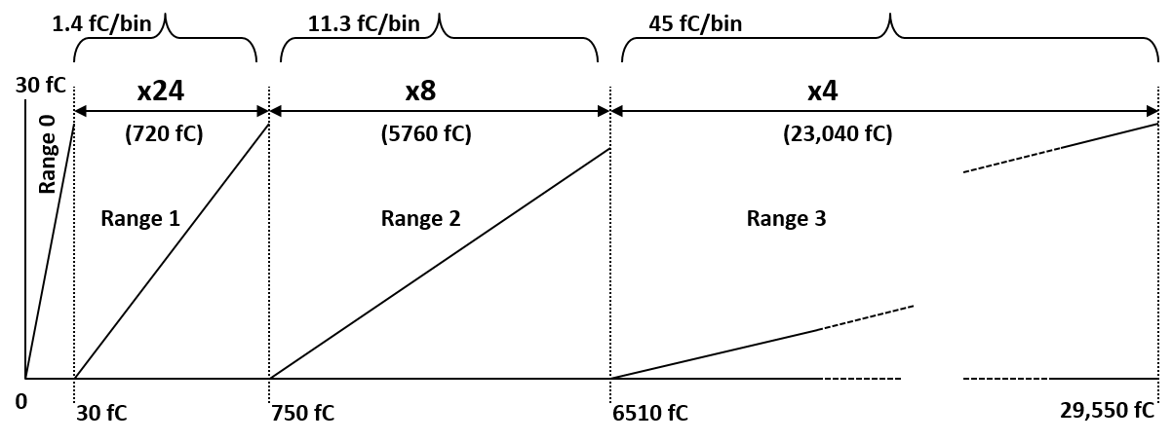
Electrical Engineering: ASICs
Grzegorz Deptuch
Al Baumbaugh, Davide Braga,
Lou Dal Monte, Farah Fahim,
Jim Hoff, Scott Holm,
Sandeep Miryala, Alpana Shenai,
Tom Zimmerman
Leading US ASIC group in HEP
Driving innovative technology
  3D chips for triggers, X-ray cameras
  Cold electronics for DUNE
Past success leads to new innovation
  QIE: a multi‐decade development effort in high dynamic range floating‐point readout chips for HEP
  Translate QIE experience to a dense pixel array application
  FASPAX: a wafer scale X‐ray camera of small pixels with unprecedented dynamic range
    100u X 100u pixels
    Multi‐range device
    Dynamic range: 1.4 fC to 30 pC

Slide 21
Electrical Engineering: ASICs
DUNE
COLDATA: COLd DAta Transmission ASIC for DUNE (CDP1 prototype under tests - OK) Data transmission from cryostat to warm side at 1.2Gbps over up to 30m of Cu links and for control of Front- End and ADC chips, TSMC 65nm, cold models and digital libraries developed, collab. with SMU and BNL
COLD ADC: for DUNE (start with LBL lead, digital back-end Fermilab)
12b, 2Msps ADC for DUNE liquid Ar TPC, pipeline with auto-calibration, TSMC 65nm, collab. with LBL, BNL

Slide 22
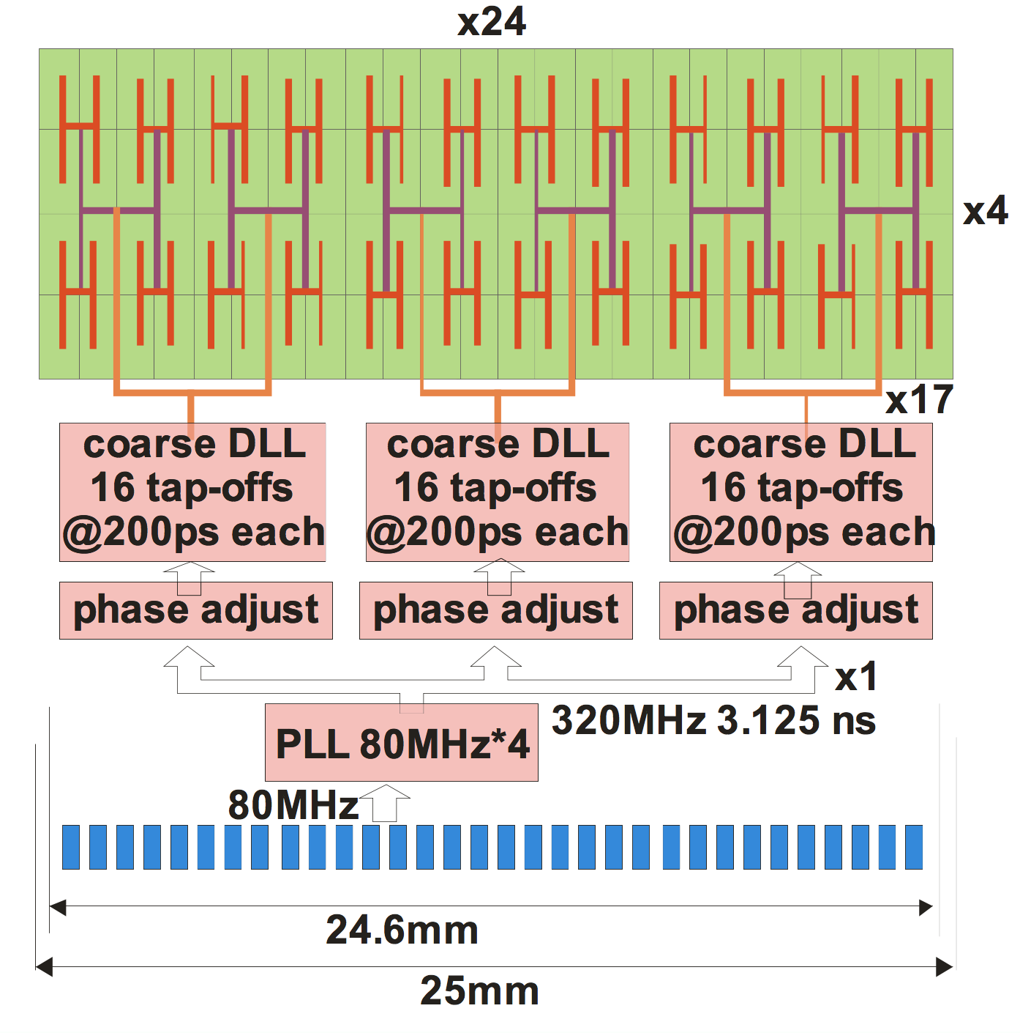
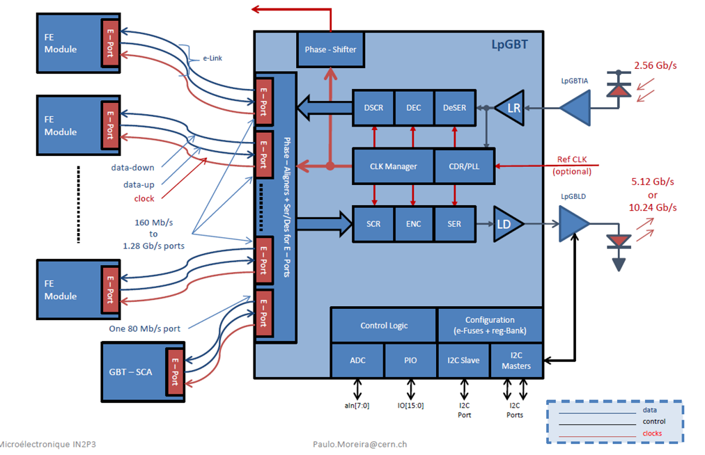
Electrical Engineering: ASICs
CMS HL-LHC
ECON: Endcap CONcentrator
Concentrates data for two paths:
  Trigger Path: Consistent data quantity grabbed every beam crossing to be captured, processed, and relayed via four 10Gbps outputs.
  DAQ Path: variable data quantity; variable data rate; data must be captured, processed, and relayed via 8 x1.28Gbps eLink outputs.
FanTastIC: Fast Timing Integrated Circuit
~20ps resolution
Synchronization and clock distribution challenging
Large pixels (1 x 3 mm)
Low power (~mW/channel) but fast readout of large pixels • Radiation hard (~200Mrad)
Collaborating TD-SRS for 3D EM studies of transmission line effects on global routing

Slide 23
Electrical Engineering: ASICs
Readout for cameras at X-ray light sources (BES)
FLORA: Fermilab-LCLS CMOS 3D-integRated detector with Autogain
50 um× 50 um pixel size
High QE in the soft X-ray range
  0.25-2.0 keV
Single photon sensitivity
  Low noise: ~ 10 e- r.m.s.
Large dynamic range: max. ~500 keV /pixel/pulse
Fast frame readout >10 kHz
VIPIC-L: Vertically-Integrated Photon Imaging Chip – Large
1.3 M‐pixel, single module camera for Timing X‐ray Photon Correlation Spectroscopy, 8‐12 keV X‐rays
ASIC is a two tier 3D ASIC of 65μm pixel pitch configurable in zero suppression or imaging mode

Slide 24
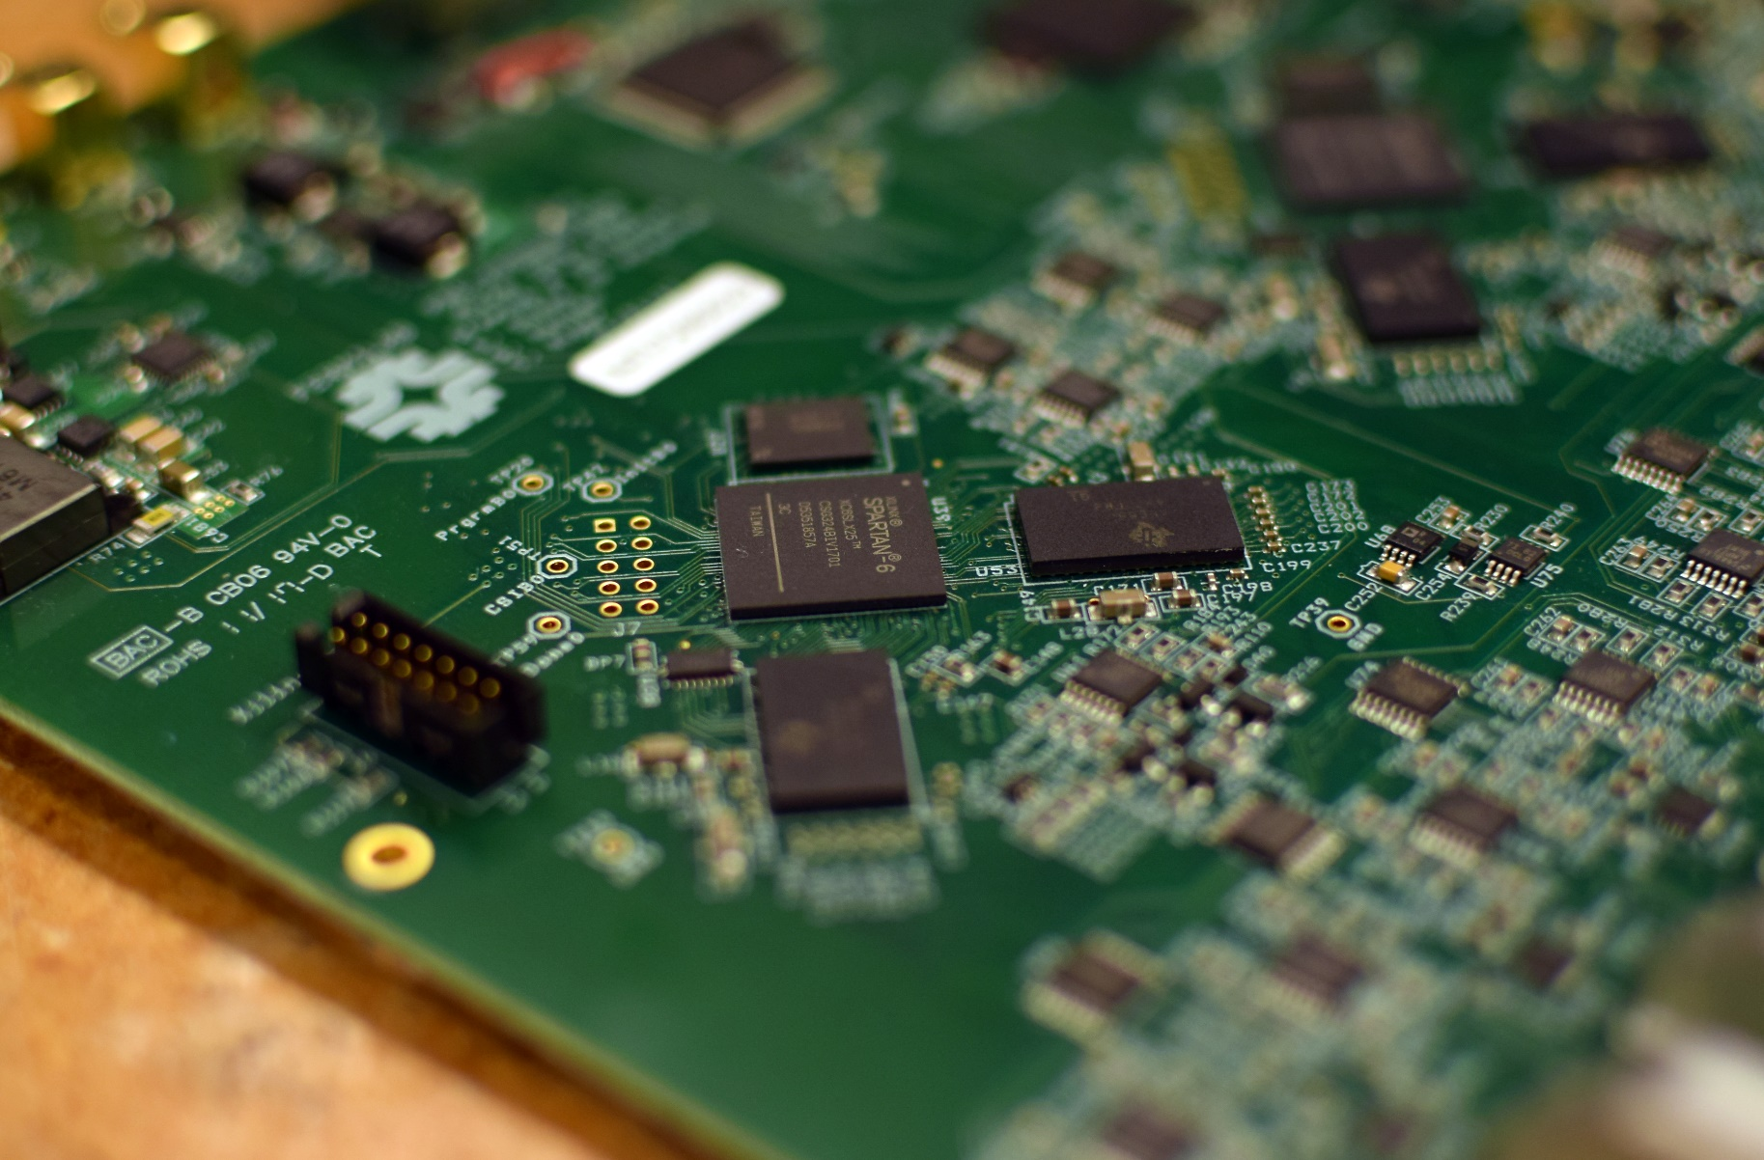
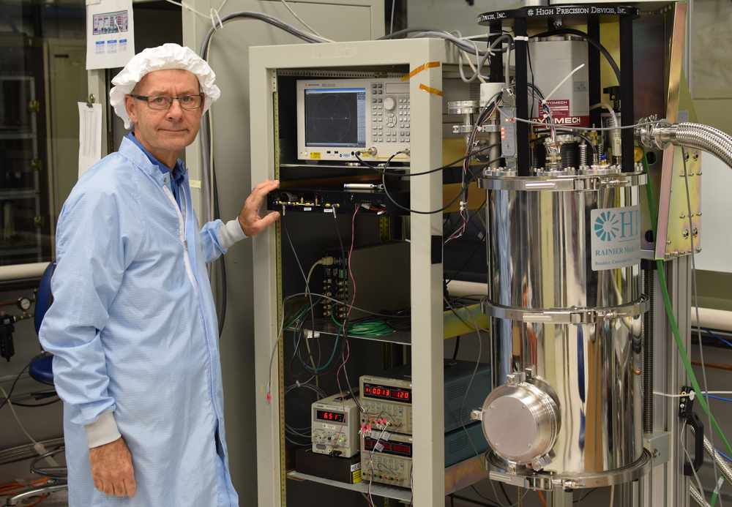
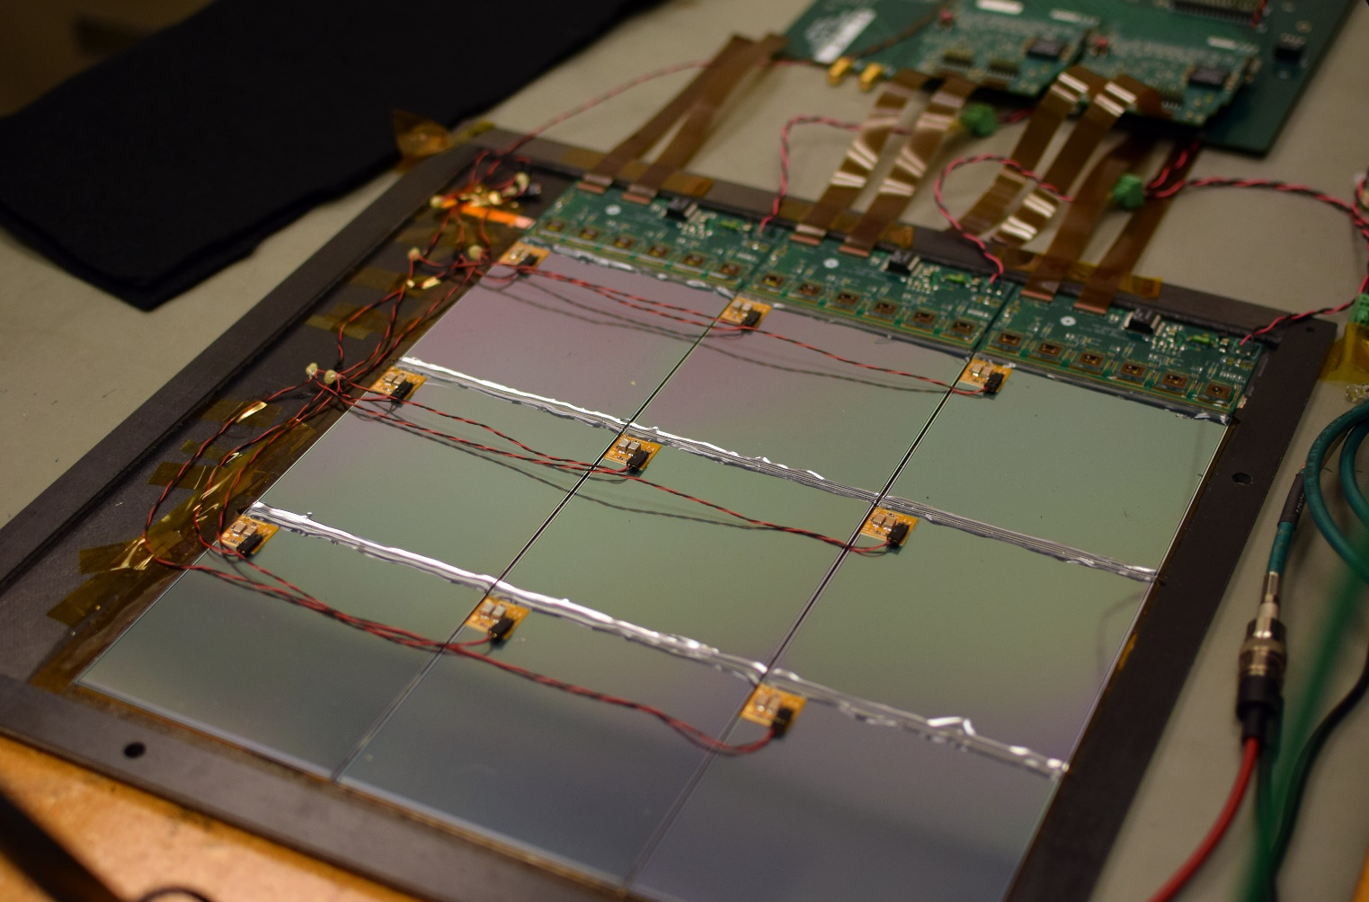
Electrical Engineering: Detector Electronics
Mu2e Cosmic Ray Veto front end boards
CCD characterization for Astrophysics experiments
Jamieson Olsen
Cristinel Gingu
Sten Hansen
Terry Kiper
Sergey Los
Paul Rubinov
Michael Utes
Jin-Yuan Wu
Silicon Muon Scanner

Slide 25
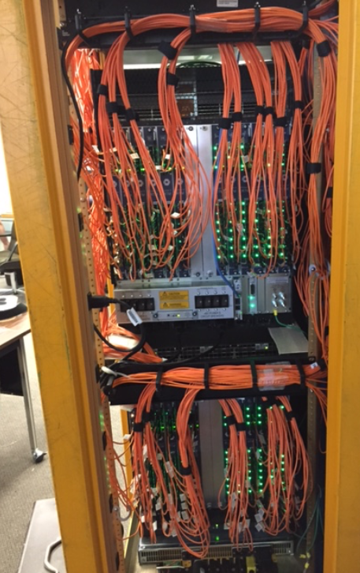
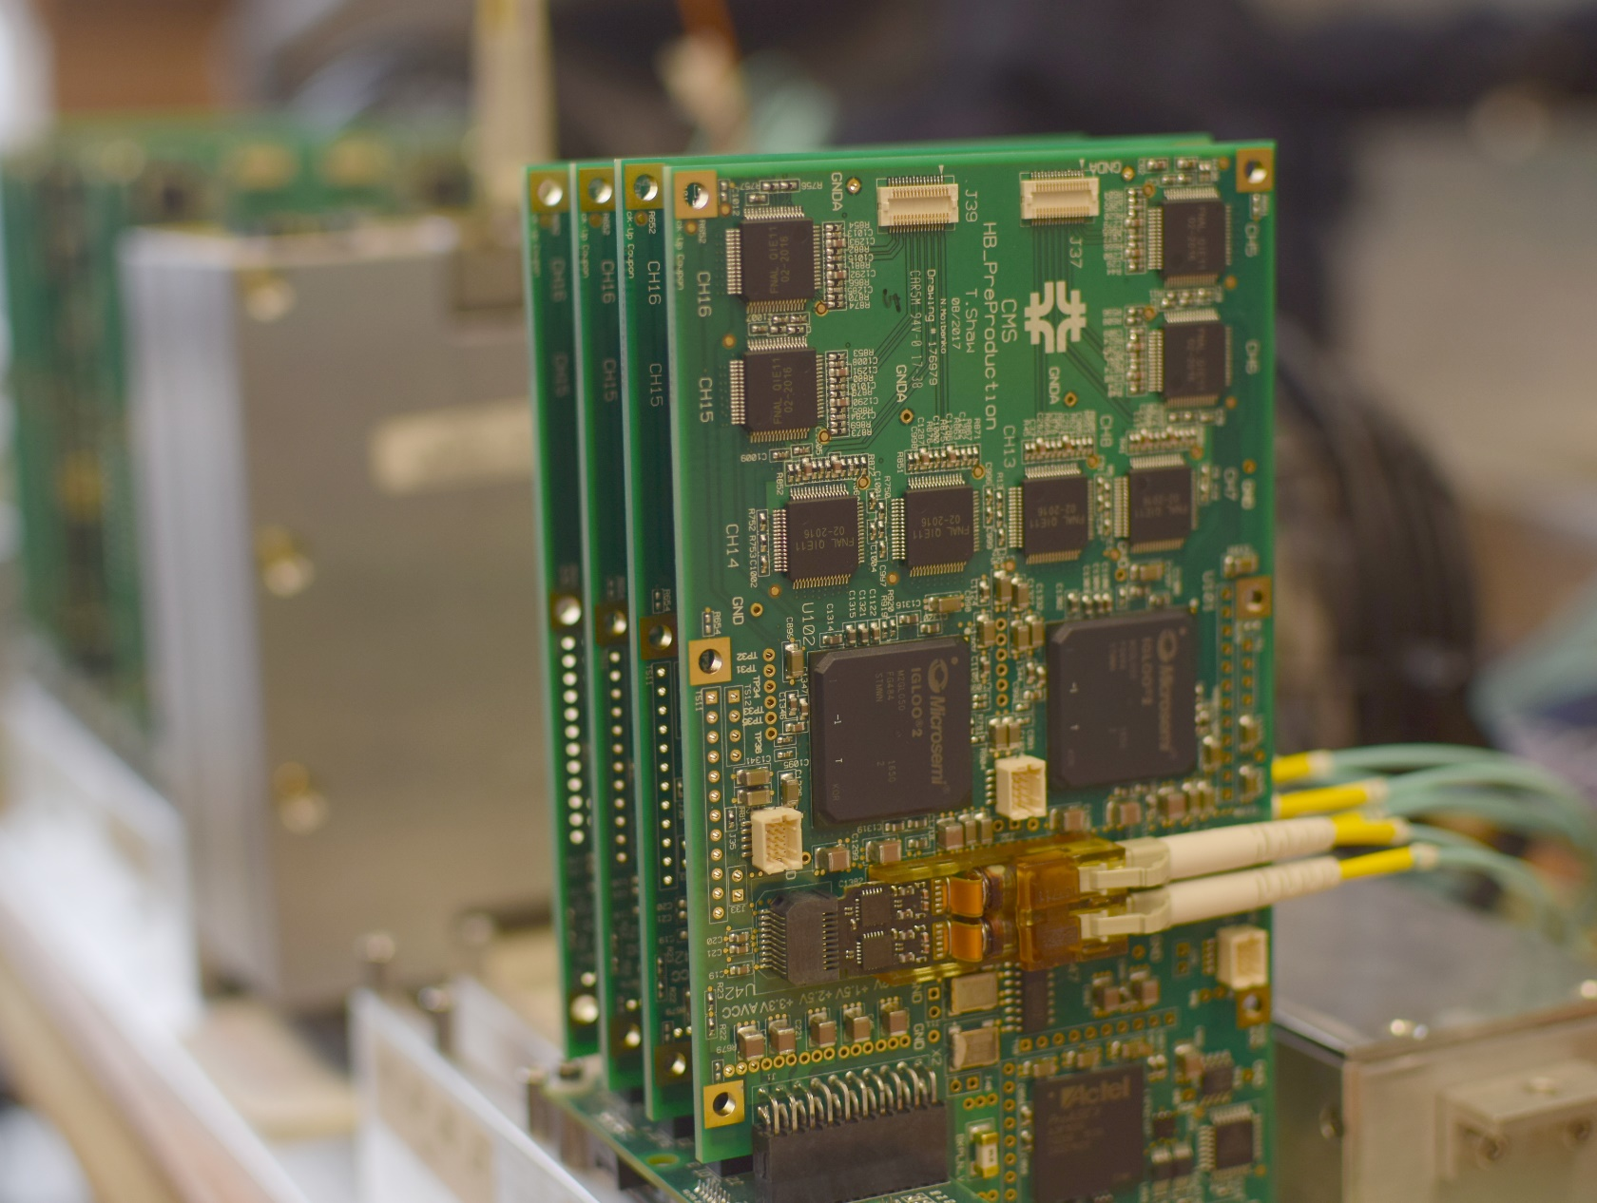
Electrical Engineering: Detector Electronics
CMS
CMS HCAL Front End Electronics –front-end board (using Fermilab designed ASIC), firmware, SiPM control board and custom backplanes
Pattern Recognition and Track Finding Firmware/Hardware

Slide 26
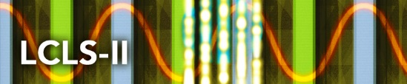







Electrical Engineering: Infrastructure Support
Mike Matulik
Steve Chappa
Arnab Ghosh
David Huffman
Walt Jaskierny
Power supplies, grounding and shielding, cabling, fabrication, etc. for many experiments and other efforts
ICARUS
protoDUNE
PPD / DDOD
CDMS
Fermilab
Astrophysics
ANNIE
Lederman
Science
Center
Fermilab AD
Fermilab ESH&Q
Security
SNOLAB
Fermilab
TD
PPD / EED
ASIC
FTBF
PPD / MED
MINERνA
SMS
LArIAT
DES /
DEC
PPD / DO
SeaQuest

Slide 27
Alignment and Metrology
Works across all divisions and supports the Fermilab user community
  Usually the first in on a project and the last out
    Providing the coordinate information for locating new project construction
    Installing control networks for the positioning of the accelerator components
    Laying out the blue line for support stands to referencing and aligning many beam-guiding and instrumentation components
    Providing as found information to the physics groups
  Operate high precision specialist instrumentation that needs to be kept in proper working condition.

Slide 28
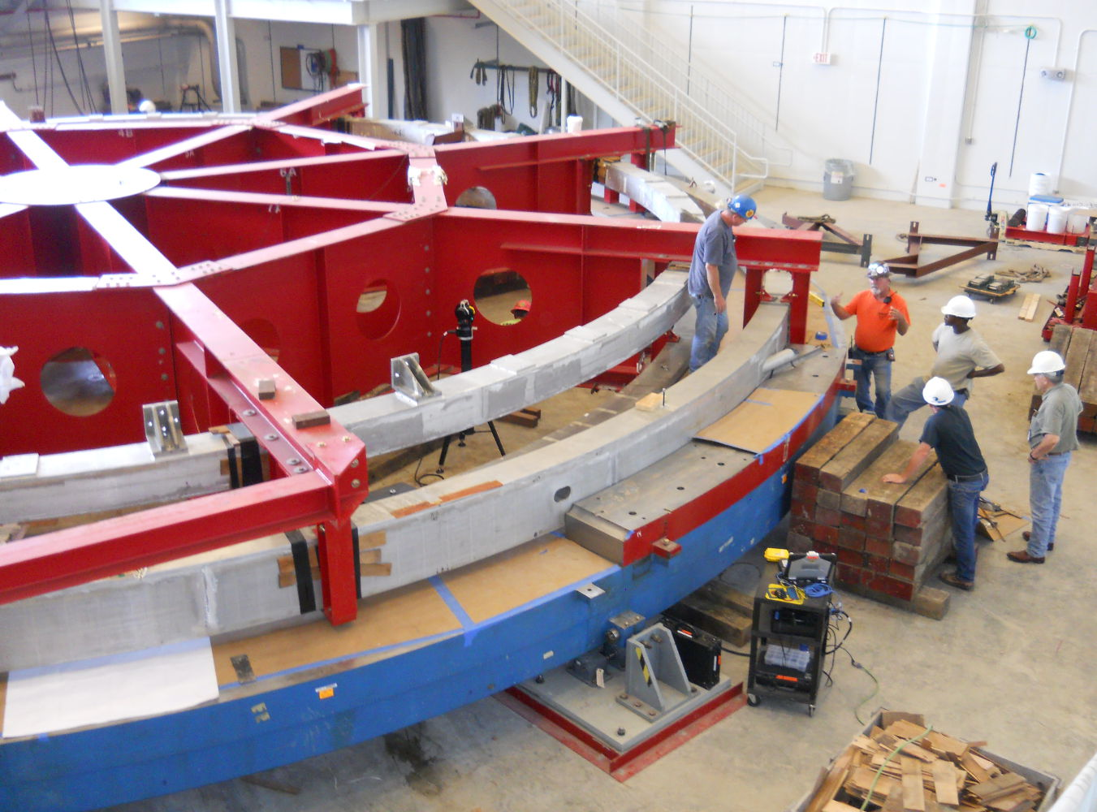
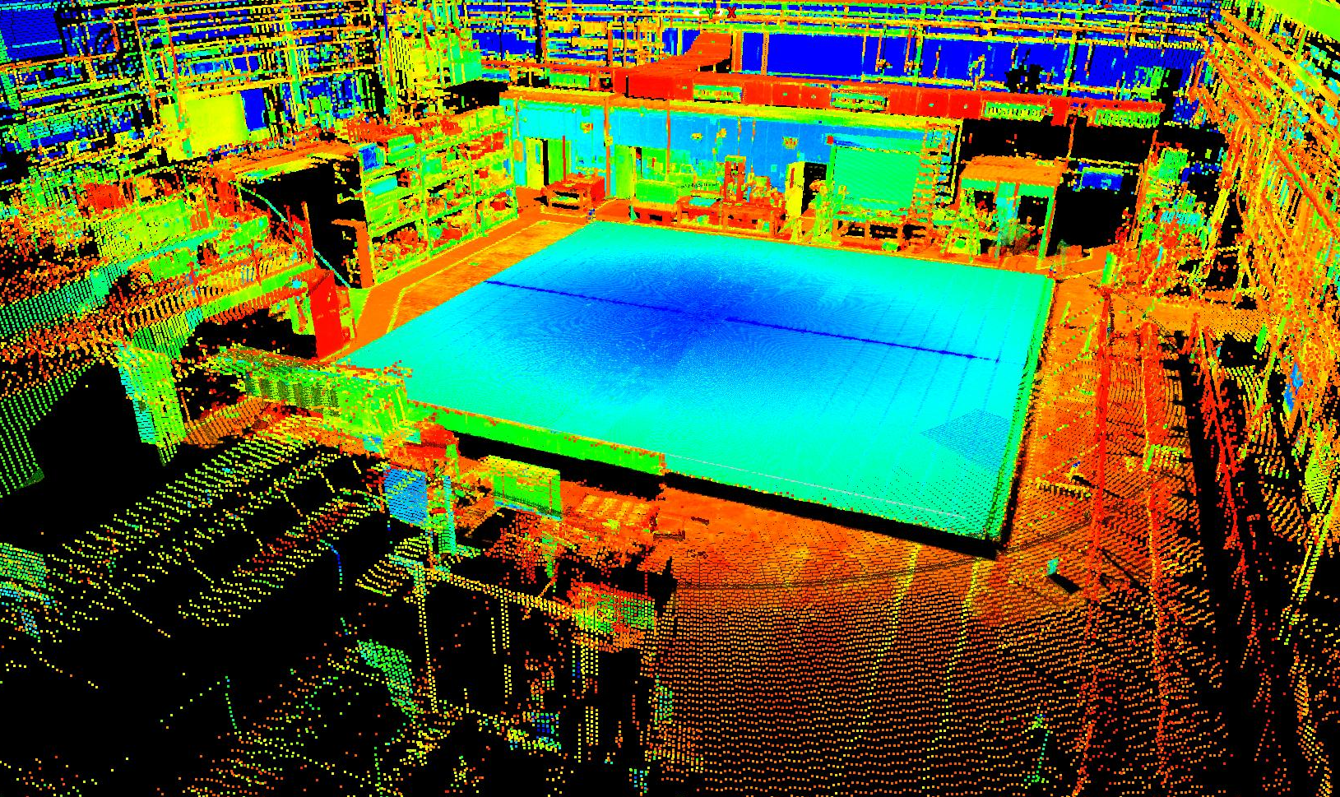
Alignment and Metrology
Horst Friedsam (Dept. Head)
Virgil Bocean
Jana Hejdukova
John Kyle
Babatunde Oshinowo
Laser Scanner test at Argonne of the first NOvA far detector plane
g-2 alignment support

Slide 29
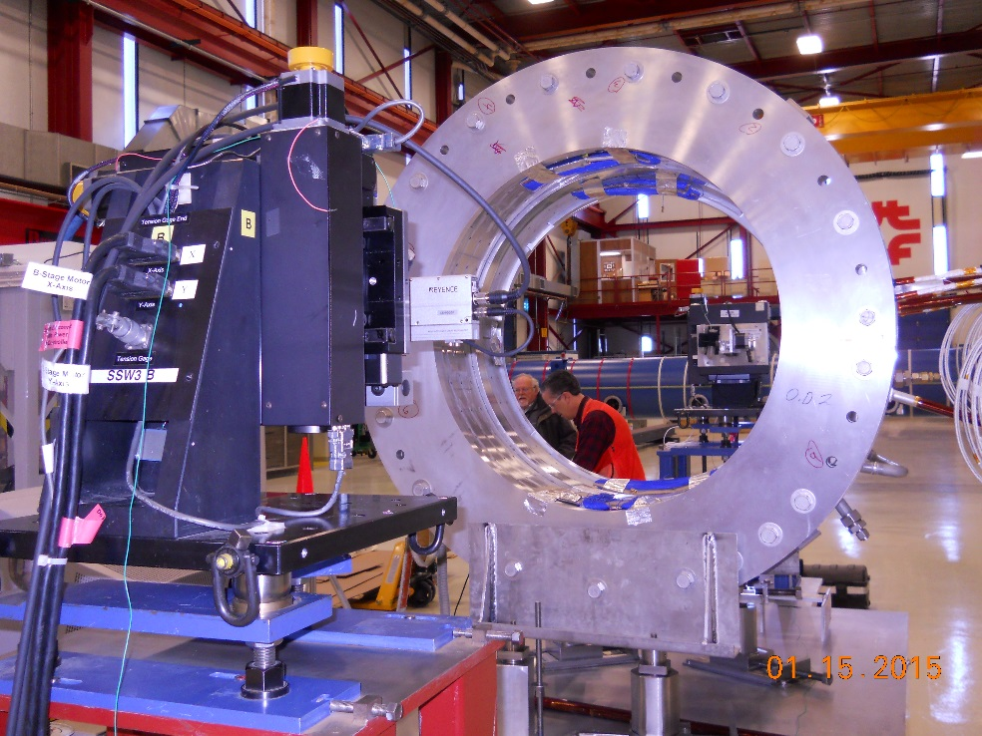
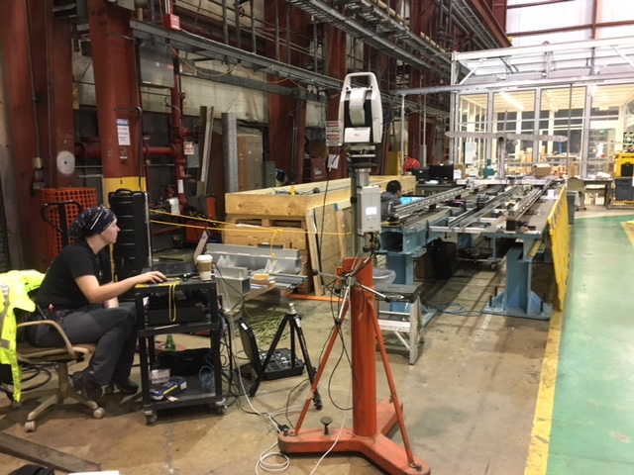
Alignment and Metrology
Mu2e alignment support
Tracking the position of the detector solenoid magnetic field mapper
Alignment support locating the vibrating wire position of the TS prototype

Slide 30
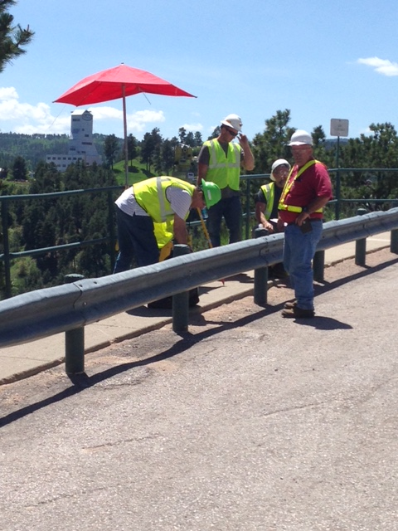
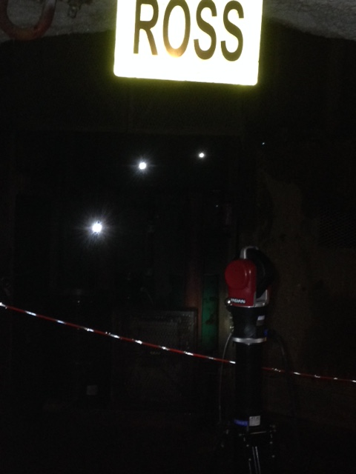
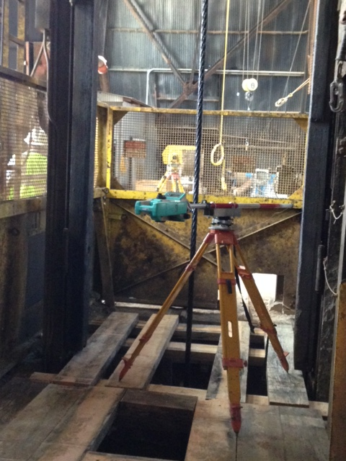
Alignment and Metrology
LBNF/DUNE
Survey party at the home stake mine utilizing a gyroscope to determine the azimuth between two GPS points
Measuring the position of the world longest plumb line at the Ross shaft (1 Mile)
Depth measurement with an electronic distance meter

Slide 31
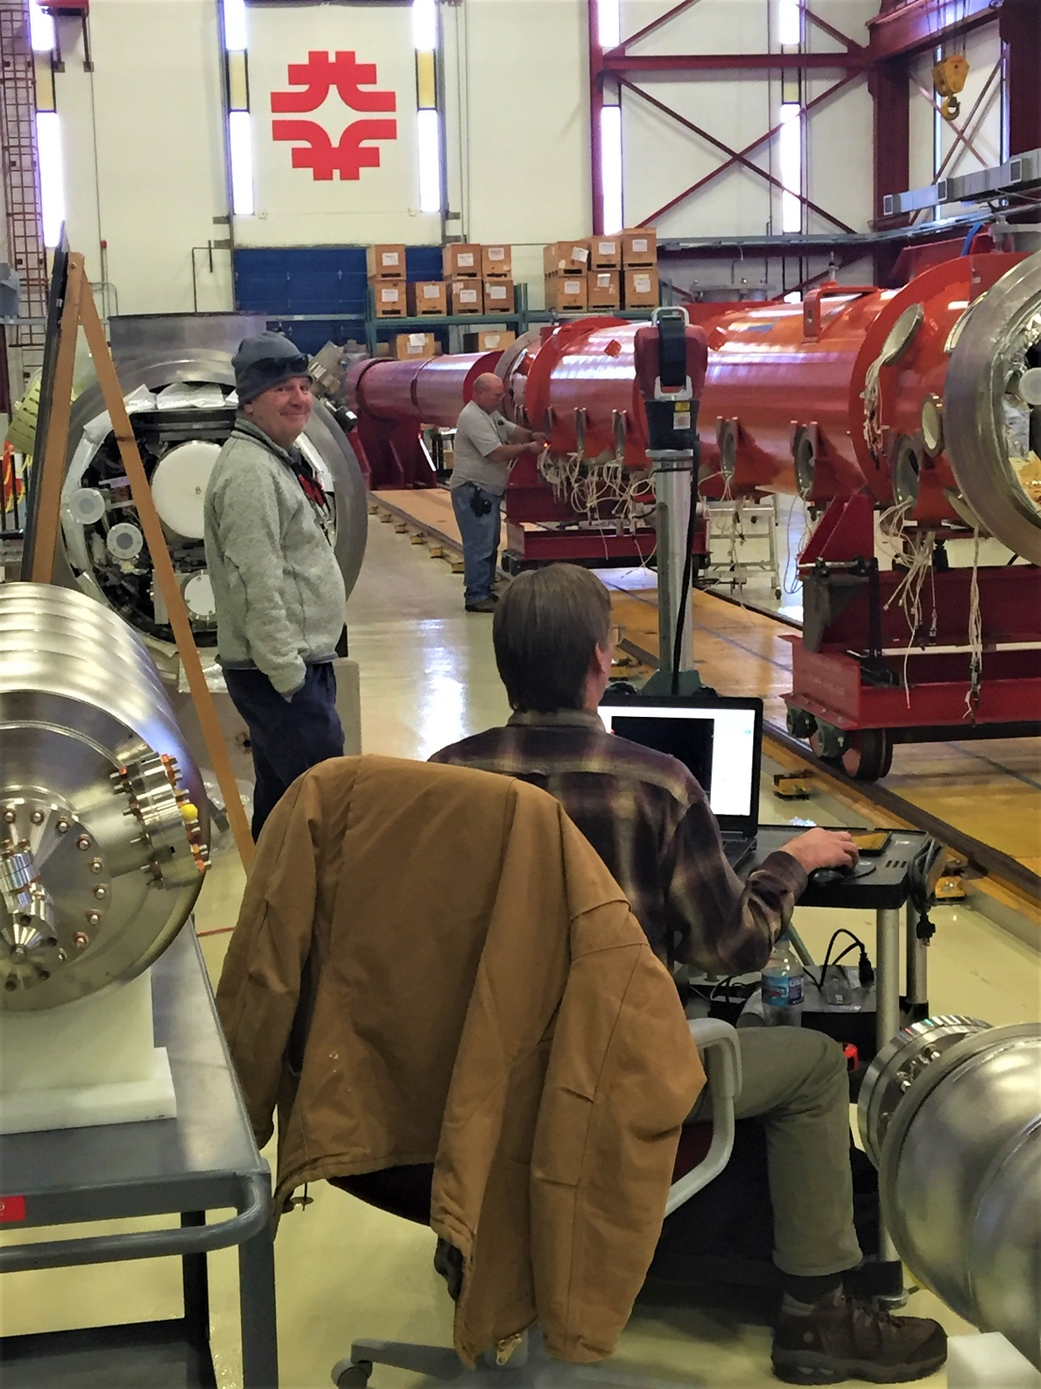
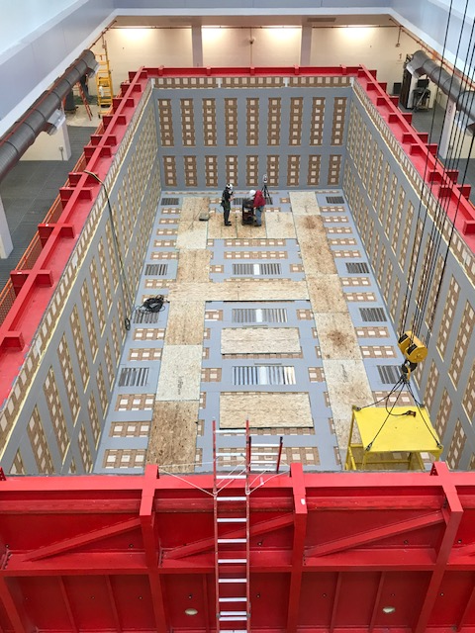
Alignment and Metrology
Short Baseline Neutrino Project (SBN): Deformation measurements load testing the ICARUS support vessel
LCLSII: Laser Tracker measurements

Slide 32
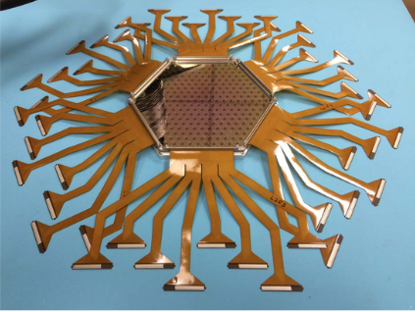
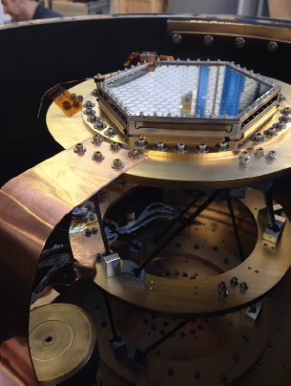
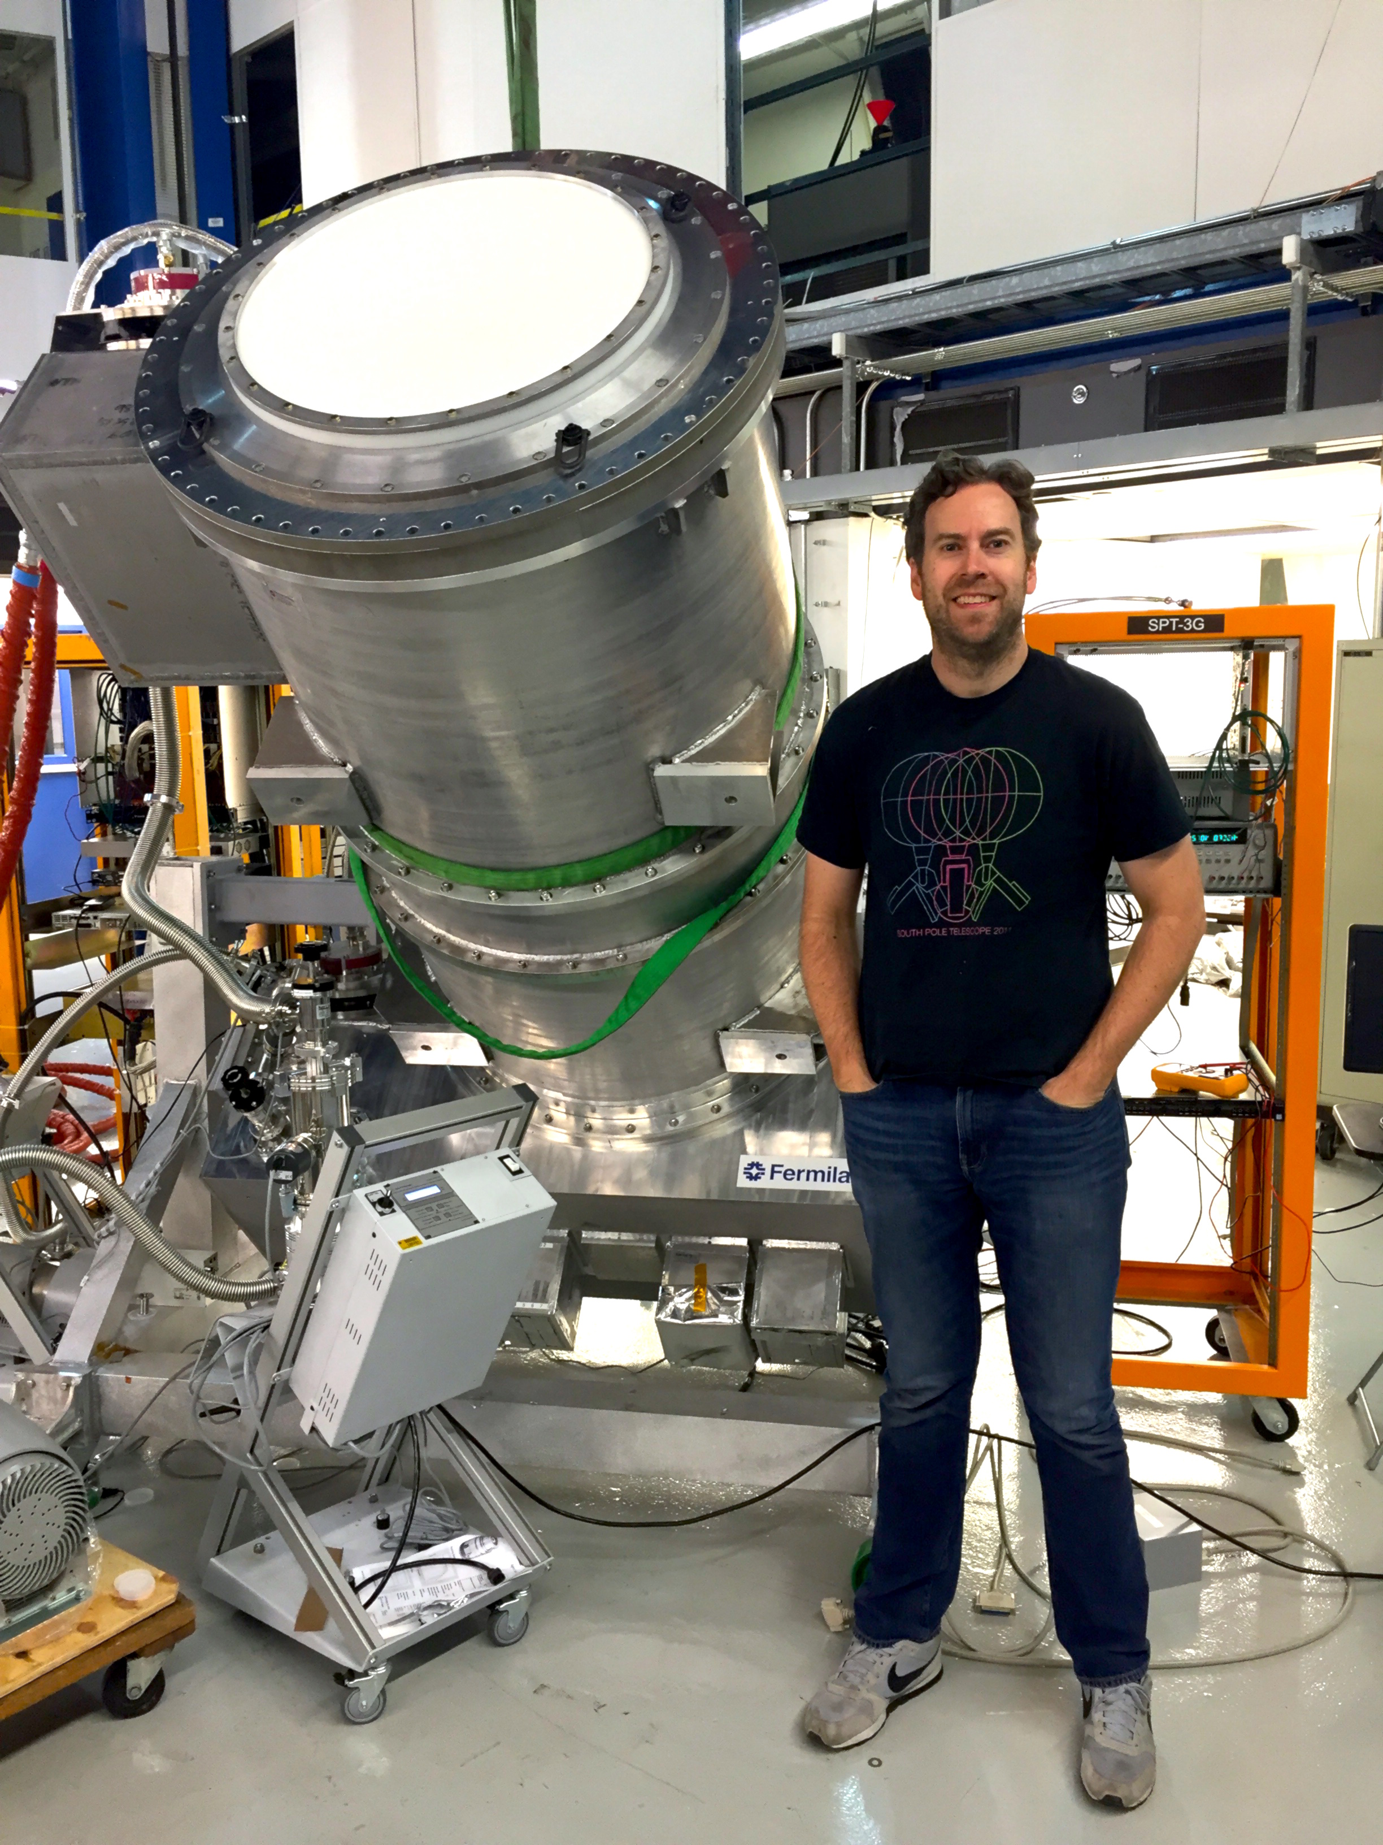
Detector Operations and Development Department
Rick Ford (Dept. Head)
Eileen Hahn
Donna Kubik
Mike Roman
Greg Sellberg
Ewa Skup
Jerry Zimmerman
Engineering Physicists develop and construct novel particle detectors
  Silicon Detector Facility
Detector assembly
Detector testing
Cryostat assembly/testing
SPT-3G deployed a new receiver on the 10-meter South Pole Telescope to study the Cosmic Microwave Background. The receiver comprises ~2700 dual-polarization multichroic pixels each pixel with broadband microwave antenna.

Slide 33
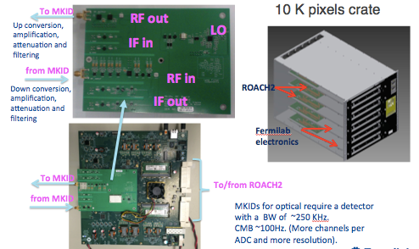
Detector Operations and Development Department
Cosmic Microwave Background (CMB) detectors of the future
  An example of cross-divisional engineering
We are studying MKIDs (Microwave Kinetic Induction Detectors) as potential microwave detectors for future CMB arrays.
The associated electronics we are testing is called FMESSI (Frequency Multiplexed Electronics for Superconducting Sensor Instrumentation), developed by Gustavo Cancelo’s group at FNAL.

Slide 34
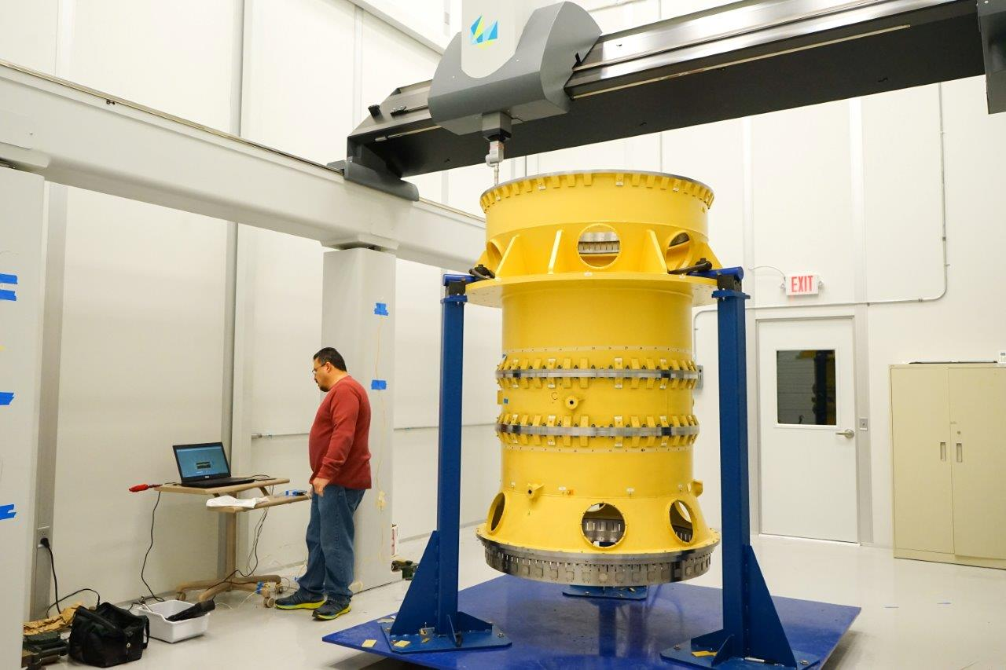
Detector Operations and Development Department
Precision Metrology
  Assembly and measurement of DESI barrel that supports telescope optics

Slide 35


Detector Operations and Development Department
Advanced Detectors
  Assembly and polishing of optical fibers
  Advanced coatings
Arapucas for ProtoDUNE

Slide 36




Detector Operations and Development Department
Fermilab Test Beam Facility
  Operate beamline instrumentation
  Assist users in mounting their experiments

Slide 37

Detector Operations and Development Department
Mr. Freeze

