Slide 1
Accelerator Division Engineering
Paul C. Czarapata
Engineering Retreat
20 February 2018

Slide 2
Organization
Engineering organized by function – report to PCC in HQ
Some embedded engineers and techs in machine departments i.e. Linac, Booster, FAST/IOTA
  Accelerator Controls – James Patrick
  E/E Support Department – Chris Jensen
  Engineering Support – James Ranson
  Instrumentation Department – Craig Drennan
  Mechanical Support Department – Mayling Wong-Squires
  RF Department – John Reid
  Target Systems Department – Bob Zwaska
      Cryogenics – consolidated in Technical Division
      Interlocks – consolidated in ESH&Q

Slide 3
Engineering and Technical in AD = 206
 | E/E | Eng Assoc | E-tech | IT | ME | Mtech | Ops Spec | Eng Phy | App Phy
APC-IOTA/FAST
 |  |  | 2 |  |  | 1 |  | 2
APC-Modeling
 |  |  |  | 1
AD-Controls
 | 6 |  | 6 | 26 |  |  |  | 2 | 1
AD-EE Support
 | 6 | 2 | 21 | 1 |  | 1 | 4
AD-Instrumentation
 | 8 | 2 | 7 | 2 |  |  | 1 | 1
AD-Mechanical Support
 |  | 3 |  | 1 | 17 | 26 | 3
AD-PIP-II
 | 1 |  |  |  | 1
AD-Proton Source
 | 3 | 1 | 6 | 1 |  |  | 3
AD-RF
 | 11 |  | 8 |  |  |  | 2
AD-Target Systems Dept
 |  |  |  |  | 8 | 8
Totals | 35 | 8 | 50 | 32 | 26 | 36 | 13 | 5 | 1

Slide 4
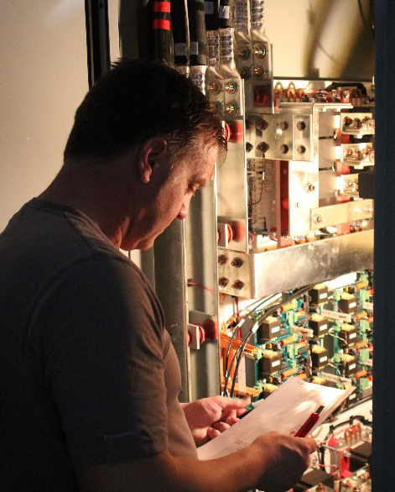
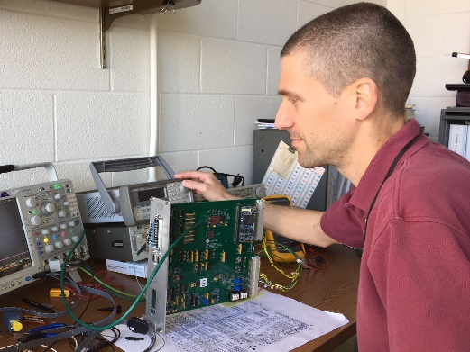
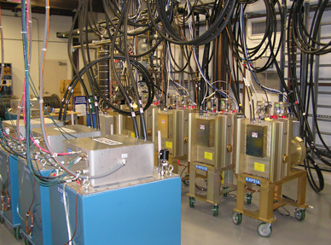
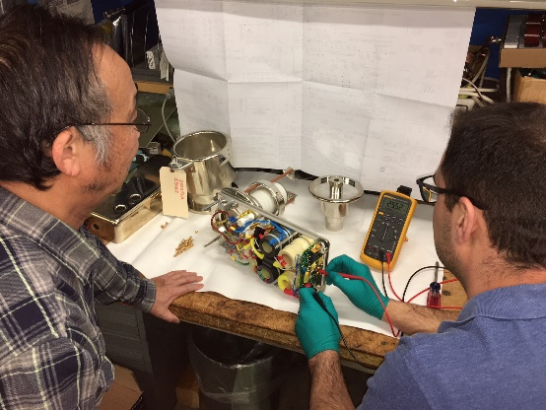
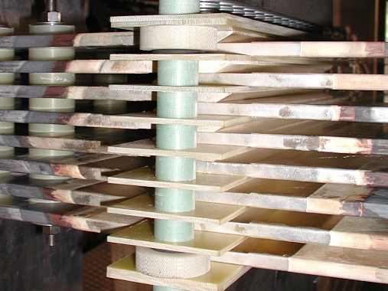
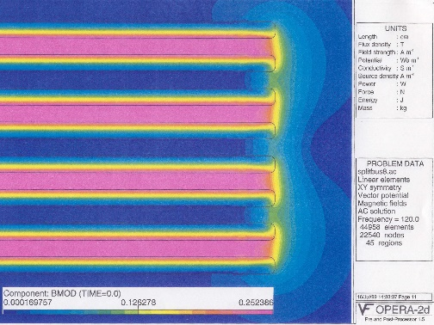
AD/EE Support – Power Supplies from DC to ns, W to MW
Kickers provides 30 kV, 1000 kA, 1.6 us wide pulses to deflect beam onto orbit. Hydrogen gas switch voltage rise is 30 kV in 20 ns into 50 Ohm resistor
Computer and Field Programmable Gate Array control of large power supplies, 50 ppm regulation of 1200 A, learning systems
Lend assistance to various other groups with respect to high voltage, high current and high speed power supplies
Circuit Simulation and EM field simulation
(NuMI Stripline, 200 kA, low inductance )

Slide 5
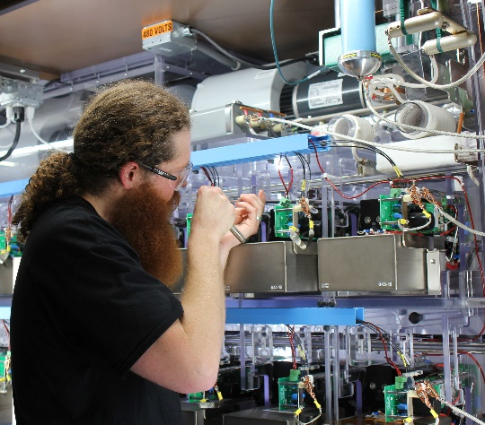
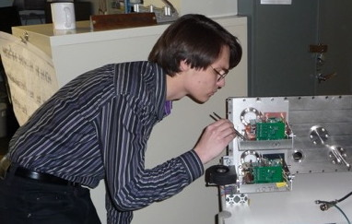
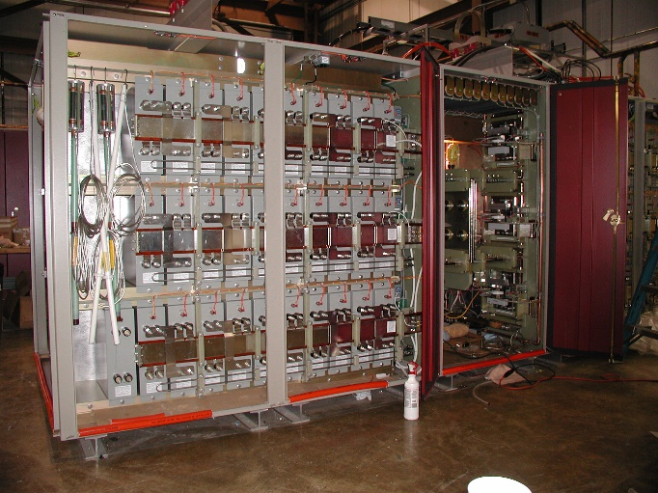
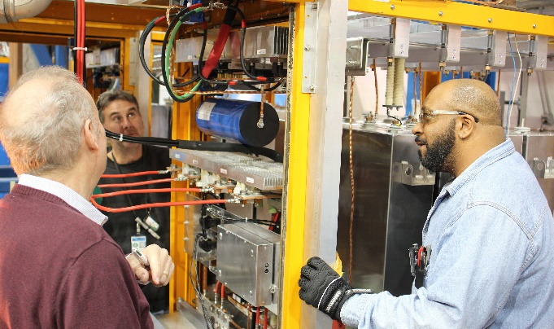
AD/EE Support – Power Supplies from DC to ns, kW to MW
Marx Modulator provides a 30 kV, 300 A,
200 us wide pulse 15 times a second to the RF amplifier tube to accelerate beam
PIP II Chopper provides 500 V, 2 ns rise and fall time arbitrary pulse pattern at 38 MHz repetition rate to deflect beam
NuMI horn ps provides 700 V, 200 kA, 2 ms wide pulse every 1.33 seconds to focus beam
Pbar lens provides 1 kV, 25 kA, 400 us wide pulse 8 times in 80 ms to drive focusing and collecting lens after target

Slide 6
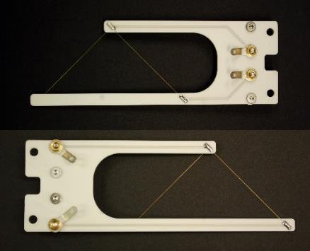
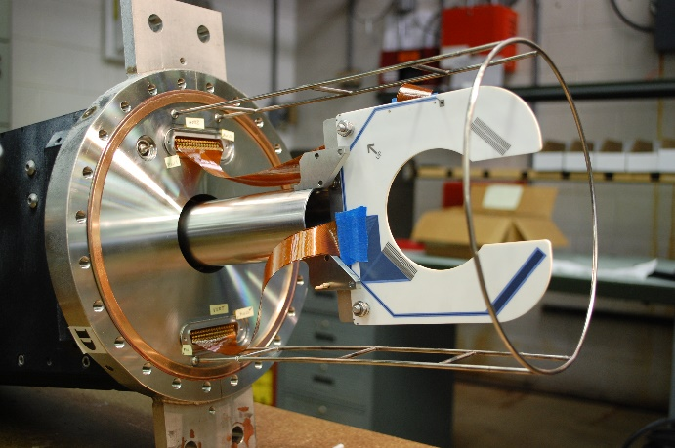
Multiwire SEM Profile Monitors
Dan Schoo
UT/Austin Multiwire Rebuild
Retired multiwire detectors outfitted with new ceramic wireplanes, motors and controls for use in Mu2e beamlines.
At a small fraction of the cost of construction for new detectors saving more than $150K in detector costs.
New Design Crawling Wire for PIP2-IT
Ceramic wireplane frame design and assembly for crawling wire
Additional Projects
Ceramic wireplanes custom designed for JPARK in Japan.
Custom designs for Finland laboratory.

Slide 7
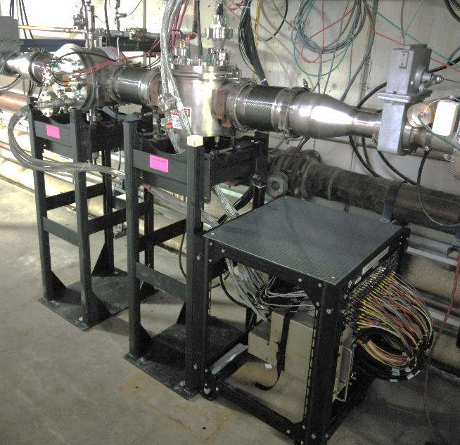
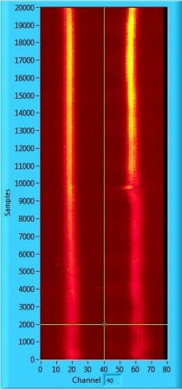
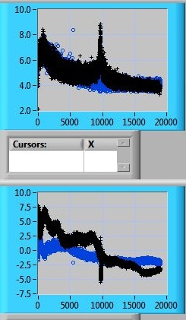
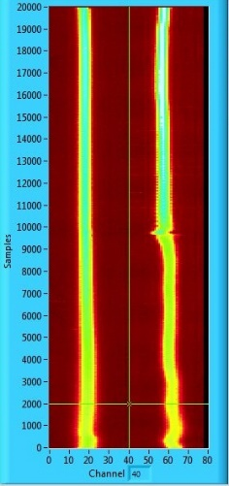
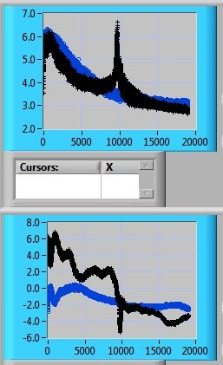
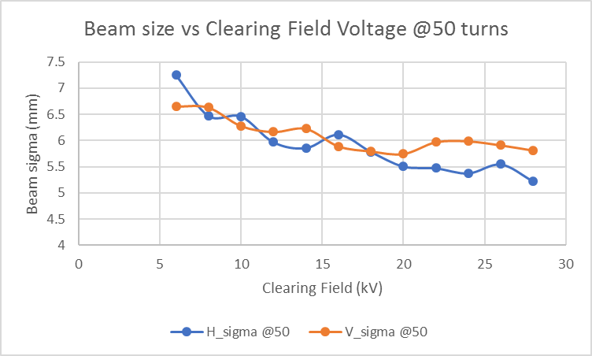
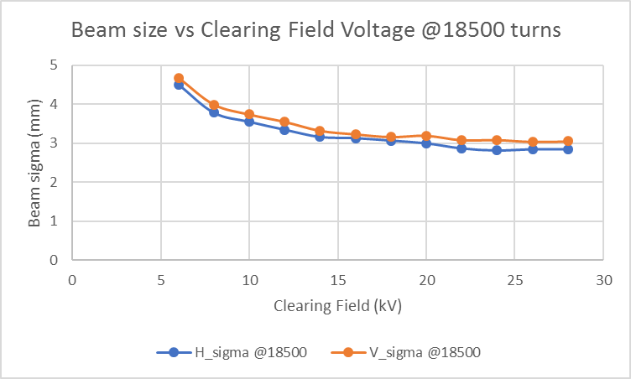
Booster Long 4 IPM Installation
Beam profile, sigma, and position
measurement with 8 kV clearing field
Beam profile, sigma, and position
measurement with 24 kV clearing field
Installation of vertical and horizontal IPMs at Long 4
-30 kV electrostatic IPMs have been installed and commissioned in the Booster
-40 channels per plane
-Increased accuracy of measurement at higher beam energy compared to 8 kV IPM, due to noticeable effect of space charge with lower clearing field voltage

Slide 8
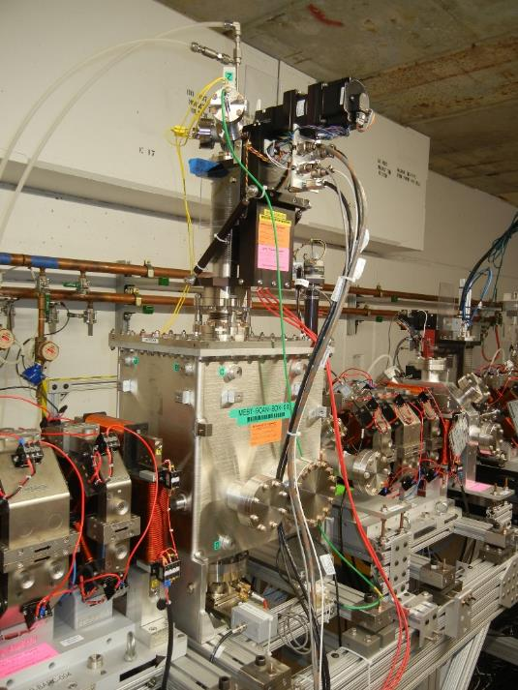
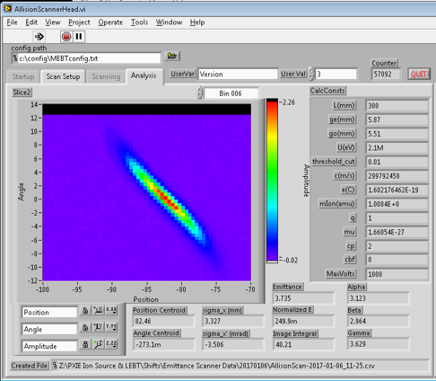
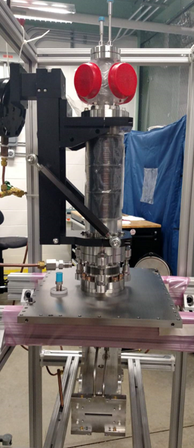
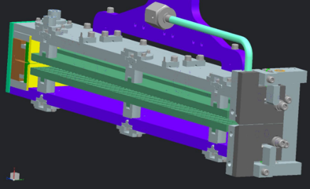
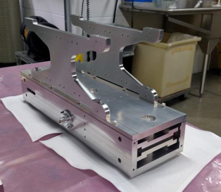
Allison-Style Emittance Scanner for PIP2IT MEBT – Blend of Instrumentation, Mechanical Engineering and PIP-II Departments
Emittance measurements of 2.1 MeV H- beam
Installed in PIP2IT beamline
CAD Design
Scanner with motion drive
Software display for emittance scanner – First data
Scanner Head
Vic Scarpine

Slide 9
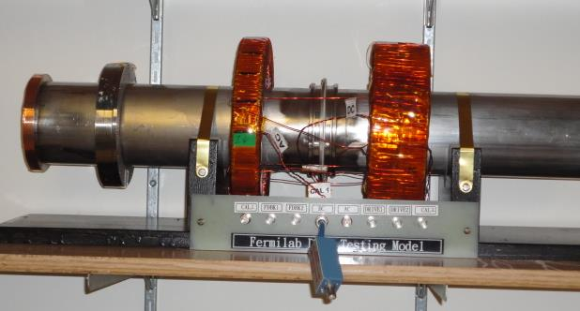
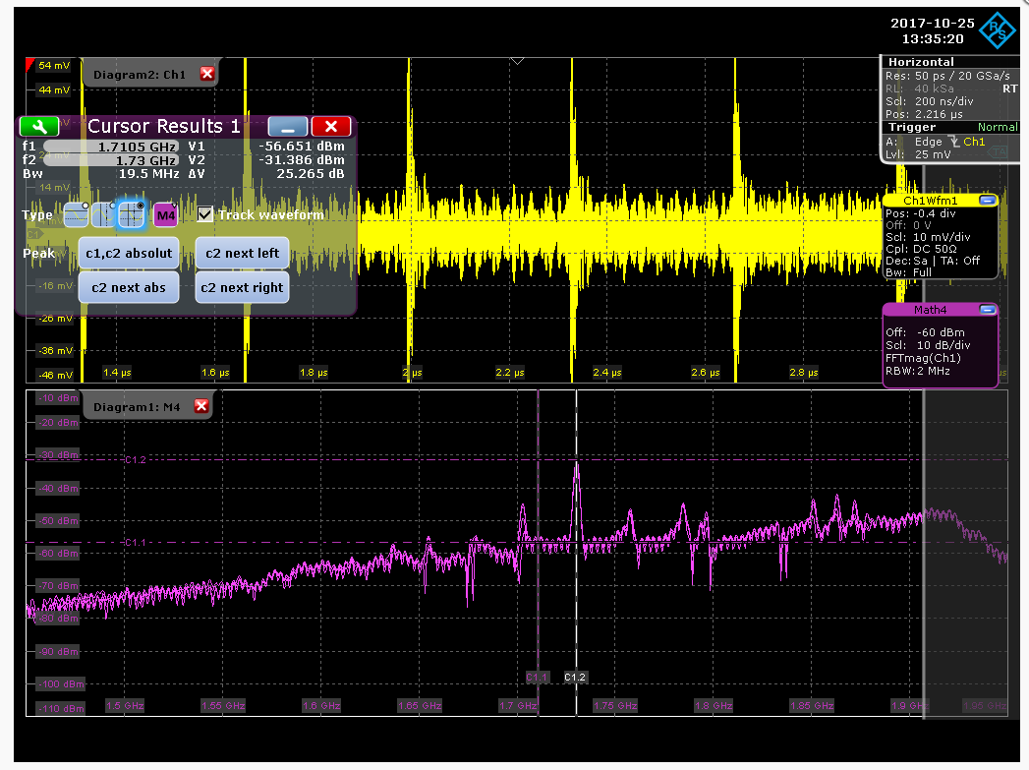
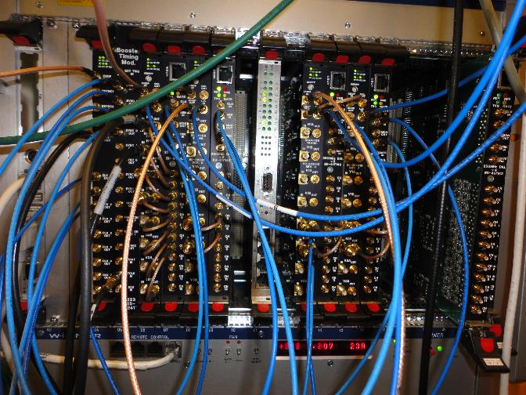
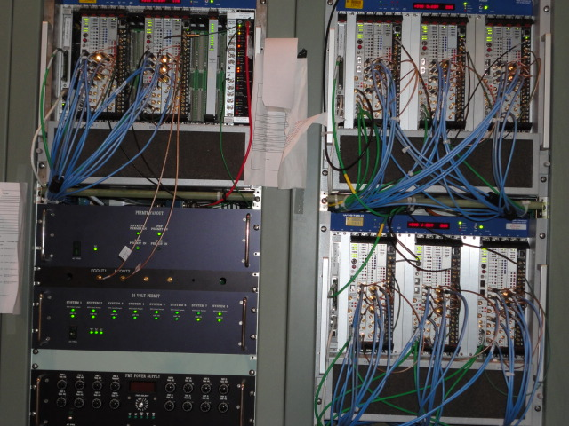
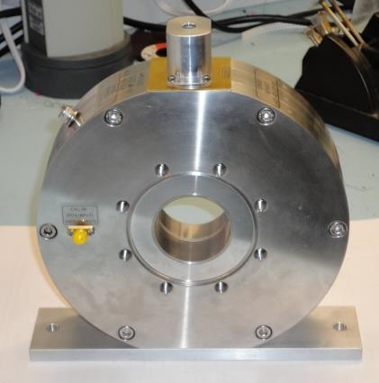
Peter Prieto
DCCT Test setup to implement Digital Feedback DCCT in RR
HOM Coupler Measurements at FAST resolved 1.71 GHz Mode
New Booster BPM timing and digitizers installed
RF Interlocks at LCLS-II
Beam Pickup for FAST Beam

Slide 10
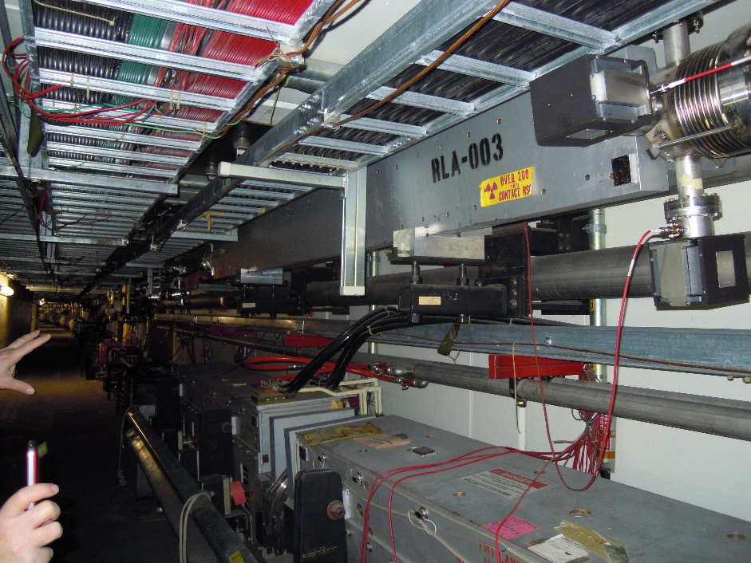
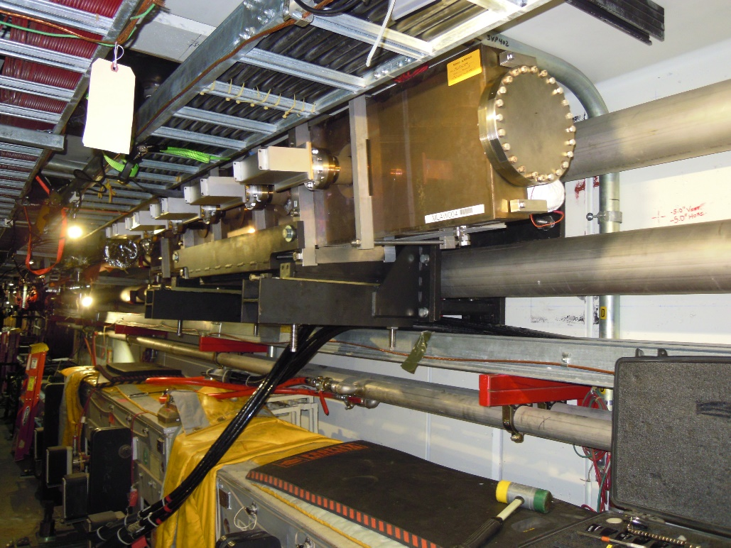
Highlights – Accelerator Complex Mech Support.
Old Lambertson: removal planning,
taking into account tight space and
heavy load (5000-lb); stand design
planning (6 degrees of freedom,
+/- 1° rotation, +/-1-inch lateral, built
around LCW piping)
New Lambertson: installed
safely in a high radiation area,
involving AD and PPD Engineers and technicians

Slide 11
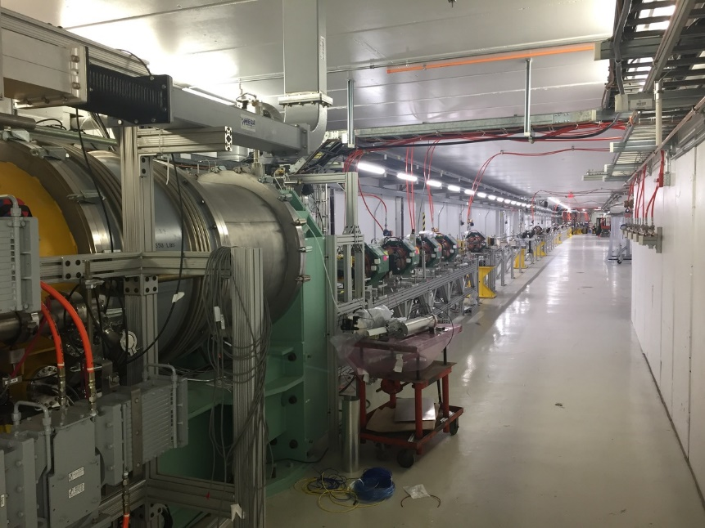
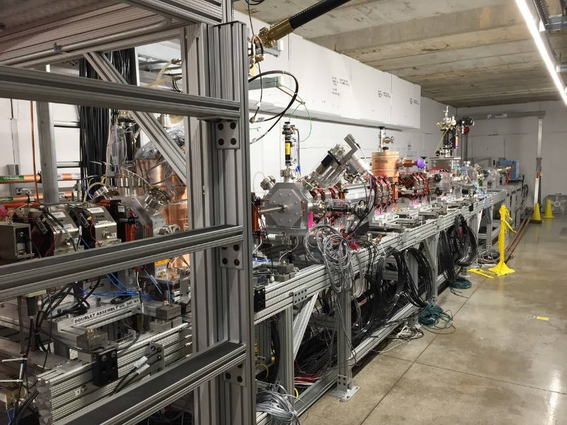
Highlights – Test Facilities (cont’d)
New FAST beamline extended
beyond cryomodule
PIP2IT’s MEBT

Slide 12
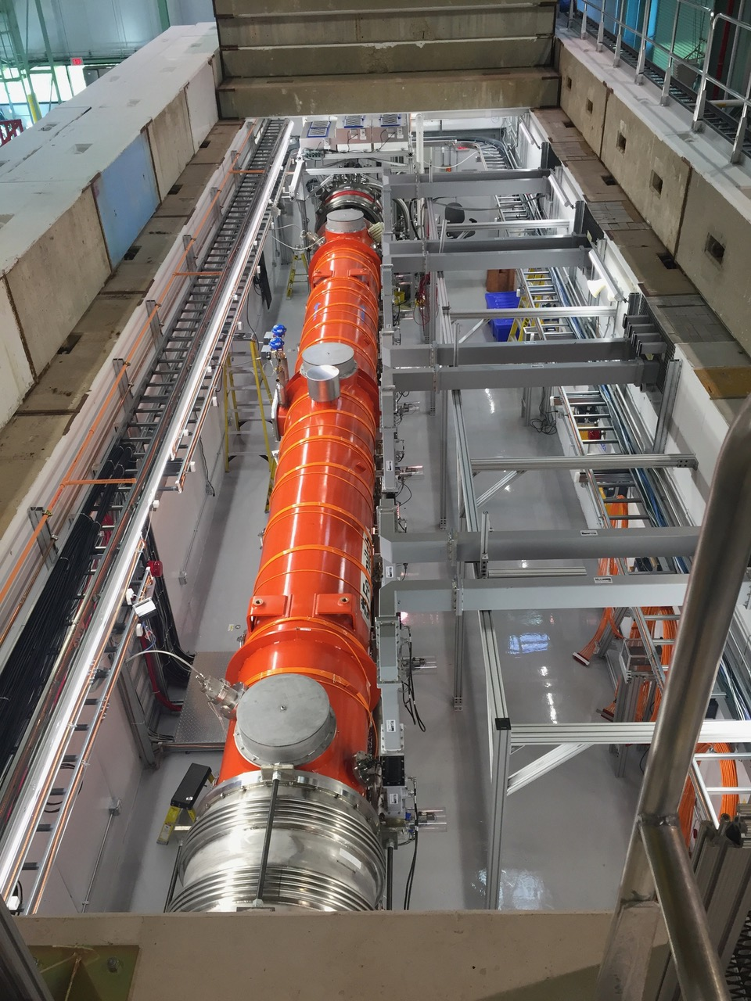
Highlight – Test Facilities (cont’d)
CMTS: Completed testing of 8
LCLS-II cryomodules

Slide 13
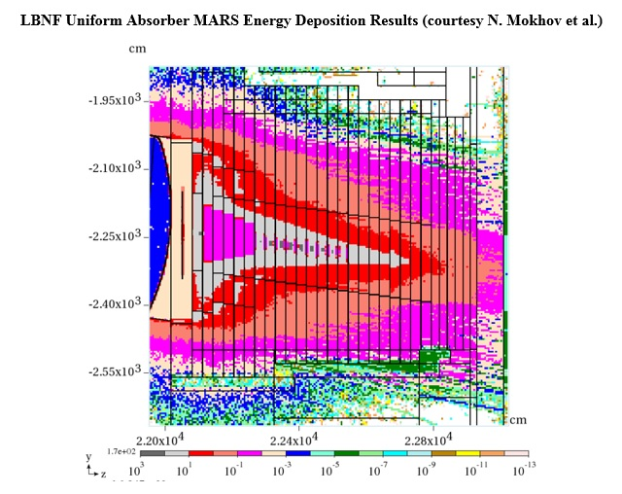
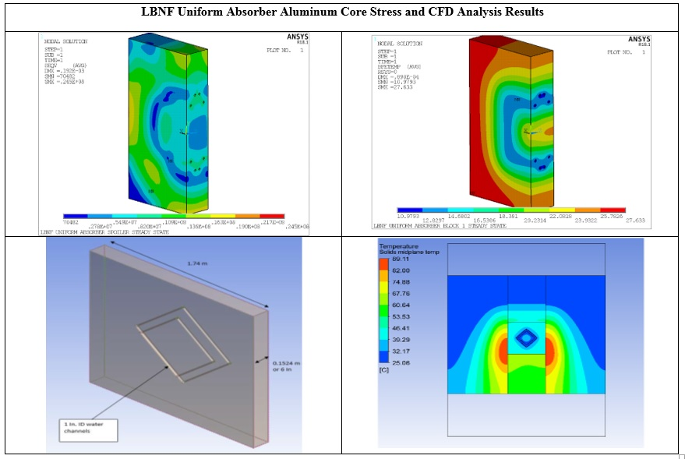
Highlights – LBNF (cont’d)
Uniform Hadron Absorber: Analyze aluminum core stress and CFD, based on MARS energy deposition simulation results

Slide 14
Highlights – LBNF (cont’d)
The Target Hall Shield Pile of the Long Baseline Neutrino Facility is being redesigned to have a uniform slope. This will allow for greater reconfigurability and more effective shielding while using 100 tons less steel

Slide 15
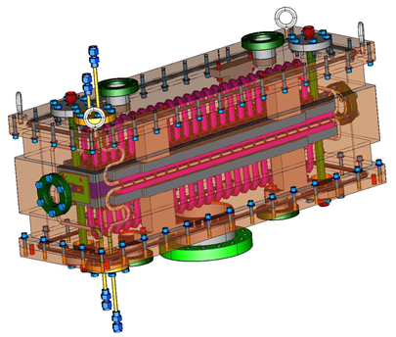
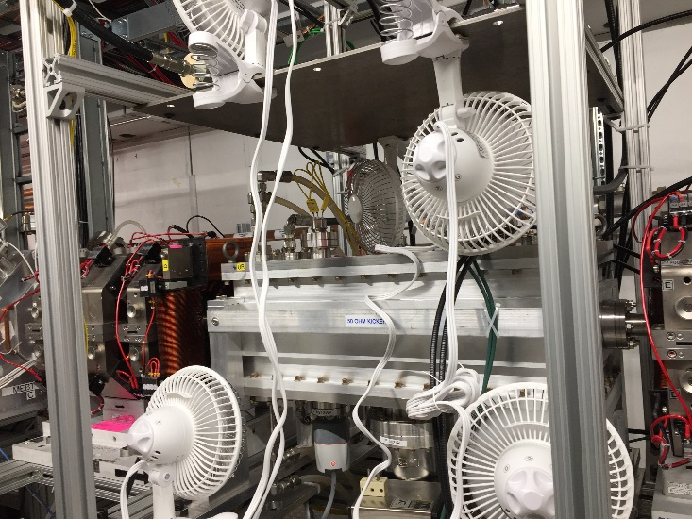
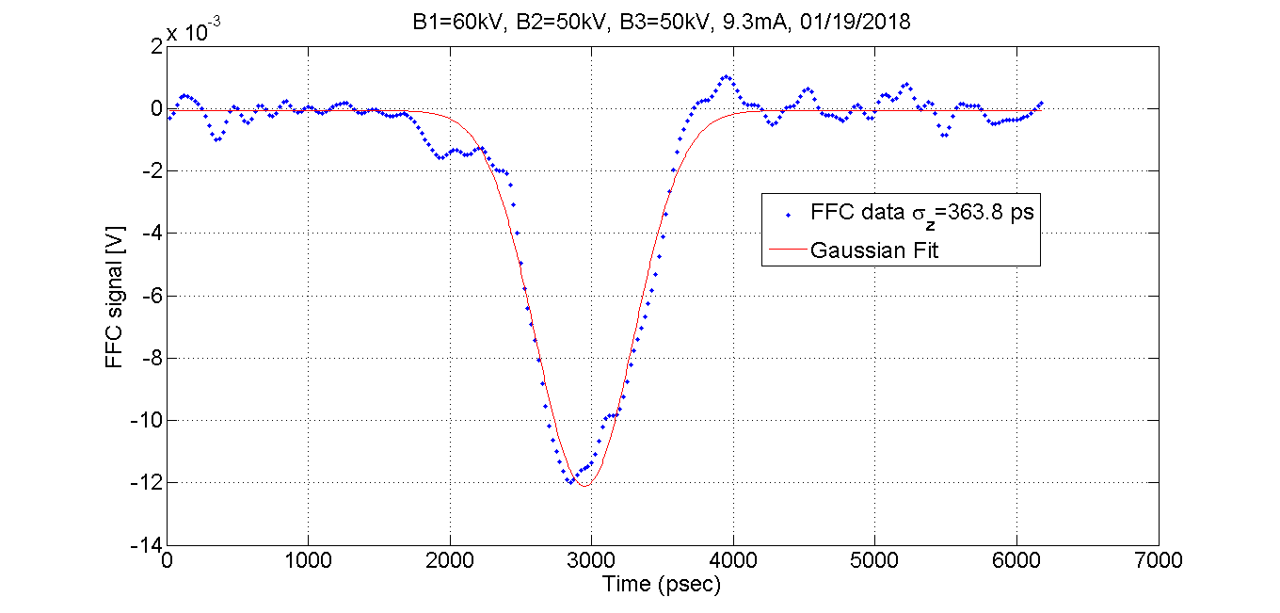
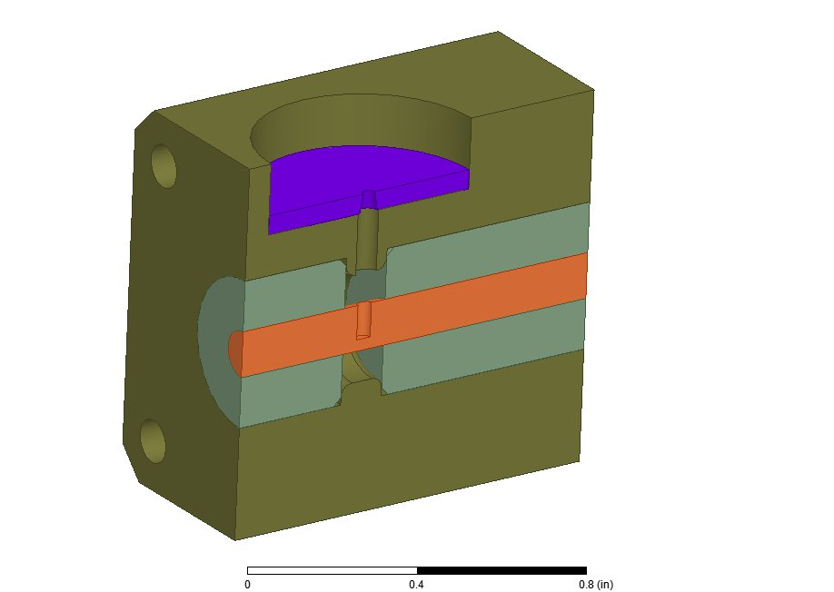
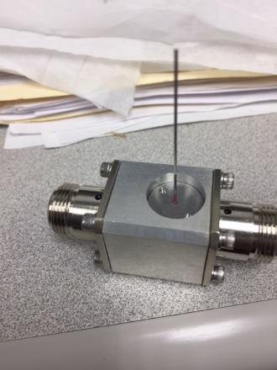
RF Department
PIP-II 50 Ohm Fast kicker – Installed at CMTF
Features:
Shielded 50 Ohm delay lines
Minimized coupling between delay lines
Reduce dispersion > bandwidth
Fast rise time & less distortion
470pSec rise time
Uses commercial amplifiers
PIP-II Fast Faraday Cup (FFC)
Gaussian Fit from FFC &
estimate of RMS bunch length

Slide 16
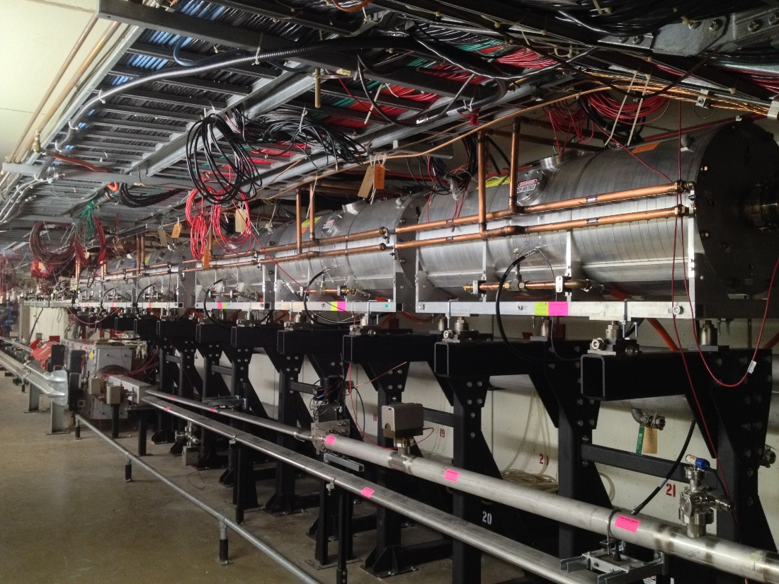
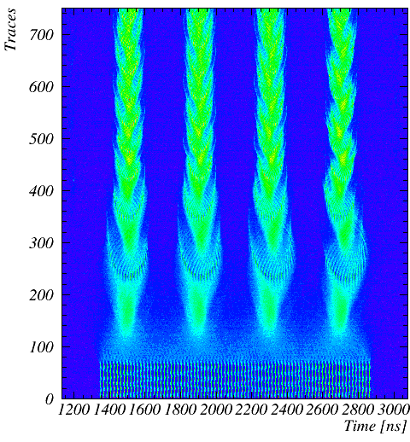
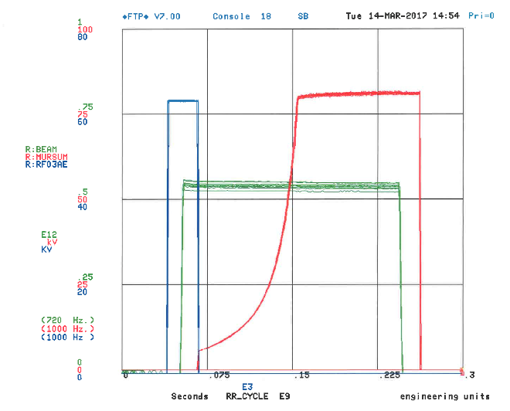
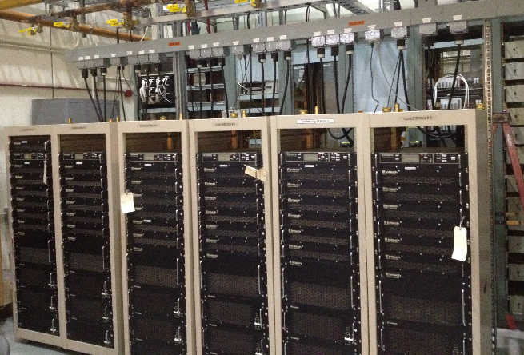
RF Department
Creating Four 2.5 MHz Bunches from
One Booster Batch in the Recycler
Six 2.5 MHz Recycler Cavities at MI-30
Adiabatic 2.5 MHz
Recycler
53 MHz
Six 2.5 MHz Solid-State
Amplifiers at MI-31
Recycler Beam

Slide 17
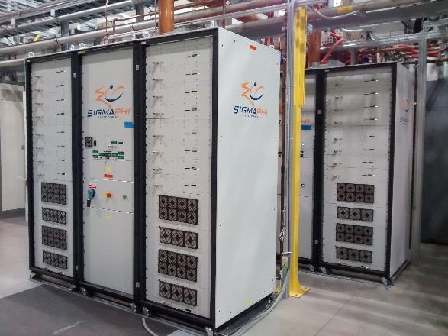
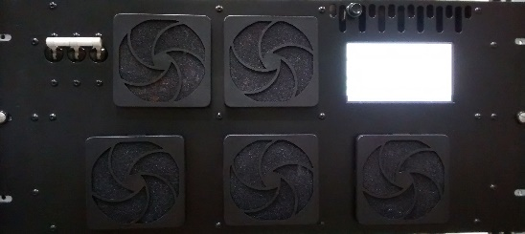
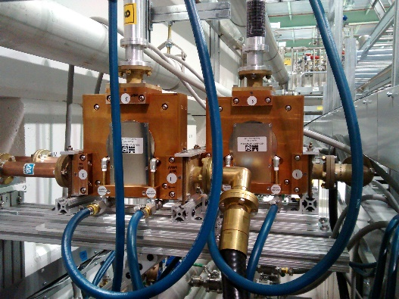
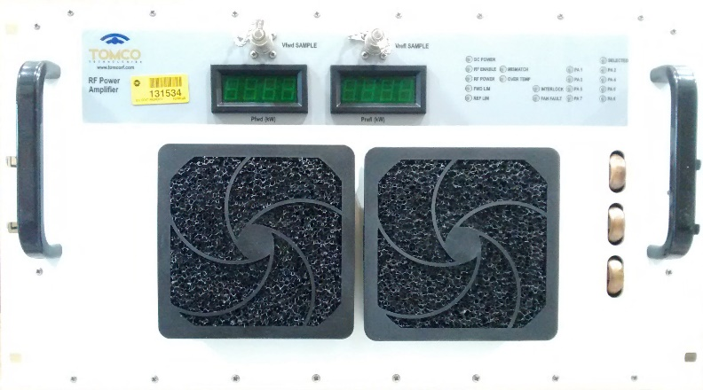
RF Department
PIP-II
SigmaPhi 162.5 MHz, 75 kW amplifiers for RFQ have been operational at PIP2IT since 2014.
Comark/Technalogix 162.5 MHz, 3 kW amplifiers
    Buncher 1, 2 & 3 operational
    All five amplifiers at Fermilab
RF Distribution in place for RFQ and Buncher 1, 2 & 3.
Four McManus 162.5 MHz, 7 kW circulators arrived in May. Two are in use for Buncher 2 and Buncher 3.
First 162.5 MHz, 7 kW CW amplifier has arrived. Up to 7 more units to be procured in FY2018.

Slide 18
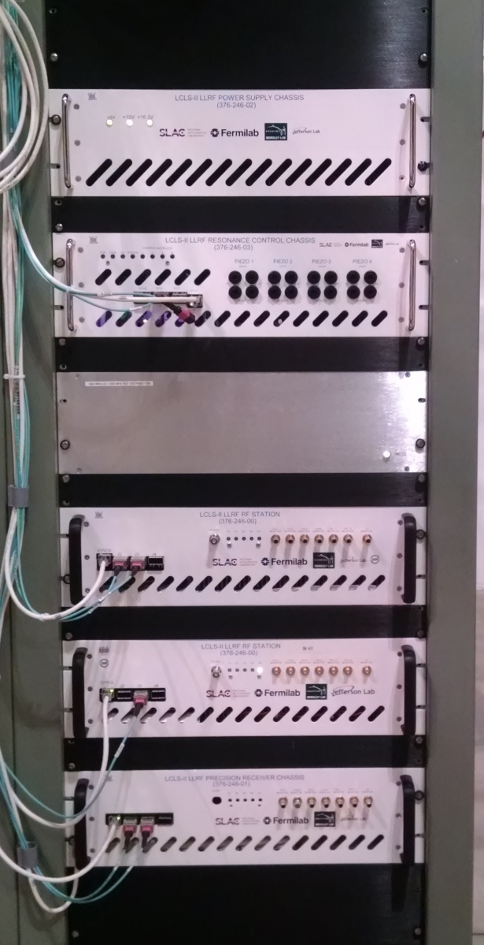




RF Department - LLRF
PIP-II Kickers
PIP-II RF Hardware
LCLS-II LLRF collaboration and cryomodule testing

Slide 19



Pre-Target Window - Design Status
High Power Limitation
Identified as likely weak point past 700kW: Poor braze quality, marginal window strength.
Requires end cap redesign and increase in beam spot size for 1MW operation.
Work to Date
Original window remodeled in ANSYS and analyzed for temperature and stress at 1MW (failed on fatigue life).
Proposed revision to existing design is an increase in beryllium thickness from a nominal .010” to .015”.
Has negligible effect on neutrino flux.
Thermal and stress analysis completed; provides a 57% stress reduction with minimal increase in steady state temperature.
Analysis and design work is scheduled for final review (2/16/18).
Analysis Credit: Raul Campos

Slide 20


Pre-Target Window – Fabrication Plans
Production Window
Window design has been presented to Vacuum Window Committee and passed requirements set forth.
Engineering note is being formalized and will be available after final review.
Drawing package is being prepared and will be available for bid submittal week of 2/19.
Fabrication Improvements
Recent work with lab vendor has markedly improved braze alloy coverage; nearly 100% on recent scans.
  Best defense against corrosive atmosphere.
  Eliminates stress concentrations at interface.
Christine Ader / VWC, to implement new production guidelines on braze assembly drawings.

Slide 21



Target Baffle - Design Status
Target Baffle
Thermal and structural analysis of existing design at 1MW completed.
Graphite internal diameter scaled with beam spot size to reach 15mm diameter.
No unforeseen issues with temperature / stress / fatigue life on both graphite collimation slugs, as well as external aluminum cooling shroud.
Air cooling still sufficient.
Summary
Minimal drawing revisions to baffle sub-assembly required; Existing production can continue.
Analysis scheduled for engineering review week of February 26th.
Analysis Credit: Kavin Ammigan

Slide 22

Horn 1 - Design Status
Inner & Outer Conductors
Thermal analysis of conductors is complete.
Assumes new water based cooling convection coefficients from planned RAW system upgrades.
Structural analysis underway and expected to be complete within 4-6 weeks.
Increase in neck or weld diameter not believed to be required at this time.
Analysis of existing design will be peer reviewed in March.
Stripline analysis to start soon; completion expected to
follow in ~2 months.
Analysis Credit: Yun He

Slide 23



Target Chase Shielding - Design
Chase Shielding
Design for cover plates over Horn 2 is complete.
Additional shield wall envisioned for separating D.S. end of Horn 1 from Horn 2; vice-versa for upstream end of Horn 2 to Horn 1.
Design review planned for week of 2/19/18.
Production drawings anticipated by end of March for April procurement start.
NuMI AIP plan was to have ready by FY18 shutdown for dose rate reduction during water line revisions.
Design Credit: Joe Angelo

Slide 24



Decay Pipe Windows - Design
U.S. Decay Pipe Window
NuMI AIP included provision for production of spare decay pipe window, as well as remote controlled robot or tooling capable of repair / replacement.
Current design work has focused on the prospect of repairing window as opposed to full fledged replacement.
Accurate chase model being created for repair mechanism design.
Repair mechanism investigation / prototyping to start soon.
Thermal & structural analysis of window is ready to begin.
Design Credit: Mike Campbell

Slide 25
Difficulties faced
Legacy technology not taught in schools any longer.
  In some of our systems only legacy equipment will work.
All national labs are looking for high power RF engineers
  On a recent trip I was told their plan was to raid talent from other labs.
Analog design for real world is not taught in depth.
  While you can do many things in the digital domain, there are some places that need analog skills for signal terminations etc.
Hard to use co-op students in some areas.
  High current and high voltage can hurt you (or worse!)
A big concern for me is finding electronic techs.
  Industry doesn’t want them repairing boards… swap and discard is the current style.

Slide 26


Slide 27


