Slide 1
FESS Engineering Departments
Russ Alber, FESS Engineering and Al Schmitt, FESS Facility Management
4TH Annual All Engineers Retreat
February 20, 2018

Slide 2
FESS
MISSION
Fermilab’s Facilities Engineering Services Section (FESS) builds and maintains mission-critical infrastructure and services from which high-energy physics research can be safely accomplished without interruption.
FESS has two engineering departments:
FESS Engineering (FESS E) -
presented by Russ Alber, FESS E Department Head
FESS Facility Management (FESS FM) -
presented by Al Schmitt, FESS FM Department Head

Slide 3
FESS Engineering

Slide 4
FESS Engineering
MISSION
Provide facilities and infrastructure that meet the initial requirements of the physics community, incorporate flexibility to adapt to changing Laboratory programs, maximize uptime, are economical to construct, operate and maintain, are environmentally responsible, and provide for human comfort and a creative workplace atmosphere.
FESS E employs 16 licensed architects and engineers in all the classical disciplines:
- Civil - Mechanical
- Structural - Electrical
- Architectural - Environmental

Slide 5
FESS Engineering
Last year FESS Engineering managed $250M in projects
Line-item Projects
- IERC $86M
- UUP $36M
- Mu2e $42M Conventional Construction
- LBNF/DUNE and PIP-II
GPP Projects $75M
- Sitewide DWS – new domestic water line down Discovery Road
- Computer Room Upgrades → Sitewide VOIP
- C0 Detector Hall – new morgue
- WH Renovation – WH13 and Ground Floor renovations
- ICB Addition – New Industrial Building Addition
- SBN Program – Complete
Operating Tasks
- $2M in miscellaneous projects – various tasks for D/S/C’s

Slide 6
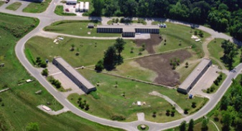
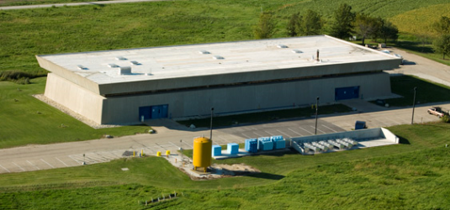
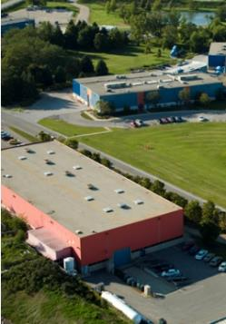
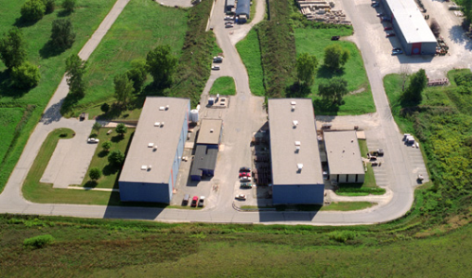
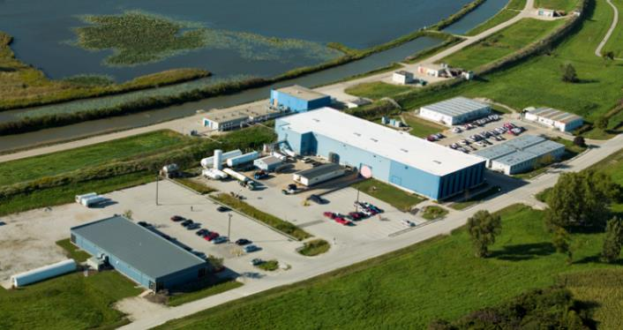
FESS Engineering – 1980’s
FESS Engineering (FESS E) evolved out of the TEV1 and TEV2 upgrades in the early 80’s
CDF, D-0, Anti-Proton, Fixed Target buildings, etc.

Slide 7
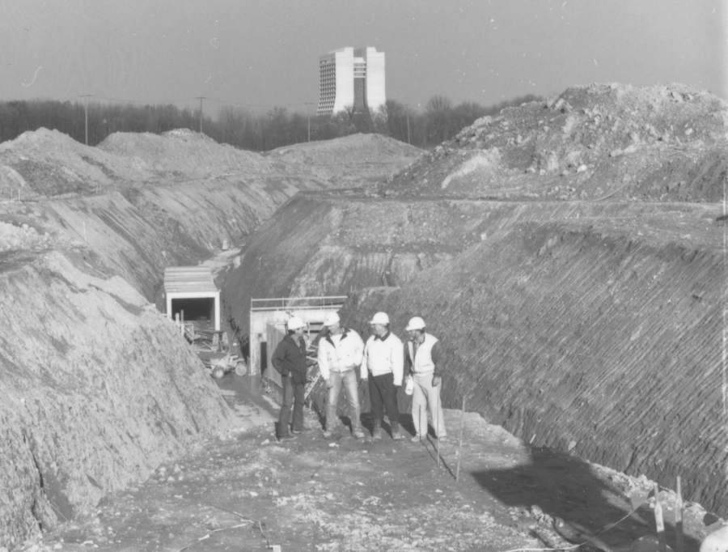
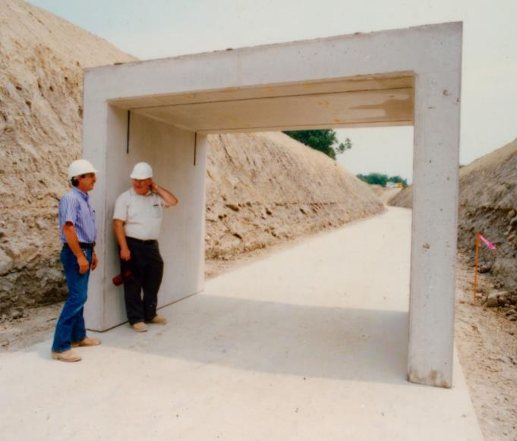
FESS Engineering – 1990’s
Main Injector Construction –
Ron Foutch, PE

Slide 8
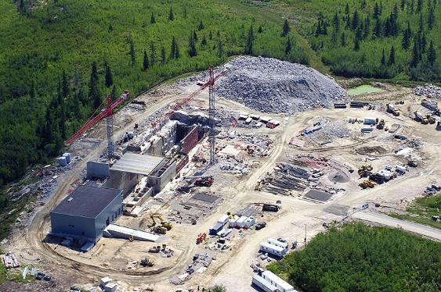
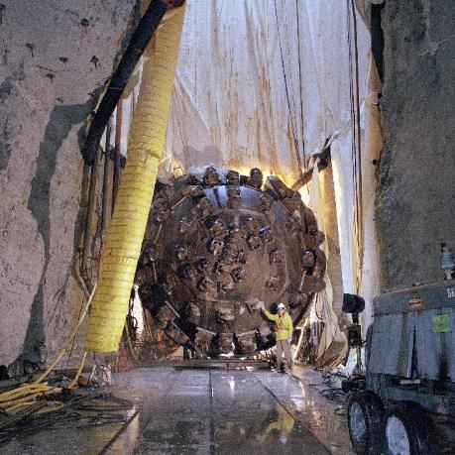
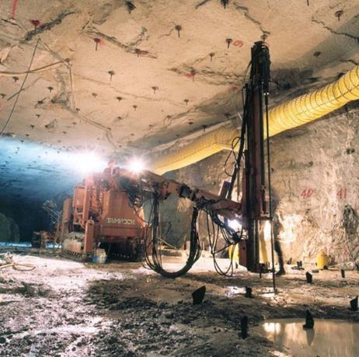
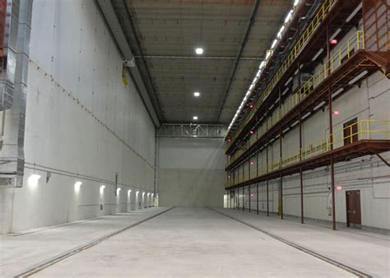
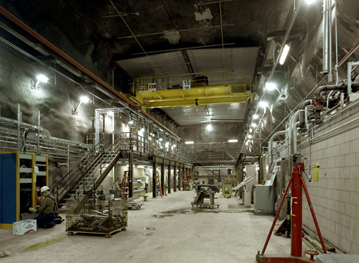
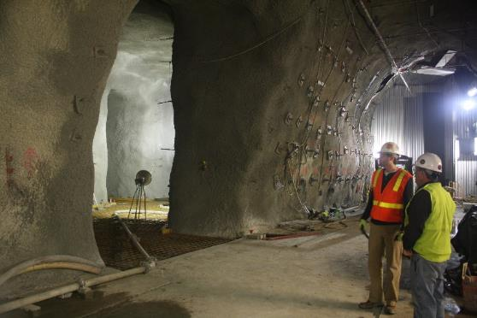
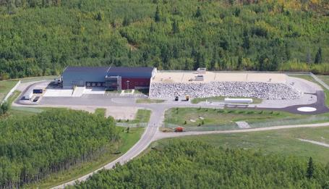
FESS Engineering – 2000’s
NuMI and NOvA Construction

Slide 9
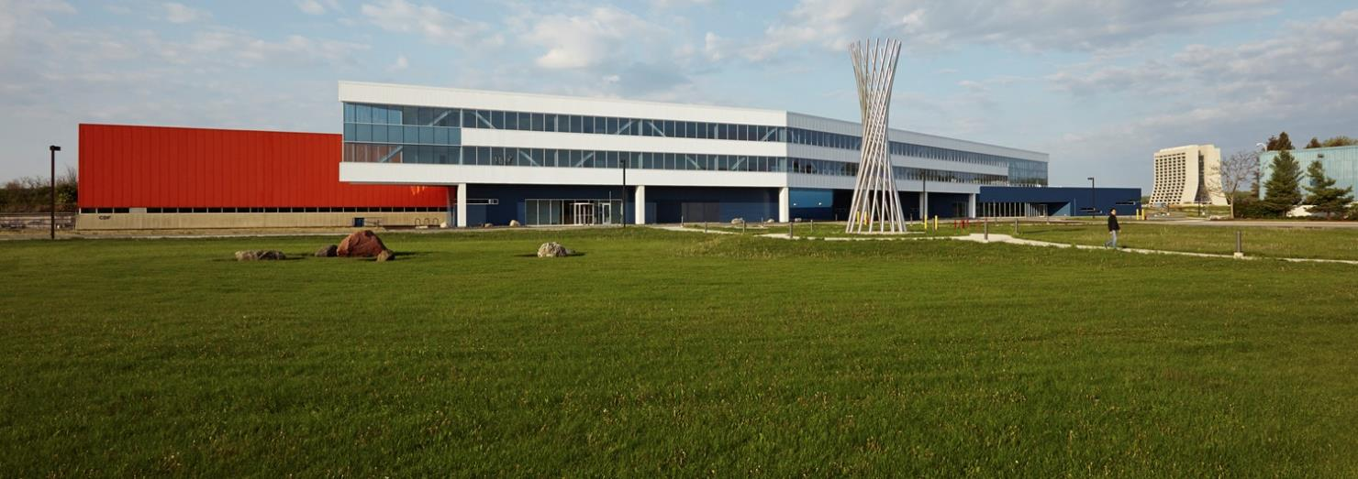
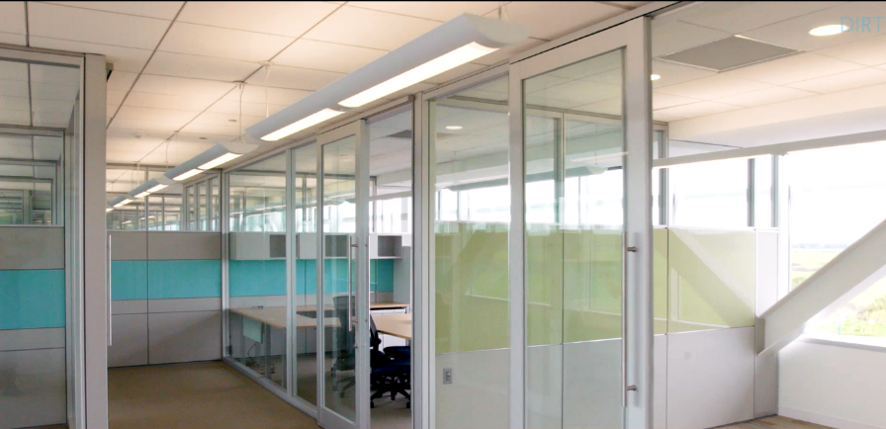
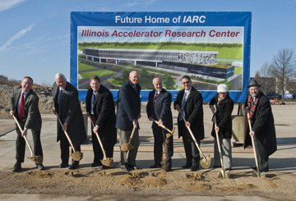
FESS Engineering – 2010’s
IARC Construction

Slide 10
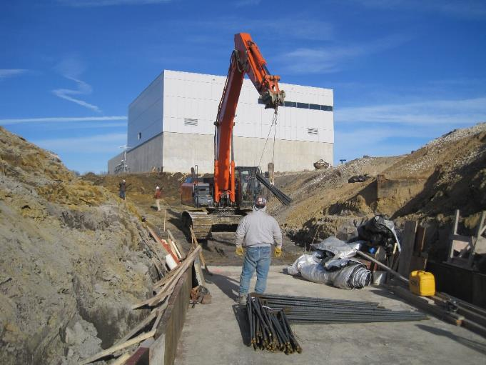
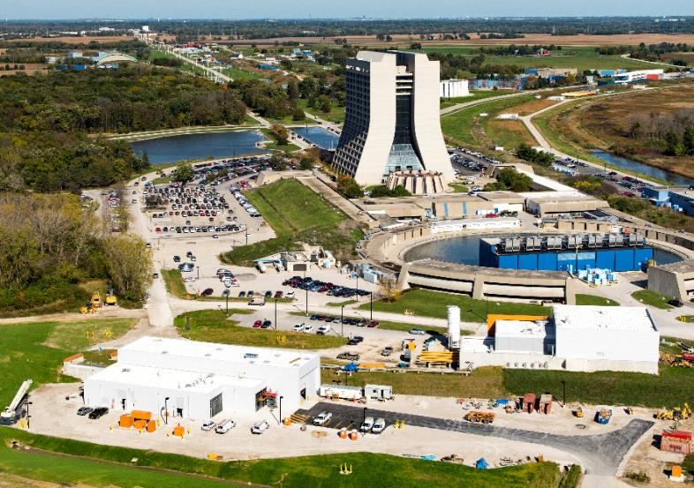
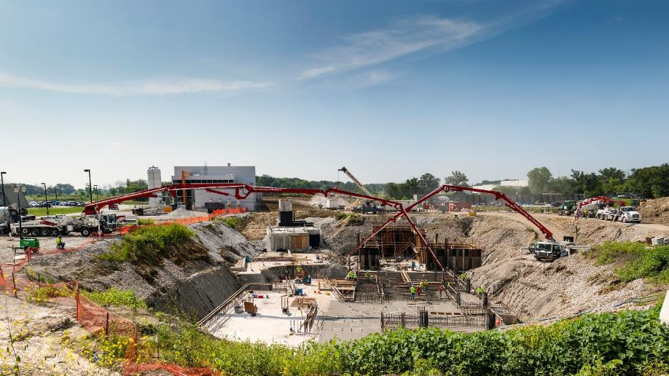
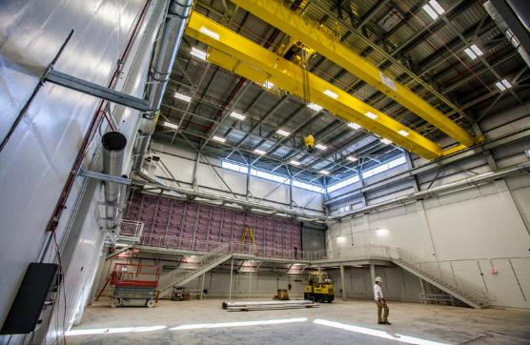
FESS Engineering – 2010’s
Muon Campus Construction

Slide 11
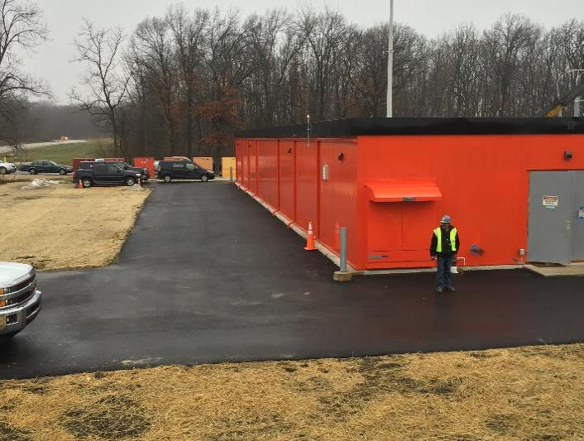
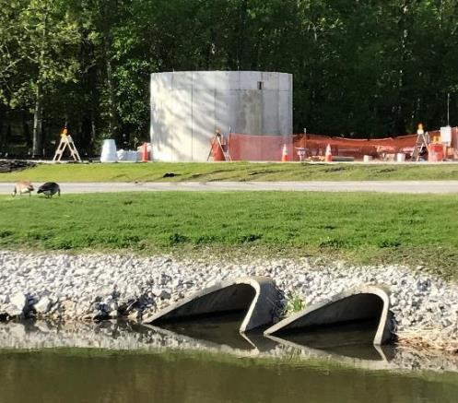
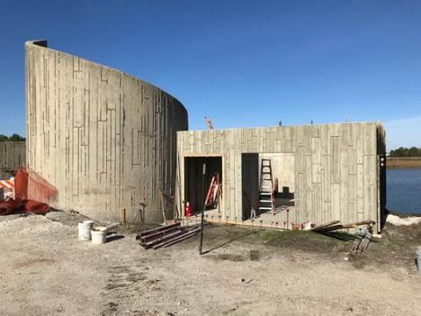
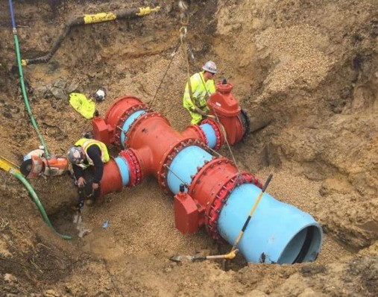
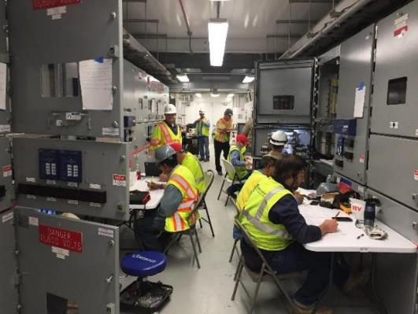
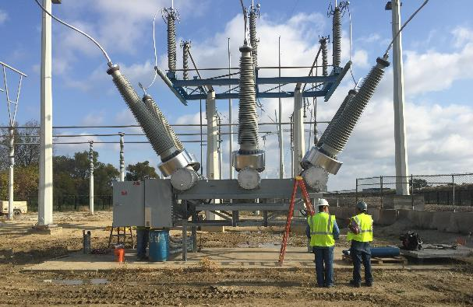
FESS Engineering – 2010’s
Utilities Upgrade Project

Slide 12
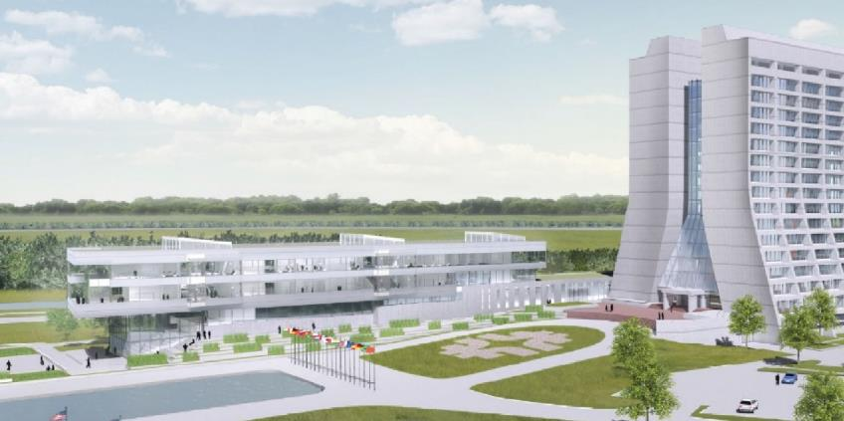
FESS Engineering – Future
Integrated Engineering Research Center (IERC)
$86M TPC, CD-1 approved in April 2017 – starting Preliminary Design
State-of-the-art laboratory, high bay, clean room, and technical spaces
World-class modernized facilities and infrastructure for R&D and construction of particle physics detectors
Integrates subset of Fermilab engineering resources scattered across the laboratory
18 Science Points of Contact (SPOCs) from across the lab helping to refine IERC science requirements
IERC Highlights:
3-stories
Direct physical connections to Wilson Hall
Collaboration spaces to reestablish vital interconnects between international science community and Fermilab engineering
IERC Conceptual Design

Slide 13
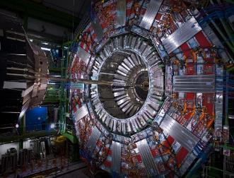
FESS Engineering – Future
IERC Connections to Fermilab Science Programs
LBNF/DUNE:
Critical element to support Fermilab’s role as host laboratory
Provides space for significantly increased collaboration required by LBNF/DUNE
High Luminosity LHC (HL-LHC):
Design and engineering technical space
Lab space for assembly, testing, and integration of HL-LHC CMS detector components
Quantum Information Science (QIS):
Ultimate home for the Fermilab Quantum Science Center
Space for collaboration, interaction, and algorithm development
Lab space for cryogenic detector R&D and superconducting detector development
FY17 FY18 FY19 FY20 FY21 FY22 FY23
IERC Funding Profile
Design Funding ($10M)
Construction Funding ($75M)
Level 4 Milestone –
Construction Complete
IERC Schedule
Design
Construction

Slide 14
FESS Engineering – Initiatives
Modifying Conventional Facilities –
including building structures (roofs, walls/partitions, roads/walks, elevators, cranes), utilities, or any impact to exiting/accessibility and changes in usage is required to be reviewed by FESS with the FESS Design Review application:
http://fess-ogfp.fnal.gov:8095/FDRF/faces/searchDp18Forms.xhtml

Slide 15
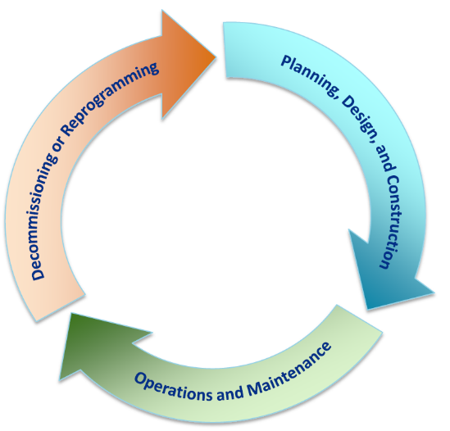
FESS Engineering – Initiatives
Fermilab Facilities Manual
DRAFT by Fall 2018
1000 Policy and Administration
Departmental Policies
2000 Planning
Master Planning and Conceptual Design
3000 Design
Permits, Guides, Standards, Building Permits
4000 Construction
Permits and Inspections
5000 Transition to Operations
Transition execution and Occupancy Permit
6000 Operations and Maintenance
O&M practices and Centralized Facility Management
7000 Demolition/Decommissioning/Repurposing
Standard Specifications

Slide 16
FESS Facility Management

Slide 17
FESS Facility Management
Facility Management is the department within FESS responsible for the operation and maintenance of non-science infrastructure at Fermilab.
MISSION
Provide our customers with deliberate and timely response to infrastructure inspection, maintenance and repair needs that are within our core services and capacity in a way that is respectful, efficient and effective.

Slide 18
FESS Facility Management
Non programmatic infrastructure managed by FESS FM includes:
Utilities
Electrical distribution
Industrial cooling water (ICW)
Surface Water
Low conductivity water(LCW) regeneration
Natural gas
Domestic water
Sanitary sewer
Central Utility Building systems

Slide 19
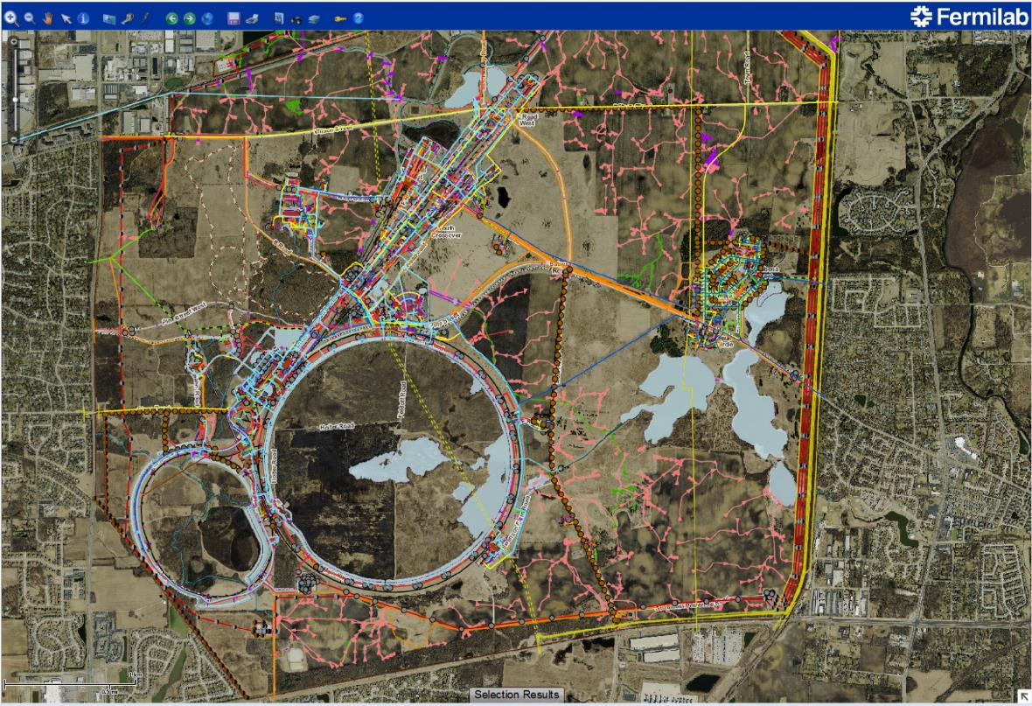
FESS Facility Management
GIS of Site Utilities

Slide 20
FESS Facility Management
Non programmatic Infrastructure managed by FESS FM includes (cont.):
Building Infrastructure and Systems
HVAC
Lighting
Electrical distribution
Plumbing distribution
Sprinkler systems
Ground water sump pumping / related systems
Building automation
Fire alarm systems
Roof inspections and repair services
Overhead door inspections and repair services
Elevator inspection and repairs
Crane inspections, repairs and upgrades
Staffed 24 x 7 x 365

Slide 21
FESS Facility Management - Staff
12 Engineers
1 Operations manager
5 Maintenance/technical supervisors
25 Shop personnel
12 Maintenance Mechanics
11 Maintenance Electricians
2 T&M HVAC Personnel
Duty Mechanic and Duty Electricians cover off-shift hours
7 Technicians
1 Construction specialist
2 Carpenters
2 Building management service specialists
1 Interior designer
5 Scheduler-Planners
5 Admin support assistants
1 JULIE coordinator
1 Functional analyst

Slide 22
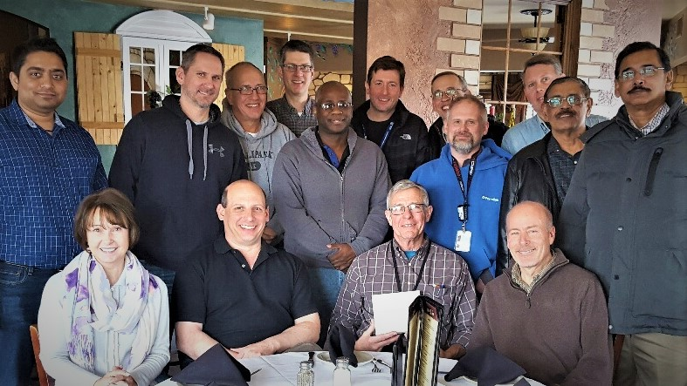
FESS Facility Management - Engineers
Facility Management
Al Schmitt, Head
Administrative Support
Building & Support Systems
Martin Bentivengo, Manager
Utilities & Engineering
Larry Sliwa, Manager
Operations & Maintenance
Greg Gilbert, Manager
Planning & Scheduling
MEDDC
Paul Ranieri, supvr.
Open Technical Specialist
Cedric Madison
Andy Martens
Mike Michalak
Open Staff Engineer
Pratik Patel
Technican
Cranes
CUB
Utility Location & GIS
Mechanics
Carpentry
High Voltage Engineering
Joseph Pathiyil, supvr
John Kruse
Prem Mattappally
Technical Specialist
CUB
Fire Systems Maintenance
Electricians
Building Management & Assessments

Slide 23
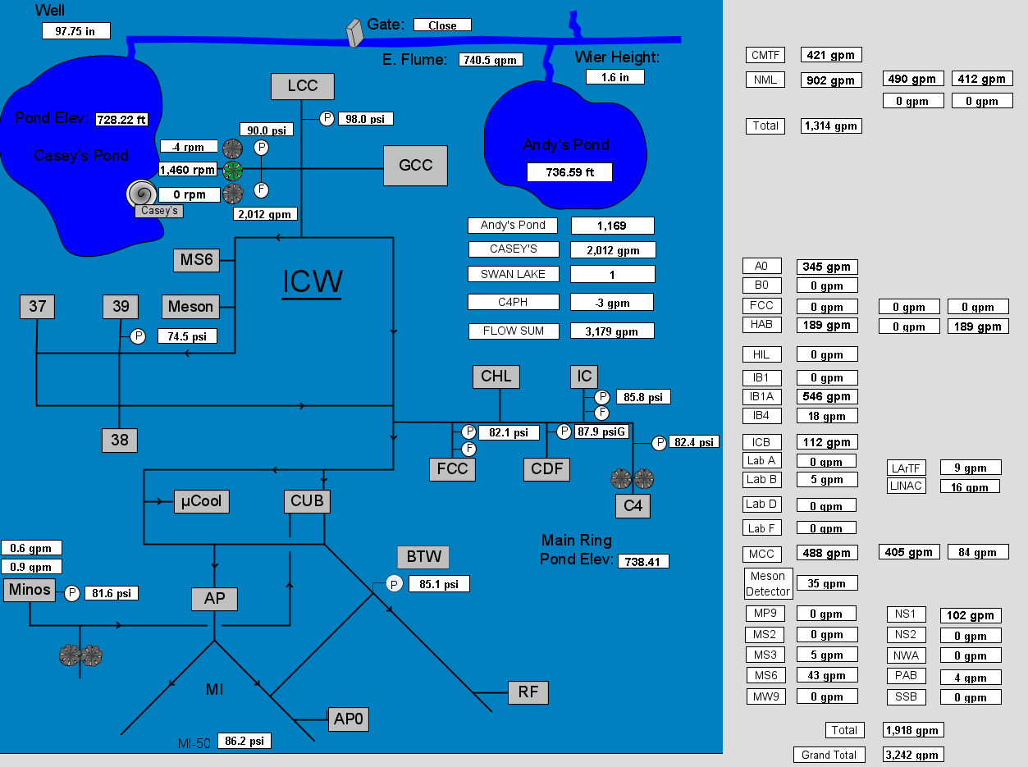
FESS Facility Management – Recent Projects
ICW Metering

Slide 24
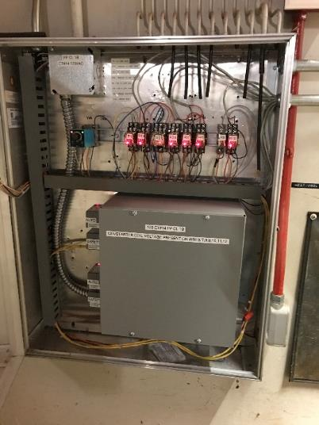
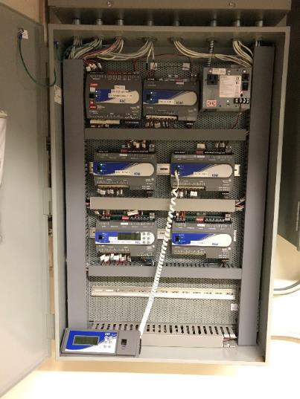
FESS Facility Management – Recent Projects
Wilson Hall DDC Upgrades
Convert old pneumatic valve actuators to electromechanical
Convert old pneumatic damper actuators to electromechanical
Upgrade old controls from the basement NC-17
Upgrade old controls from the Mezzanine NC-7

Slide 25
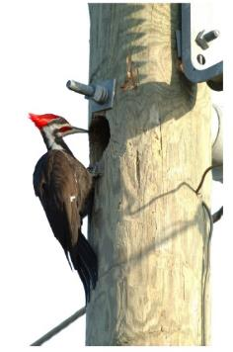
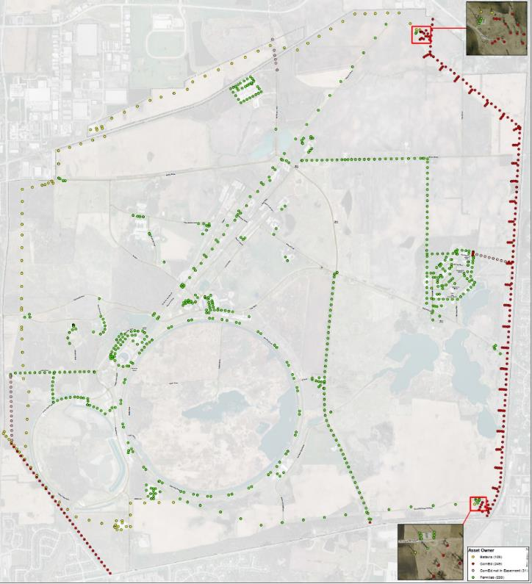
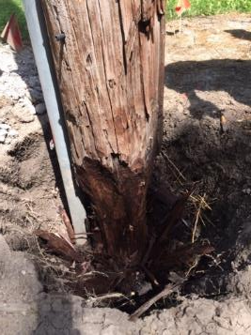
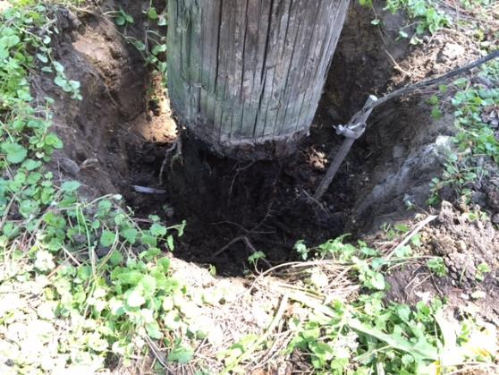
FESS Facility Management – Recent Projects
Fermilab FM High Voltage Utility Pole Inspection Program

Slide 26
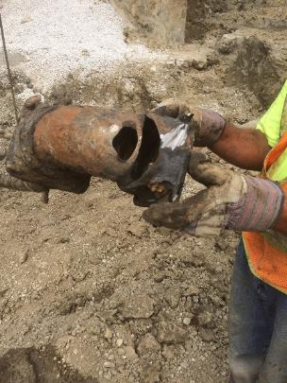
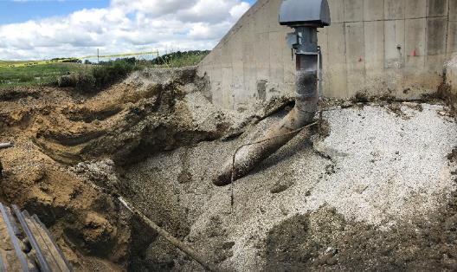
FESS Facility Management – Recent Projects
MI-52 Sump Pump Discharge

Slide 27
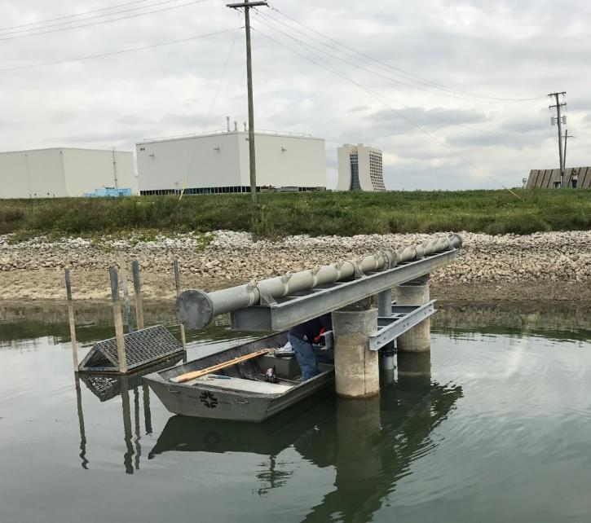
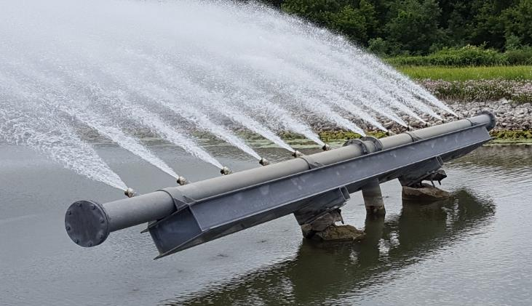
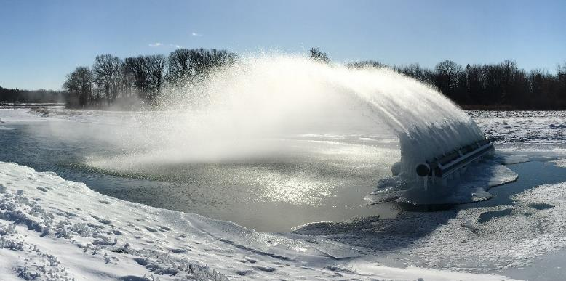
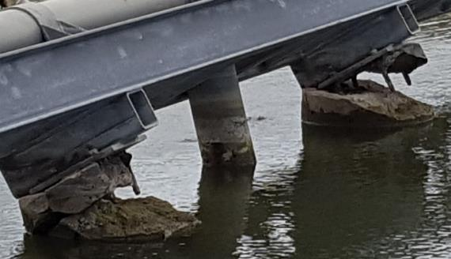
FESS Facility Management – Recent Projects
MI-62 Spray Header Repair

Slide 28
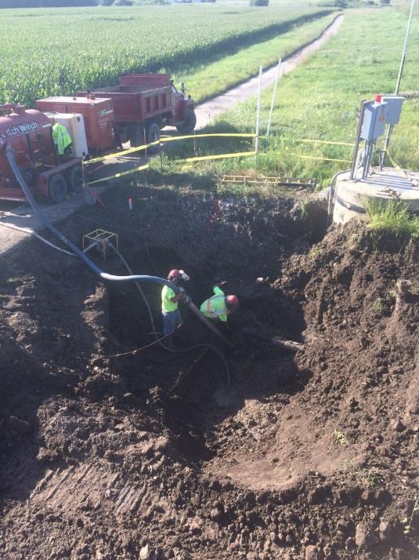
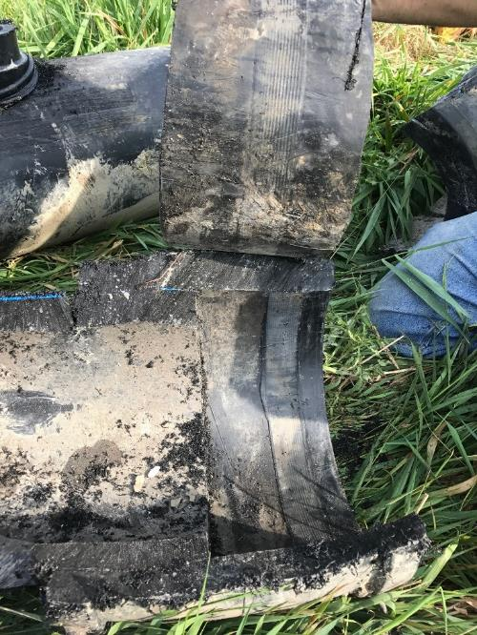
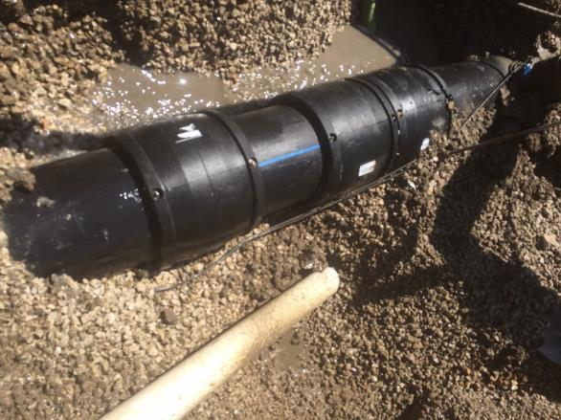
FESS Facility Management – Recent Projects
HDPE ICW Failures

Slide 29
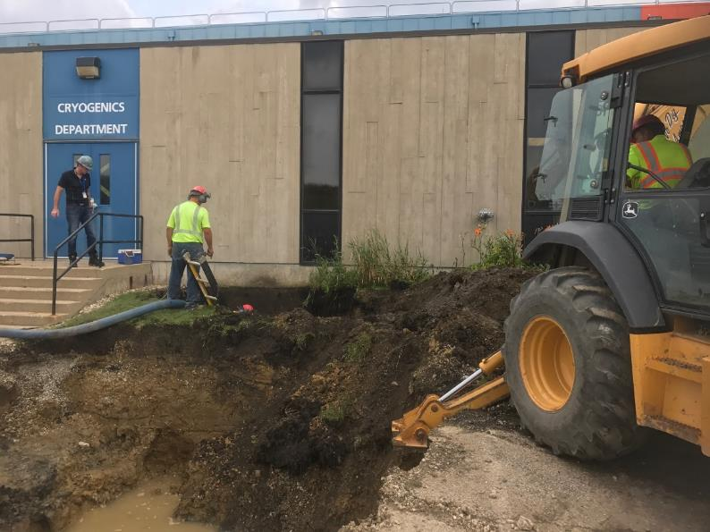
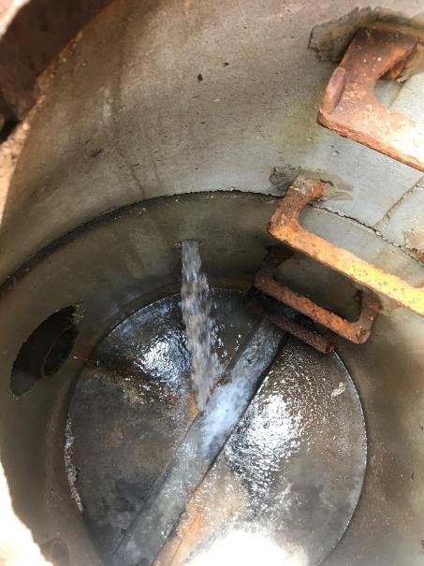
FESS Facility Management – Recent Projects
Large DWS Leak @ MW9 (Under building structure)

Slide 30
FESS Facility Management – Initiatives
Centralized Facility Management PILOT–
One year
3 participants
ESHQ
WDRS
Neutrino Division
Advisory group providing feedback on program development
Service Level Agreement will define responsibilities
Next steps -
Continue regular Advisory Group Meetings
Finalize Service Level Agreement document(s)
Fund/Implement FY18 EOL workplan
Look-ahead to full program roll-out

Slide 31
FESS - Conclusion
FESS is responsible for designing, constructing and maintaining conventional facilities (buildings, utilities and infrastructure) across our 6,800 acre site.
FESS assures integration of conventional facilities with the labs programmatic requirements and integrates the lab’s many stand-alone campuses into a robust conventional facility and infrastructure system.

