Slide 1
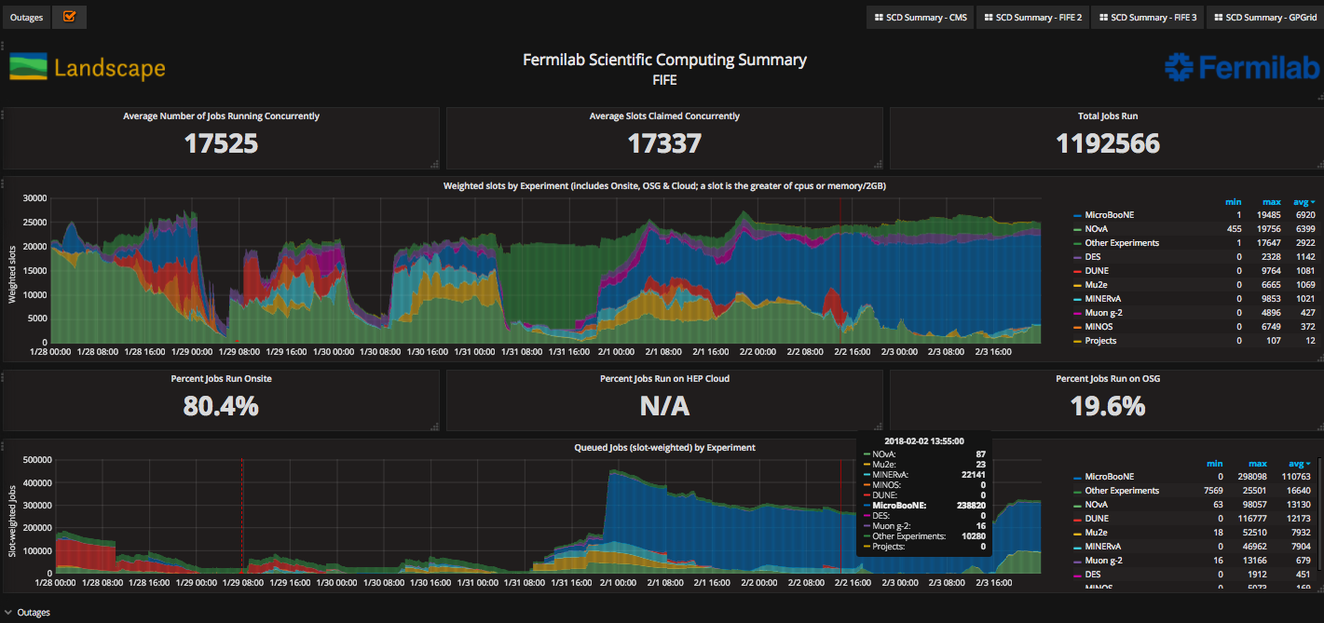
FIFE Operations (combined offsite and onsite)
https://fifemon.fnal.gov/monitor/dashboard/db/scd-summary-fife
Sam web server VM went down Monday evening. Rebooted Tuesday morning.
Batch system host became unavailable after yum auto updates Friday morning. Fixed by midmorning on

Slide 2
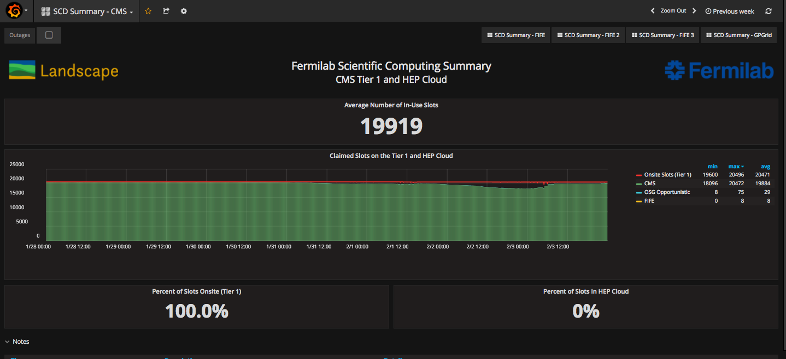
CMS Operations
https://fifemon-pp.fnal.gov/dashboard/db/scd-summary-cms

Slide 3
Operational issues from the past week
Several workflows are causing bottlenecks and reduced efficiencies.
Still trying to categorize them – primarily from analysis users.
List includes (but is not limited to)
  Jobs loading [the same] large tarball to worker nodes
  Failure to prestage from tape before running campaigns
  Network issues at OSG sites
Still working on
  Collecting requirements/use cases from experiments in their small file access patterns
  Improving analytics to understand root cause how to best address. Approach will vary depending on result(s)
Mitigations/solutions depending on more information:
  Balance cost vs performance

