Slide 1
Accelerator Division Status
Daniel Johnson
All Experimenters’ Meeting/Lab Status Meeting
05 February 2018

Slide 2
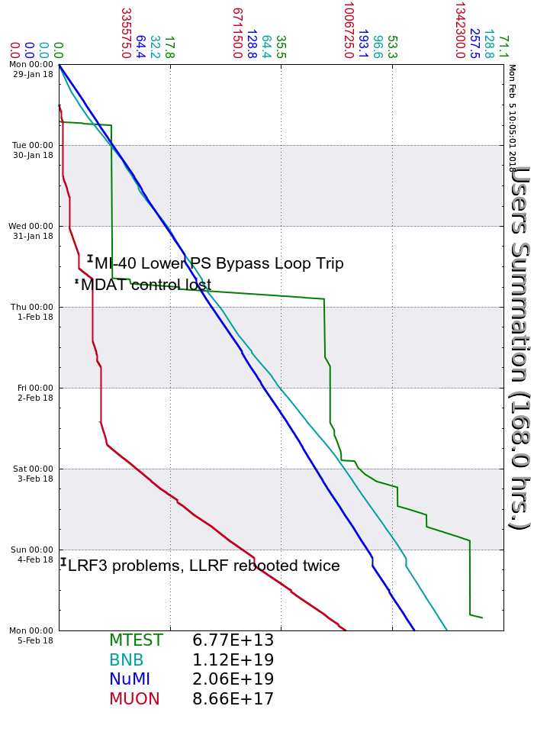
Accelerator Operations Summary
From: January 29, 2018 (0000 hours)
To: February 05, 2018 (0000 hours)
Calendar Week # 05
NuMI Weekly Integrated Intensity 2.06 E19 protons
Beam Hours To NuMI 159.0 hours
BNB Weekly Integrated Intensity 1.18 E19 protons
Beam Hours To BNB 160.4 hours
Muon Weekly Integrated Intensity 8.66 E17 protons
Beam Hours To Muon 99.7 hours
MTest Weekly Integrated Intensity 6.77 E13 protons
Beam Hours To MTest 29.9 hours
MCenter Weekly Integrated Intensity 0.00 E12 protons
Beam Hours To MCenter 0.0 hours

Slide 3
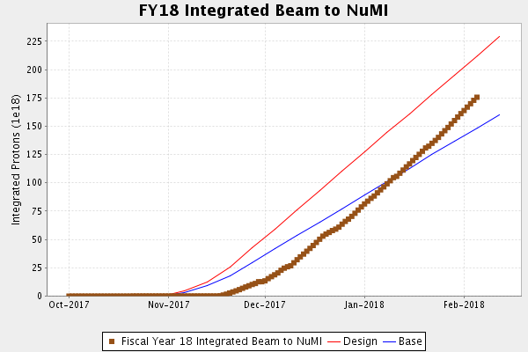
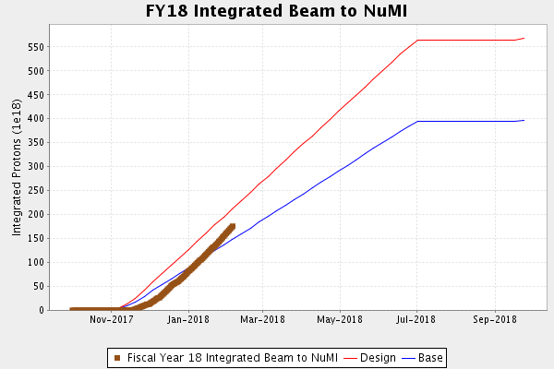
NuMI Operation

Slide 4
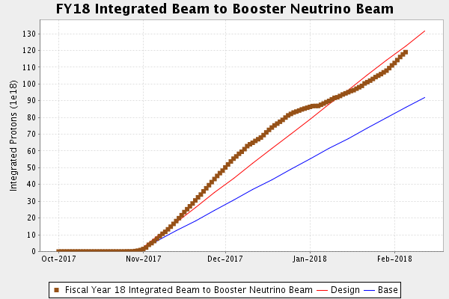
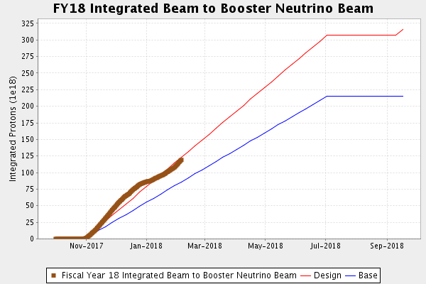
BNB Operation

Slide 5
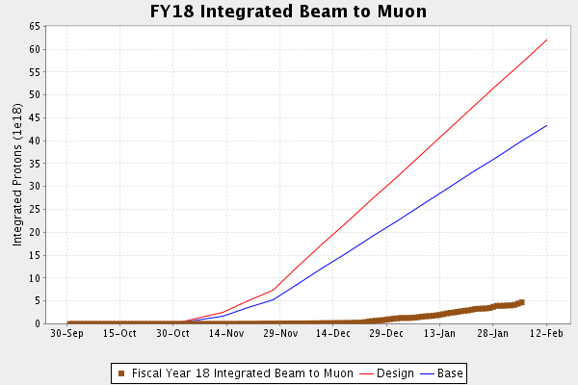
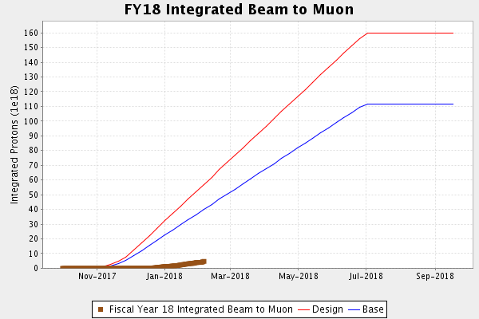
Muon Operation

Slide 6
Complex Status
LINAC
  Laser Notcher operational
Booster
  Tuning continues
MI/RR
  Tuning continues
NuMI
  Running at ~725kW (without switchyard)
  Record week
Booster Neutrino Beamline (BNB)
  Stable operation
Switchyard
  Meson Test
    Magnet replacement MT3U-1
    ~ 1 week
Muon Campus
  Tuning & studies
    16 pulse test today
General
  ICW electrical work at Casey’s Pond pump house went well
  Tuesday, February 6th Shutdown
    Beam off at 0700
    BNB beam around 1200
    NuMI, Muon beam around 1500
    Marx modulator LRF5, etc….

Slide 7
PIP-II Injector Test & FAST/IOTA Status
PIP-II Injector Test
  Shutdown
    Shutdown for 4 weeks beginning January 22nd
      RFQ work
        New tuner slugs
        New high power couplers
        Leak checking
FAST/IOTA
  300 MeV Commissioning Run Successful
      IOTA Installation underway

Slide 8
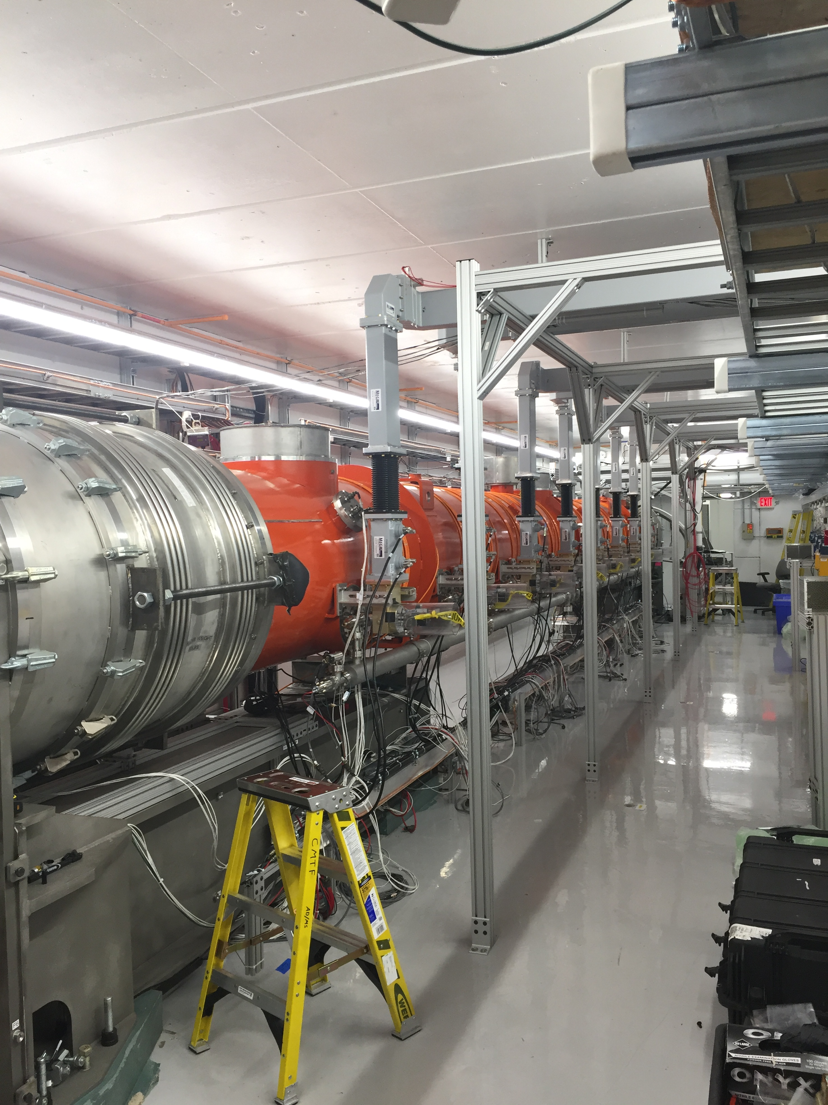
CMTS1 Status
LCLSII Cryomodule F1.3-07
  Testing complete, very good cryomodule
    Warmup today
    Removal planned for this week
  F1.3-09 next module in a couple weeks

Slide 9
Schedules and Links
Schedule can be accessed from the Operations Department Home Page
  Schedules -> Operations Schedule
Direct link to schedule
  http://www-ad.fnal.gov/ops/schedule.html

