Slide 1
Accelerator Status Report
Monday
2-5-18

Slide 2
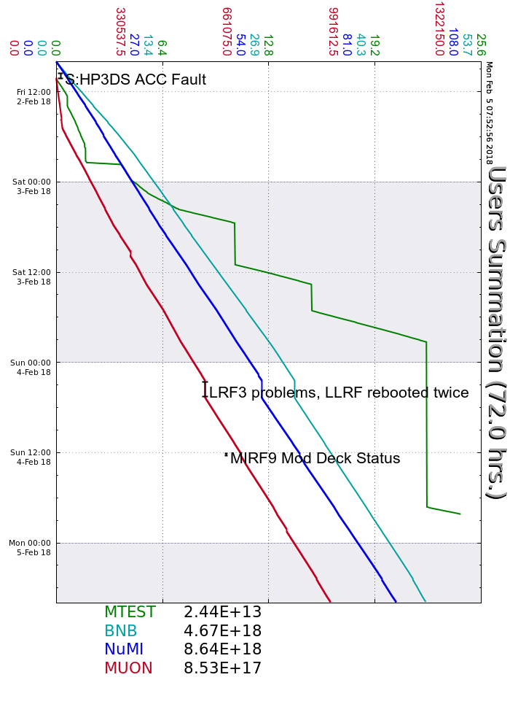
Friday
MI10 LCW pump 2 trip
HP3DS xfmr level
MIRF14 Bias AC-OI
Saturday
Good day
Sunday
LRF3 issues
MIRF9 deck power. Bypass.
Monday
M03 Supervised Access for MT3U magnet change
Your Shift Plot
could be here!
Ask me how!
Weekend accelerator summary

