Slide 1
The Mu2e experiment: Target Extinction Monitor
Avery Archer
Purdue University

Slide 2
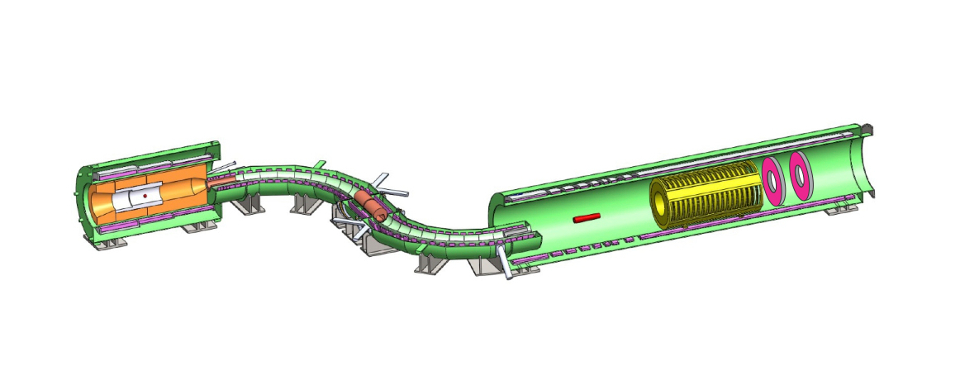
Mu2e—the experiment
Proton beam
Production Solenoid
Detector Solenoid
Transport Solenoid
Tracker
Production Target
Stopping Target
(aluminum foils)
Calorimeter

Slide 3
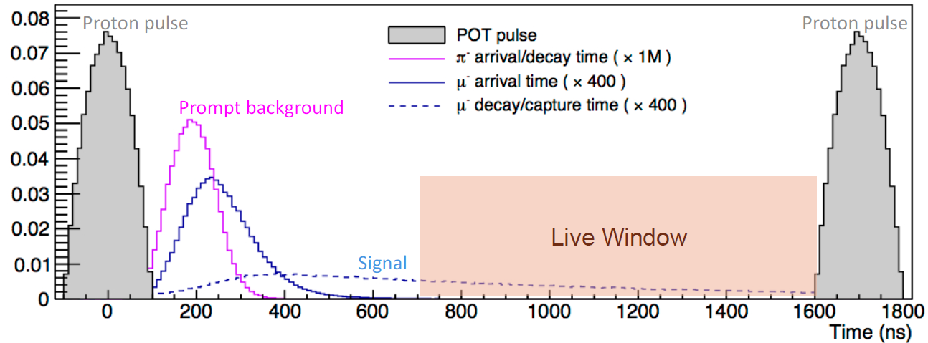
Extinction
Beam extinction: Fraction of protons arriving at production target outside the pulse time window
Extinction level of $<{10}^{−10}$ required
Notes:
The protons arrive and a blast of junk, which includes the desired muons, but also includes particles that could fake a conversion electrons, come down the beamline. The junk particles annihilate or decay or travel into a beam dump fairly quickly, but the muonic atoms hang around for a long time. So, we wait about 700 ns until the junk is almost gone, but plenty of muonic atoms still remain, and thaht’s where we atrt collecting data. The pulsed beam is an important aspect of the experiment, it allows us to run at much higher beam intensities and still not blind the detectors with high rates while we are looking for the conversion electrons.
Pions are among the junk that comes down the beam line. They could cause background that looks like a conversion electron if they stop in the target. Ythis ahhpens immediately when the pions stop, they are stongly interacting and annihilate on the nucleus, and when they do they can make an energetic electron in the vicinity of the conversin electron energy, producing a fake signal. It is absolutely crucial to have almost no protons hititing th eproduction target during the meaur,ment period to keep from making a pion tat could arrive at the stopping taget during the measurement period, so we have to suppress the number of protons by 10 orders of magnitude- this is called our extinction requiremen, and I wil lcome back to how we meaure this later.

Slide 4
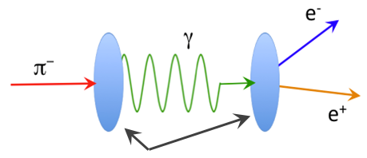
The Need for Extinction
Background (Radiative pion capture only):
$N\left(ξ\right)=\left(0.0153±0.0014\right)+\left(0.0247±0.0003\right)×\frac{ξ}{{10}^{−10}}$
Assuming no extinction:
$N\left(ξ=1\right)≈{10}^{10}$
Assuming extinction of $10^{−10}:$
$N\left(ξ={10}^{−10}\right)=$ $\left(0.0153±0.0014\right)+\left(0.0247±0.0003\right)$

Slide 5
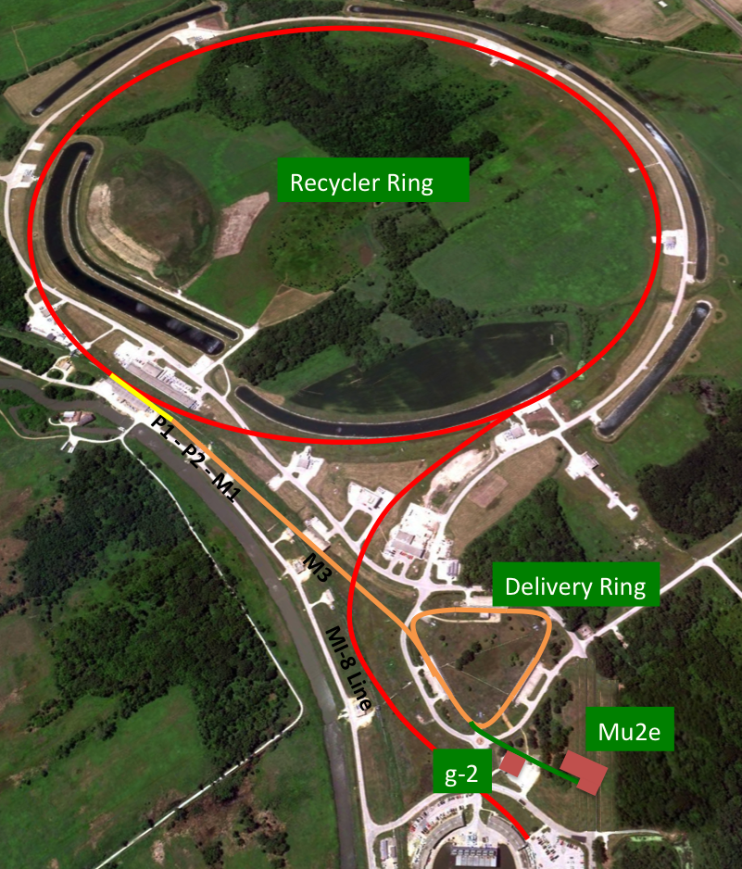
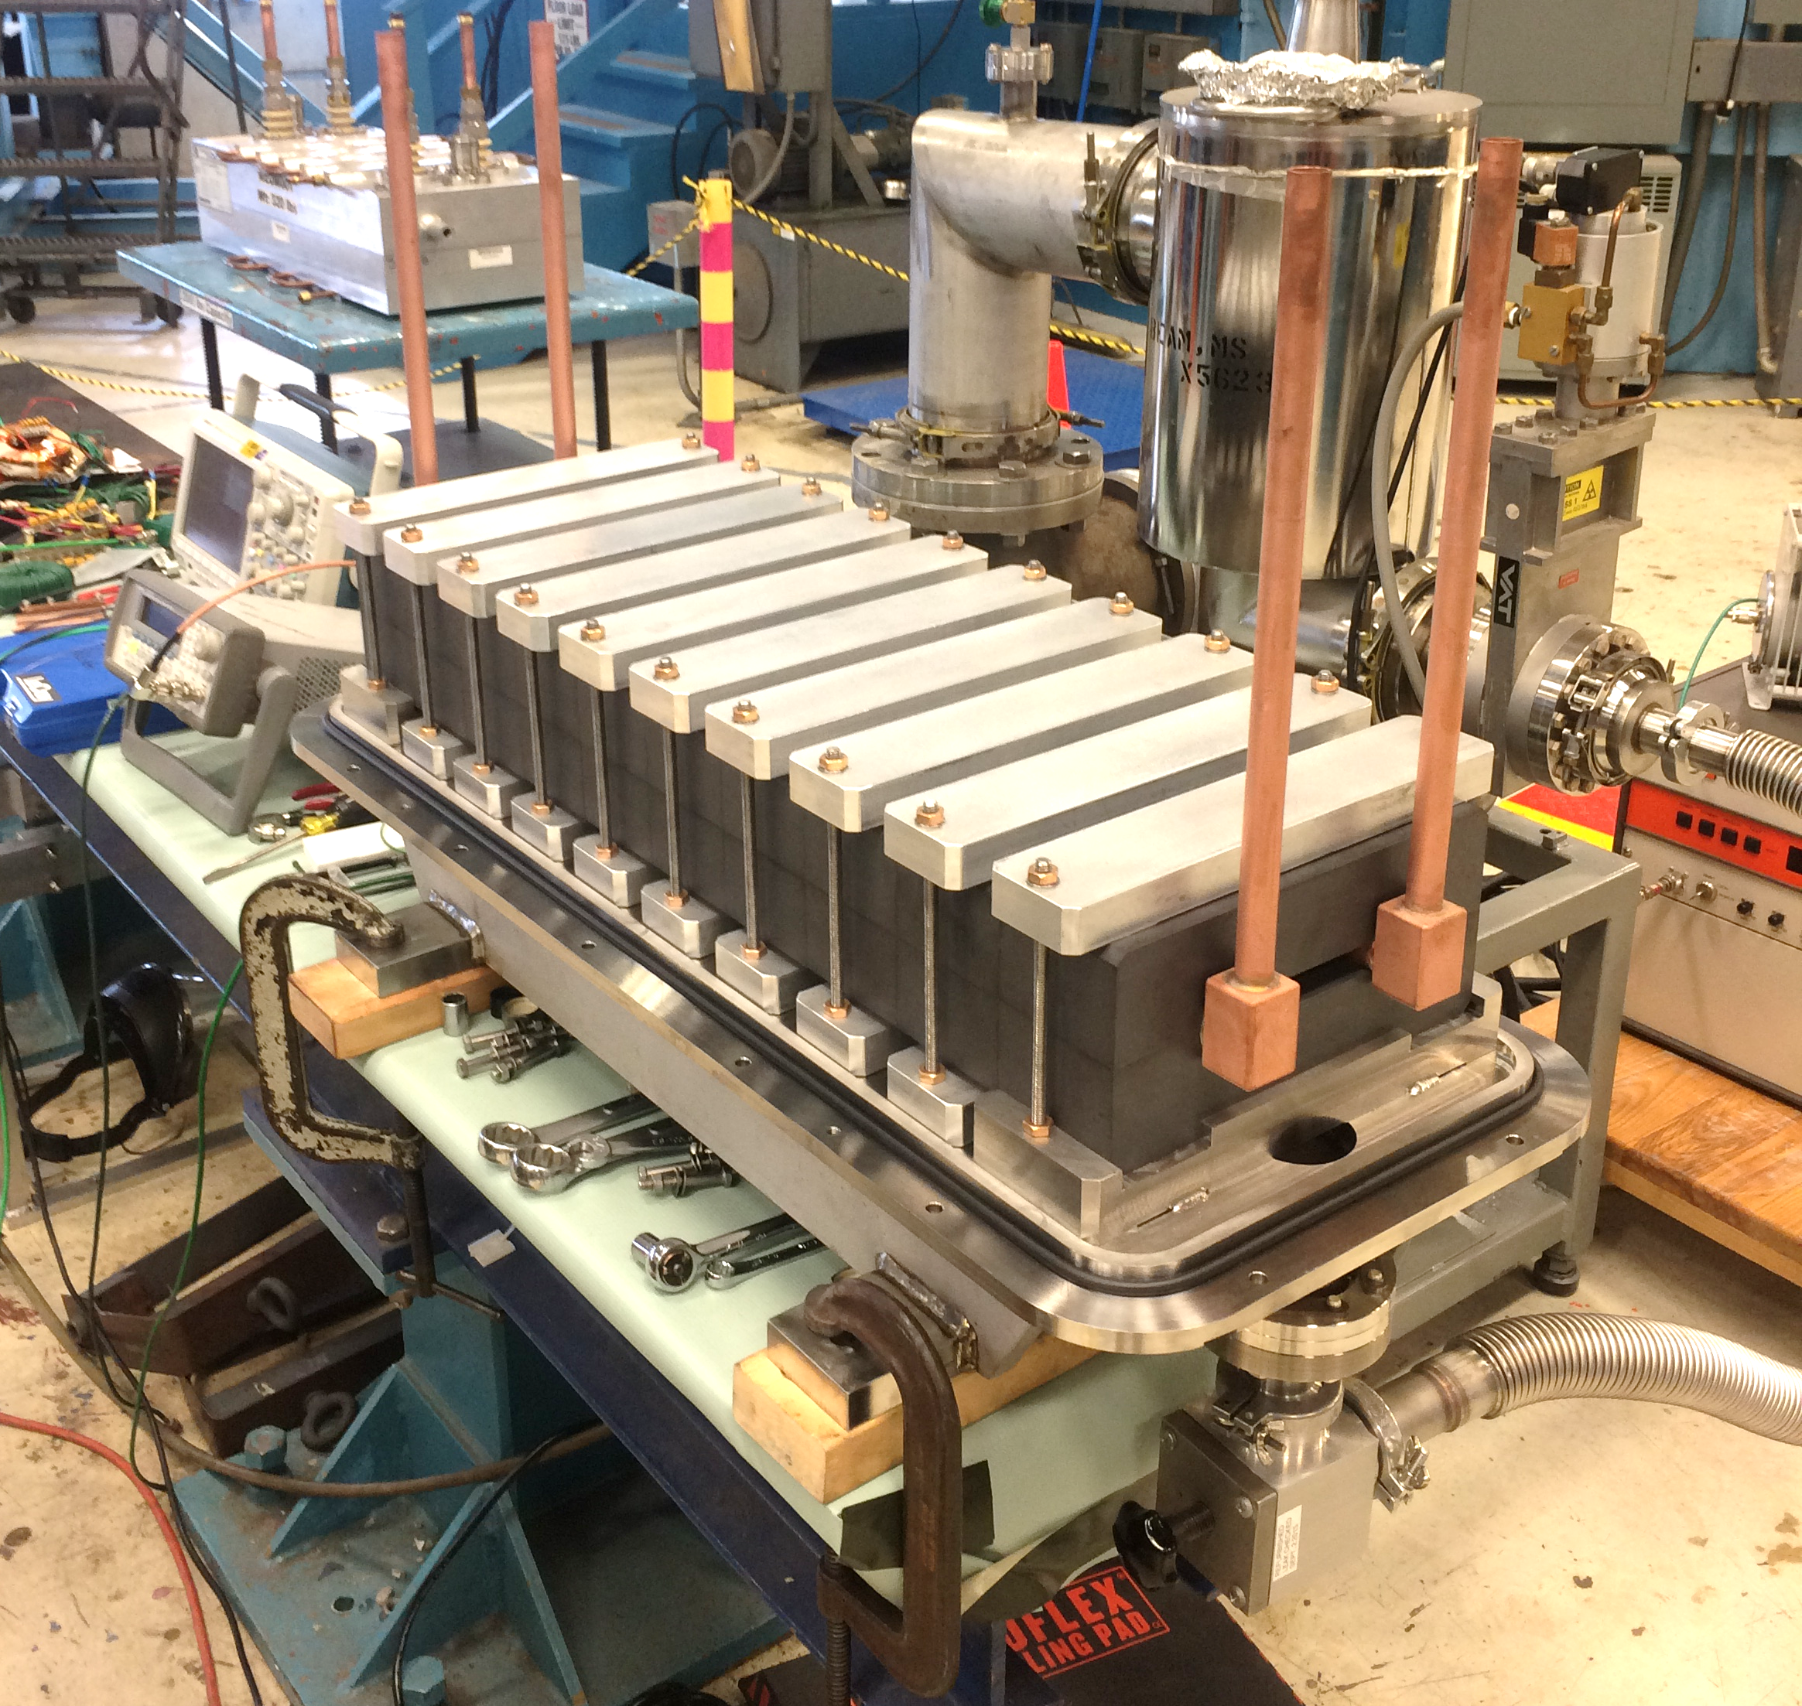
Extinction in 2 Steps
Beam formation directs proton pulses to Mu2e production target
Extinction factor $\sim {10}^{−4}$ or better
Oscillating dipoles (“AC dipoles”) in beamline deflects out-of-time beam
Extinction factor $\sim {10}^{−7}$ or better
Notes:
Extinction from forming bunch structure
Expected extinction of ${10}^{−4}$ or better
Oscillating dipoles (“AC dipoles”) in M4 beamline
Expected extinction factor of ${10}^{−7}$ or better

Slide 6
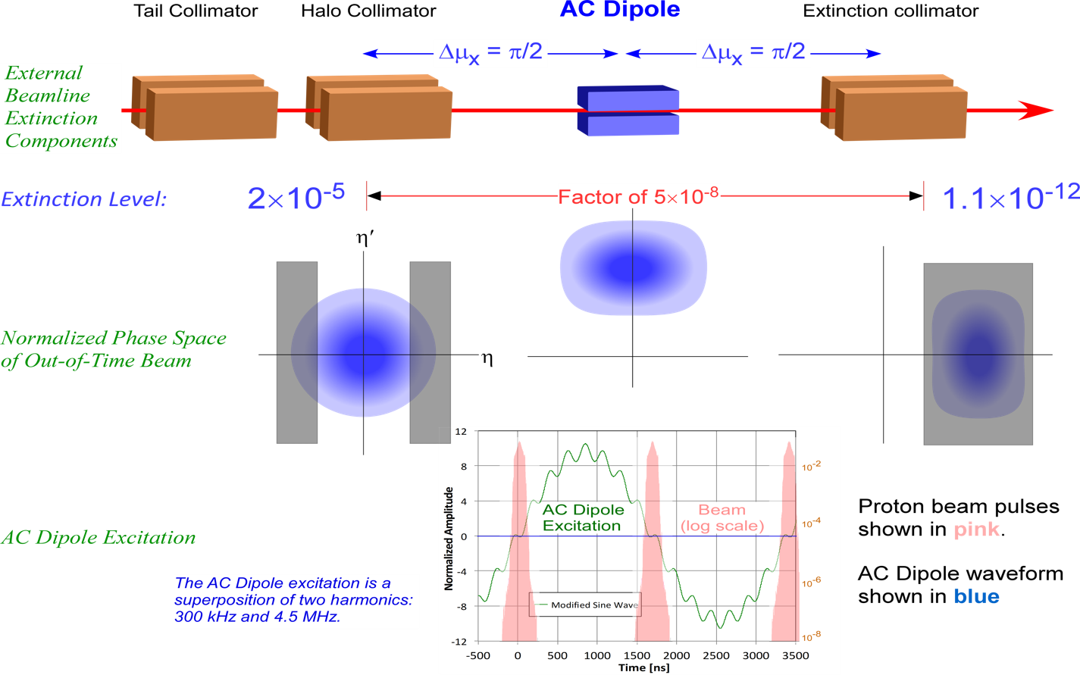
AC Dipole Magnet
Hiring Postdoc!
Eric Prebys (prebys@fnal.gov) or see https://recruit.ucdavis.edu/apply/JPF02131
Notes:
Principal of operation of the AC dipole/collimation system. The dipole system introduces an angular deflection, which causes a lateral transverse deflection 90 deg betatron phase advance downstream.

Slide 7
Measuring Extinction
Extinction requirement $<{10}^{−10}$ (95% C.L.)
$4×{10}^{7}$ protons per pulse
$⇒1$ out of time proton per 250 pulses
$6×{10}^{12}$ proton/s $=150,000$ pulses/s
$⇒$ Extinction measurement time: $10,000$ s
$⇒6×{10}^{16}$ protons on target
$2.3×{10}^{10}$ particles to set limit
$⇒$need to count at least $≈16$ particles per pulse
Notes:
This is a low statistics per pulse measurement, meaning we can’t give an extinction measurement for a specific event.
There are 1.5e9 pulses during extinction measurement lifetime. We need 2.3e10 to be able to measure the extinction limit. This means 16 particles per pulse are expected, we need good reconstruction and a very low false positive rate.

Slide 8
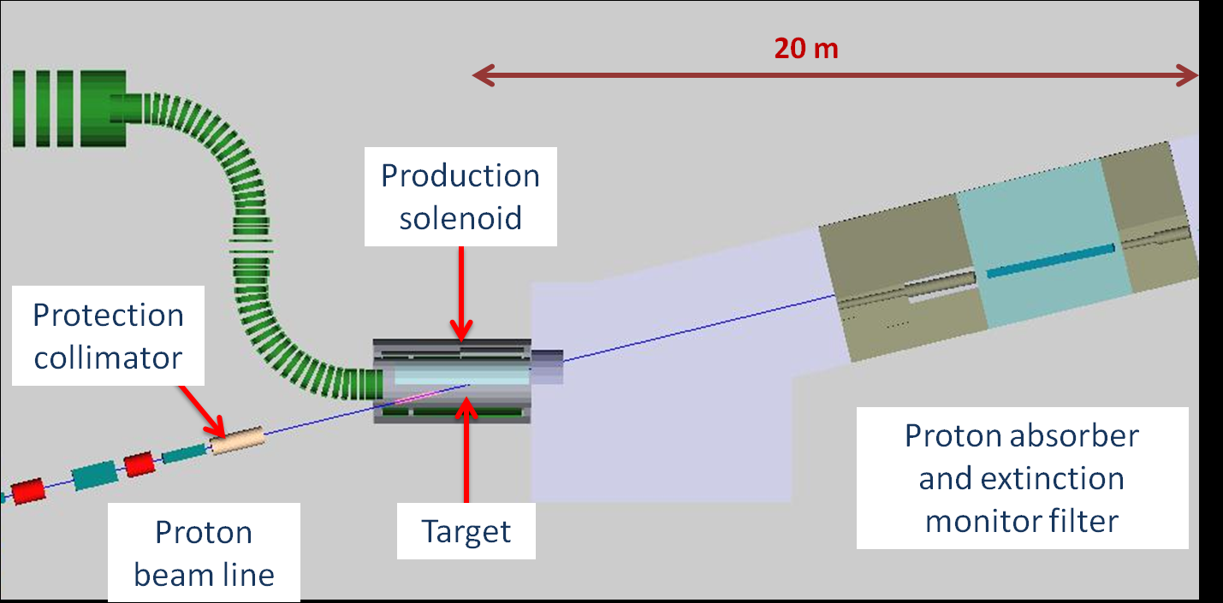
Mu2e—Target Extinction Monitor

Slide 9
Extinction Monitor Detector
Notes:
Description of basic components.
Production target off to bottom left.

Slide 10
Pixel Telescope System
8 detector planes
Upstream
Downstream
Permanent dipole magnet
Notes:
4.2 GeV protons enter from left. Low momentum particles are swept away by magnet.
Upstream: 1 sensor on each side
Downstream: 1 sensor on side, 2 sensors on back
Total 20 sensor modules

Slide 11
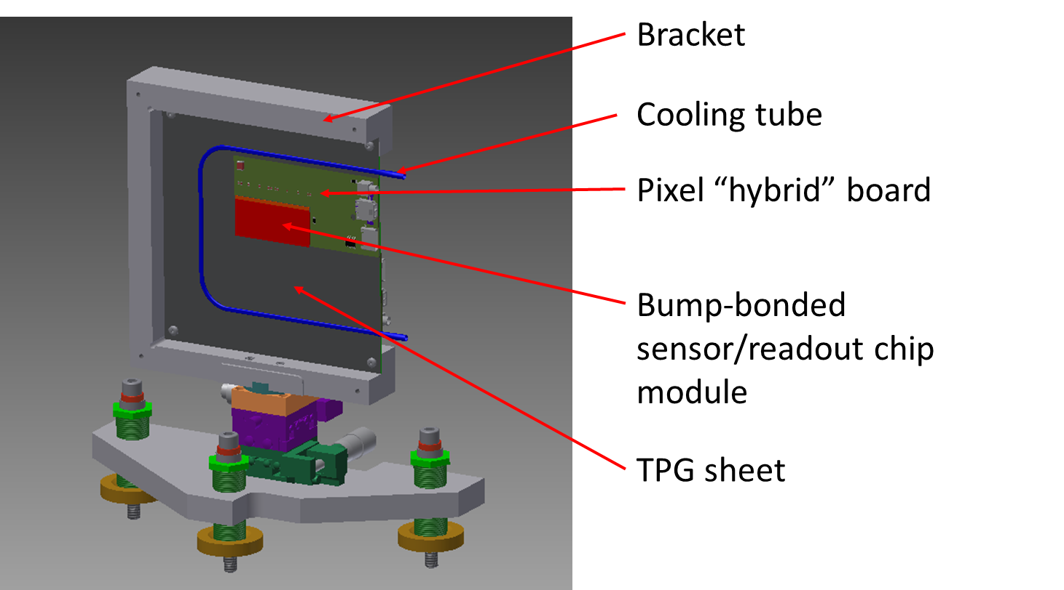
Pixel Plane
(heat speader)

Slide 12
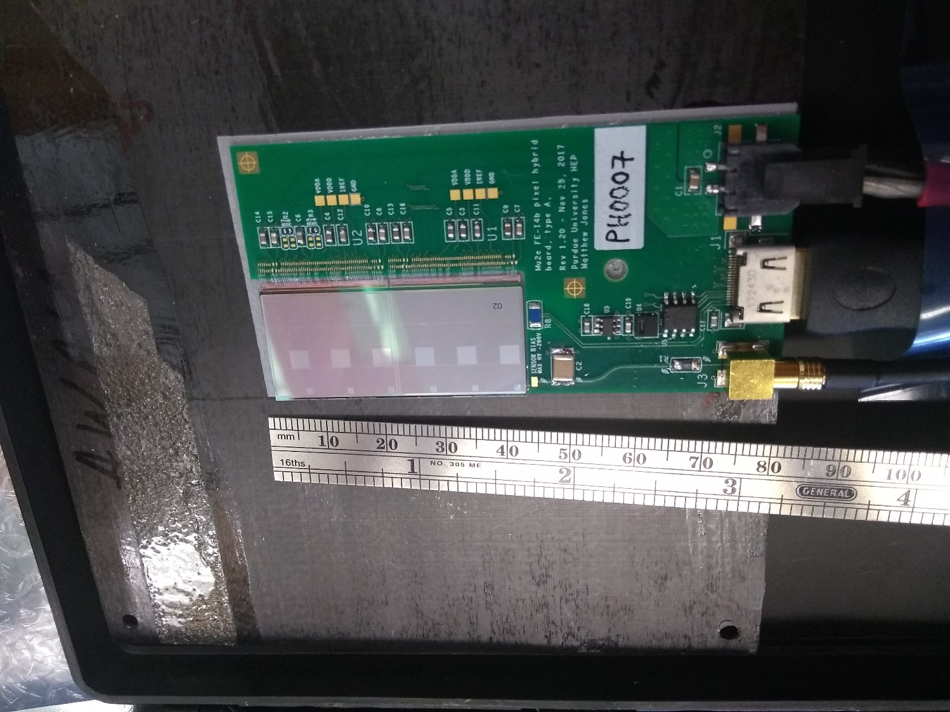
Pixel Plane

Slide 13
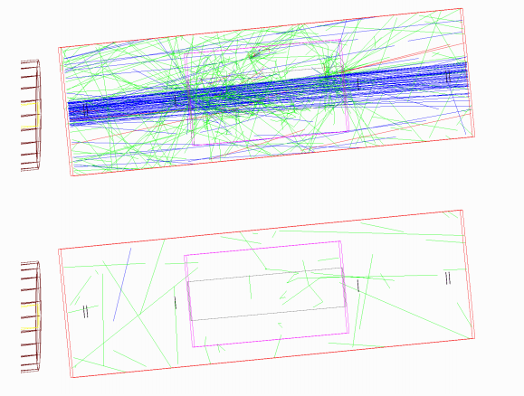
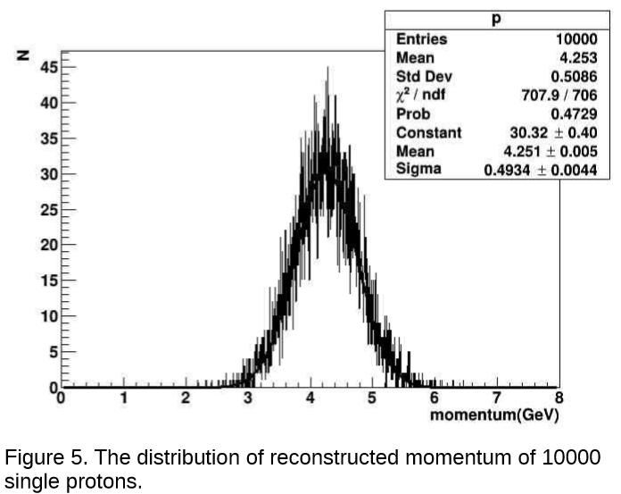
Pixel Tracker
designed for $≈25$ protons per pulse (safety margin for 16)
Need highly efficient track reconstruction
Low fake track reconstruction rate

Slide 14
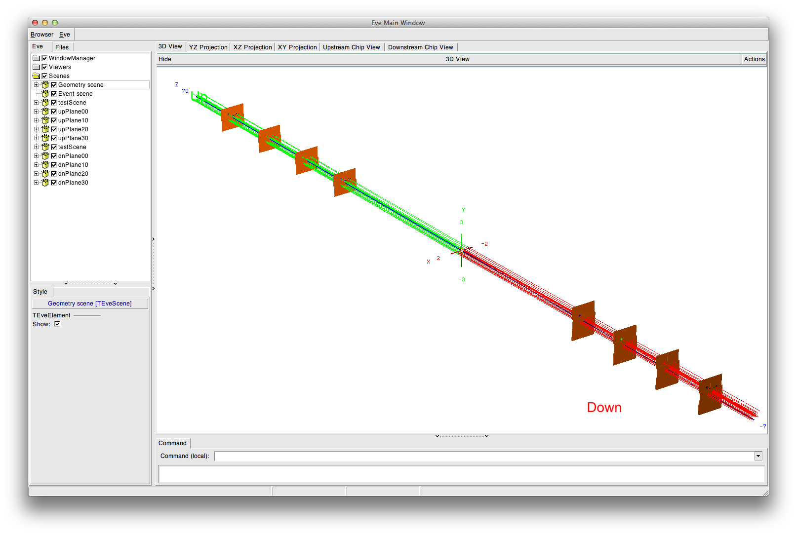
Extinction Monitor Event Display

Slide 15
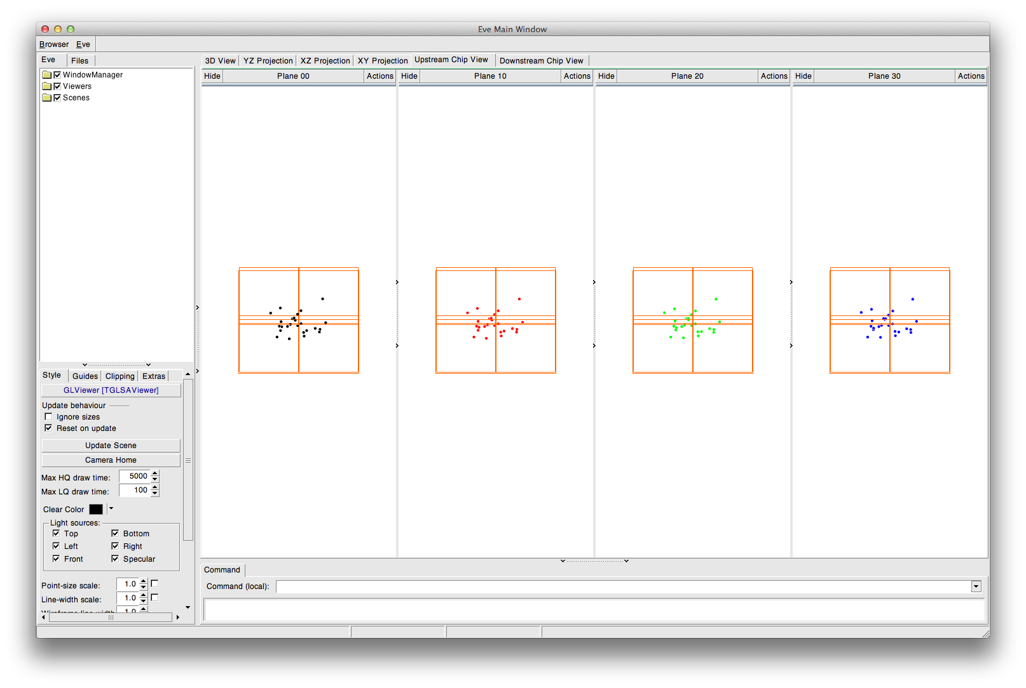
Extinction Monitor Event Display
Upstream
Downstream

Slide 16
Summary
Mu2e will improve limit on $R_{μe}$ by four orders of magnitude
Extinction requirement $<{10}^{−10}$
Extinction measurement is important to success
More information: http://mu2e.fnal.gov
Mu2e in this session:
Mu2e Straw Tracker design from Kate Ciampa and Fawzi Abusalma
Mu2e Calorimeter clustering studies from Emma Castiglia
Now Hiring for Post-doc positions!! Contact:
John Finley (finley@purdue.edu) or Matthew Jones (jones105@purdue.edu) or see https://jobs.physicstoday.org/jobs/11106208/postdoctoral-research-associate
Eric Prebys (prebys@fnal.gov) or see https://recruit.ucdavis.edu/apply/JPF02131

Slide 17
Questions?

Slide 18
Backup Slides

Slide 19
Extinction in 2 Steps

Slide 20
Extinction in 2 Steps

Slide 21
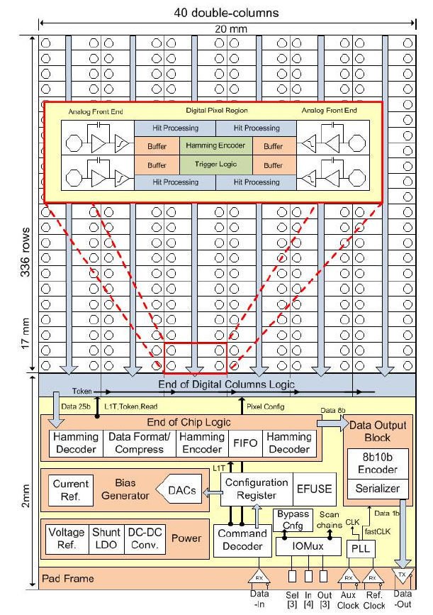
Extinction Monitor Pixels
Count 20-50 particles per pulse
Fully efficient for out-of-time particles
Very low false signal background
Pixel tracker
ATLAS FE-I4b pixel readout chip
80x336 pixel array (50x250 µm)
25 ns timestamp resolution
160 (or 320) MBPS data rate
Radiation hard (up to 300 Mrad)

Slide 22
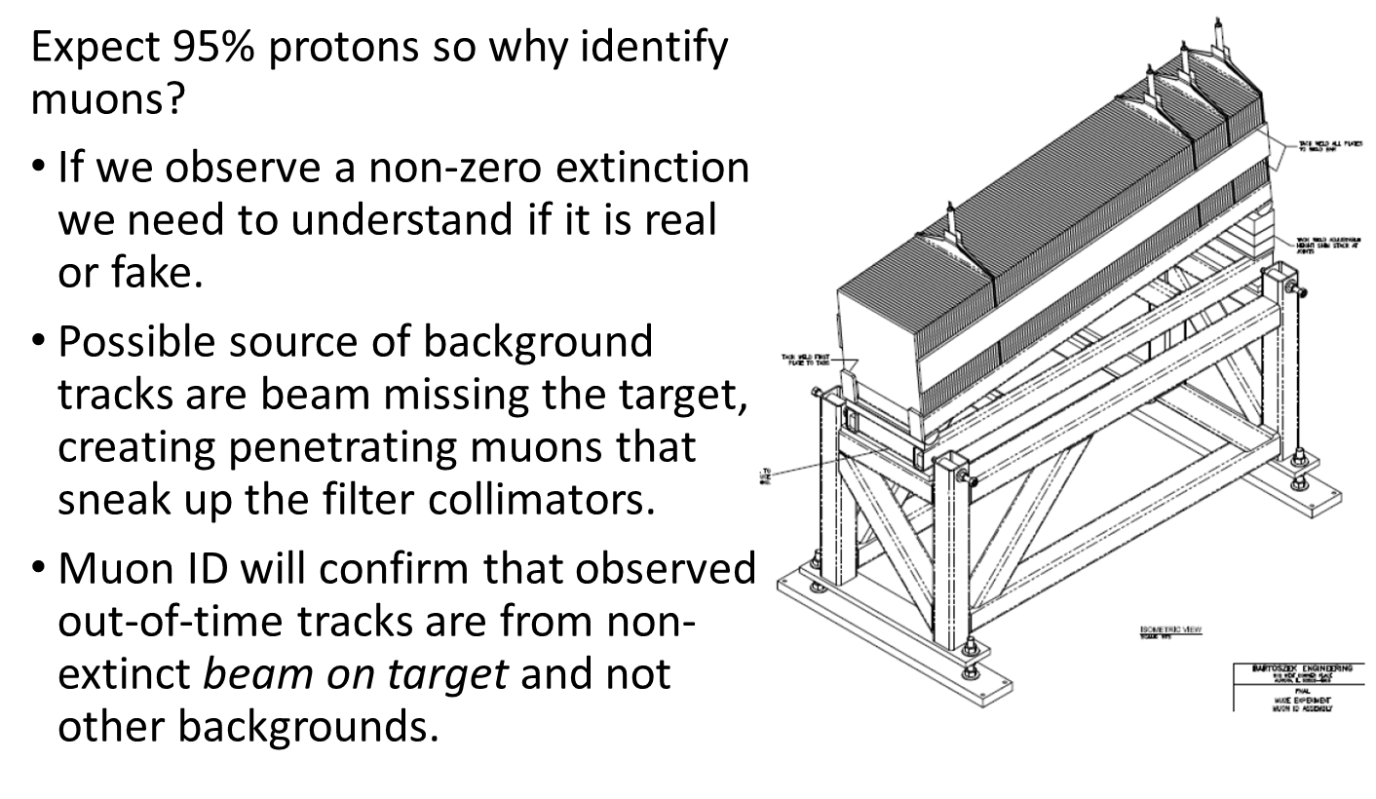
Muon ID

