Slide 1
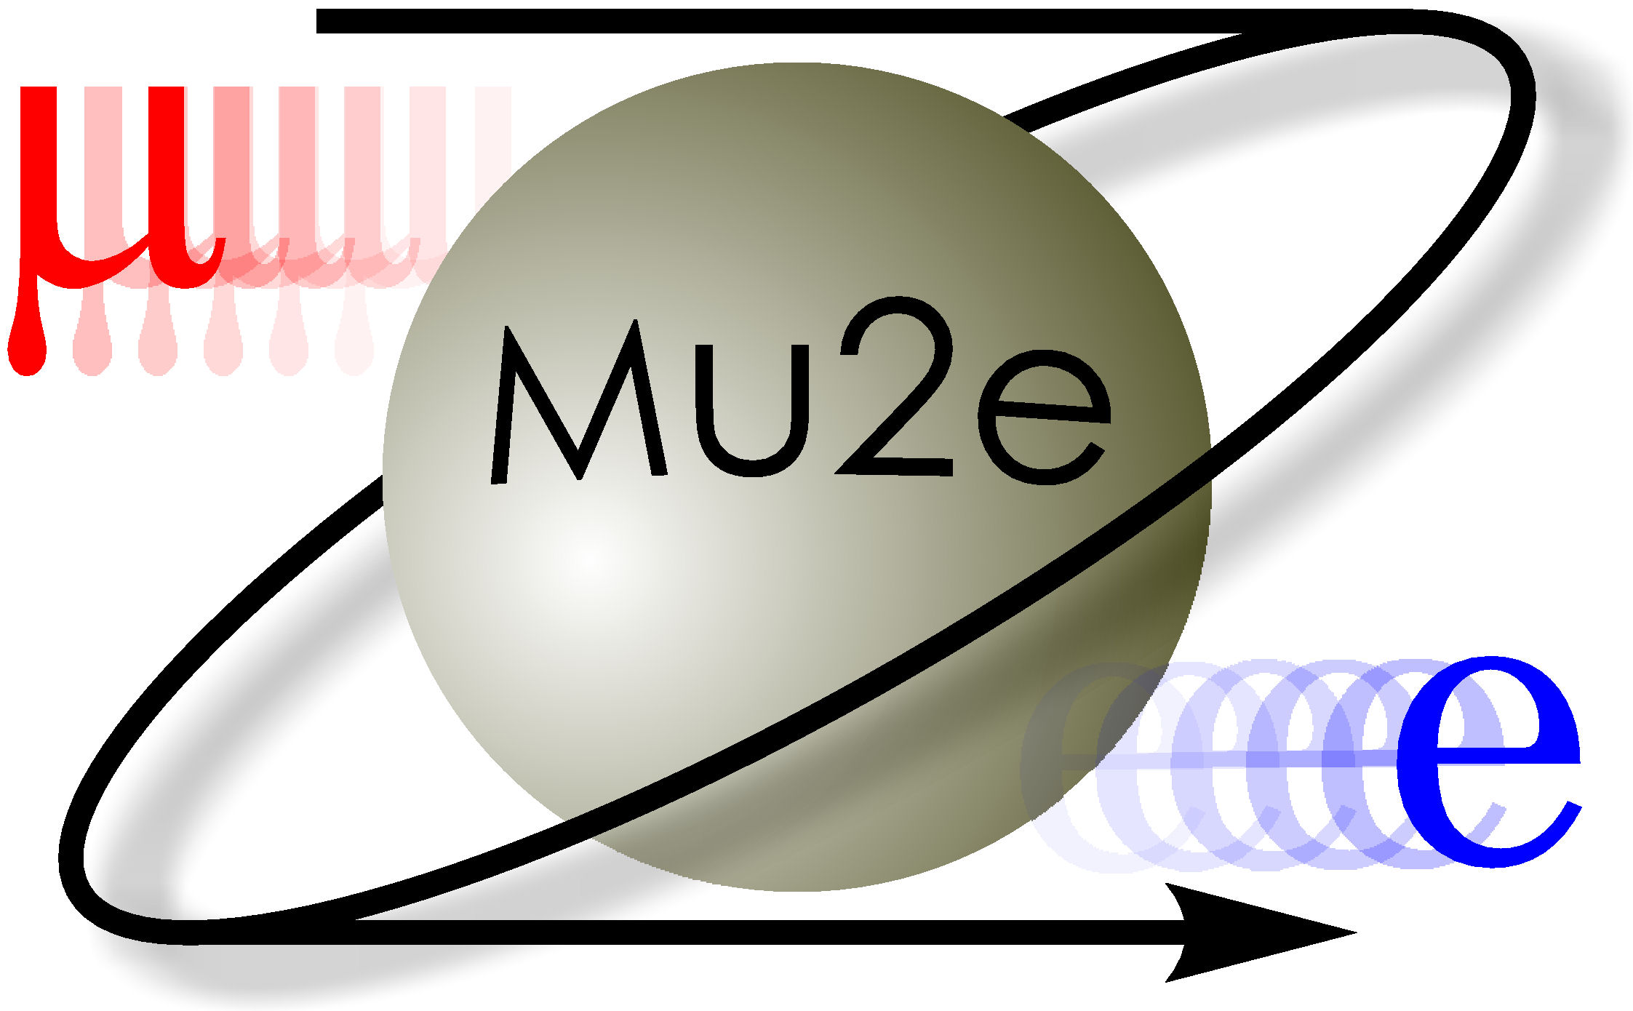

Mu2e Calorimeter Clustering Studies
Emma Castiglia
with Giani Pezzullo and Sarah Demers
Yale University
New Perspectives 2018

Slide 2
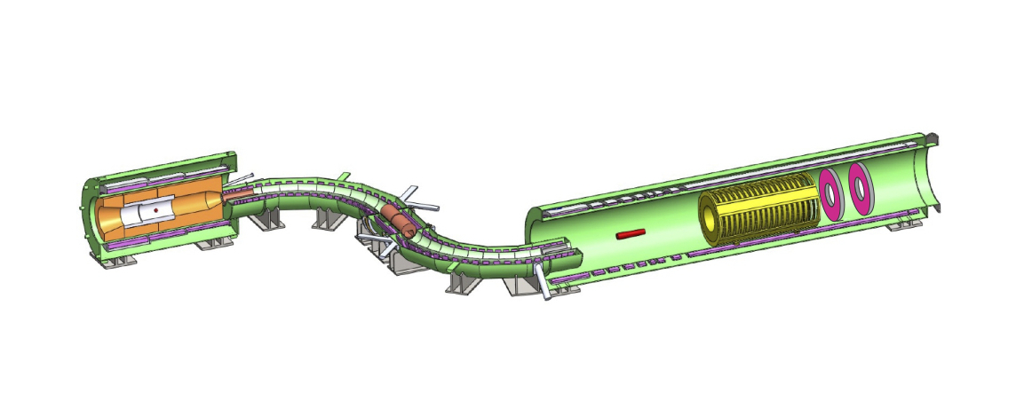
Mu2e Calorimeter Overview
Signal: 105 MeV Conversion
Electron (CE) without neutrinos
Requirements of Calorimeter:
  Energy Resolution: ~10%
  Timing Resolution: ~1ns
  Position Resolution: 1cm
Calorimeter Role:
  Particle Identification – reject bkg
    Cosmic Ray Muon
  Needs to be a trigger for data storage!
Production Target
Tracker
Stopping Target
Transport Solenoid
Calorimeter
Notes:
Detector solenoid???
cosmic rays induced backgrounds 2 components irreducible and reducible – identify mostly muons, calo and tracker can kill that, electrons generated from not stopping target – can trace back
irreducible – cosmic rays that look like they are from the stopping target – cannot stop that – create a CRV
requirements from particle identification performance

Slide 3
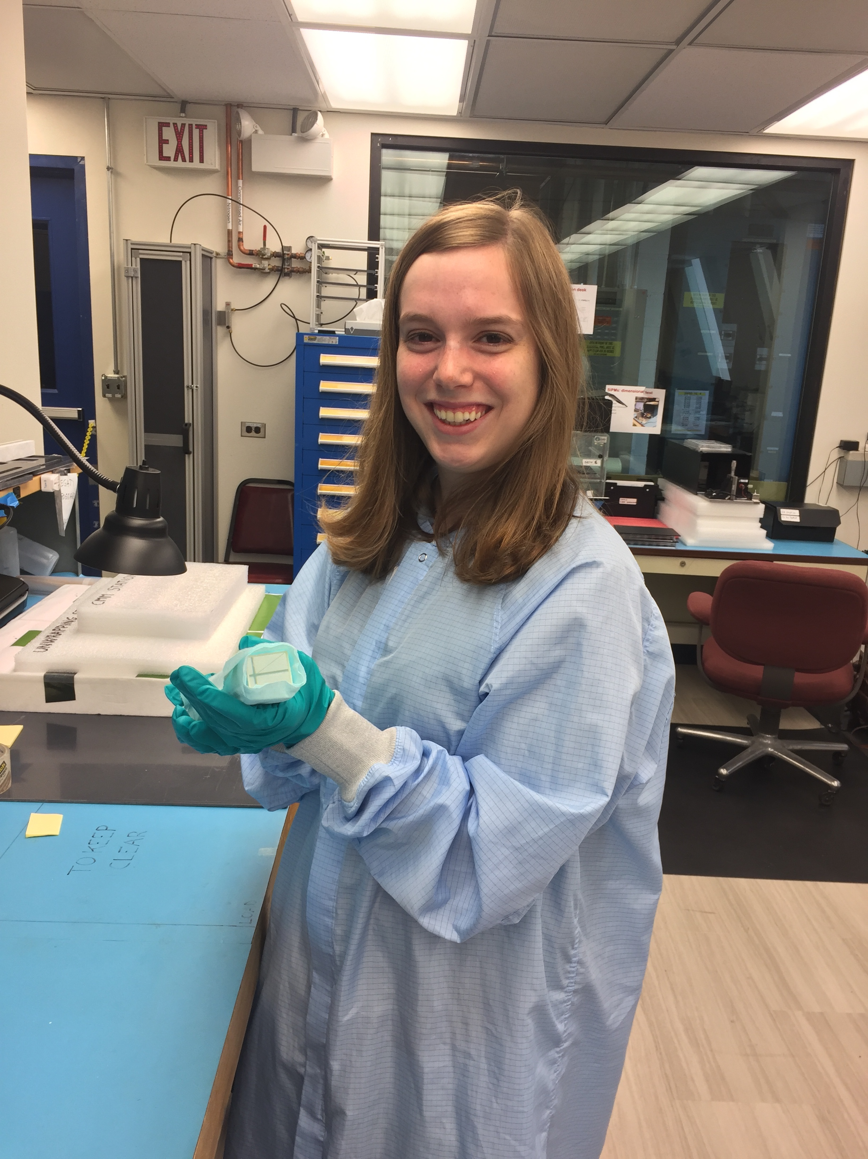
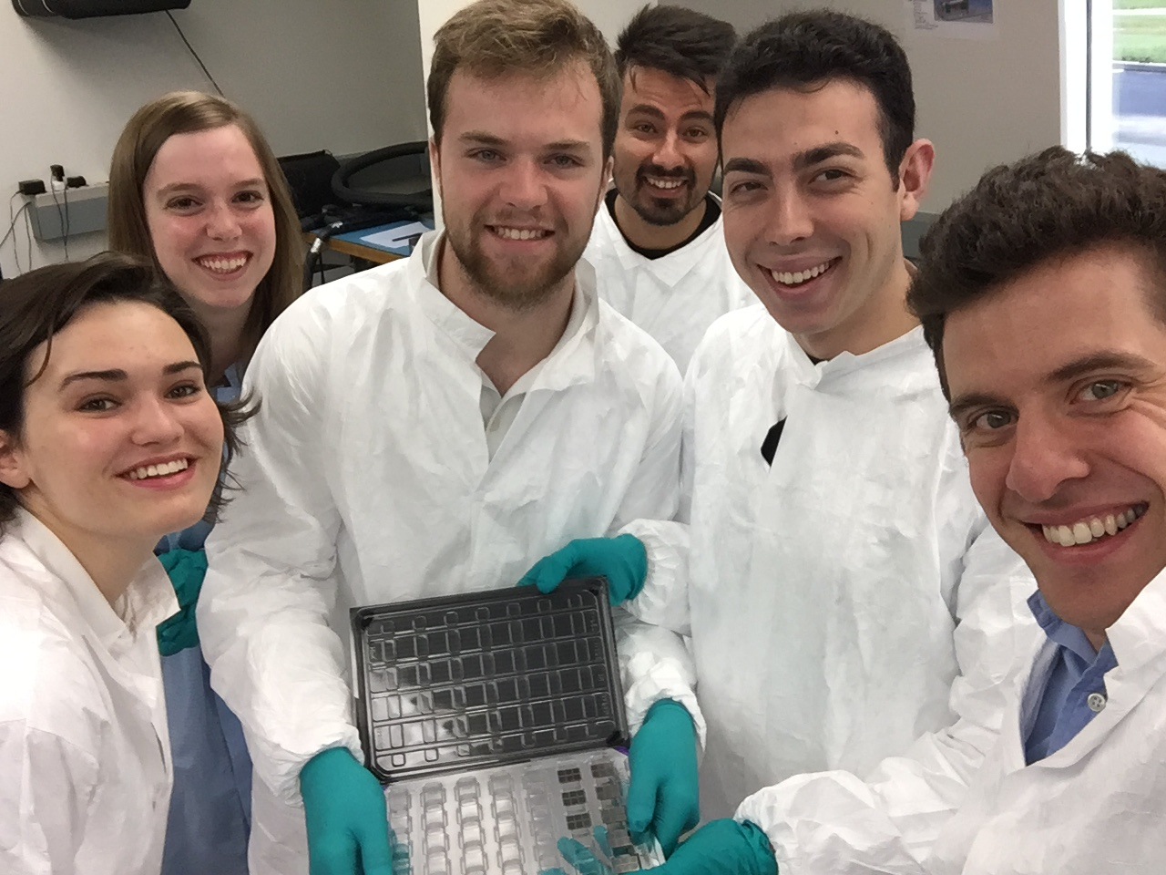
Mu2e Calorimeter Specifications
Two annular disks of undoped CsI Crystals
  Dimensions: 3.4x3.4x20 cm³
  Radiation length of 2.1 cm (~10 lengths in crystal)
  Total of 1356 crystals
Crystals are read out by 2x3 of 6x6 mm² UV-extended SiPM
Signal digitized at 200MHz
Measured performance at test beam (100 MeV)
  100ps is time resolution
  5% is energy resolution
Notes:
Silicon Photo multipliers – convert light deposited to energy? lower voltage required than normal PMT
Moliere radius is 3.5cm
2 arrays reading same crystal for redundancy – cannot be accessed frequently
200 mhz is 5ns
measured performance at test beam is 100ps and 5% energy resolution at 100MeV

Slide 4
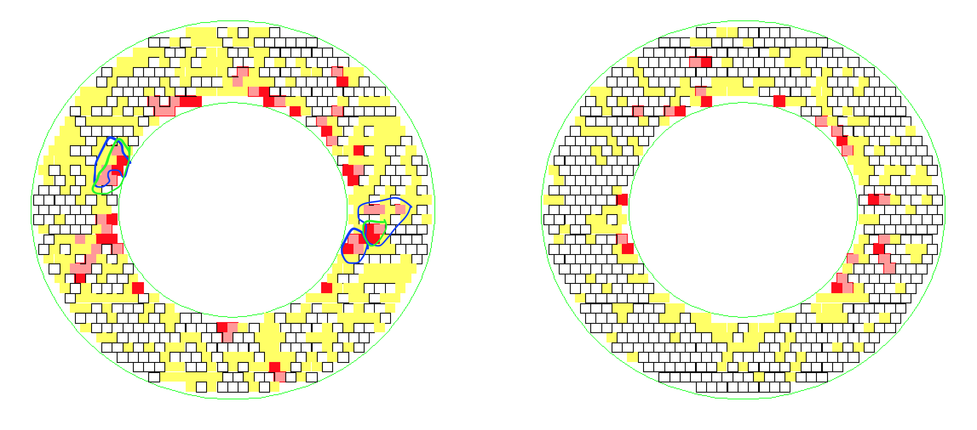
Mu2e Calorimeter Clustering
How it works?
Sort crystal hits by energy deposited and then group adjacent ones
2 algorithms that do this differently
    Full (proto): Slower but more Accurate – use in offline reconstruction
    Fast: Quicker and Simple– could be trigger if runs in real time
If able to identify potential signal events, can trigger on those events
Notes:
white is below threshold we set
neighbors – time domain and geometrical domain
energy threshold ~1 MeV

Slide 5
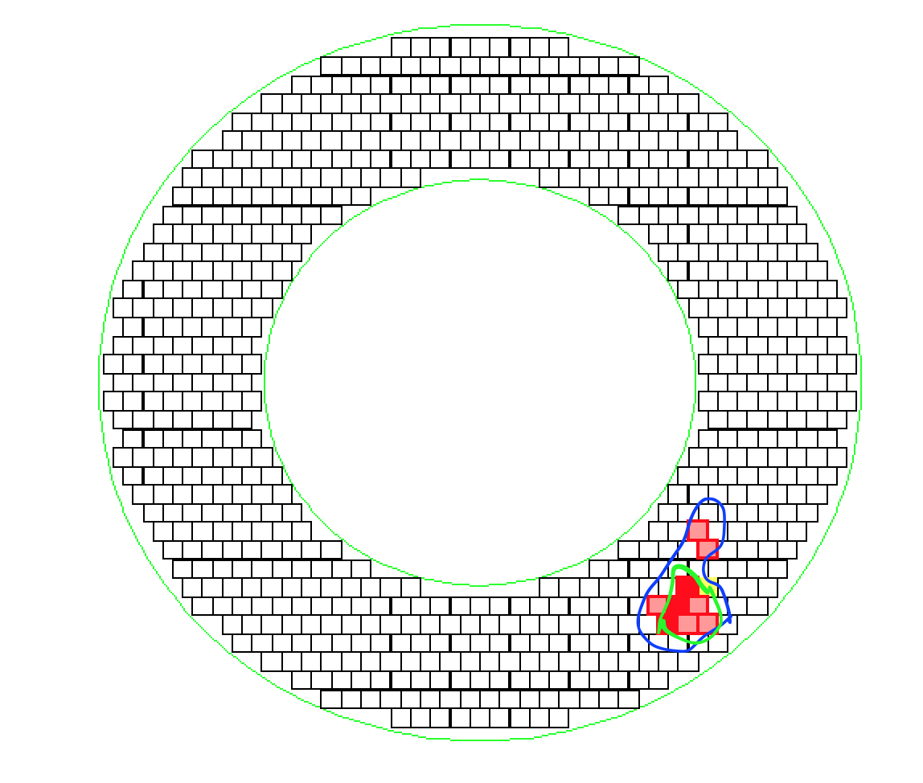
Fast Algorithm for Clustering
  Steps:
  Take highest energy crystal – seed with >10MeV
  Look at neighboring crystals over energy threshold and group - green
  Remove crystals that are clustered together from list of crystals
  Start process over with next highest energy crystal
Modification:
Include next, next to next neighbors, etc
Adds time:
1 ring – 6 crystals
2 rings – 12 crystals
3 rings – 18 crystals
Fast

Slide 6
Full Algorithm for Clustering
  Steps:
  Take highest energy crystal –> seed with >10MeV
  Look at neighboring crystals over energy threshold and group
  Look at non-adjacent crystals with large energy deposits - blue
  -> could be deposited by photons emitted (within speed of light)
  3a. Sometimes end up grouping two smaller clusters into one larger cluster
  Remove crystals that are clustered together from list of crystals
  Start process over with next highest energy crystal
Full

Slide 7
Goals for Clustering Studies
GOAL 1
Compare Fast and Full Algorithms for accuracy and timing performance
GOAL 2
Find discriminating variables for improving CE selection from background

Slide 8
  How do we know if we are correctly identifying conversion electrons (CE)?
Use information from the Virtual Detector
G4 sensitive detector right before the calorimeter that stores the information of particles passing through it without affecting them
    Can get energy, radial position, etc. about the incoming CE
    Truth – has conversion electron events that may miss the calorimeter

Slide 9
Virtual Detector – Acceptance
Acceptance: 95%
Leakage: Sharp Edge - detector is 20cm deep and 30cm wide
->shower loss due to depth/reflection
Energy resolution:
Full: 6.4%
Fast: 8.6%
FWHM:
Full: 6.2 MeV
Fast: 8.2 MeV
Events
MeV
Notes:
depth is big issue
particles can be emitted backward! pair production, radiation, so we don’t catch all energy with time windows
fraction of shower contianed
performance extra 1 million
less particle going backward to the shower

Slide 10
Timing Comparison
  Have a few ms per event within which to trigger on or reject
  Calo Cluster Fast:
  ~.2ms per event
  Includes fast processing of digitized hits
  Full Clustering:
Algorithm takes 2.3ms per event
Needs Template Fit: 25ms per event
Complete time for each event is >27ms
=> Fast Algorithm is more robust – could use as trigger
Voltage
time

Slide 11
Energy versus Cluster Size - Fast
MeV
CE Only:
Peak at 80-100 MeV and 6-9 crystals
Background Only:
Peak at 10 MeV and 1 crystal
Calo Disk
Calo Disk
inner edge
# of Crystals
MeV
# of Crystals
Notes:
Edge effect of algorithm

Slide 12
Comparing CE and bkg only - Fast
ENERGY
Drop off at ~50 MeV
Distinctive background shape
RADIAL POSITION
Drop off at 410mm
Normalized Events
Normalized Events
MeV
mm

Slide 13
Comparing CE and bkg only - Fast
RATIO OF SEED TO CLUSTER ENERGY
Background has more clusters with only 1 crystal
Normalized Events
Seed Energy/Cluster Energy

Slide 14
Conclusion and Next Steps
  Results so far:
  Fast is quick and performs well enough to be used during triggering
  Energy resolution of Full could be improved in Offline
  Variables that could be used to differentiate:
    Energy and Size
    Radial Distance
    Ratio of Seed Energy to Cluster Energy
  Next Steps:
  Look at adding more rings of neighbors to Fast
  Change minimum energy cutoff for clusters – currently 10 MeV

Slide 15
Questions?
  Thanks for listening!

Slide 16
Backup Slides

Slide 17
FWHM Fits
Events
Events
Crystal Ball
Crystal Ball
MeV
MeV
Events
Events
Gaussian
Gaussian
MeV
MeV
Notes:
remove entries

Slide 18
MC comparison of Recon with VD
Reconstructed Clusters miss energy as compared to the MC energy
Proto Algorithm has more accurate reconstruction energy
                Fast:
                Mean: 1.7
                σ: 1.81
                Full:
                Mean: 0.87
                σ: 1.26
Events
MeV
Notes:
remove entries

Slide 19
Virtual Detector Truth – Radial Position
CE Only
Events
Full
mm
Notes:
dimension of crystal is 34 mm

Slide 20
Current list of histograms
1 –D
Timing of cluster
Energy of cluster
Energy of clusters over 50MeV
Radial position of cluster
Energy of clusters outside 450mm
Angle of Cluster
Angle if cluster >2 crystals
Cluster Size
Seed Energy
MC truth w/recon energy
MC truth w/MC energy
Energy diff (MC – Recon)
Ratio of Seed Energy to cluster energy
Highest Energy Cluster:
Recon Energy of cluster
Radial position of cluster
Angle of cluster
Size of cluster
2 –D
Energy vs. Cluster Size
Energy vs. Angle
Energy vs. Time
Energy vs. Radial positon
Comp of MC and Recon crystal energy
Comp of MC and Recon Seed Energy
Comp or Ratio to Cluster Energy
Comp of Seed and Cluster Energy
Virtual Detector
Radial of True
Energy of True
Energy Missed by Fast
Energy Missed by proto

