Slide 1
Muon g-2 at Fermilab
Cristina Schlesier
University of Illinois at Urbana-Champaign
New Perspectives
19 June 2018

Slide 2
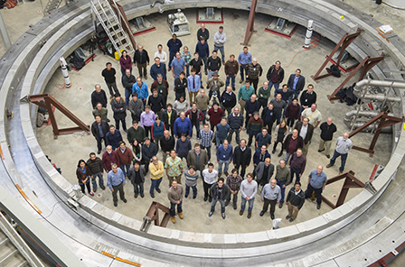
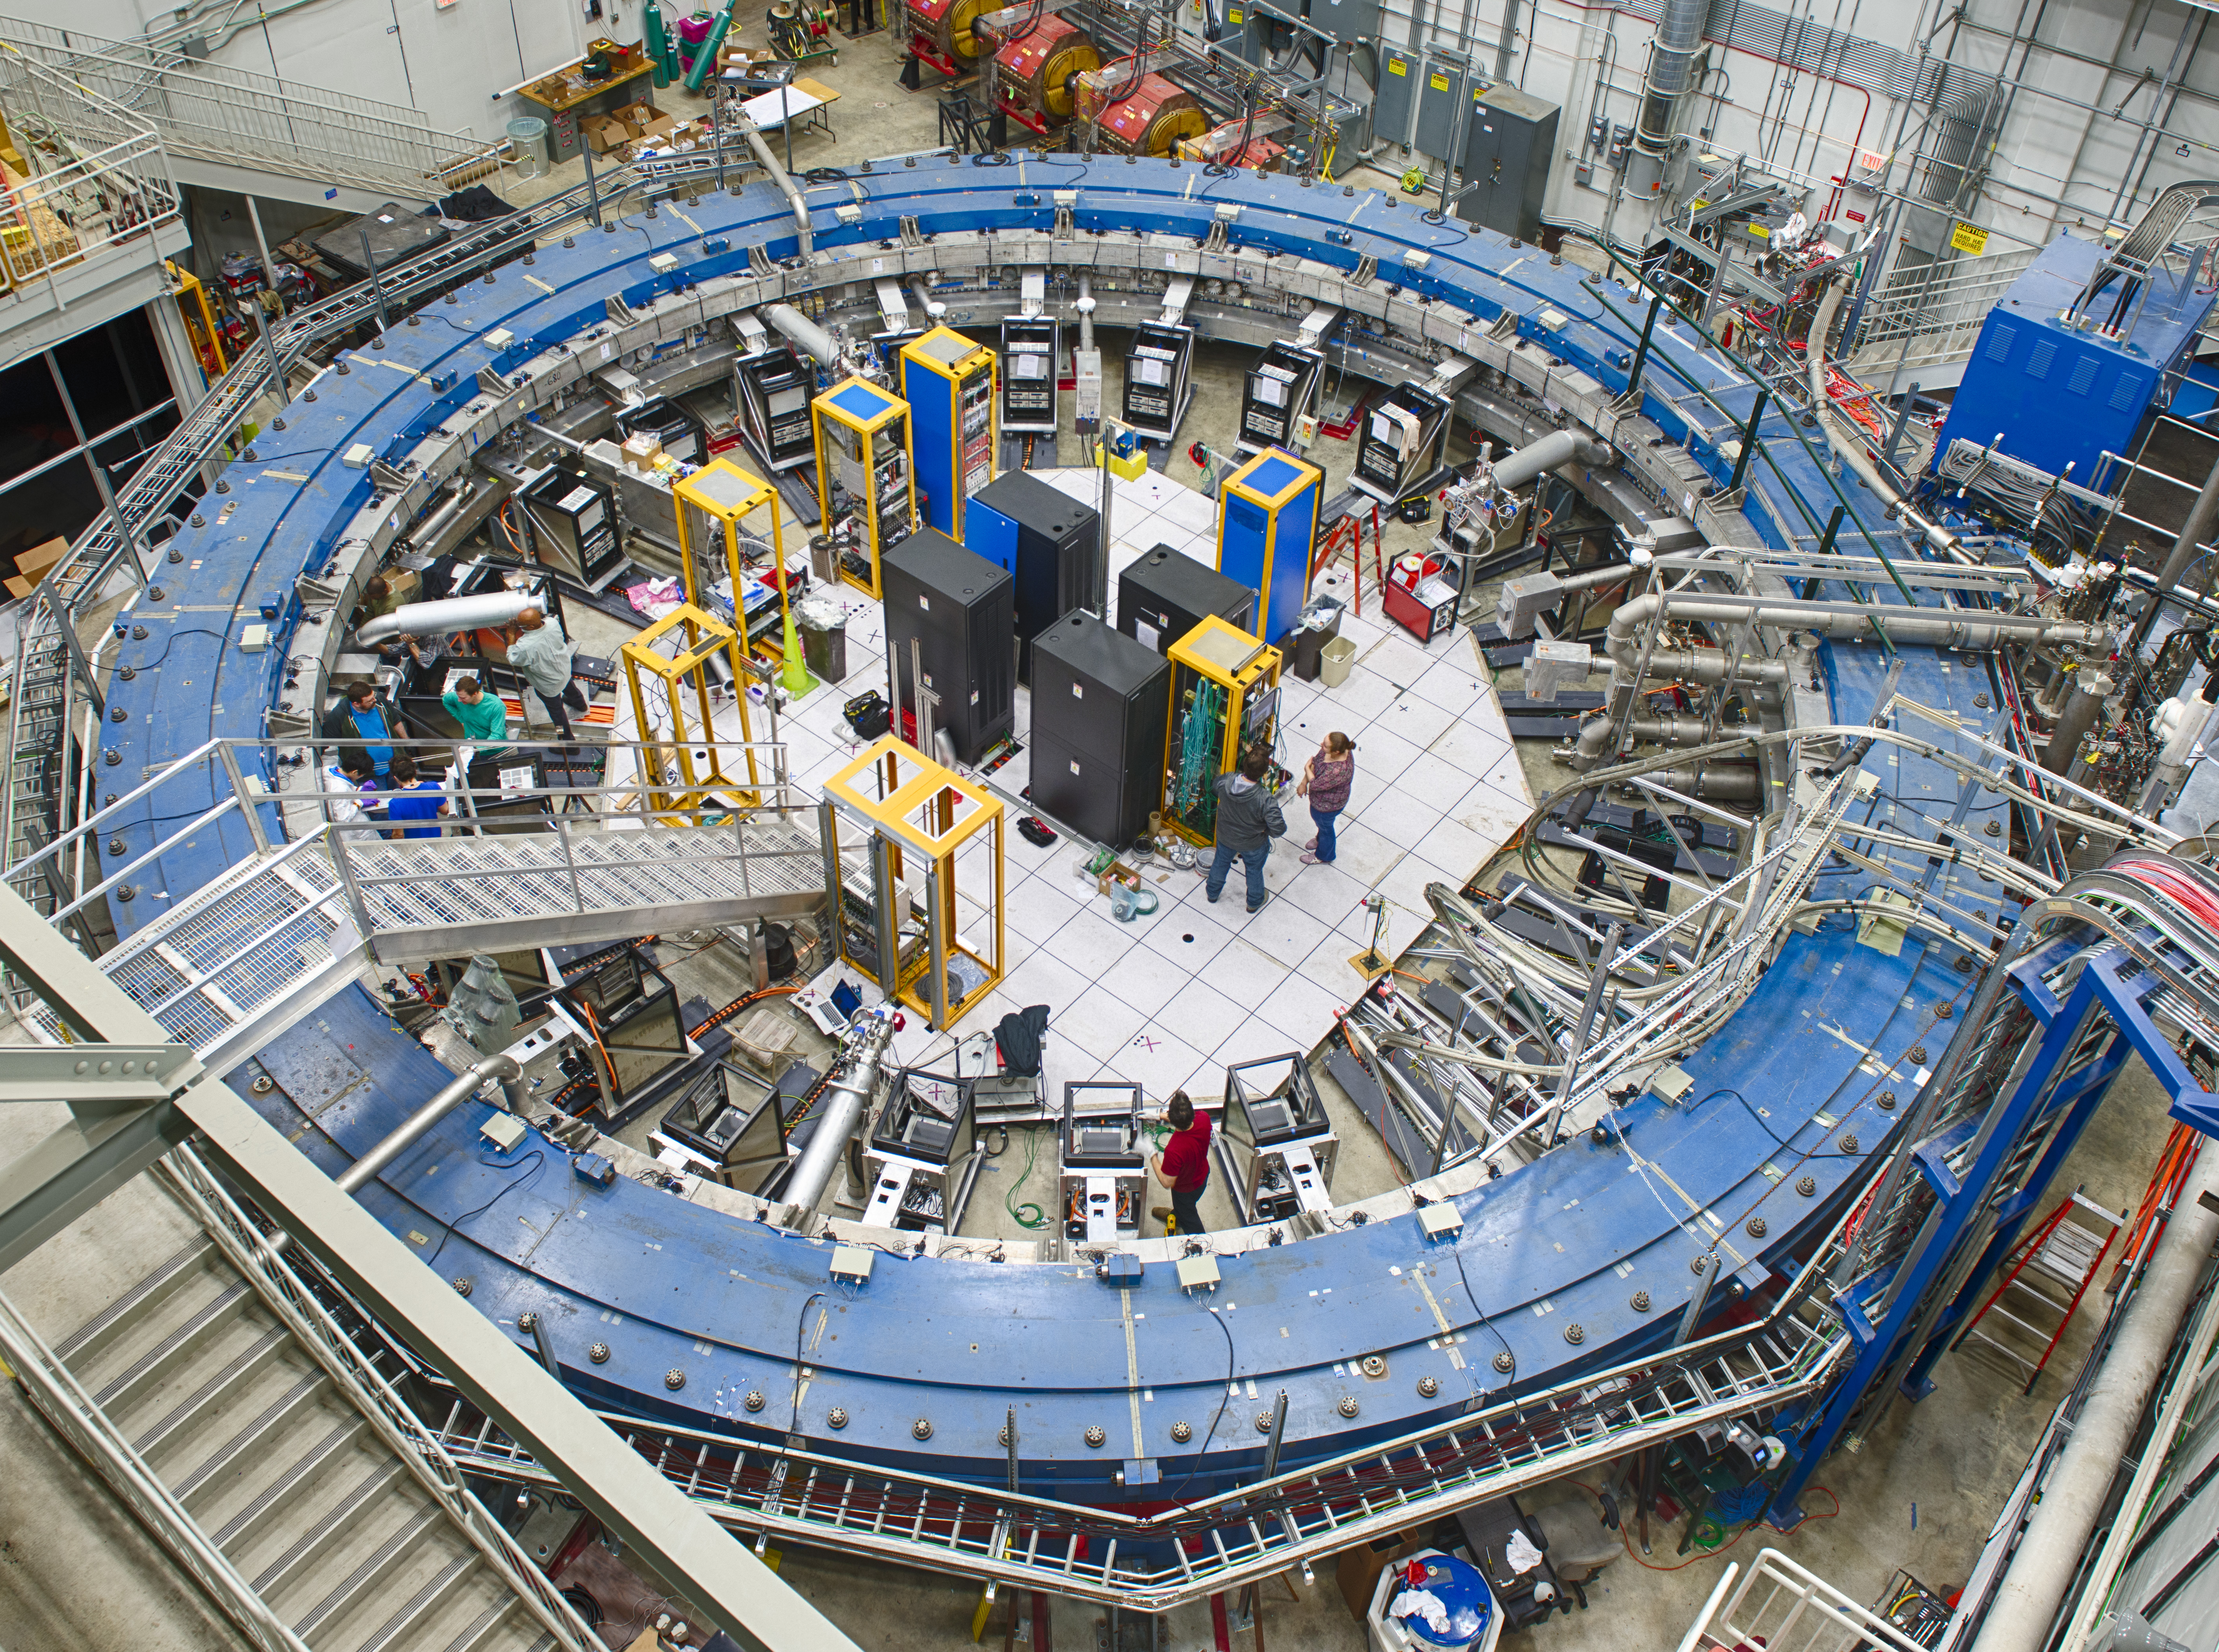
Outline of this talk*
Motivation
Experimental Technique
Hardware
Status
*magnetic field covered in next talk by R. Osofsky
Notes:
7 countries
34 institutions
~185 authors
Backup slides to include
standard model prediction
How omega_a and omega_ p are extracted

Slide 3
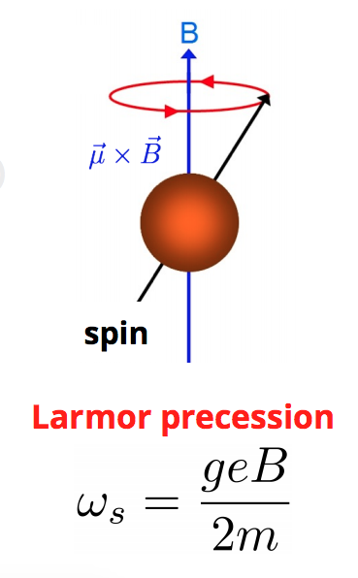
What are we doing and why?
Measuring the magnetic moment of the muon
Muon mass ~105 MeV (200x electron mass)
Muon lifetime 2.2e⁻⁶ s at rest
Produced via pion decay
Muon decay via weak interaction
Magnetic moment
where the g-factor relates spin to magnetic moment
Notes:
Weak interaction – only left handed muon neutrinos are produced in the pion decay
Thus the emerging muon(+) has its spin antiparallel to its momentum direction

Slide 4
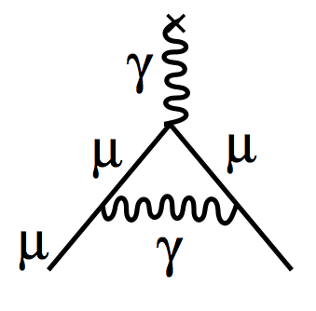
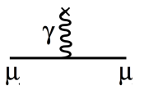
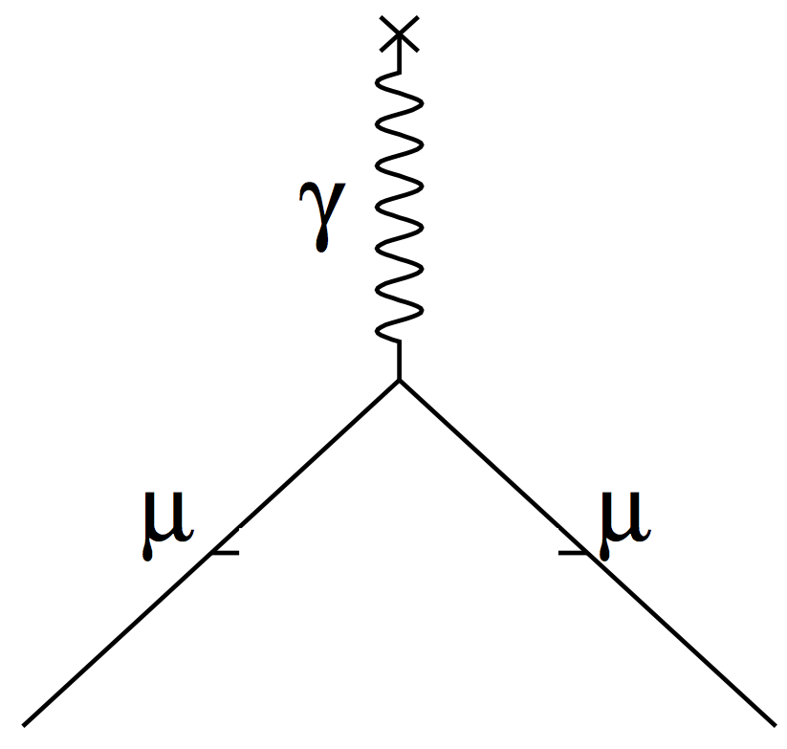
What are we doing and why?
First Dirac, g=2
Then Schwinger, g>2
+
… + many more contributions
$$a_{μ}^{SM}=a_{μ}^{QED}+a_{μ}^{EW}+a_{μ}^{HVP}+a_{μ}^{HLBL}$$
μ = (1+a)*(e/2m) s
Pure Dirac part + anomalous part
$a_{μ}=\frac{1}{2}\left(g−2\right) ;$ “anomaly”
a_{μ} can be calculated by SM to high precision – a deviation from a_{μ} could be evidence of new physics
+ BSM?
?
Notes:
Dirac predicted g=2
but interactions with virtual particles perturb this value
The anomaly is defined by a deviation from the expected g=2
This anomaly can be calculated using the SM
A deviation from a_mu would be evidence of physics beyond the SM
Anomaly of muon is more sensitive than electron because of heavier mass

Slide 5
Evidence for discrepancy with Standard Model?
BNL E821 precision: 540 ppb
Goal of new experiments:
- Fermilab : 140 ppb - J-PARC: 370 ppb in phase 1 / 100 ppb in phase 2
F. Jegerlehner, arXiv:1804.07409
Notes:
Mistakes in theory calculation
Unaccounted for systematics in experiment
Or
New physics

Slide 6
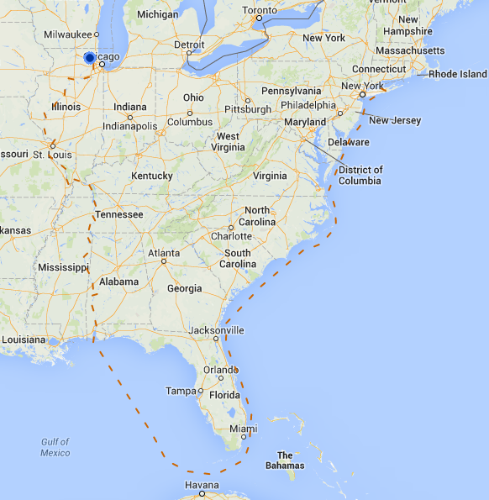
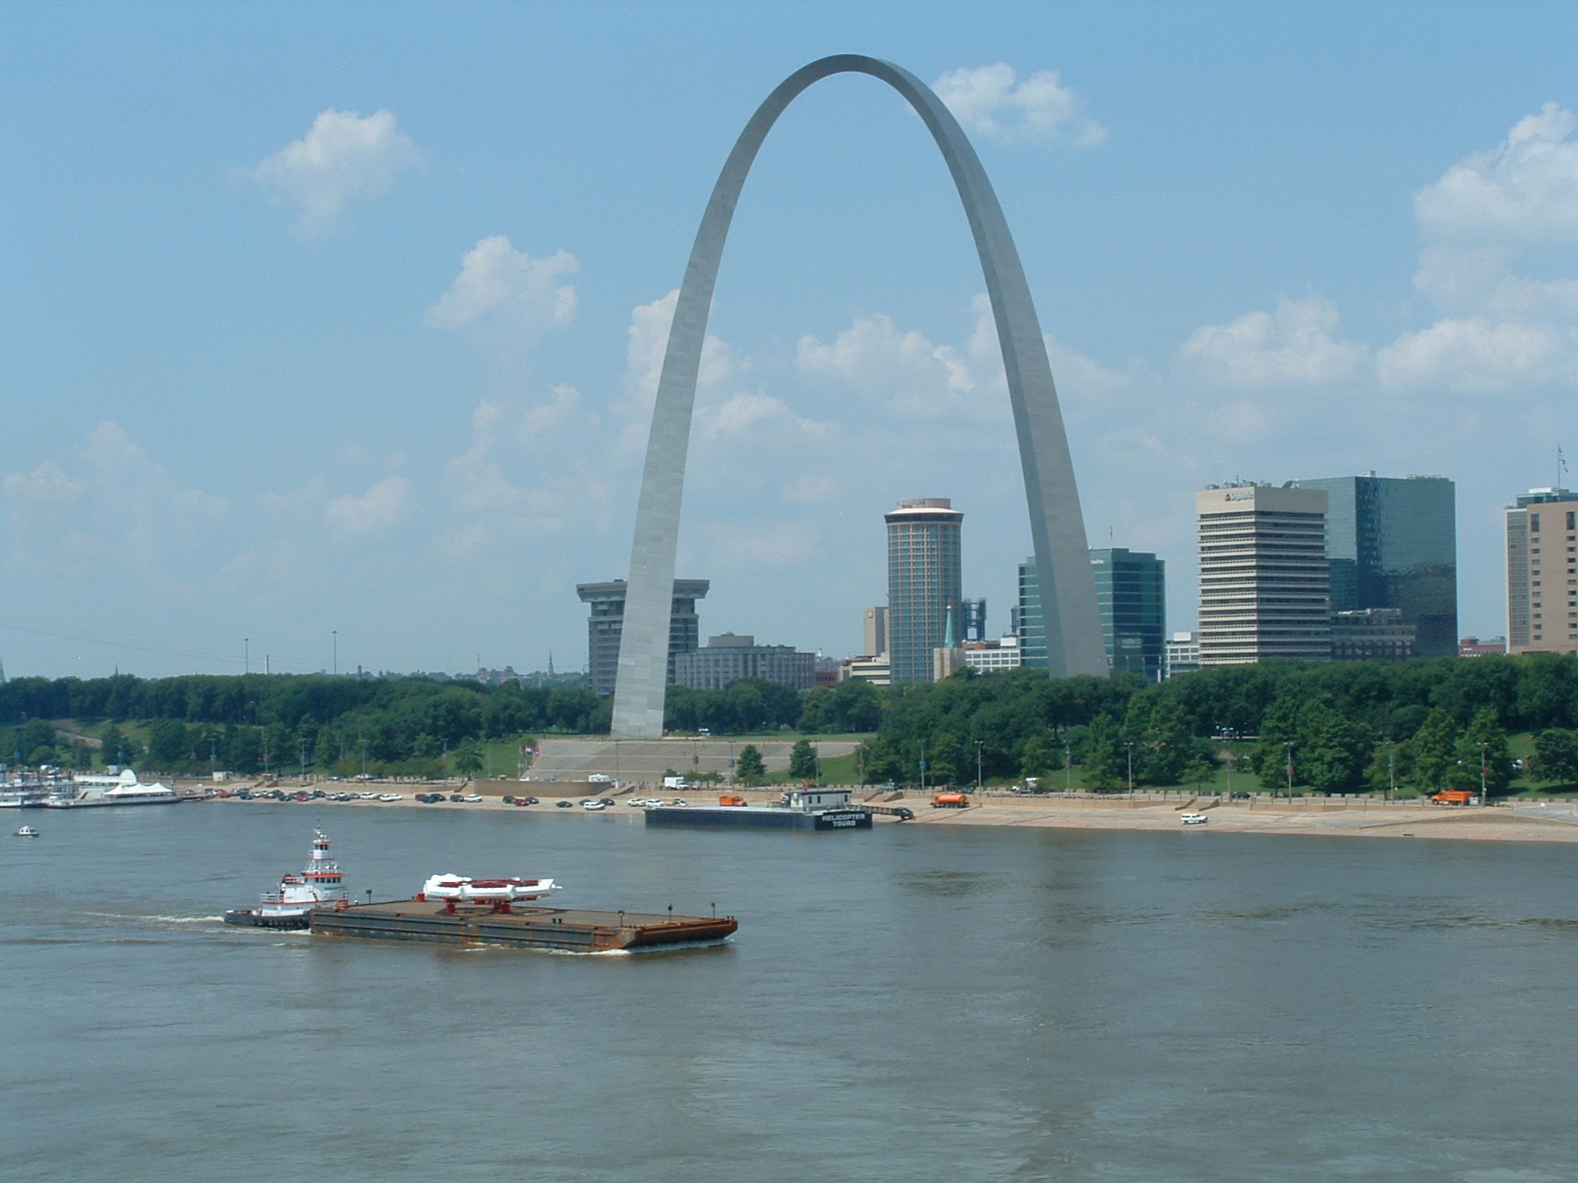
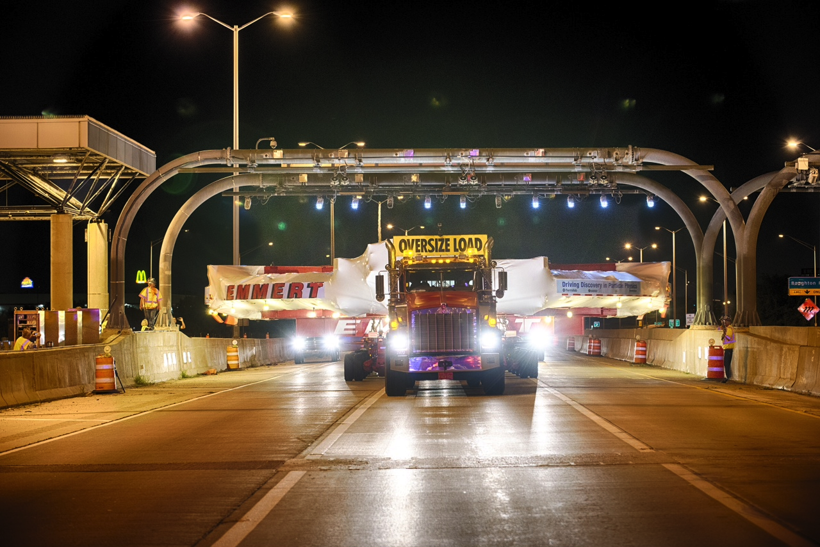
Built on the foundations of Brookhaven experiment (E821)
Some major components reused (after refurbishing):
- Magnet - Inflector*
- Vacuum chambers But also many new designs:
- Beamline - Detectors - Kicker - Electronics - DAQ/Computing
*new inflector is under construction

Slide 7
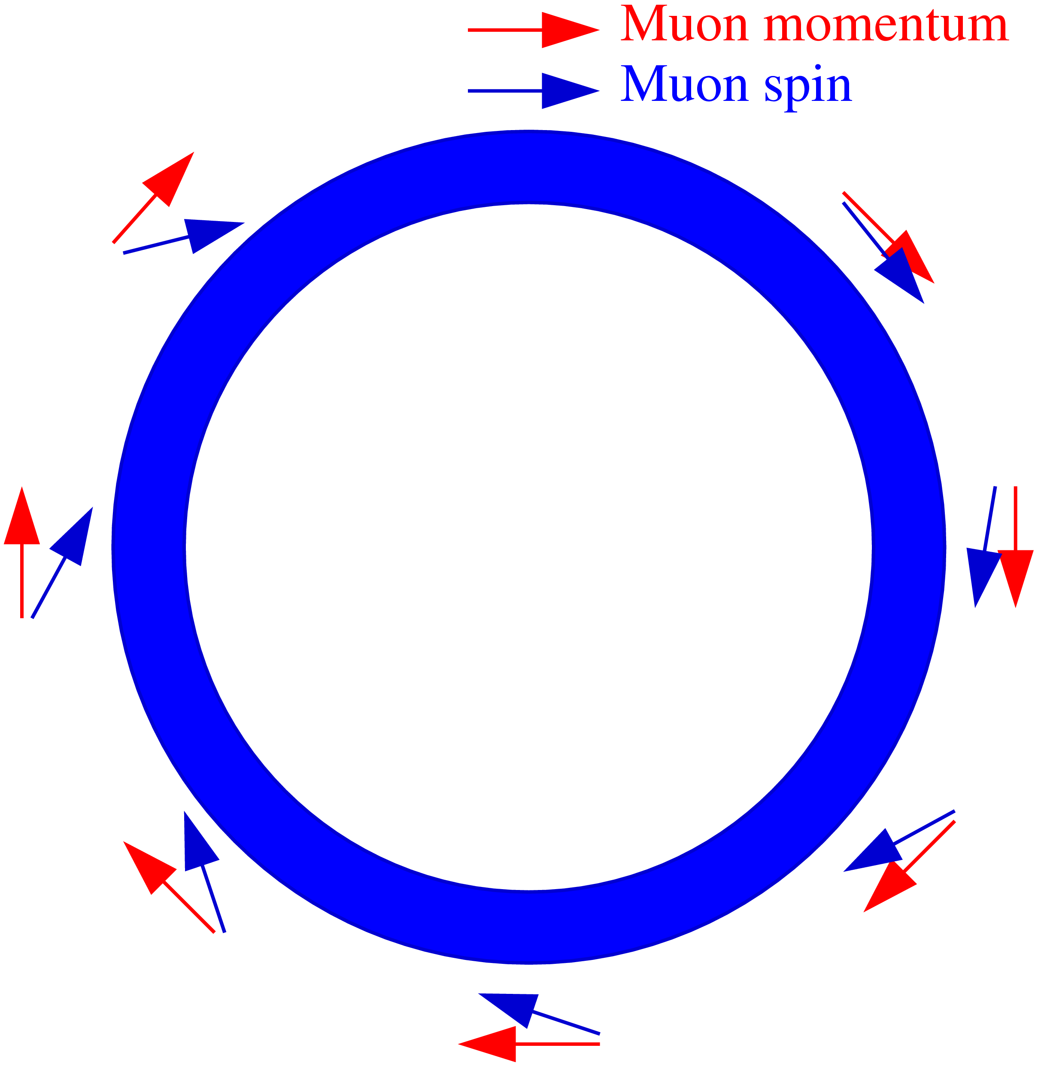
Basic principle of Muon g-2 Experiments
$$\vec{B}$$
Anomalous precession frequency:
$$ω_{a}∝g−2$$
We store a polarized beam of muons in a uniform magnetic ﬁeld and observe the spin precession.

Slide 8
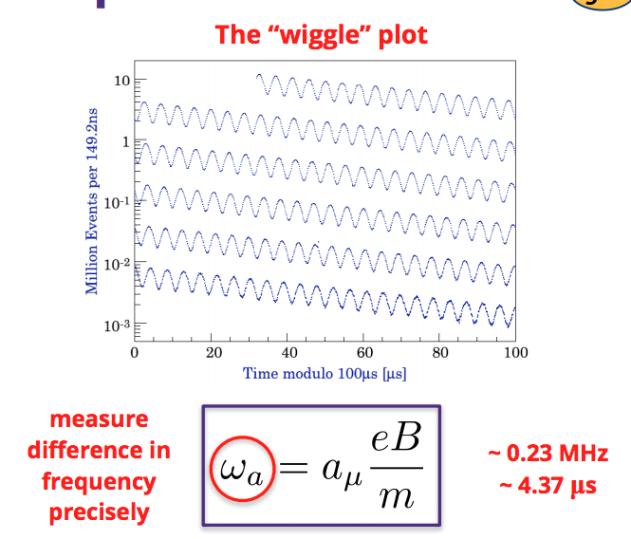
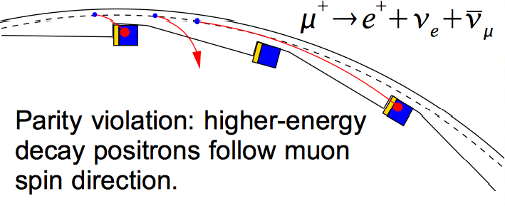
Measured quantities ω_{a} and ω_{p}
ω_{p} : muon distribution weighted field
ω_{a} : Larmor and Thomas precession frequency minus cyclotron frequency

Slide 9
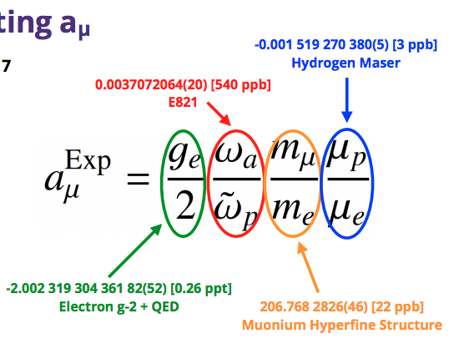
How are we measuring g-2?
Notes:
Backup slides to include
standard model prediction
How omega_a and omega_ p are extracted

Slide 10
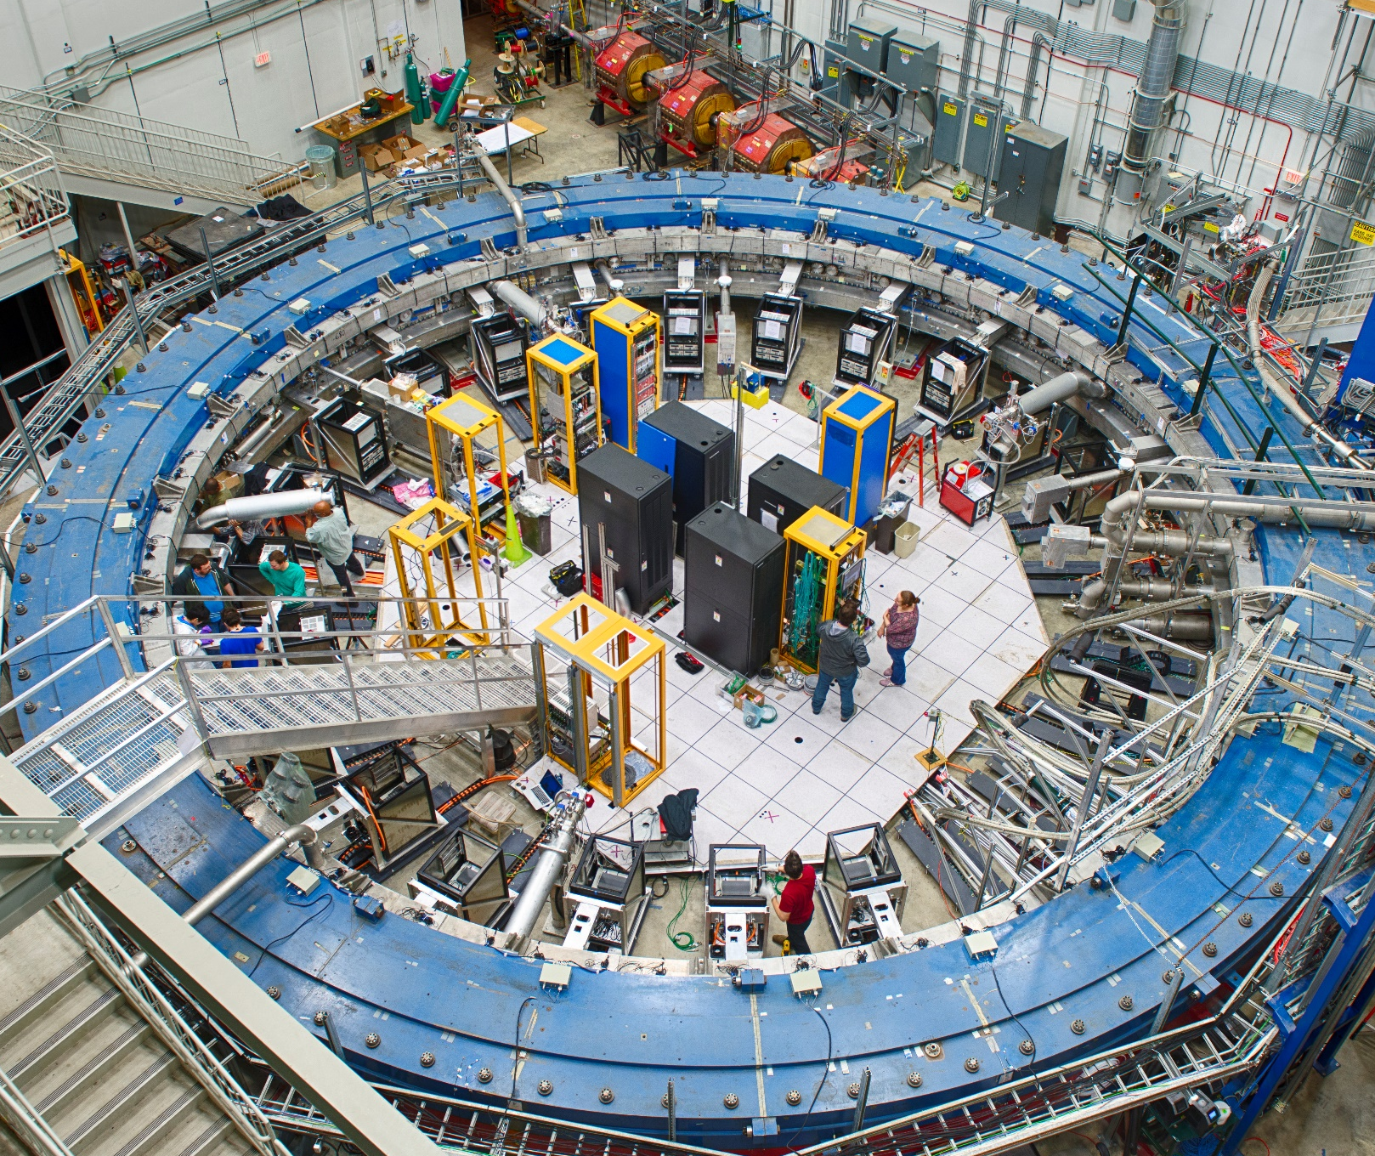
Muon g-2 at Fermilab
Parameters
r = 7.112 m p_{µ} = 3.09 GeV/c (“magic”) γτ = 64.4 µs
B = 1.45 T τ_{c} = 149 ns τ_{a} = 4.37 µs
Notes:
700 tons of iron yoke
Cyclotron period of 149 ns
Electric field cancels in first order at magic momentum
Still need electric field corrections however bc not every muon is on the magic orbit at the magic momentum

Slide 11
Magnetic field shimmed to 10 ppm
…requiring a different scale for the graph.
Started with this . . .
…and ended up with this!
Blue: Brookhaven
Red: Fermilab

Slide 12
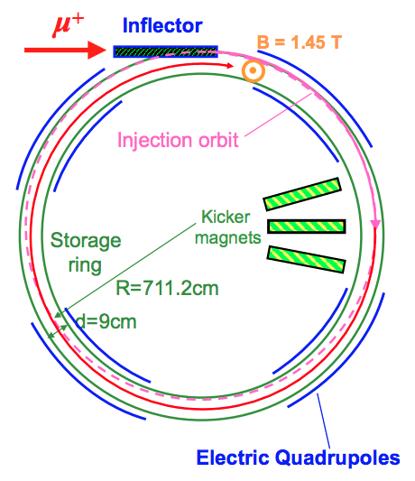
What tools do we need to measure g-2?
Ring
Magnetic Inflector
Injects the beam
Highly uniform magnetic field
NMR probes
Vacuum chambers
Electrostatic quadrupoles, fast magnetic kicker, and collimators
Put the beam in the right place
Detectors
Calorimeters
Straw Trackers
Beam monitors
Fiber harp
IBMS
Notes:
Backup slides to include
standard model prediction
How omega_a and omega_ p are extracted

Slide 13
Calorimeters
Measure the energy and hit time of decay positrons
24 calos around the inner radius of the storage ring
Calo gain continuously monitored by laser system
Notes:
15 by 23 by 14 Cm^3
Cherenkov signal – fast
Low magnetic susceptbility

Slide 14
Straw Trackers
Measure beam profile around the ring over the course of the fill
Notes:
Understand beam dynamics and make sense of what the calorimeter is seeing

Slide 15
How is it going so far?
Notes:
Wiggle plot

Slide 16
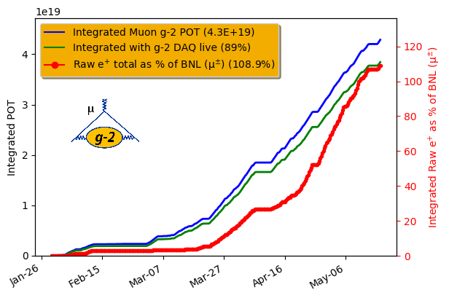
Statistically, already >100% of Brookhaven

Slide 17
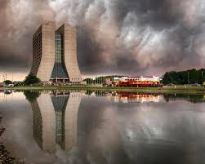
Thanks!

Slide 18
Main systematics for precession analysis
Notes:
Reduction in statistical uncertainty
21 times more decay positrons than BNL

