Slide 1
Accelerator Division Status
Daniel Johnson
All Experimenters’ Meeting/Lab Status Meeting
12 February 2018

Slide 2
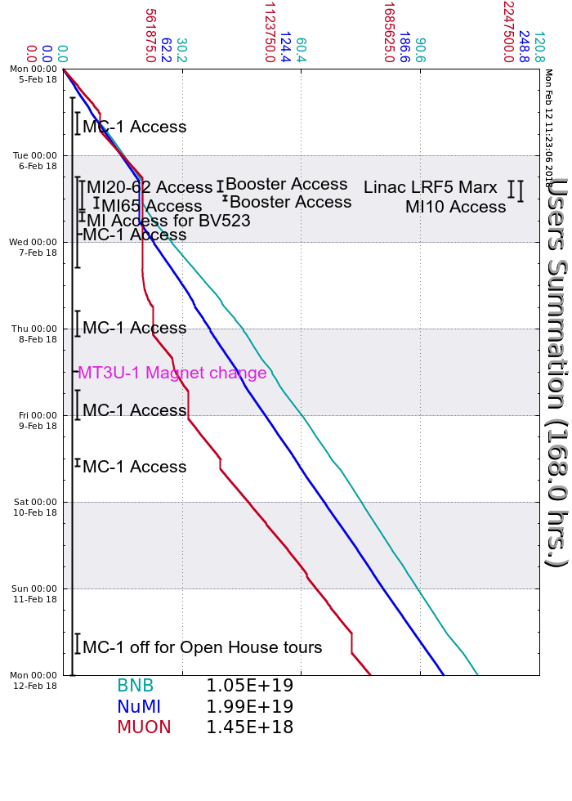
Accelerator Operations Summary
From: February 05, 2018 (0000 hours)
To: February 12, 2018 (0000 hours)
Calendar Week # 06
NuMI Weekly Integrated Intensity 1.99 E19 protons
Beam Hours To NuMI 151.8 hours
BNB Weekly Integrated Intensity 1.02 E19 protons
Beam Hours To BNB 157.2 hours
Muon Weekly Integrated Intensity 1.45 E18 protons
Beam Hours To Muon 120.9 hours
MTest Weekly Integrated Intensity 0.00 E13 protons
Beam Hours To MTest 0.0 hours
MCenter Weekly Integrated Intensity 0.00 E12 protons
Beam Hours To MCenter 0.0 hours

Slide 3
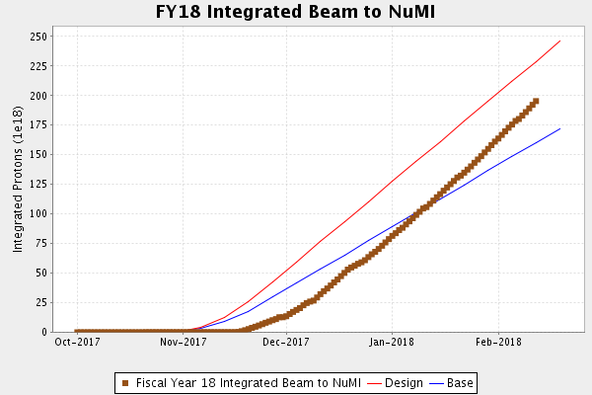
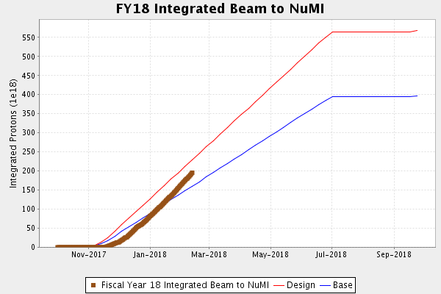
NuMI Operation

Slide 4
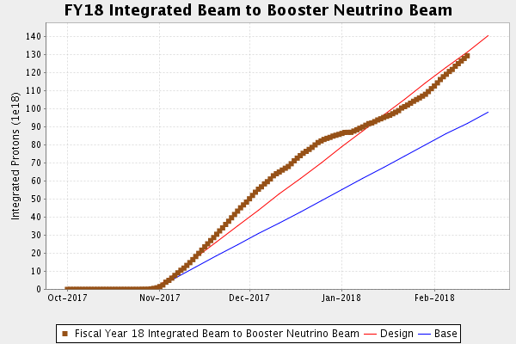
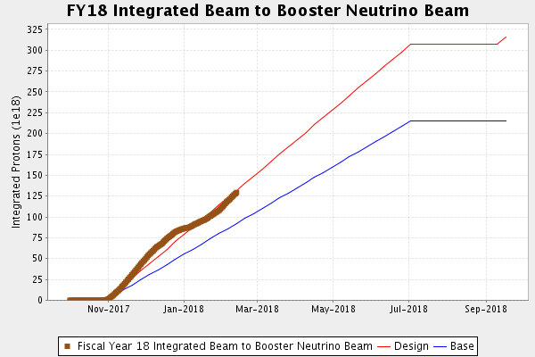
BNB Operation

Slide 5
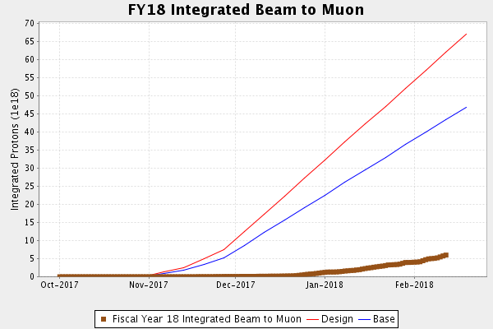
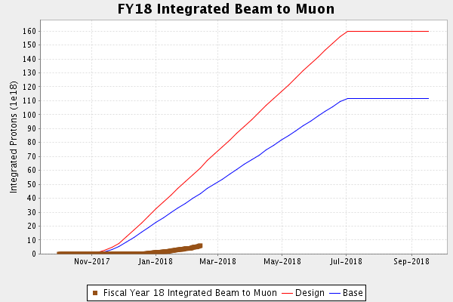
Muon Operation

Slide 6
Complex Status
LINAC
  Laser Notcher operational
Booster
  Tuning continues
MI/RR
  Tuning continues
NuMI
  Running at ~725kW (without switchyard)
Booster Neutrino Beamline (BNB)
  Stable operation
Switchyard
  Meson Test
    Magnet replacement MT3U-1
    Ready for operation by Friday
Muon Campus
  Tuning & studies
    16 pulse test Monday
General

Slide 7
PIP-II Injector Test & FAST/IOTA Status
PIP-II Injector Test
  Shutdown
    Shutdown for 4 weeks began January 22nd
      RFQ work
        Complete
        Conditioning
        Operational gradients achieved in pulsed mode
      MEBT work
        First Buncher prototype cavity replaced with production cavity
        Installation of new diagnostics
FAST/IOTA
  300 MeV Commissioning Run Successful
      IOTA Installation underway

Slide 8
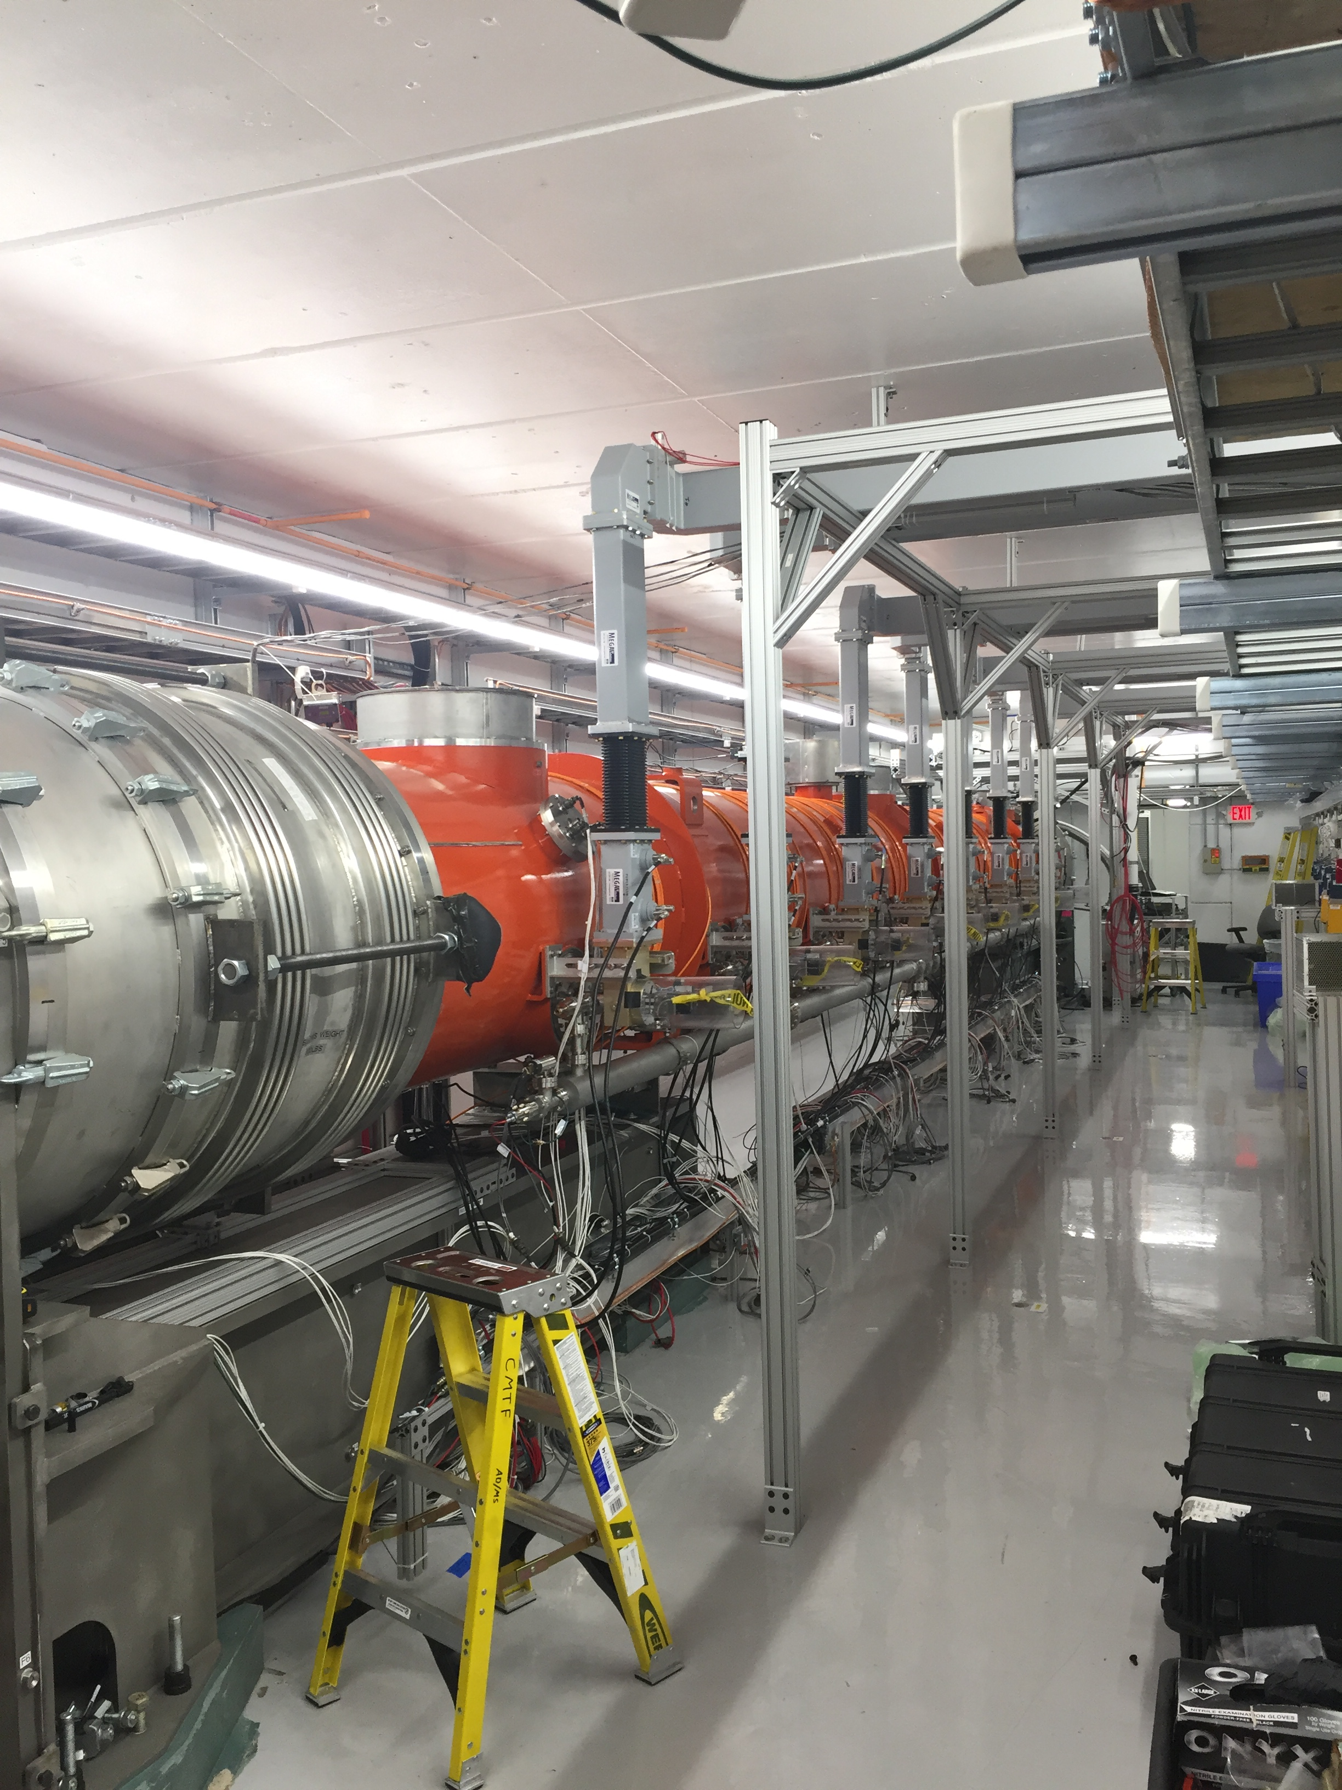
CMTS1 Status
LCLSII Cryomodule F1.3-07
  Testing complete
    Removal this week
  F1.3-09 next module

Slide 9
Schedules and Links
Schedule can be accessed from the Operations Department Home Page
  Schedules -> Operations Schedule
Direct link to schedule
  http://www-ad.fnal.gov/ops/schedule.html

