Slide 1
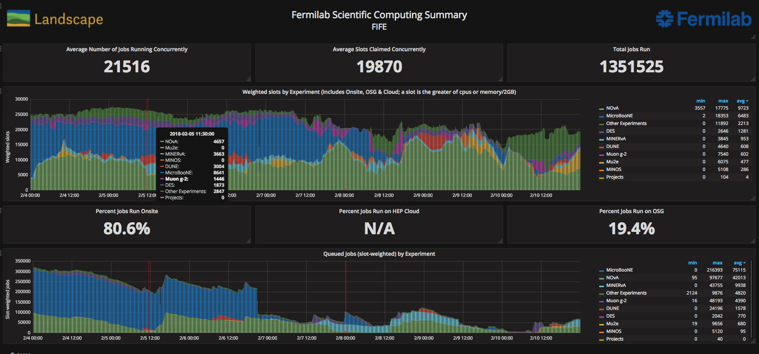
FIFE Operations (combined offsite and onsite)
https://fifemon.fnal.gov/monitor/dashboard/db/scd-summary-fife
Sam web server VM went down Monday evening. Rebooted Tuesday morning.
Batch system host became unavailable after yum auto updates Friday morning. Fixed by midmorning on

Slide 2
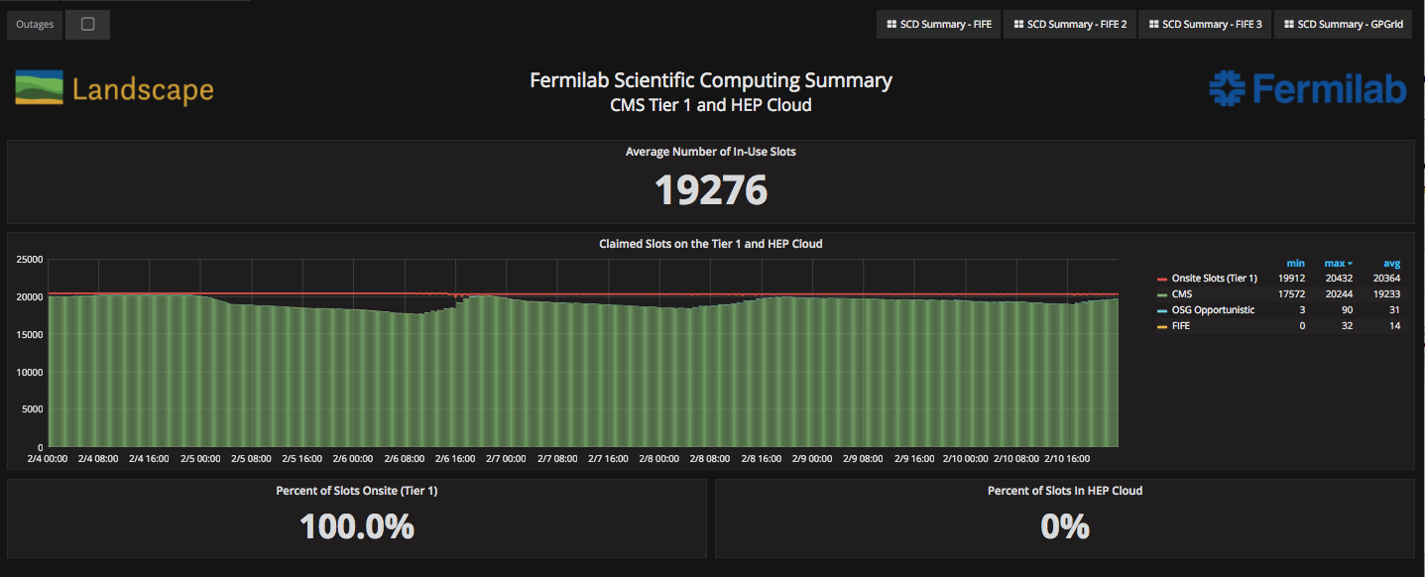
CMS Operations
https://fifemon-pp.fnal.gov/dashboard/db/scd-summary-cms

Slide 3
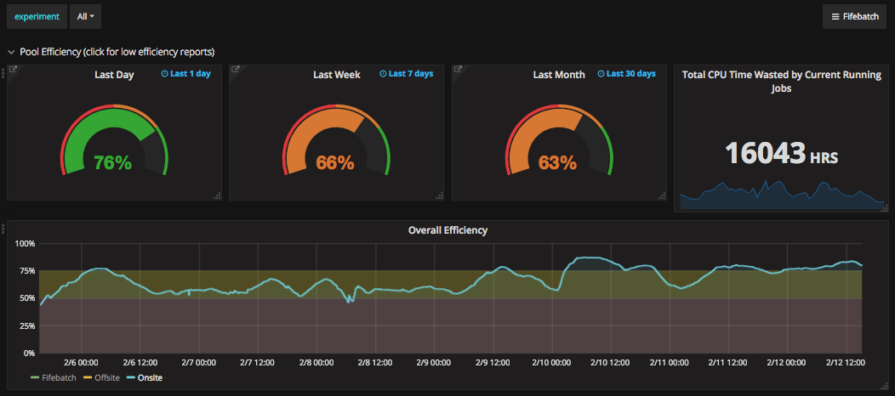
Overall efficiency
Continued work with experiments to address inefficiencies by improving workflows.

