Slide 1
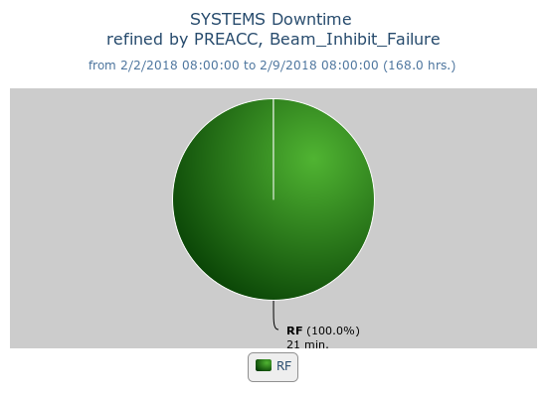
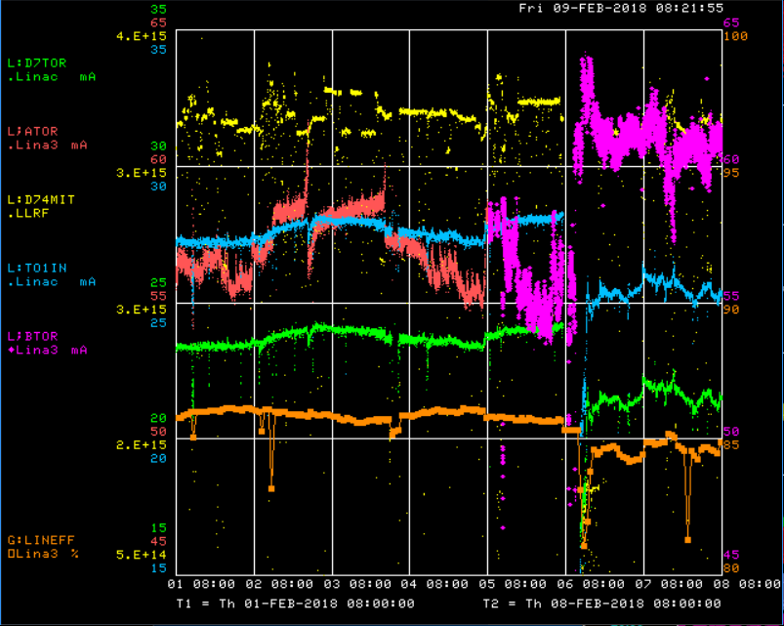
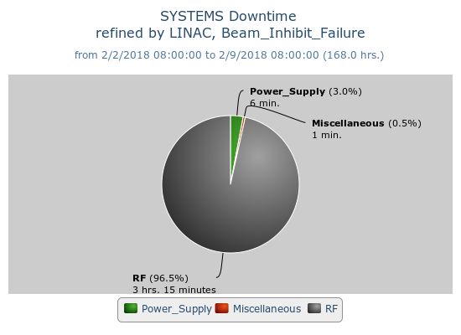
Preacc/Linac Weekly Preformance
Switched to Source B
Replaced laser notcher cavity
Marx modulator testing at LRF5

Slide 2
Current Conditions
Source B – 57 mA
Linac input – 25 mA
Linac output – 22 mA, ~2.32E17 p/hr.
KRF3 regulation issues
May request 10-15 min. to take a look

