Slide 1
Operations Summary
John Kuharik
9:00
14 February 2018

Slide 2
Past 48 hours
Monday
AP0 ventilation fan belts replaced
NS2 LCW trip
NBPMOV Numi orbit verifier node needed reboot
Muon campus 16 extraction studies with 1.4s timeline
Tuesday
Steady running
Wednesday
Handful of Linac and Booster minor RF trips

Slide 3
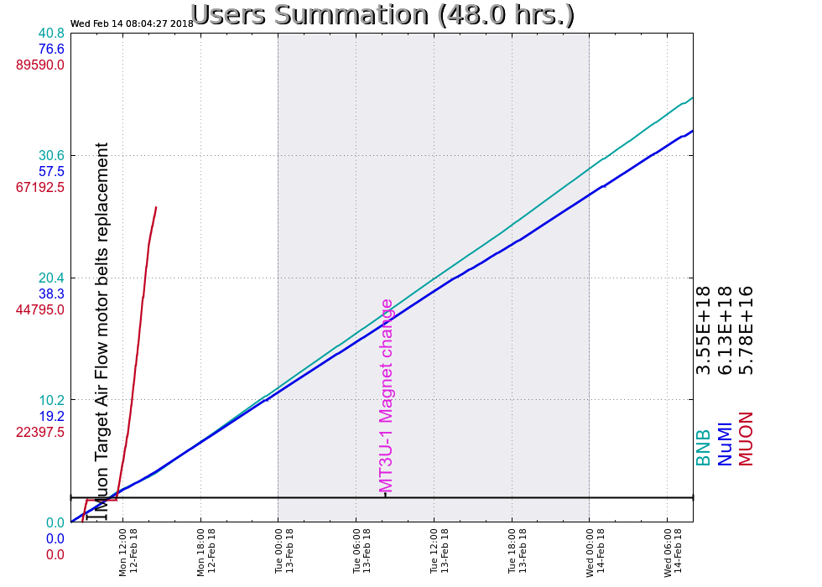
Current conditions
Numi: 707 kW
BnB: 7.7e16 p/h

