Slide 1
Tracking positrons
Diktys Stratakis
Discussion
Feb. 15, 2018

Slide 2
Details
Target is run with GEANT4
Simulation is run with low statistics (5x10^8 POT)
For this reason, this study is only focused on the M2-M3 lines + 1 DR turn
Detector solenoid
Production solenoid

Slide 3
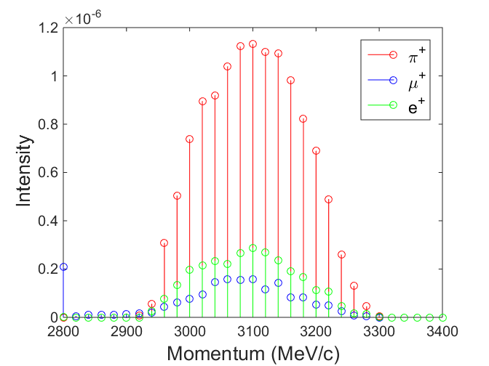
Beam at the end of M3
Detector solenoid
Production solenoid
Positrons and muons = same order magnitude

Slide 4
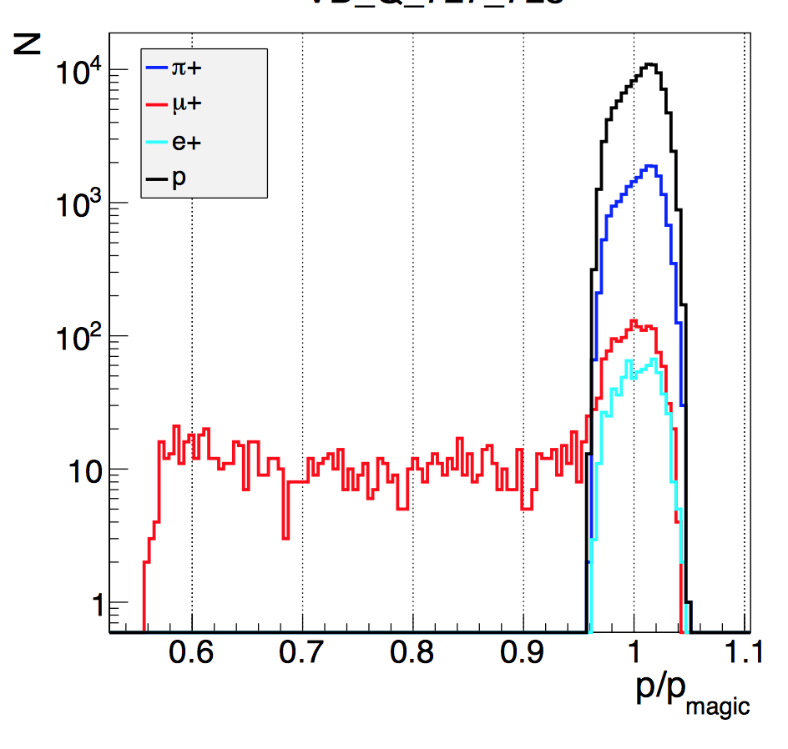
Old study in the AP2 line
Detector solenoid
Production solenoid
gm2-doc-db-1885 (Tishchenko et al)

Slide 5
Solutions tried
Modeled a titanium window downstream the target station
  No success
Modeled an Ion Chamber (IC740) along the beam path
  No success
Added a gate valve at the end M3
  See next slides
Detector solenoid
Production solenoid

Slide 6
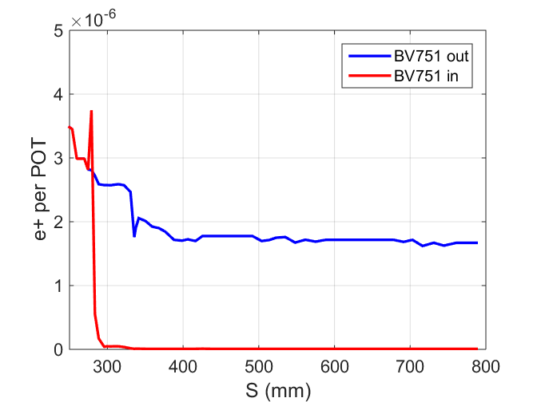
The good news (e+)
Detector solenoid
Production solenoid
Total removal of e+

Slide 7
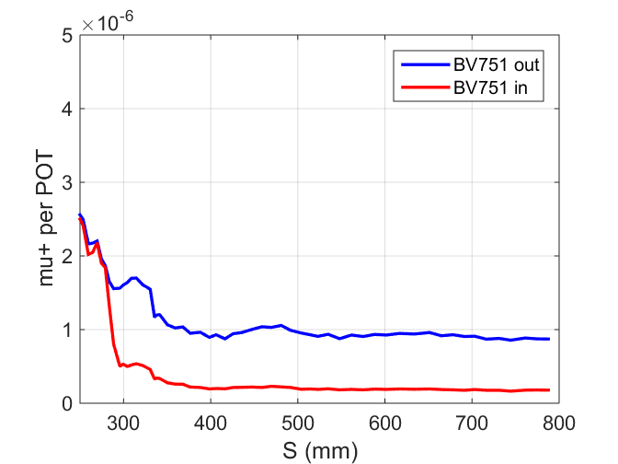
The not so good news (mu+)
Detector solenoid
Production solenoid
A factor of 4 less muons

Slide 8
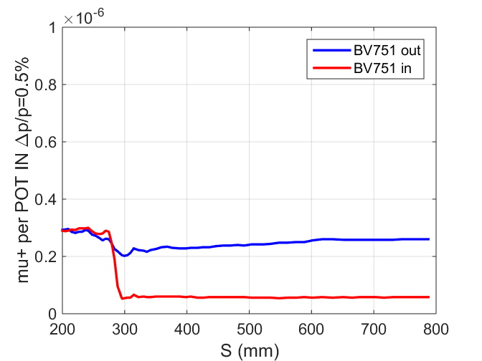
The accepted muons
Detector solenoid
Factor of 4 loss
Notice that the line is flat now due to pions loss
Production solenoid

Slide 9
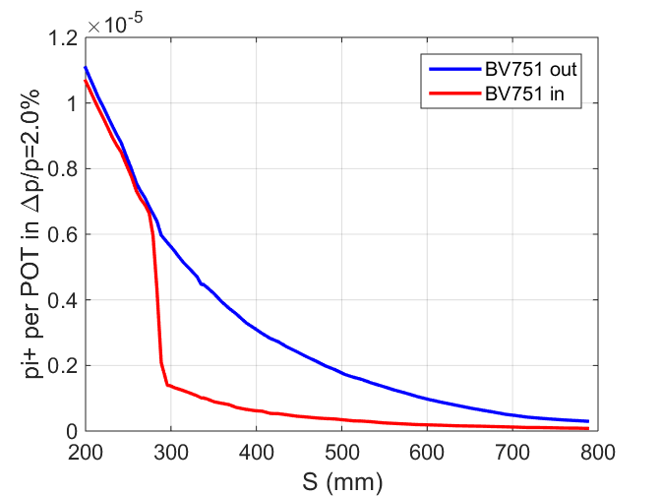
Pions
Detector solenoid
Production solenoid

Slide 10
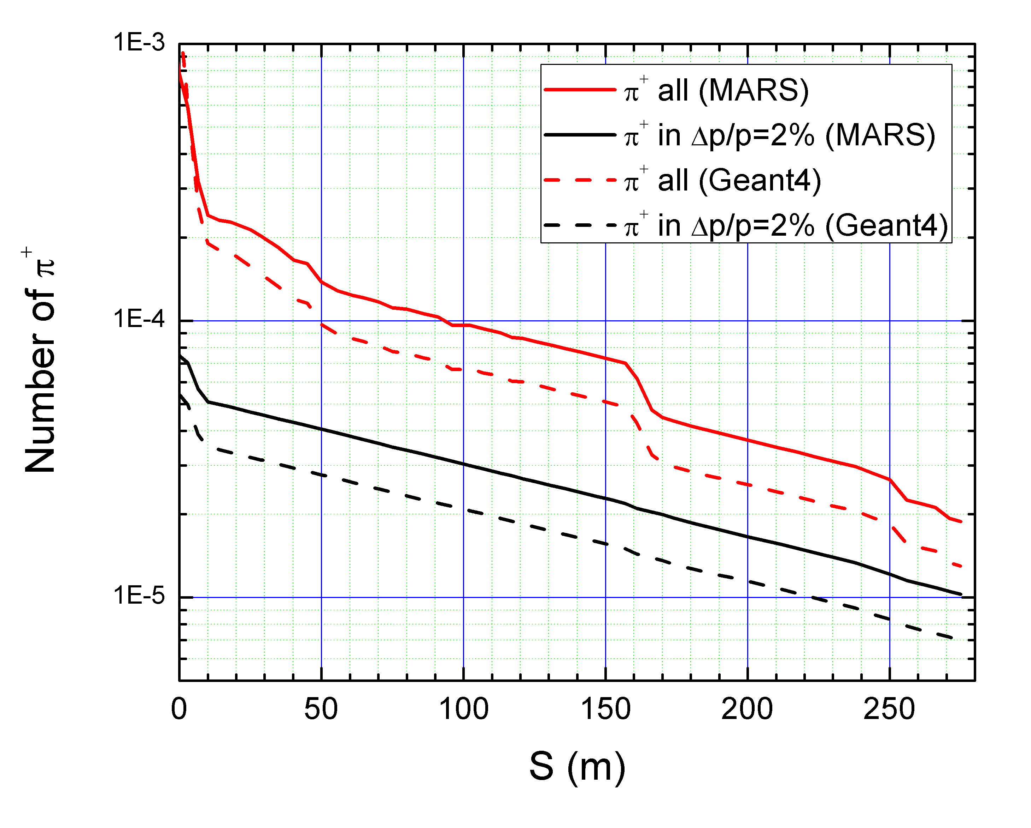
Positrons are not the problem…
Same behavior along the M2-M3 line but 30% less beam for the G4 model

Slide 11
Next steps
Experimental confirmation for positron removal with gate valves
  Do a test in the M4 or M5 line and measure intensity downstream.
The polyethylene wedge may remove positrons without loosing the muon beam. Worth to simulate.
  Will require runs with more statistics
Run MARS independently so that to better understand the 30% discrepancy
  I am in touch with Nikolai’s group for help.
Detector solenoid
Production solenoid

