Slide 1
Dual Phase Electronics Consortium
Dario Autiero (IPNL Lyon) and Takuya Hasegawa (KEK)
January 30, 2018

Slide 3
Last TB meetings:
9/11 https://indico.fnal.gov/event/15690/ (next steps towards Technical proposal and Technical Design Report)
7/12 https://indico.fnal.gov/event/15874/ (follow-up and interface documents)
21/12 https://indico.fnal.gov/event/16000/ (interface documents discussions and request for strategy document)
11/1 https://indico.fnal.gov/event/16172/ (planning of 2018 activities)
25/1 https://indico.fnal.gov/event/16261/ (risks and requirements documents to be provided for the next LBNC meeting middle of February)
Main activities:
Schedule of consortia activities in 2018-2019 leading to TDR in 2019, related to technologic
Interface documents with other consortia (provided by 21st December), main interfaces PD and DAQ
Cost estimates (practically completed, based on ProtoDUNE-DP production experience + some larger scale production savings)
TDR/TP editing (see presentation today)
Strategy document (provided by TB of January 25th), based on discussion of consortia activities in 2018-2019 leading to TDR in 2019 we had at the consortium meeting in December
Risk and specifications documents + updated WBS (by next LBNC) (see talk later)
FD construction schedule (to be developed)

Slide 4
Interfaces:
Cryostat: no consortium (LBNF)
Photon-Detection: Cabling and expected input on number of channels (temporary assumed 1000)
CRP Assumed same anode cabling as in PD-DP
DAQ: Network links, data flow, data transmission protocols
Documents provided at DAQ design workshop
https://indico.fnal.gov/event/15366/:
https://indico.fnal.gov/event/15366/session/2/contribution/26/material/slides/0.pdf (document)
https://indico.fnal.gov/event/15366/session/4/contribution/29/material/slides/0.pptx (slides)
Further discussions with other consortia + TB to finalize

Slide 5
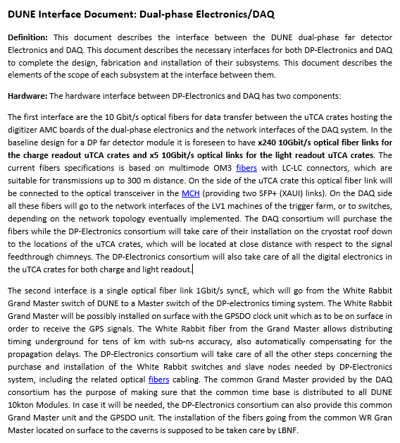
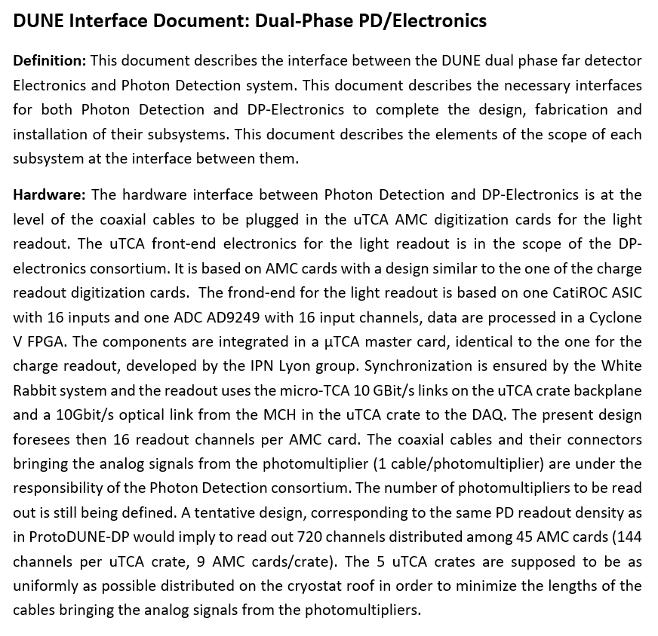

Slide 6
Cost estimates:
For DP electronics these are quite solid since they rely on the electronics already purchased for PD-DP (all money has been already spent and we know very well the costs at that production scale) → little risk associated
Last activities: to evaluate the large scale production savings: several meetings with CAEN, the actual PCB and components producers and suppliers, NAT/EMG2 for the uTCA and White Rabbit components
NAT in addition to evaluations related to uTCA (270 systems/module including spares) is also evaluating the cost for shipping the crates pre-mounted.
The number of spares is an issue related to the obsolescence of components over 20 years of running of the experiment (there should be a common policy in DUNE)
This is not directly due by our consortium but we made also an estimation of the DAQ backend based on an evolution of what has been designed for PD-DP.

Slide 7
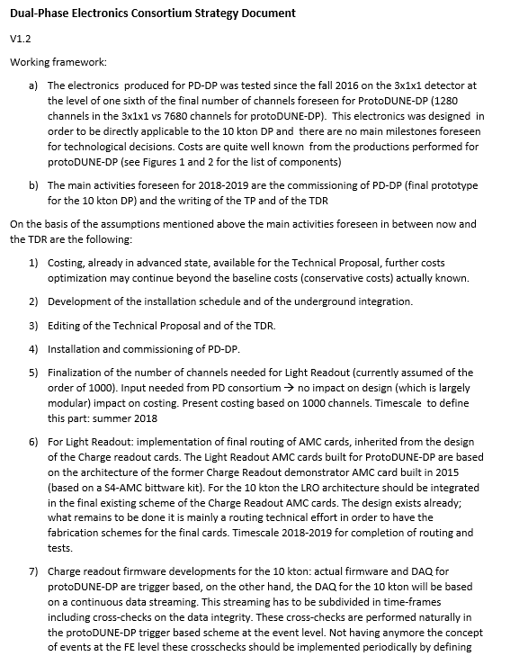
Strategy document, based on DP-electronics consortium expected activities for 2018-2019 discussed in December

Slide 8
Schedule:
Very high level information provided so far to consortia:
→ Need to go in much finer granularity and in particular for detector #2

