Slide 1
Initial thoughts on strategy towards Global Integration Testing stragety towards Detector Integration and Installation important interfaceissues from Dual Phase Electronics Consortium
What to do next
In conjunction with February LBNC and beyond
from Dual Phase Electronics Consortium
Dario Autiero (IPNL Lyon) and Takuya Hasegawa (KEK)
January 30, 2018

Slide 2
Focus in the next four months
Further WBS development
Further development of interface documents
Further development of 2018/2019 schedule including milestones
Production of consortia strategy documents
Development of initial cost estimates
Documentation of subsystem requirements
Development of initial risk registry

Slide 3
Current status
Done and being finalized
Further WBS development
Further development of interface documents
Further development of 2018/2019 schedule including milestones
Production of consortia strategy documents
Development of initial cost estimates
Documentation of subsystem requirements
Development of initial risk registry
Additional new request

Slide 4
Toward LBNC Review(19 Feb-21Feb)
Initial draft of “one-page” subsystem requirements
Initial draft of “one-page” subsystem risk registries
*see next two slides which show examples
posted as well at
https://indico.fnal.gov/event/16261/
* Deadline: Friday, February 9th at the latest.

Slide 5
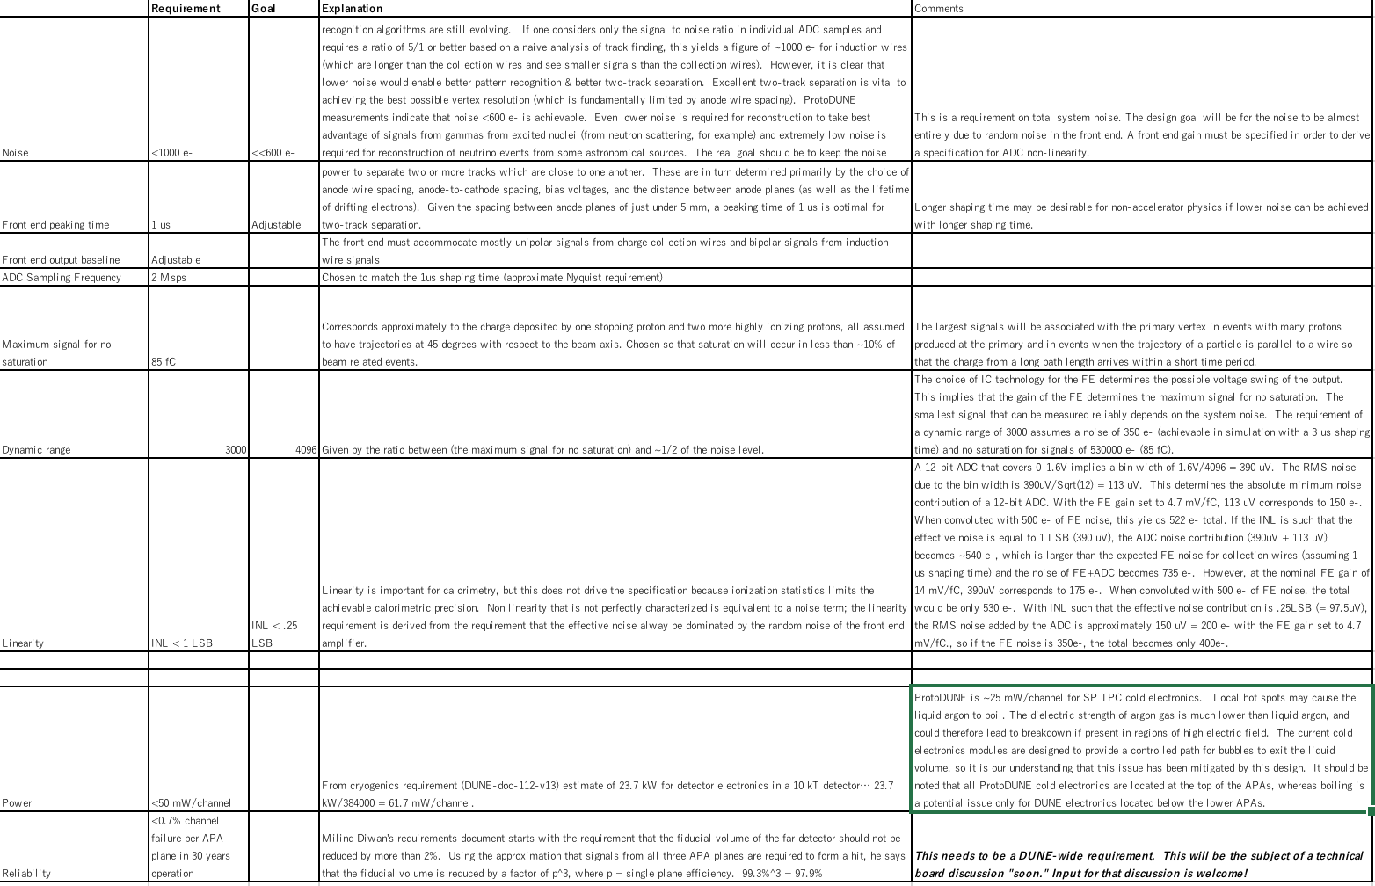
Requirements (ex. from SP TPC el.)

Slide 6
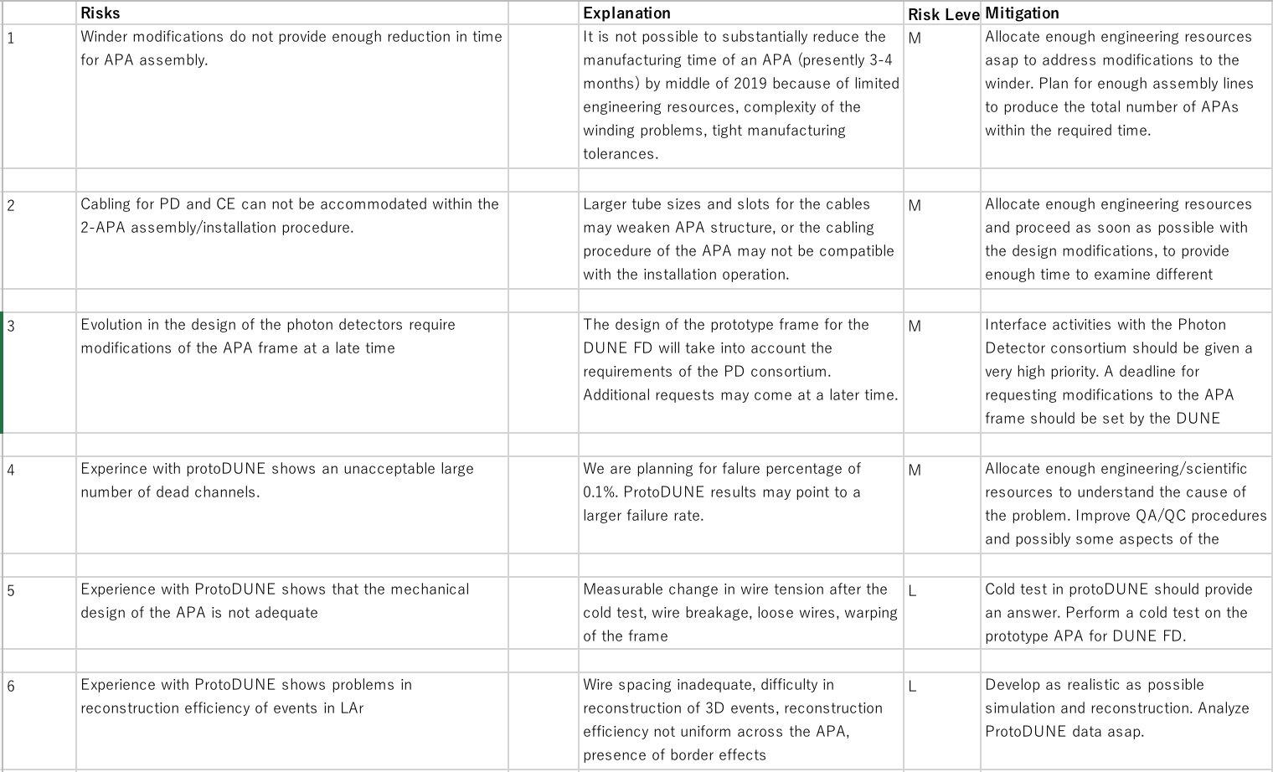
Risk registries (ex. from APA)

Slide 7
Possible risk examples
Obsolescence of electronics components for a >=20 year project
Mitigated by including a correct number of spares, should be a common policy for other DUNE (accessible) electronics components
Evolution in the design of photon detectors → similar mitigation as foreseen for the APA example in the previous page
Data flow increase related to coherent noise related to grounding problems and inefficiency in compression → development of a safety margin in the occupancy of the data links (actually a factor 5), may further increase with the availability of faster MCH (40 Gbit/s), → strict control of grounding issues (common to SP)
Damages to electronics due to discharges or other reasons → design of protection components on FE standing HV discharges, analog FE electronics is accessible and replaceable in the DP scheme
Requirements:
Quite straightforward, can be taken from existing specifications, slightly different from SP in terms of:
Noise (less stricter)
Dynamic range (DP dynamics)
Reliability (not immersed electronics)
Sampling frequency (2.5 MHz)

Slide 8
And next
Development of initial cost estimates
Baseline estimate has already been existing based on knowledge/experience so far
Further cost reduction/optimization will be examined according to the latest market situation
Quite advanced for DP electronics, costs already know extrapolated to 10 kton, still to integrate a few details on cabling

