Slide 1
Accelerator Division Status
Duane Newhart
All Experimenters’ Meeting/Lab Status Meeting
26 February 2018

Slide 2
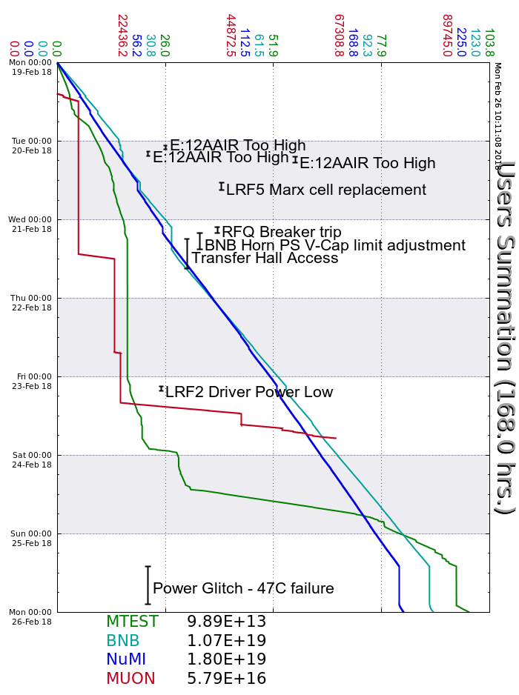
Accelerator Operations Summary
From: February 19, 2018 (0000 hours)
To: February 26, 2018 (0000 hours)
Calendar Week # 08
NuMI Weekly Integrated Intensity 1.80 E19 protons
Beam Hours To NuMI 145.7 hours
BNB Weekly Integrated Intensity 1.02 E19 protons
Beam Hours To BNB 136.3 hours
Muon Weekly Integrated Intensity 5.79 E16 protons
Beam Hours To Muon 13.0 hours
MTest Weekly Integrated Intensity 9.89 E13 protons
Beam Hours To MTest 86.1 hours
MCenter Weekly Integrated Intensity 0.00 E12 protons
Beam Hours To MCenter 0.0 hours

Slide 3
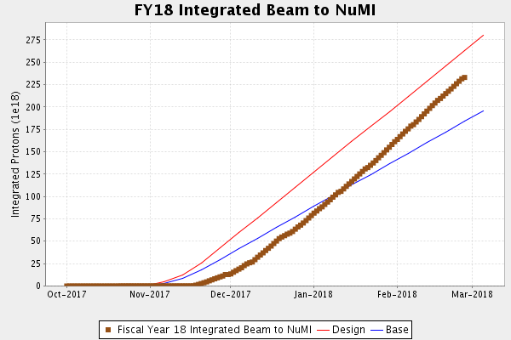
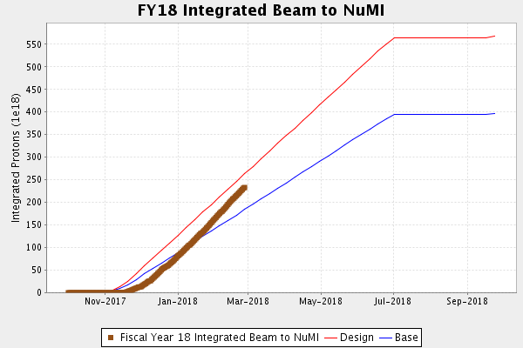
NuMI Operation

Slide 4
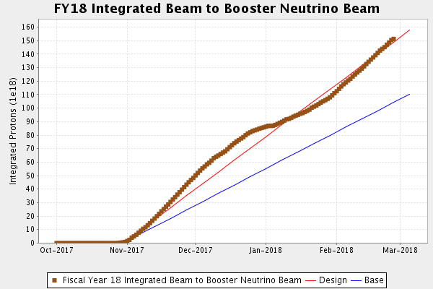
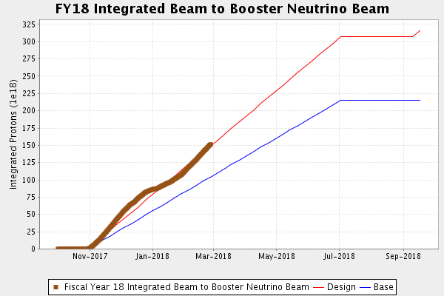
BNB Operation

Slide 5
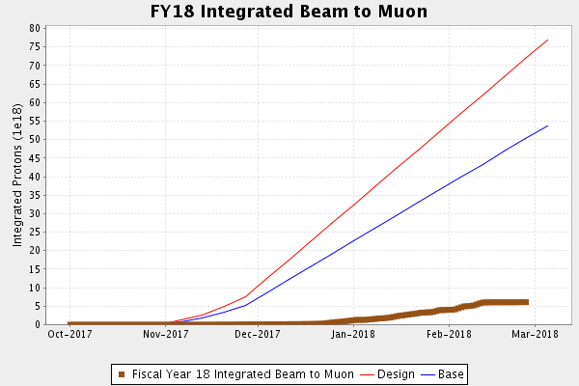
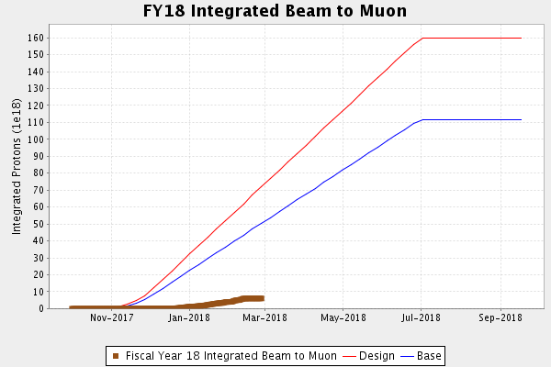
Muon Operation

Slide 6
Complex Status
LINAC
  Laser Notcher operational
  Replacing failed resistor in Marx for LRF5
  Replacing KRF4 filament power supply
Booster
  Tuning continues
  Kicker oil check
MI/RR
  Tuning continues
  MI Access today to reset RGA
NuMI
  ~650kW with SY
  >700kW without SY
Booster Neutrino Beamline (BNB)
  Stable operation
  Water/Rain causing12AAIR interlock trips
  Replacing DI bottles this morning
Switchyard
  Meson Test taking beam
  Dealing with sump issues at F2
Muon Campus
  Tuning & studies
  g-2 issues
General
  Still recovering from the Feeder 47C fault.

Slide 7
PIP-II Injector Test & FAST/IOTA Status
PIP-II Injector Test
  Starting Up
    RFQ work
    Successfully ran the RFQ at full nominal power on frequency for the first time
    Developed vacuum leak. Repairs underway
    MEBT work
      First Buncher prototype cavity replaced with production cavity
      Installed new diagnostics
      Vacuum issues in the MEBT being addressed
      ORC walkthrough this week
      Hopeful for beam by end of week
FAST/IOTA
  The IOTA nonlinear magnet will be moved into the Cave this week for field mapping prior to installation.
  Construction of the 2 amp supplies for the skew quads, trims, and octupoles will be finished this week and installed in ESB next week.
  90% of the hardware fasteners for the vacuum installation have been cleaned.
  Magnet cable pulls are complete and instrumentation cable pulls are underway.
  LCW manifold installation is set for completion by March 5th.

Slide 8
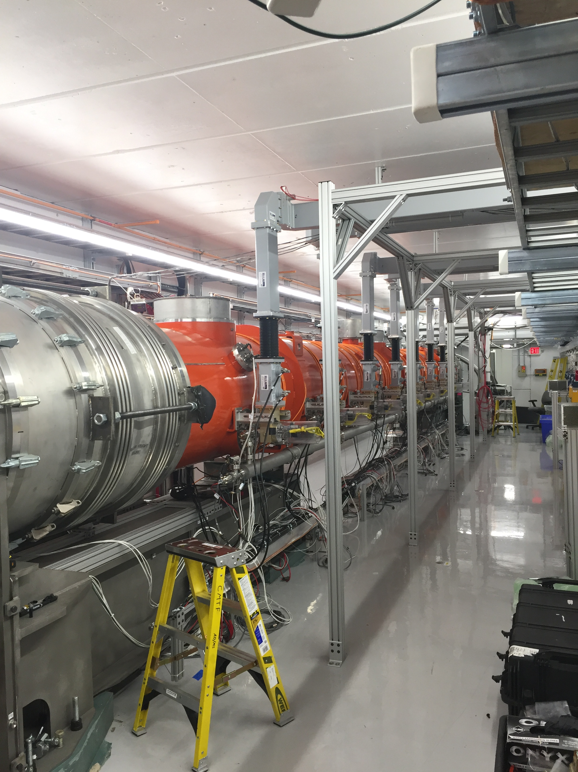
CMTS1 Status
LCLSII Cryomodule F1.3-09
  Installing in test cave
  Expect cooldown next week
  Testing early March
LCLSII Cryomodule F1.3-07
  Best module
  Being instrumented for move to SLAC

Slide 9
Schedules and Links
Schedule can be accessed from the Operations Department Home Page
  Schedules -> Operations Schedule
Direct link to schedule
  http://www-ad.fnal.gov/ops/schedule.html

