Slide 1
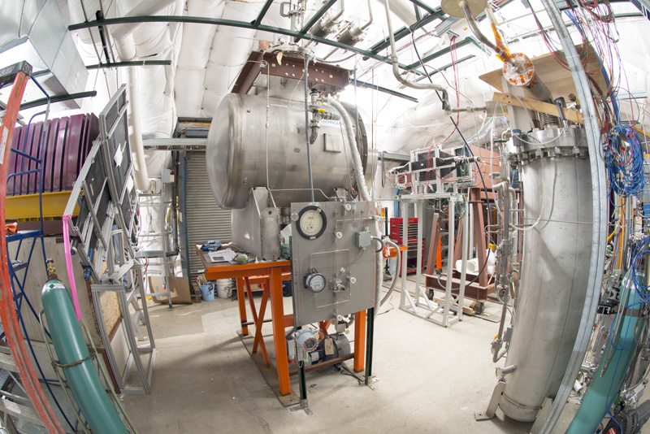
LArG4
Hans Wenzel
27th February 2018

Slide 2
Relationship with Geant4 Collaboration
Many changes just for the IF community:
Optical
Providing highly configurable physics constructors and interfaces that we requested→ no need to do your own plumbing.
Eliminate performance bottle necks, e.g.access to material properties much faster.
Eliminate features: e.g. various cross sections much improved.
Physics use the new configurable and extendable Physicslistfactory:
Allows to select all reference physics lists
Can be extended e.g. we use
G4optical physics.
Step limiter for charged particles.
Neutron time cuts
For the brave build your own physics lists, modify existing ones

Slide 3
GDML(+ extensions): a complete description of detector configuration (at runtime)
Materials, volumes etc….
Assign step-limits to specific volumes.
Optical properties (bulk and surface)
Assignment of sensitive detectors of predefined type to logical volumes→ automatically trigger the creation and filling of the appropriate hit collections
Assignment of optical surfaces
Visualization attributes (color, solid,….)
Makes use of formulas and loops → to keep gdml file compact
Homogeneous electric field (no electric field→ no separation of charge)

Slide 4
Motivation: Modular system
build detector from predefined components at runtime.
μ
BeamDump
Currently implemented
PhotonSD
TrackerSD
CalorimeterSD
DRCalorimeterSD
InterActionSD
EM
Hadronic
Tracker
Particle ID
Target
Cerenkov Radiator
InteractionSD
produces InteractionHits
PhotonSD
produces ArtPhotonHits
DRCalorimeterSD
produces ArtDRCalorimeterHits
TrackerSD
produces ArtTrackerHits
StoppingCalorimeterSD
Pro. ArtCalorimeterHit

Slide 5
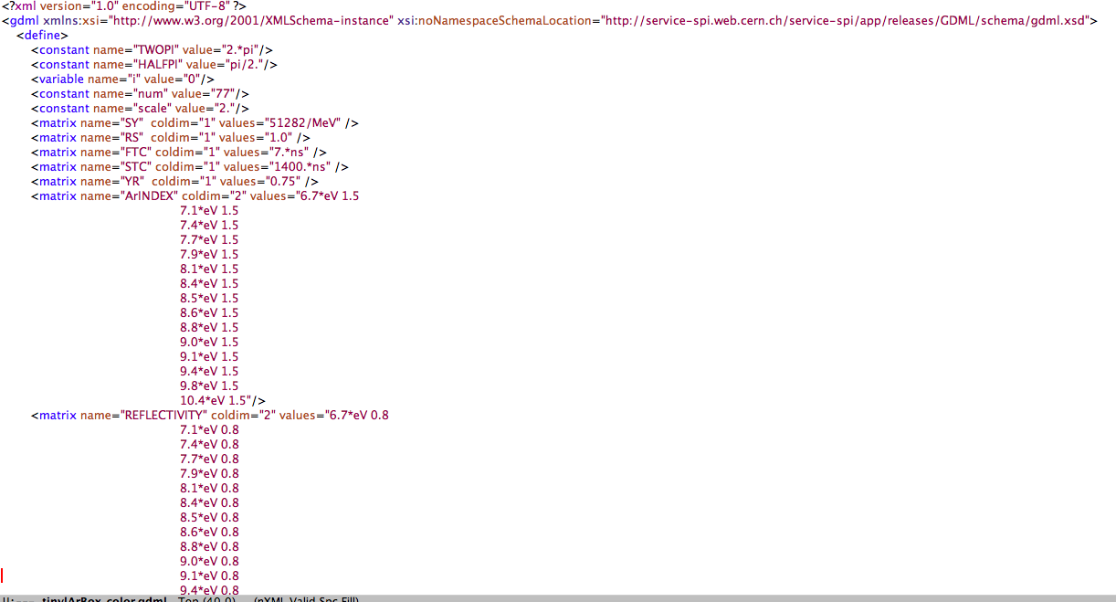
Optical properties

Slide 6
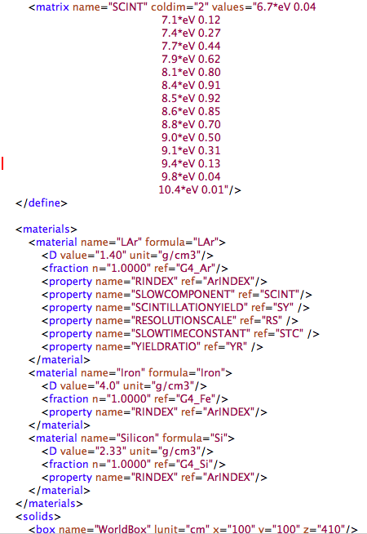

Slide 7
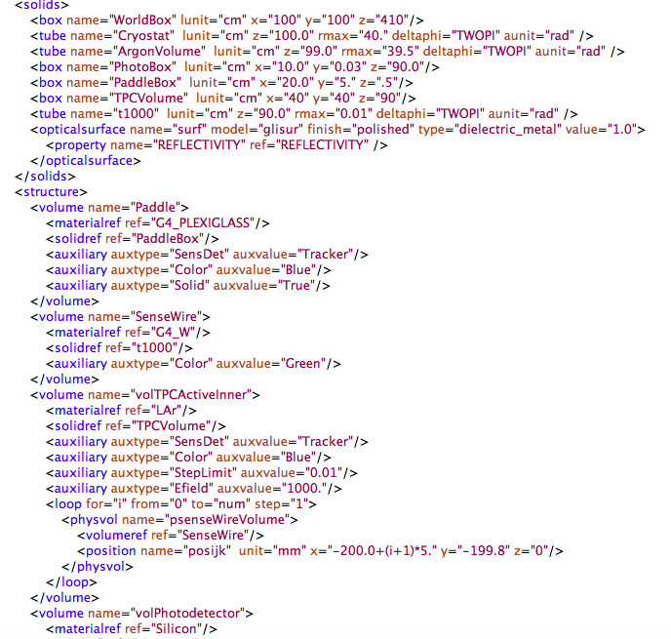
Logical Volumes

Slide 8
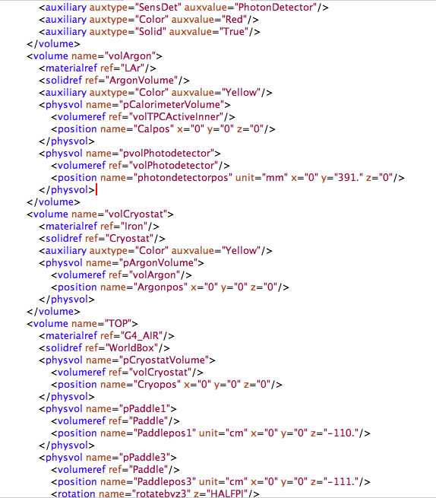

Slide 9
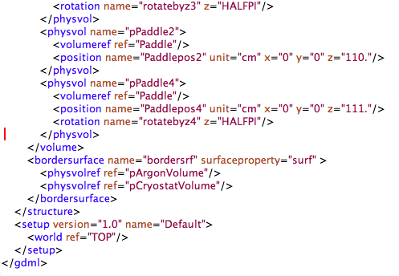

Slide 10
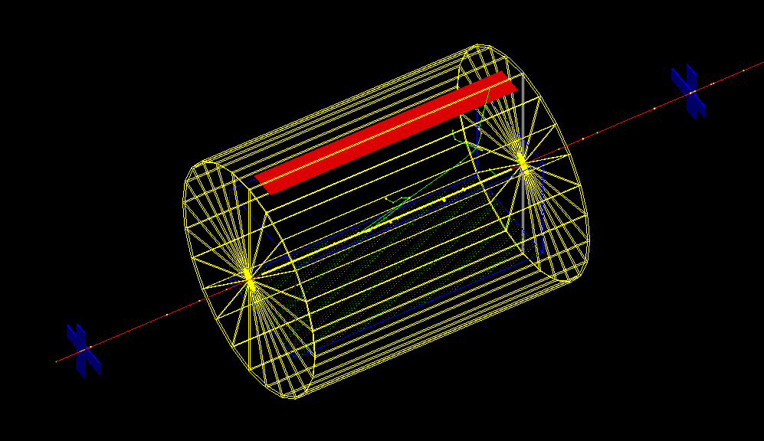

Slide 12
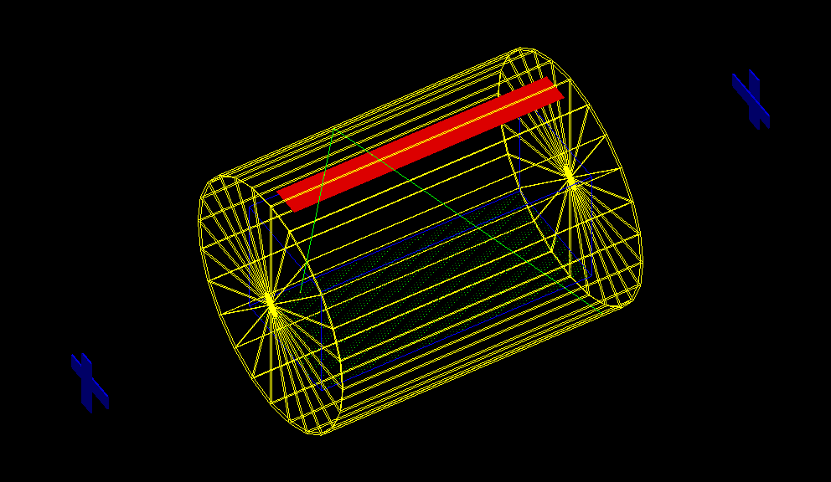
Tracing of a single optical photon (reflectivity on tank 80%)

Slide 13
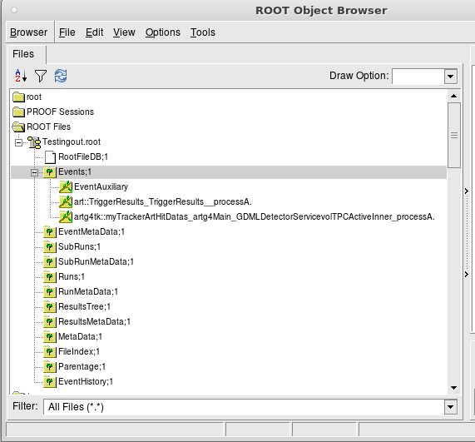

Slide 14
Status
Whole chain is working
Need to rename and rearrange
Currently fill geant4 hit collections first and then copy over to art hit collections (want to skip the geant4 step)

