Slide 1
Unorthodox Musings toward Pixel–based 3-D Readout for a Multi-kton LAr TPC
David Nygren
University of Texas at Arlington
5 March 2018

Slide 2
Far Detector Perspective - official
“The two current designs are good enough”
    Is the scientific reach “maximized” ?
    What about unplanned discovery potential?
“The plan is solid and fixed”
    The time for new or better ideas is over
    But, has due diligence been exercised ?

Slide 3
Far Detector Perspective – nonofficial
“A design with small pixels will be best”
    Does a pixelized TPC really provide better physics?
  Is a pixelized design technically possible?
    If yes, then:
      Can a pixelized design be demonstrated timely?
      Is a pixelized design affordable?
      What would a demonstration plan look like?
  “There isn’t time to do it right, but there is always be time to do it over.”

Slide 4
Axiomatic Starting points
  Electronics embedded in LAr forever… (SPF)
  Simplest possible system concept… (Einstein)
  Power dissipation must be ‘low’… (LAr heating)
  Data quality must be ‘high’ … (must be Better)
  follow the electronic principle of “least action”
  System concept may be unconventional
  Take advantage of intrinsic resource: ³⁹Ar decays

Slide 5
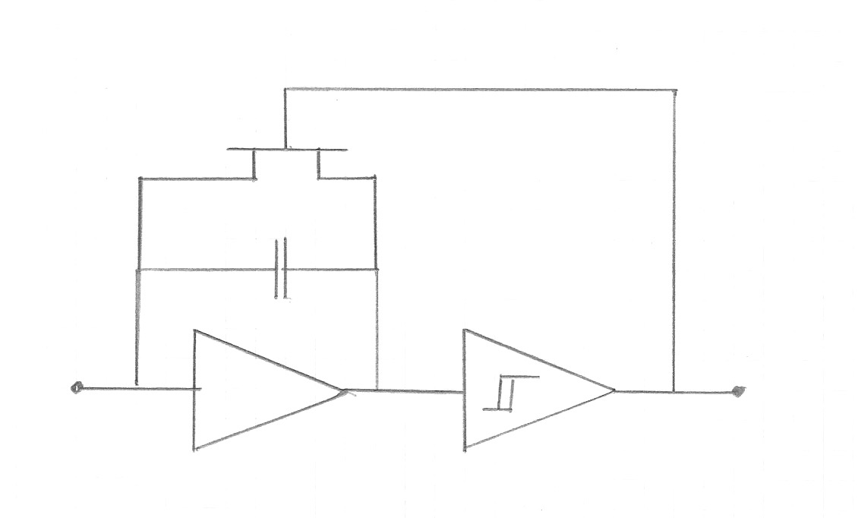
The Charge Integrate-Reset (CIR)
Reset switch
Input
‘Reset’
charge-sensitive amplifier
Schmitt trigger

Slide 6
Classical C-I-R Behavior
Current arriving at input is integrated on C
After integrating charge δQ on C, V_{th} is met
Comparator triggers, closing switch
Capacitor C is discharged, returned to baseline
Cycle begins again, ad infinitum
Classically, trigger augments a counter by one.
Number of counts is proportional to total Q

Slide 7
The Advanced CIR Block
Reset switch
Input
‘Reset’
charge-sensitive amplifier
Schmitt trigger

Slide 8
We do something different
“Local Clock”
runs free
Oscillator
100 MHz Ring ?
38-bit Gray-code counter
38-bit latch
Reset trigger latches the contents of counter–
this action captures local time at instant of reset
Notes:
Oscillator only attached to Gray-code scaler – not distributed within ASIC –minimizes power dissipation

Slide 9
Now what ?
Take the difference between sequential resets
This is the Reset Time Difference = RTD
Total charge for any RTD = δQ
RTDs are not generated at ASIC level!
RTDs are computed by off-detector GPU…

Slide 10
Now what ?
RTD is a good measure of average currents
  Small average current (background): Large RTD
    Background current from ³⁹Ar is ~40 aA (very small!)
  Large average current (signal): Small RTD
    Typical track current from min-I is ~2nA
Background and signal are ‘easy’ to distinguish

Slide 11
The RTD patterns
Background
Signal
Time
µs
Seconds

Slide 12
Leakage current
Critical for the success of this approach is that all extraneous leakage currents at the CIR input node are small compared to ³⁹Ar current
The background current from ³⁹Ar decay provides an automatic charge calibration from histograms of RTD (highly bimodal spectrum)
At LAr temperatures, can extraneous leakage currents be shown to be <<40 aA ?

Slide 13
Signal Characteristics
Choose δQ such that Min-I track will cause several resets during one track arrival:
  Choose δQ = 1.3 fC
Signal: a contiguous sequence of small RTDs
A conventional current waveform of arbitrary length and complexity can be reconstructed from the RTD sequence.

Slide 14
In other words…
RTD = inversely proportional to input current
Background: ³⁹Ar decays lead to ‘heartbeat’
  heartbeat RTD ~20 seconds
  natural calibration available – form histograms
Signal: typically a few na, → RTD < 1 µs
  Three to five or so contiguous small RTDs
  Easy to recognize signal against background!
  No signal differentiation! (unlike induction wires)

Slide 15
Precision
Remember:
    Charge resolution here is “exactly” δQ
    Time resolution is ~10 ns
The charge pump has good resolution’ for small, short currents, e.g. soft electrons
How much dynamic range is really needed?
    proton decay within Ar → nuclear fragmentation
    not so clear what is needed

Slide 16
Waveforms
CIR waveform: varying time intervals between equal charge quanta.
Conventional: varying charges between equal time quanta.
Simulations have been initiated by Yuan Mei
  Encouraging!
  Much work remaining!

Slide 17
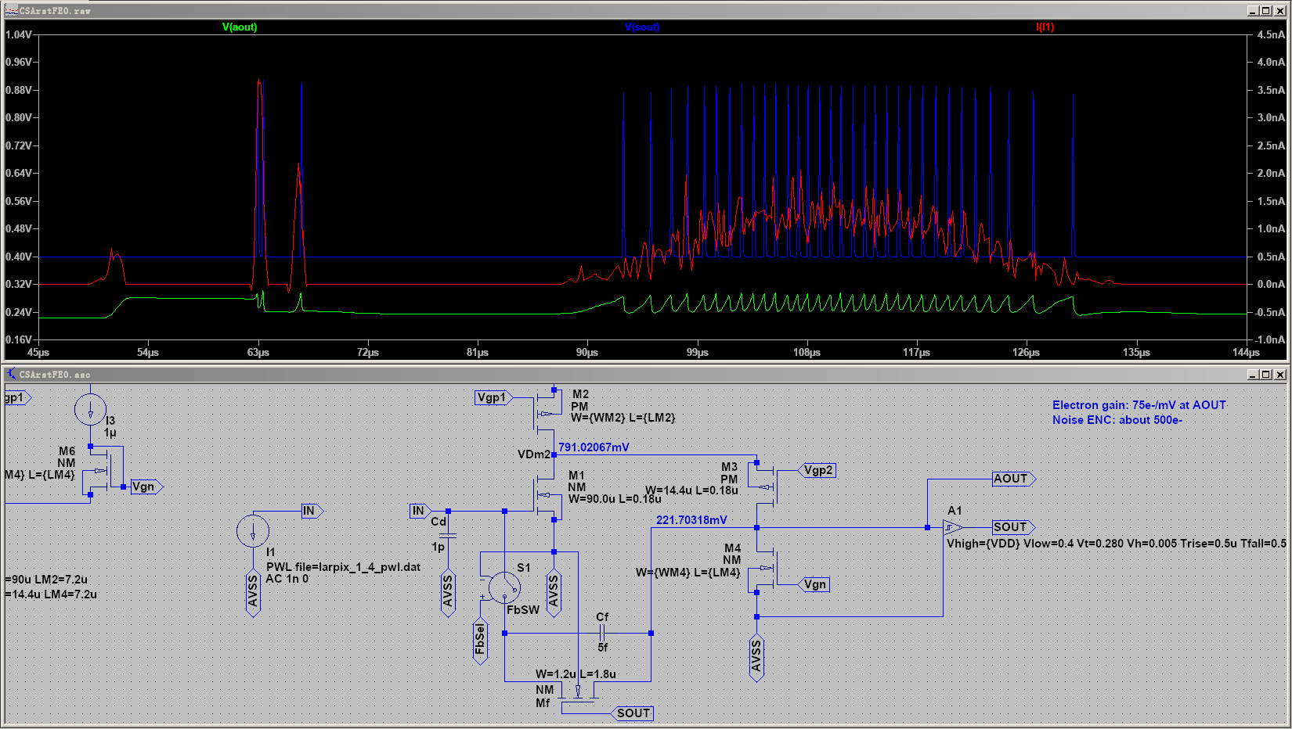
Yuan Mei
LBNL
180nm CMOS, 2.5V power supply. Front-end consumes 2.2uA current.
Noise (ENC) is around 500e-. Schmitt trigger is still ideal (rise and
fall time limited). Wavefrom from Dan Dwyer

Slide 19
Time-stamping Waveforms
‘Time’ is kept by a local free-running oscillator
Local Time-stamp is provided by a fit to the string of RTD values, or to reconstructed signal
Local time is uninteresting…
How to establish global time reference frame?

Slide 20
Time-stamping ?
The local clock runs freely at f ~100 MHz
  No phase-locked loop
Must be stable: δf/f < 1 x 10^{–6} per second
  Once a second, ask ASIC “What time is it?”
  ASIC captures local time and sends it @ 1Hz
  Simple linear transformation: T = A•F/f + B
  F is master clock synched to GMT
But we have seen this before!

Slide 21
IceCube: Digital Optical Module Block Diagram
Trigger (2)
10b
FPGA
ADC
Pulser
1 megabaud
DOR
Delay
x16
8b
DAC
ATWD
10b
LPF
x2
x0.25
CPU
+/-5V, 3.3V,
2.5V, 1.8V
DC-DC
ATWD
10b
x 2.6
x 9
fADC
10b
Configuration
Device
8Mbit
MUX
OB-LED
40 MHz
DP
Ram
32b
SDRAM
16Mb
16Mb
(n+1)
LC
SDRAM
(n–1)
20 MHz
Flash
Flash
CPLD
16b
Monitor
& Control
Oscillator
4Mb 4Mb
Corning Frequency Ctl
(was Toyocom)
8b
Flasher
Board
DACs & ADCs
PMT Power
64 Bytes
GTP, LBNL, 26 Mar, 2004
8b, 10b, 12b

Slide 22
Clocks…
IceCube: ±2 ns rms within 1 km³ of ice!
  works flawlessly and invisibly
Oscillator precision in IceCube is ~1 x 10 ^{–10}/s
  hard to measure!
DUNE: ±1 µs precision
  requires δf/f < 1 x 10^{–6} per second for local clock
  This is (?) probably(?) easy to achieve in LAr
What works in IceCube can work in DUNE

Slide 23
ASIC
16 pixels/ASIC
1 free-running clock/ASIC
1 capture register for clock value, ASIC, pixel subset,
Buffer depth as needed to store beam, SN event…
Logic to manage:
  dynamic network,
  token passing,
  clock domain crossing,
  data transfer to neighbor in network
  exception states, including “kill switch”

Slide 24
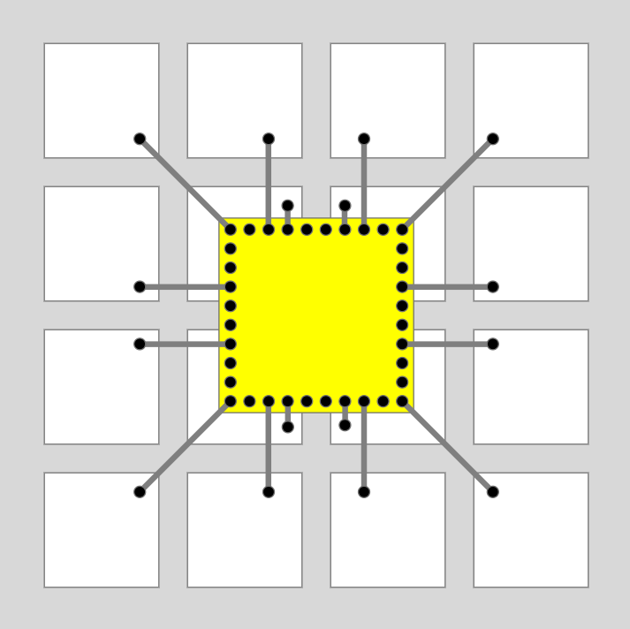
Pixel Array ?
The local clock serves 16 pixels in one ASIC
View from inactive side
Wire-bonds connect
each pixel to ASIC; via connects to small button on active side, minimizing capacitance and noise;
concern: parasitic triggers

Slide 25

16 x 16 Tile of 256 ASICs, 4092 pixels

Slide 26
here…
Local clock interrogation
signal enters at any corner of tile, and propagates as a wave to any neighbor

Slide 27
Local clock interrogation
signal enters at any corner of tile, and propagates as a wave to any neighbor
Or here…

Slide 28
The pixel “button”
The pixel must be a small button exposed to LAr active volume, not a space-filling square
The dielectric surface exposed to LAr active volume will automatically ‘heal” to create the desired electronstatics: “all charge to button”
→ Dielectric properties of first dielectric surface are important: teflon seems likely

Slide 29
The 64-bit datum
Clock value 38 bits
ASIC location 8 bits
Pixel address 16 bits
Flags 2 bits
Total: 64 bits

Slide 30
Data Flow
Clock calibration: once per second
  → 16,384 bits/tile
Assume 20,000 tiles/10 kton module
  ~40 MB/s per module
Easily digestible locally by GPU to transform data to global time frame & prepare histograms
Very little data represents event data to surface

Slide 31
No single-point failure ?
Flat architecture avoids clock distribution
Local clock interrogation ‘wave’ sweeps around any dead or troubled ASIC;
Any of four corners provides entry point for interrogation and for data recovery.
Wave mode seems fanciful, but I don’t see why it couldn’t work…

Slide 32
Three Central Technical Issues
CIR Input:
  all extraneous leakage currents at the CIR input node are small compared to ³⁹Ar current
    If not LAr, then a reproducible I_{cal} must be supplied
Clock:
  Must be stable: δf/f < 1 x 10^{–6} per second
    I think this will be easy… –but at what power level?
Surface Charge Creep:
  Must be negligible relative to ³⁹Ar current
    This can be tested, I think…

Slide 33
Perspective
IceCube demonstrated that it is rational to embed complex electronics in perpetuity
  care taken in design phase to avoid bleeding edge
  care taken in qualifying parts list
  care taken in fabrication & test
IceCube demonstrated that unorthodox time-stamp method meets high performance goals.

Slide 34
Summary
The Charge-Integrate-Reset pixel extracts all energy, spatial and time information with high precision and appropriate dynamic range.
Several aspects are just assertions at this point
It seems plausible that an unorthodox scheme to realize a fully pixelized DUNE might work.
I would like to explore this technical approach as “Generic R&D”
Anybody interested?

Slide 35
Summary
The Charge-Integrate-Reset pixel extracts all energy, spatial and time information with high precision and appropriate dynamic range.
Several aspects are just assertions at this point
It seems plausible that an unorthodox scheme to realize a fully pixelized DUNE might work.
I would like to explore this technical approach as “Generic R&D”
Anybody interested?

Slide 36
Summary
The Charge-Integrate-Reset pixel extracts all energy, spatial and time information with high precision and appropriate dynamic range.
Several aspects are just assertions at this point
It seems plausible that an unorthodox scheme to realize a fully pixelized DUNE might work.
I would like to explore this technical approach as “Generic R&D”
Anybody interested?

Slide 37
Summary
The Charge-Integrate-Reset pixel extracts all energy, spatial and time information with high precision and appropriate dynamic range.
Several aspects are just assertions at this point
It seems plausible that an unorthodox scheme to realize a fully pixelized DUNE might work.
I would like to explore this technical approach as “Generic R&D”
Anybody interested?

Slide 38
Summary
The Charge-Integrate-Reset pixel extracts all energy, spatial and time information with high precision and appropriate dynamic range.
Several aspects are just assertions at this point
It seems plausible that an unorthodox scheme to realize a fully pixelized DUNE might work.
I would like to explore this technical approach as “Generic R&D”…
“Far-Pix” collaboration, anyone?

