Slide 1
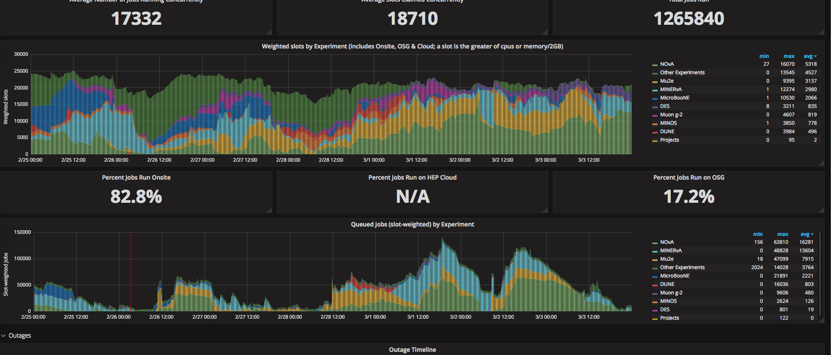
FIFE Operations (combined offsite and onsite)
https://fifemon.fnal.gov/monitor/dashboard/db/scd-summary-fife
Intermittent raid failures on specific class of dcache hardware. Under investigaton

Slide 2
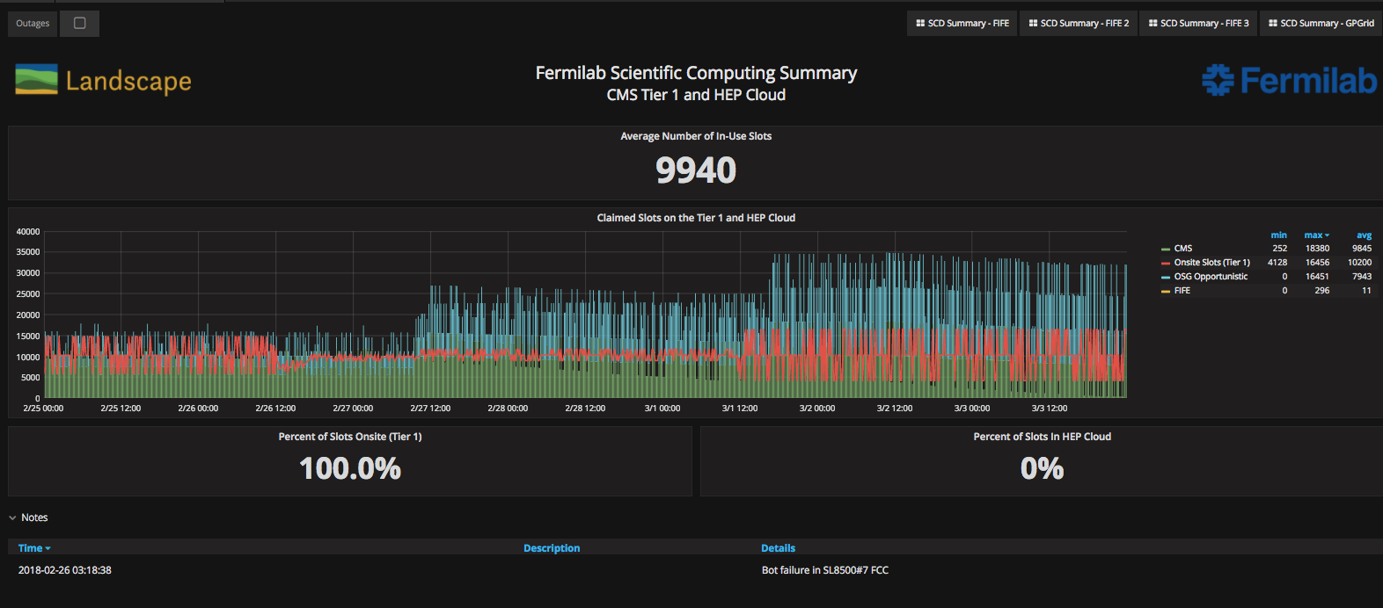
CMS Operations
https://fifemon-pp.fnal.gov/dashboard/db/scd-summary-cms
Cluster is still in transition – being upgraded to SLF7 and docker containers

Slide 3
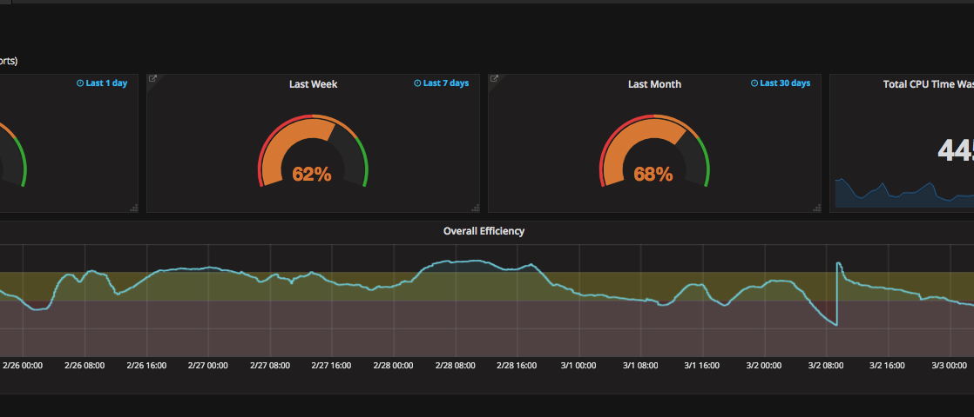
Overall efficiency
Continued work with experiments to address inefficiencies by improving workflows.

