Slide 1
PD/APA/CE Interface
D. Warner
E. Segreto
3/1/18

Slide 2
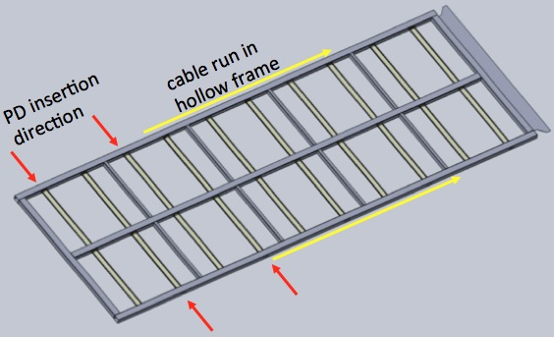
Baseline PD Cable Routing:
Each APA frame contains 10 PD modules
5 per side
All 10 cables from the lower APA also have to sun through the upper APA (10 cables per side total in upper frame)
Current plan calls for running cables inside APA side tubes

Slide 3
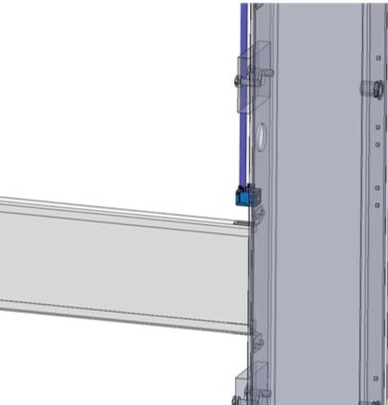
Alternate Cable Routing Option
A possible alternate routing scheme is under consideration
Route cables inside APA frame rather than inside tube
Still requires penetrations into side tubes for connecting to modules
Additional holes in top and bottom frames may also be required

Slide 4
Cable Routing Assumptions
Although other cable selections are still possible, we will assume that the PD cable area will not exceed that required for 10 Cat-6 cables per APA (as in protoDUNE)
Current baseline design envisions installing PD cables in the APAs prior to wire wrapping
We assume that there will be a connector junction at the following locations
At the junction between lower and upper APA frame (to facilitate installation into the cryostat)
At the top of the upper APA (for all PD cables) to facilitate APA stringing and cable routing)

Slide 5
Important CE cable interfaces
Need to make sure no signal interference (either way)
Need to plan order of installation such that CE cables don’t interfere with PD installation through side tunes (impact on order of installation?)
Need to make sure that any CE cables in central APA tube do not interfere with PD installation
Need to plan cable routing and cable trays to facilitate installation

Slide 6
Important PD Cable/APA Interfaces
Need to understand if cable routing inside APA frame (alternate proposal) causes insurmountable problems for frame design (extra holes in frame)
Need to insure pre-installing cables does not interfere with wire wrapping operations
Need to find space in top-bottom frame junction for PD cable connectors
Need to plan order of installation and supply chain logistics for cables

Slide 7
Current PD System Planning
CSU (Warner) will act as initial primary contact between the PD system and the CE and APA systems for cabling.
It would be great if we had particular points of contact within those groups to advance interface plans.
We would welcome regular (every other week?) focused meetings between PD, CE and APA contacts for at least the next few months while this interface is further defined
We hope to take advantage of the CE test stand planned for FNAL to study interfaces between CE and PD cables
We think that it is critical that the PD be involved in integration testing (at Ash River?) to test installation plans.

