Slide 1
72 Hour Weekend Summary
Donovan Tooke
Monday 09:00 Meeting
March 5, 2018

Slide 2
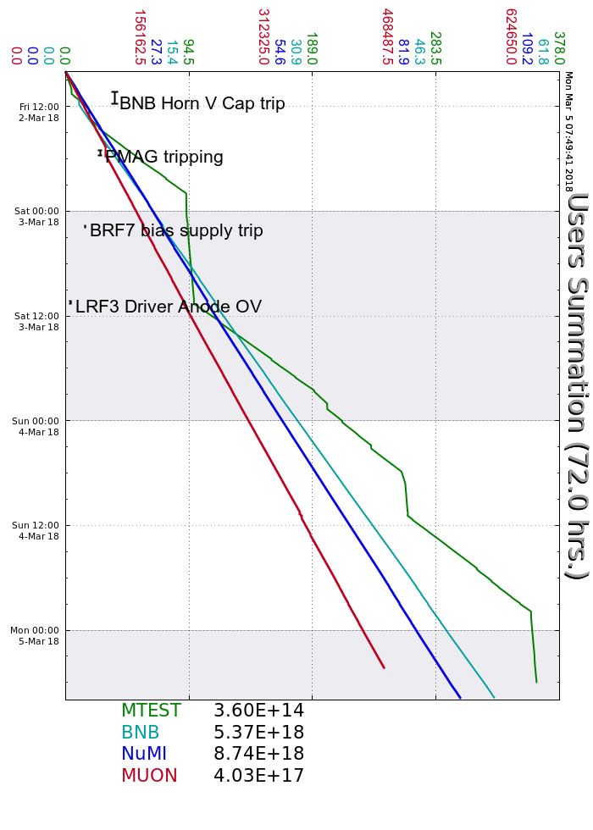
Friday
BNB Horn PS: Vcap limit inc.
PMAG toggled from fast slew rate
Booster EAPS tripped on LCW flow (Sat)
Saturday
BRF7 FBS yard breaker trip
Spare BRF19 sparked/turned back off
LRF3 Driver Anode OV (Sun)
BNB MI-12 Berm chipmunk/FSV
Cycled MI20 LCW pond to 60 HP: sup temp
Sunday
B. West Gal Per 23 AC unit 480V brkr trip
Opened rollup door/fans placed
BRF15 sparking w/no beam
Turned off Sun due to excessive sparking
Turned back on Mon

Slide 3
Current Conditions
Beam to NuMI
656 kWatts
50.3 E12
Beam to BNB
7.43 E16 p/hr
5 Hz
MC-1 open access

