Slide 1
Wednesday 9:00
2018-03-07

Slide 2
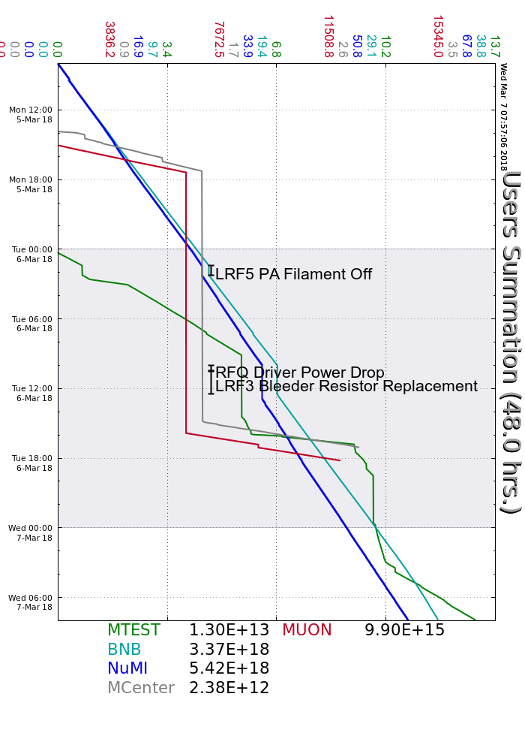
Monday
Accessed SY F1 to reset vacuum valve
P1 and P2 regulation work
Booster Period 23 AC unit repaired
Tuesday
LRF5 PA Filament trip
RFQ Driver Power issues during tornado drill
Scheduled downtime:
LRF3 & LRF1 resistor work
MI8 LCW instrumentation found misconfigured, re-wired
NuMI Absorber and Alcoves Access
New code added to NBPMOV, rebooted multiple times
D18 and Elog issues
Muon Campus studies
MI Studies had issues with MIRF06, exerts investigated
F:MT4W ramping issues, experts repaired
MI-20 LCW temperature regulation issues, cycled to 60HP pump
Wednesday
RFQ 4616 trips, experts investigating regulation scripts
Current Conditions
Beam to NuMI, BNB and MTest

