Slide 1
Beam Plug Installation Status in EHN1
Cheng-Ju Lin
08-March-2018
ProtoDUNE-SP ITI Meeting

Slide 2
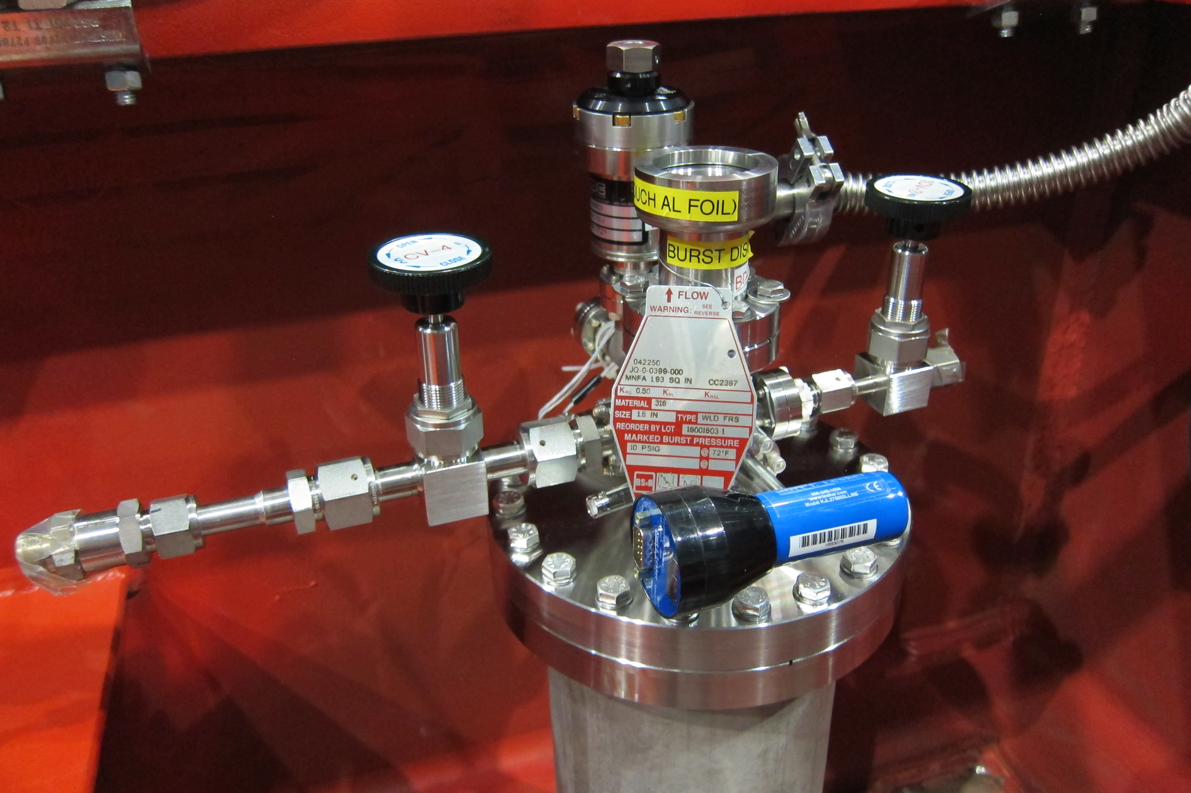
Feedthrough Flange
On Tuesday, beam plug feedthrough flange installed on penetration port 18.1
17’ (~5m) of stainless steel N2 hose is connected to the underside of the feedthrough flange
The hose is a “double-hose” system for supplying N₂ gas to the beam plug and circulating the gas back to the top of the cryostat

Slide 3
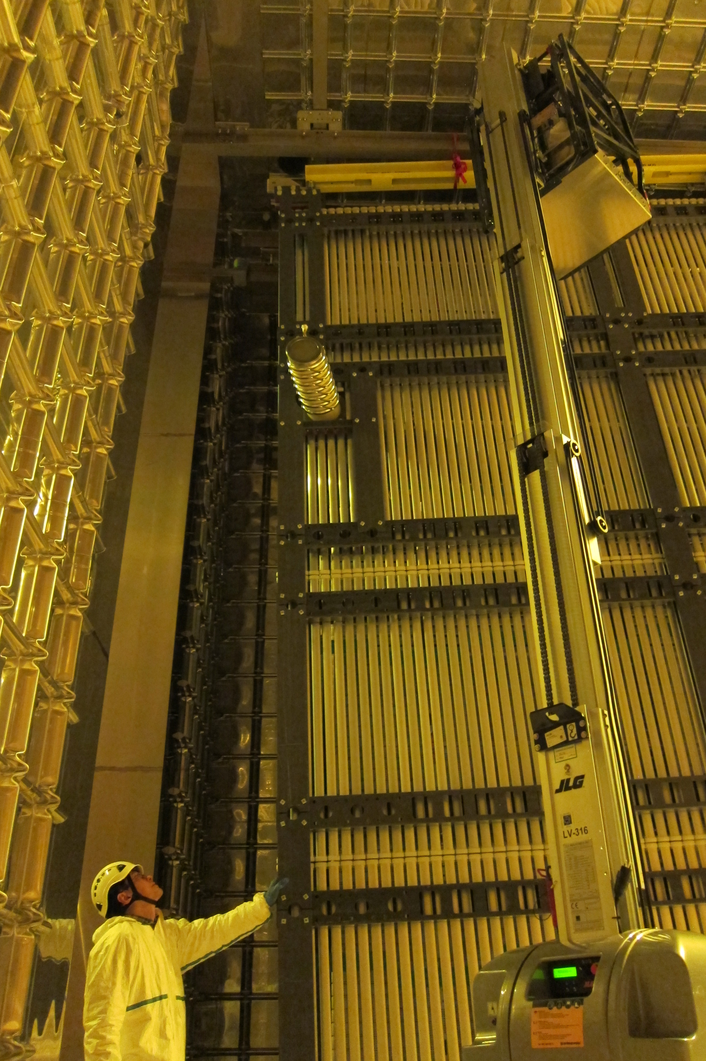
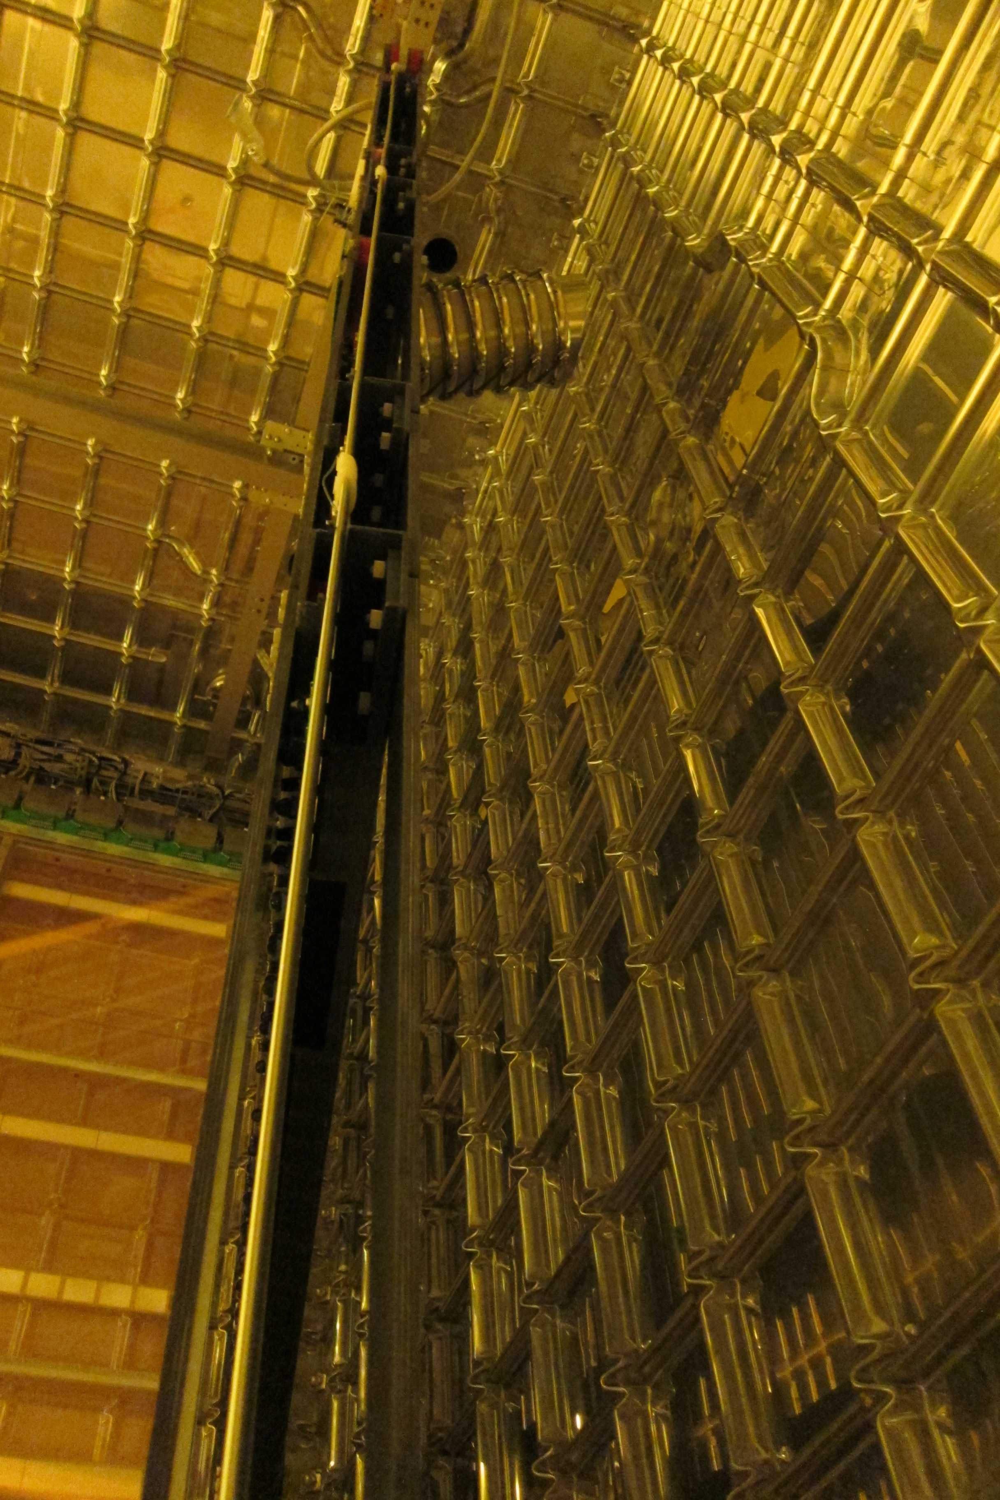
Beam Plug Installation
Endwall Panel With BP Pushed into Cryostat
Endwall Panel With BP in Nearly Final Position

Slide 4
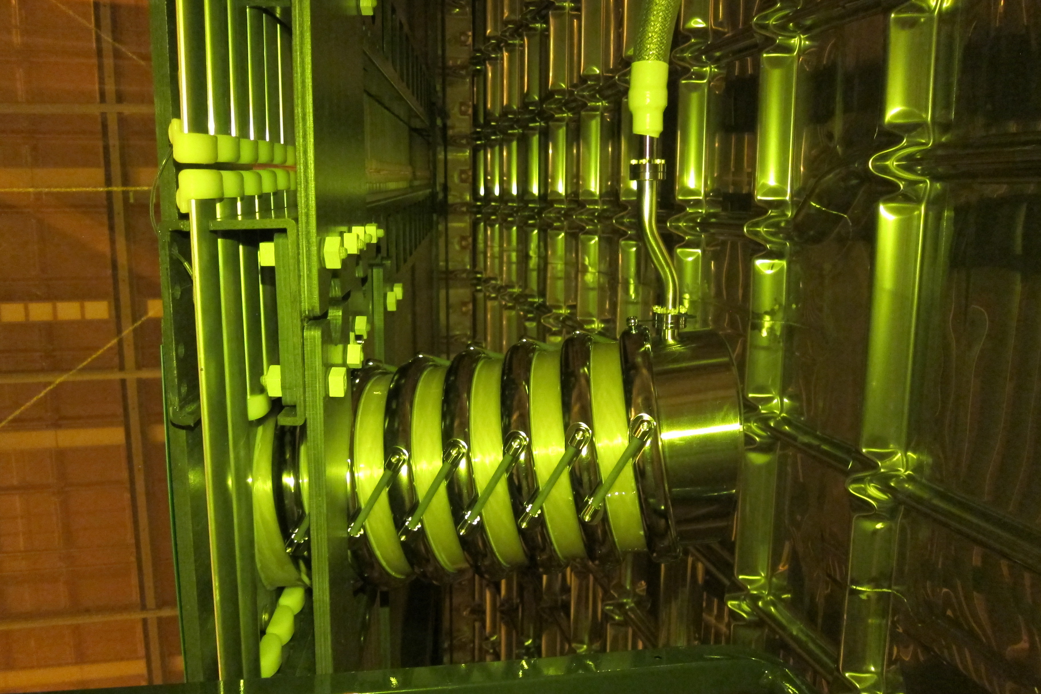
This morning we connected the N₂ hose to the beam plug
Top portion of N2 hose is temporarily tied to the field cage box beam for strain relief. Will properly dress the hose after cable tray is installed (wait for CPA in final position)

Slide 5
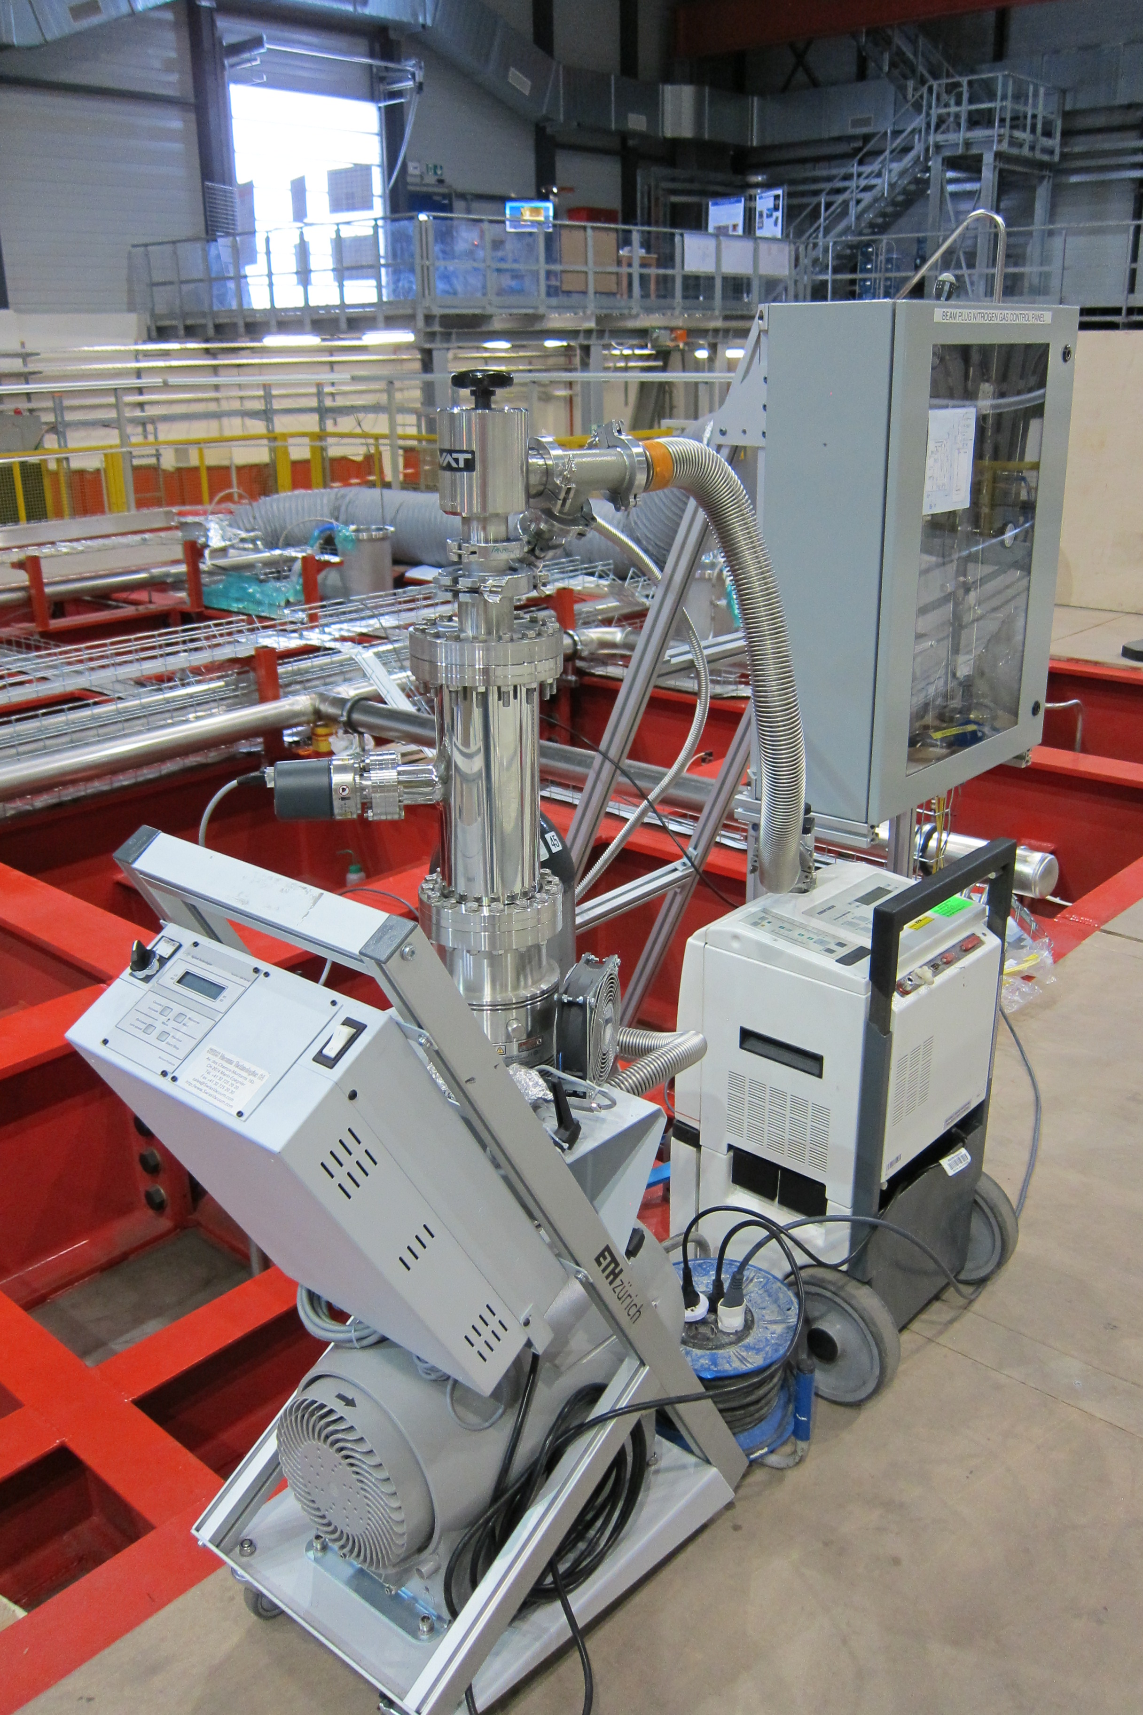
Leak Checking the Beam Plug System
Individual beam plug components were leak checked previously
Now we have a complete closed system. Will leak check the entire chain
Pulling vacuum from the feedthrough flange. Spray He inside the cryostat around the beam plug and N2 hose connection, and also the feedthrough flange on top of the cryostat
Start pumping down today

Slide 6
To Do List
Complete the full system leak check
Install cable tray and strain relief 17’ nitrogen hose. After bridge beam C (CPA) is in the final position
Work on integrating beam plug sensors into Slow Control

