Slide 1
Challenges for Future
Energy Frontier Colliders
Sergei NAGAITSEV (Fermilab)
Nearly all slides are from Vladimir Shiltsev
March 9, 2018

Slide 2
( Yes or No ) = ( Physics × Feasibility )
Will There Be Energy Frontier Colliders After the LHC?
PHYSICS case of post-LHC high energy physics machine depends on the LHC discoveries:
  it might call for a collider (if signals are clear)
  otherwise, search for signs of new physics in the neutrino/rare decays (Intensity Frontier) or astrophysics
FEASIBILITY of an accelerator is actually complex:
  Feasibility of ENERGY
    Is it possible to reach the E of interest / what’s needed ?
  Feasibility of PERFORMANCE
    Will we get enough physics out there / luminosity ?
  Feasibility of COST
    Is it affordable to build and operate ?

Slide 3
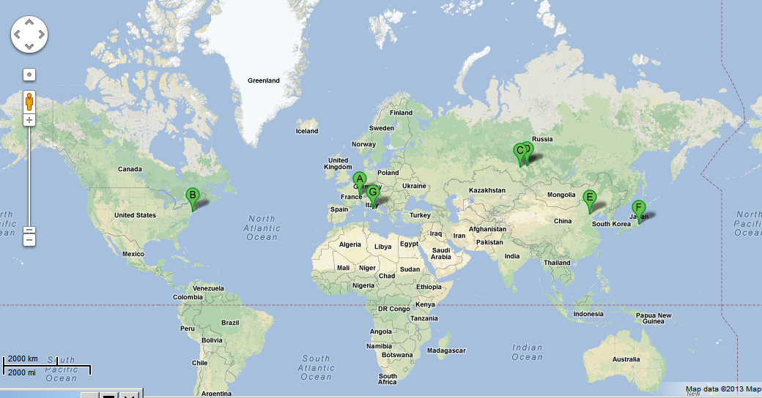
Colliders: 29 Built… 7 in Operation
VEPP-2000
VEPP-4M
LHC
RHIC
BEPC-II
DAFNE
KEK-B
One under construction: NICA (JINR, Dubna), two new ones proposed

Slide 4
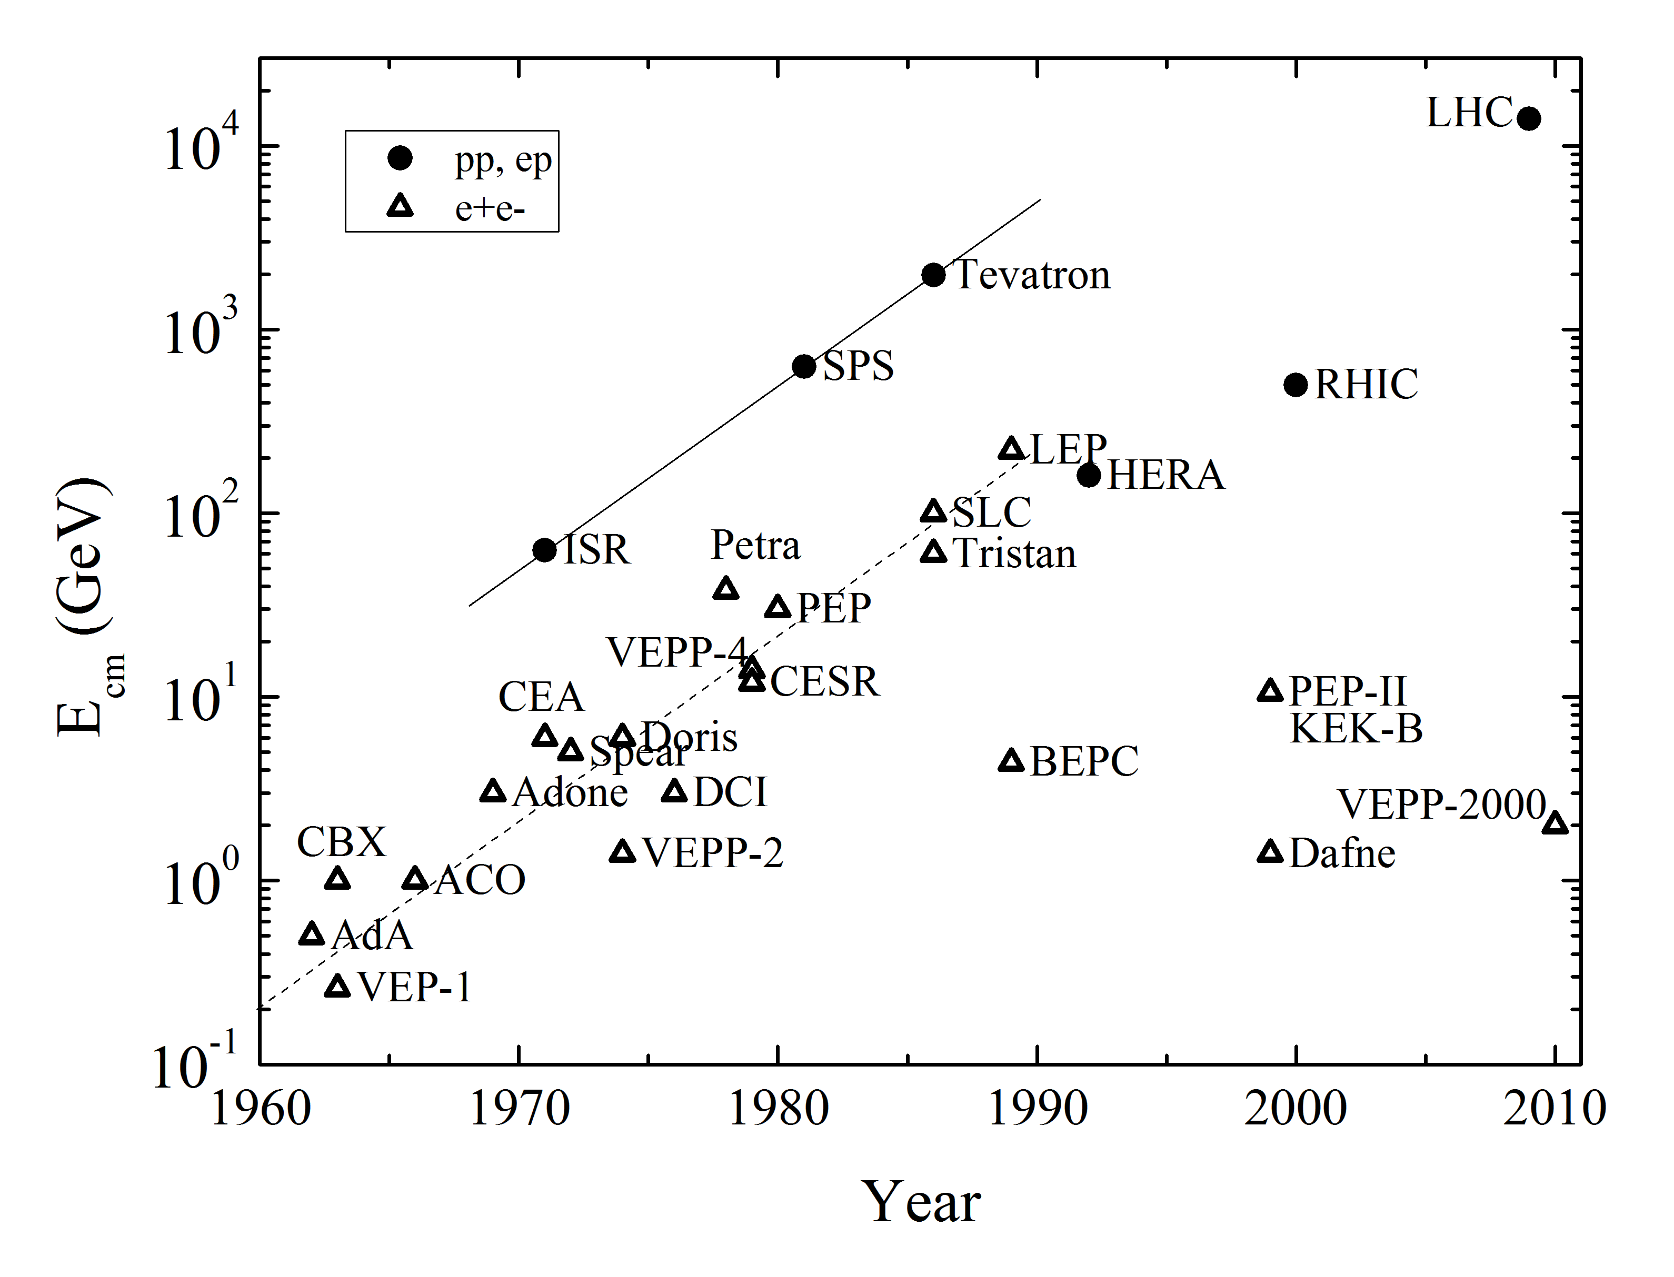
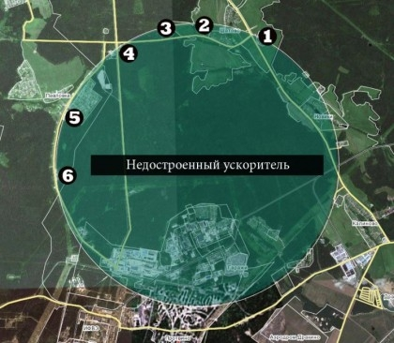
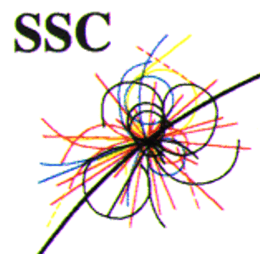
Colliders: Glorious Past
→ ?
E~exp(t/5yrs)
UNK

Slide 5
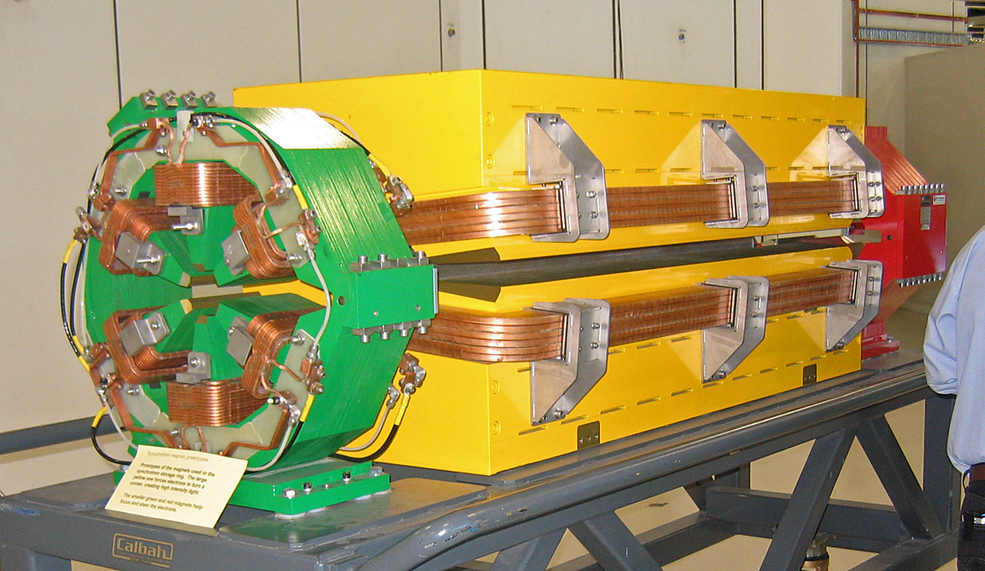
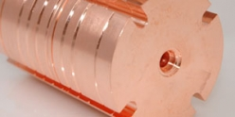
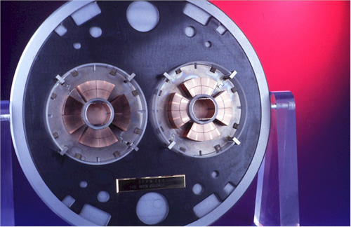
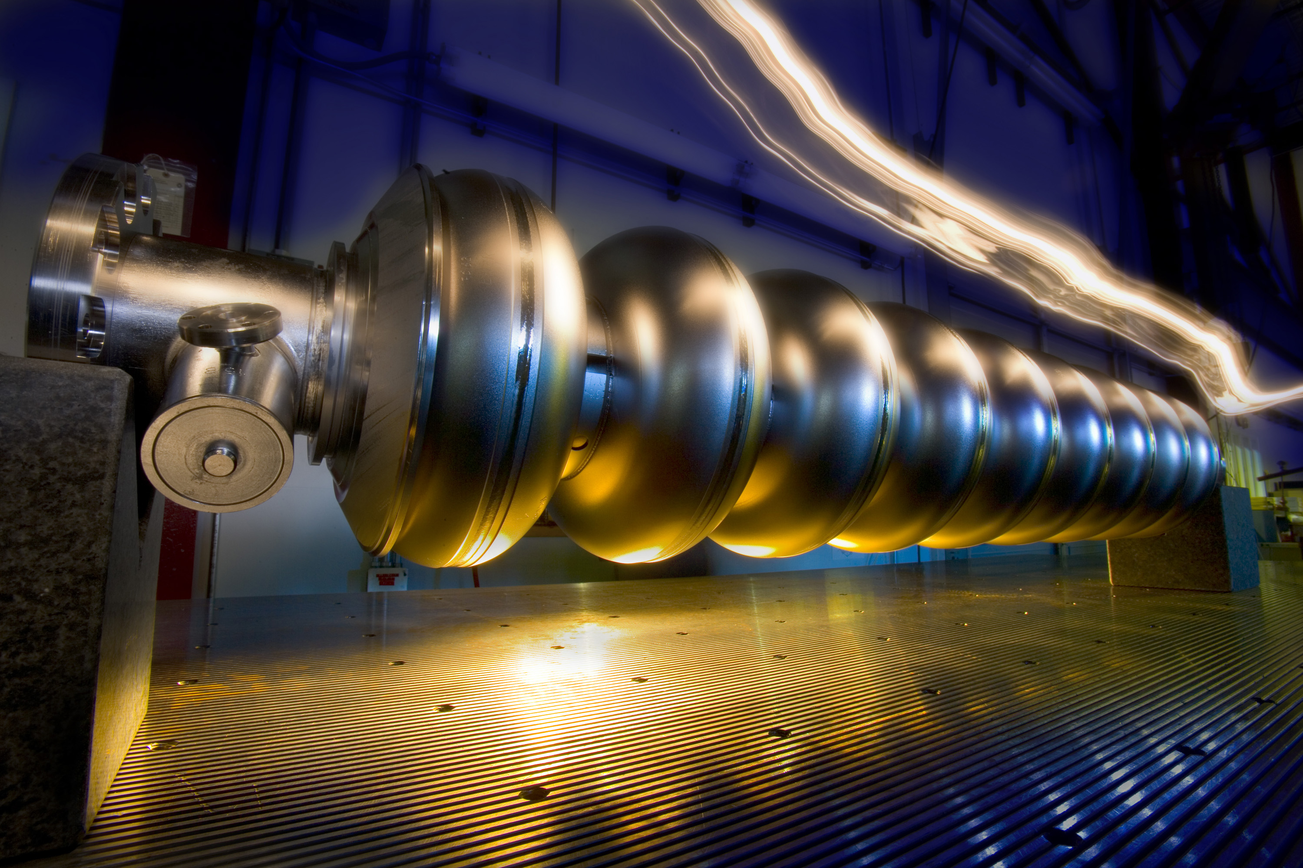
Four “Feasible” Technologies
(CLIC)
Normal Conducting Magnets
Normal Conducting RF
SC magnets
SC RF
… in addition to “traditional” technologies of tunneling, electric power and site infrastructures, etc …

Slide 6
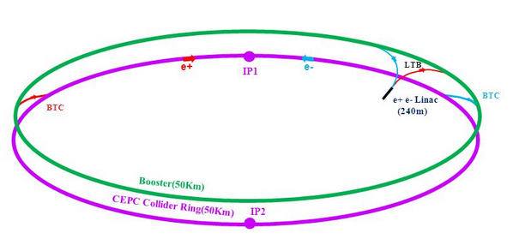
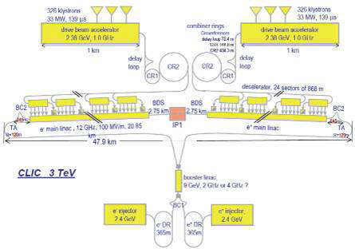
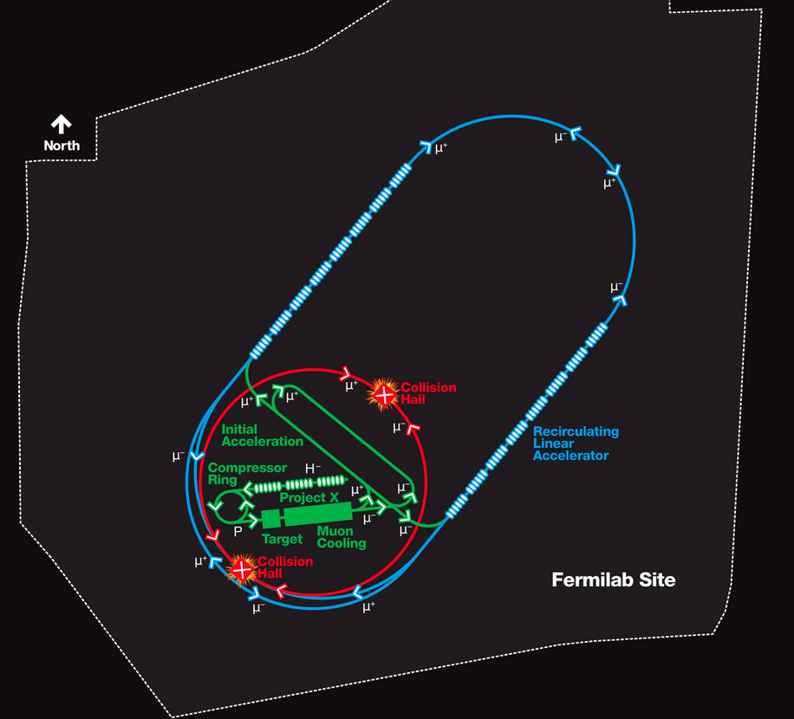
Possible Future Lepton Colliders
CepC/FCC-ee 250GeV cm
C=52/100 km SCRF NC Mag
ILC 30 km long, 250 + 250 GeV e⁺e⁻ - SCRF
Muon Collider
~15km μ-μ+ 3+3TeV
CLIC
e⁺e⁻ 50km
1.5 + 1.5 TeV
NC RF
Two beam
acceleration
NC RF+SC Magn+Muon produc’n; cooling; accel’n

Slide 7
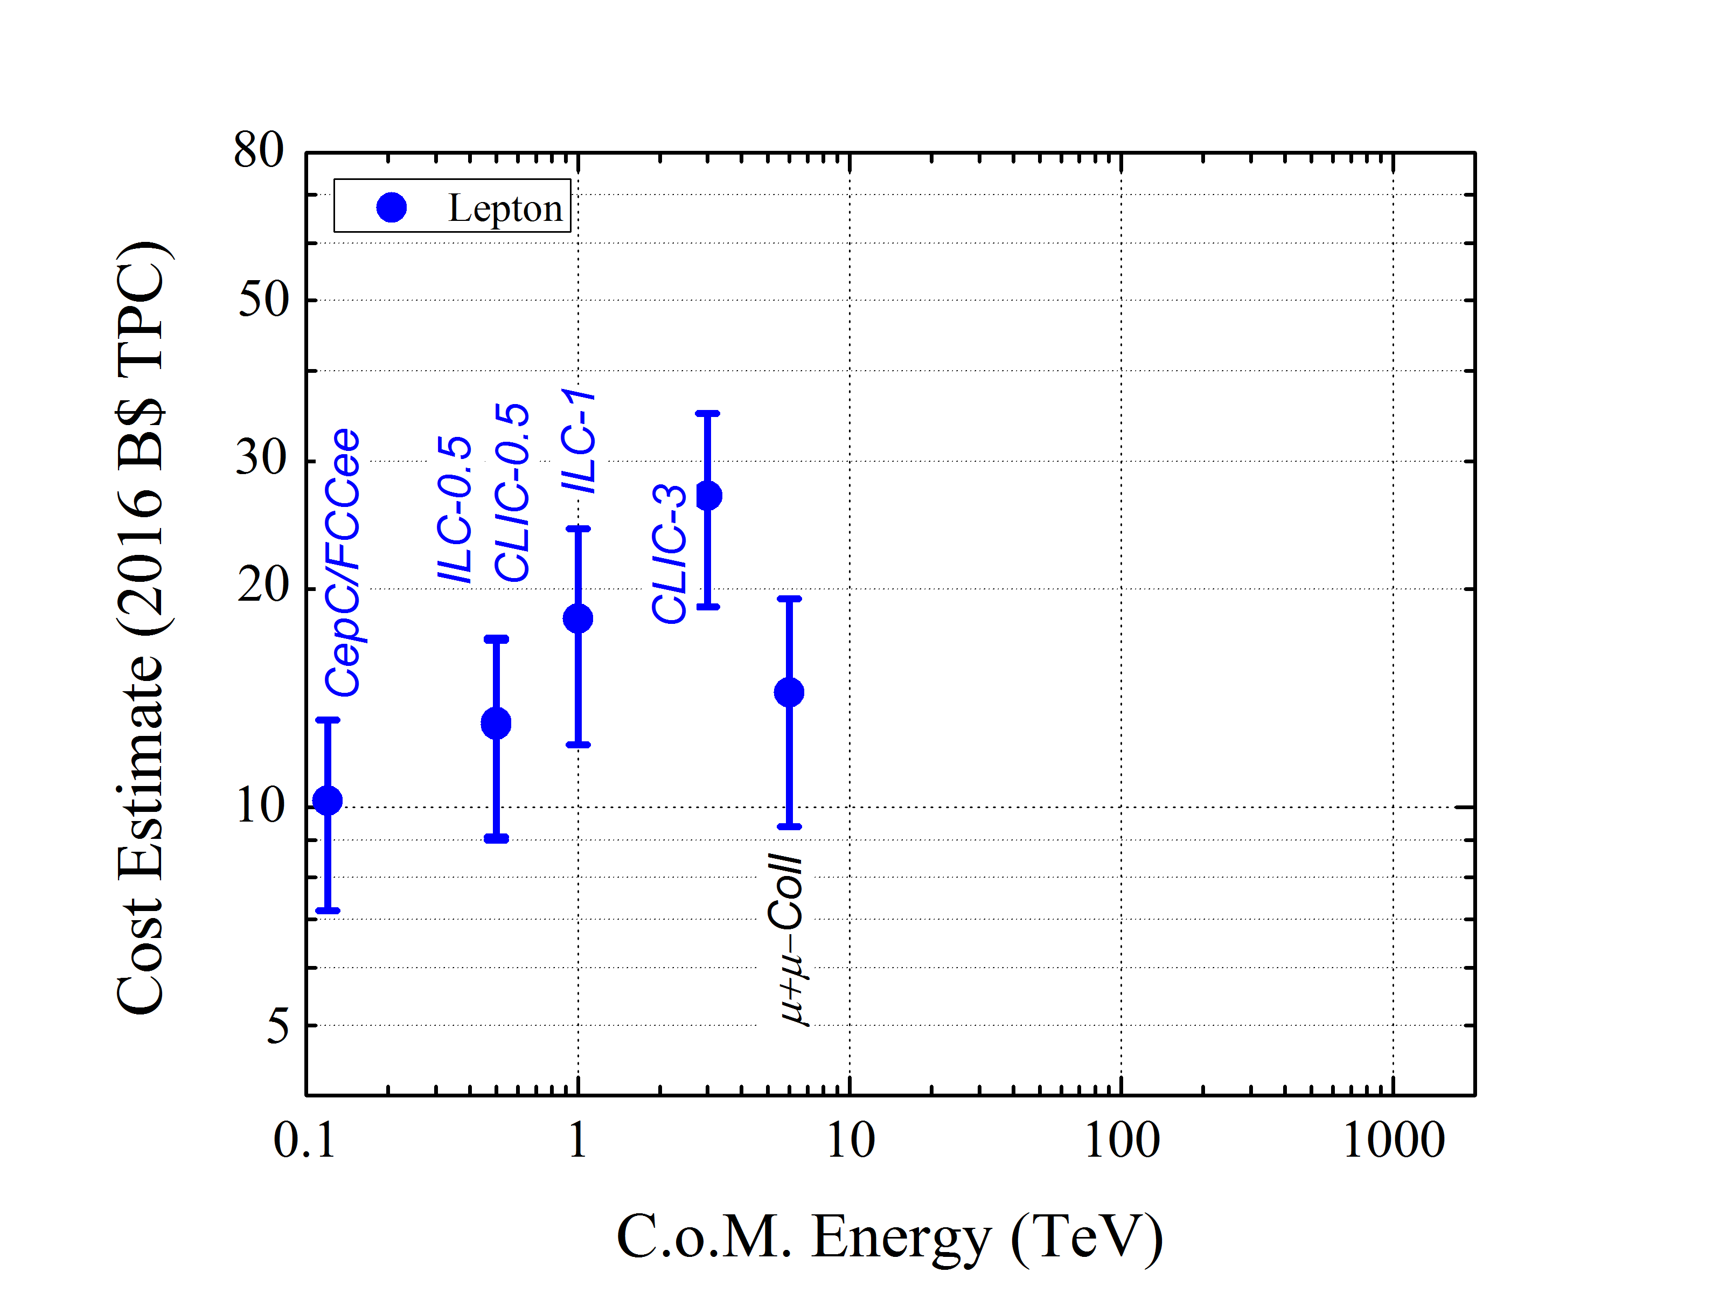
Vladimir’s cost model: https://arxiv.org/abs/1511.01934
LHC reference

Slide 8
Some thoughts about advanced concepts: plasma and dielectric
To compete with ILC or CLIC designs, an Adv Accel collider concept needs to achieve a luminosity of ~2x10³⁴ at ~1 TeV c.m.
The upper energy for an electron-positron collider is limited by beamstrahlung (not by accelerating technology).
We should keep in mind that particle physicists are asking for an electron-positron collider, NOT electron-electron. Thus, it is important for a plasma-based concept to work equally well for both electrons and positrons.
  Maybe gamma-gamma?
Early non-HEP applications ~2035-2040, time-scale (according the the

Slide 9
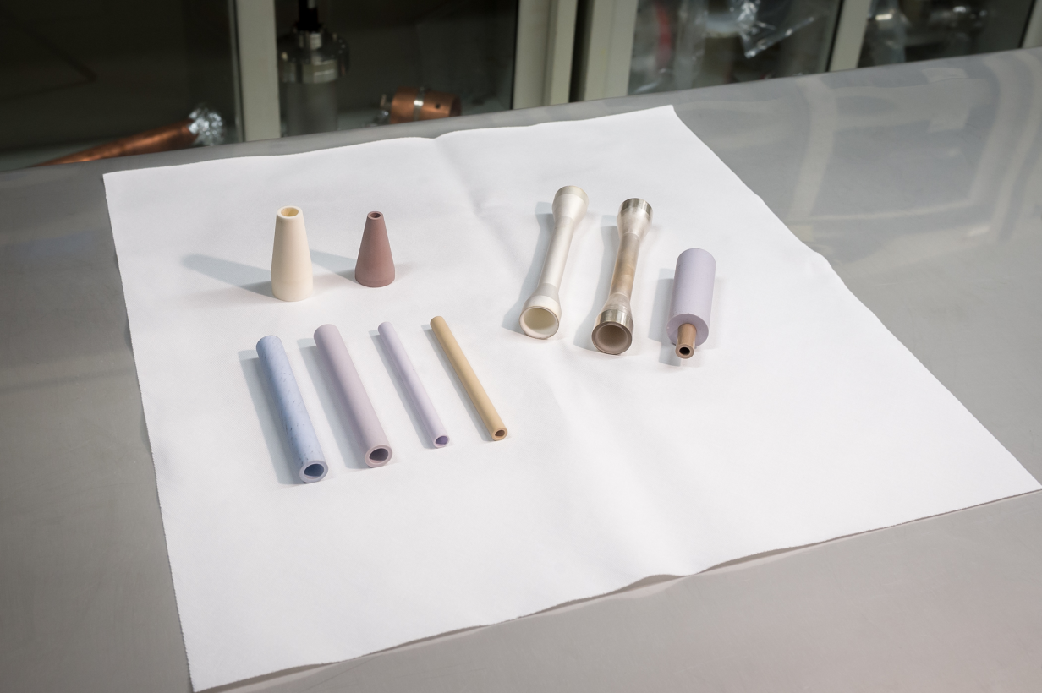
Dielectric Structures: Potentially higher gradient; lower cost due to simpler geometry
Capitalizes on CLIC studies
Two Beam Acceleration
Simplicity

Slide 10
Advanced LC concepts vs CLIC (3 TeV cm)
(a simplified personal view)
 | CLIC | DWA-LC | PWFA-LC Blow-out | LPA-LC Linear & hollow
Energy | Gradient & staging de- monstrated, e+ OK | Gradient OK, staging demo, e+ OK | Gradient OK, No staging demo, e+ questionable | Gradient OK, No hollow channel & linear regime demo yet.
Luminosity | High risk | High risk, similar to CLIC | Very high risk | Very high risk
Cost, site power | TPC(US) ~$26B 560 MW | TPC(US) ~XXB$ similar to CLIC ~400 MW | Potential of lower power and lower TPC | Potential of lower power and lower TPC, Promise of many applications

Slide 11
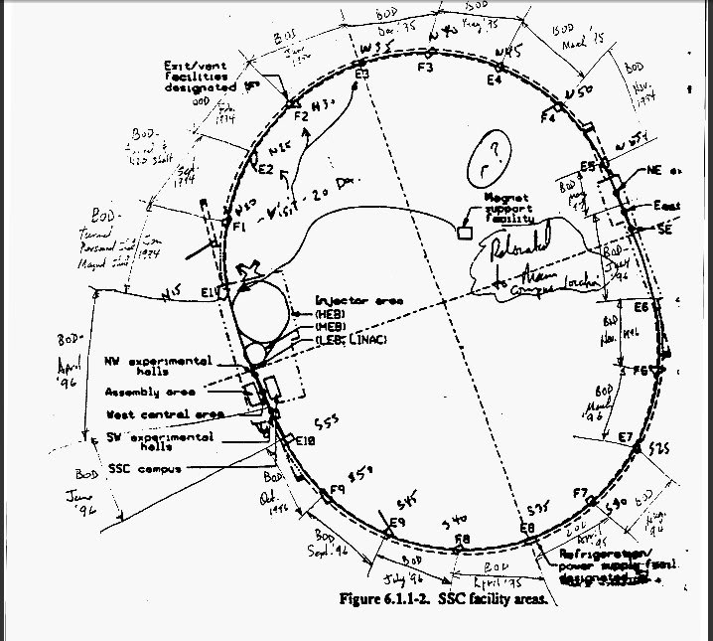
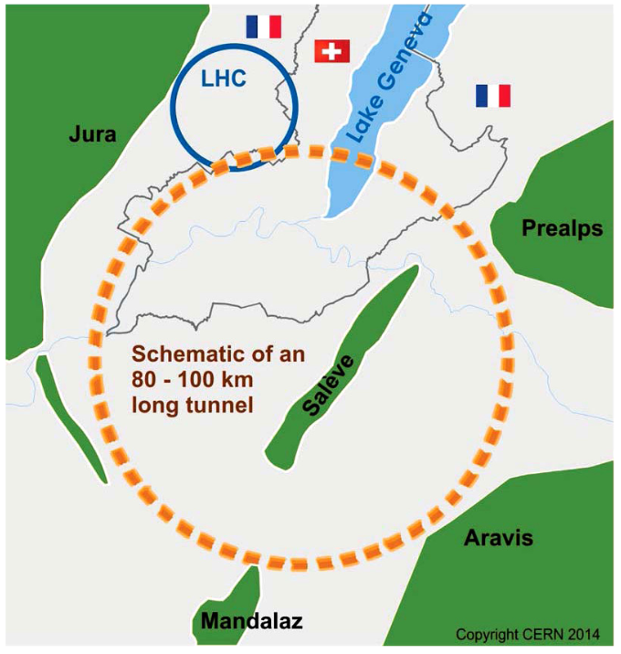
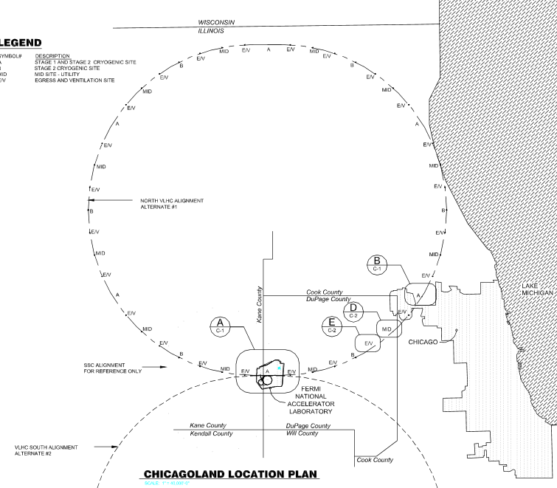
Possible Future Hadron Colliders
HE-LHC same tunnel, 25-30 TeV cm pp 16T SC magnets
FCC/SppC
80-100/54 km
100/70 TeV cme
16-20T SC Magn
VLHC
233 km
175 TeV cme
9.8T SC Magnets
SSC 87km
40cme=20+20TeV
6.6T SC Magnets
Muon Collider
~15km μ-μ+ 3+3TeV
NC RF+SC Magn+Muon produc’n; cooling; accel’n

Slide 12
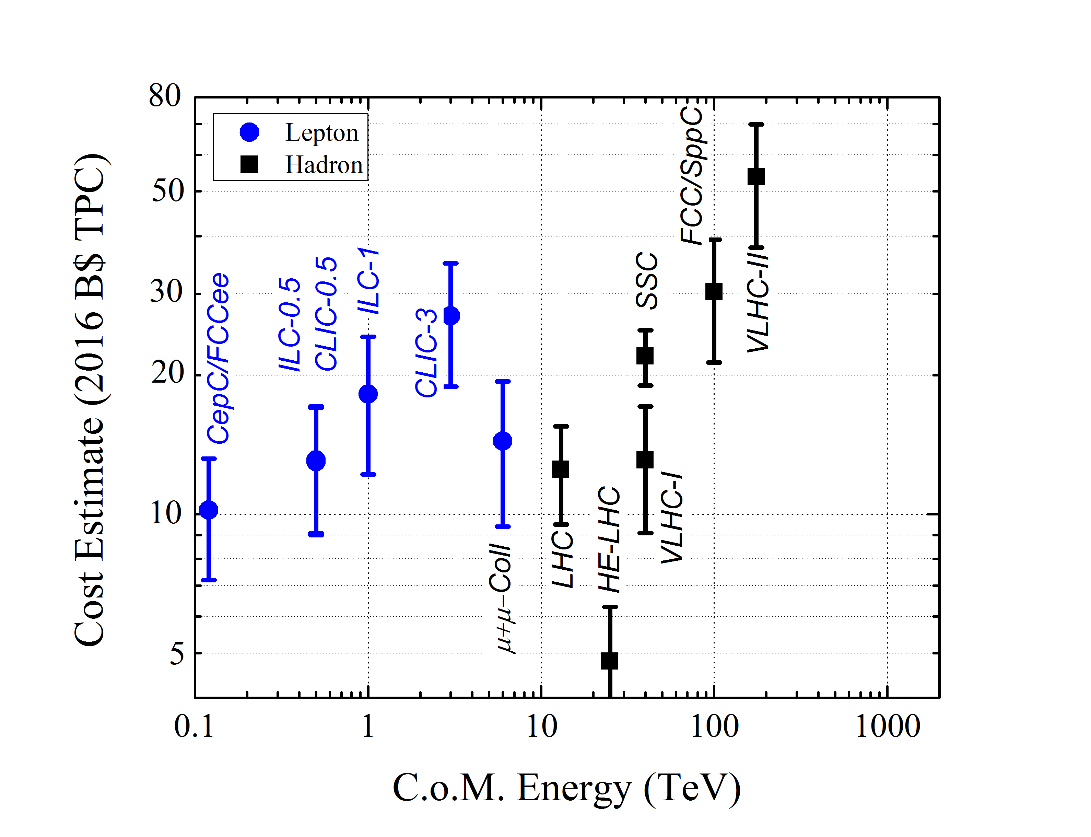
Option 1: re-use
LHC, inj, infrastr.

Slide 13
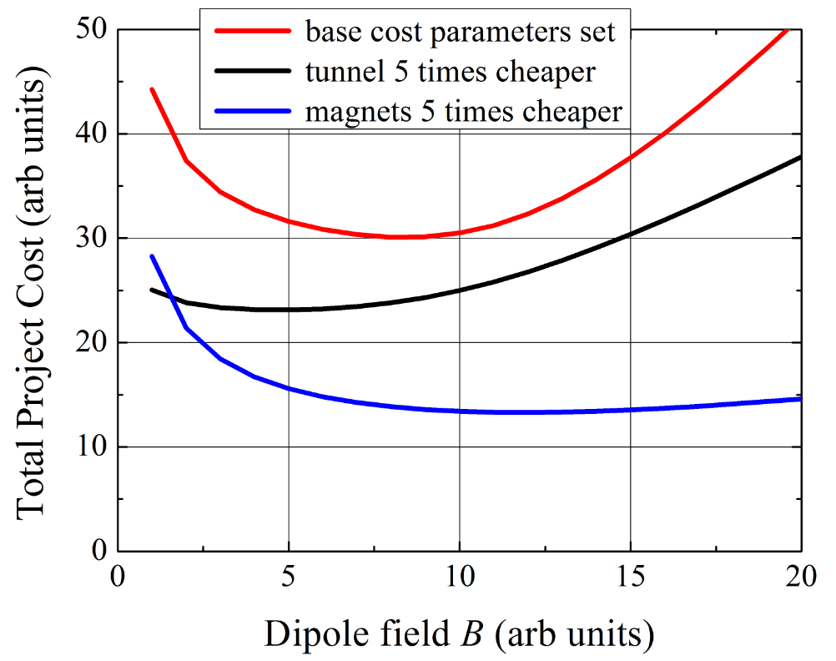
100 TeV pp : Qualitative Cost Dependencies
Option 2 : Develop Technology to Lower the Cost
* for illustration purposes only

Slide 14
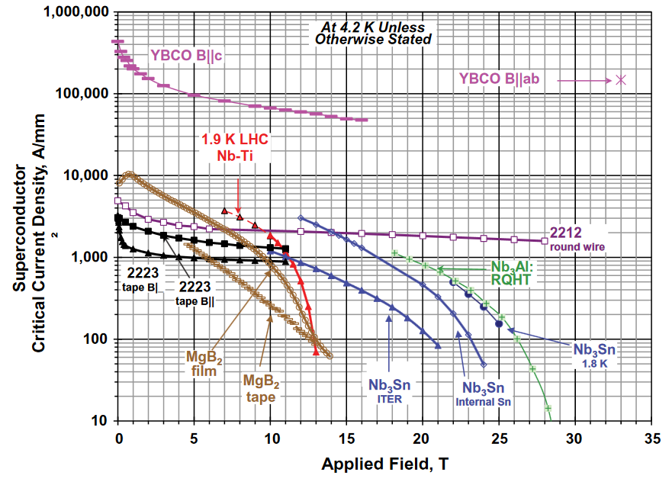
On SC Magnet Technology
Driven by SC cable technology
NbTi – upto 10 T
Nb₃Sn – upto 16 T
HTS – 20+T
Cost of SC conductor
NbTi – $$
Nb₃Sn – $$ x 5
HTS – $$ x 25

Slide 15
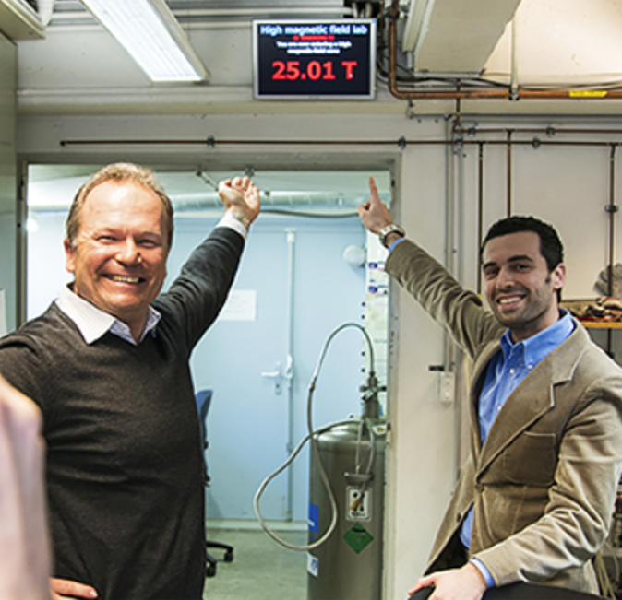
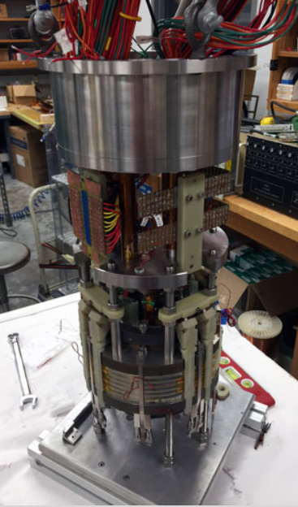
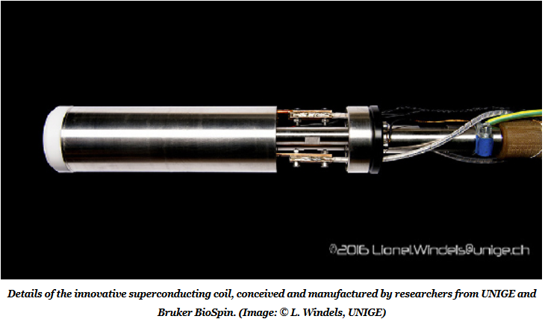
High Temperature Superconductors (HTS)
REBa2Cu3O7-x (REBCO, RE = rare earth)
coated conductors Geneva, 2016
NHMFL (Talahassie)
YBCO coil test (2015)
Achieved 25 T = 21T LTS +4T HTS insert
27 T = 18T LTS +9T HTS insert

Slide 16
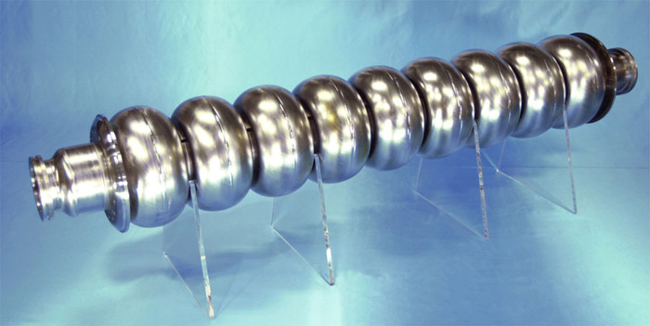
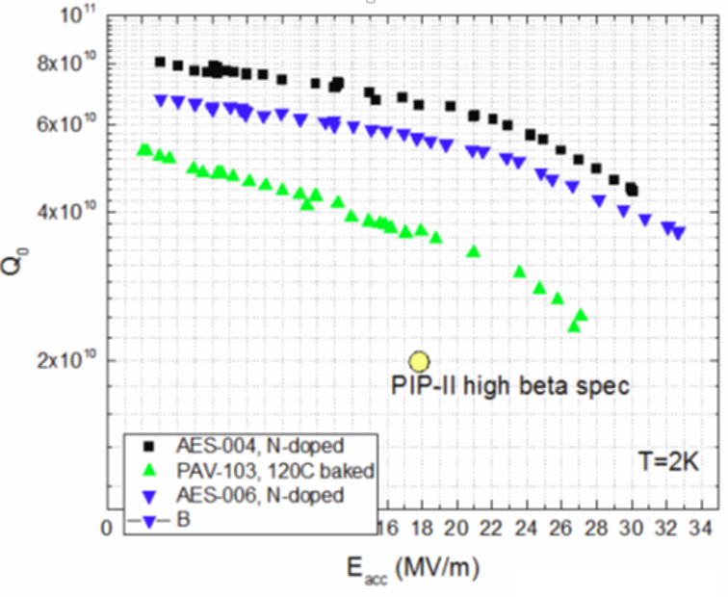
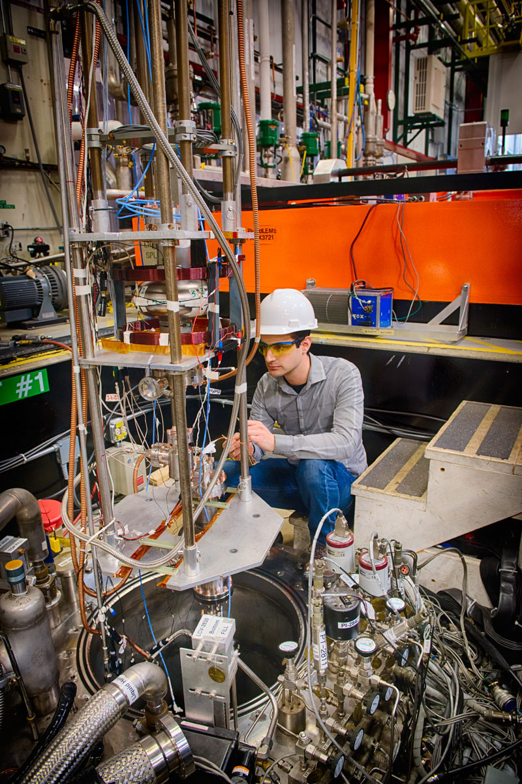
R&D On Cost-Effective SRF Structures
31.5-35 MV/m
ILC prototype elipical cell “π-cavity” (1.3 GHz): field alternates with each cell
(ILC)
New materials (Nb3Sn) –
higher gradients
New techniques (Nb on Cu) – lower cost
Surface treatment (N2 doping) – higher Q0 and lower operation cost

Slide 17
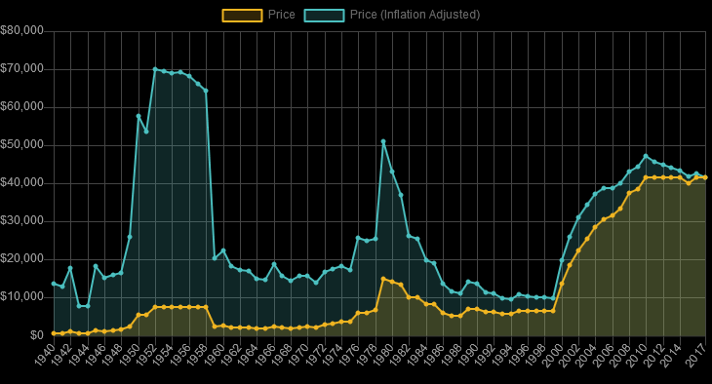
Historical prices of Niobium (per ton)

Slide 18
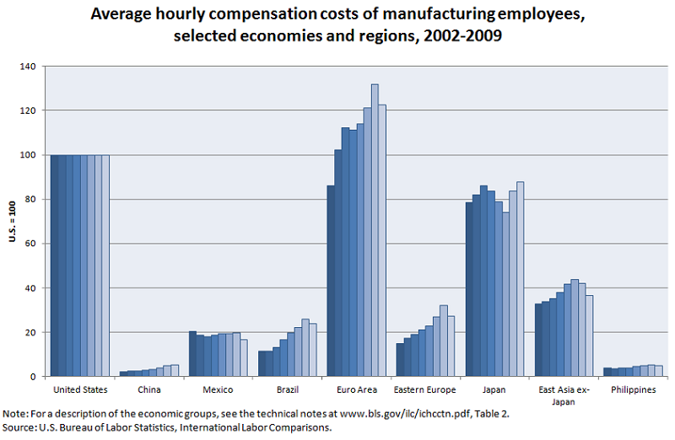
Option 3: “Move to China !”

Slide 19
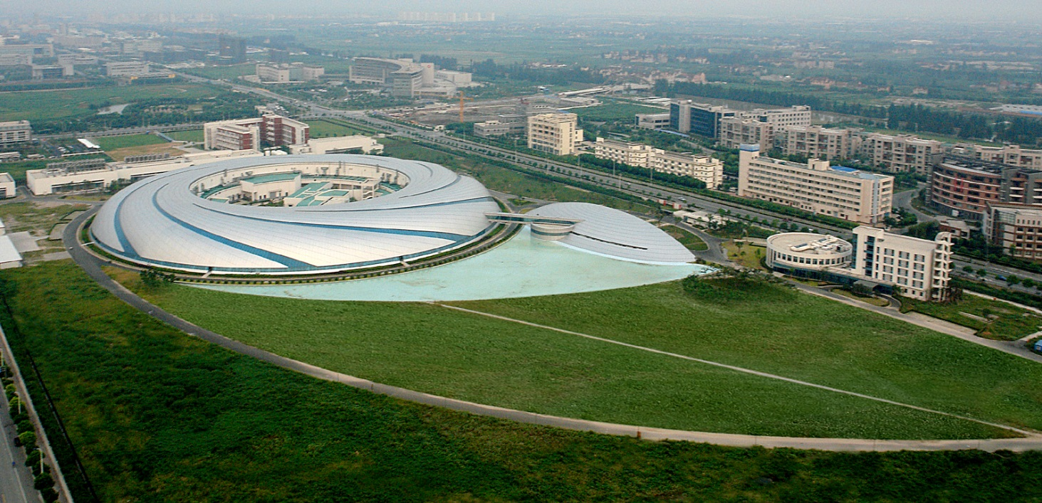
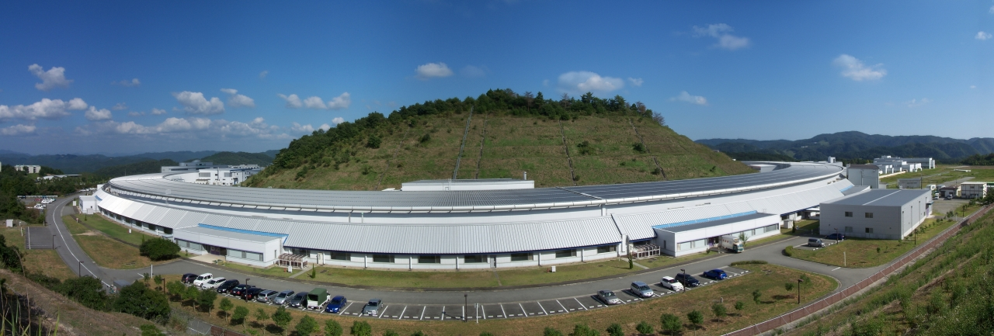
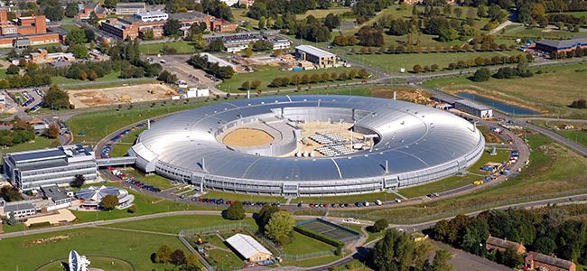
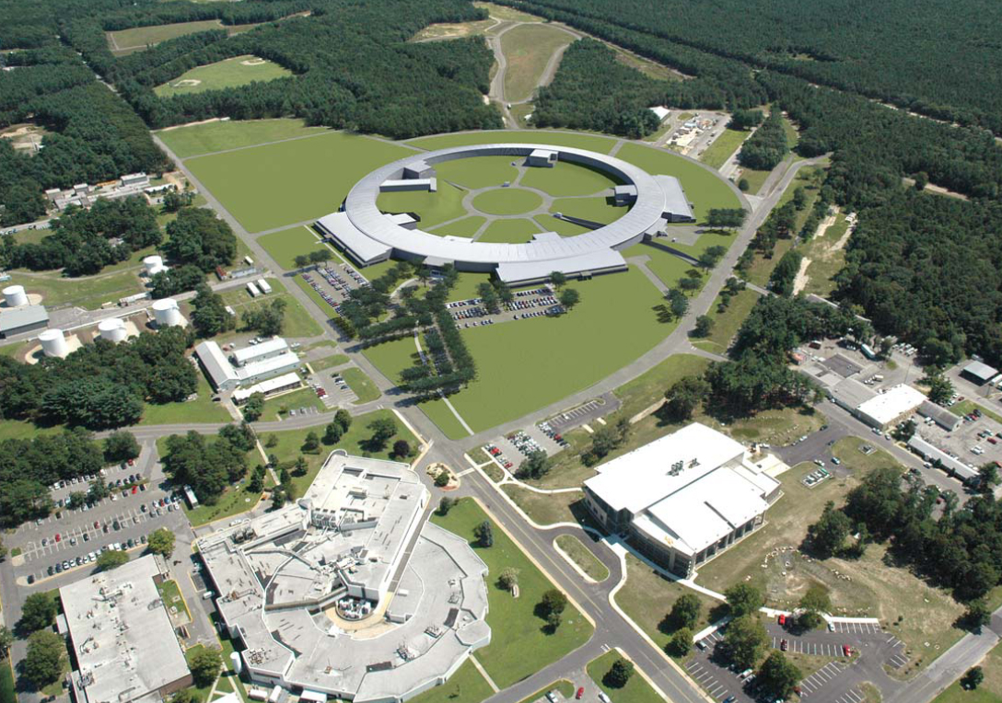
SSRF Spring-8 Diamond NSLSII
China Japan UK USA
432 m
3.5 GeV
1.2B RMB 2007
1436 m
8 GeV
11 BY
1997
562 m
3 GeV
383 M £
2007
792 m
3 GeV
912 M$
2015
Account infl’n, convert to USD and scale to sqrt(1 km):
350 M$ 772 M$ 1040 M$ 1024 M$

Slide 20
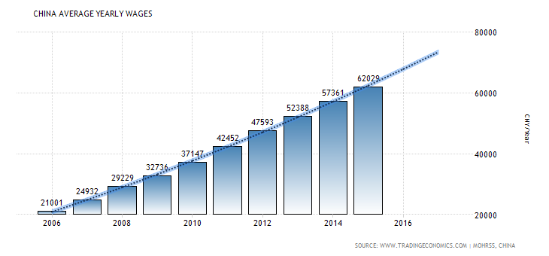
“Move to China !” - Caveats

Slide 21
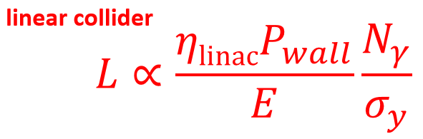
A “Dream” Collider
Far Future “Energy Frontier” assumes
  300-1000 TeV (20-100 × LHC)
  “decent luminosity” (TBD)
What we know:
For the same reason there
is no circular e+e- collider above
Higgs-F there will be no circular pp
colliders beyond 100 TeV → LINEAR
2. Electrons radiate 100% beam-strahlung (<3 TeV) and in focusing channel
(<10 TeV) → µ+µ- or pp

Slide 22
Summary
Post-LHC colliders are possible but :
  Dependent on the LHC results (motivation)
  if based on current technologies (SRF, SCMag, etc) only HE-LHC is cost feasible (<LHC), some are close (CepC/FCCee, ILC, Muon Coll, VLHC-I), others need significant R&D (FCC)…or move to China (?)
  Or must be based on an entirely new technology

