Slide 1
Energy Frontier Retreat Discussion: ILC, CLIC, CepC (and SppC)
Anadi, Paddy, Sergey, Dmitri

Slide 2
Physics Goals and Challenges of the Future Colliders
Today there are two areas where new colliders are especially important
“Higgs factory” – a collider (most probably e⁺e⁻) with a center of mass energy 250 GeV and above and high luminosity to study the Higgs boson properties
“~100 TeV” pp collider to get to the “next energy frontier” an order of magnitude or so above LHC
Study distances up to ~10⁻¹⁹ cm and particles masses up to ~50 TeV

Slide 3
Colliders
of first physics
Absolute majority of colliders are circular
Single e⁺e⁻ high energy linear collider - SLC

Slide 4
Medium Term Colliders Projects Under Development
ILC - International Linear Collider
250 GeV linear e⁺e⁻ collider (recent option has “staging” with second stage at 500 GeV)
Higgs factory (and top quark factory after upgrade)
Location – Japan. Start of construction ~2021? Estimated cost ~$4B
CLIC – Compact LInear Collider
380 GeV linear e⁺e⁻ collider (with potential upgrade up to 2 TeV)
Higgs factory and top factory
Location CERN. Start of construction – after 2026. Estimated cost $6B
FCC – Future Circular Colliders – Anady’s talk
350 GeV e⁺e⁻ and/or ~100 TeV pp (and HE-LHC)
Higgs factory and/or next energy frontier
Location – CERN. Start of construction – after 2026. Estimated cost - ?
CepC – Circular Electron Positron Collider
~250 GeV circular e⁺e⁻ collider (the tunnel could be later used for pp collider)
Higgs factory and top factory
Location – China. Start of construction ~2021. Estimated cost ~$5B

Slide 5
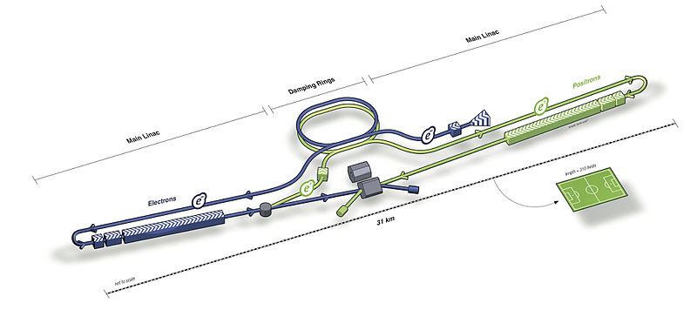
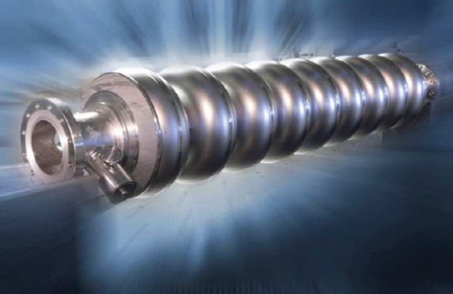
International Linear Collider
ILC or International Linear Collider is e⁺e⁻ linear collider with the following main parameters
Center of mass energy 250 GeV (upgradeable to higher energies)
Luminosity >10³⁴ cm⁻²s⁻¹

Slide 6
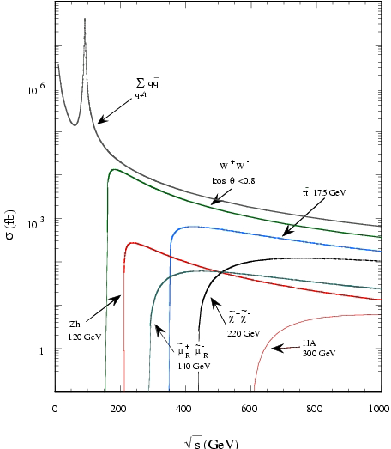
ILC Physics and Experiments
Low cross sections
High luminosity needed
Low rate of interactions
Collect all events
High efficiency needed
Point like particles colliding
Sharp thresholds
Can be used for precision measurements including top quark mass
Large number of different production/decay channels

Slide 7
ILC Status and Plans
After success of SLAC’s linear e⁺e⁻ collider in 1990’s (SLC) various proposals developed to go to even higher colliding energy
Among them NLC(SLAC), TESLA(DESY), “ILC at Fermilab”
Starting in 2008 Global Design Effort (GDE) progressed developing
Technical design of the ILC
Cost estimate and international cooperation plan
GDE concluded in 2012
Including TDRs for the accelerator and detectors
Physics case strengthened with the Higgs discovery
In 2012 Japan expressed strong interest to host the ILC
Part of Primer Minister Abe election plaform
Recently
Substantial progress in technical developments
Development of cooperation between participants on “Governments level”
All involved agree that ILC project should be international project with Japan as the host country
Funding for this international project, including in Japan, is expected to be “in addition to the existing particle physics funding”
Japan to make “a decision” in 2018, otherwise not part if European Strategy

Slide 8
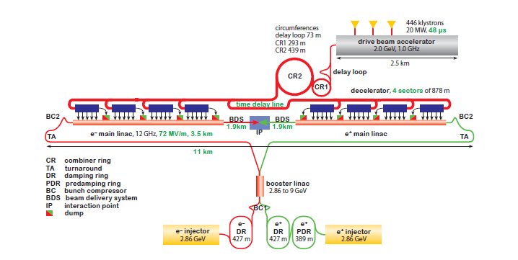
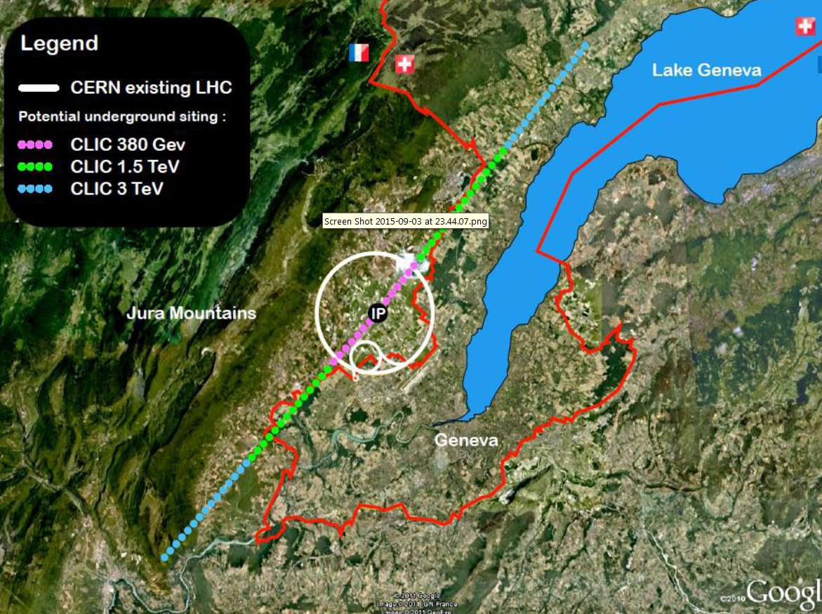
CLIC Collider at CERN
CLIC is a linear e⁺e⁻ collider based on “warm” RF technology with 70+ MV/m acceleration
The only way to get to multi-TeV e⁺e⁻
11km long for 380 GeV in the center of mass
Under active design development

Slide 9
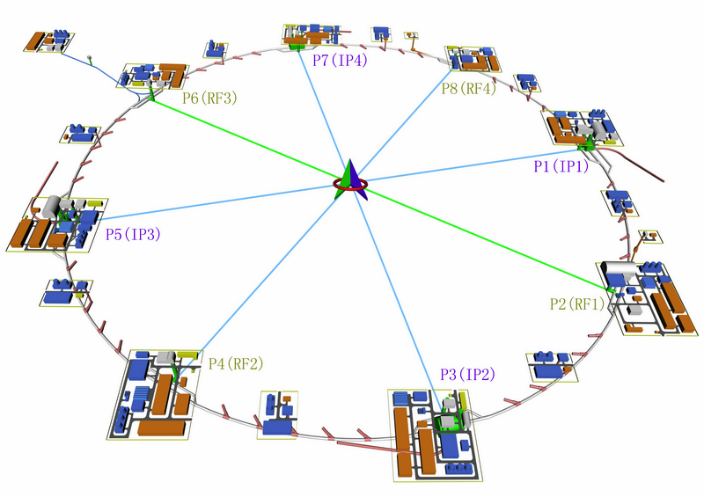
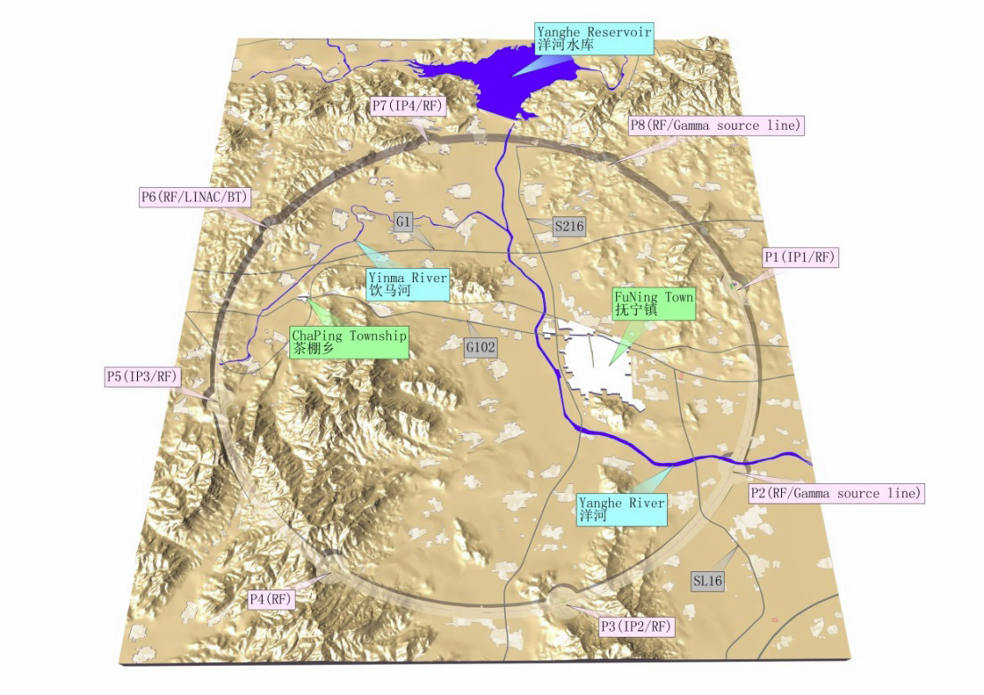
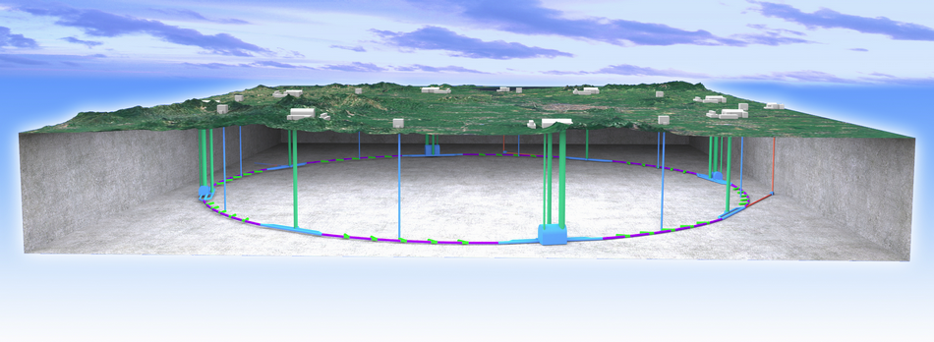
Proposals for Colliders in China: CepC and SppC
CepC – Circular Electron Positron Collider
~100 km long ring
90-250-380 GeV in the center of mass
Z boson and Higgs boson factory
SppC – Super Proton Proton Collider
In the same ring as CepC
~100 TeV with 16 T magnets

Slide 10
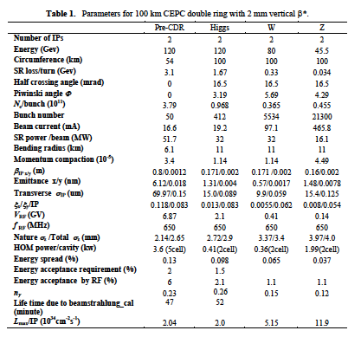
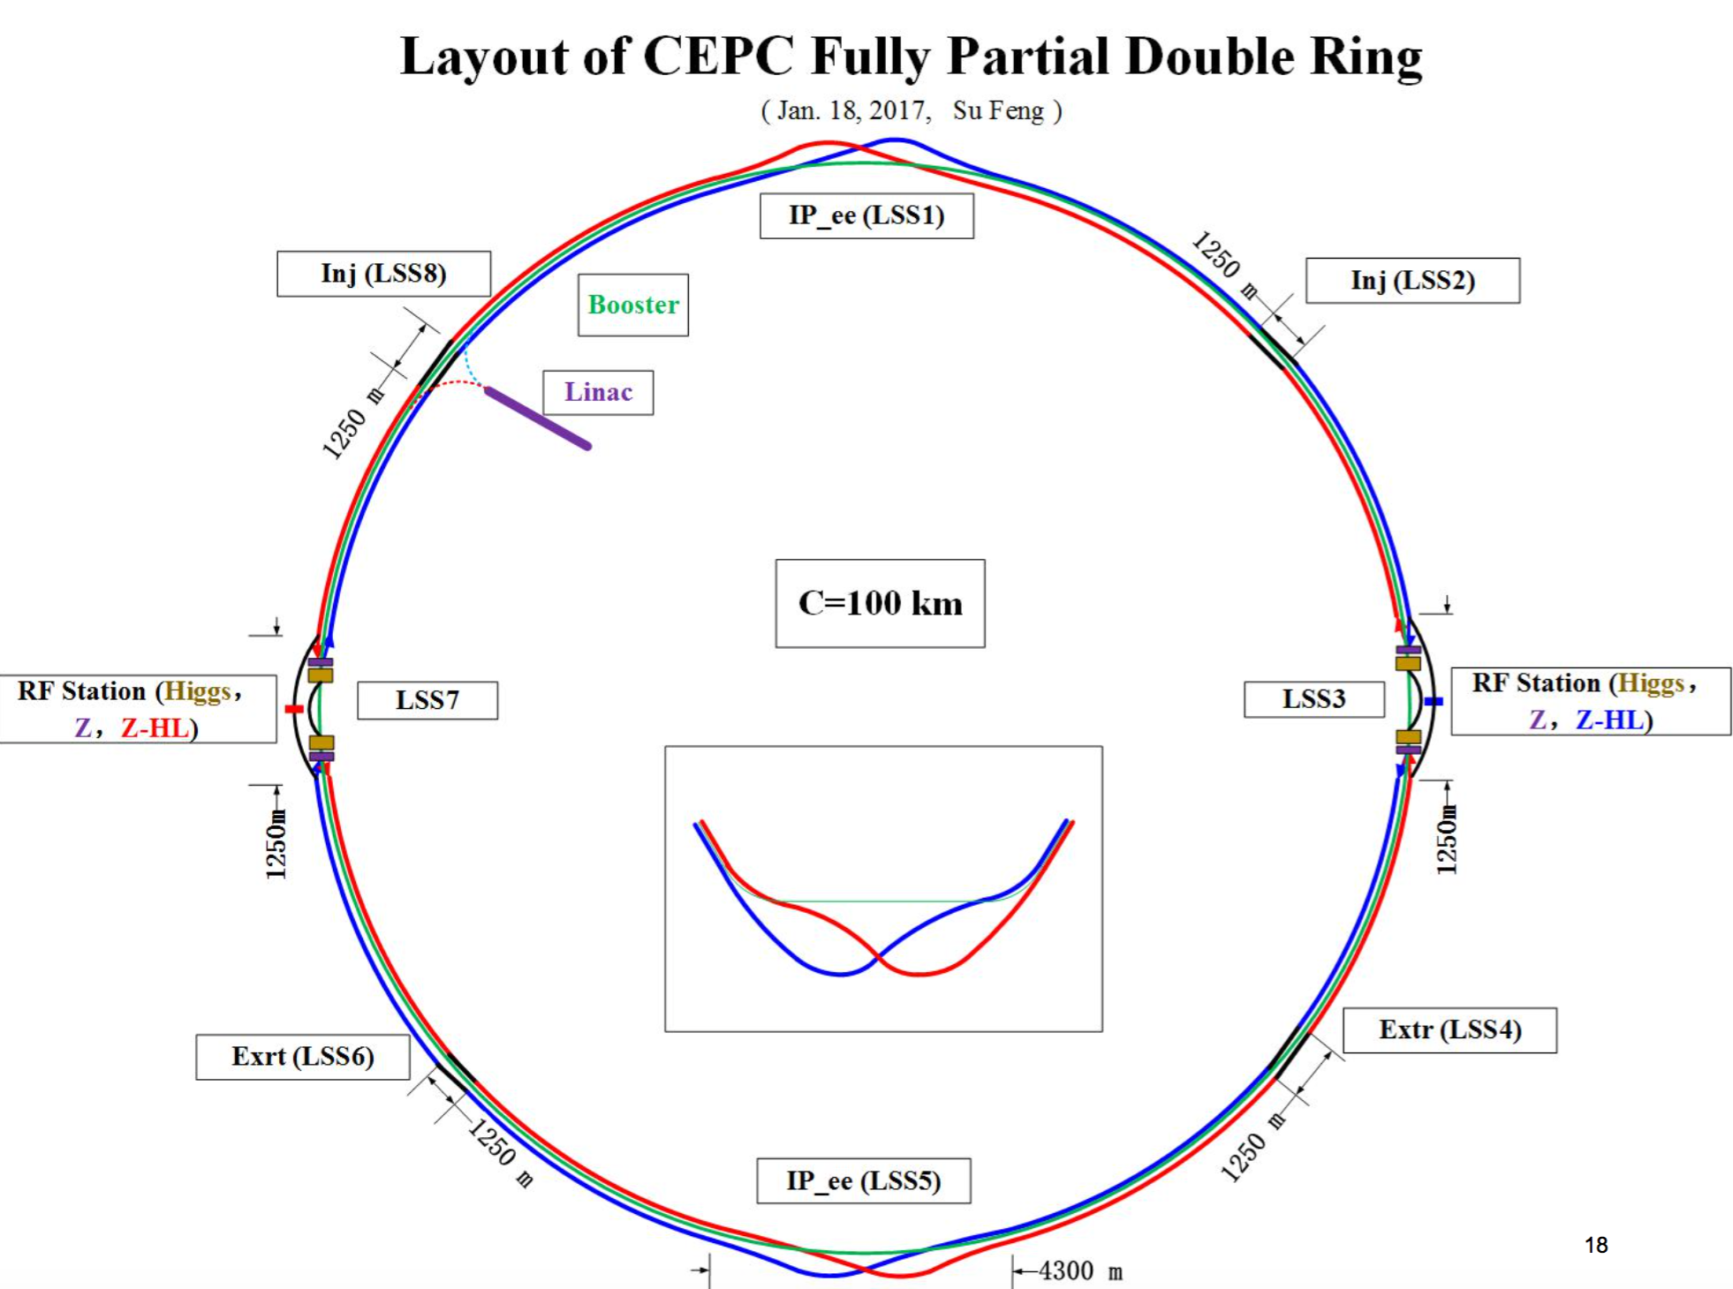
CepC Design with 100 km Ring

Slide 11
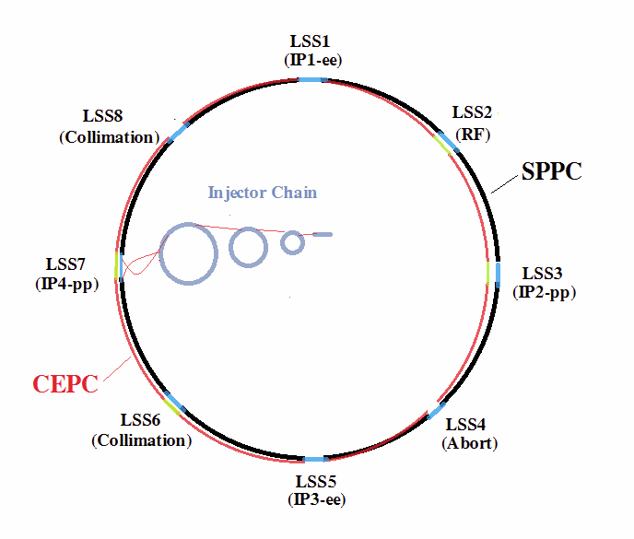
Future Colliders in China
Active progress with the CepC and SppC design over last two years
International reviews (positive) of the conceptual proposals in 2015
Plan is to get funding for detailed technical design report
Completed by early 2020s
Construction of CepC to start in ~2021
Completed in 2027
Data collection 2028-2035
SppC time line
Design 2020-2030
Construction 2035-2042
Physics at ~100 TeV starting in 2043
The proposal is based on
Experience with BEPC e⁺e⁻ collider
Relatively inexpensive tunneling in China
Strong Government interest in scientific leadership – both CepC and SppC are “national projects with international participation”

Slide 12
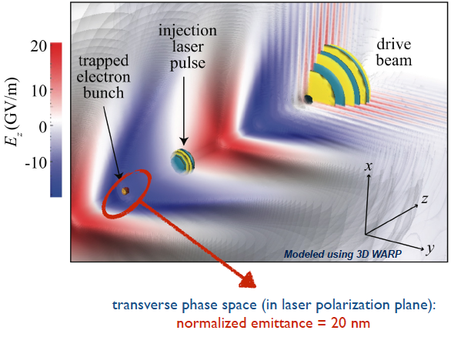
Novel Ideas in Very High Gradient Acceleration
Leverage the potential for accelerating gradients in the GV/m range
Beam-Driven Wakefield Accelerators
In US: FACET/FACET-II
Laser-driven Wakefield Accelerators
In US: BELLA
Dielectric Wakefield Acceleration
In US: AWA, ATF
Major research efforts are also underway in Europe and Asia
Some are: AWAKE (CERN), Eupraxia, FLASH_Forward (DESY), SPARC_Lab (INFN)
For now these methods are in the initial stages of development
Europeans are starting efforts in this area

Slide 13
Participation in European Strategy Efforts
ILC
Well defined organization: Lyn Evans (accelerator), Jim Brau (physics/detectors)
Many areas where Fermilab has expertise
CLIC
Well defined organization: Steinar Stapler (accelerator), Phil Burrows (physics/detectors)
Fermilab colloquium by Phil Burrows on April 4th
Fermilab is not involved yet
CepC (and SppC)
Not yet defined how Europeans will deal with proposing participation
Strong interest from scientists in various European countries
“Novel acceleration methods”
Not clear if any proposals will be submitted to the European strategy

