Slide 1
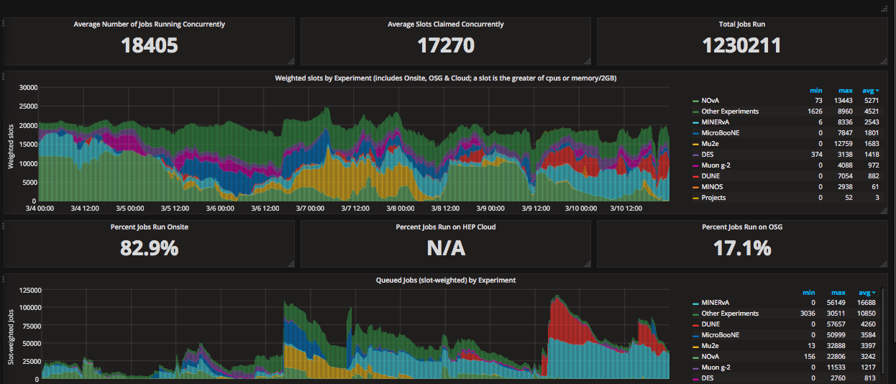
FIFE Operations (combined offsite and onsite)
Problem with uboone conditions database on Friday – too many connections. Server rebooted. Under investigation.

Slide 2
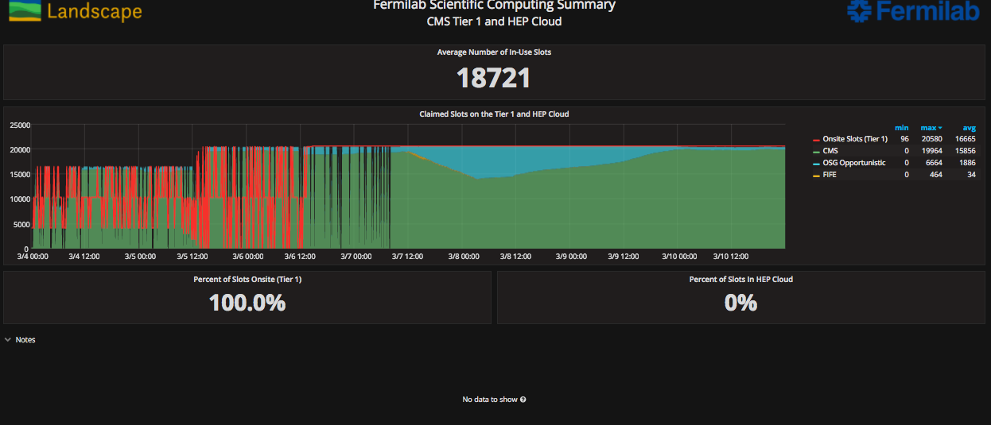
CMS Operations
SLF7 upgrade finished.

Slide 3
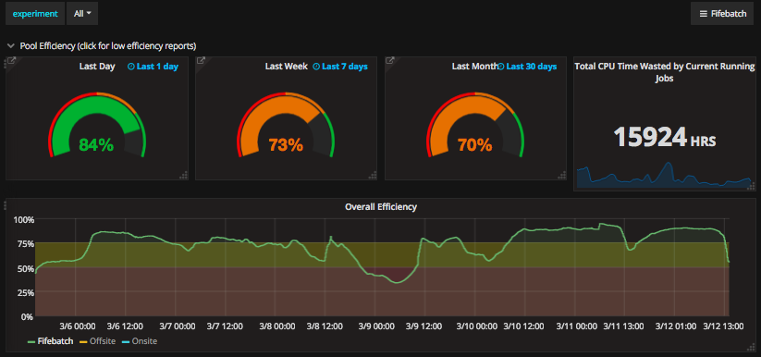
Overall efficiency
Continued work with experiments to address inefficiencies by improving workflows.

