Slide 1
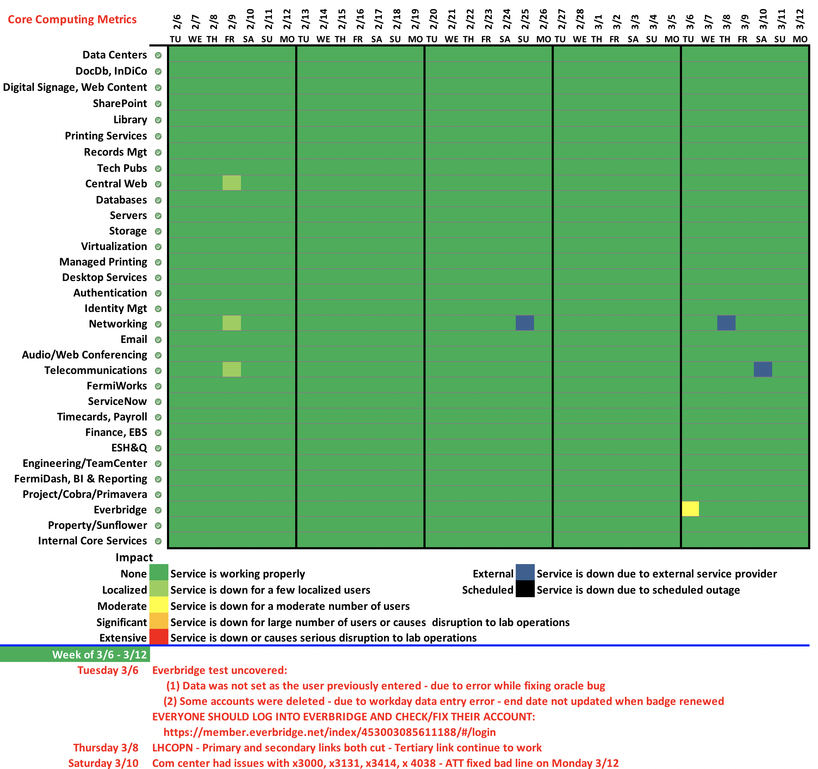

Slide 2
CCD Week of March 6-12
Everbridge test uncovered:
Notification data previously set by some users was changed while we were fixing a oracle bug – There isn’t a development Everbridge site and an incorrect file was transmitted
Some accounts were deleted – due to workday data entry error – end dates were not updated when badge renewed
EVERYONE SHOULD LOG INTO EVERBRIDGE AND CHECK/FIX THEIR ACCOUNT: https://member.everbridge.net/index/453003085611188/#/login
Open a ticket if you need help.
LHCOPN – Primary and secondary links both cut last Thursday, the tertiary link continue to work (at a lower rate)
Com center had issues with x3000, x3131, x3414, x4038 on Saturday
ATT fixed bad line on Monday 3/12

