Slide 1
Accelerator Division Status
Daniel Johnson
All Experimenters’ Meeting/Lab Status Meeting
12 March 2018

Slide 2
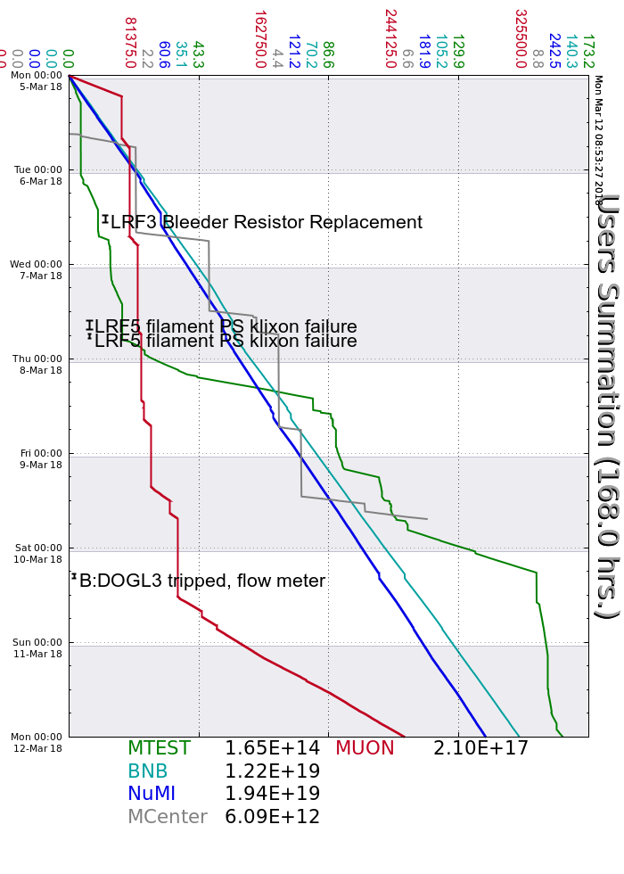
Accelerator Operations Summary
From: March 05, 2018 (0000 hours)
To: March 12, 2018 (0000 hours)
Calendar Week # 10
NuMI Weekly Integrated Intensity 1.94 E19 protons
Beam Hours To NuMI 156.2 hours
BNB Weekly Integrated Intensity 1.16 E19 protons
Beam Hours To BNB 157.3 hours
Muon Weekly Integrated Intensity 2.01 E17 protons
Beam Hours To Muon 50.9 hours
MTest Weekly Integrated Intensity 1.65 E14 protons
Beam Hours To MTest 90.5 hours
MCenter Weekly Integrated Intensity 6.10 E12 protons
Beam Hours To MCenter 11.5 hours

Slide 3
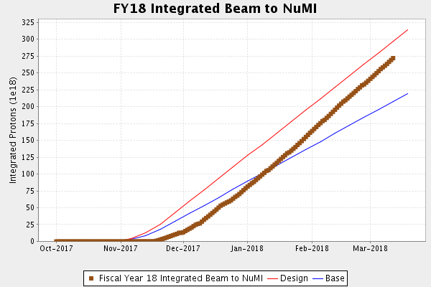
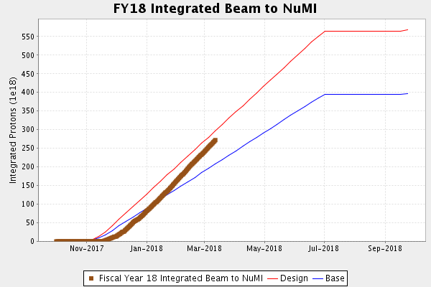
NuMI Operation

Slide 4
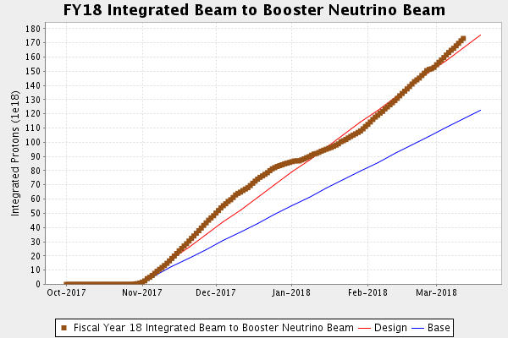
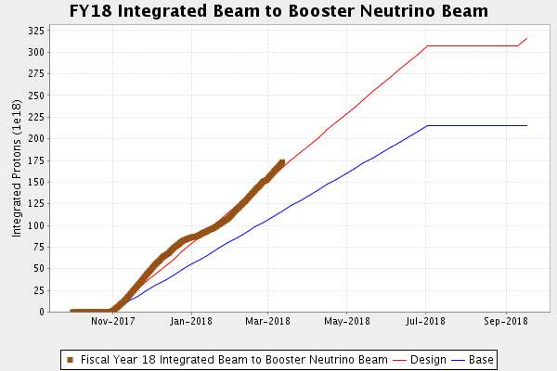
BNB Operation

Slide 5
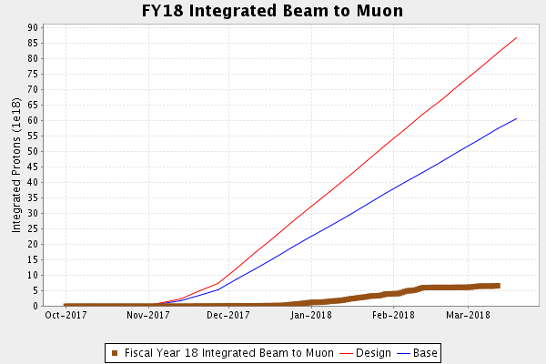
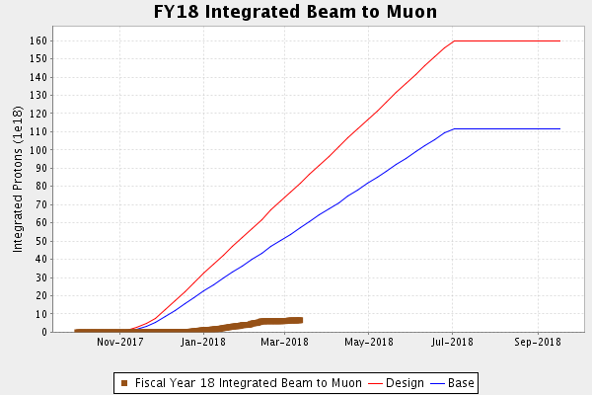
Muon Operation

Slide 6
Complex Status
LINAC
  Laser Notcher operational
  LRF2 & LRF5 modulators
Booster
  Tuning continues
MI/RR
  Tuning continues
  Instrumentation BPM noise
NuMI
  ~650kW with SY
  >710kW without SY
Booster Neutrino Beamline (BNB)
  Stable operation
Switchyard
  Meson Test taking beam
  EDIT Program successful
Muon Campus
  Tuning & studies
  g-2 operation
General
  Monday, March 12th @ 0730
    3-4 hour downtime
    Linac (LRF2 & LRF5)
    MI keys at 0845
    Instrumentation, PA, and water leaks
    Other small jobs
  Tuesday, March 20th
    Next Scheduled Downtime

Slide 7
PIP-II Injector Test & FAST/IOTA Status
PIP-II Injector Test
  Starting Up
    Conditioned New Buncher Cavity
    Commissioned RFQ & Inflector cavity in CW mode to operating gradients
    Started up beam to LEBT
    Working toward establishing beam to beam valve
    April/May Cryo work shutdown
FAST/IOTA
  The IOTA nonlinear magnet being prepared for field mapping prior to installation.
  The 2 amp supplies for the skew quads, trims, and octupoles installed in ESB.
    Powered first ring magnet – skew quad
  90% of the hardware fasteners for the vacuum installation have been cleaned.
  Vacuum components flanges and tubes in weld shop
  Magnet cable pulls are complete and instrumentation cable pulls are underway.
  LCW manifold installation finishing up.

Slide 8
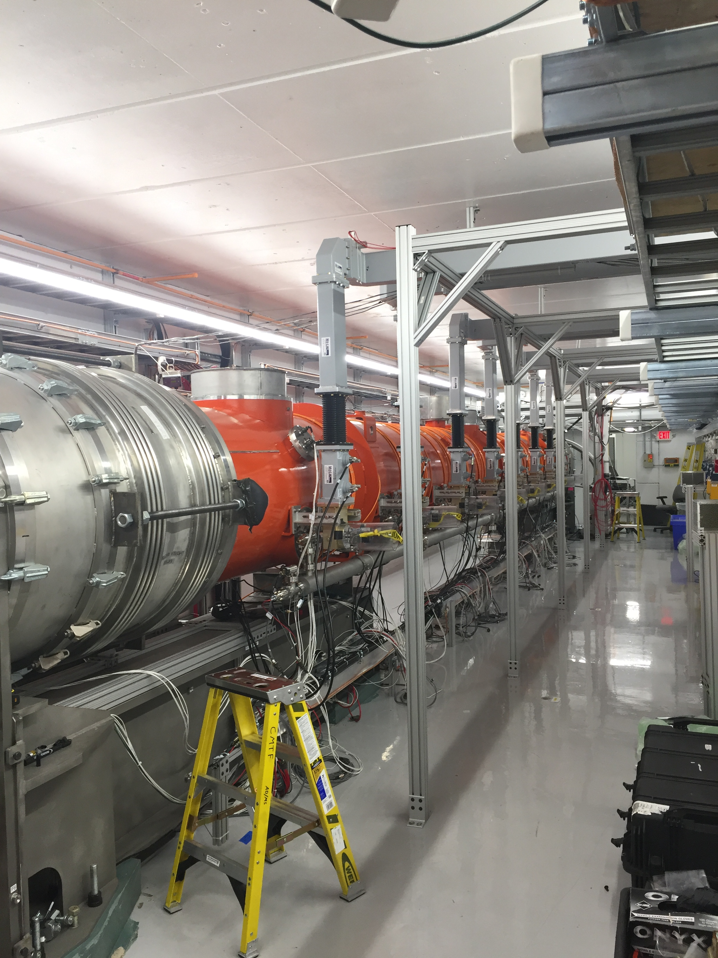
CMTS1 Status
LCLSII Cryomodule F1.3-09
  Cold
  Testing under way
  Looking good
LCLSII Cryomodule F1.3-07
  Best module
  Being instrumented for move to SLAC

Slide 9
Schedules and Links
Schedule can be accessed from the Operations Department Home Page
  Schedules -> Operations Schedule
Direct link to schedule
  http://www-ad.fnal.gov/ops/schedule.html

