Slide 1
Tritium Debrief: BNB Canopy and Berm Stabilization
Cons Gattuso
March 12, 2018

Slide 2
BNB Tritium Mitigation
Annual cost of disposal and risk to surface water and groundwater
~$350-400K+ for disposal cost
Canopy will allow for observation of leaks while intercepting at least ~70% of water
Represents most of the tritiated water
Lateral infiltration volume to exterior wells is estimated as a maximum of ~30% of pumped water from system (in winter frozen surface conditions)

Slide 3
Vertical Infiltration Solution: Roof/Clay Option
Multi prong approach to address vertical infiltration
Building Drainage modifications – West Side Done
Berm Grading/Stabilization (Secondary/tertiary mitigation)
Starting in ~2-3 weeks
No beam to BNB during the concrete work that request us to dig into the berm. (projected to be 2 day shifts)
Retaining walls around
50 meter absorber diagnostic box
Berm cooling unit
Stairwell work
Adding clay to the berm should not impact operations
COMM and safety cables relocation
Canopy (Primary vertical infiltration mitigation)
Summer shutdown time frame

Slide 4
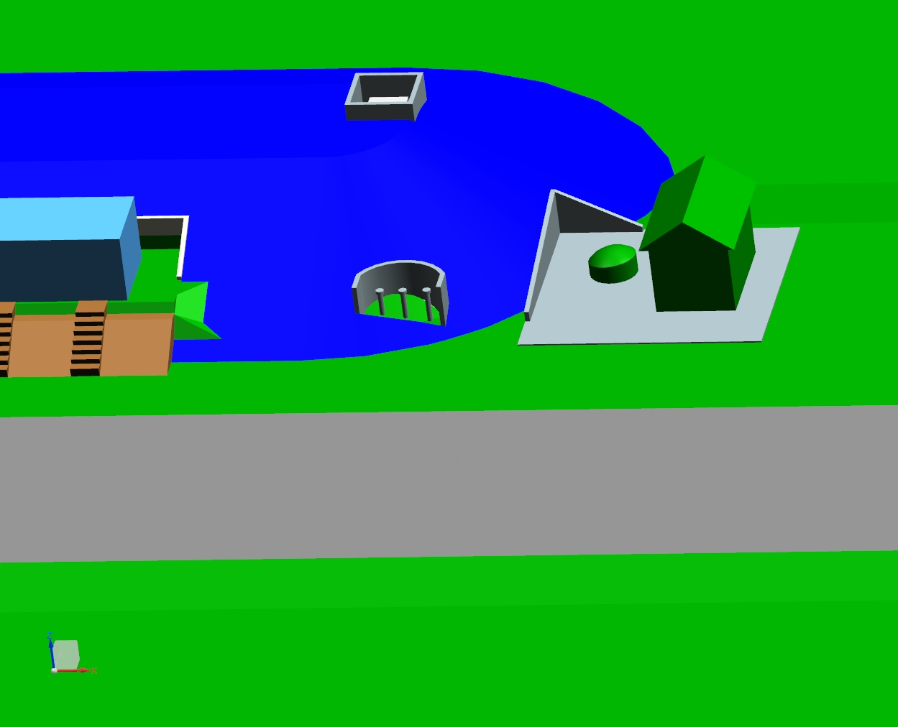
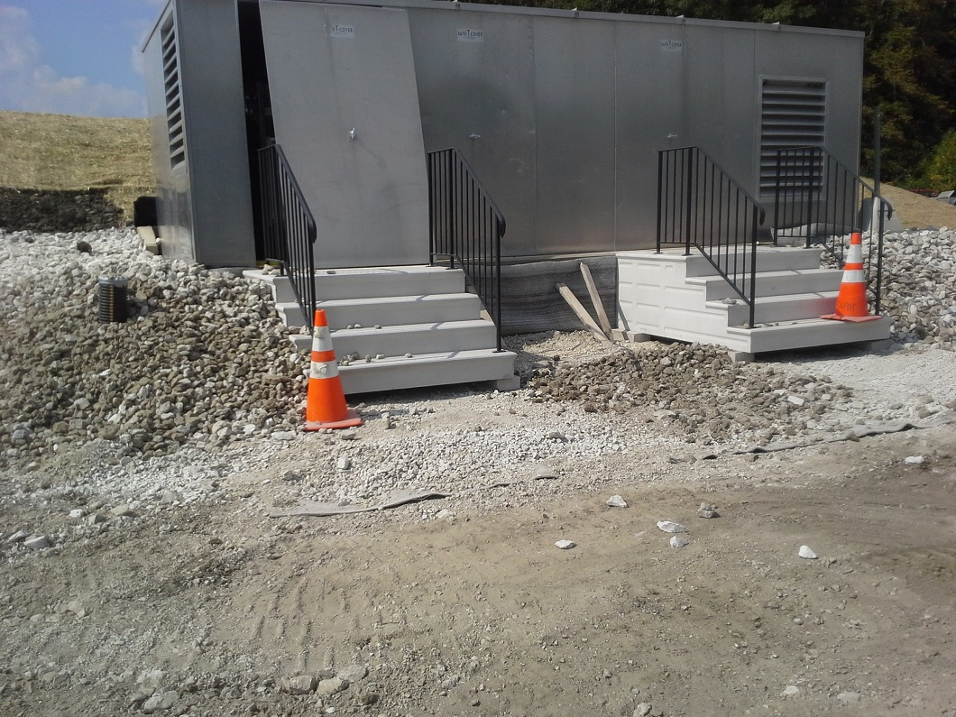

Slide 5
MI-12 Finished
Removable roof section
for 25M absorbers
Sky lights
Remove for well
access

Slide 6
Canopy Criteria Sent to Various Vendors
Length: 200’
Width: 80’
Height: 18’
Type: Straight walls to a height of ~7’
End Walls: Open
Access Doors: (1) 16’ wide x 12’ high
Personnel Doors: (2) 3’ wide x 7’ high
Special: There is a hatch in the middle of the length that requires access. We are flexible as to how this occurs. It could be a removable section or installed in such a way that those segments can be removed in the future.
Notes:
Berm Grading/Stabilization
Bring the berm height back to original height and grade along the length of the berm
Settling and erosion
Secondary line of defense for vertical mitigation of water
Installation issues
Stair replacement at South end near MI12 service build
Build up of wall behind berm cooling system
Well collars to maintain access to wells
Removal of French drain at north end of the berm
Redirect the sump of the Peanut tank at north end of berm
Grading west side of the berm toward Indian creek

Slide 7
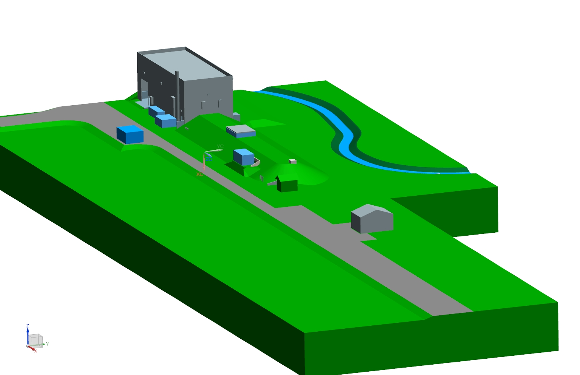
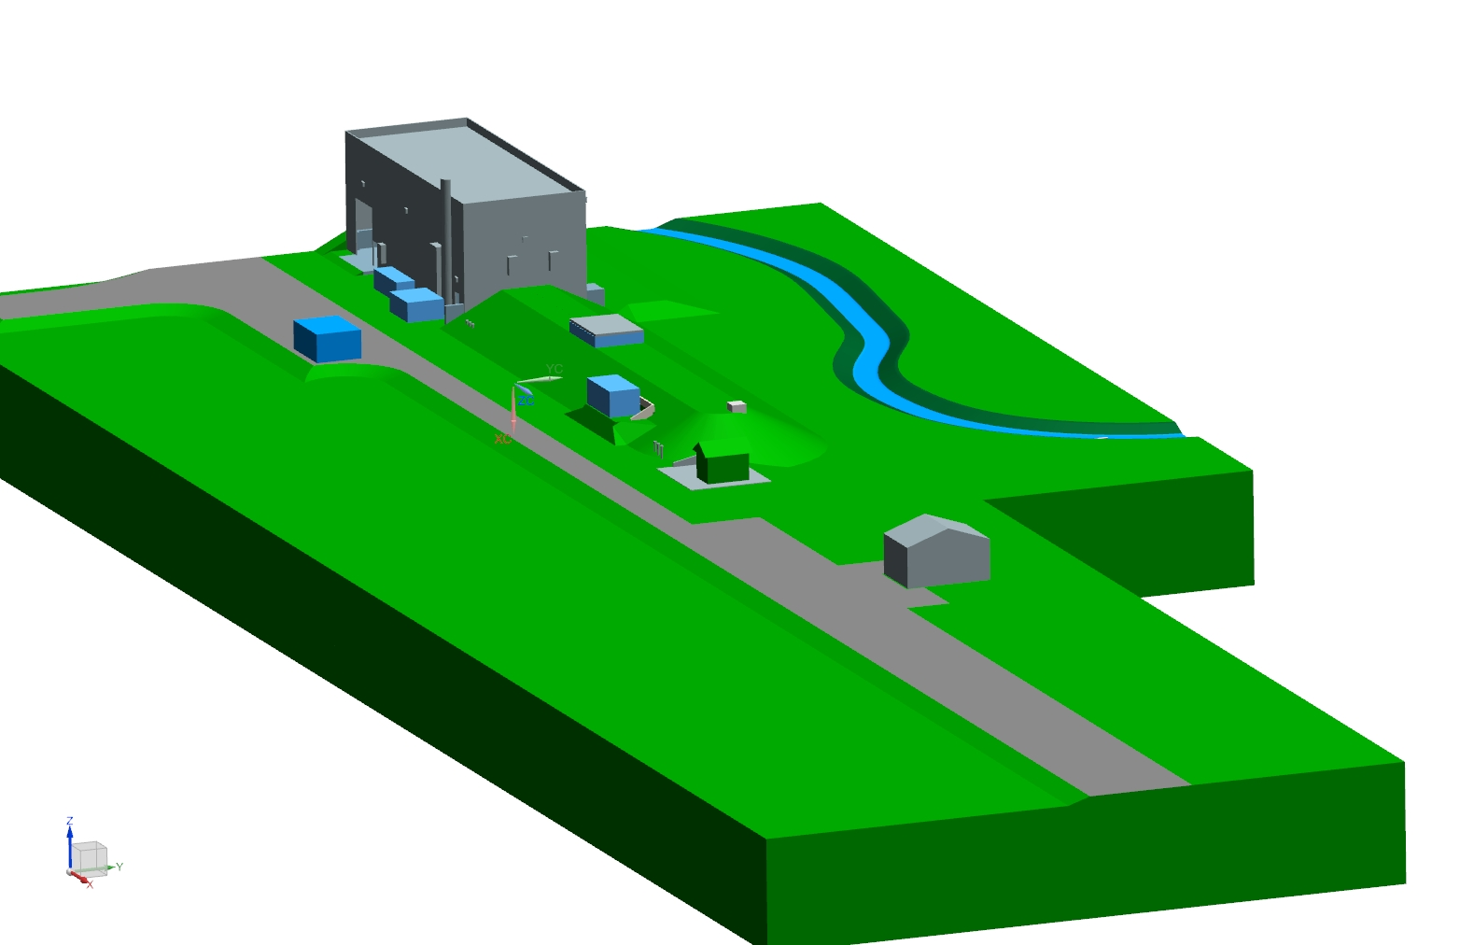
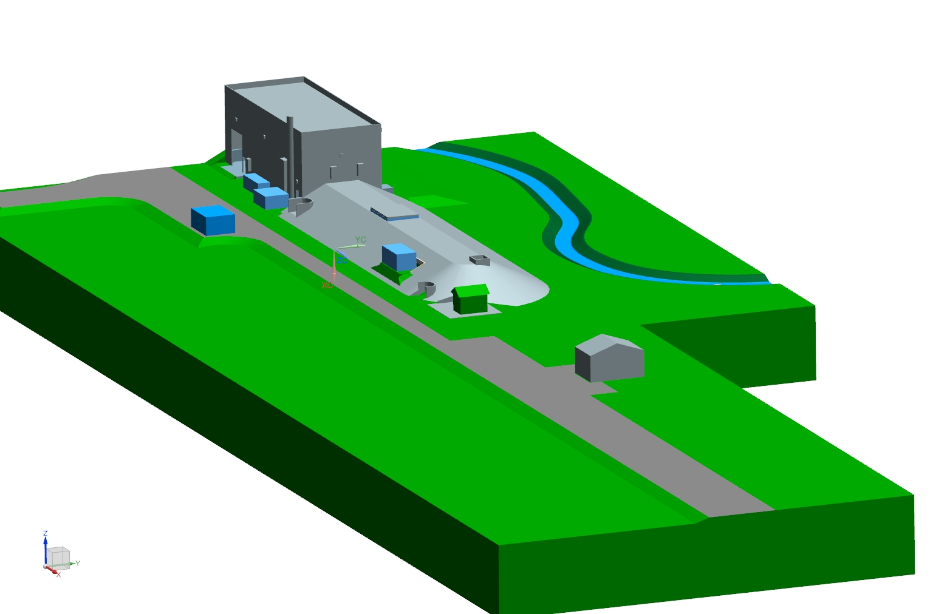
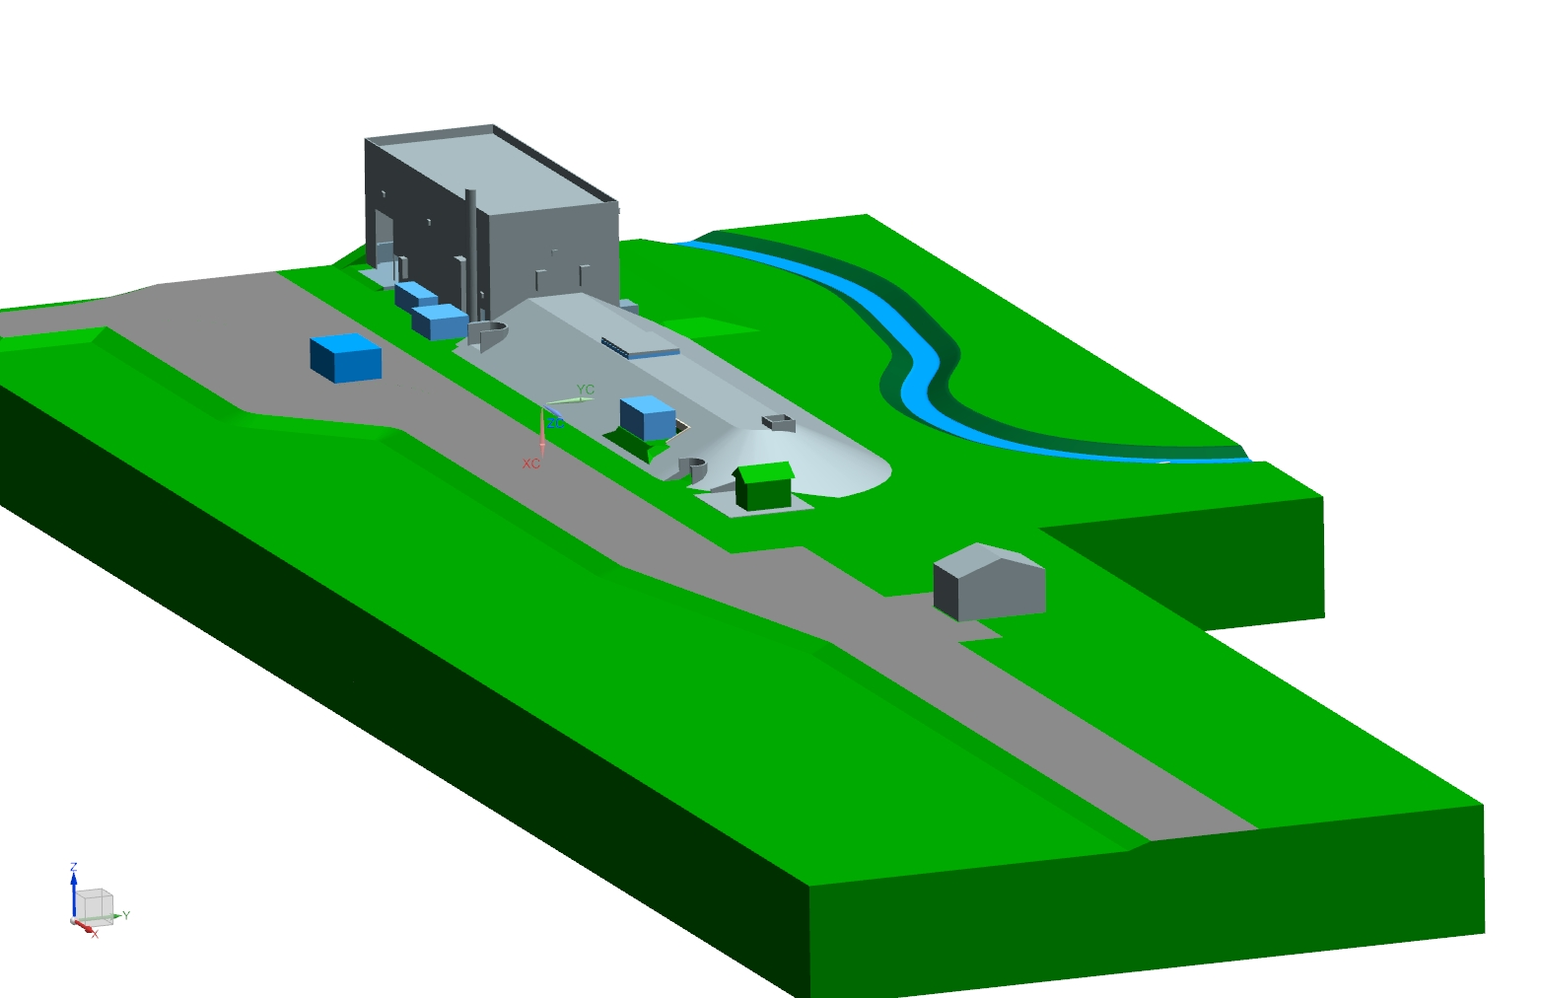
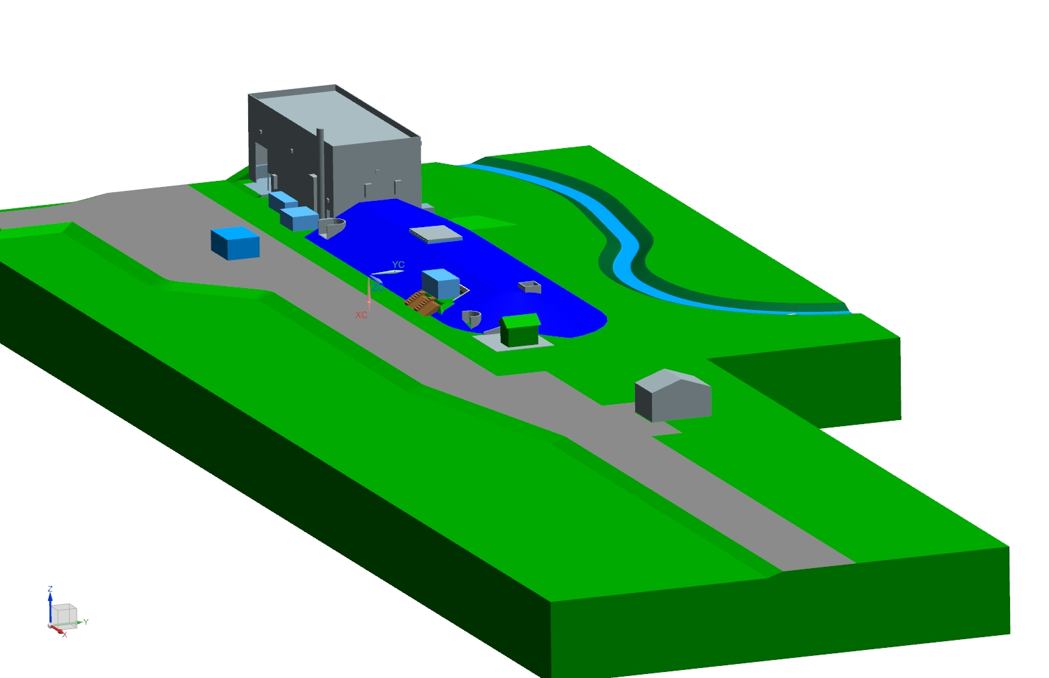
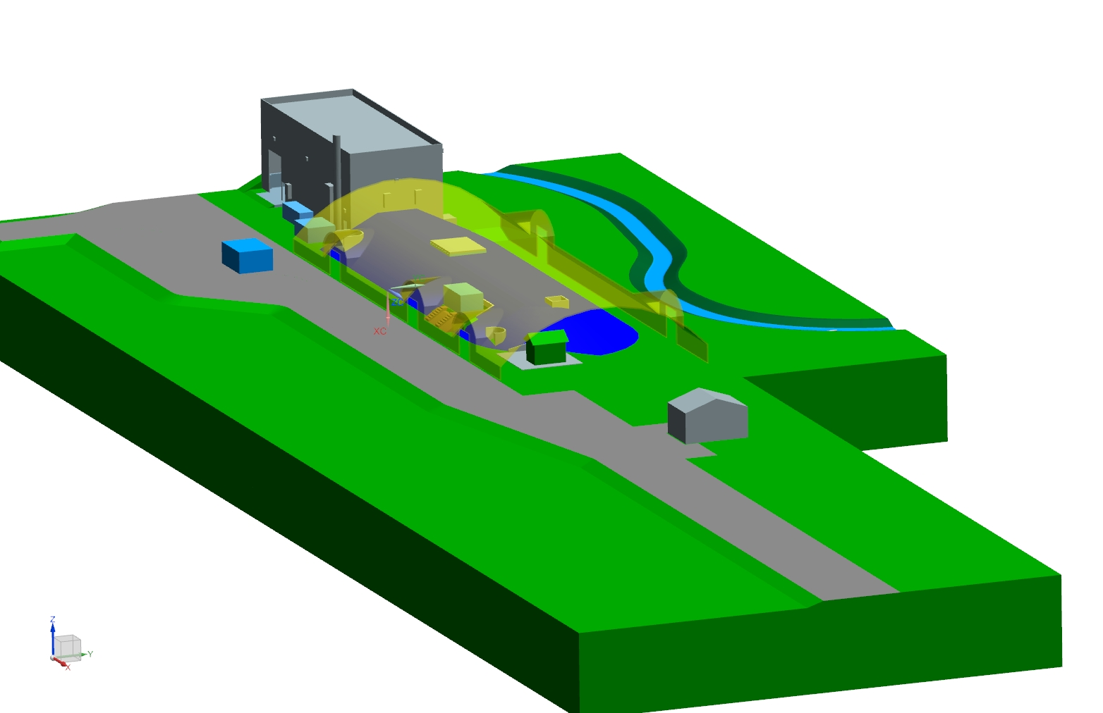
MI-12

Slide 8
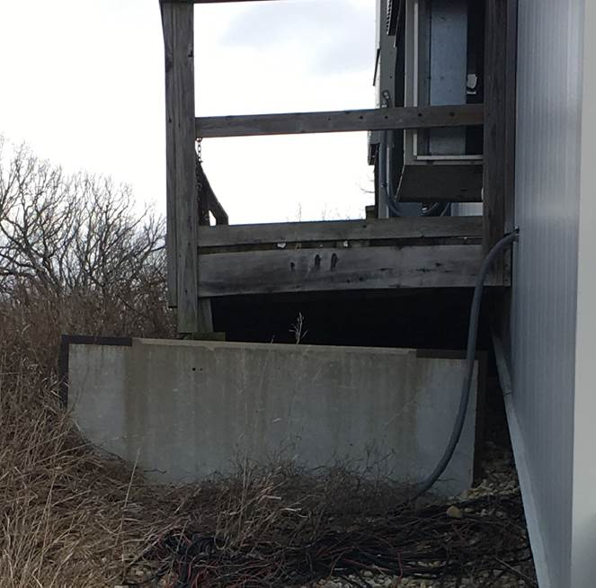
Utility Interference issues
Removal of French
Drain system
Verification of COMM
line running to SBNB
Location of direct bury
120V power line to MI13A
Notes:
Relocation of Buried 120V power line to MI13A

Slide 9
11/2/2016
Presenter | Presentation Title or Meeting Title

Slide 10
MI-12 to MBD Duct
Cable | Signal(s) | Status | Notes
36-C Multimode fiber | TCLK, MIBS, MDAT, NuMI-BP | active/damaged | 5 fibers in use; OTDR shows loss at ~700 ft
24-C Singlemode fiber | ACNET, various signals | active | all fiber in use; network, etc.
1/2" Cablewave 50 Ohm Coax | BRF | (SBN) | rf at MBD
1/2" Cablewave 50 Ohm Coax | BES | (SBN) | No BES at MBD
1/2" Cablewave 50 Ohm Coax | RWM | no longer in use | TDR'd OK
1/2" Cablewave 50 Ohm Coax | spare | unused | TDR'd OK
20 Cond 18 AWG Blue Jacket | Safety- Interlocks | active | NuMI Interlocks
20 Cond 18 AWG Blue Jacket | Safety- Interlocks | active | NuMI Interlocks
4 Twisted Pair 18 AWG Blue Jacket | Safety- Interlocks | active | NuMI Interlocks
4 Twisted Pair 18 AWG Blue Jacket | Safety- Interlocks | active | NuMI Interlocks
4 Twisted Pair 18 AWG Orange Jacket | Fire Protection | active | FP network, MSB to MI-65
75 ohm 1/2" Hardline | CATV | unused | not terminated at MBD
75 ohm 1/2" Hardline | CATV | unused | not terminated at MBD
75 ohm 1/2" Hardline | CATV | unused | not terminated at MBD
75 ohm 1/2" Hardline | CATV | unused | not terminated at MBD
Moved in 2016
Determining the status
Will be installed in 5-6 weeks
Abandon in place
11/2/2016
Presenter | Presentation Title or Meeting Title

Slide 11
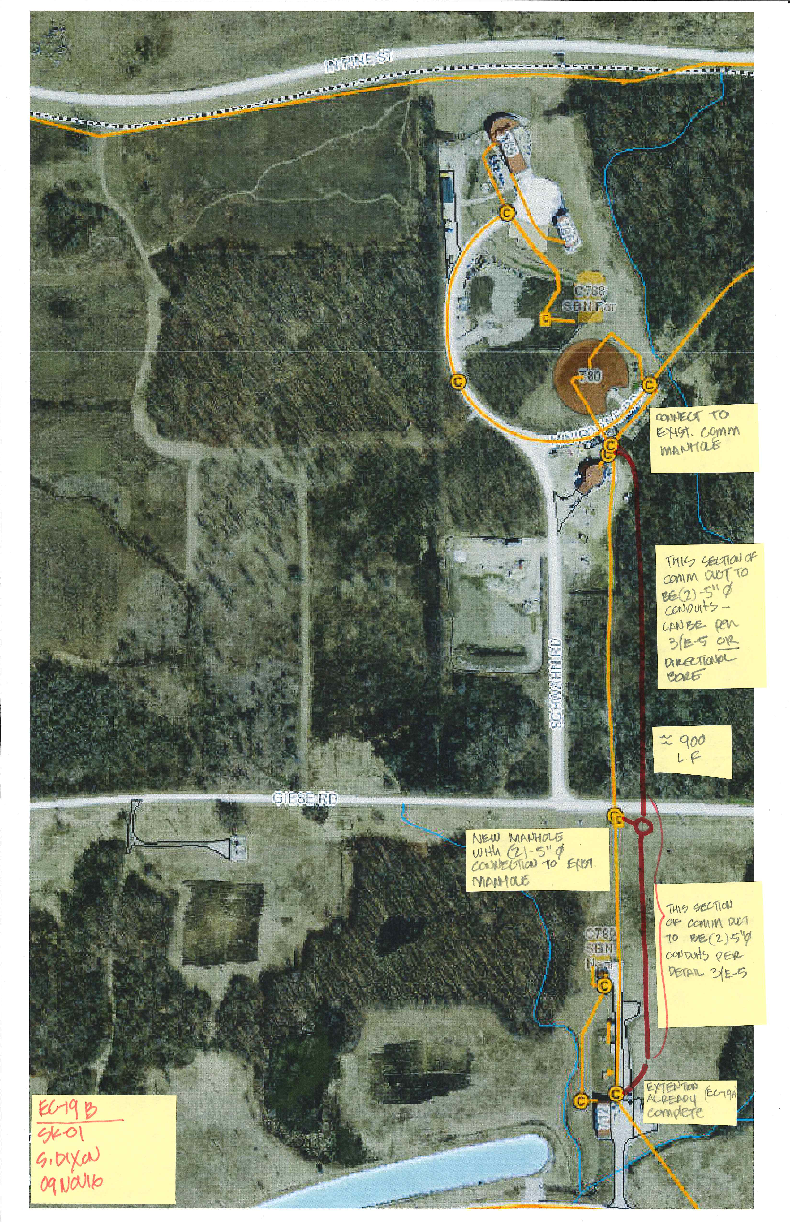
New Communication Duct
New duct bank installed (partial)
MI-12 to just short of Geise Road
Cable relocation process
Once all the cable arrives we will pull it
Connection will be made up during the summer shutdown period
Will not impact operation
11/23/2016
Daniel ohnson | MI-12 Duct Meeting

