Slide 1
Goals of the “database” workshop
Stoyan Stoynev, FNAL
DB Workshop
7 May 2017

Slide 2
Goals
Define which superconducting accelerator magnet test
data is relevant for sharing
(implying also analysis and preservation)
At the end of the workshop we should have
agreement on core data we want to share.
Agree on common procedures/protocols/standards
(in particular for data taking)
Agree on common data formats (processed and eventually “raw” data) – even if data is not currently shared
Establish procedures and tools for sharing
Review constraints in sharing

Slide 3
Context
The HiLumi project (for HL LHC) is a good model where we can implement and test all those approaches
- There is ongoing work on all fronts though not necessarily unified so far
There is a larger international effort (magnet labs) related
to data sharing
One can view this workshop as supporting effort to find working solutions on the topics raised

Slide 4
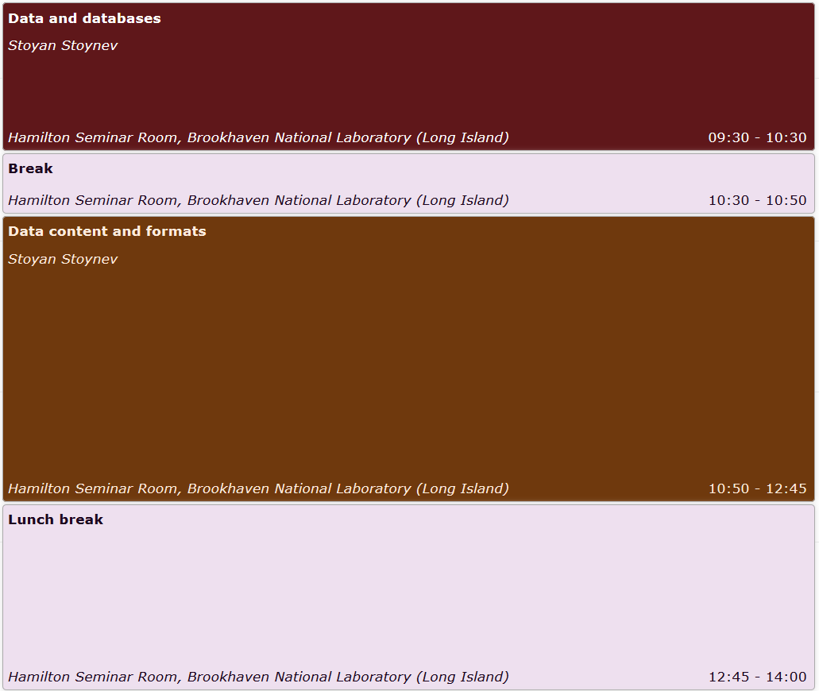
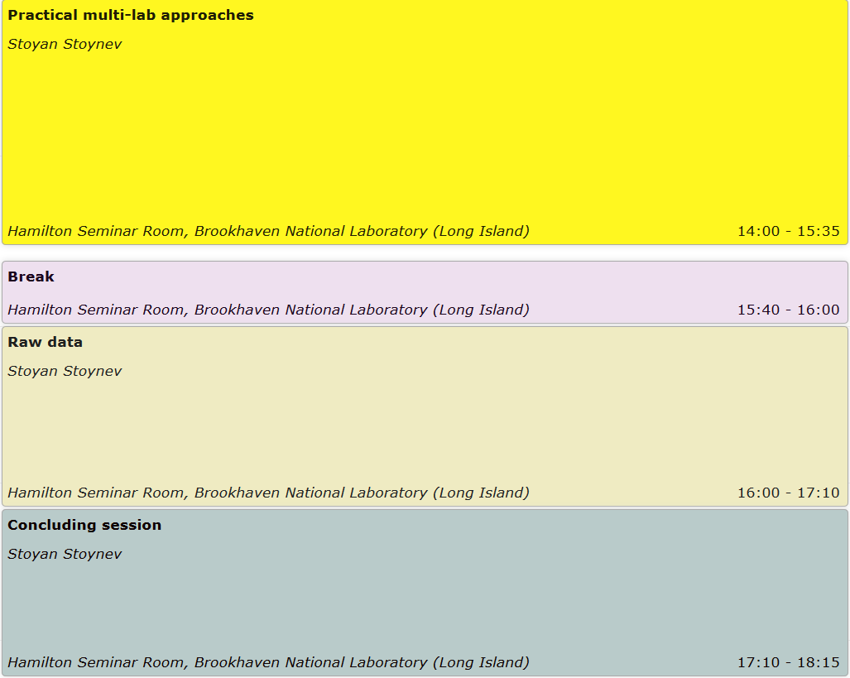
Program for the day
Data and databases - what is this in the workshop context?
Procedures/protocols for data taking and sharing, preservation.
Data distribution in various labs - status. Which data we'd like to share and in which formats?
Standardized data taking, “raw” data.
What we want to conclude from the DB workshop.

