Slide 1
Data and their distribution model at LBNL
GianLuca Sabbi
May 7, 2018

Slide 2
Background
Traditional approach:
The system owner carries out data acquisition, validation, analysis
Original data is stored locally and used/distributed on a case by case basis to carry out analysis, or cross-correlate different magnets/systems
Motivations:
Data acquisition systems were custom made and controlled locally
Validation and reduction by system owner is required
Analysis requires a complete data set on the magnet (design, fabrication, instrumentation) and how the test was performed
Project/collaboration owns is responsible for results analysis/publication
Going forward:
Expanding collaborations and larger projects: need to integrate information from different sites, facilities and magnet tests
New tools/vision can help but various challenges and constraints remain

Slide 3
Data Formats
Many formats have been used, depending on time period, type of instrument, DAQ architecture, project team/collaboration etc.
In general it is not an issue to translate to a different format as long as there is clear documentation on how the data is provided
  Optimal format can depends on individual magnet/instrumentation
  Diagnostics capabilities and systems keeps evolving
  A possible strategy is focusing on documenting the different approaches and allow time for a common standard to emerge
On specific systems and tools
  Use of commercial DAQ/software: optimized storage/speed, added capabilities and built-in tools vs. accessibility (near term and long term: licensing, updates/backward compatibility, preservation)
  Integration of measurements from standalone systems and measurements taken at different stages of fabrication and test (magnetic measurements, strain gauges)

Slide 4
Test progress information
Goals: report key results, actual test sequence in relation to test plan, needs for re-evaluation depending on magnet performance, system availability etc.
Communication by email, web status pages, logbooks/e-logs
  Also essential for later analysis and pointers to data
  Review status of e-logs, any opportunity to converge on a single platform
  A quench summary table is usually compiled with key information quench conditions (e.g. time, temperature, ramp rate) results (e.g. currents, MIITs), special notes.
Beyond that: appropriate level of information to be distributed
  Quench history, training, ramp rate and temp. dependence, field quality
  Automatically generated quench locations

Slide 5
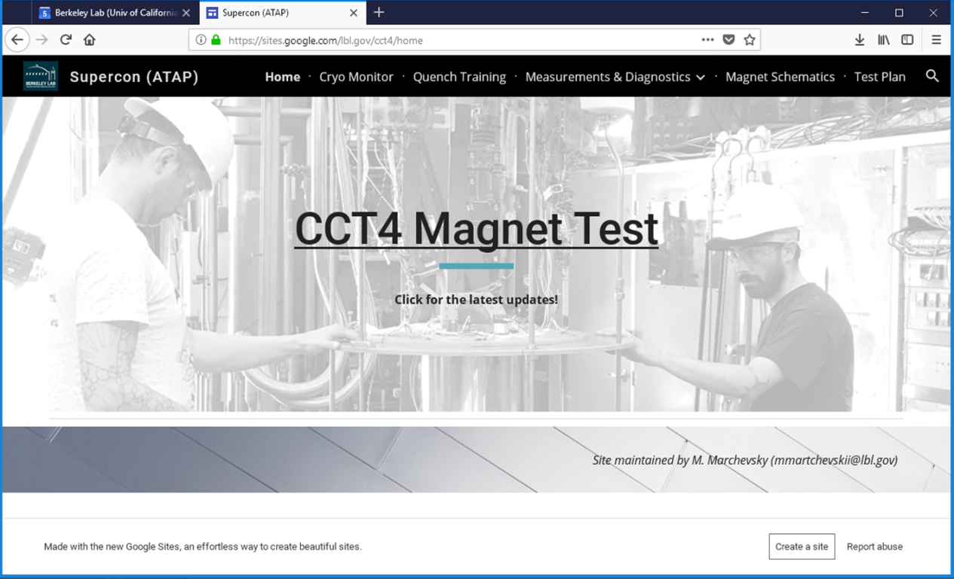
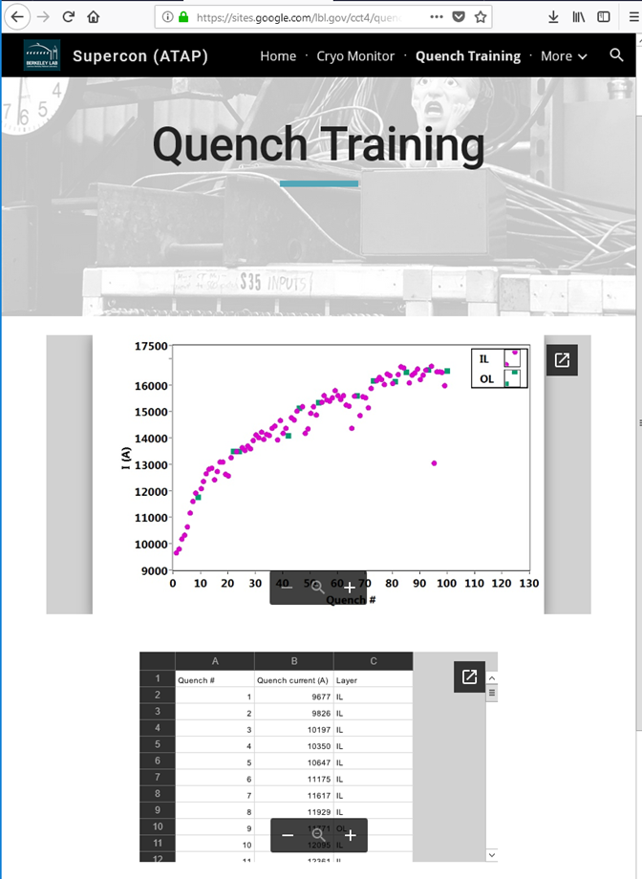
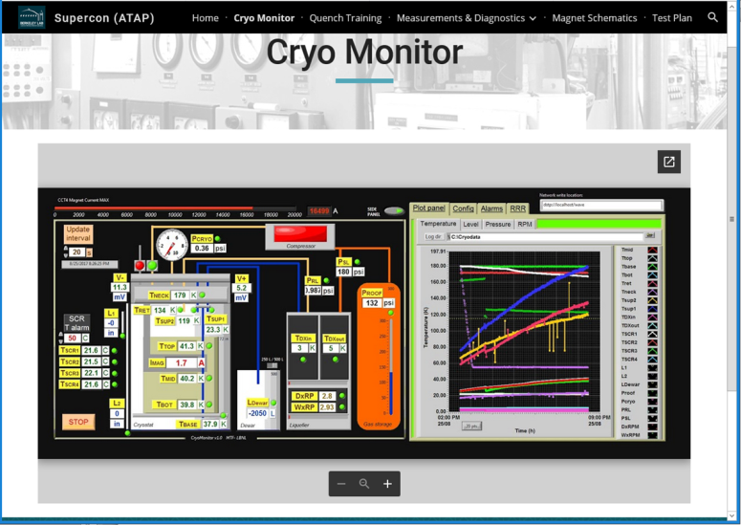
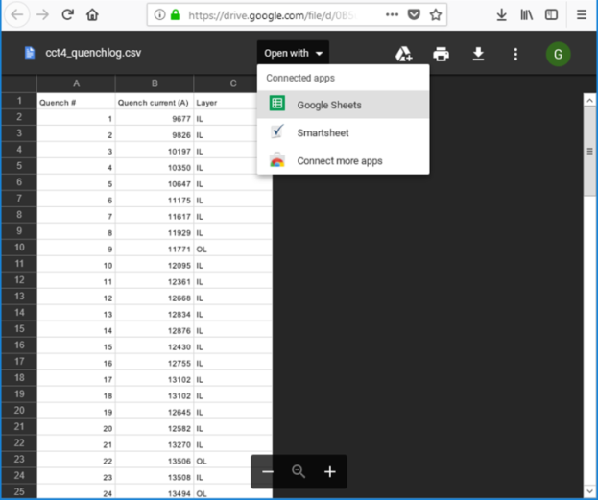
Test information page
(brief) Test log
Real time
quench updates
Built-in open/edit
apps
Quench current spreadsheet
System status

Slide 6
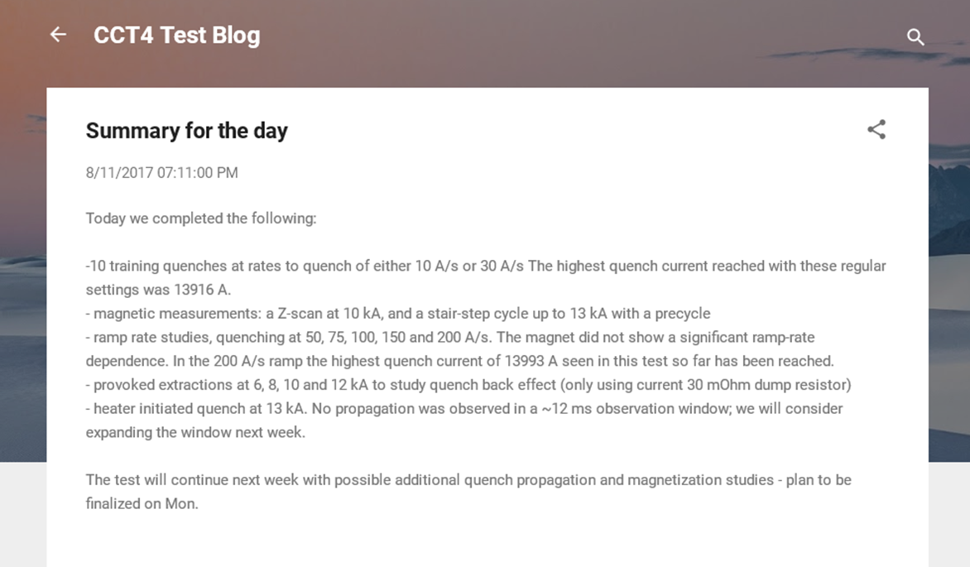
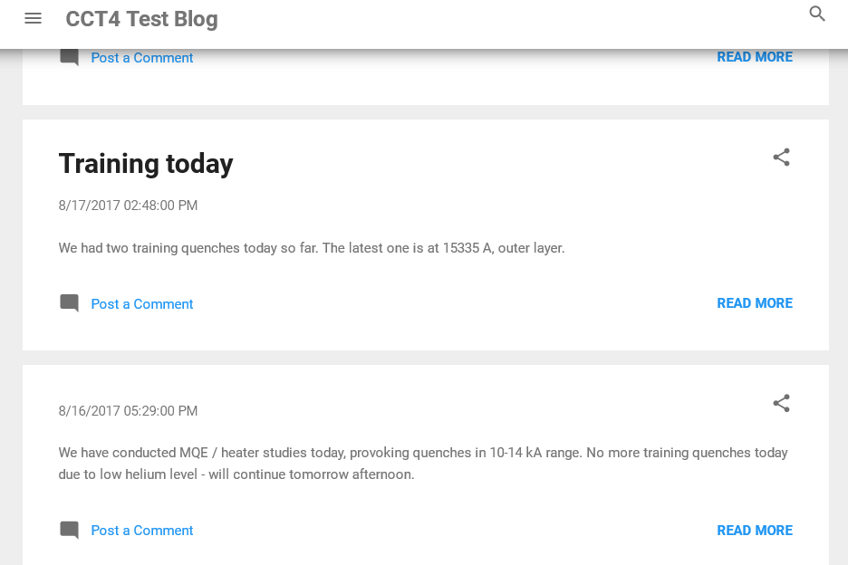
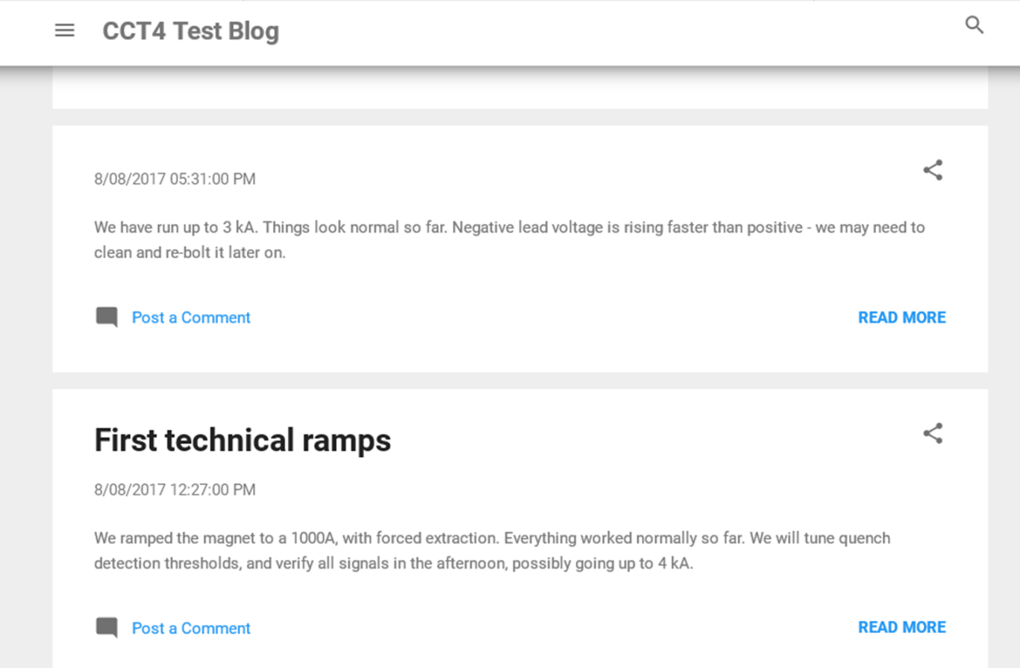
Status Updates

Slide 7
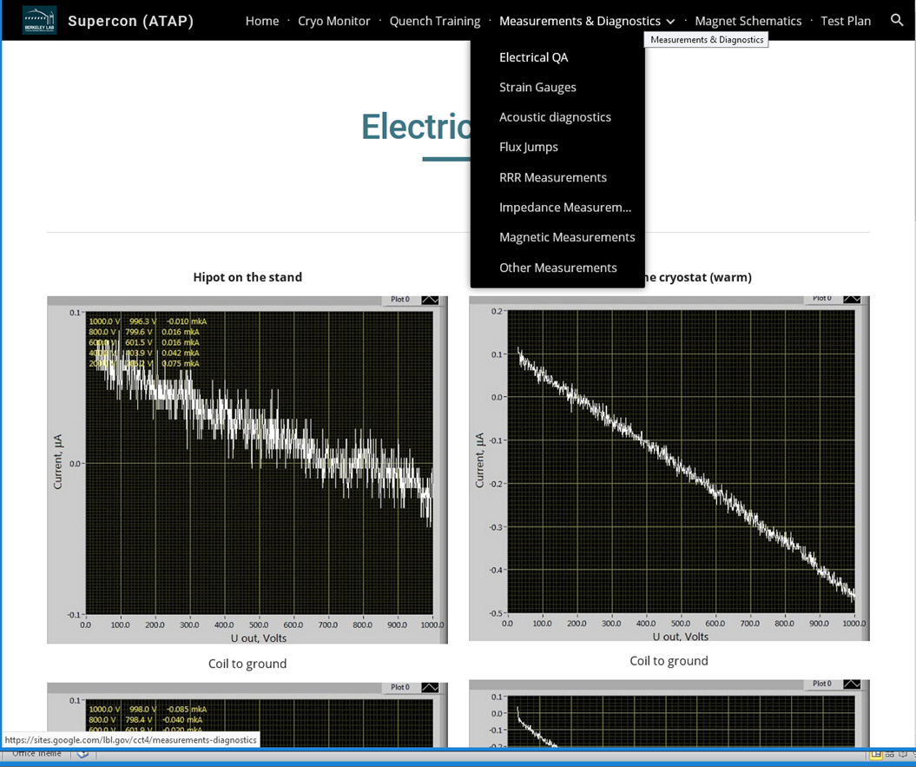
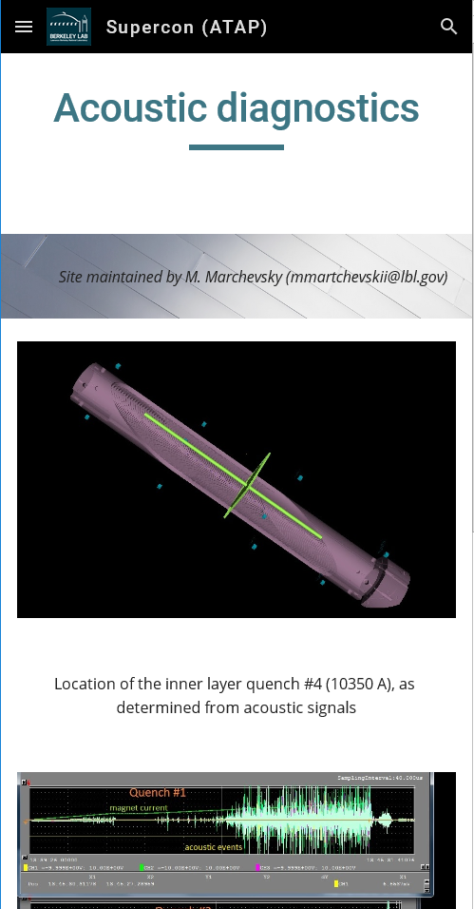
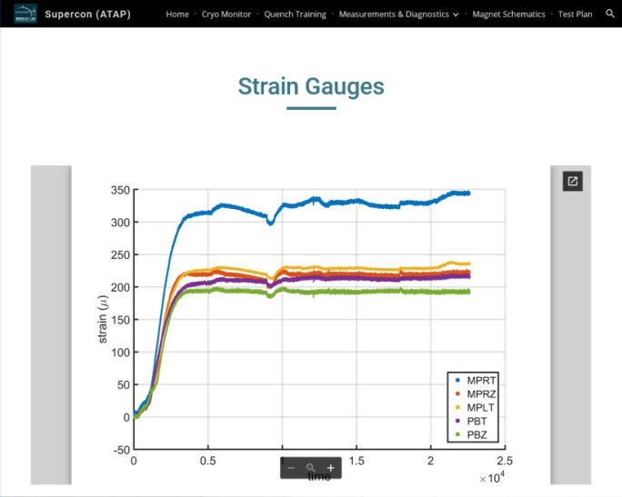
Measurements and Diagnostics
Define proper level of real time data distribution (reliability, collaboration framework etc.)
Mostly a test update tool, actual analysis still largely based on “traditional approach”

Slide 8
Data Storage and Distribution
Lab internal servers are the norm and work well for single Lab projects
  Managed in accordance with local IT policies
  Access by team members falls within pre-established procedures
For multi-lab collaborations we are looking at the following characteristics
  Conformance to policies of collaborating Labs & sponsoring agencies
  Streamlined procedures relative to those required to access Lab servers
  Sufficient storage capability (both total and single file)
  Safe/transparent backup and recovery capabilities, high availability
  High speed of data upload, download, and handling for all sites
  Refined access control tools to meet individual program needs
  Accessibility from different platforms (browsers, OS, devices incl. mobile)
  Availability of mirroring/syncing apps for a variety of platforms
  Built-in tools for file access

Slide 9
Commercial platforms
And
more…
Google drive selected and sponsored by LBNL IT: unlimited “free” storage, conformance etc.

Slide 10
Comments on Goals and Approach
Facilitate data sharing and analysis across members of multi-Lab projects and collaborations
  Focus on opportunities for significant impact in the near term
  Current projects can create tools and procedures which will provide a basis for further progress
Main issues from a project perspective:
  Availability of key information on test progress/data in real time
  Exchange and integration of data among different systems/teams
  Distribution of validated/reduced data in simple format
  Test Logs with history information and pointers to data files
Conductor, magnet design, fabrication data are needed to interpret test data but not owned by the test facility.
  Initial focus on making test data available to project, this may provide a basis for integrating design and fabrication data

