Slide 1
ADMX Magnet Workshop Goals
Andrew Sonnenschein
April 13, 2018

Slide 2
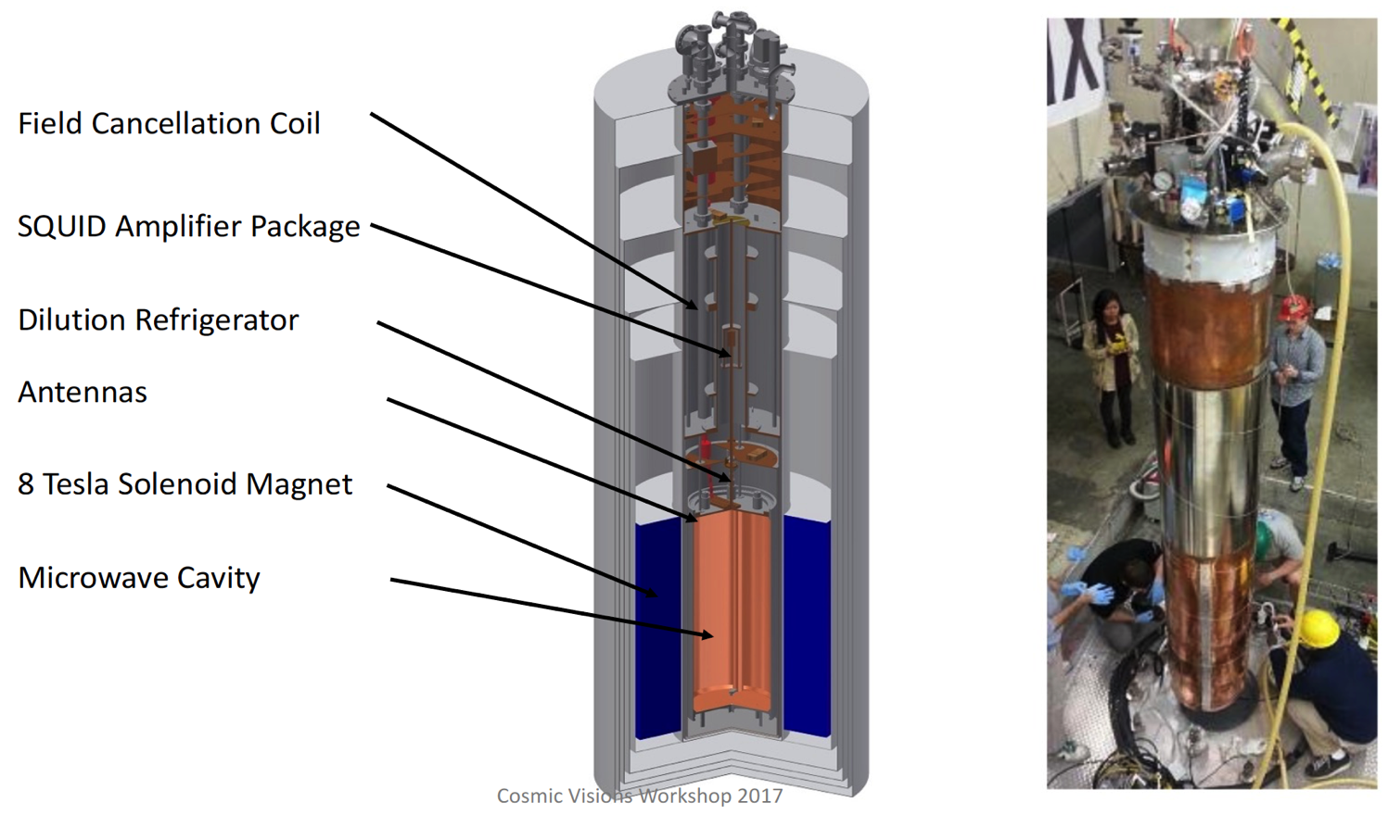
ADMX Detector

Slide 3
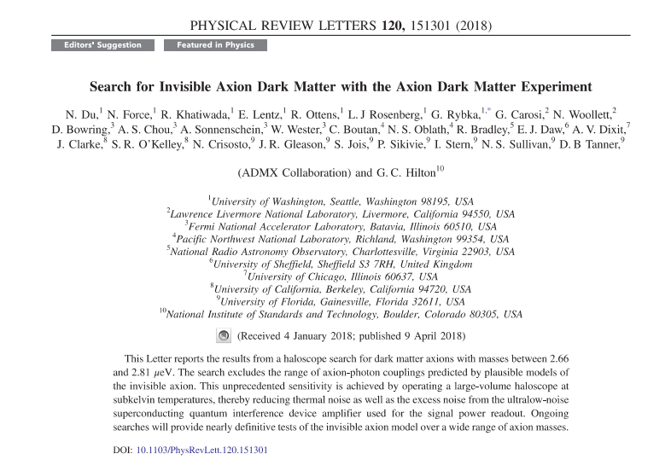
First ADMX- G2 Publication

Slide 4
Long Range Plan For ADMX
Magnet R&D starts in FY19?
Magnet delivered to ADMX in FY23?

Slide 5
Purpose of this Workshop
What magnet options may be available for ADMX on 5-year time scale?
  Bore size
  Field strength
  Cost
  Risk. What R&D is needed?
ADMX collaboration will use input from this meeting to optimize the experiment configuration.
  Balance complexity and cost of magnet with complexity and cost of resonator system and electronics and cryogenics.

Slide 6
Opportunities for Partnership Between Labs
One purpose of this meeting is to get the labs talking with each other.
Assuming this is a complex, expensive magnet probably would not be done by one lab alone.
We assume funding most likely to come from DOE HEP and HEP lab participation will be essential.
NHMFL partnership with DOE labs?

Slide 7
Outsert/ Insert Approach?
Larger diameter, lower field magnet optimal for low frequency axion search. Maximize stored energy.
Smaller diameter, higher field needed for higher frequencies.
Could we build this magnet in a series of steps?
  A large bore NbSn magnet for low frequency range (3-6 GHz?)
  A HTC insert for higher frequency ranges?
  The insert could come a few years after the outsert.
  Cost would be spread out
  Possible risk reduction (or increase)?

Slide 8
White Paper
Introduction for non experts to the state of art in high field solenoids.
A series of sections each describing a magnet option. Should describe costs and risks. We need people to agree to write up each section.
A summary of the options including a table comparing bore size, field strength, cost.
How would labs work together to make the magnet?

Slide 9
Logistics
Dinner tonight @ Meson Sabika, 1025 Aurora Ave, Naperville
We have reservations at 7:30 pm for 12 people. Please let me know if you want to come and didn’t already email.
My cell phone 312 730 7638

