Slide 1
Fermilab Magnet Sector
G.Velev
ADMX Magnet Workshop
Apr 13, 2018

Slide 2
Outline
Introduction
SC magnet activities based on Nb₃Sn
  HL-LHC Accelerator Upgrade Project
  High Filed Magnet R&D, 15 T dipole
HTS R&D
Manufacturing capabilities
  Previous work for others
Testing capabilities
Summary

Slide 3
Magnet Sector - Experienced Staff with Unique Skills
Approximately 100 scientist, engineers and technicians
Scientists, physicists and eng. physicists for SC/resistive magnet development and design, data analysis, project management
  Magnet design, data analysis, quench and thermal processes
  Magnetic probe and instrumentation development
Engineers
  Magnetic and Mechanical Design (ANSYS, OPERA, ROXIE, COMSOL....)
  Instrumentation development
  Production and Tooling
Technicians specialized in conventional and superconducting magnet fabrication
  Strong technical staff, “tunnel trained” for in situ magnet repair and accelerator shutdown work

Slide 4
Projects, Programs and Activities
Prod.
Sol.
LCLS II
Quads
CLAS12
Transp.
Sol.
Acc.
Maint.
Mu2e
AS
Project
PIP
AIP
Detector
Sol.
11 T
Dipole
Beamline
magnets
LBNE
TD
MSD
MDP/HFM
Program
15-16
Magnets
AIP
Muon
Campus
LARP
QXF
150mm
g-2
PIPII
mu2e
LHQ

Slide 5
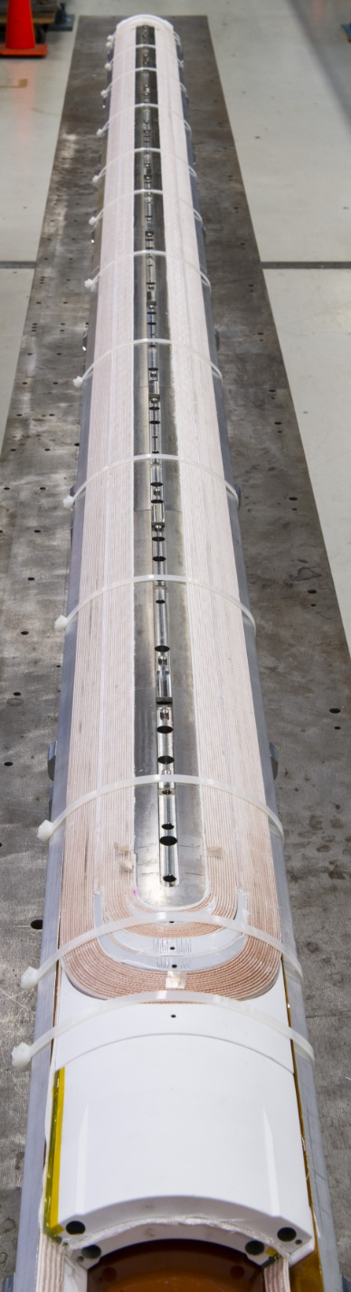
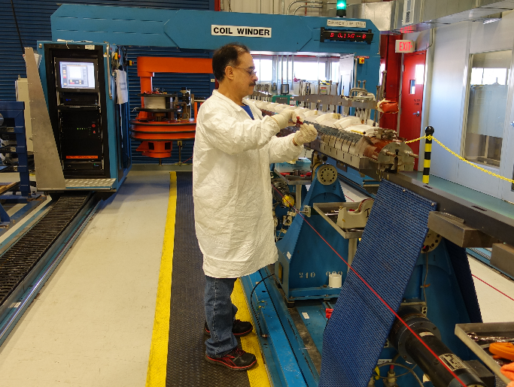
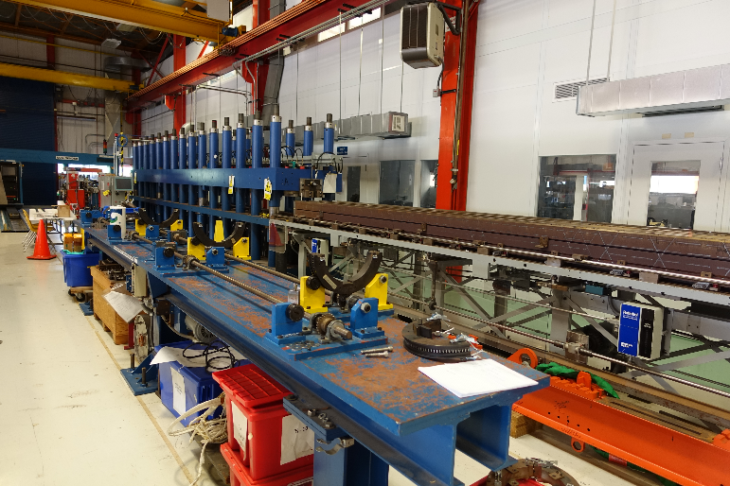
Coil production for HL-LHC AUP
HL_LHC project is a collaboration between BNL,FNAL, LBNL
It I s ~ $240M project
Together with 11T dipoles (FNAL design) these are the first Nb₃Sn magnets going into the accelerator
Fermilab is responsible for the coil winding and final magnet assembly (cryostating)
Nb3Sn coils use a technology “ wind and react” - Nb₃Sn is very fragile practically brittle.
QXFA coil winding
7.7 m curing press

Slide 6
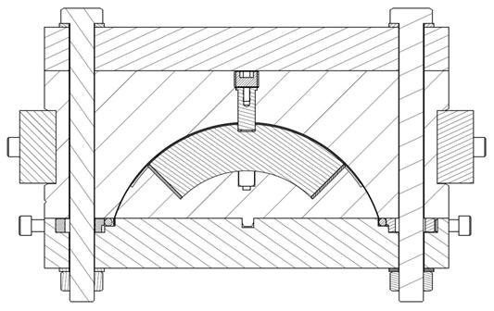
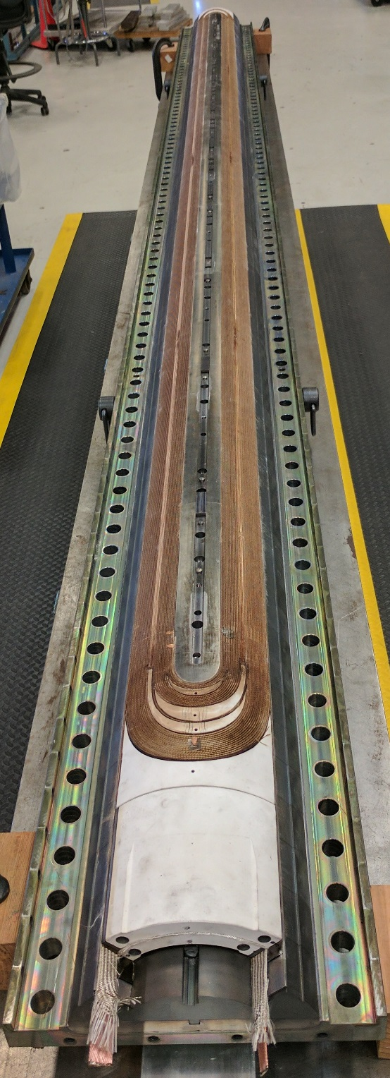
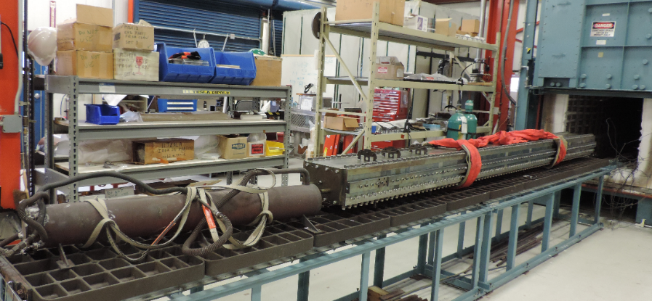
Coil Reaction
6 m long reaction gas tight furnace
  8 separately powered heating zones
  4 interior fans for uniform temperature distribution
  1000° C max temperature
Reaction cycle is in an argon atmosphere and at 210° C for 48 hours, 400° C for 48 hours and 665° C for 50 hours. The heat treatment lasts about 10 days including ramp up and cool down.
Coil QXFA
Coil QXFA

Slide 7
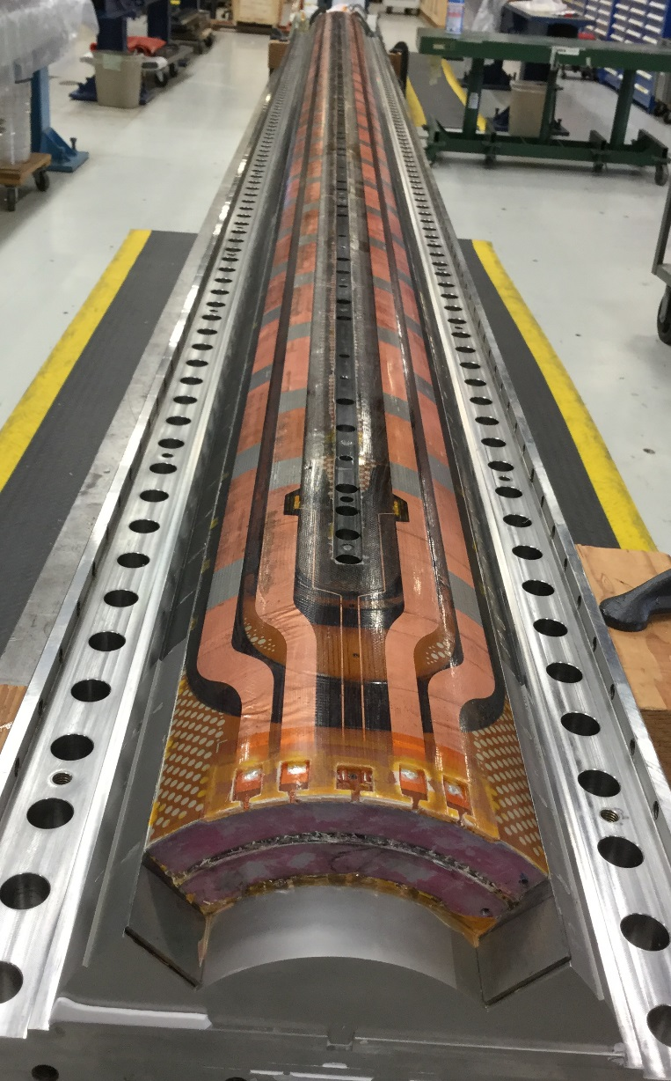
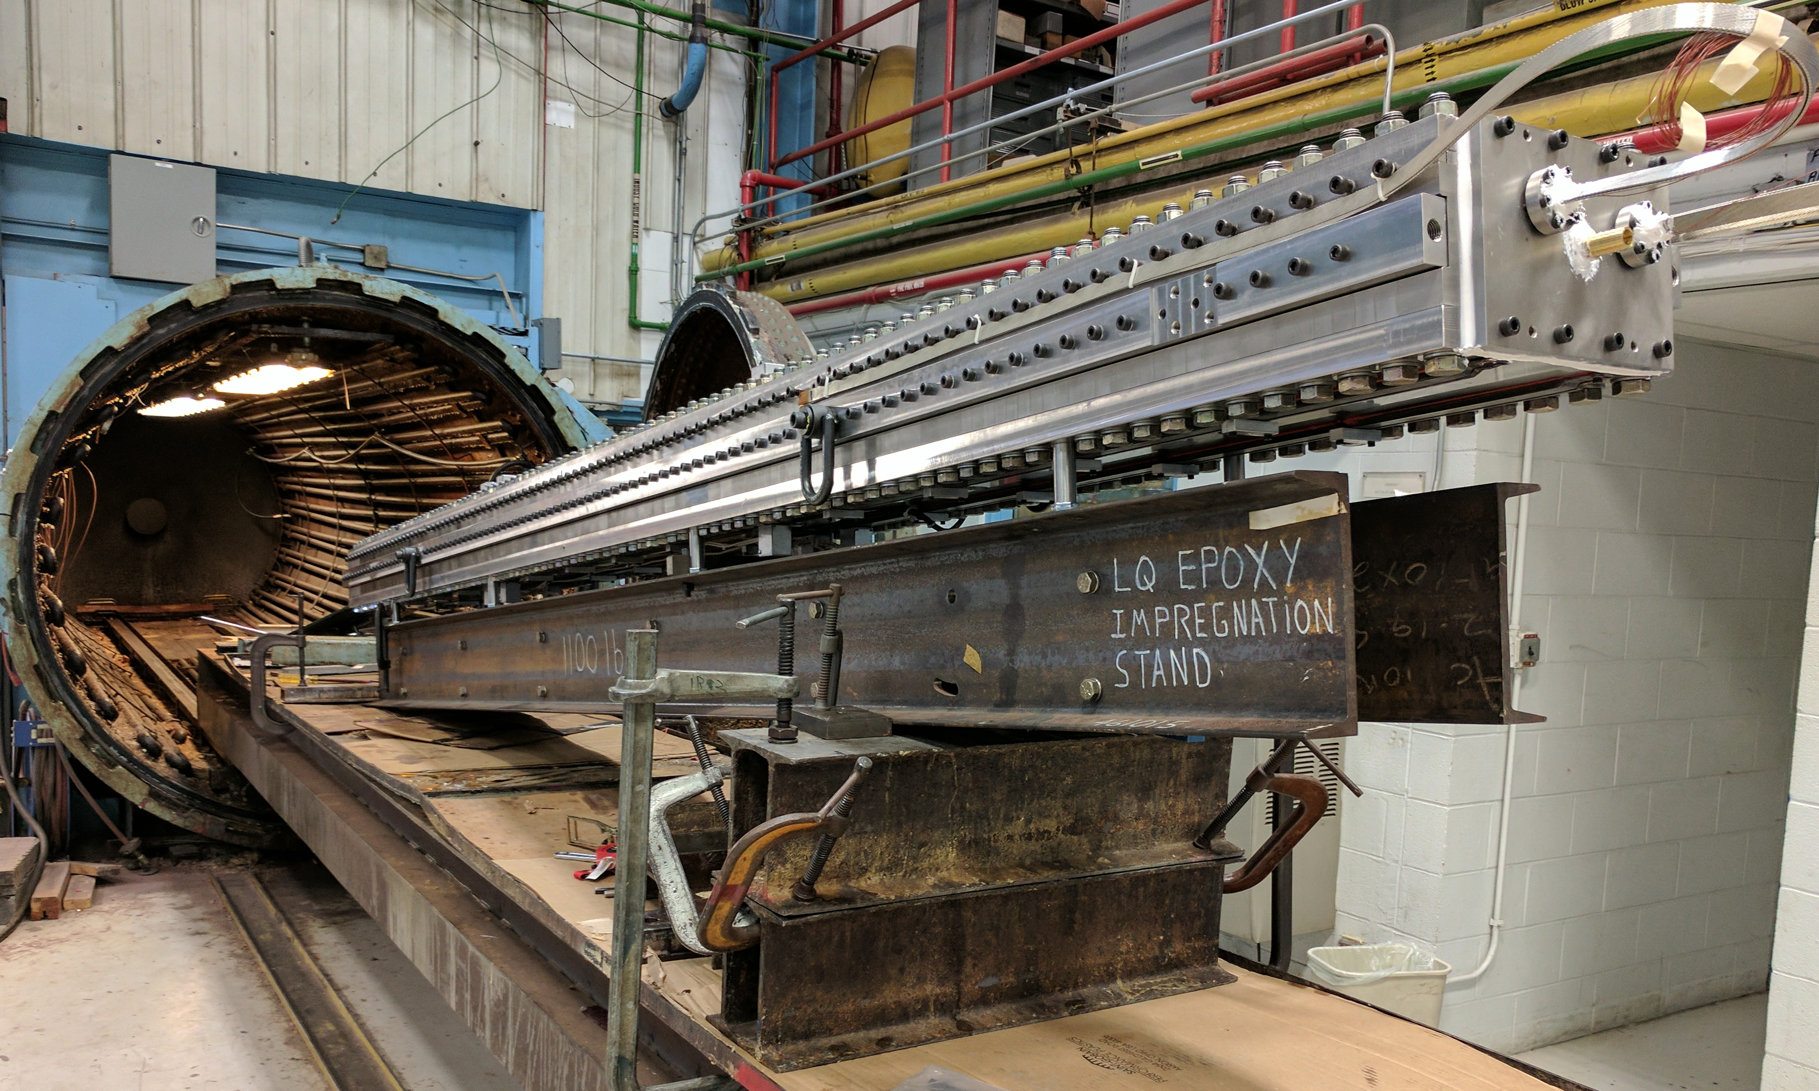
Coil Epoxy Impregnation
7 m long vacuum oven
  CTD101K epoxy impregnation at 60° C
  Epoxy cure at 125° C
  Curing is in the same oven at 125° C for 16 hours using external heaters mounted on the tooling.
Coil QXFA
Coil QXFA

Slide 8
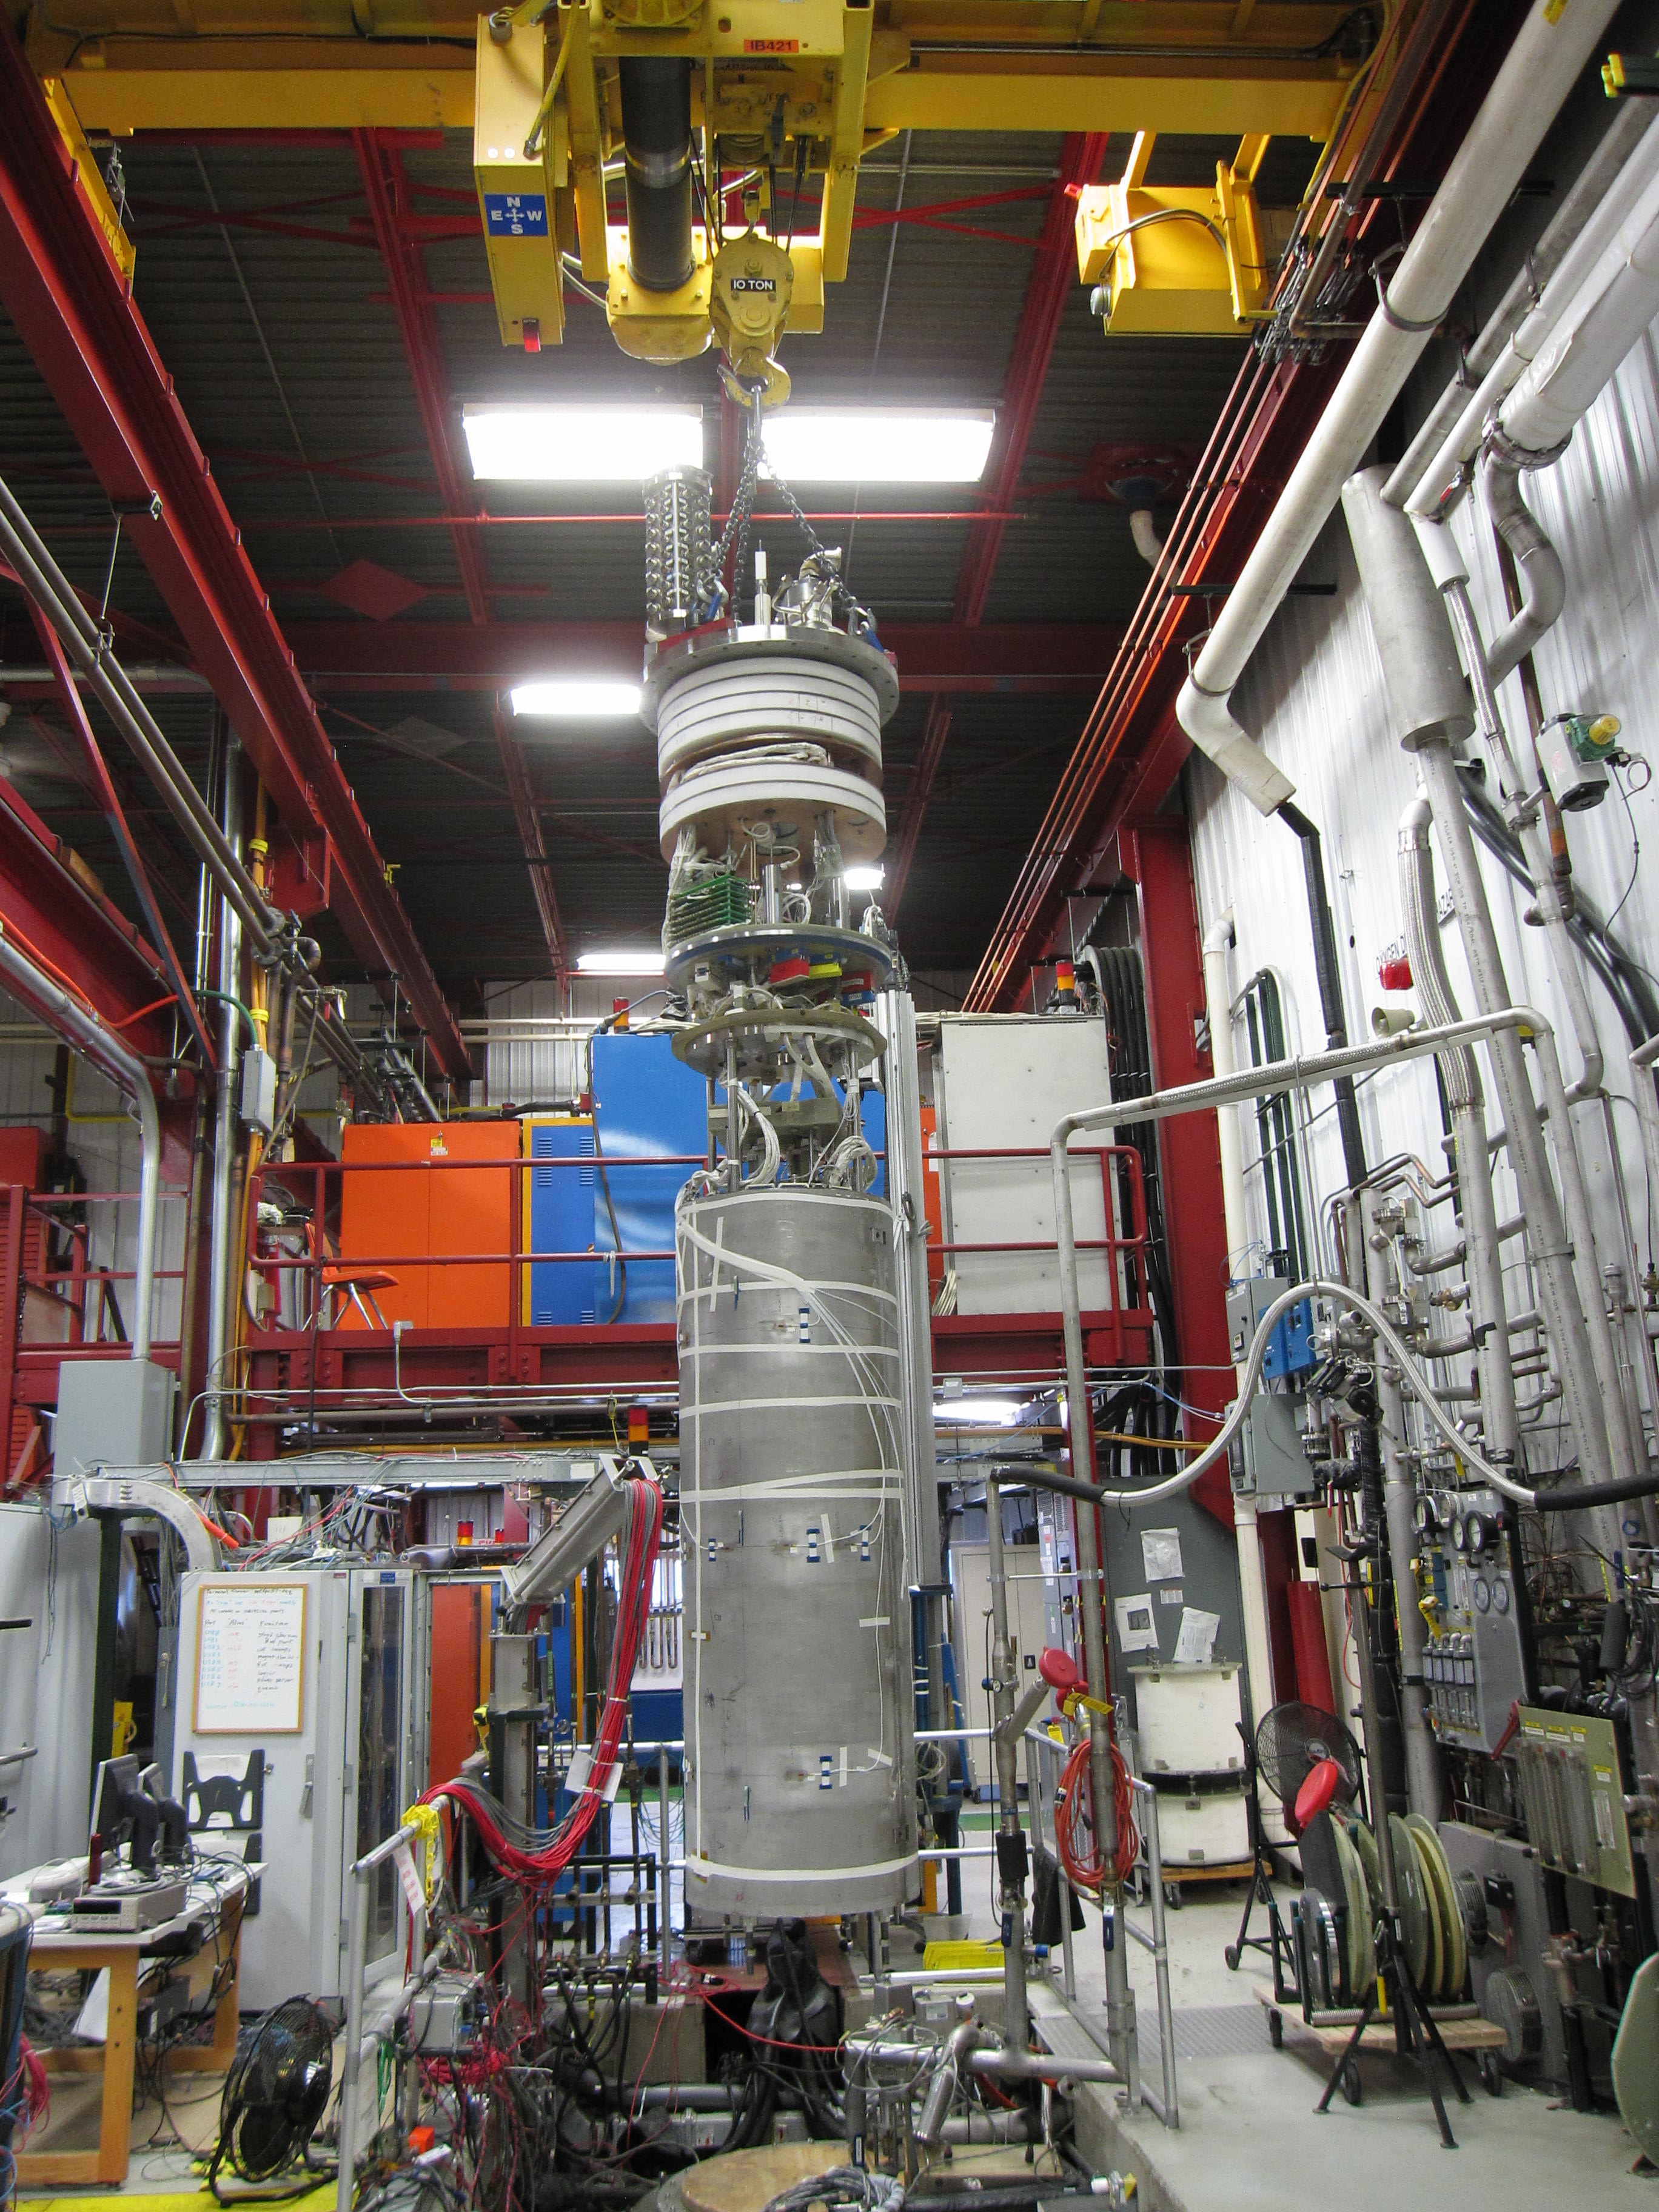
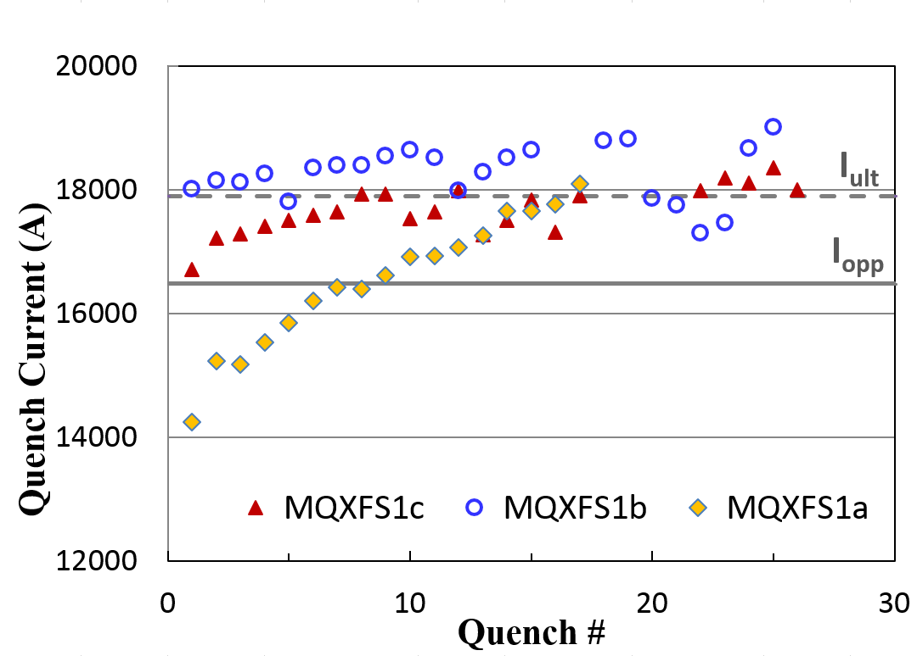
Prototype Testing
143 T/m and 150 mm aperture

Slide 9
FNAL 15 T Demonstrator
Two major goals
  first to pave the way of designing 16 T and higher mechanical structure which can be used as prototyping of HE-LHC and FCC dipoles
  “to beat the curse” of the 20 years old D20 (13.7 T in 1997).
Magnet aperture is 60 mm.

Slide 10
Conductor stress (I. Novitski) – why is 15T?

Slide 11
15 T Status
All the magnet parts are in house
Inner and outer coils are wound and reacted
Impregnation is in progress
Assembly starts at end of May
Test in September

Slide 12
HTS Magnets – R&D
Fermilab HTS R&D was executed in “start/stop” mode.
Fermilab R&D was directed toward accelerator/collider magnets - until last year, the HTSs (BISCO, REBCO, IBS) were not considered as valuable option for accelerator magnet
The last significant effort in MS was done for Muon Collider and/or Neutrino Factory accelerator magnets – strong solenoids (50 T) for 6D phase space muon cooling channel
Currently we are restoring the HTS R&D - directors fund (LDRD)

Slide 13
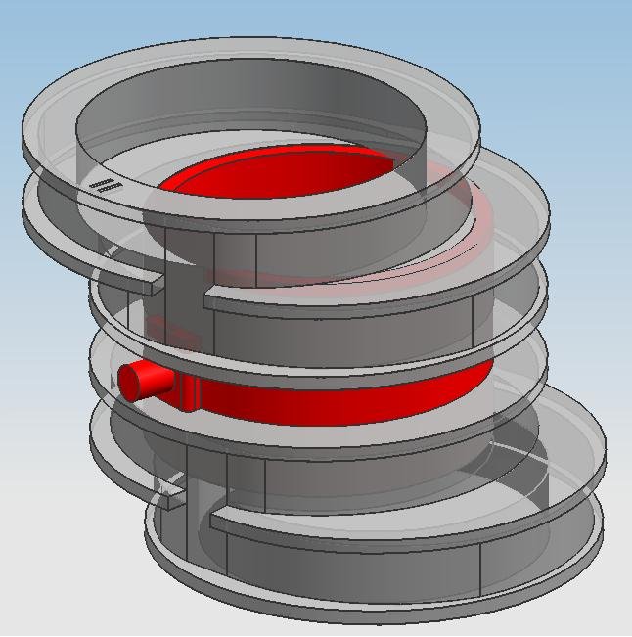
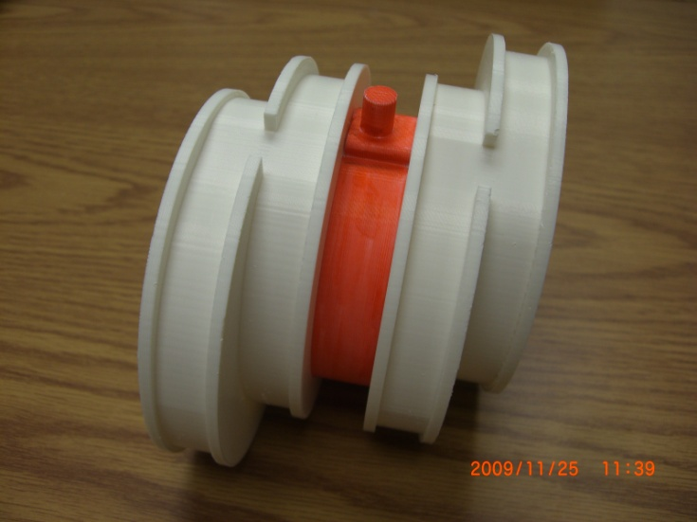
Modeling HTS section with RF

Slide 14
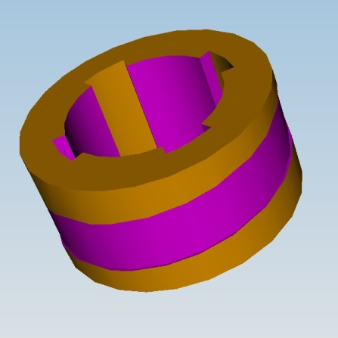
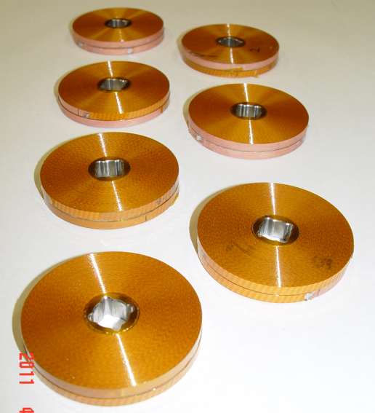
REBCO (YBCO) Double-Pancake Units
Conductor | SuperPower SCS4050-i
Ic (A) Average @77K,0T | 113 A
Ic (A) Minimum @77K,0T | 107 A
Ic Standard Deviation | 2.7%
Turn to Turn Insulation | Spiral Wrapped Kapton
Coil Geometry | Double Pancake – no inner splice
Coil ID | 19 mm
Coil OD | 62 mm
Conductor Thickness | 0.1 mm
Conductor + Insulation Thickness | 0.2 mm
Packing Factor | 50%
Turns per Single Coil | 108
Conductor length per Coil | 13.9 m
Overall Conductor Length | 27.8 m
Coil Resistance @ 300K | 2.87 Ohm
Coil Inductance @1kHz | 1.5 mH

Slide 15
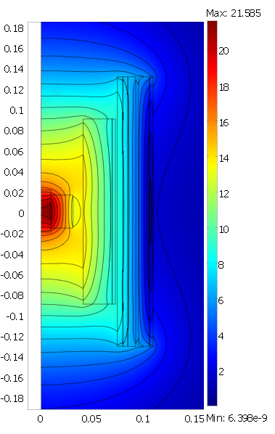
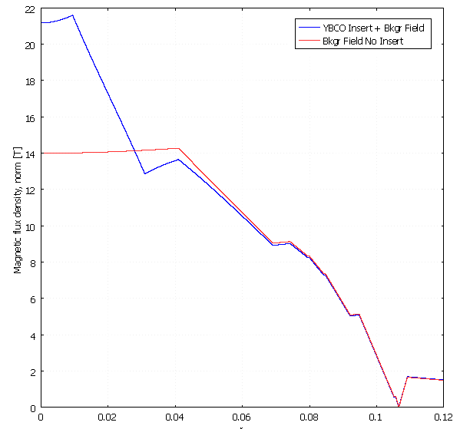
Result - 21.2 T with 14 T Bkg. Field
REBCO Insert Coil
External Magnet
Max Current Reached | 335 A
SSL | 92%
Peak Field on Conductor | 21.5 T
Peak Axial Field | 21.2 T
R (cm)

Slide 16
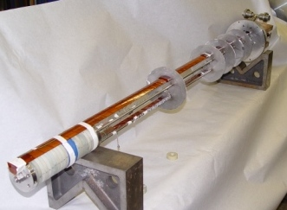
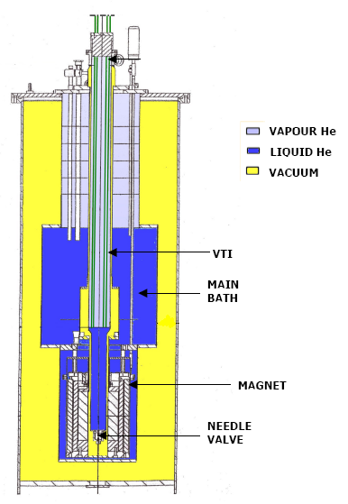
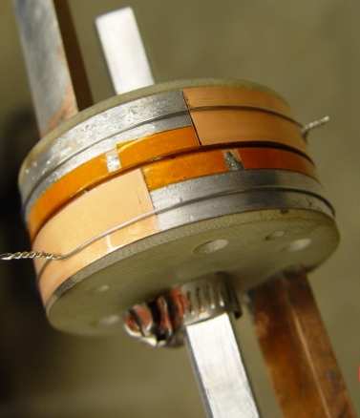
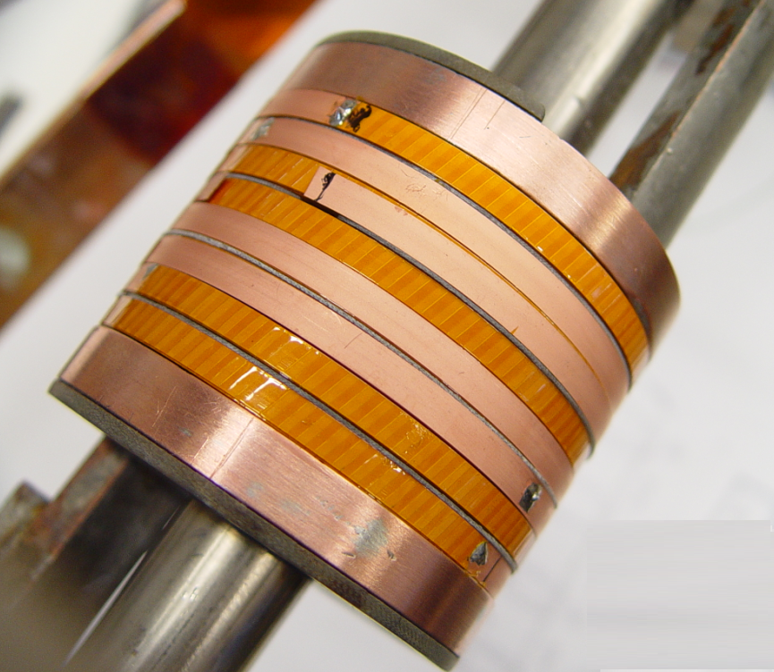
Test Setup at SCSC facility
Modular Insert Test Facility
Coil1
Coil2
Coil3
14 T solenoid with
77 mm bore
Coil4

Slide 17
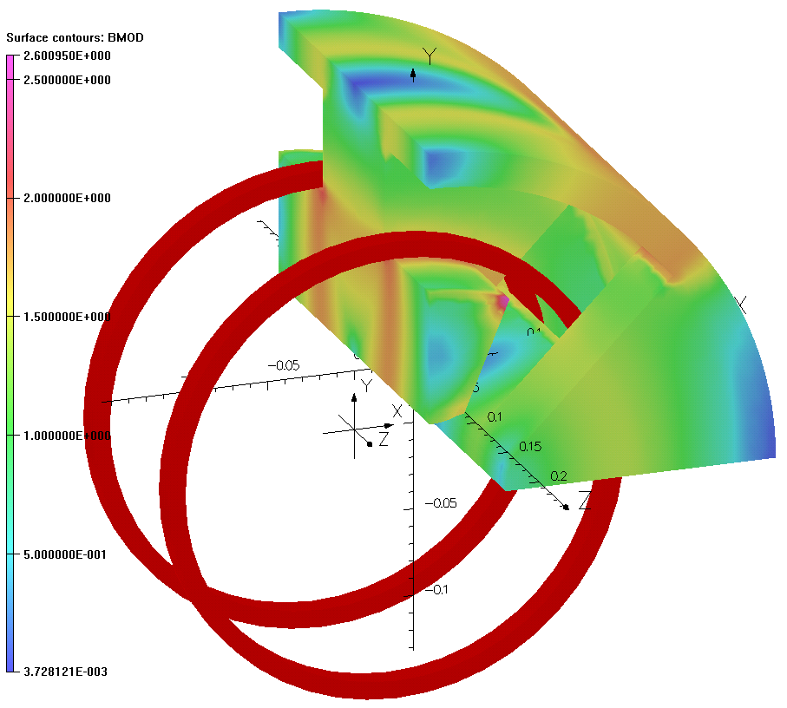
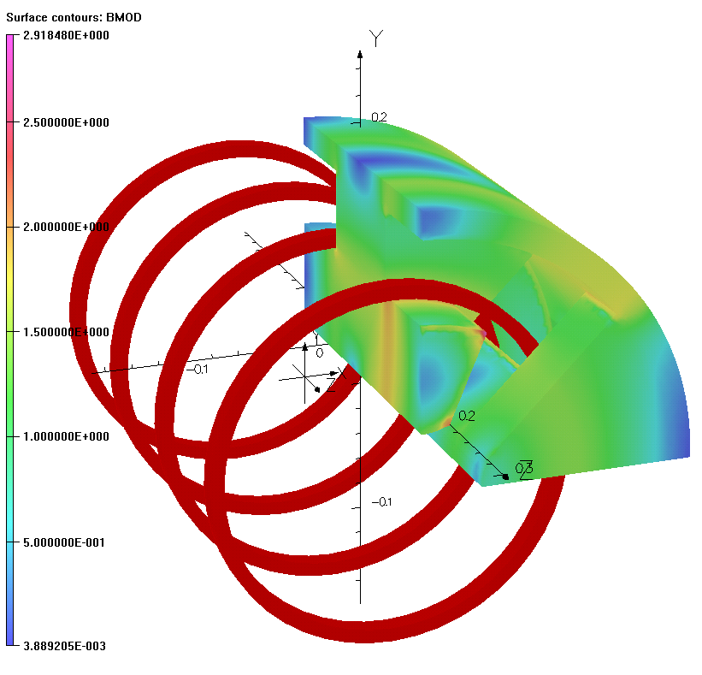
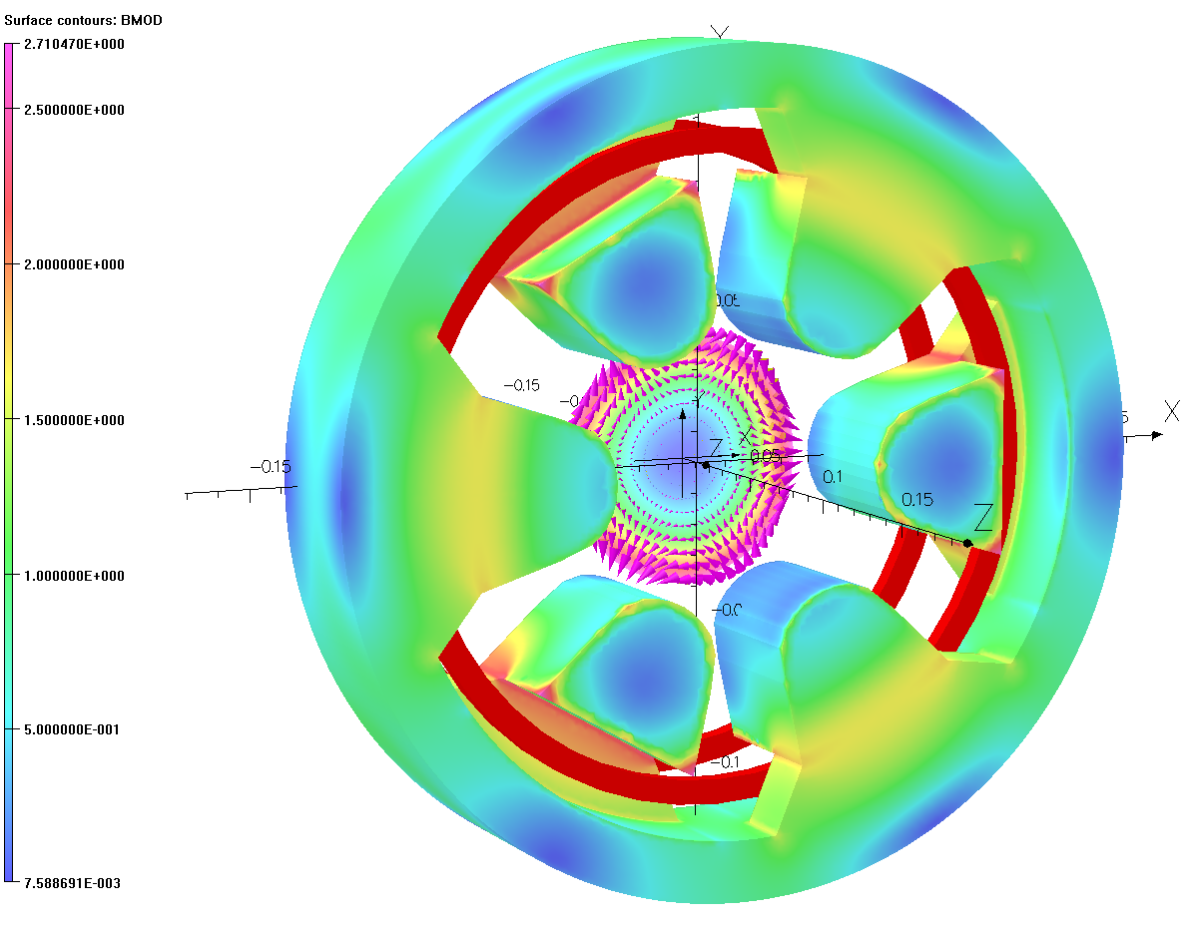
Multi Coils SC Quadrupole and Sextupole
Single coil quadrupole has the solenoidal field component Bz=0.045 T. Two coils design configuration eliminate the integrated solenoidal field.
Circular coils are suitable for using HTS superconductor.
Quadrupoles
At Fermilab initiated LDRD to fabricate and test
HTS superconducting magnets. The iron dominated magnet will be used to test various high temperature superconducting coils.
The main goal of this R&D is to develop efficient HTS magnet technology capable to compete with room temperature, and LTS magnets.
Sextupole

Slide 18
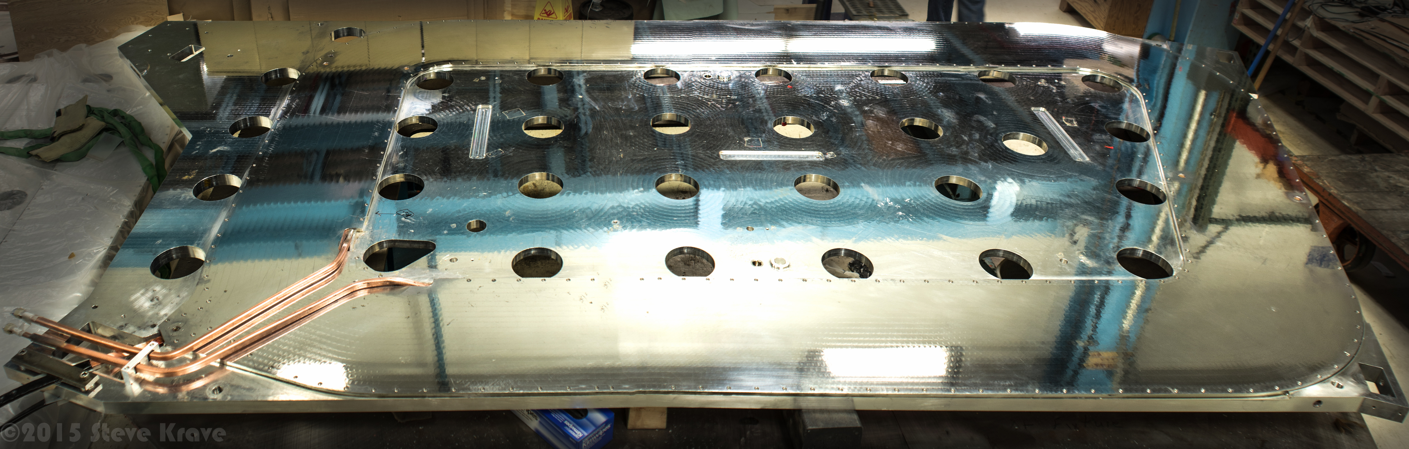
Manufacturing capabilities
The magnet sector has all the devices needed to manufacture small and large coils: from winding to vacuum/pressure impregnation
All devices needed for magnet assembly: presses, welding fixtures and etc.
QA/QC based on travelers and capability for full set of Magnetic measurements
Example for a large coil produced is Jlab CLAS12 TORUS Coils - 4x2.5 m²

Slide 19
Some pictures

Slide 20
Cold Testing
Parameter | VMTF | Stand 3 | STF
Operating Temperature | 1.8K | 4.3K | 4.5K
Maximum Current (1st PS) | 30 kA | 30 kA (re-use existing) | 2.5kA
Helium Vessel Diameter | 25.8 inches (655 mm) | 20 inches (508 mm) | 120 inches
Maximum Length of Test Object | 3750 mm | 590 mm | 60 inches
Maximum Diameter of Test Object | 630 mm | 490 mm | 114 inches
Crane Capacity | 10 tons | 25 tons | 50 ton
Location | IB-1 VMTF Bay | IB-1 (IB1 High Bay) | HAB (CDF)

Slide 21
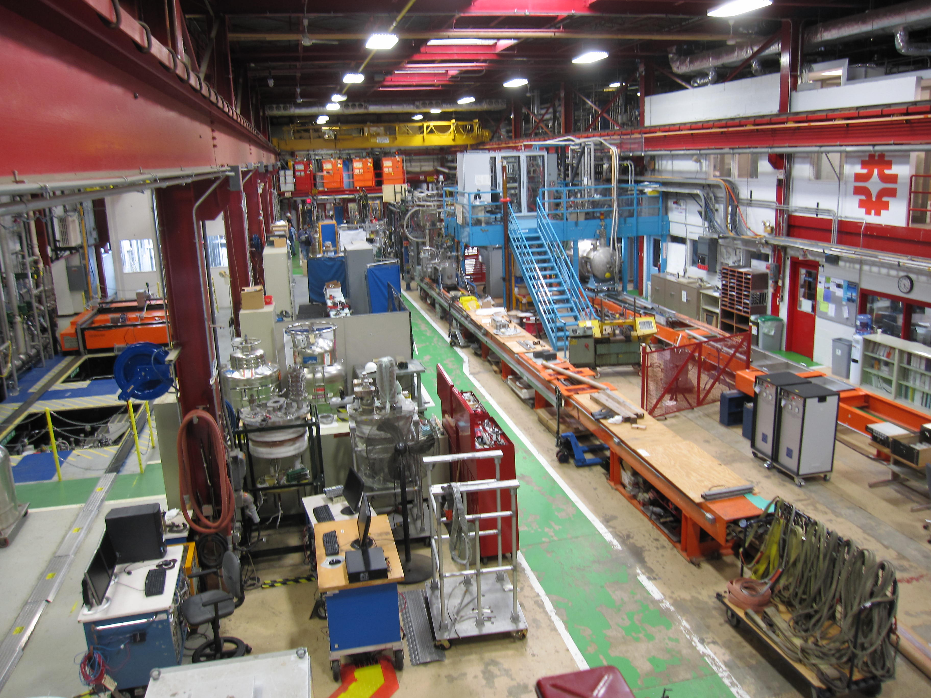
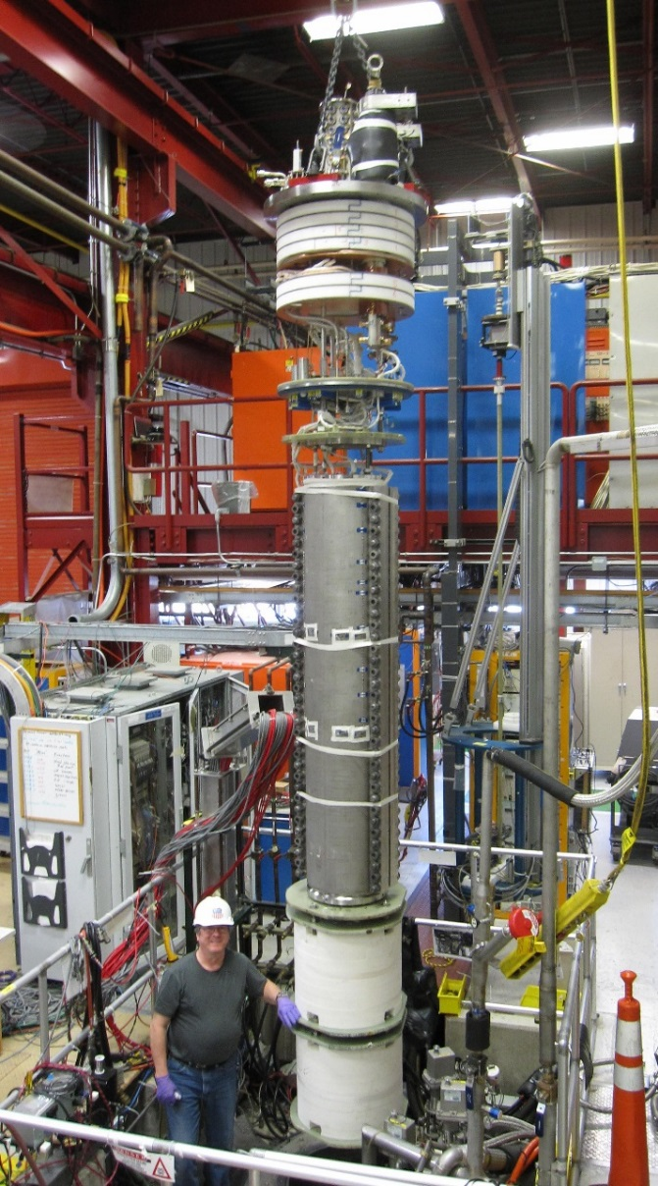
Pictures
Stand 3
VCTF
Stand 4
STF/HAB
VMTF

Slide 22
Summary
Magnet Sector has experienced staff and capabilities to produce LTS and HTS magnets
HTS R&D has been restarted
We have the test facilities providing:
  Cold tests at lower as 1.8K
  Full set of magnetic measurements
We have extensive experience in supporting the operation of SC magnets

Slide 23
Exciting advances in HTS vs Nb₃Sn properties, but cost remains a major hurdle

