Slide 1
FNAL 120 GeV Slow Spill from Main Injector
Denton Morris
Main Injector/Recycler Dept.
12 March, 2018

Slide 2
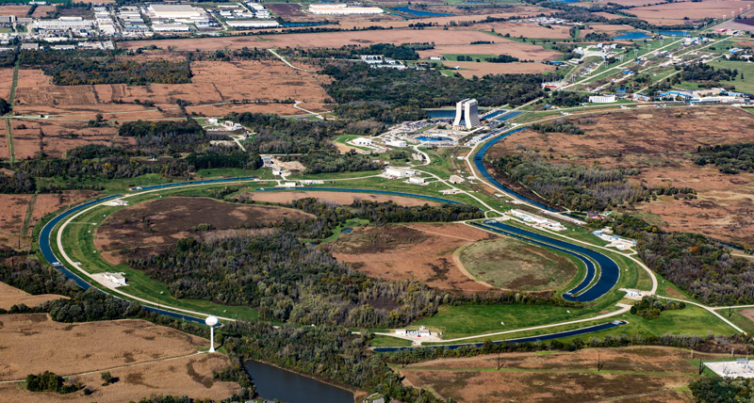
Beam Facilities at Fermilab
Ext. Beamlines
Proton Source
Muon Campus
Recycler
Main Injector

Slide 3
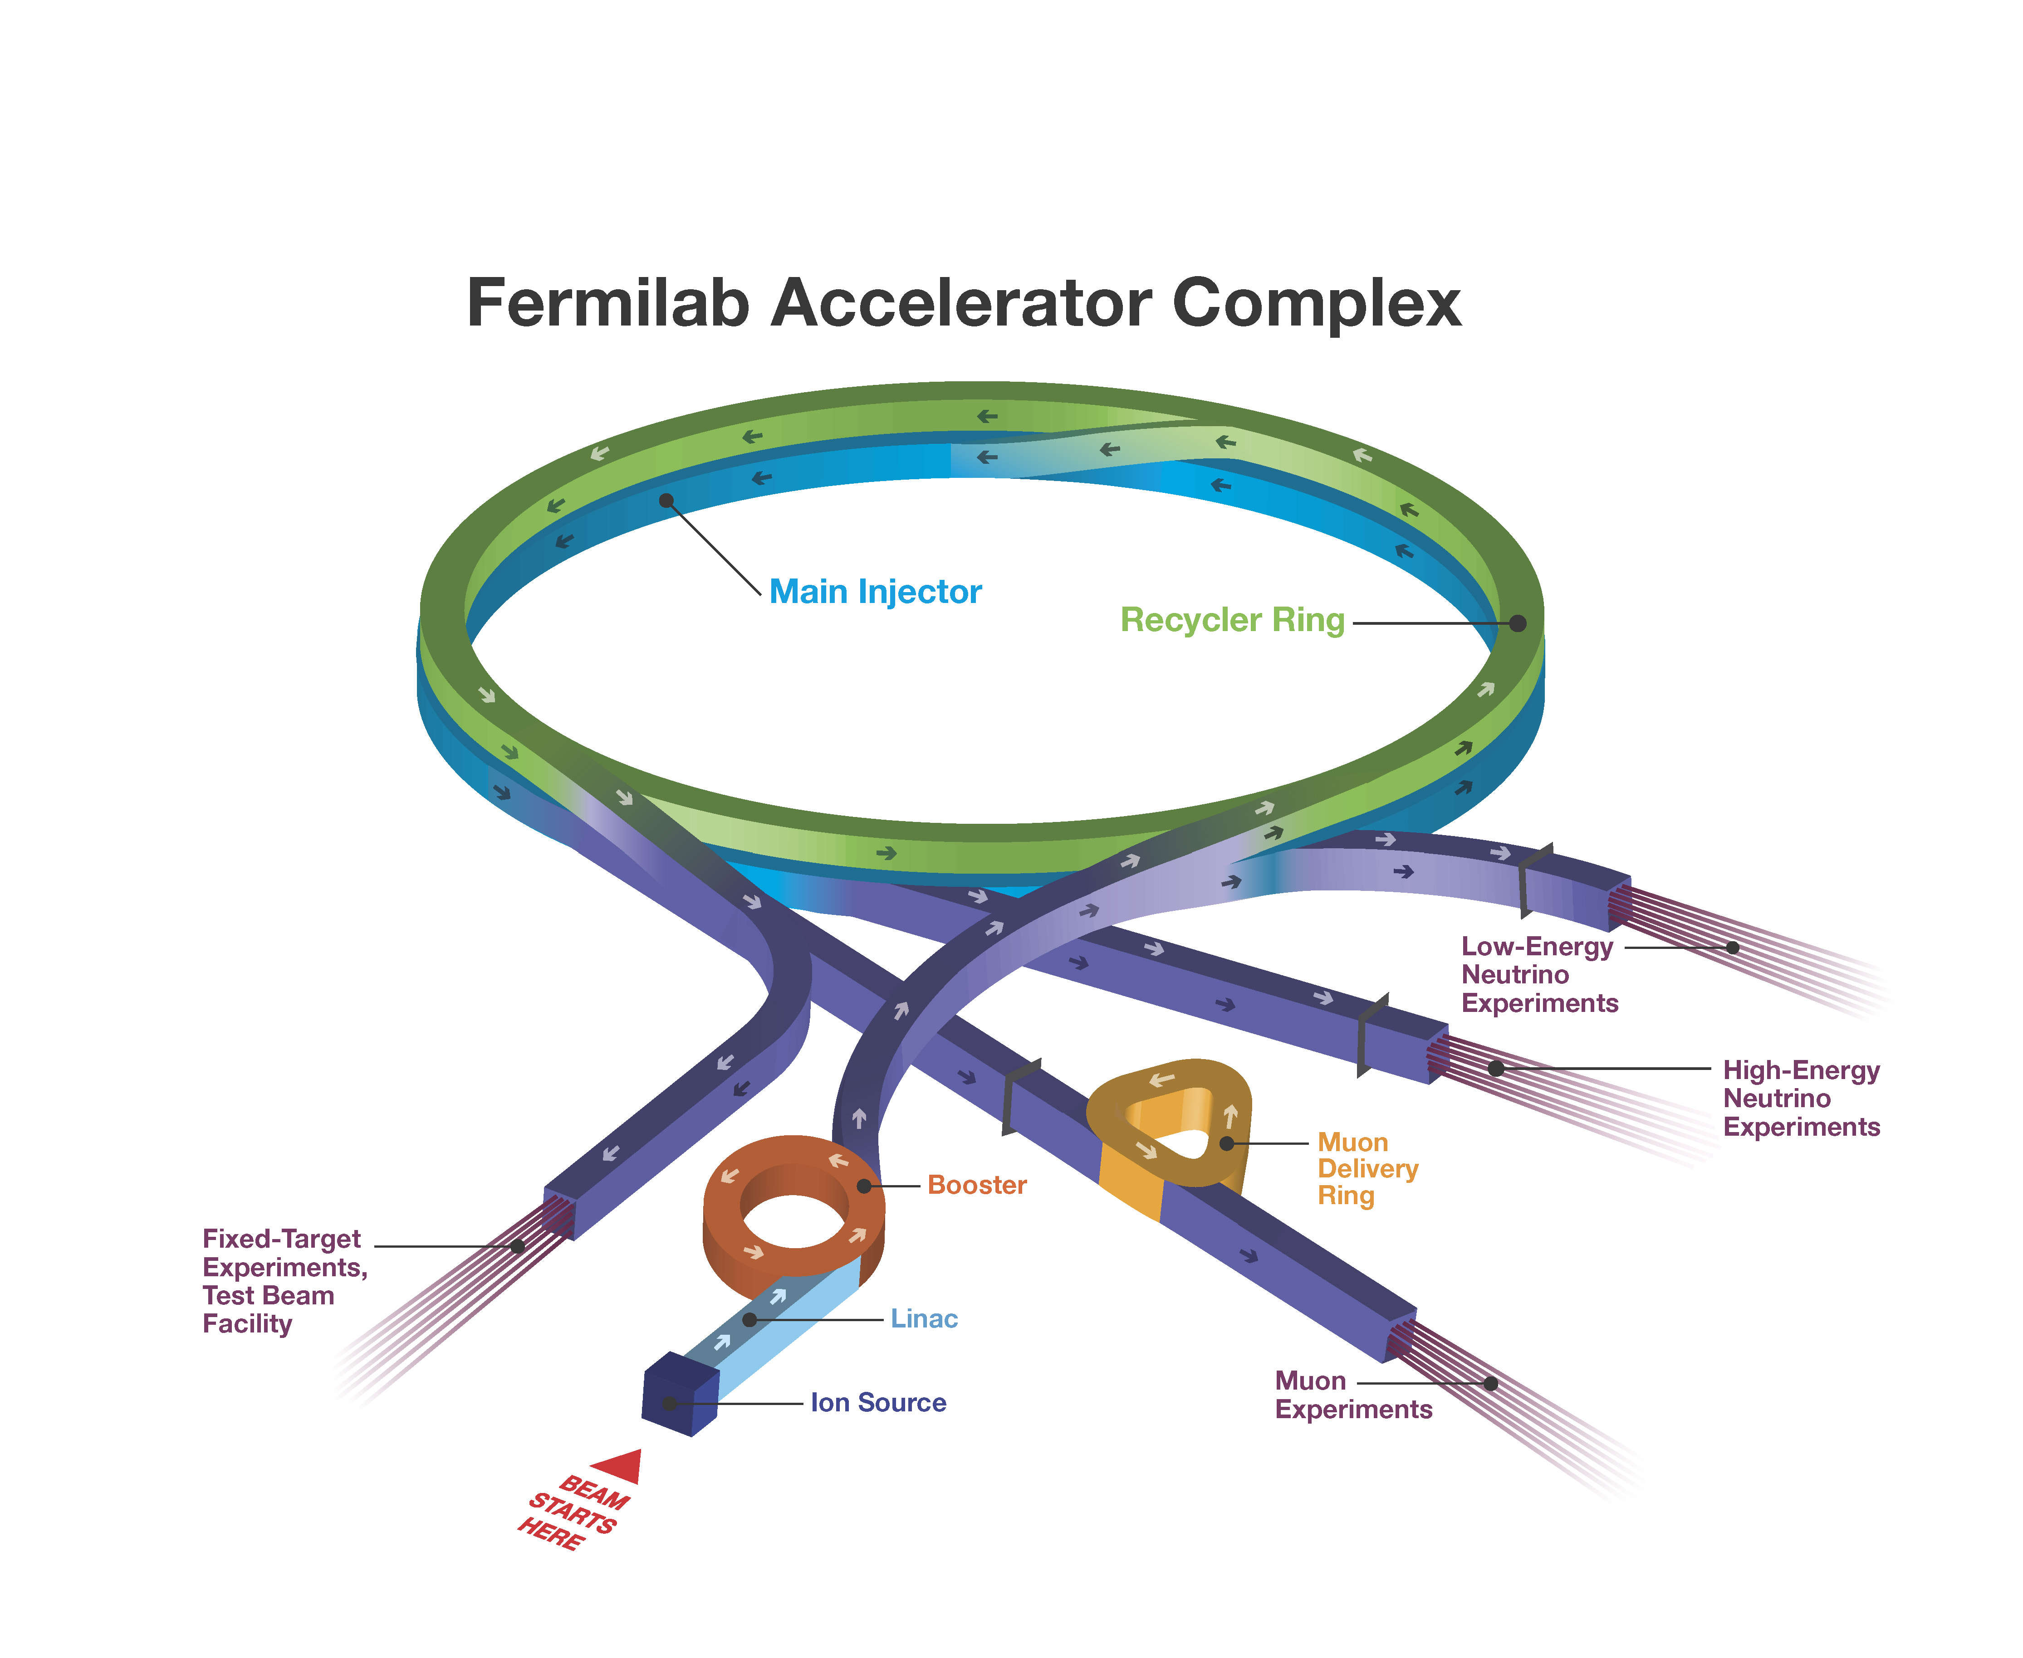
Main Injector Slow Extraction Program
The Fermilab Main Injector :
120GeV/c
53MHz RF bunch structure
588 RF bucket circumference
486 bunches @ 2e10 ppb
4 second slow spill

Slide 4
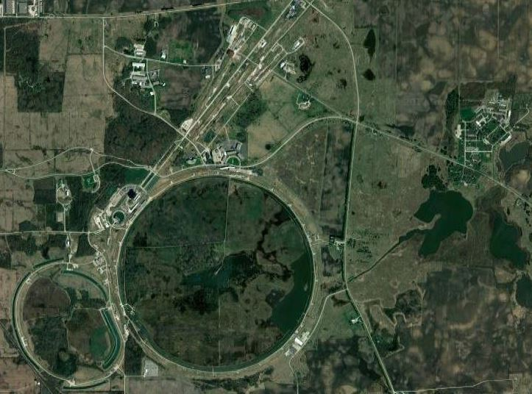
Main Injector Slow Extraction Program
1
2
3
Three main user areas for slow spill beam:
1 – Mtest (Detector development)
2 – Mcenter (Detector development)
3 – Neutrino/Muon Hall (SeaQuest/Drell-Yan experiment)

Slide 5
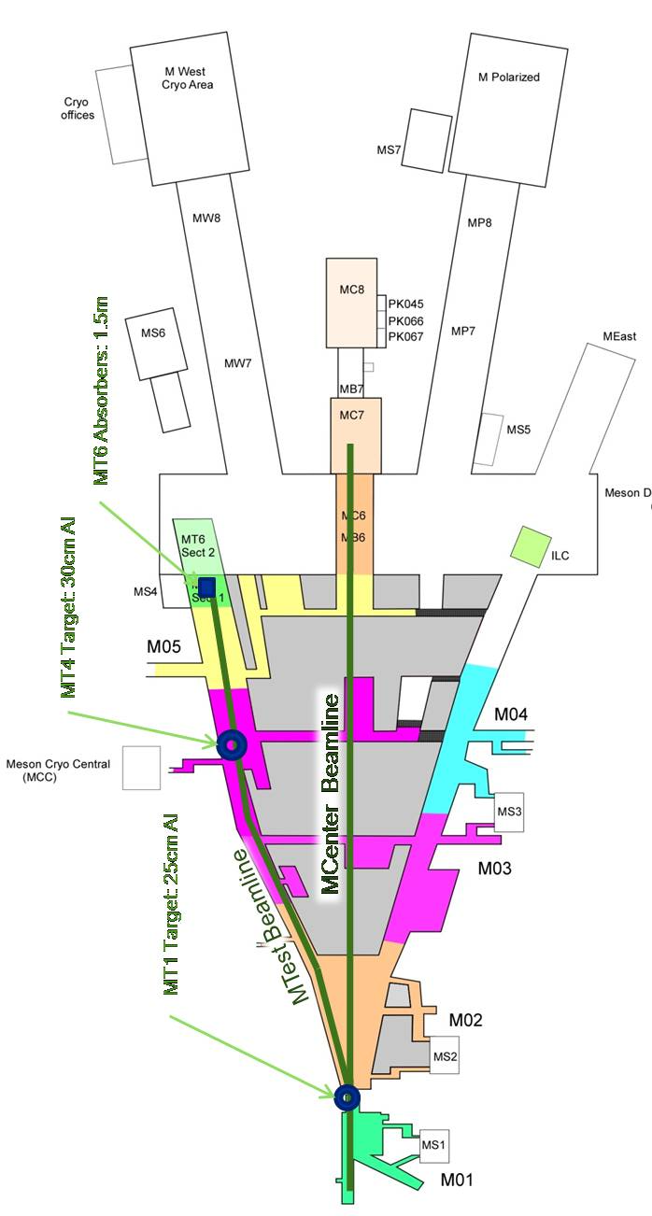
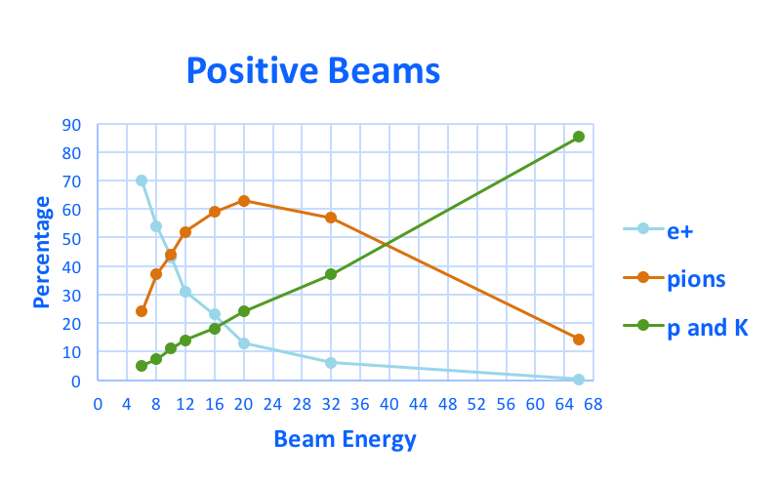
Low and Medium Energy User Test Beams at Fermilab
CERN 2019/2020 test beam shutdown
  Far-reaching impact on HEP
Mixed test beams will be available only at Fermilab
Low to medium energies, two production targets
Two test beam lines; 2% Δp/p
    120 GeV primary protons from MI (high intensity, 10¹³p/spill)
    8-60 GeV pions and some protons (MT1 target)
    1-32 GeV pions, electrons, kaons, or broadband muons (MT4 target)
      Electrons can be eliminated
    1-32 GeV pions, electrons, kaons, or broadband muons (MT4 target)
    High energy positrons (60 GeV) have been observed
    0.2-1 GeV pions, protons, kaons (tertiary target, MCenter line, MC5)
C. Johnstone

Slide 6
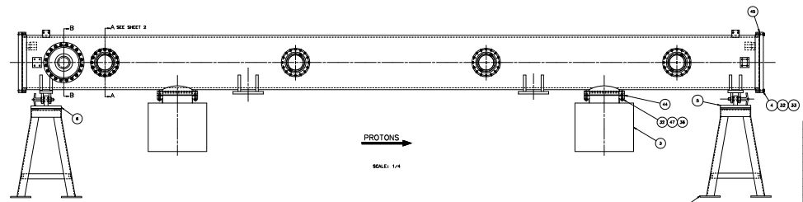
Main Injector Slow Extraction Program
Particle extraction occurs through two 3 meter electrostatic septum and three magnetic septum (Lambertsons)

Slide 7
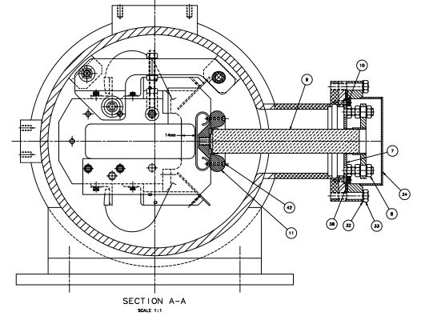
Main Injector Slow Extraction Program

Slide 8
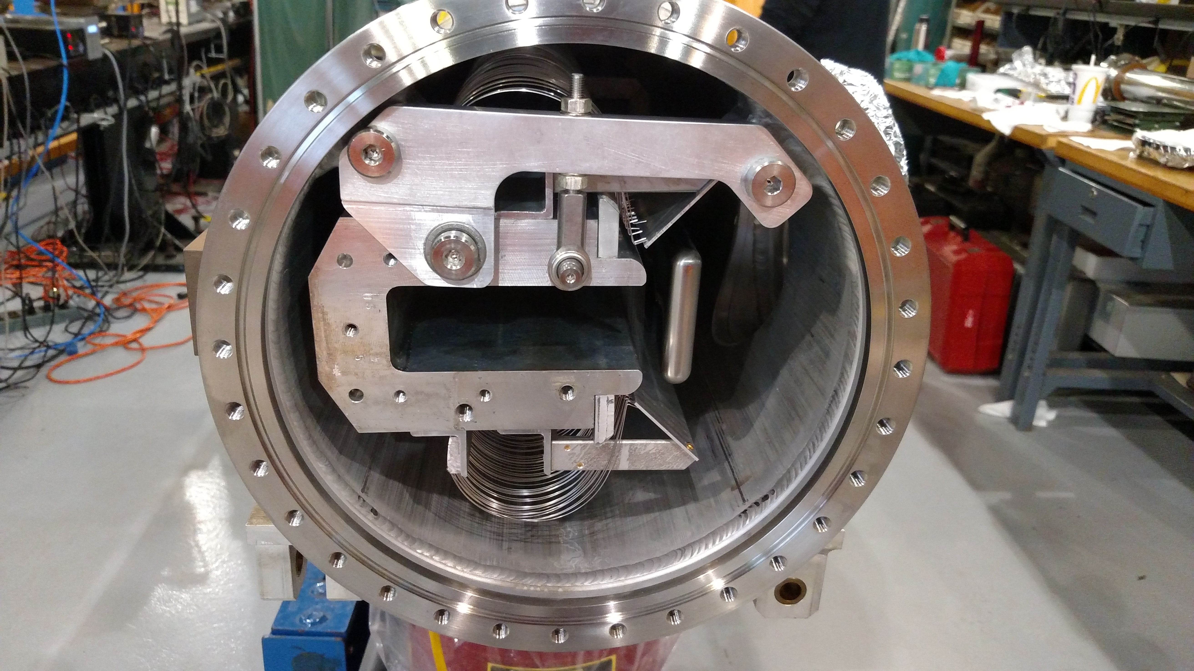
Main Injector Slow Extraction Program
Each septum uses 0.1mm Tungsten (75%) Rhenium (25%) wires to isolate circulating protons from the high voltage extraction field region of the septa.
We have experimented with 0.05mm wire septa. Extraction losses were reduced as expected but the wires experienced a high failure rate.

Slide 9
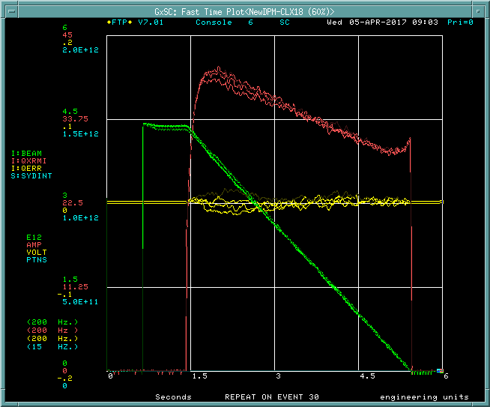
Main Injector Slow Extraction Program
Slow Spill from Main Injector uses half integer resonant extraction driven by
two 0th harmonic air-core quadrupoles (QXR) and two orthogonal families of eight 53rd harmonic quadrupole correctors.
Peak intensity: 1e13 protons
Protons per bunch (circulating): 2e10
Spill duration: 4 seconds
Protons per extracted bunch: ~4e4

Slide 10
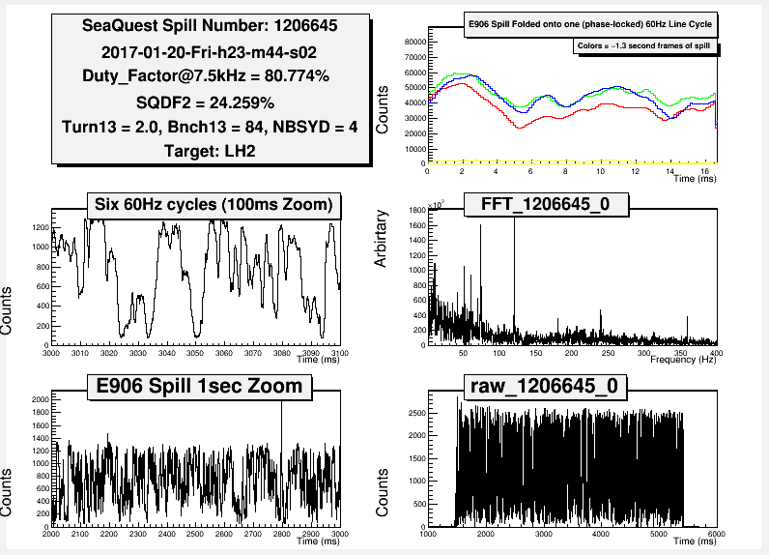
Main Injector Slow Extraction Program
Effective bandwidth of resonant beam feedback system is ~300 Hz.
Typical spill duty factor (53 MHz) ~ 45%

Slide 11
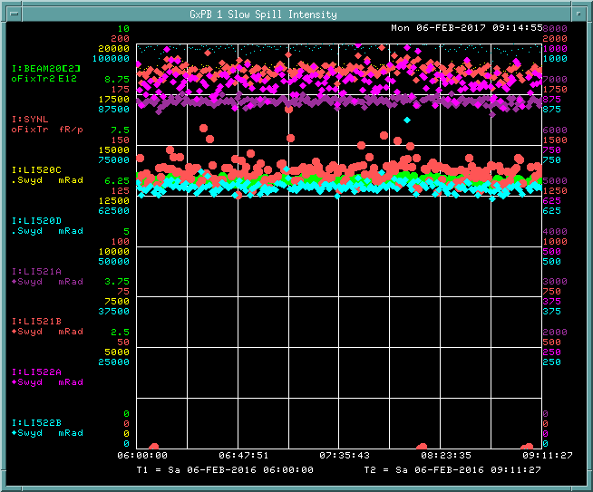
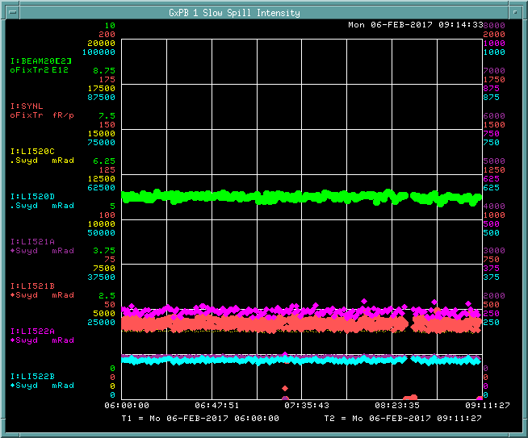
Main Injector Slow Extraction Program
Losses during slow extraction. 0.1 mm versus 0.05 mm wire
0.1 mm wire
0.05 mm wire

Slide 12
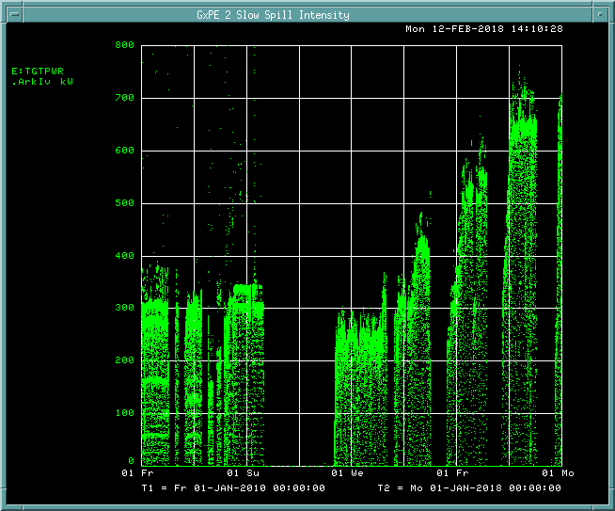
Main Injector Slow Extraction Program
Circulating beam power
For NUMI (2010 – 2018)

Slide 13
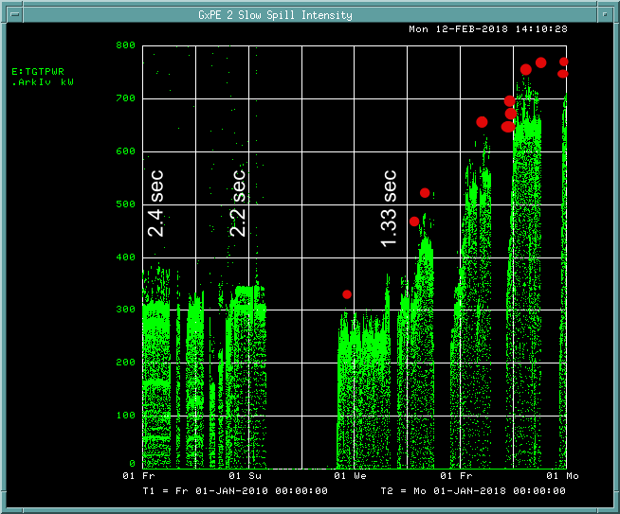
Main Injector Slow Extraction Program
Circulating beam power
For NUMI (2010 – 2018)

Slide 14
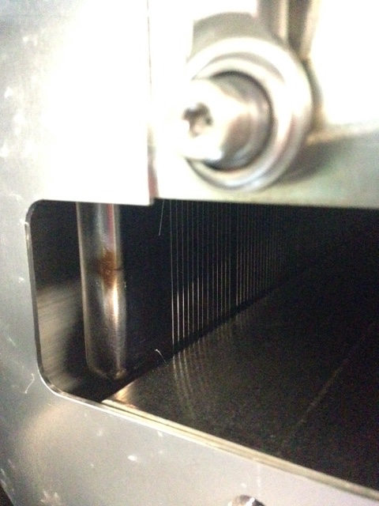
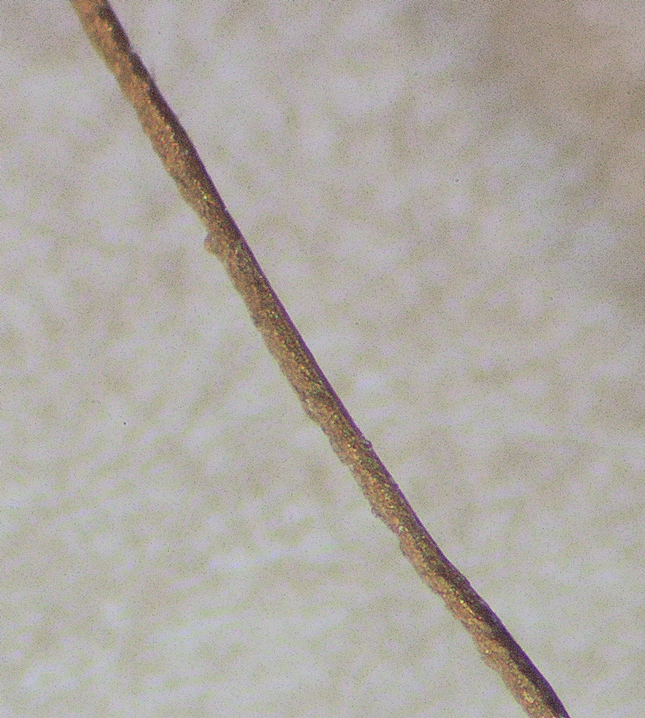
Main Injector Slow Extraction Program

Slide 15
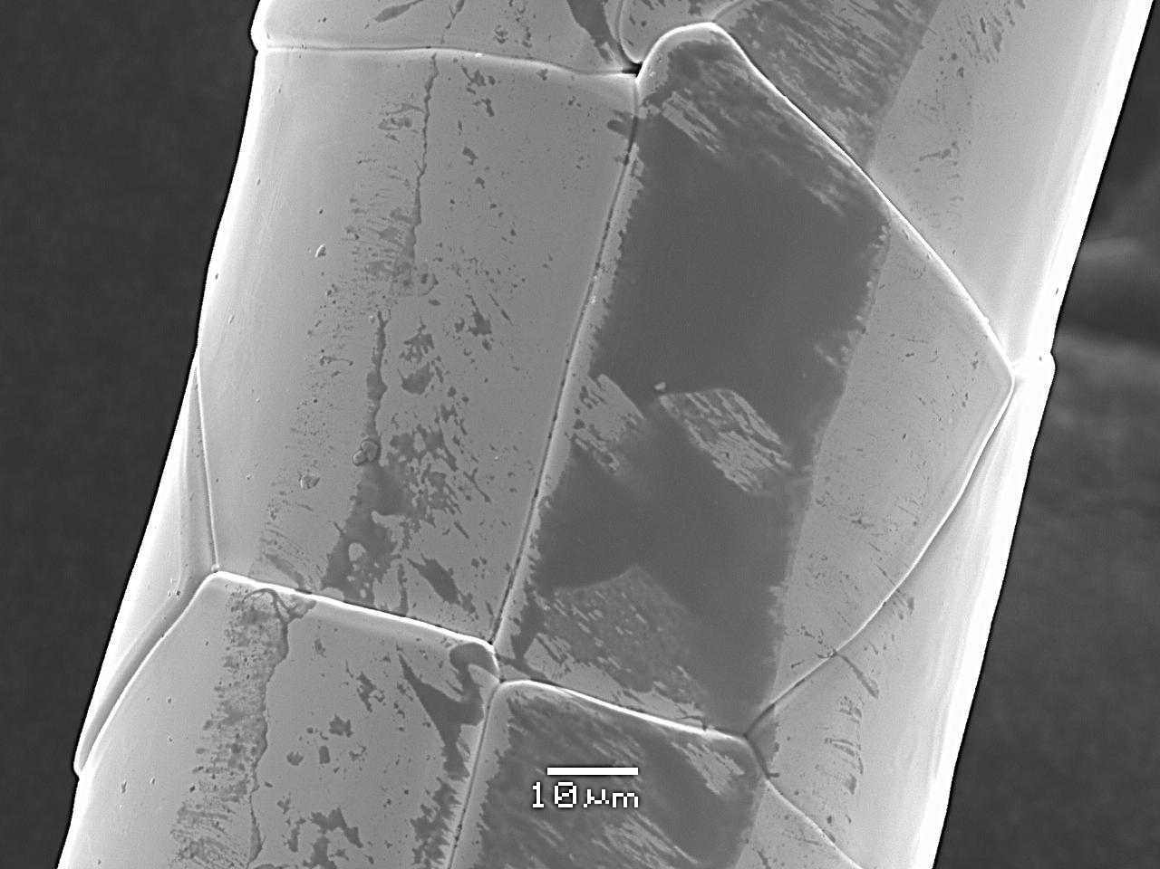
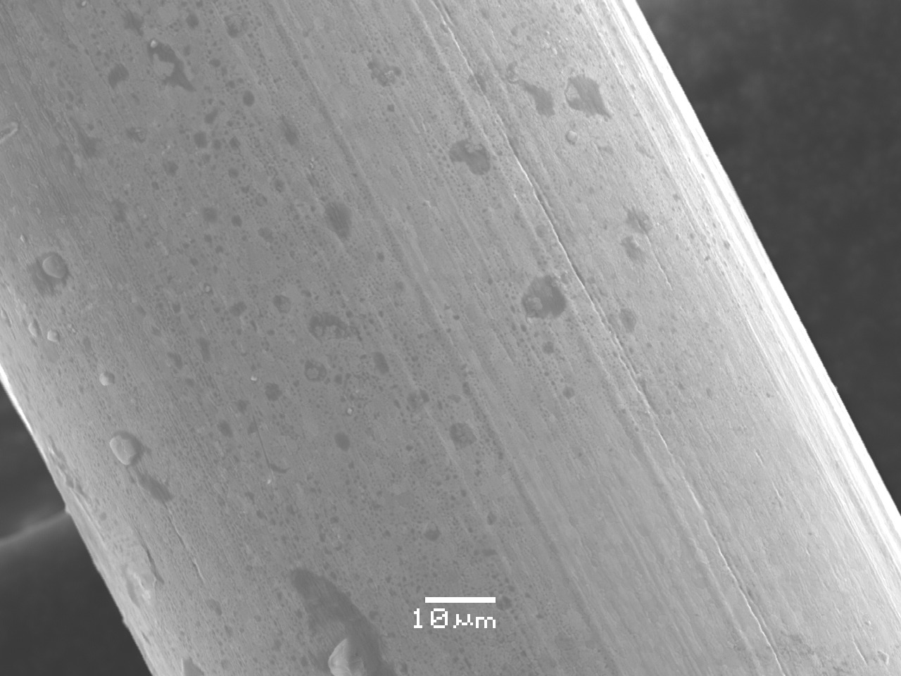
Main Injector Slow Extraction Program

Slide 16
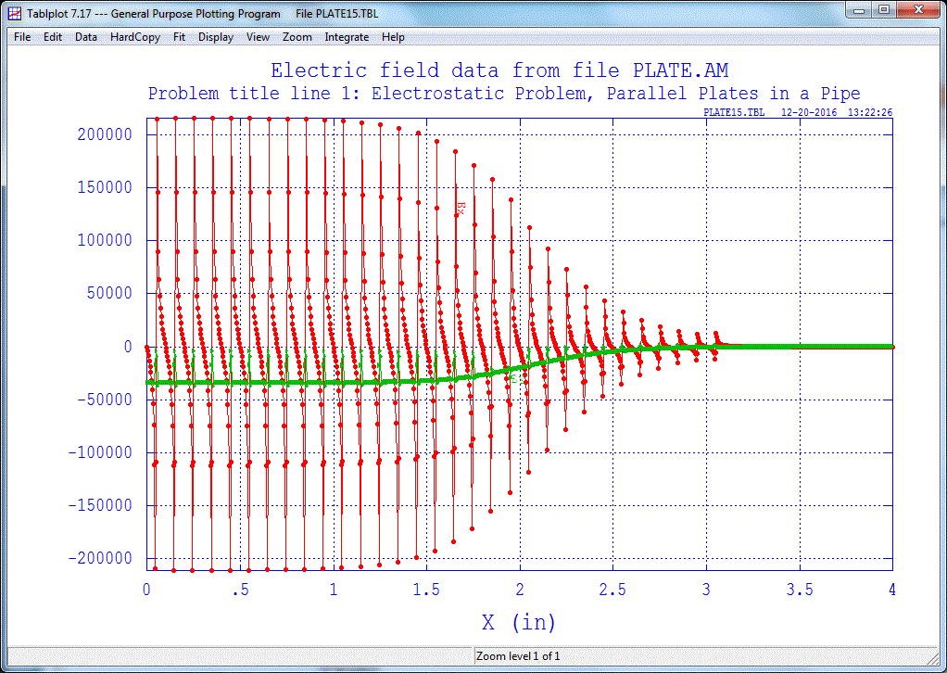
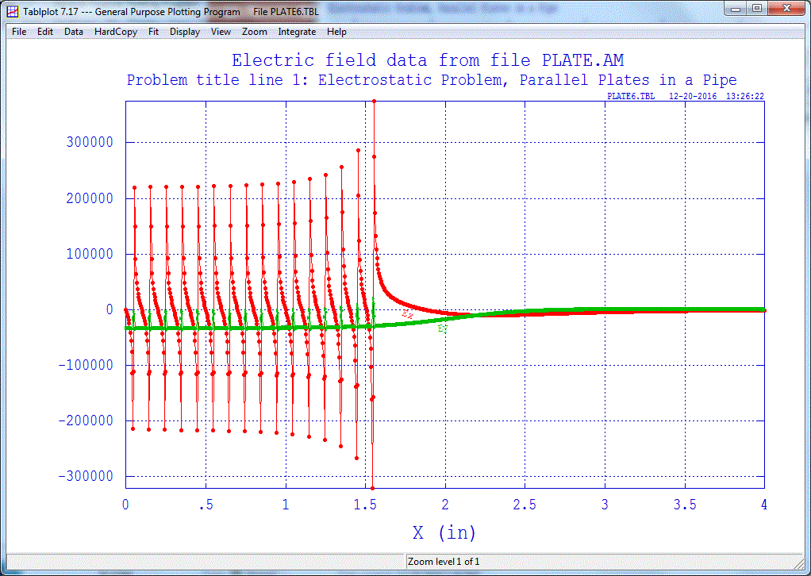
Main Injector Slow Extraction Program

Slide 17
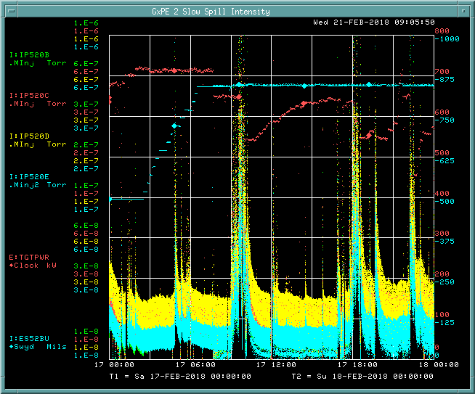
Main Injector Slow Extraction Program
Vacuum burst
investigation

Slide 18
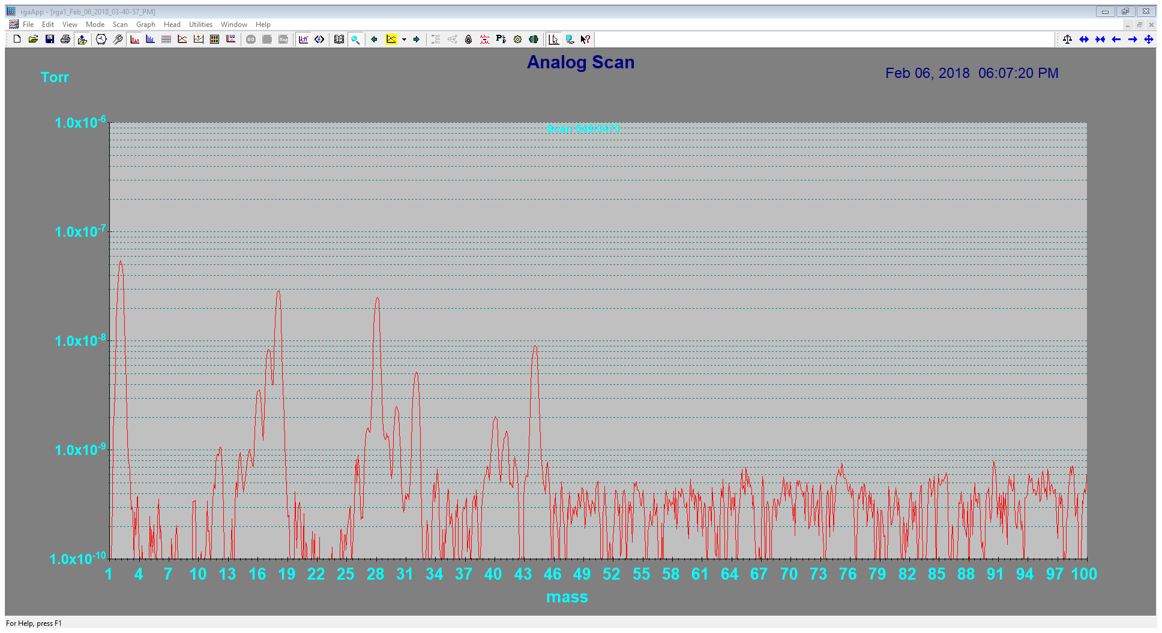
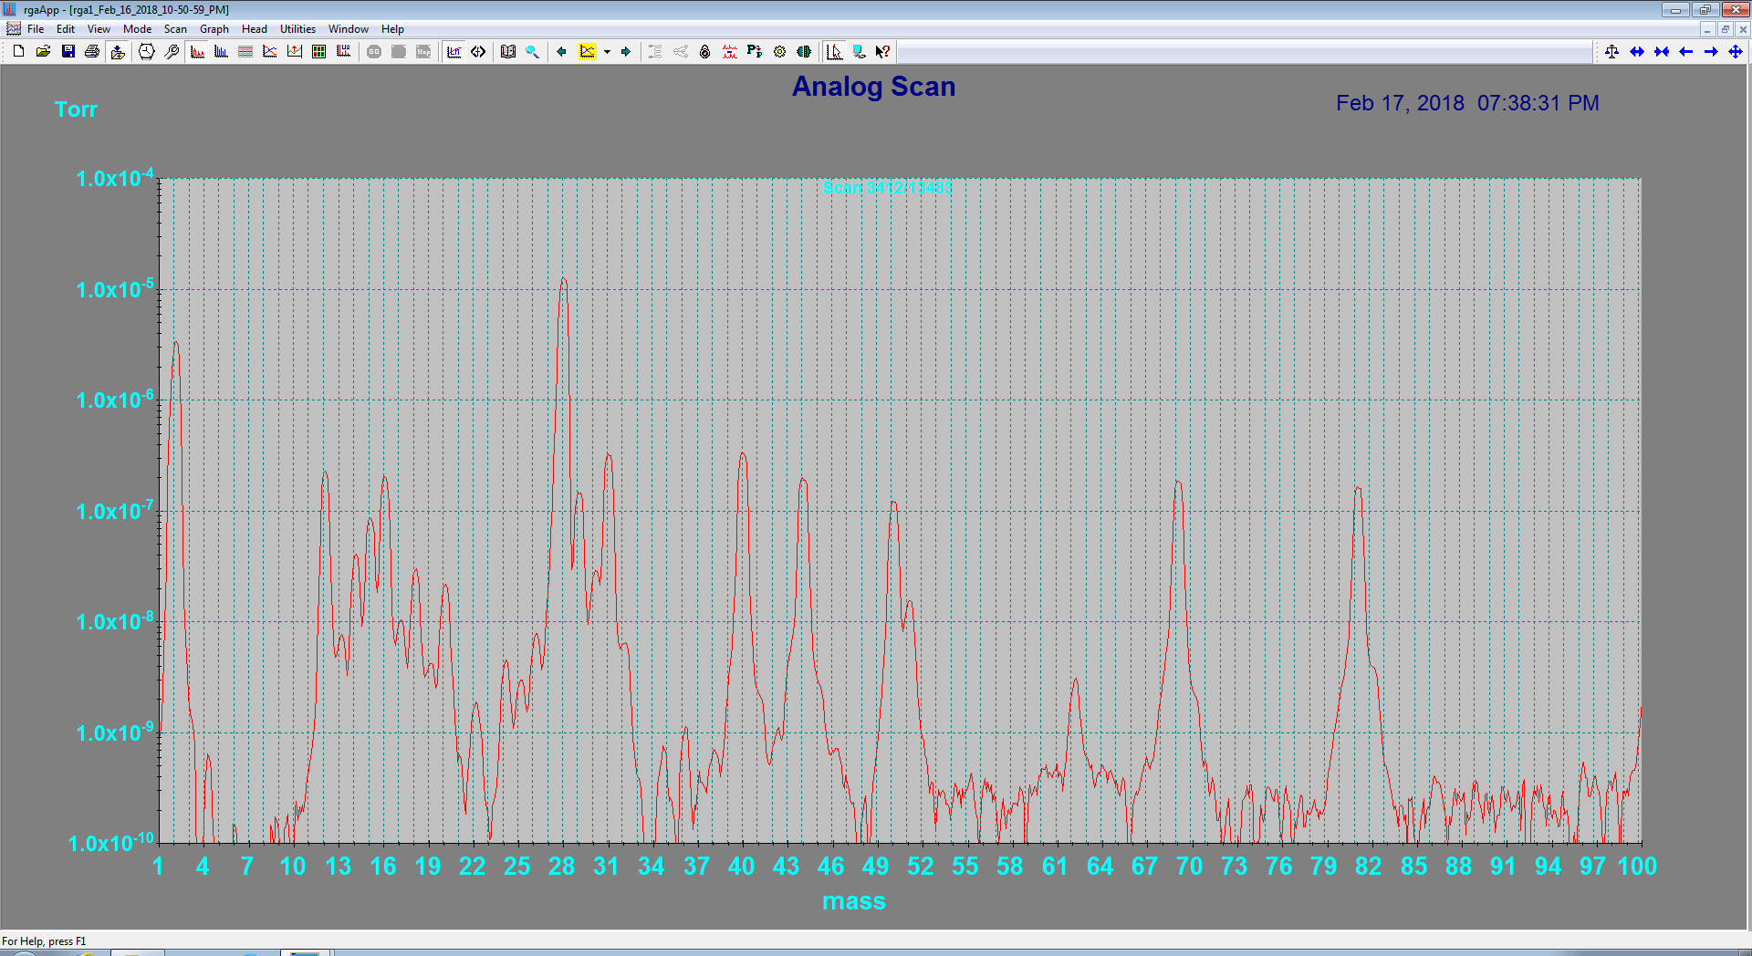
Main Injector Slow Extraction Program

Slide 19
Main Injector Slow Extraction Program
Going Forward:
Re-establish our ability to make MI septa
Understand and rectify the vacuum issues
Understand and correct issues contributing to wire failures

