Slide 1
Mu2E Septa Fluorinert (FC-40) Feedthrough Preliminary Flow Modeling
Abhishek Deshpande (Dez)
Update
March 12, 2018

Slide 2
Overview
Geometry
Inlet and outlet in the same plane (Horizontal inlet)
Inlet and outlet in different planes (Vertical inlet)
Flow model details
Results
Geometry modified
Fluid gap reduced to 0.5 In.
Velocity profiles for the modified geometry
Geometry modified
An annular tube section is placed in the shell
Velocity profiles in the inner shell section
Conclusions
Future work

Slide 3
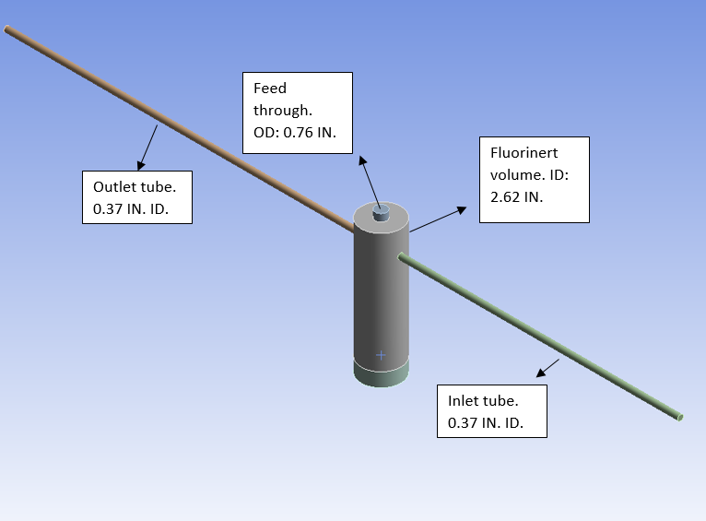
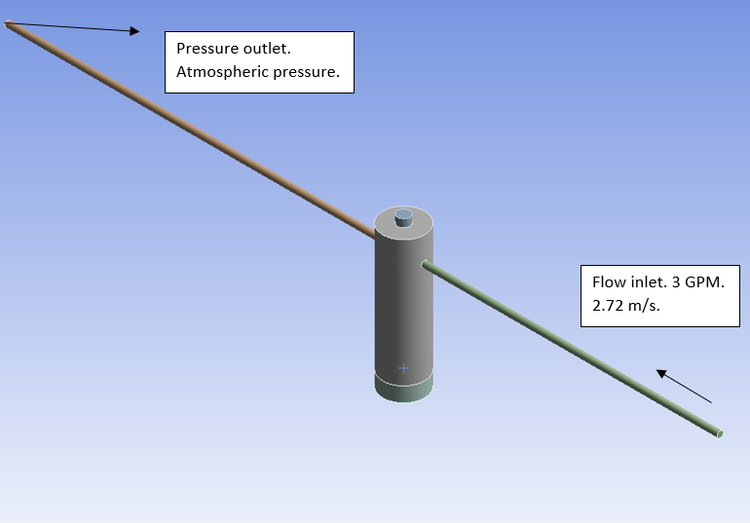
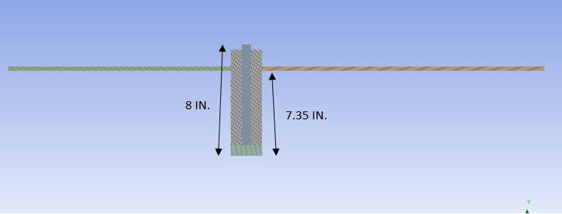
Geometry: Inlet and outlet in the same plane

Slide 4
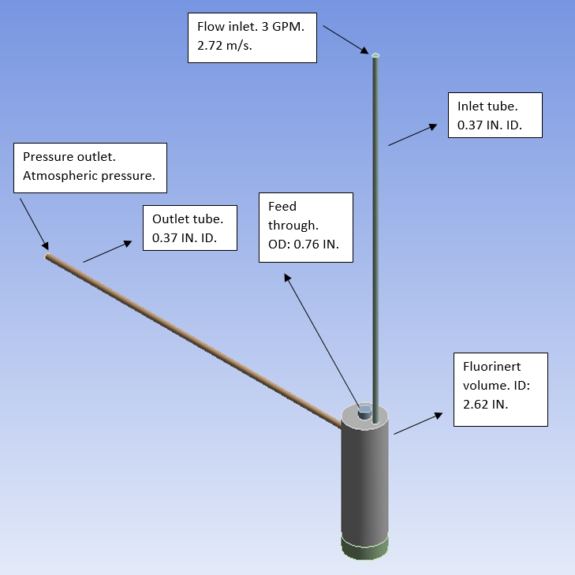
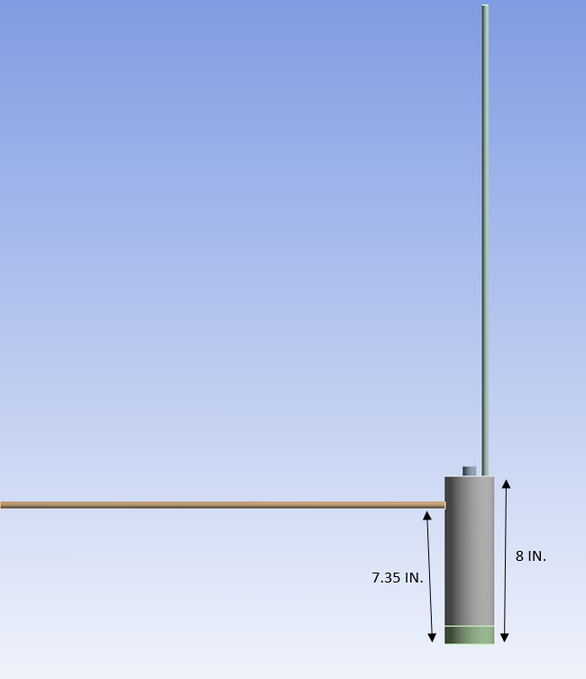
Geometry: Inlet and outlet in different planes

Slide 5
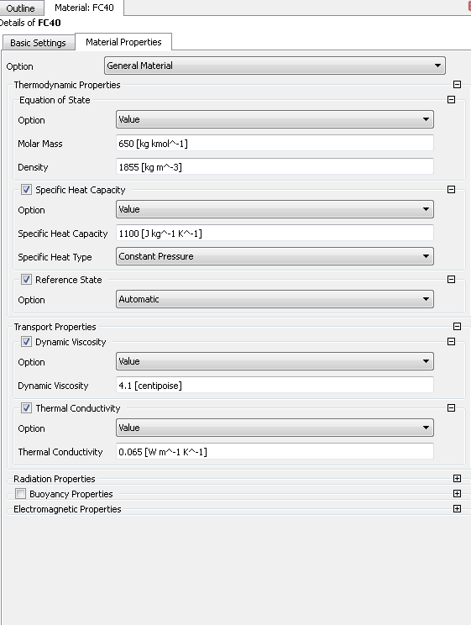
Flow model details
ANSYS CFX was used to model the flow.
Transient simulation:
Total time: 4 s.
Time step: 0.01 s.
Turbulence model: k-epsilon.
Isothermal solids and fluids. 25 Deg.C.
Grid independent solution simulated.
FC-40 properties used.

Slide 6
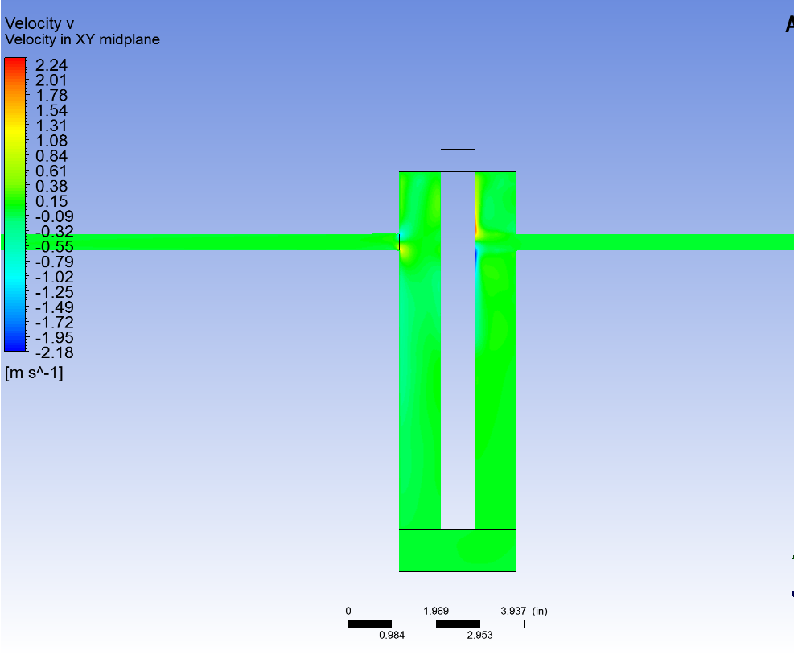
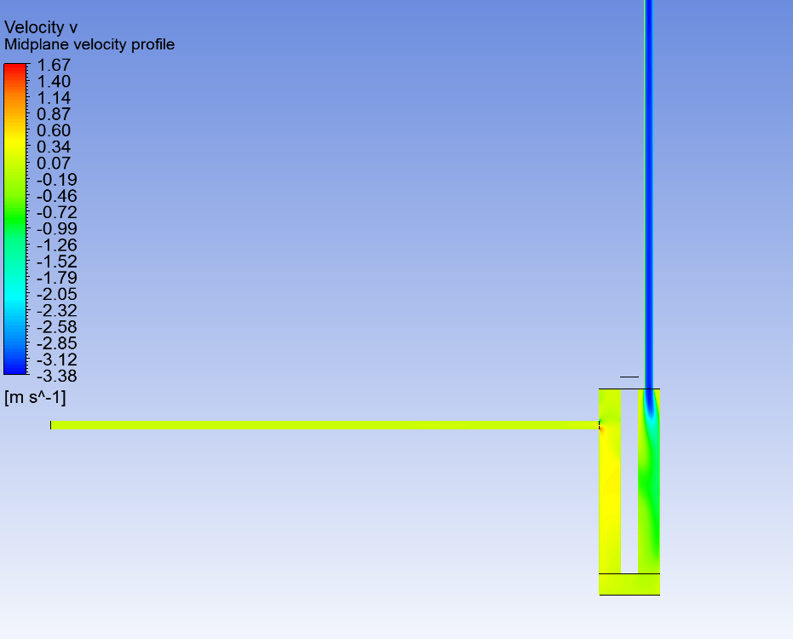
Results
Mid-plane vertical component velocity contour
Mid-plane vertical component velocity contour

Slide 7
Results

Slide 8
Results: Animation (Hover over and click play)

Slide 9
Results: Animation (Hover over and click play)

Slide 10
Results: Animation (Hover over and click play)

Slide 11
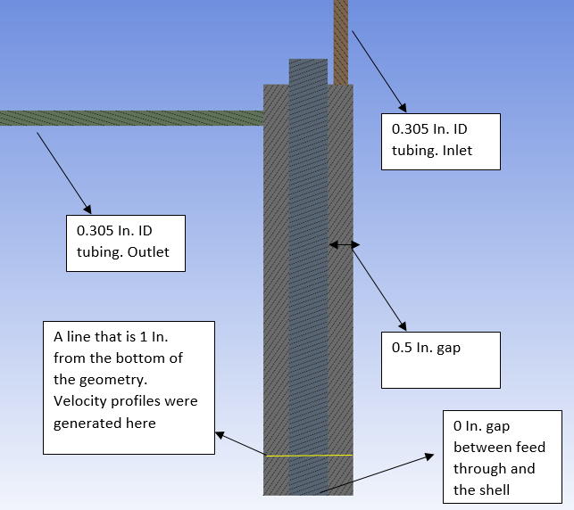
Modified design
Following design changes were made to the geometry:
A transient simulation was generated with a total time of 40 Sec.

Slide 12
Velocity profiles

Slide 13
Velocity profiles

Slide 14
Velocity profiles

Slide 15
V velocity animation (Hover over and click play)

Slide 16
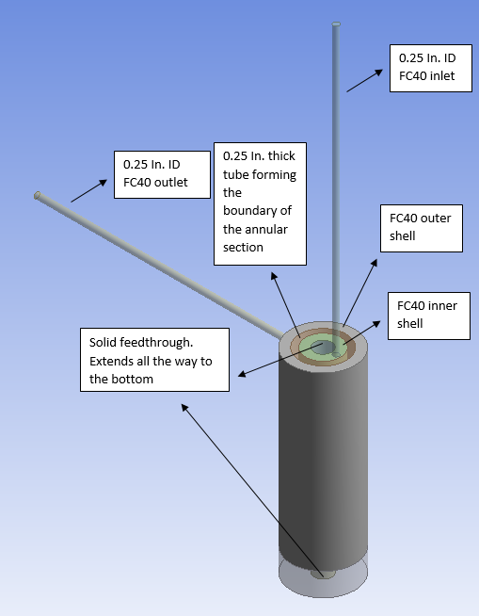
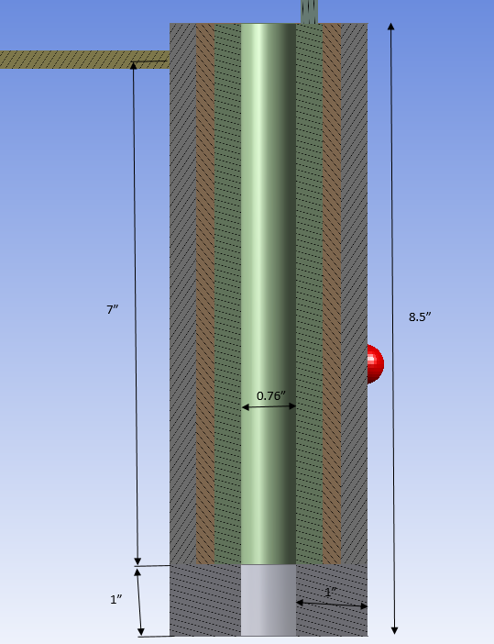
Geometry modified: An annular tube section is placed in the shell

Slide 17
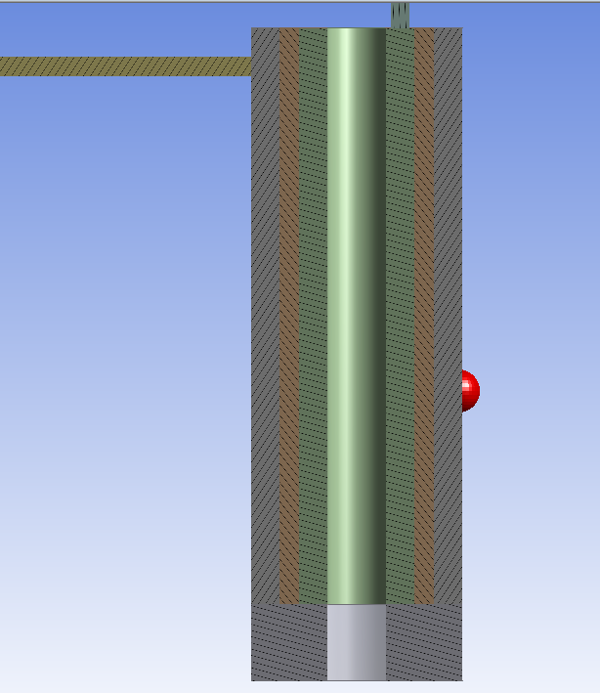
Geometry modified: Flow path

Slide 18
Velocity profiles in the inner shell section

Slide 19
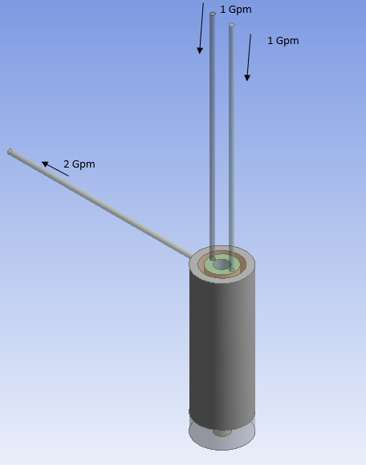
Geometry modified: An annular tube section is placed in the shell and two inlets are added
A geometry was made with two 0.25 In. ID inlets
The inlets are symmetric about the axis of the feedthrough

Slide 20
Velocity profiles in the inner shell section

Slide 21
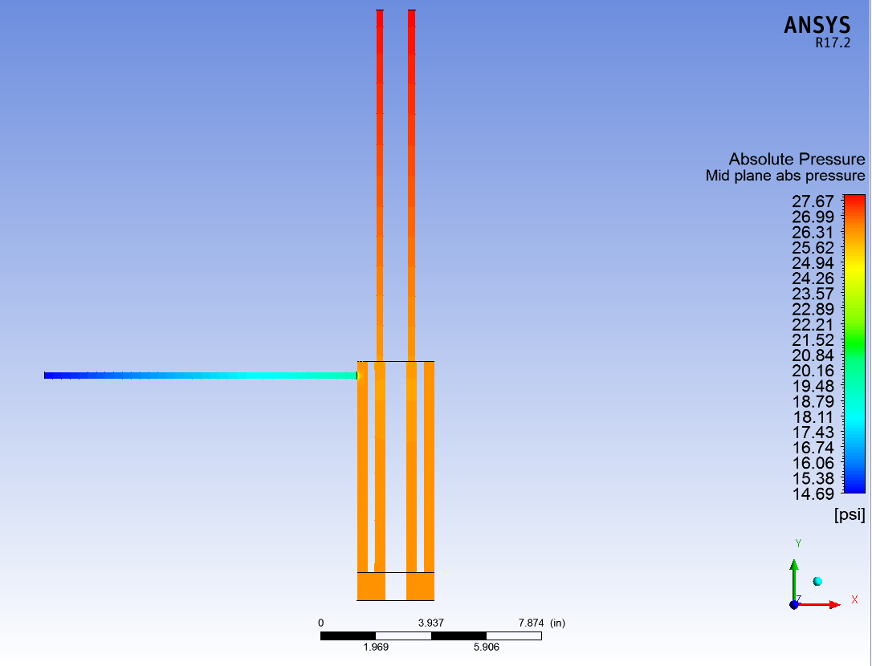
Pressure drop through the geometry
For a total flow of 2 Gpm through the geometry (1 Gpm per inlet), the pressure drop is 12.98 Psid.

Slide 22
Animation (Hover over and click play)
1 Gpm through one top inlet
1 Gpm through each inlet

Slide 23
Results
Enhanced flow along the feedthrough in the model with vertical inlet.
Reversing flow predicted along the feedthrough in the model where the inlet and outlet were in the same plane.
With no gap between the feedthrough and the shell, the Y velocities observed in the region of interest are very low. On the order of 0.04 m/s.
Annular geometry with two inlets at the top results in highest velocity (~0.25 m/s (0.82 ft/s) and more symmetric velocity profiles in the bottom portion of the geometry.
Future iterations:
Increase the length of the annulus region
Add one more inlet?

Slide 24
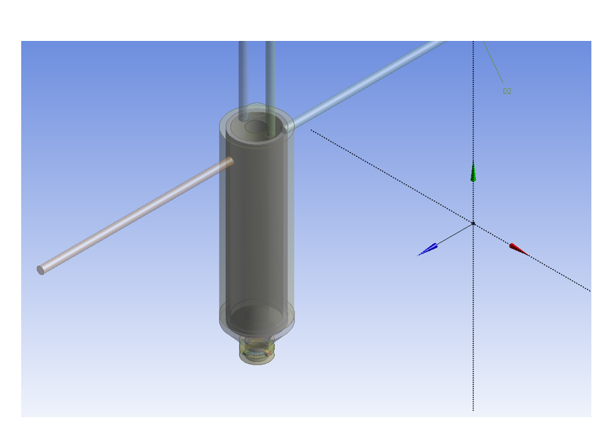
Future work: Adding more detail to the geometry
Inlets
Outlet
Outlet

Slide 25
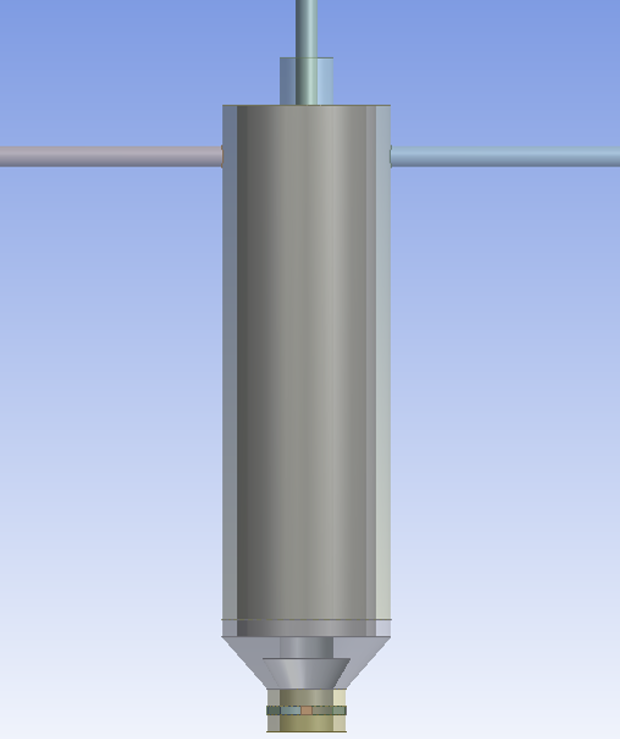
Future work: Adding more detail to the geometry
Feedthrough
Annulus
Outer shell
Need efficient circulation in this region
Feedthrough

Slide 26
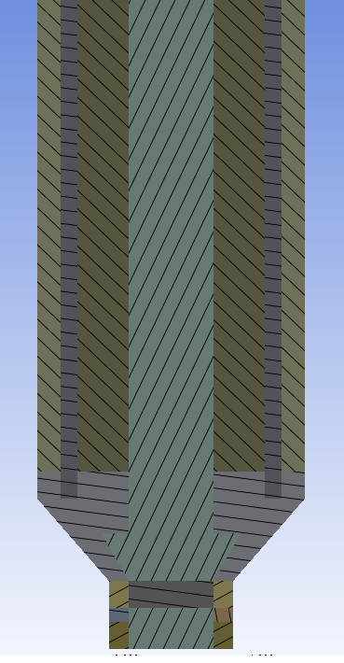
Future work: Desired flow pattern
Outlet
Inlet
Inlet
Outlet

