Slide 1
MI Septa EM modes
Rob Ainsworth
12 March 2018

Slide 2
Outline
Question - Are any EM modes in the septa potentially dangerous?
Create 3D model
Simulations using ACE3P
Time domain (T3P)
Frequency domain (Omega3P)

Slide 3
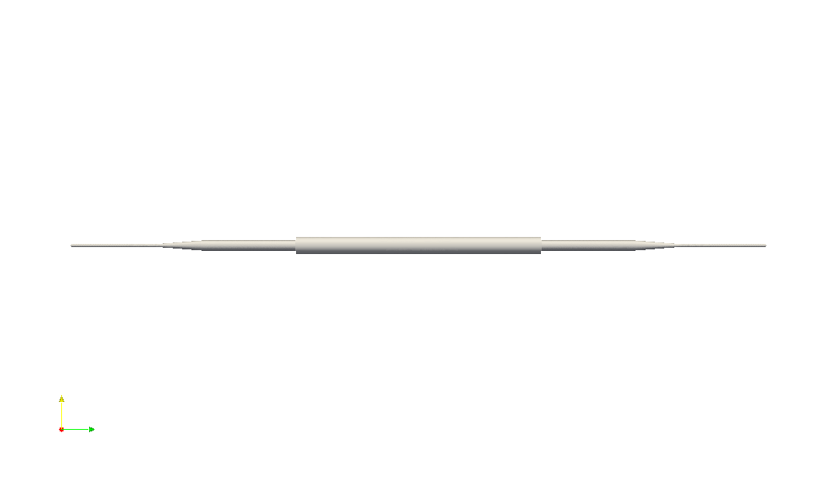
Model

Slide 4
Time Domain Simulation

Slide 5
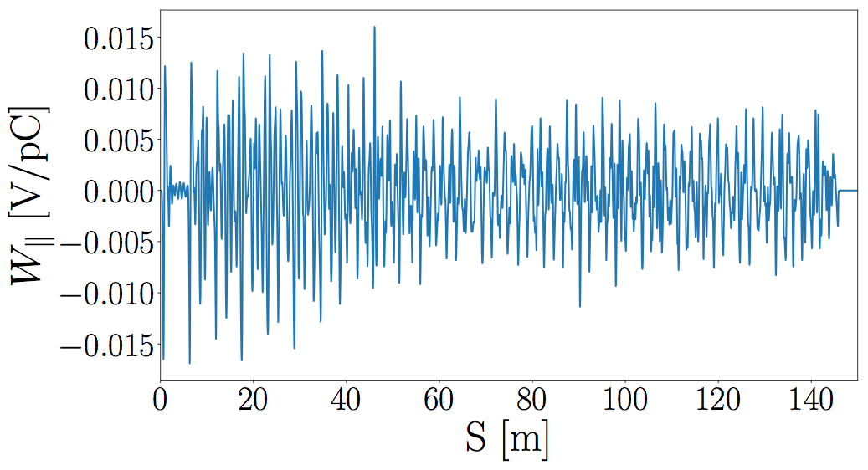
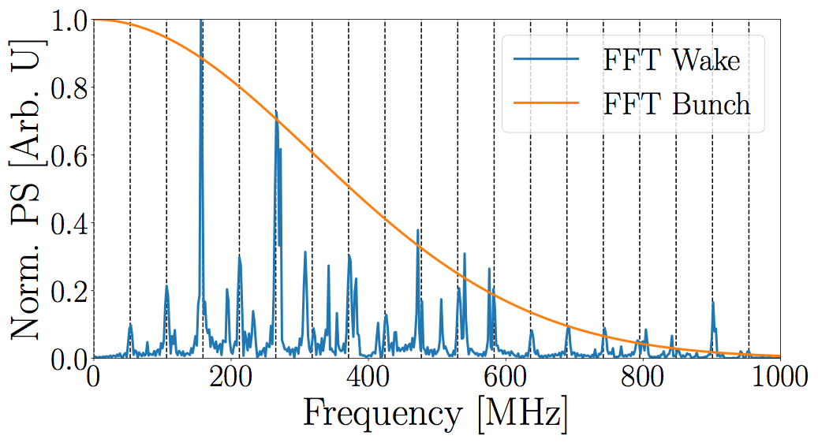
Time Domain Analysis
Wakefield from 10 bunch
excitation
Dashed lines - n*53MHz
Power spectrum of wake and
bunch

Slide 6
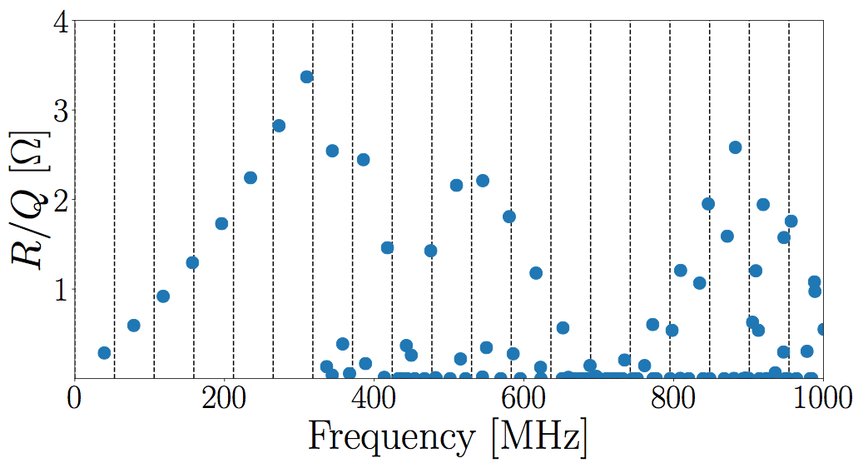
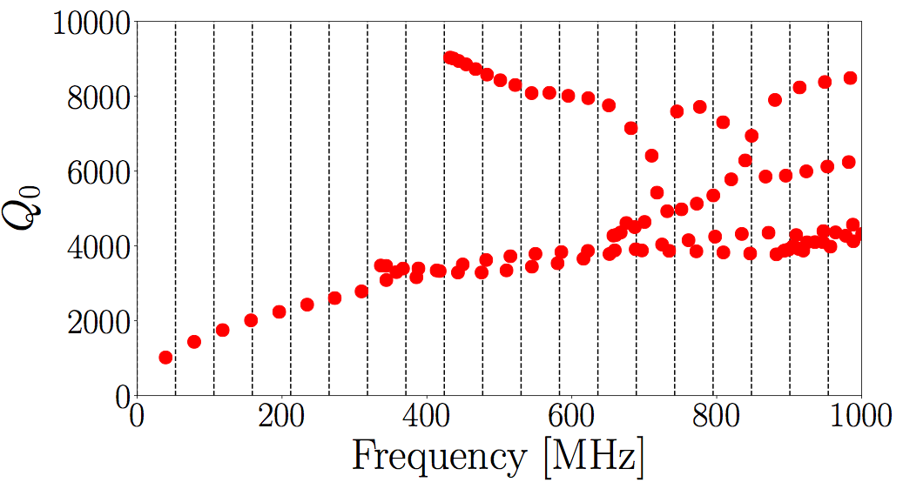
Frequency Domain Analysis
Dashed lines - n*53MHz
R/Q - shows how much beam will
couple to a mode

Slide 7
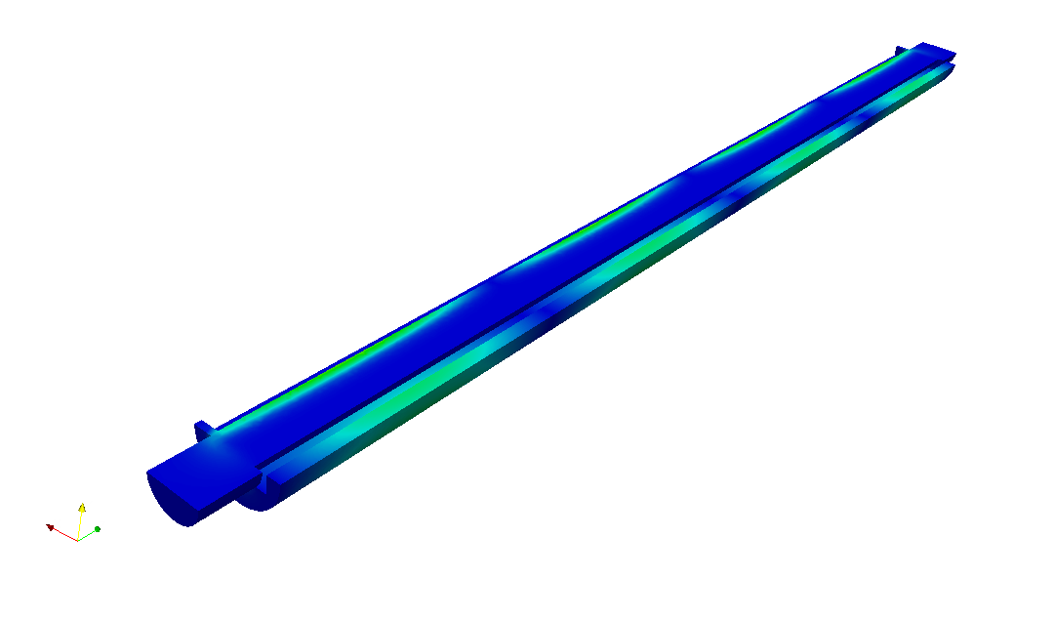
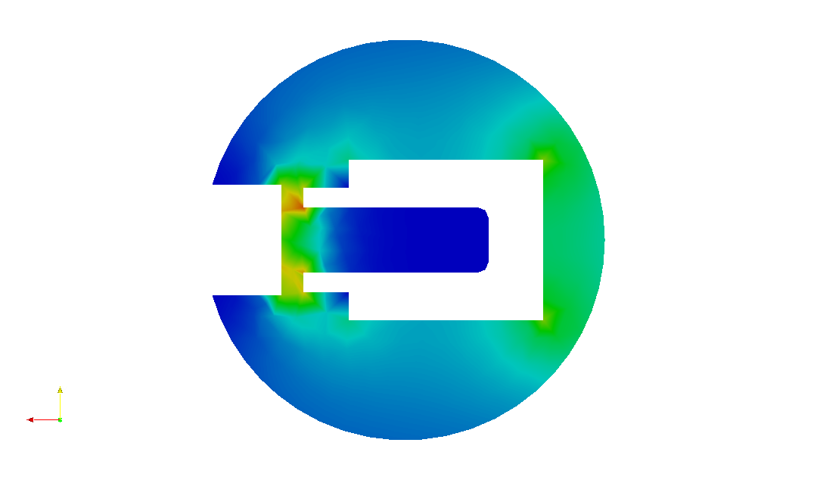
Mode at 157 MHz

Slide 8
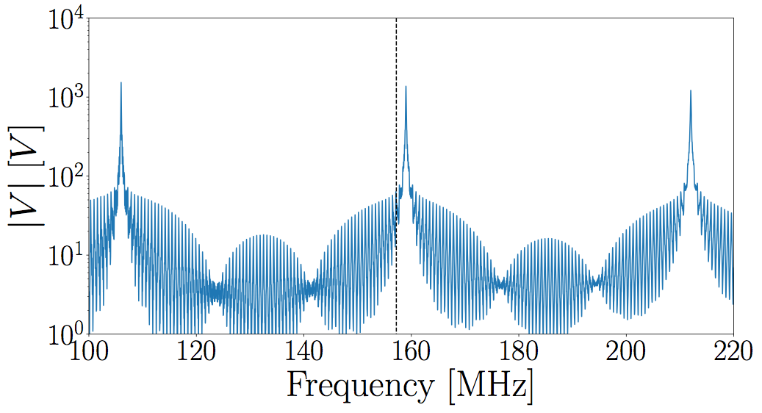
Voltage in particular mode
Induced voltage
Voltage present at next bunch arrives if t=tb
157 MHz mode
Keep R/Q, Q constant and
vary frequency

Slide 9
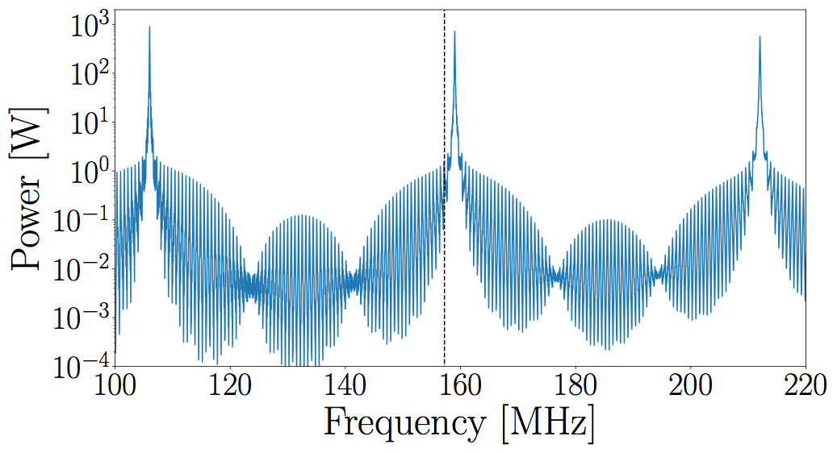
Power
Mode at 157 MHz
will deposit only 2W
in cavity walls

Slide 10
Summary
Unless mode is within ~1MHz of machine line, calculated deposited power is very small
Mode at 157 MHz is close to machine line, if real mode frequency is closer to 159 MHz, power could be 0.1-1kW.

