Slide 1
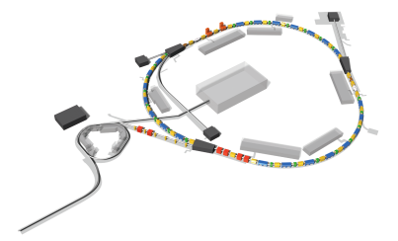
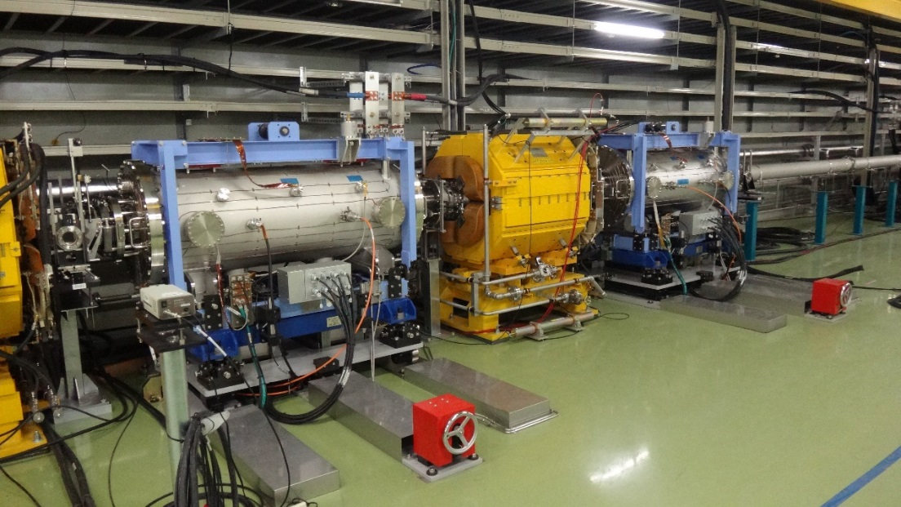
ESS status and progress（Ti ESS, feedthrough dose measurement, others)
Y. Arakaki (KEK)
J-PARC
MR
HD
RCS
MLF
Nu
Linac

Slide 2
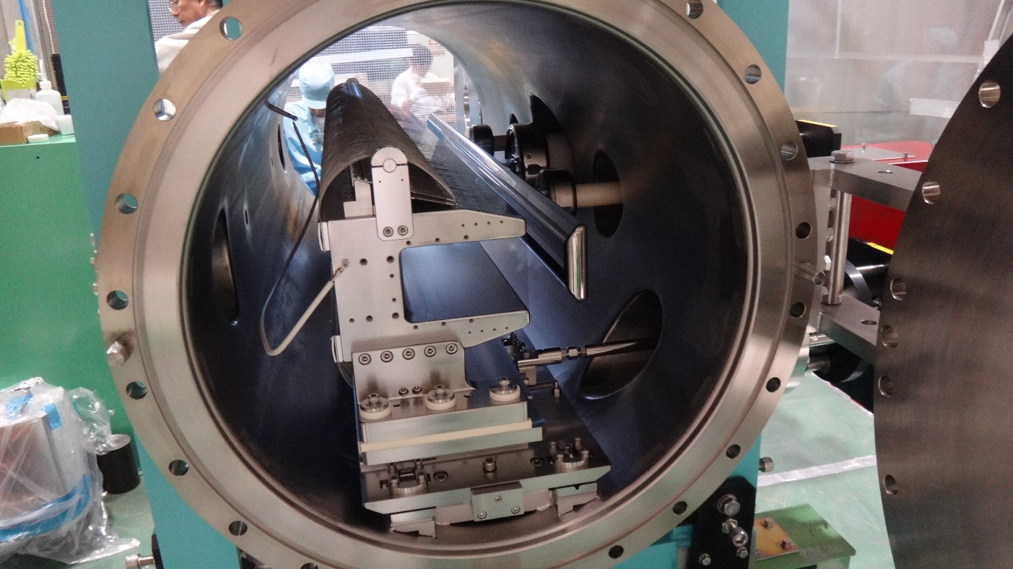
ESS configuration
Ti-yoke
Ti-ESS1
Feedthough
Positioning (Electrode）
Electrode
Positioning (Yoke）
Ti chamber：φ593.6mmx1700mm
Material ： pure titanium II
surface treatment ： San-titan

Slide 3
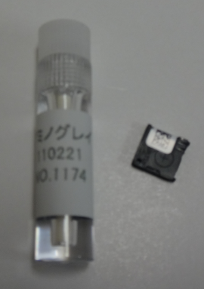
Absorbed Dose Measurement @Feedthough
Period of installation | RUN | ESS1（Gy） | ESS2（Gy)
2012/01/19~2012/02/24 | RUN40(SX) | 432 | 79.9
2012/02/24~2012/06/06 | RUN41,42(FX） | 20.238 | 25.535
2012/06/06~2012/07/10 | RUN43(SX) | 1061.5 | 124.5
2012/12/12~2012/12/28 | RUN45(SX) | ---------- | -----------
2012/12/28~2013/01/17 | RUN46(SX) | 1332 | 173
2013/01/17~2013/03/06 | RUN47(FX) | 47 | 43
2013/03/06~2013/05/08 | RUN49(SX,FX) | 1003 | 147
2014/03/17~2014/08/29 | RUN52~56(FX) | 1.222 | 0.509
2014/08/29~2015/04/02 | RUN57~61(FX) | 15 | 19
2015/04/02~2015/06/03 | RUN62(SX,FX) | 3824 | 478
2015/06/03~2015/07/01 | RUN63(SX,FX) | 5015 | 526
2015/09/29~2016/01/19 | RUN64~65(SX) | 14966 | 1946
2016/01/19~2016/05/25 | RUN66~68(FX) | 111 | 14
2016/05/25~2016/08/03 | RUN68~69(SX) | 8798 | 1093
2017/01/25~2017/04/12 | RUN72~74(FX) | 762 | 73
2017/05/31~2017/10/10 | RUN75(SX) | 12272 | --------------
Measurement Range
Alanine dosimeter :10Gy~100kGy
OSL(Optically Stimulated Luminescence Dosimeter)
:0.1mGy~10Gy

Slide 4
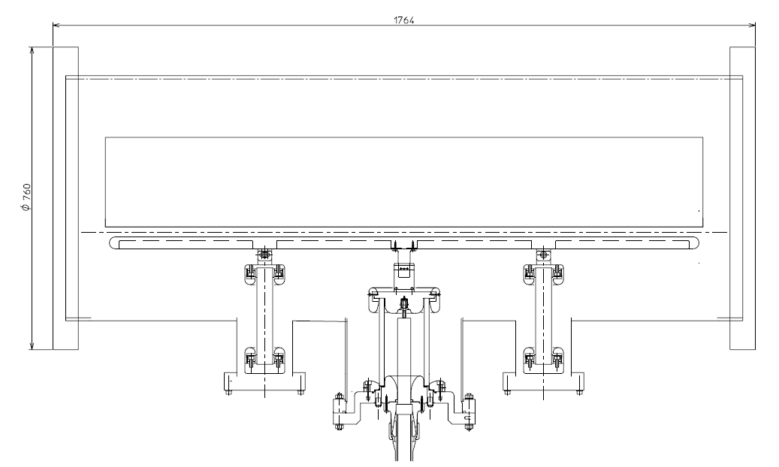
yoke
Beam
Electrode
Alanine dosimeter (Downstream)
Alanine dosimeter (Upstream)

Slide 5
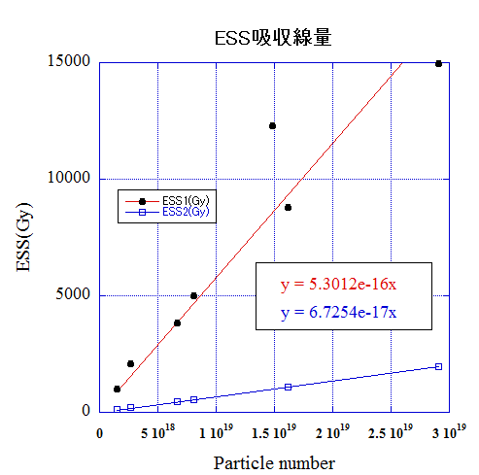
Dose of ESS @ Feedthough
Only one ESS operation
in May 2017
due to the serious
failure.
The absorbed dose of ESS1 is 8 times higher than that of ESS2

Slide 6
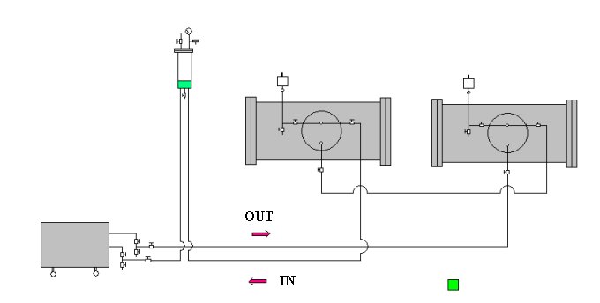
Fluorinert circulation system in ESS (Closed system)
ESS1
ESS2
Expansion Tank
Feedthough
Pipe
Line size: 3/8
Material:SUS316L
Total length:~50m
Fluorinert Circulation
Device
Fluorinert FC40
Since the resistant pressure of feedthough is 0.157MPa, The pressure limit
is set to be 0.1MPa in case of clogging.

Slide 7
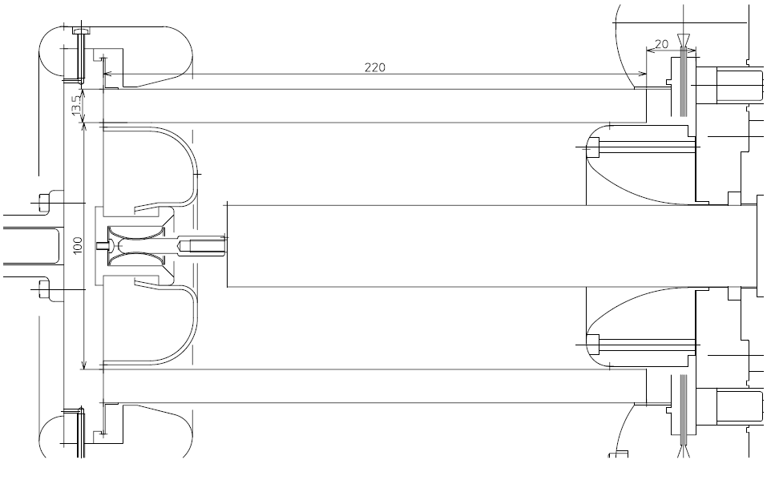
Old type feedthough (SUS304)
160cc
Stress cone(Hollow)
ICF
Out
200cc
Flange and stress cone
is separated
polyethylene
IN
Fluorinert(FC４０)
0.2L+1.15L+0.16L
=1.51L
Ceramic (KP-999)

Slide 8
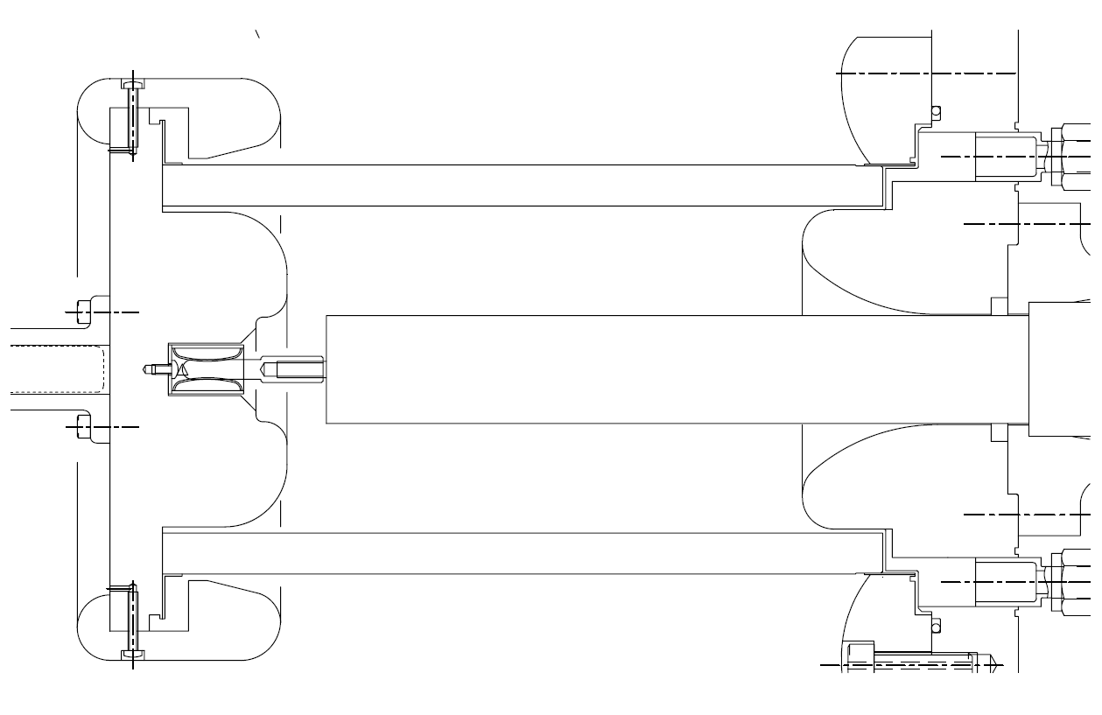
Welding
Metal O-ring with silver coating
New type Feedthough (Ti)
Metallized
&brazing
Mounting flage
(Unibody)
Stress cone(Solid)
Polyethylene
EPDM rubber
(radiation resistant)
Fluorinert(FC４０)
1.15L
Ceramic (A-601L)

Slide 9
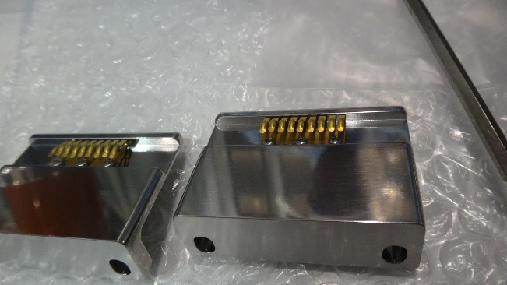
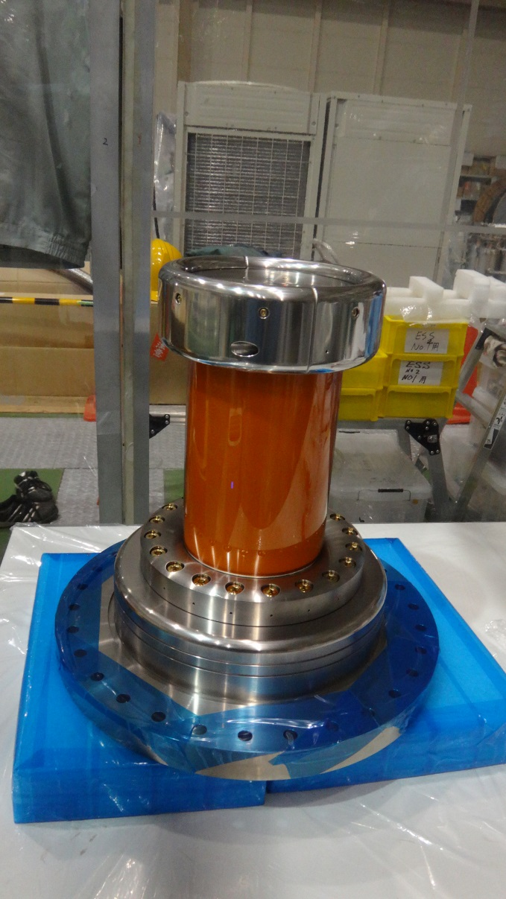
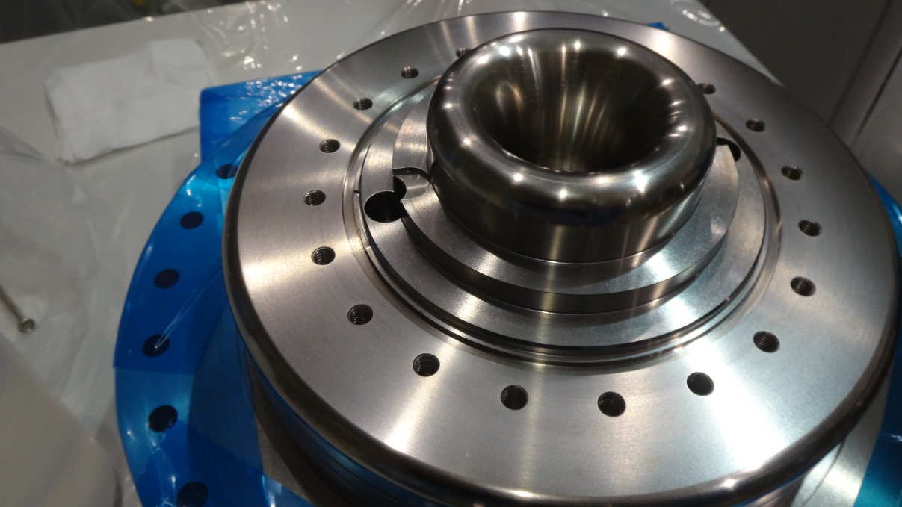
Assembling the feedthogh
Mounting Flange
Finger contact
M8-30 bolt
Ti64aroy
with TIN-coating
to avoid galling
Kapton film
for protection of ceramic
while assembling
material:Titanium
Ceramic bushing

Slide 10
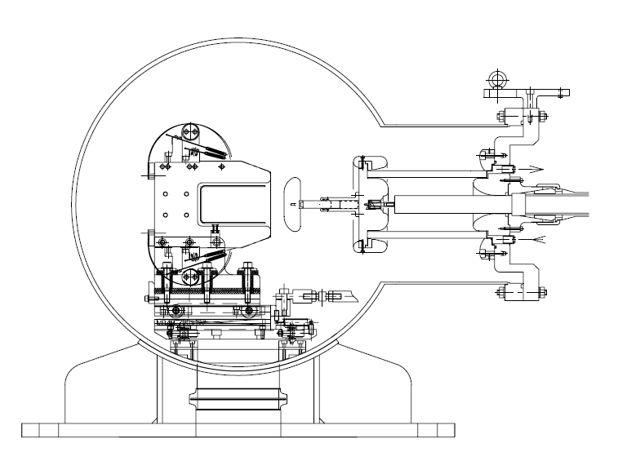
A cross sectional view of the Feedthough

Slide 11
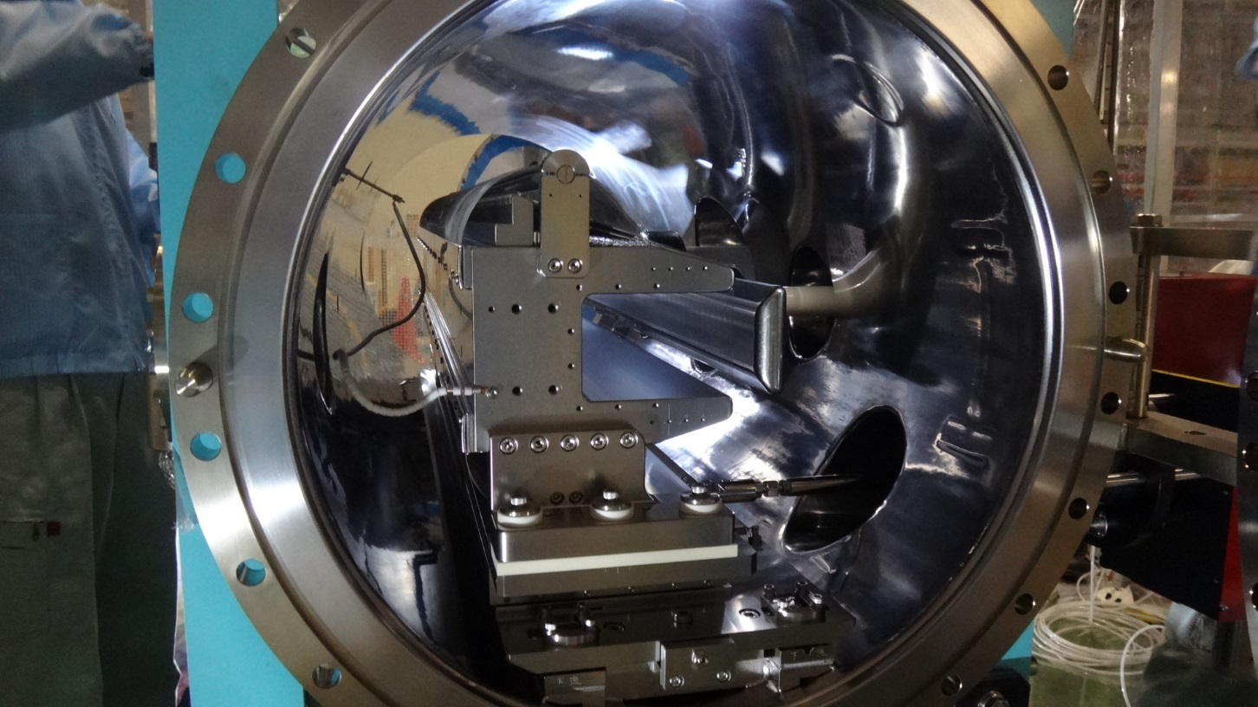
Ti-ESS2
The surface is finished with San-titan after buffing

Slide 12
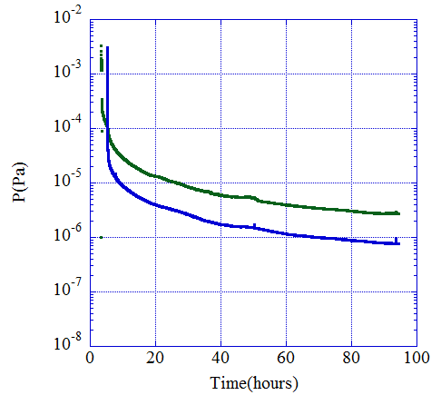
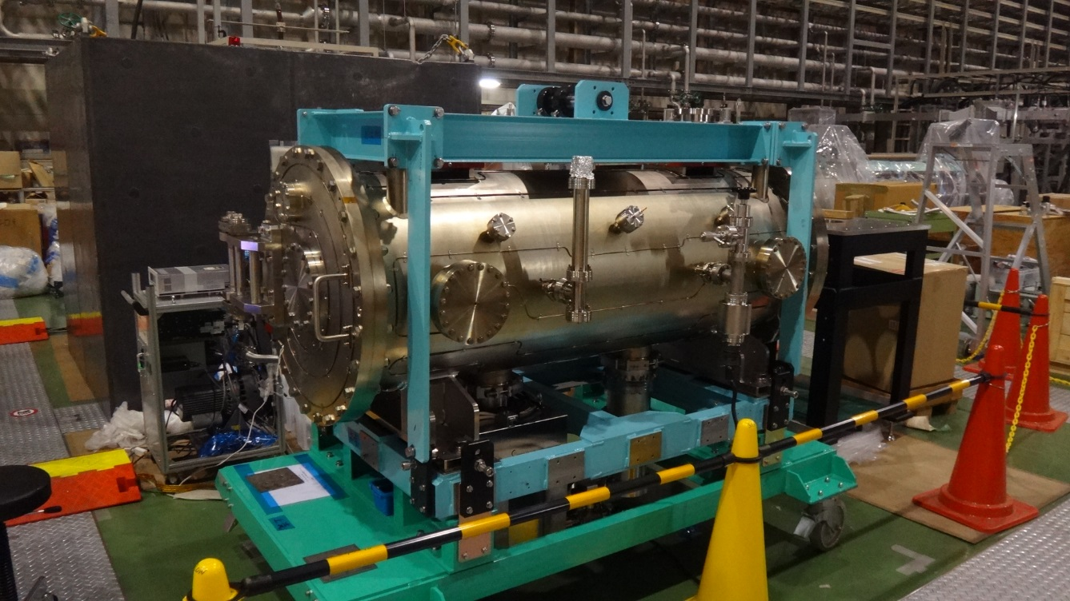
Vacuum features in Ti-ESS2
Blue line :Ion pump
Green line: Ion guage
2.8x10-6Pa
7.9x10-7Pa
Ion pump(600L/s)
TMP(480L/s)
Ion guage
Scroll pump ON
(pumping from atmosphere)
2018/03/05
2018/03/09

