Slide 1
Accelerator Division Status
Daniel Johnson
All Experimenters’ Meeting/Lab Status Meeting
19 March 2018

Slide 2
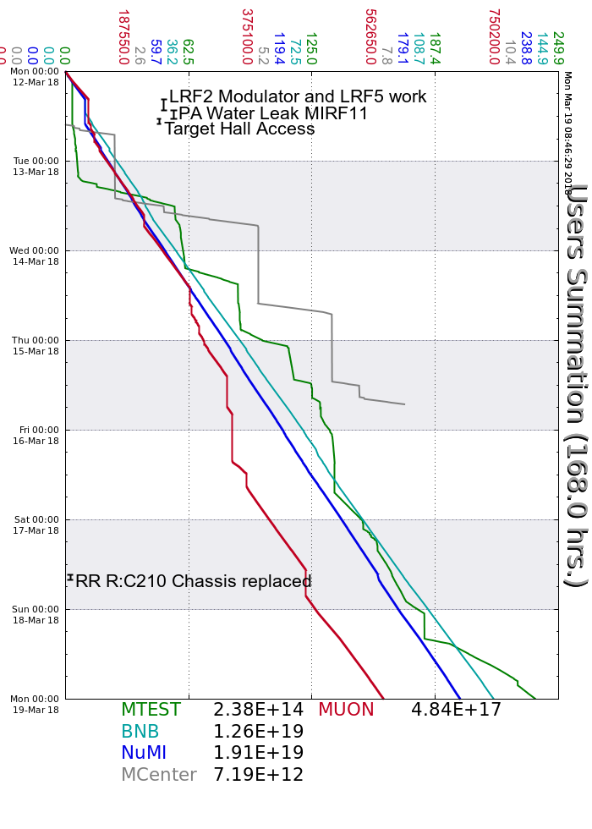
Accelerator Operations Summary
From: March 12, 2018 (0000 hours)
To: March 19, 2018 (0000 hours)
Calendar Week # 11
NuMI Weekly Integrated Intensity 1.91 E19 protons
Beam Hours To NuMI 154.8 hours
BNB Weekly Integrated Intensity 1.21 E19 protons
Beam Hours To BNB 158.3 hours
Muon Weekly Integrated Intensity 4.84 E17 protons
Beam Hours To Muon 114.8 hours
MTest Weekly Integrated Intensity 2.38 E14 protons
Beam Hours To MTest 109.6 hours
MCenter Weekly Integrated Intensity 7.20 E12 protons
Beam Hours To MCenter 12.9 hours

Slide 3
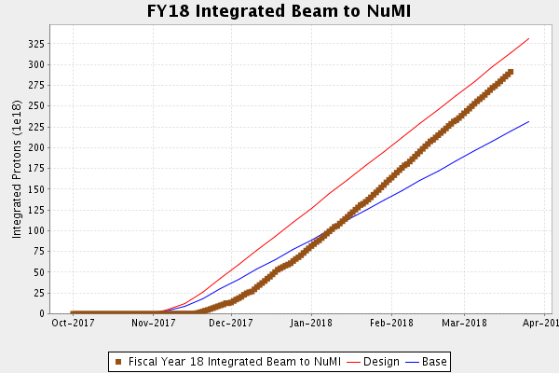
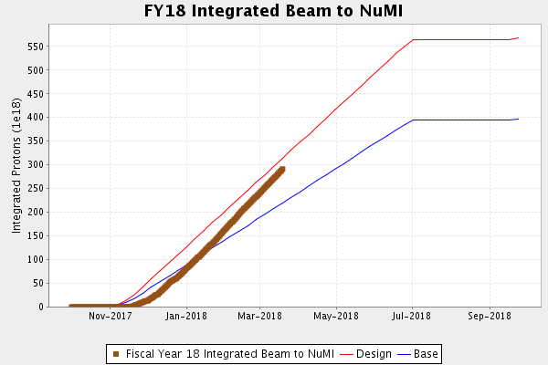
NuMI Operation

Slide 4
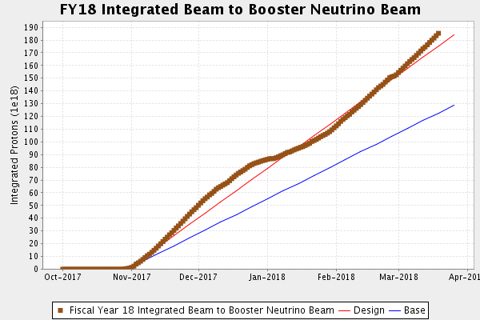
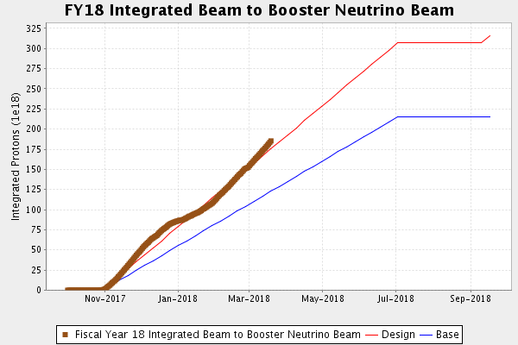
BNB Operation

Slide 5
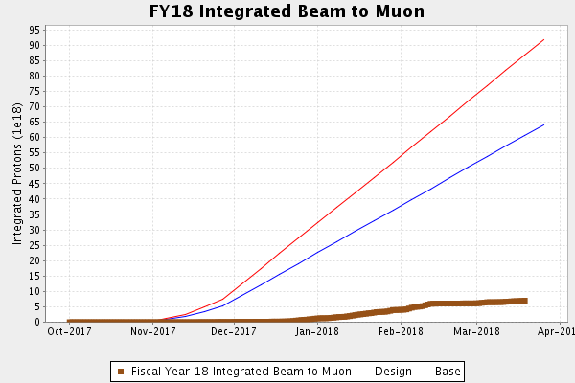
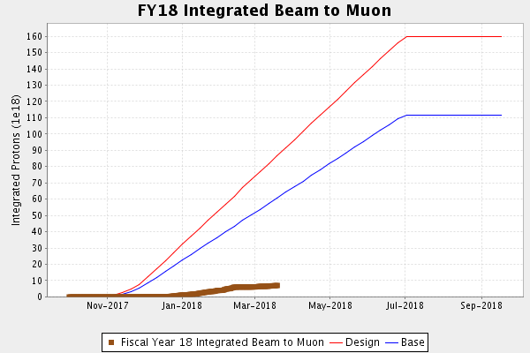
Muon Operation

Slide 6
Complex Status
LINAC
  Laser Notcher operational
  LRF2 & LRF5 modulators
Booster
  Tuning continues
MI/RR
  Tuning continues
NuMI
  ~650kW with SY
  >710kW without SY
Booster Neutrino Beamline (BNB)
  Stable operation
Switchyard
  Meson Test taking beam
  EDIT Program
Muon Campus
  Tuning & studies
  g-2 operation
General
  Tuesday, March 20th & March 21st
    Beam off 0600
    MI/RR down 2 days
      Back Wednesday afternoon
    Linac/Booster down 1 day
      Studies Wednesday
    Muon Campus/NuMI/Switchyard
      Back later Wednesday afternoon
      Switchyard vacuum/septa dependent
    BNB
      Back Wednesday evening?
      Off Thursday/Friday Day shift

Slide 7
PIP-II Injector Test & FAST/IOTA Status
PIP-II Injector Test
  Starting Up
    Try operating RFQ in CW mode
    Beam established to the dump
    Working towards high duty cycle operation
    Testing MPS operation
    April/May Cryo work shutdown
FAST/IOTA
  The IOTA nonlinear magnet being prepared for field mapping prior to installation.
  The 2 amp supplies for the skew quads, trims, and octupoles installed in ESB.
    Powered 4 of 20 skew quad magnets in ring
  90% of the hardware fasteners for the vacuum installation have been cleaned.
  Vacuum components flanges and tubes in weld shop
  Girder spool piece vacuum checks
  Magnet and vacuum cable pulls are complete
  Instrumentation cable pulls nearly complete
  Sync-light cable pulls to begin
  HRM power supply controllers being prepared

Slide 8
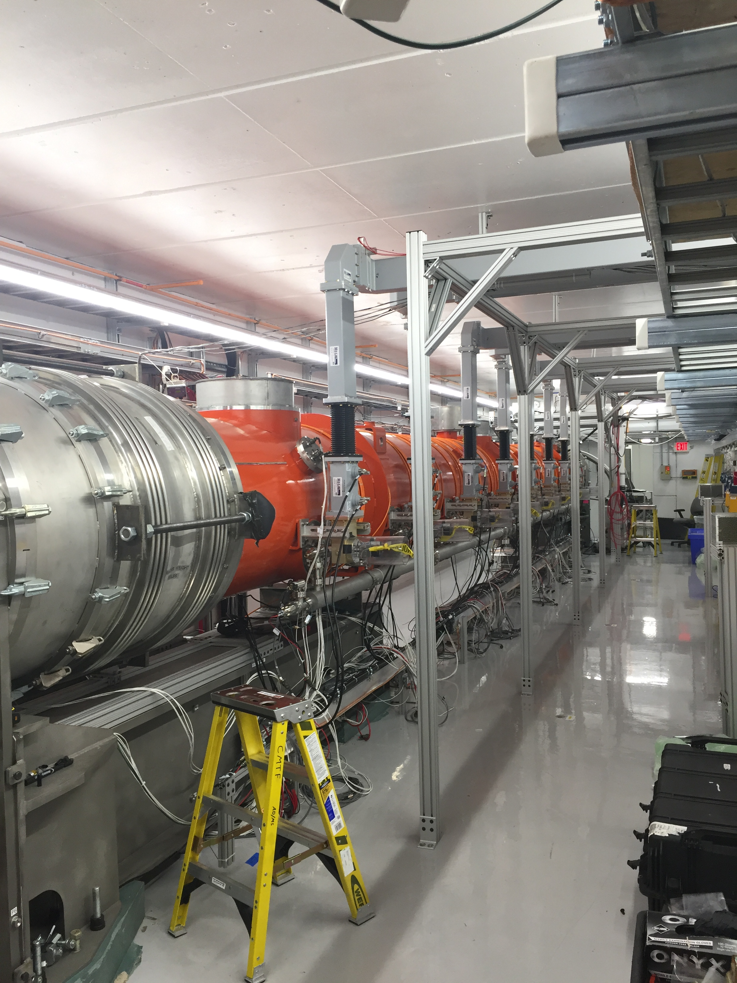
CMTS1 Status
LCLSII Cryomodule F1.3-09
  Testing continues
  Looking good
  Successfully ran Cryomodule continuously for 24hrs (including magnets)
LCLSII Cryomodule F1.3-07
  Best module
  Being instrumented for move to SLAC

Slide 9
Schedules and Links
Schedule can be accessed from the Operations Department Home Page
  Schedules -> Operations Schedule
Direct link to schedule
  http://www-ad.fnal.gov/ops/schedule.html

