Slide 1
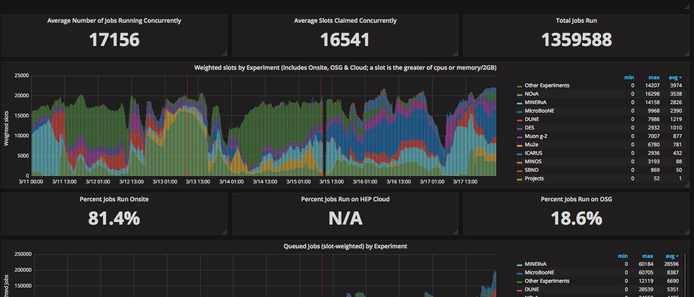
FIFE Operations (combined offsite and onsite)
Monthly downtime on 3/15

Slide 2
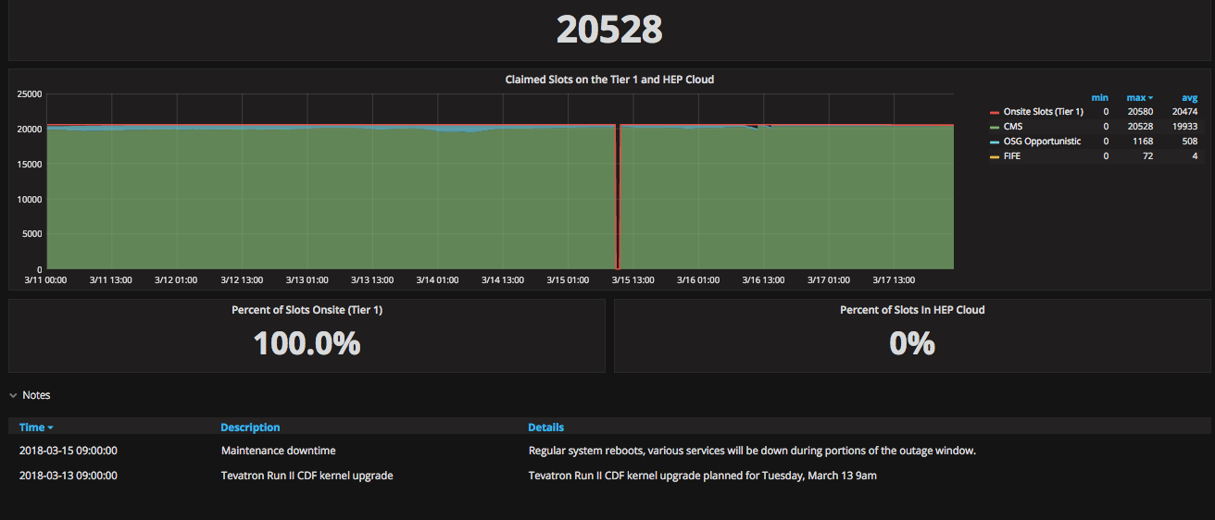
CMS Operations

Slide 3
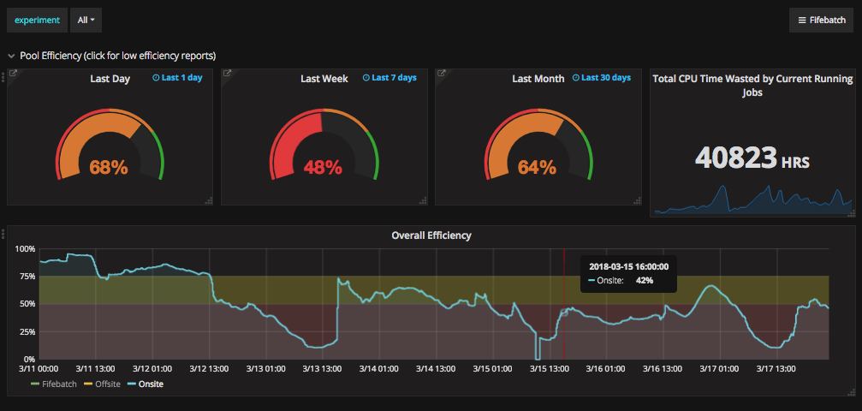
Overall efficiency
Needed to block uboone production because of unintentional DOS attach on dCache. Was off hour – working on communication path to the experiments when that happens.
Are experiments unable to get their work done because of the above inefficiencies? Primary source this week is production code self-DOS attacks on services

